Slide 1

Date
Haddon Township School District
Meeting of the Board of Education
August 15th, 2024
Robert J. Fisicaro, Superintendent
Chantelle Shorter, Assistant Superintendent
Jennifer Gauld, Business Administrator
TITLE

Slide 2


District Snapshot
ENROLLMENT
DISTRICT GOALS
PROJECT UPDATES
CHALLENGES
OPPORTUNITIES

Slide 3
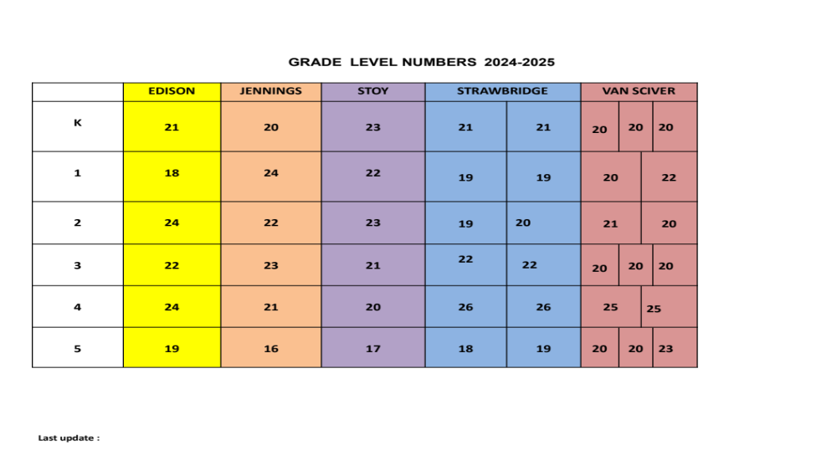
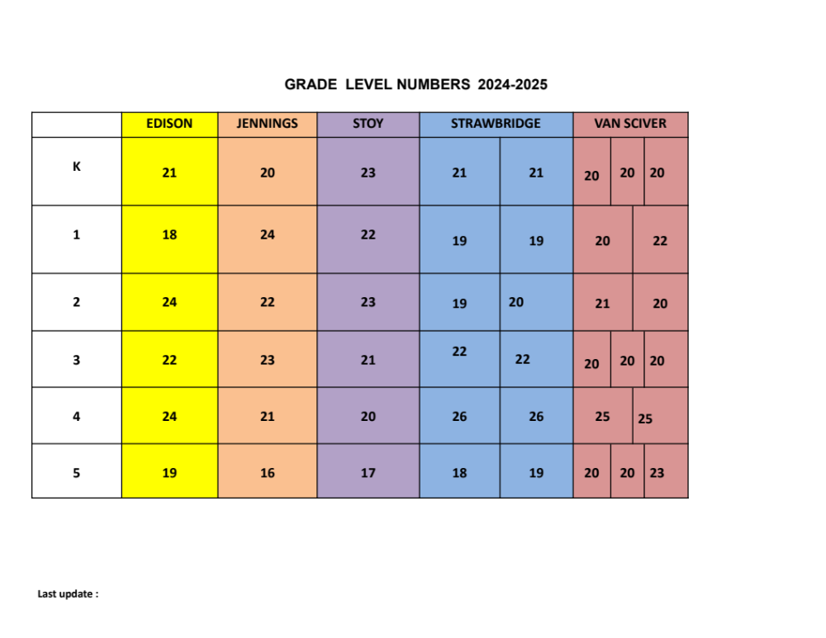
August 15th 2pm

Slide 4
2024-2025 DISTRICT GOALS (REVISED)
Plan and Execute Bond Construction and Project Alignment
Transparent Communication
Stakeholder Engagement
Maximize Quality and Frequency of Student Feedback
Online Gradebook Parents/Students
Consistent Horizontal Norms Across Grade Level and Department
Improve Proactive External Communication Measures
Website (FAQ’s)
    District Practices & Traditions

Slide 5
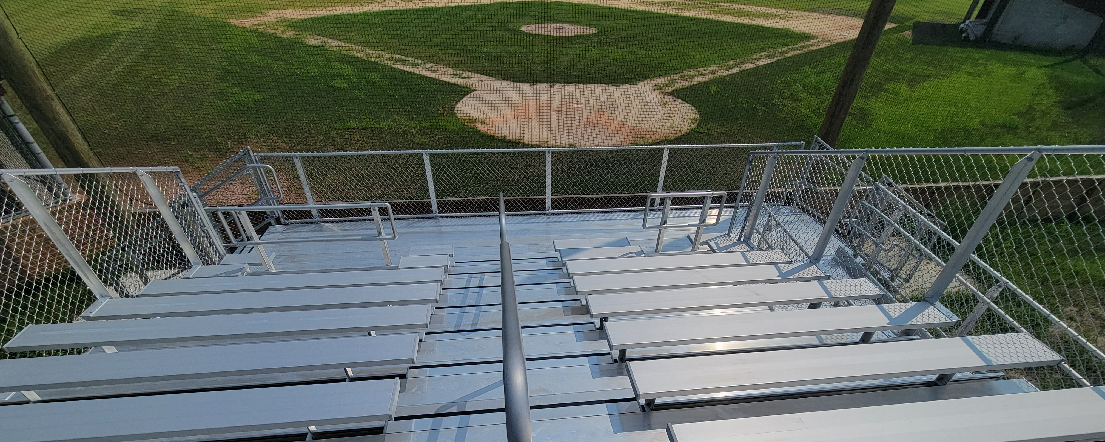
PROJECTS

Slide 6
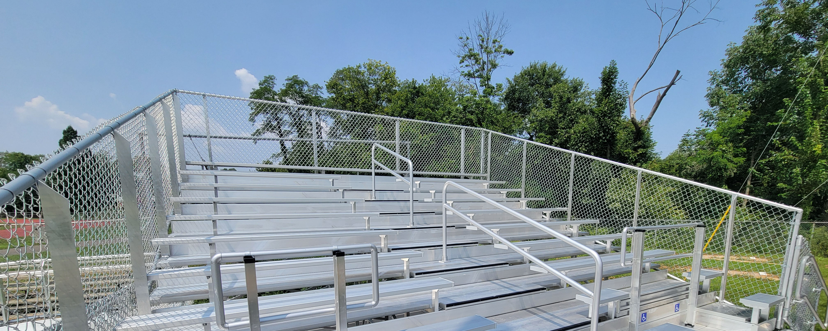
PROJECTS

Slide 7
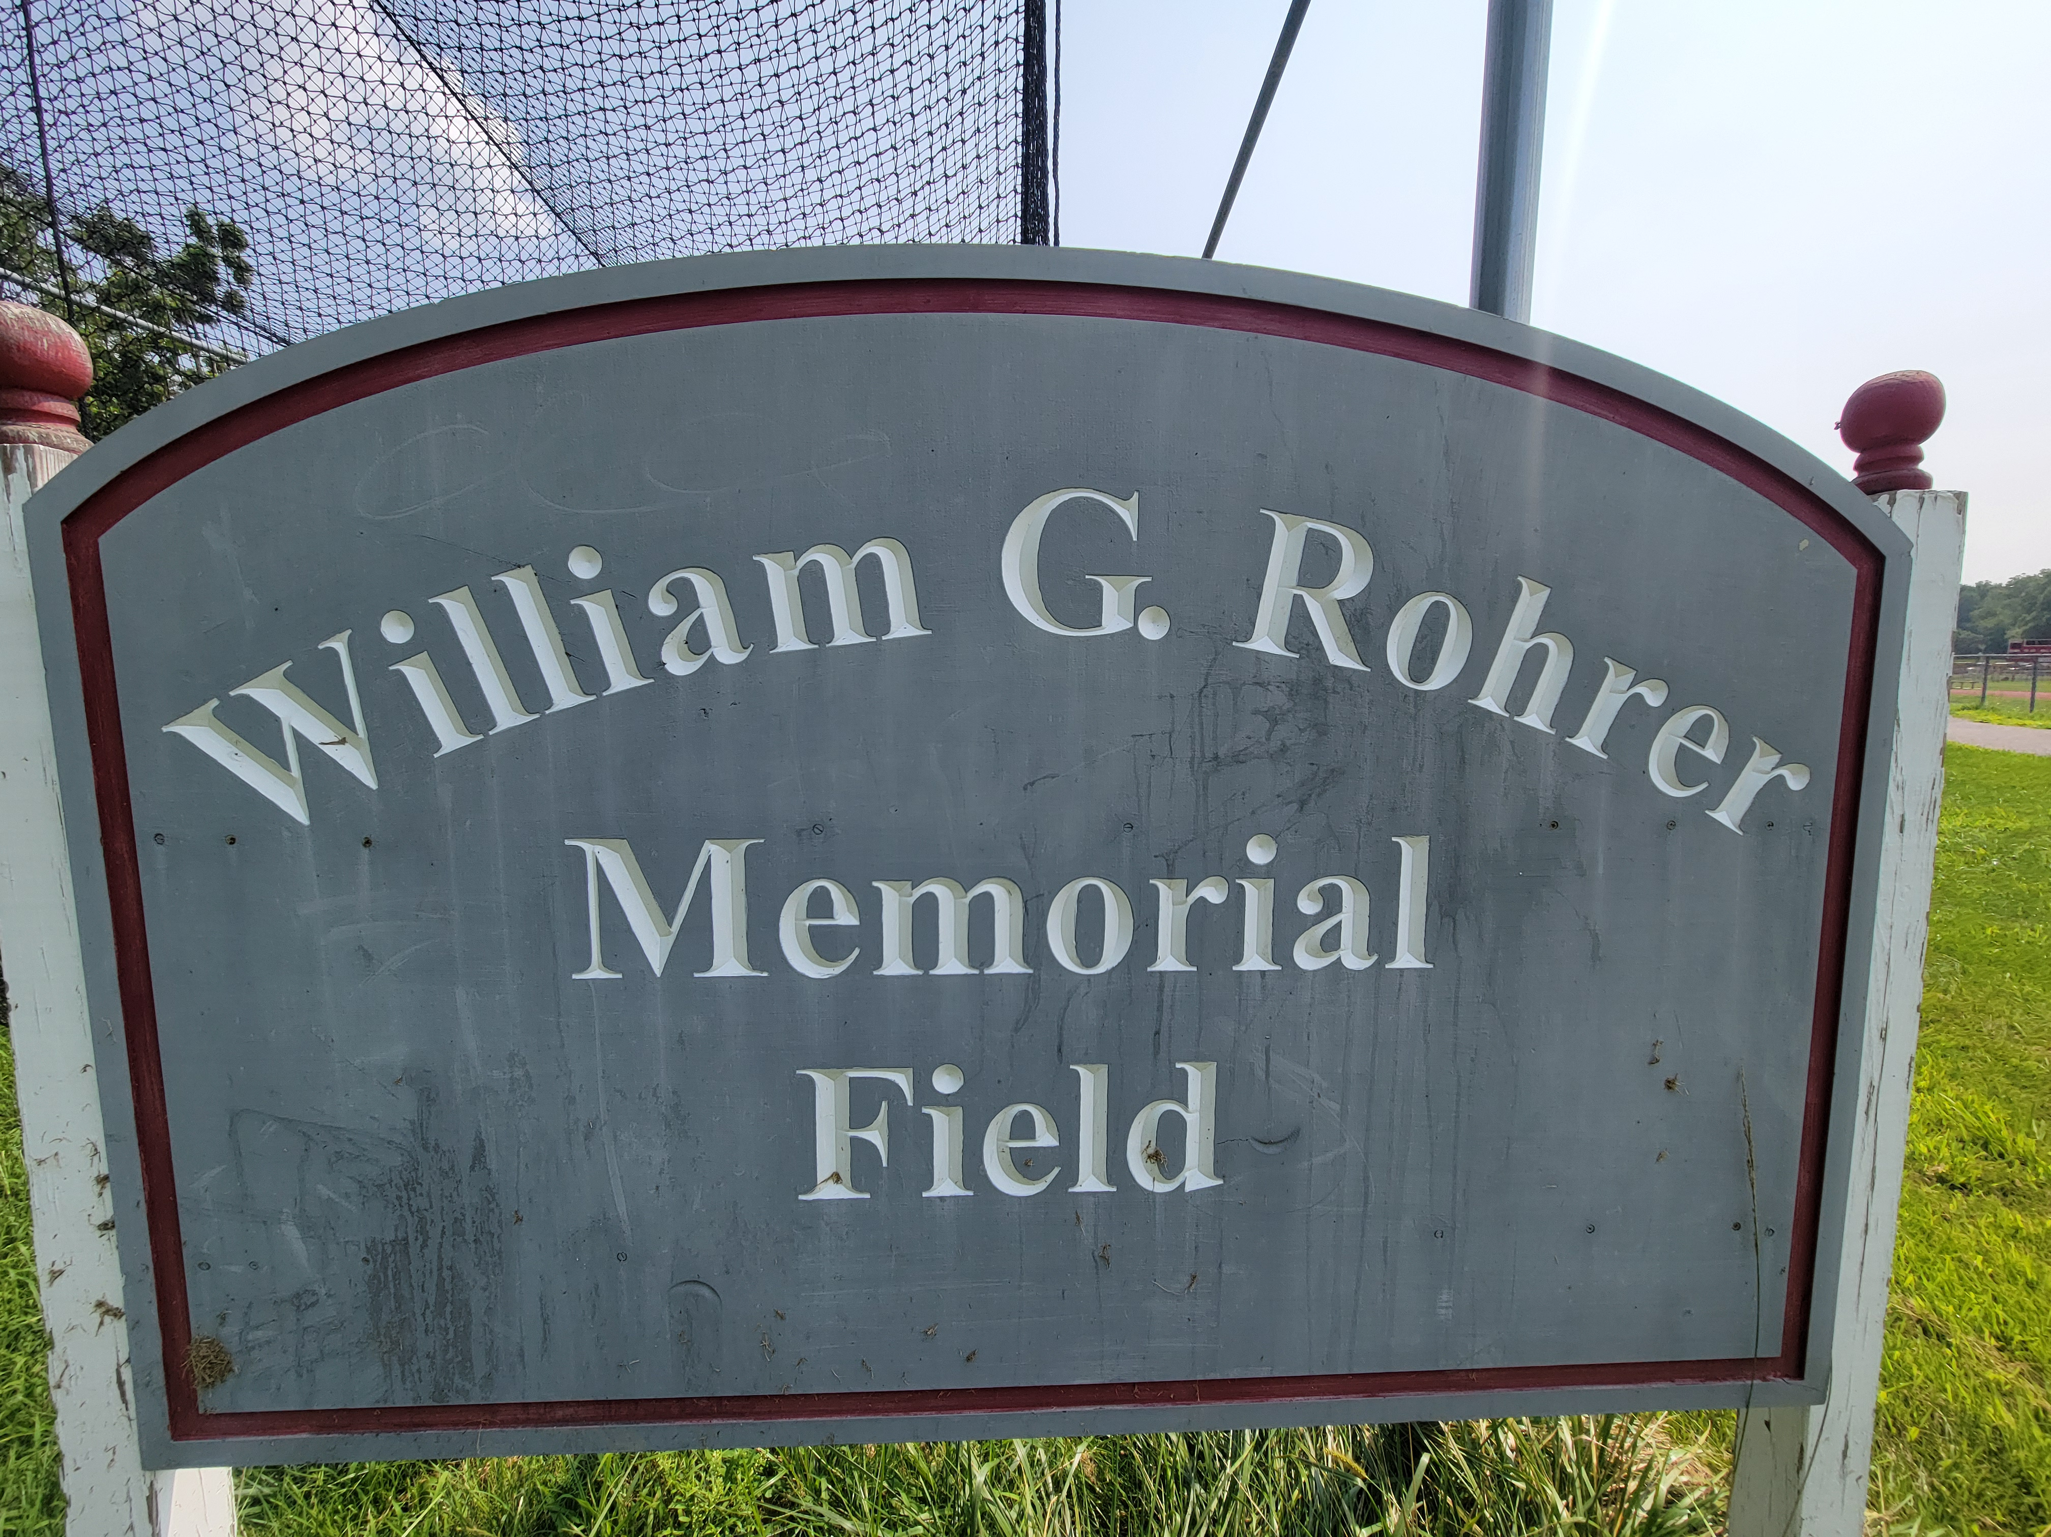
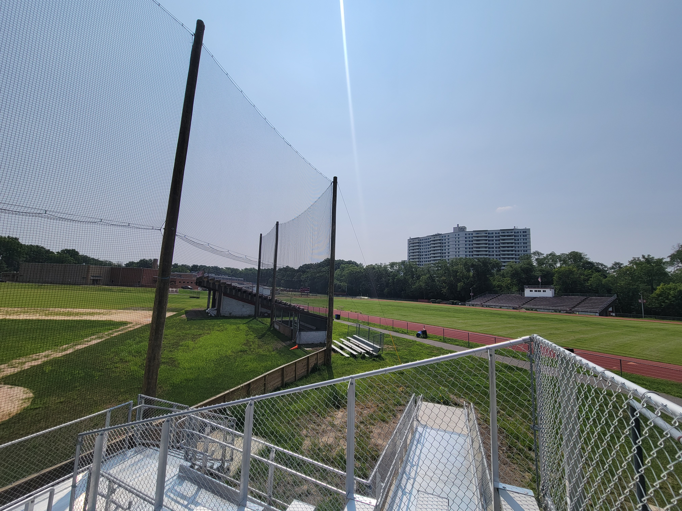
PROJECTS

Slide 8
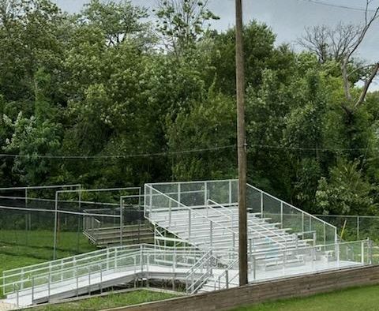
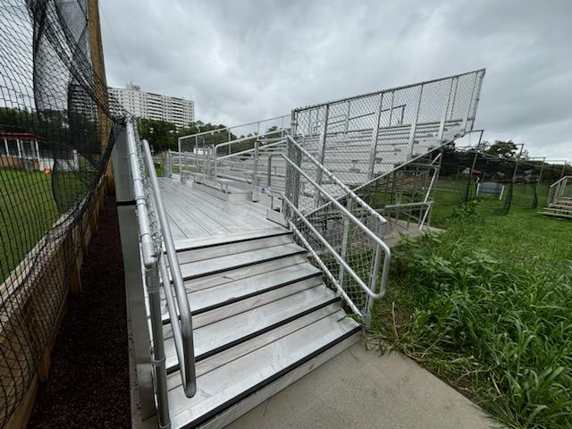
PROJECTS

Slide 9
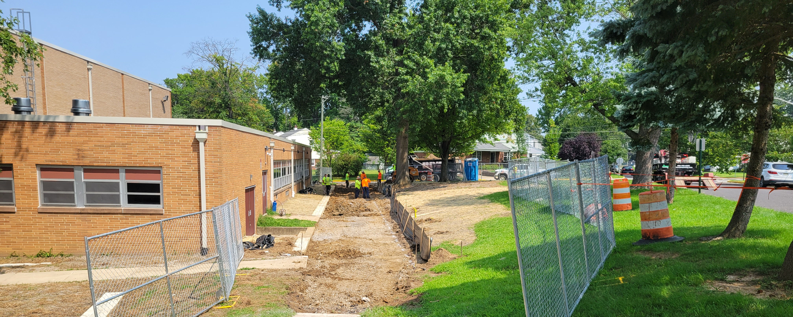
PROJECTS

Slide 10
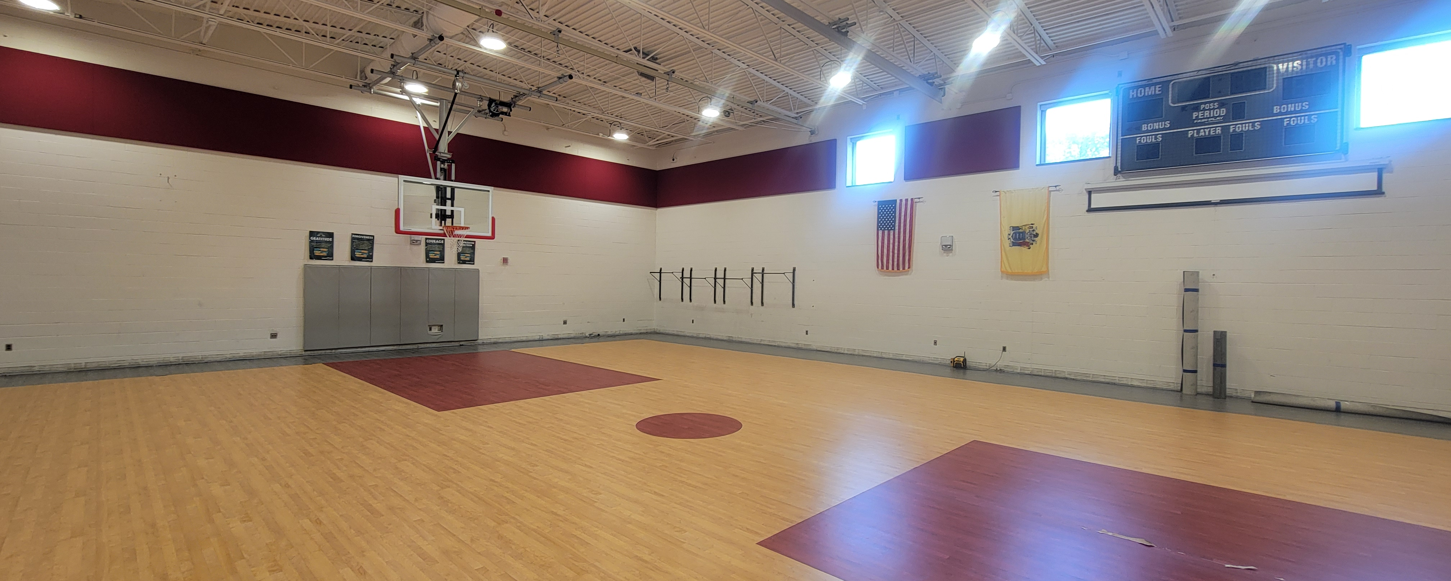
PROJECTS

Slide 11
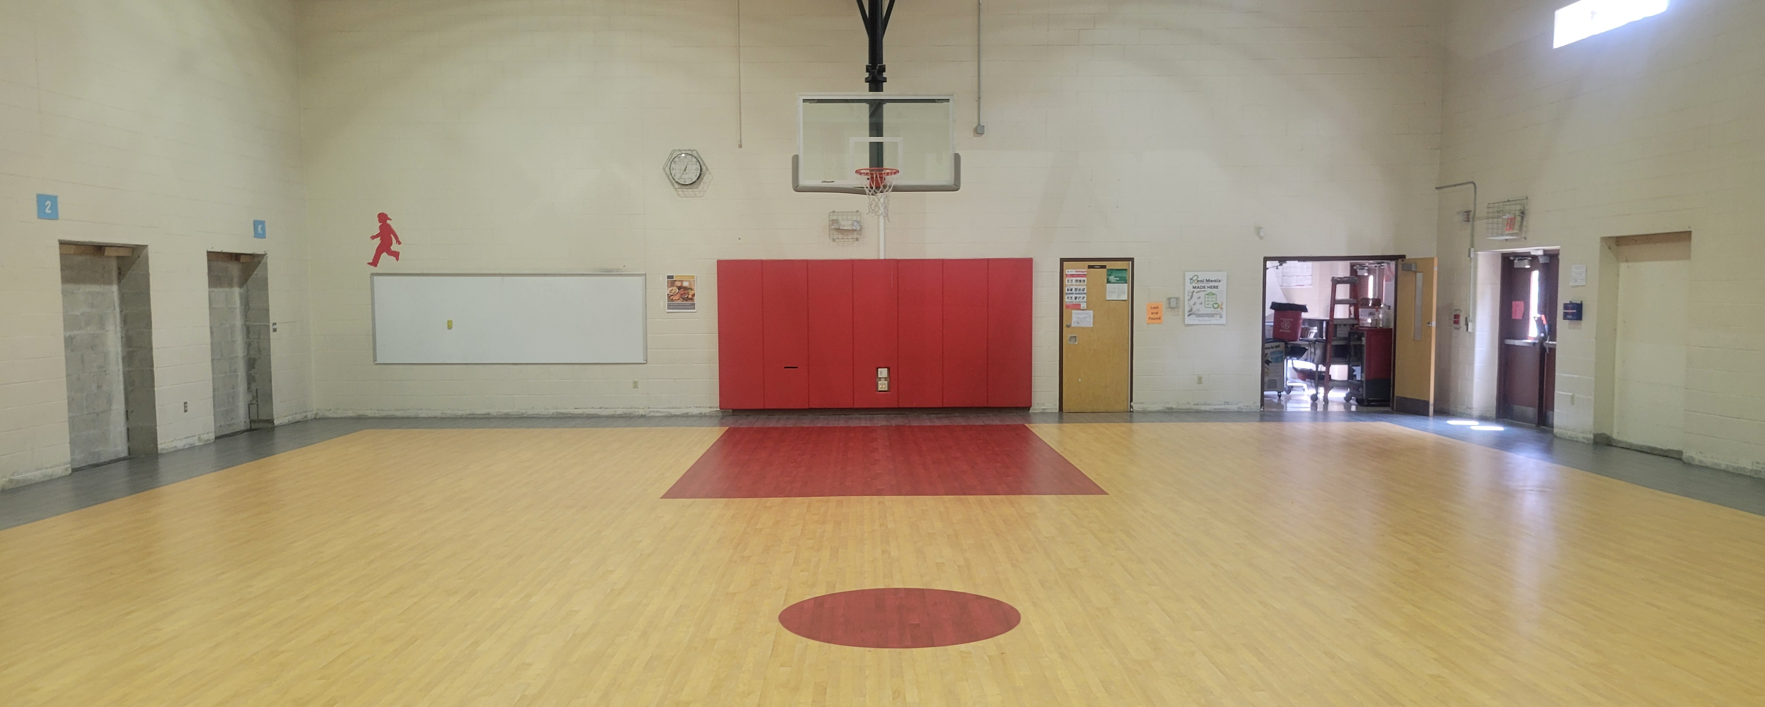
PROJECTS

Slide 12
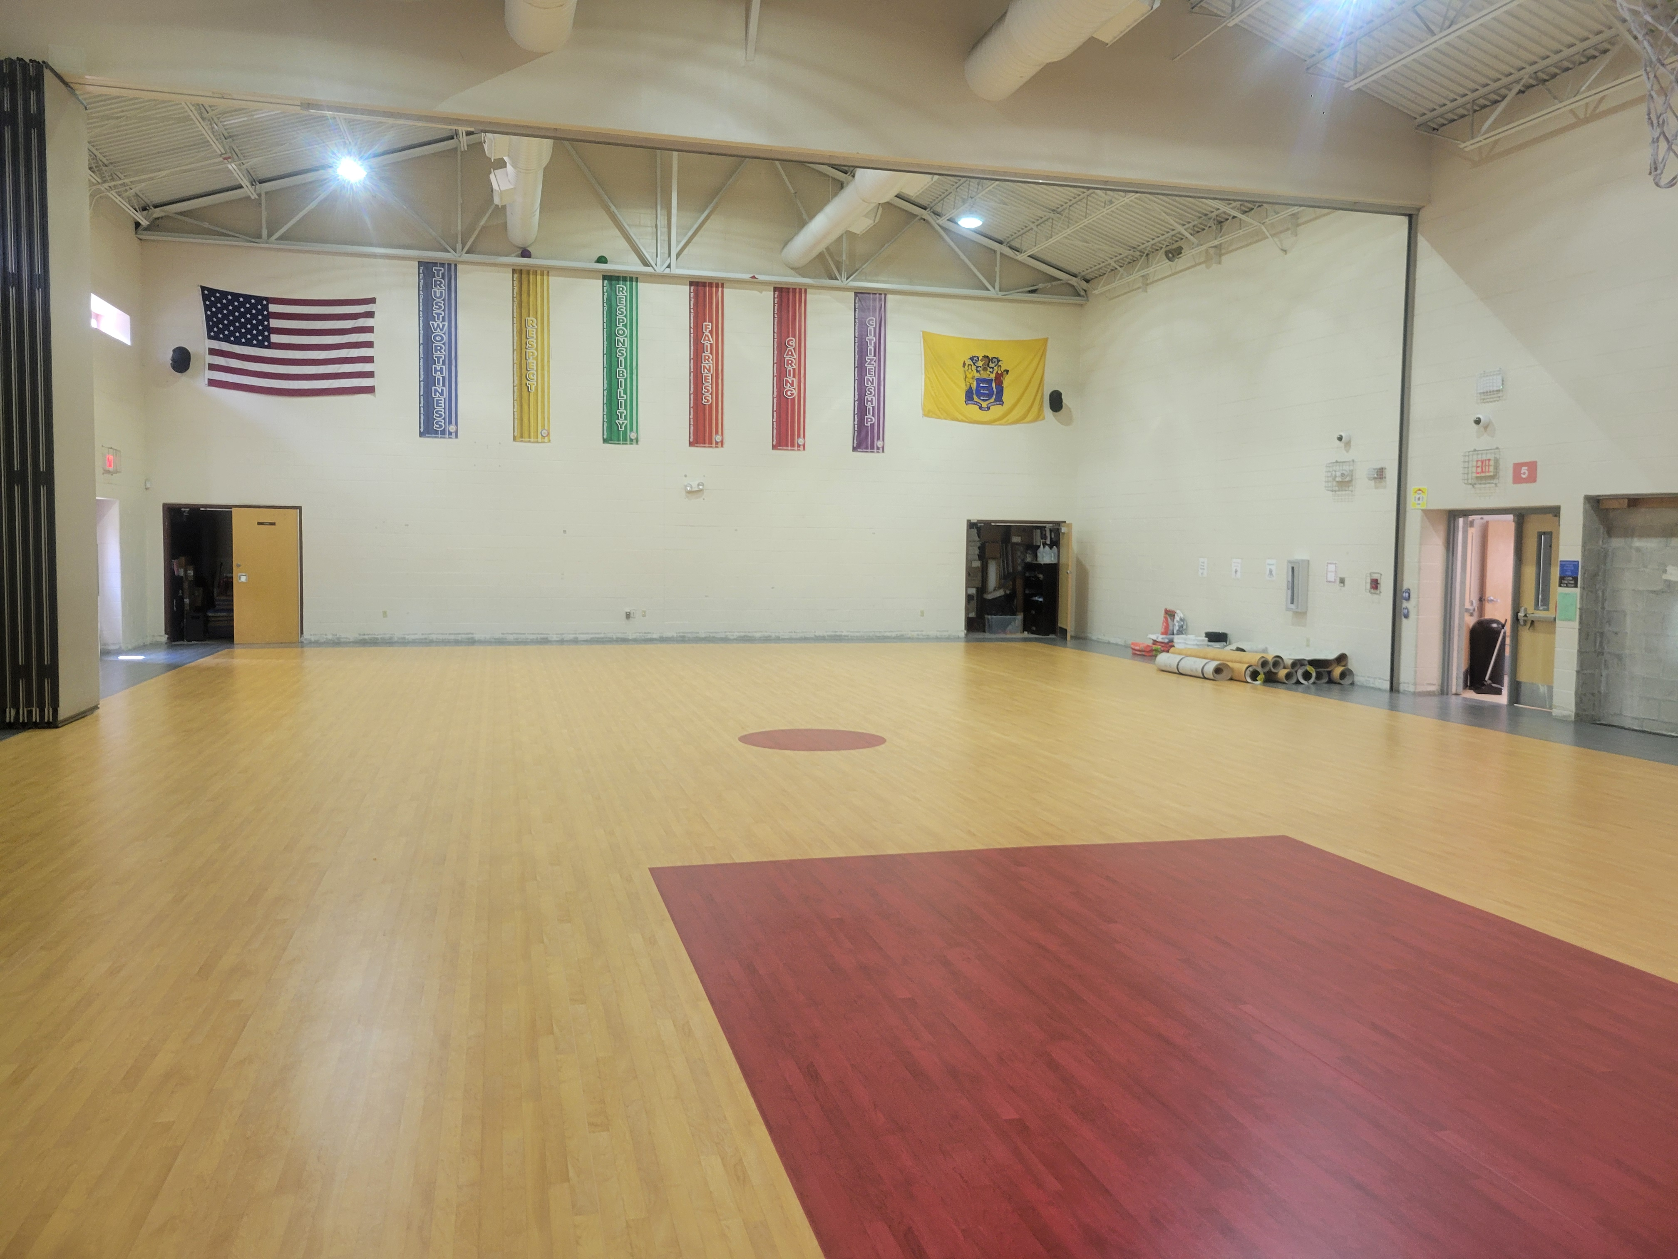
PROJECTS

Slide 13
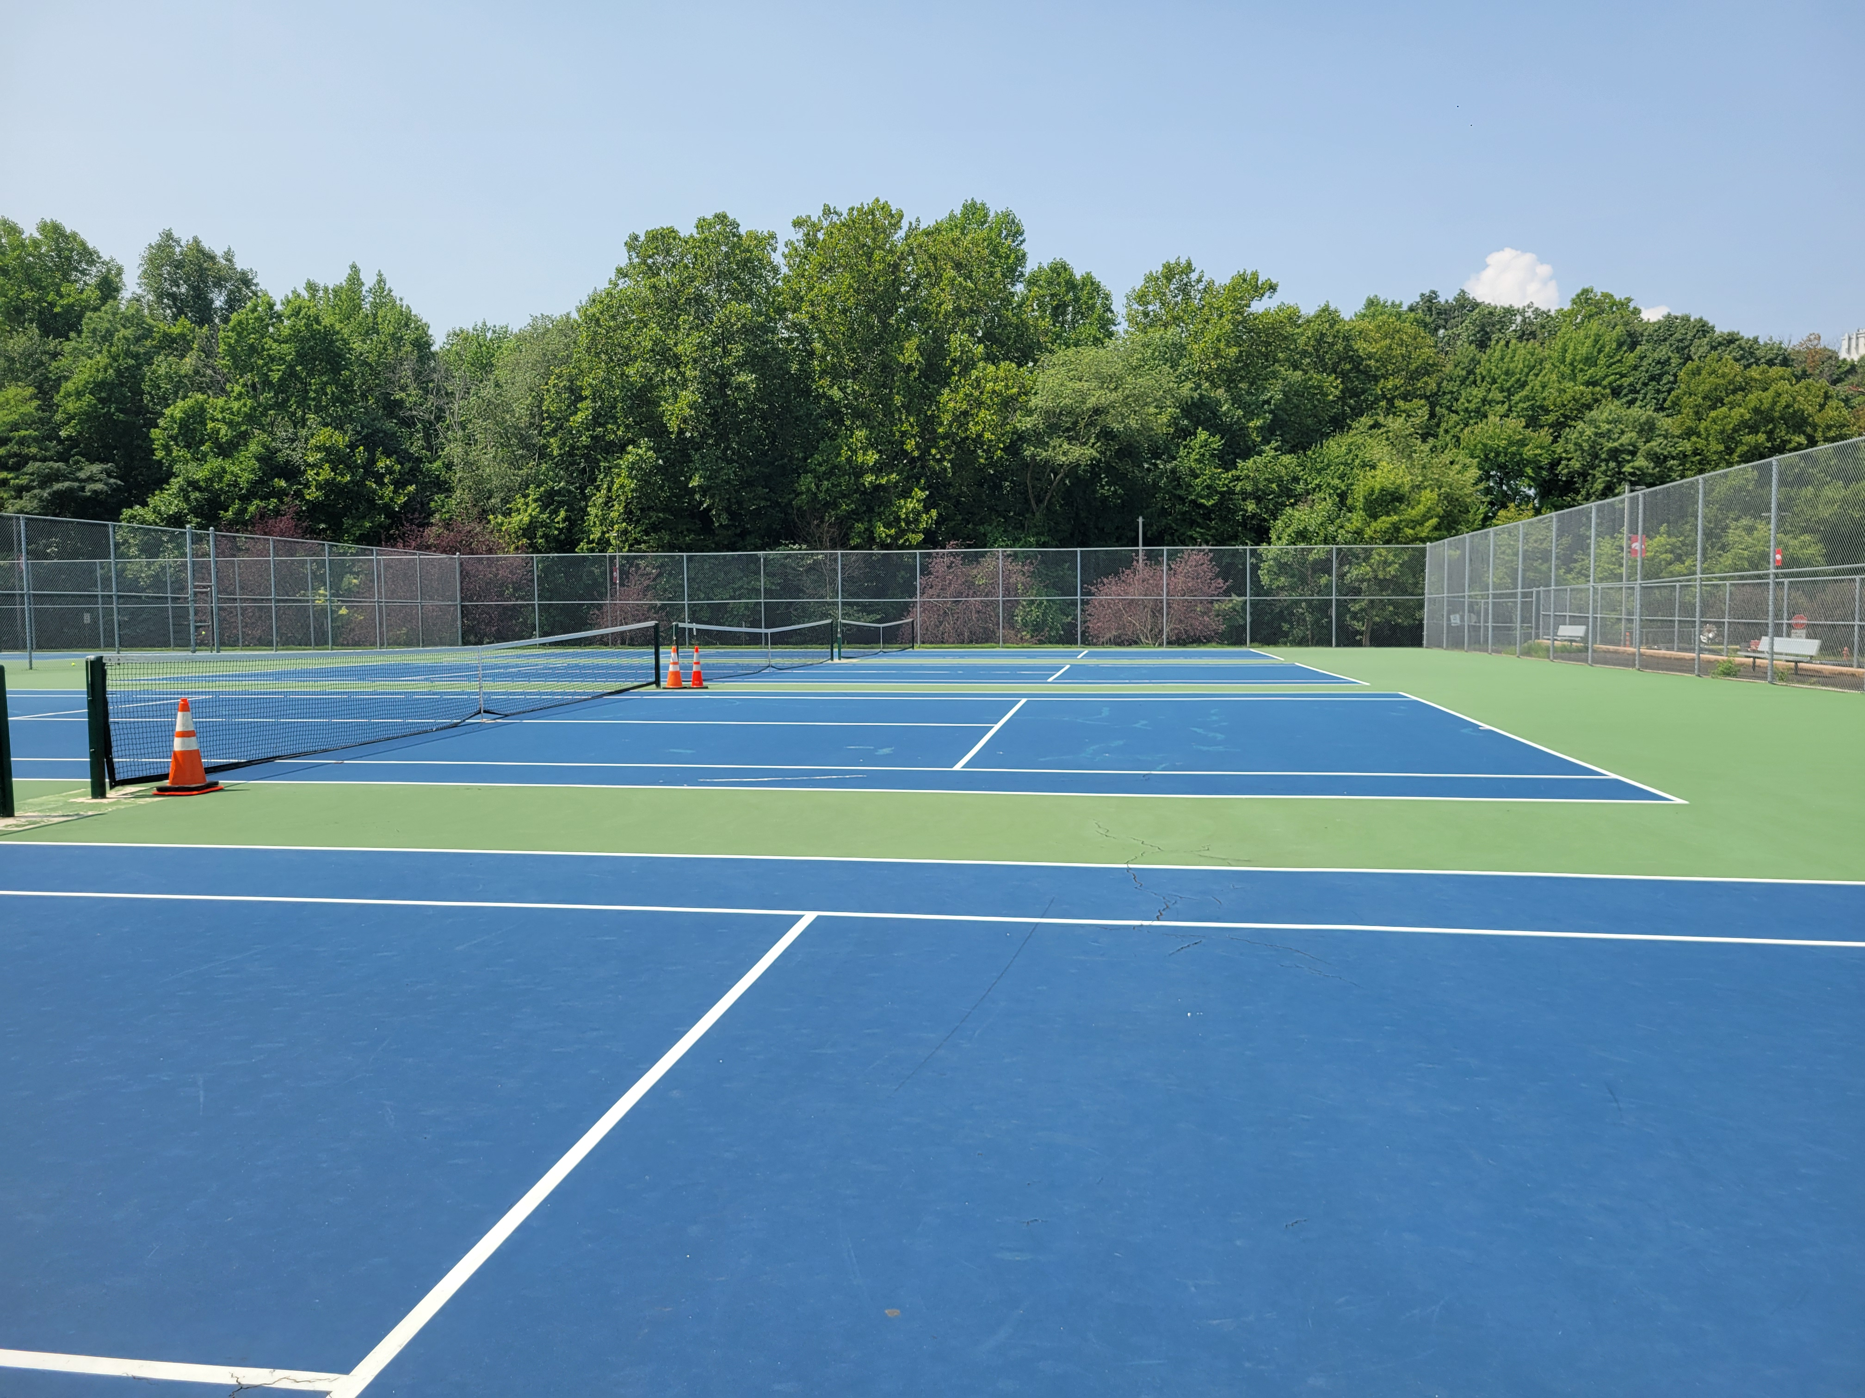

Slide 14
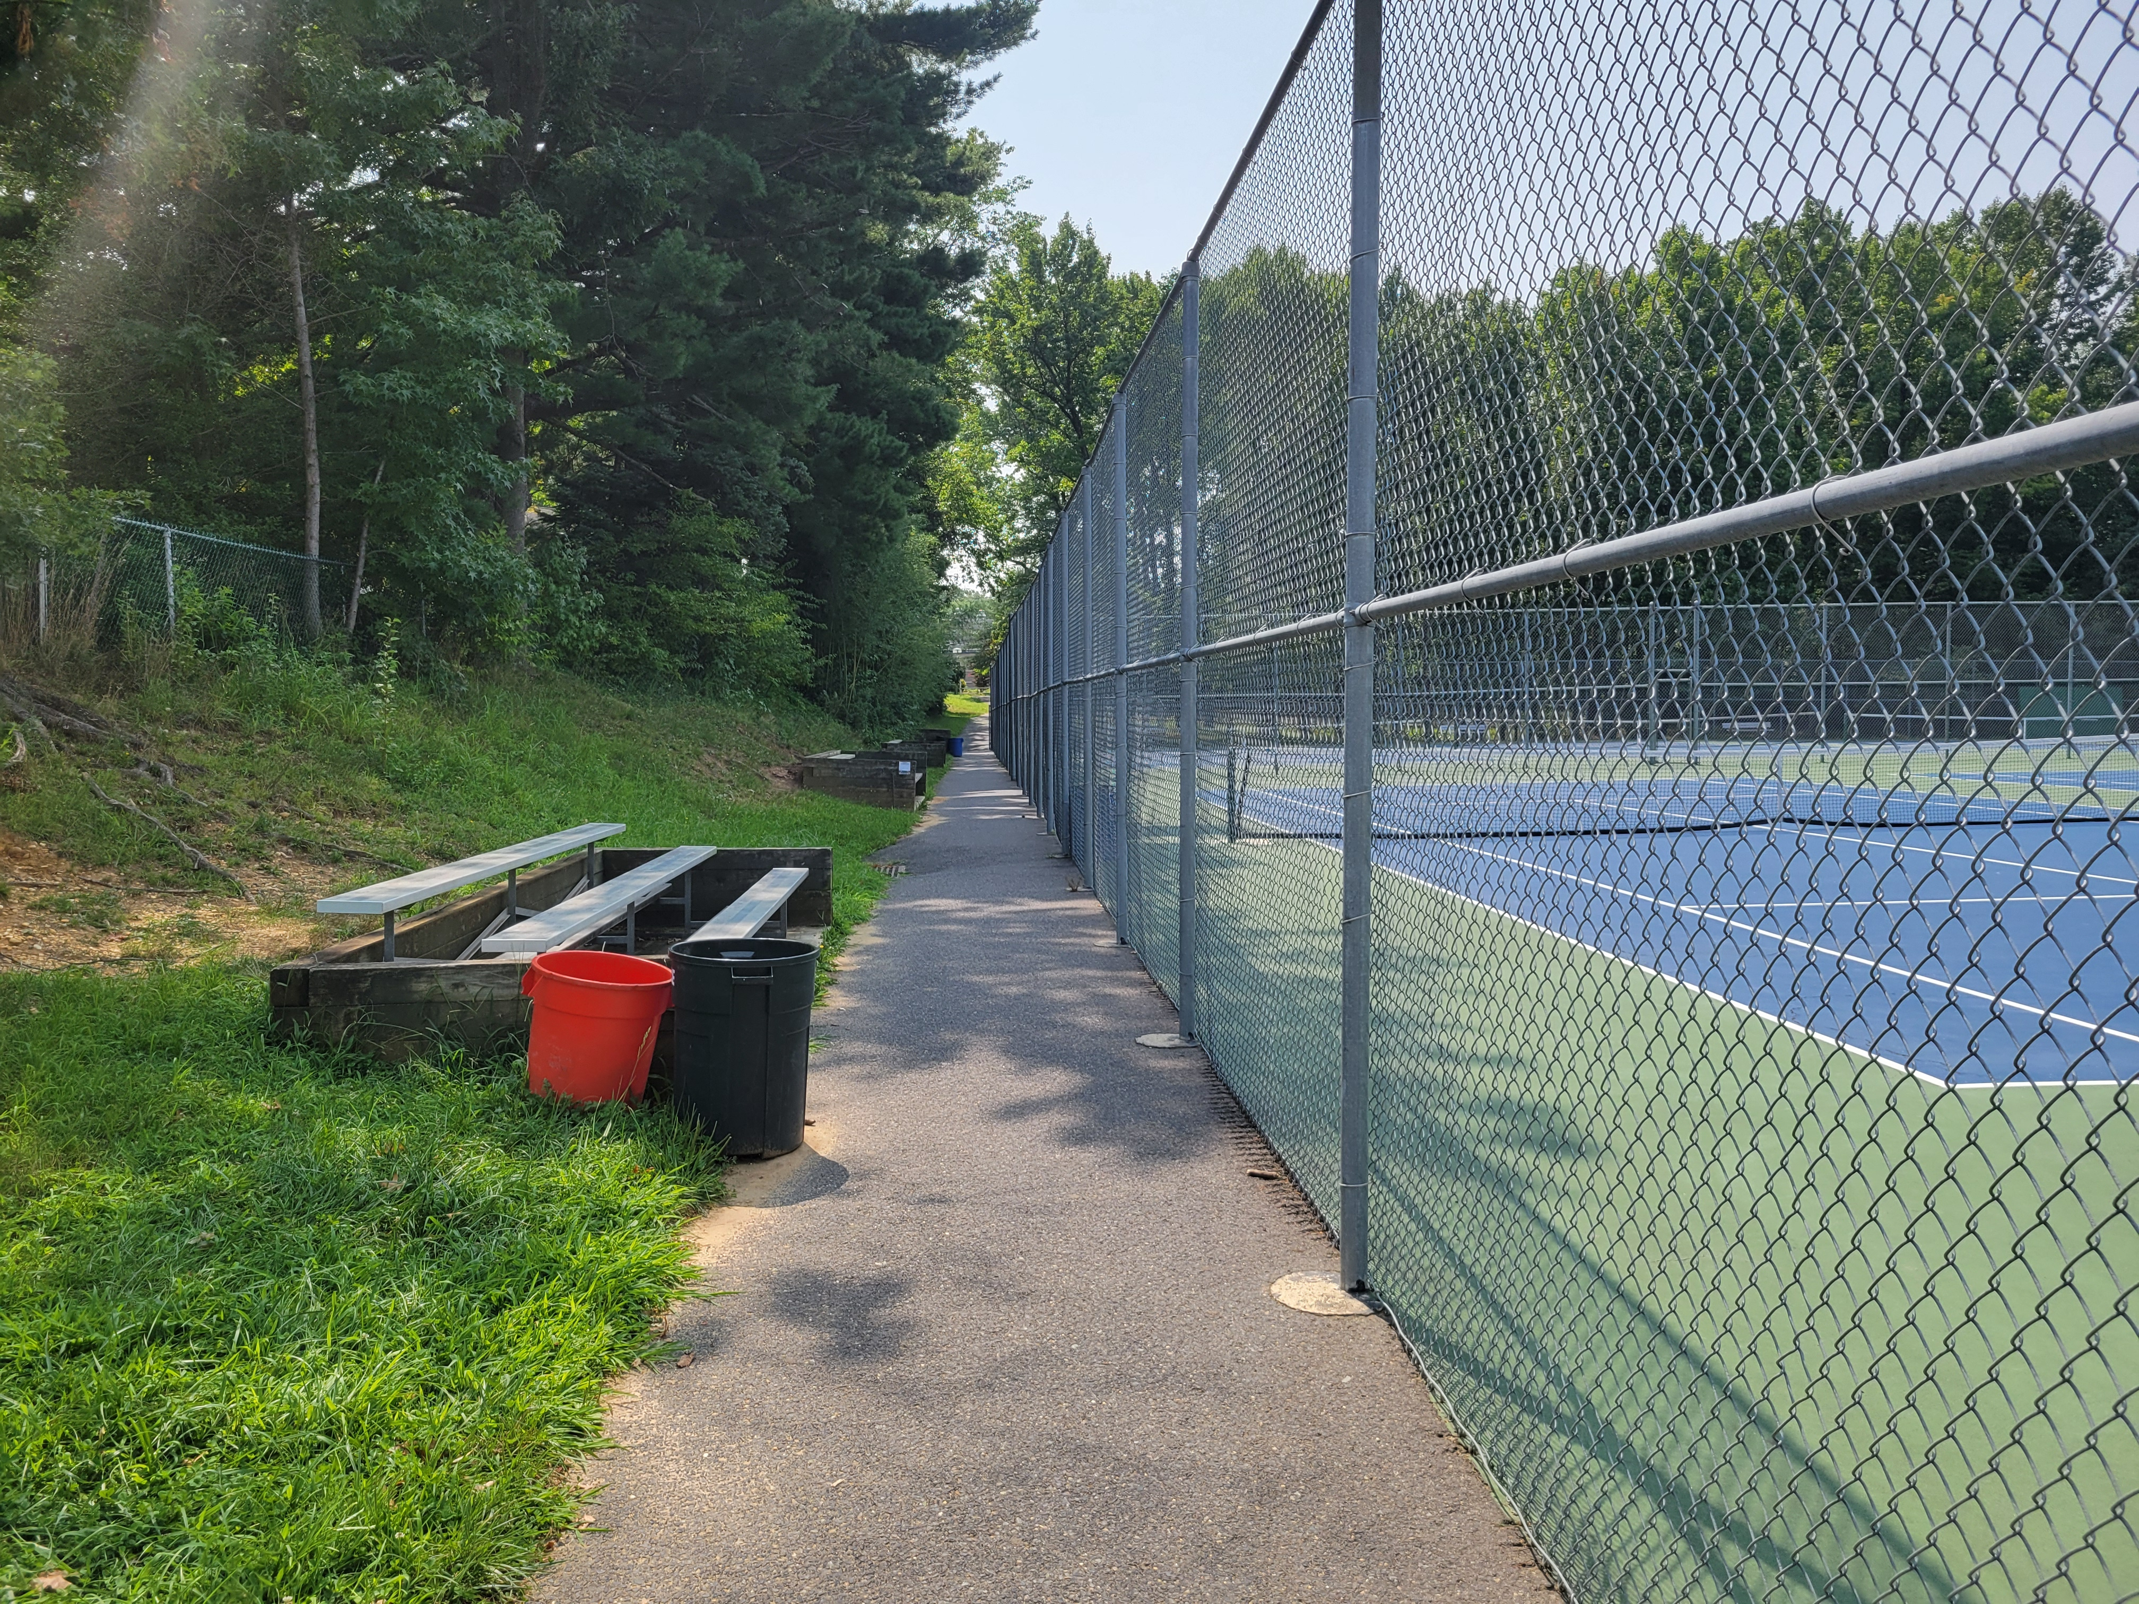

Slide 15
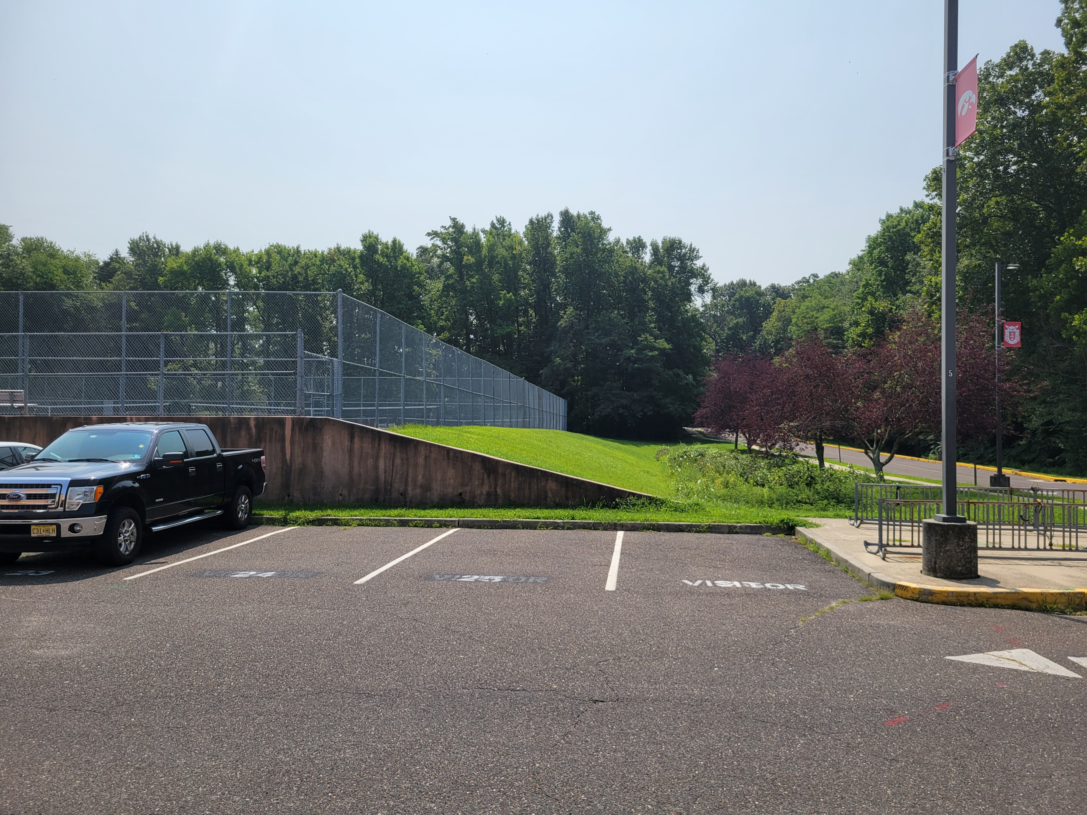

Slide 16

CHALLENGES
Music Staffing and Programming
Gifted and Talented Education
Bond Projects/Design and Implementation

Slide 17
OPPORTUNITIES & CELEBRATIONS
MAXIMIZING STUDENT VOICES
EQUITY & INCLUSION COLLABORATIONS
HTHS AP SCORES and PARTICIPATION
SCHOOL FUNDING ADVOCACY
OUT of DISTRICT TUITION/EXCHANGE PROGRAMS
TRANSPORTATION

Slide 18
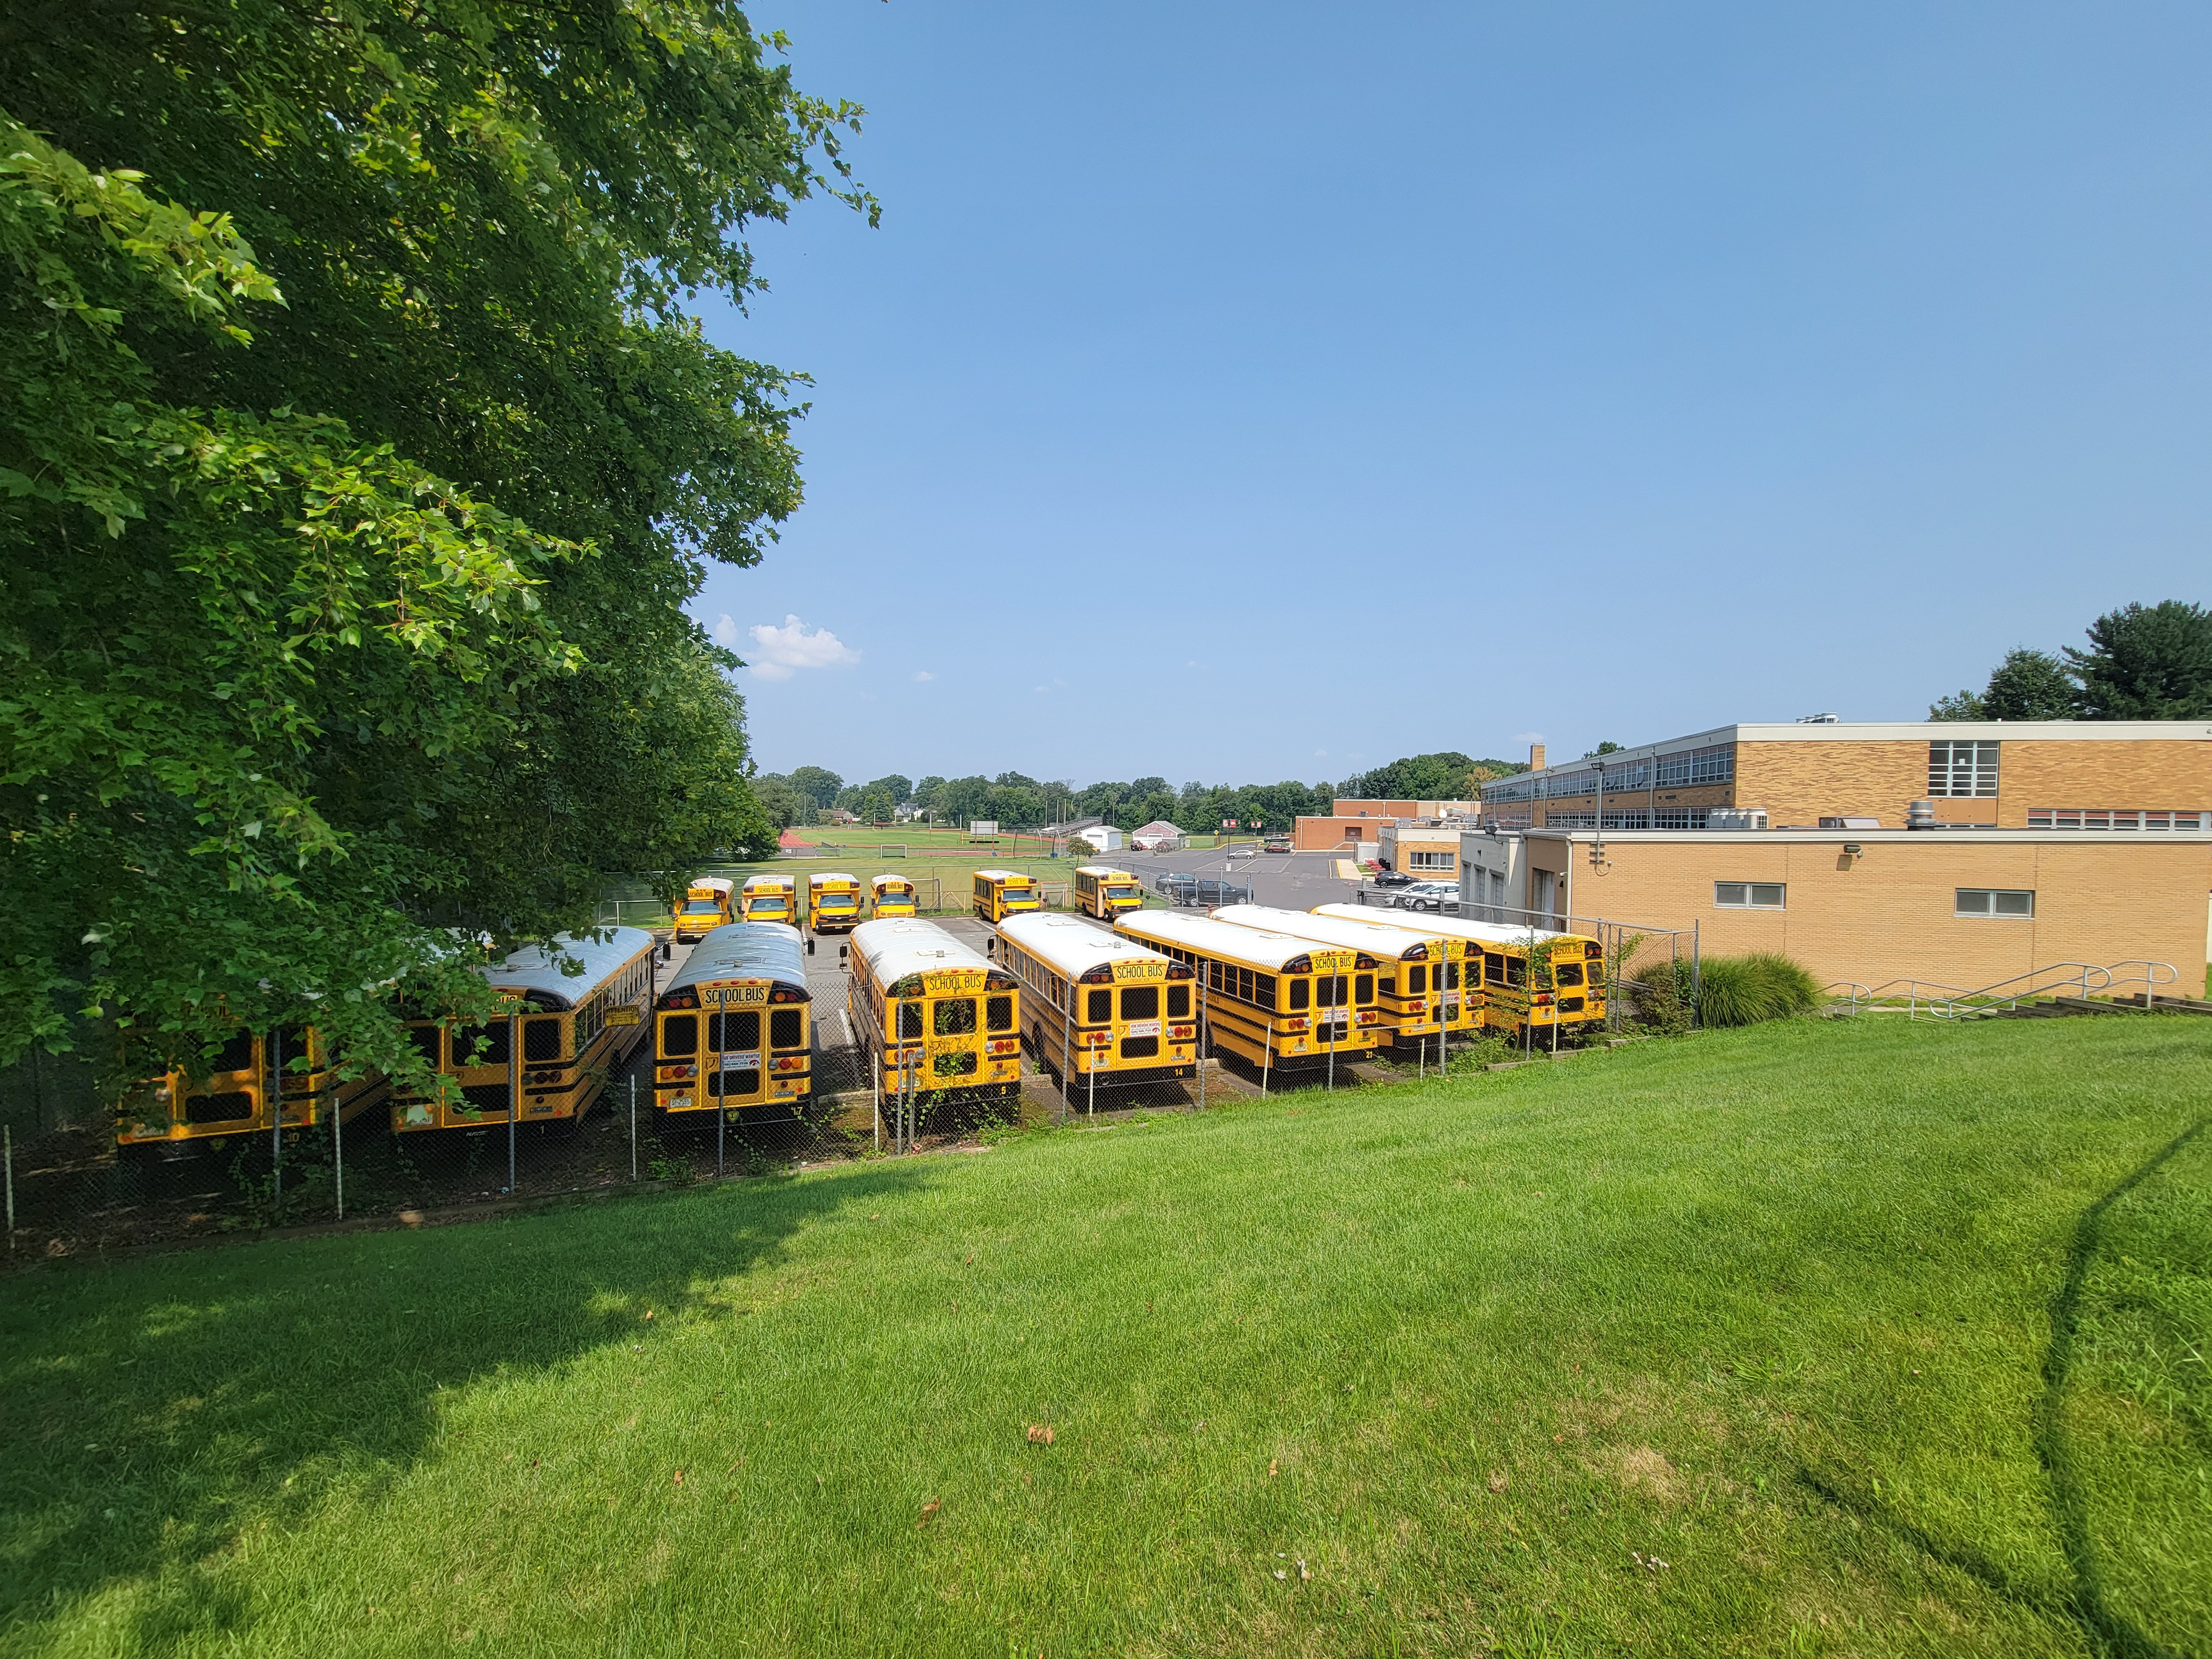

Slide 19
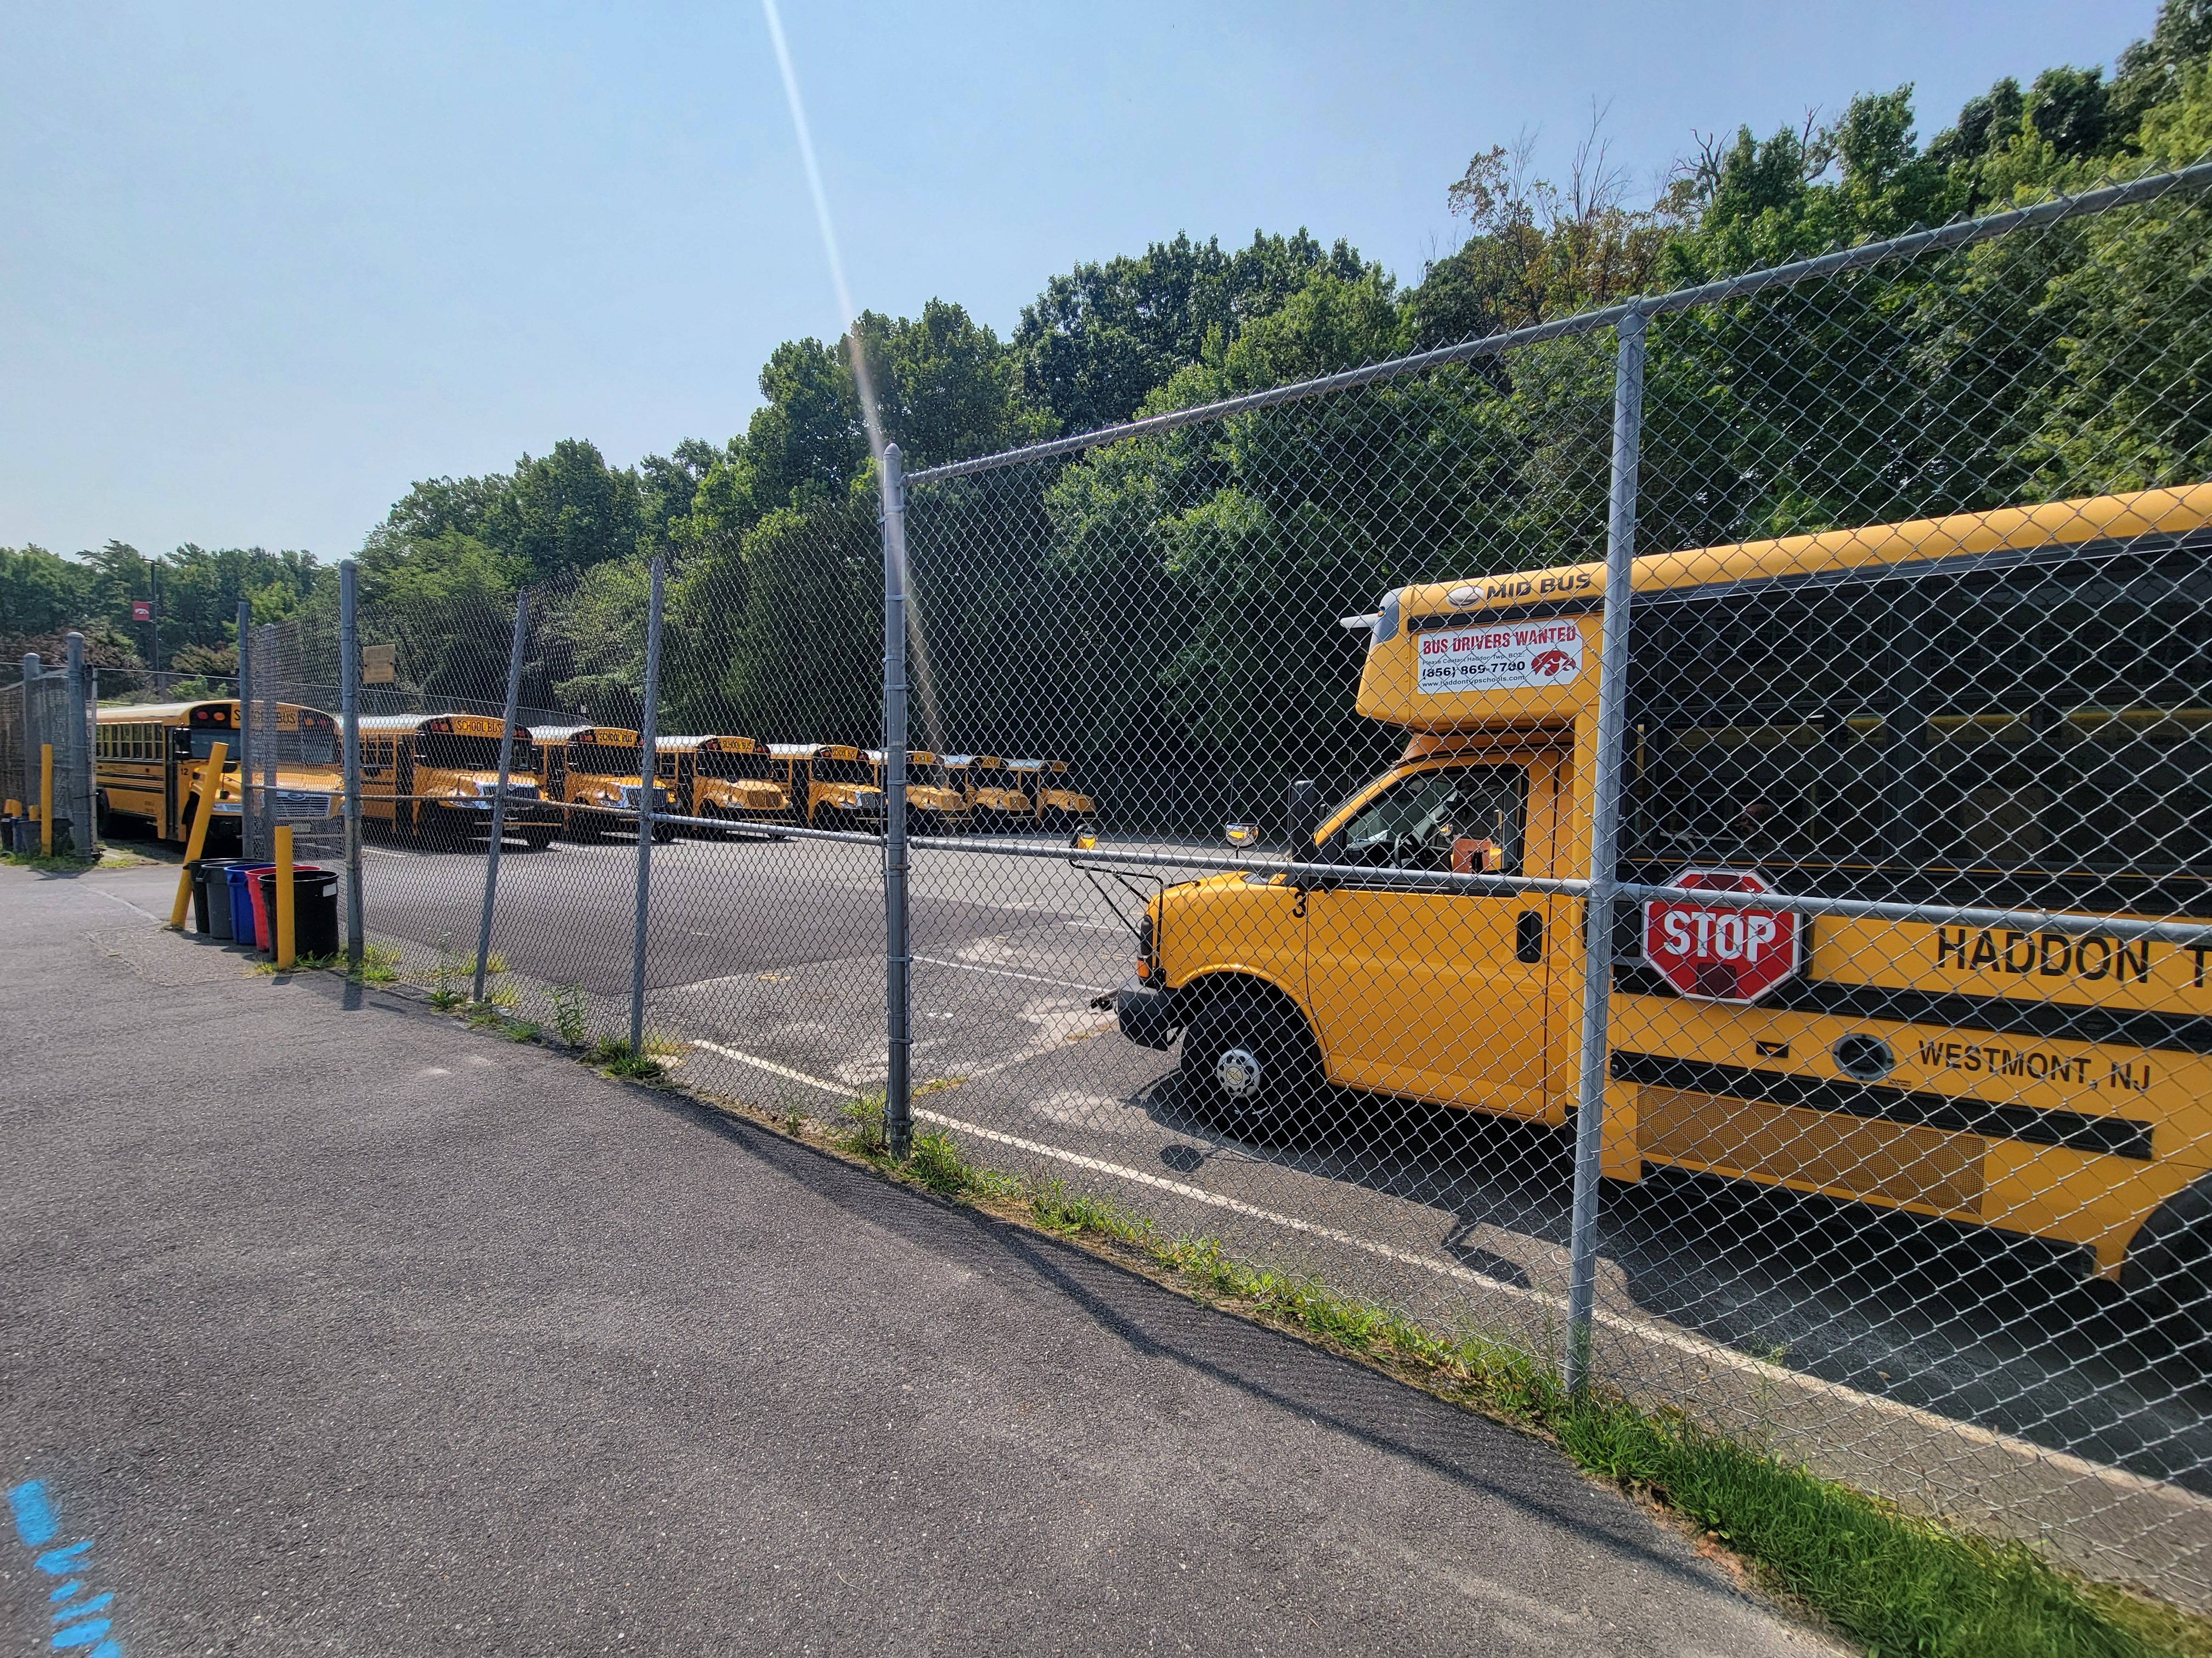

Slide 20
BI-ANNUAL REPORT ON
VIOLENCE AND VANDALISM
PERIOD 2: Jan. 1, 2024 – June. 30, 2024

Slide 21
REPORTING REQUIREMENTS
Summarize the monthly Student Safety Data System Report presented to the BOE at each meeting
Identify the efforts of the district to address violence and vandalism
Generate discussion about the district’s efforts

Slide 22
REPORTING CATEGORIES
Incidents (Violence, Vandalism, HIB, Weapons Offenses, Substance Offences)
Other Incidents Leading to Removal
HIB Alleged
HIB Trainings
HIB Programs

Slide 23
SSDS 2023-24 PERIOD 1
Incidents by Reporting Category
 | Violence & Vandalism PERIOD 1: Sept. 1 – Dec. 31, 2023 | Other Incidents Leading to Removal Suspensions ISS/OSS | HIB Alleged | HIB Trainings | HIB Programs
Edison |  |  |  | 1 | 6
Jennings |  |  |  | 2 | 3
Stoy |  |  |  | 1 | 3
Strawbridge |  |  |  | 1 | 6
Van Sciver |  |  |  | 2 | 3
RMS | 7 | 21 |  | 4 | 5
HS | 4 | 26 | 1 | 3 | 3

Slide 24
Incidents by Reporting Category (Period 2)
 | Violence & Vandalism PERIOD 2: Jan. 1 – June 30, 2024 | Other Incidents Leading to Removal Suspensions ISS/OSS | HIB Alleged
Edison
Jennings
Stoy
Strawbridge
Van Sciver | 0 | 4
RMS | 16 | 44 | 1
HS | 13 | 30 | 1

Slide 25
PROGRAMS PROVIDED UPON DISCIPLINARY ACTION
Assignments, instruction and/or support services
In-school programs
In-district programs
Home assignments/home instruction
Counseling services
Parent conference/student conference

Slide 26
Questions/Discussion
Student Safety Data System Report

