Slide 1


Meeting of the Board of Education
ROBERT J. FISICARO, ED.D: SUPERINTENDENT
JENNIFER GAULD: SCHOOL BUSINESS ADMINISTRATOR/BOARD SECRETARY
CHANTELLE SHORTER: ASSISTANT SUPERINTENDENT
February 19, 2026

Slide 2

Superintendent’s
Report
Media Center
Staff Survey Results
Right At School Child Care
Special Events and Dates
Student Representatives’ Reports
2

Slide 3
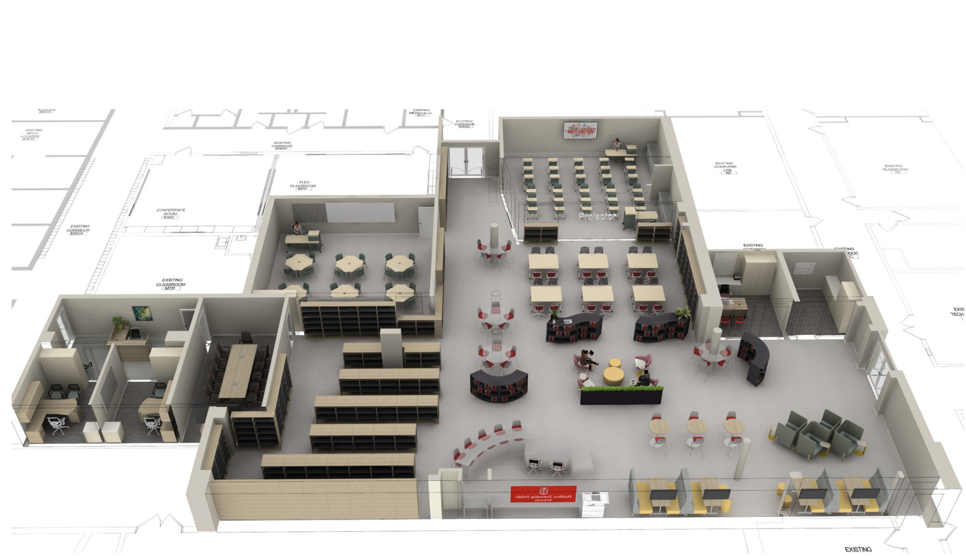

Slide 4
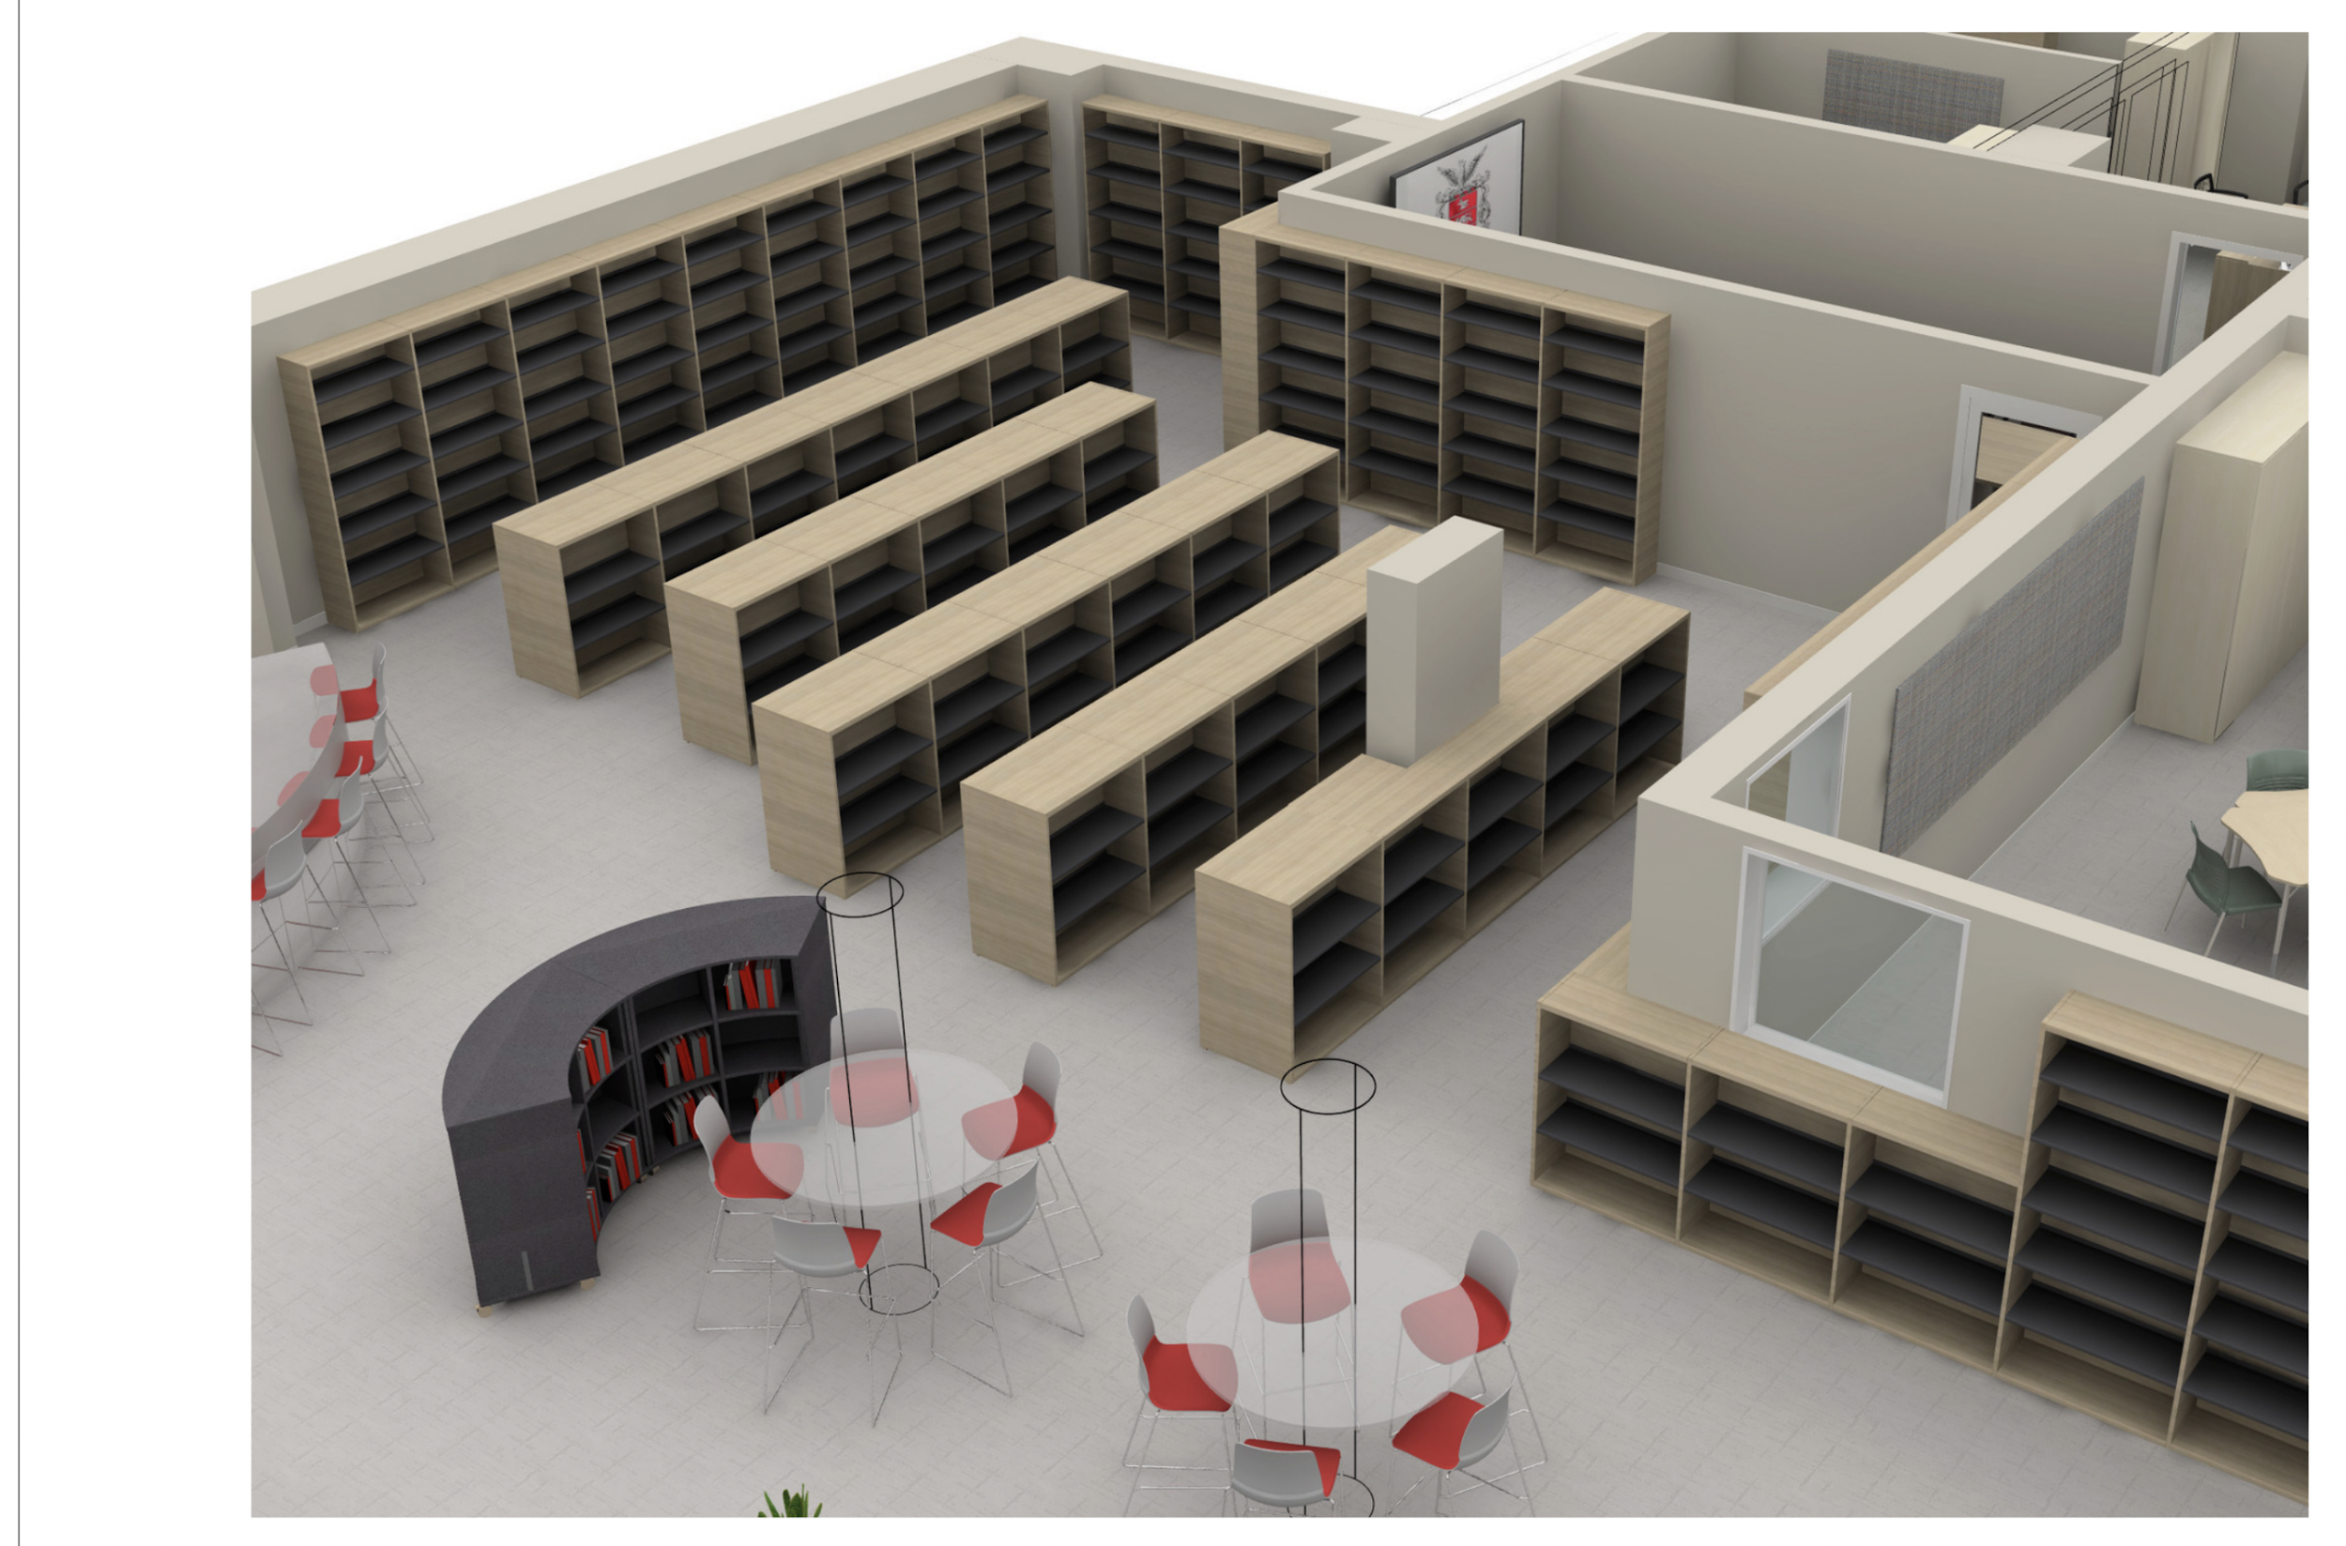

Slide 5
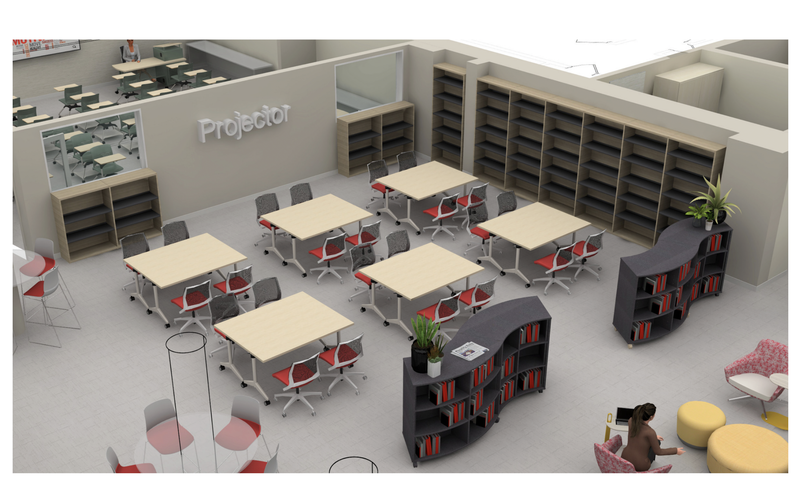

Slide 6
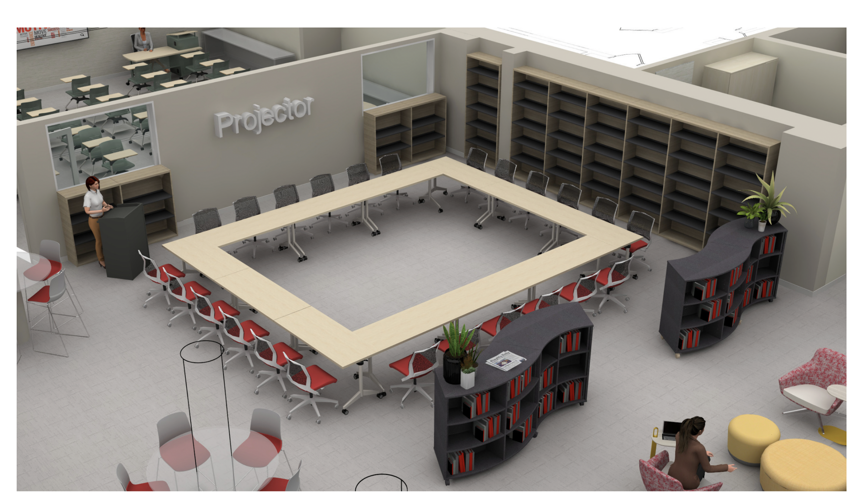

Slide 7

Staff Survey Culture and Climate
Participation
  147 Total Responses- Anonymous
  82% Teaching Staff
  18% Full Time Non-Teaching Staff
Environment
  Physical & Psychological Safety
  Connectedness/Sense of Belonging
  Trust
Leadership & Support
  Reliability
  Management and Administration
  Listening/Collaboration/Input
3

Slide 8
Key Takeaways
Strengths
  Meaningful Collaboration Among Staff
  High Levels of Peer & Admin Support
  Strong Sense of Community and Pride
  High Sense of Belonging, Trust, & Respect
Areas for Growth
  Time and Workload Management
  Facility and Space Concerns
Open Ended Analysis
  What is the biggest obstacle currently preventing you from doing your best work for your students?
4

Slide 9
Likert Scale Question ( 1-5) | Percentage of Staff (Strongly Agree & Agree)
I feel physically safe performing my duties in this building. | 95.3%
It is safe to take professional risks or try new teaching methods here. | 91.4%
I have positive collaborative relationships with my colleagues. | 95.9%
I am trusted to choose the teaching methods that work best for students. | 92.5%
Teachers and administrators work in partnership. | 83.0%
I feel like a valued and respected member of the school staff. | 89.8%
I feel a strong sense of belonging within this community. | 86.4%

Slide 10
Before and After Care- Right at School
Program Enhancements
  Consistent/Collaborative Pricing ( 3% Increase)
  Before Care @ Each School
  Summer Rec Flexible Scheduling
  August Summer Rec Offerings
  Potential School Day Off Offerings
  Consistent Employment- Current HTSD Staff
6

Slide 11

Calendar/Dates
March 6, 9am- Special Event HTSD, Camden County Legislators, Special Guest Assemblyman Louis D. Greenwald (D), District 6
March 6, 7 pm- HTEF Trivia Night
March 12- Release of State Aid Figures
March 19- Meeting of Board of Education
March 19- Budget Due to County Office
March 26, 27, 28-Haddon Township Production, “Newsies”
April 16- Meeting of the Board of Education
Paul F. Gilligan III Media Center
Re-Dedication TBA
May 7- Public Hearing on 2026-27 Budget

