Slide 1
Haddon Township School District
2024 BUSINESS PLAN
Notes:
***********EDIT THIS SLIDE- Replace XYZ with your district’s name.

Slide 2
School Nutrition is Not Just a Meal!
Meals at school play a critical role in the overall education experience of young people. School breakfasts and lunches can mean the difference between a healthy child, eager to learn, and a hungry child with diminished energy, unable to focus in the classroom.
Whitsons is committed to helping students lead healthier lives through balanced nutrition. We are honored to partner with your school community and are proud to present you with a recap of the current school year and our plans for the next.

Slide 3
Presentation Overview
FINANCIAL REVIEW OF CURRENT SCHOOL YEAR
ACCOMPLISHMENTS THIS YEAR
SIMPLY ROOTED® UPDATE
3-YEAR STRATEGIC PLAN

Slide 4
Breakfast Meals

Slide 5
Breakfast ADP

Slide 6
Breakfast Participation

Slide 7
Lunch Meals

Slide 8
Lunch ADP

Slide 9
Lunch Participation

Slide 10
Snack Meals

Slide 11
Snack ADP

Slide 12
Snack Participation

Slide 13

WHITSONS SCHOOL NUTRITION IS…
WE ARE COMMITTED TO PROVIDING WHOLESOME, HIGH QUALITY MEALS PREPARED FRESH FROM ALL NATURAL INGREDIENTS INCORPORATING ORGANIC, NON-GMO, AND LOCALLY SOURCED WHENEVER POSSIBLE.

Slide 14
WE LIVE OUR SIMPLY ROOTED® PHILOSOPHY EVERY DAY, THROUGH OUR…
PEOPLE
FOOD
COMMUNICATION

Slide 15
People
Sofia Zois– General Manager
*Completed All NJ State Professional Standard Training
*National Restaurant Association – Serv Safe Certification
Brad Schweitzer – Chef Manager
*Completed All PA & NJ State Professional Standard Training
*National Restaurant Association – Serv Safe Certification
Notes:
***********EDIT THIS SLIDE- List all your recent enhancements that fall under the PEOPLE category.

Slide 16
People
Cory Goldfarb –District Manager-
*Completed All State Professional Standard Training – March 2023
* FMP (Food Management Professional) National Restaurant Association professional standards designation.
*Member SHFM –Society for Hospitality & Food Management Professionals
* National Restaurant Association – Certified Trainer /Proctor
*National Restaurant Association – Serv Safe Certification
* Member School Nutrition Association – NJ & PA
Shannon Loschiavo, DTR – Operations Manager
*Completed All State Professional Standard Training – March 2023
*Nutritionist Dietetic Technologist
*National Restaurant Association – Certified Trainer /Proctor
*National Restaurant Association – Serv Safe Certification
* Member School Nutrition Association – NJ
Notes:
***********EDIT THIS SLIDE- List all your recent enhancements that fall under the PEOPLE category.

Slide 17
Food
RECENT ENHANCEMENT #1
Whitsons Introduced “Pop Up Shops” Strategically designed promotions to maximize excitement for a shorter period of time in an effort to inject more variety into our menu selections. The Pop-Up Shops Include:
2024 Pop Up Shops: Wing Shack, Sabrosos Taco Truck, Yardbird Chicken, Ciabatta Sams Sandwich Stop, Nashville Kickin Chickn – Crispy Chicken Sandwiches with a kick, Seoul Taco Korean Fusion, Incredibowls, and Tot Spot.
RECENT ENHANCEMENT #2
Introduction of Plant Based Entrees. The Humane Society of the US. And Whitsons Culinary Group have partnered to increase Healthy, Sustainable, Plant Based Menu offerings with a target of reaching 10% Plant Based Menu items within the next Two Years. Meatless Mondays.
RECENT ENHANCEMENT #3
New Menu line of Bento Boxes, Smoothies and yogurt parfaits rolled out at both the Middle School and High School to increase grab & go selections served in plant based containers used to spearhead our district-wide green initiative for 2024-25.
Notes:
***********EDIT THIS SLIDE- List all your recent enhancements that fall under the FOOD category.

Slide 18
Food
RECENT ENHANCEMENT #4
Offered snacks at elementary levels, starting in December. Increasing sales over $100 per day
RECENT ENHANCEMENT #5
Introduction of Hot Breakfast Sandwiches weekly to the Breakfast menu at High School.
RECENT ENHANCEMENT #6
Introduction of BIC to the elementary schools, increasing participation encouraging more F/R participation.
Upcoming Enhancements
Expanded locally grown fruits and vegetables – Local Farm partners These vendors expand Whitsons Simply Rooted Harvest of the month Promotions that are offered on our menus and also are major contributors to our Farmers Market Quarterly Promotions.
Notes:
***********EDIT THIS SLIDE- List all your recent enhancements that fall under the FOOD category.

Slide 19
Communication
RECENT ENHANCEMENT #1
“Student Faves” (student favorites) student menu creation initiative implemented to further gather input and survey students of likes and dislikes of new food product and menu ideas. Students sample new menu items and vote on menu additions.
RECENT ENHANCEMENT #2
Enhancements made to Whitsons FD Meal Planner interactive menu and meal planning website and app. To enhance menu and nutritional information and expand allergen communication to district families.
Notes:
***********EDIT THIS SLIDE- List all your recent enhancements that fall under the COMMUNICATION category.

Slide 20

HOW DEEP ARE YOUR ROOTS?
The advancement of your school nutrition program is as important to us as it is to you.
As part of our Simply Rooted® philosophy, Whitsons has taken the next step in our commitment to providing a successful and sustainable operation.

Slide 21
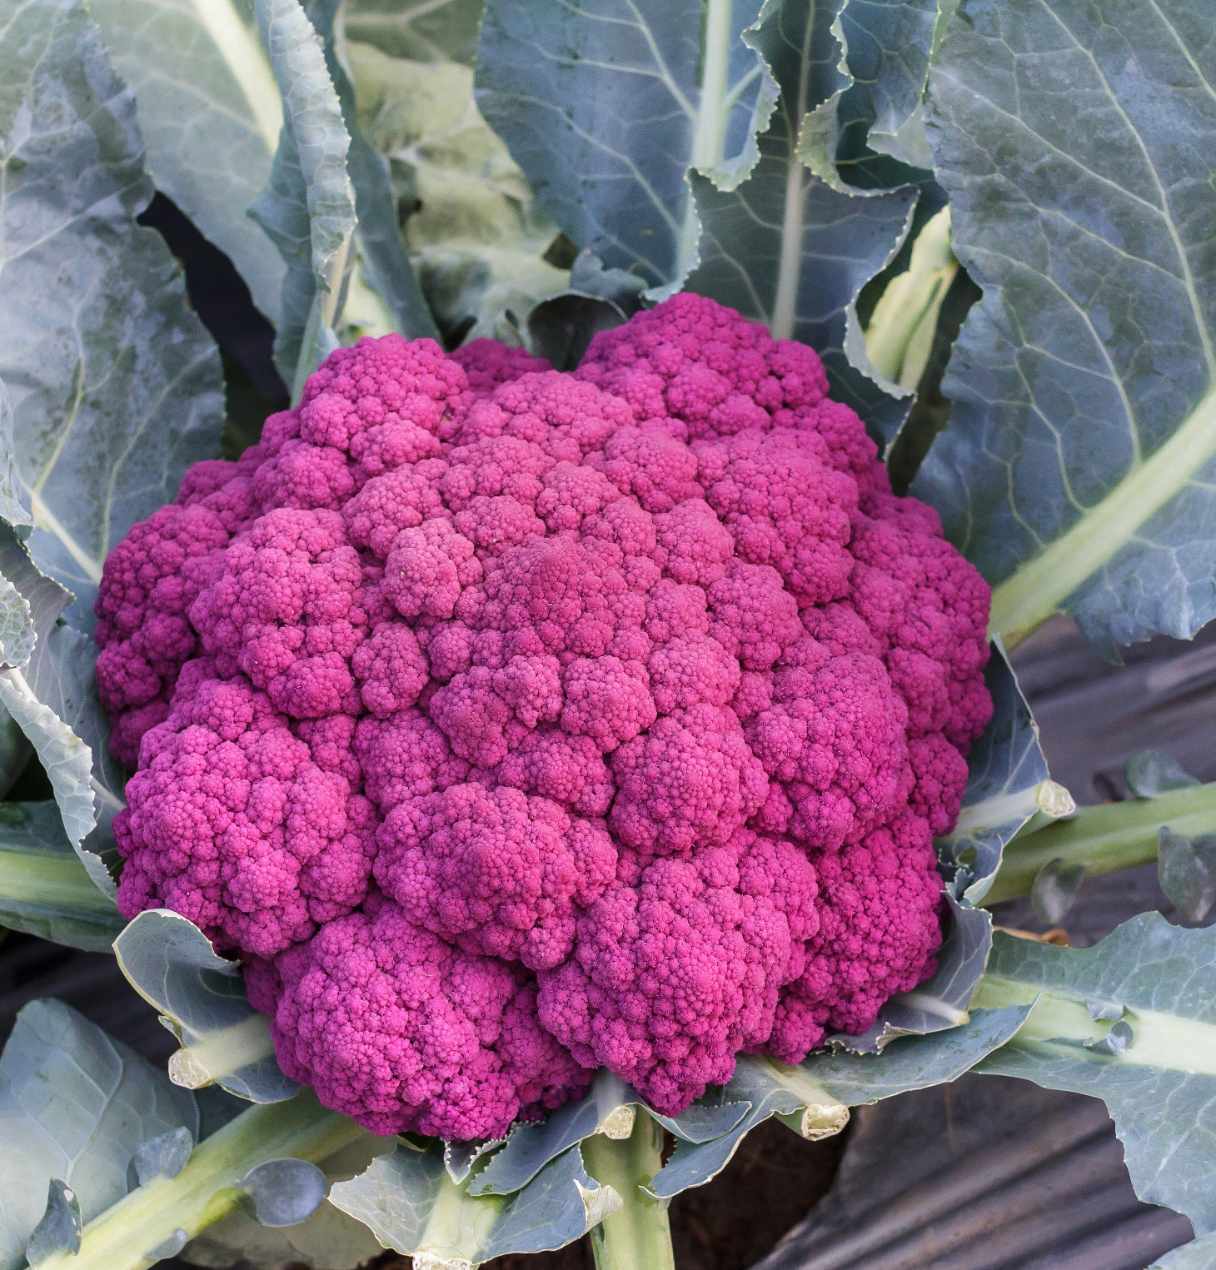
Our Root Rating
We have implemented a Root Rating scale in order to evaluate the school nutrition program’s sustainability efforts.
This rating helps us understand where the program stands and will guide us in nurturing your program to the next phase.
We are proud to announce that Our Root Rating is currently in the BLOOM phase.
This is currently the highest rating that exists in the company.
Notes:
***********EDIT THIS SLIDE- Edit the text in red to show what phase your district is currently in. Then convert the text back to gray.

Slide 22

NEXT STEPS…

Slide 23
District Strategic Goals
We understand your goals for the school nutrition program, and we feel that a strategic goal alignment is essential for the success of your operation, therefore we have summarized what is most important.
FACILITIES & EQUIPMENT- Routinely research, evaluate, improve equipment in all schools in order to stay ahead of the curve and avoid any potential service interruptions.
PROGRAM- Keep the program “fresh” by offering new products, menus and locally sourced items while building nutritional awareness and creating menus that go beyond the USDA minimum standards in order to increase student participation.
TEAM & SKILLS- Build and nurture an exemplary food service team by coaching and promoting from within whenever possible, while providing a supportive management structure and a succession plan for the management team.
TECHNOLOGY- Use technology to advertise, educate and solicit feedback in order to create efficiency and improvements throughout the district.
COMMUNITY- Create new and develop existing partnerships with various groups within the schools and community, while educating and collecting feedback to improve the school nutrition program.
MARKETING- Enhance communication and marketing to inform and educate families, share success stories, accomplishments and efforts.
Notes:
***********EDIT THIS SLIDE- This is a full listing of goals and you should only display what applies, delete all that do not apply.

Slide 24
Strategic Plan
GOAL ALLIGNMENT | GOAL | STRATEGIES TO ACHIEVE THIS GOAL
TEAM & SKILLS
 | 1. Increase the number of Serv Save certificate holders throughout the district | 1. Develop action plan for staff to Team Lead development and ensure the Serv Safe Certificate is the priority in the job description.
 | 2. Reline labor utilizing time management and shared staff across schools | 2. Reassign team members and work scheduled to eliminate downtime. Staff will have new school assignments and reduction in hours.
PEOPLE

Slide 25
Strategic Plan
GOAL ALLIGNMENT | GOAL | STRATEGIES TO ACHIEVE THIS GOAL
PROGRAM | 1. Increase the pop-ups | 1. Introduce the new up with a preview the week before. Including the new Pop-ups for the school year.
 | 1. Develop after school snack program for student athletes and afterschool Programs Nutrition and refueling station in the HS | 1. Continue to build relationship with new Athletic department team to support after school snack programs and needs. During the school year and into the summer months. Meeting the athletic department to strategically plan the menus.
FACILITIES & EQUIPMENT
 | 1. Apply for NJ equipment grant | 1. Asses the needs of each school. Outlining the needs and replacement of any equipment. If needed apply for the Nj Equipment grant,
 | 2. Upgrade POS system throughout the schools | 2. Work with the district to replace POS terminals and systems in all schools.
FOOD

Slide 26
Strategic Plan
GOAL ALLIGNMENT | GOAL | STRATEGIES TO ACHIEVE THIS GOAL
TECHNOLOGY
 | 1. Add full color copy machine and printer to support all marketing promotions and nutrition education print outs. | 1. Collaborate with vendors and acquire proposals for client and Board review.
COMMUNITY | 1. Continue Assisting coordinating open house and back to school events. | 1. Coordinate this through the principal of each school or the PTO of each school
 | 2. Increase frequency of student feedback. | 2. Monthly student advisory committee meeting. Student surveys in Fall & Spring.
MARKETING | 1. Add local vendors and entrepreneurs to marketing and promotion plan for upcoming school year. (Common Market) | Reach out to community restaurant and food vendors to inquire and establish relationships and set calendar for next year.
 | 2. Partner with local pizza vendor | 2. Work with Passariellos Pizza, as a result of the student feedback.
COMMUNICATION

Slide 27
Whitsons is proud to be part of your community and we are committed to providing a child nutrition program that is in alignment with your school and community’s goals.
THANK YOU!

