Slide 1

Board of Education Meeting
HADDON TOWNSHIP SCHOOL DISTRICT
Where Students Thrive
March 21, 2024
Robert J. Fisicaro, Ed.D., Superintendent
Notes:
NOTE:
To change the image on this slide, select the picture and delete it. Then click the Pictures icon in the placeholder to insert your own image.

Slide 2
Annual Cycle
  May 1-August 30
  Why/When/How?
  September 1- November 1
Communicate
Implement
Plan/Evaluate
Align Budget and District Goals
Monitor/Adjust
  February 1-April 30
  (Budget/Goals
  Adoption)
  November 1- January 30

Slide 3



HTHS GRADING SCALE

Slide 4
PROCESS SUMMARY
Over 75 hours of Evidence Gathering and Qualitative Research
Personal Consultations with over (30) Director Level College Admissions
Engagement with (40) NJ Superintendents (many of which changed grading scales)
Consultations with third party group College-Wise (experts in college applications)
Consultations with John Durante, Principal of Syosset High School, NY & host of the The College Admissions Podcast (200 episodes)
Literature Review/Consultation with Rick Clark author of “The Truth About College Admission: A Family Guide,” current Undergraduate Admissions Director/Georgia Tech University
External Collaborations: NJCAC ( National Association for College Admission Counseling, PACAC ( Pennsylvania Association for College Admission Counseling)
Internal Collaboration with Parents, Staff, BOE Members, and Community

Slide 5
Five Inter-Connected Factors and Levers
What is a Grade? What Does it Mean?
Merit Aid for “Grades”
College Admissions
Crosswalking the Grades to a 4.0 GPA
Timing-When Can Change Occur and for Who & How?
(Must be in the most valid, reliable, and equitable way)

Slide 6

Role of the School Profile
“The first question that readers ask when they open a college application is where does this student go to school?”
For college admissions counselors, a school profile is the gold mine of information and insight.”
Page 101
The Truth About College Admission

Slide 7
UNIVERSITY OUTREACH
The standardized question posed to all was, “Does Haddon Township’s 8-point grading scale in any way, place our students at a disadvantage when it comes to consideration for A) admission or B) scholarships?”
Attempt was made to reach the highest-ranking director level admissions officer possible with a consistent unbiased question.
Responses- a) Emphatic/Unanimous “NO” (In fact, just the opposite is true).
b.) Automatic Merit ( GPA “coupons”) available at some schools

Slide 8
MERIT AID and HTHS 2023 SENIORS
89 students attended 57 universities that do NOT offer automatic merit aid for specific GPAs. These schools typically are “selective” with higher standards and more competition for admission.
22 students attended 12 schools who offer GPA “coupons” for a specific GPA. Typically, these are less selective schools, commonly with (90% admission rate or higher).
  Some will recalculate a numeric score to a more advantageous scale.
  Some will accept submission of final grades to maximize financial awards.
  Some will do neither.
  Note: The average coupon is between $1,000 and $1,500 per year, per step

Slide 9
Course Performance/Grades/Trends
“We get applications from over 3,000 schools around the world and have seen every conceivable combination of curriculum, grading and weighting. It’s not the GPA that matters. It’s what’s behind the GPA that is important.”
Mike Sexton, Vice President for Enrollment Santa Clara University
To determine course performance….regardless of a school’s grading scale colleges are looking at grade distribution and numbers of students in a class. (page 104)

Slide 10
College Admissions & High School Achievement
Elite
Excellent
Good
Average
Poor
Universities expect high schools to do this because students are compared to other students within the same system; “there is no comparison from one system or one district to another (unanimous).”

Slide 11
Course Performance/Grades/Trends
The proliferation of different grading scales in our nation’s high schools over the last decade has been simultaneously maddening and humorous to colleges….not to be outdone by the numbers the alphabetic grading scale has its modifications….some schools have now fully embraced the entire alphabet (Page 103-104)
Regardless of grading scales, recalculations, and weighted/unweighted GPAs, when it comes to assessing academic performance college admissions reviewers are asking and discussing a very simple question: “Has this student taken challenging classes and done well?” (page 104)
….Colleges will not simply be putting GPAs into a spreadsheet and sorting them to make admissions decisions ….the assessment process is nuanced. (Page 105)

Slide 12
THE MOST IMPORTANT QUESTION
How are OUR students doing on our current scale?
AND
What is the impact?

Slide 13
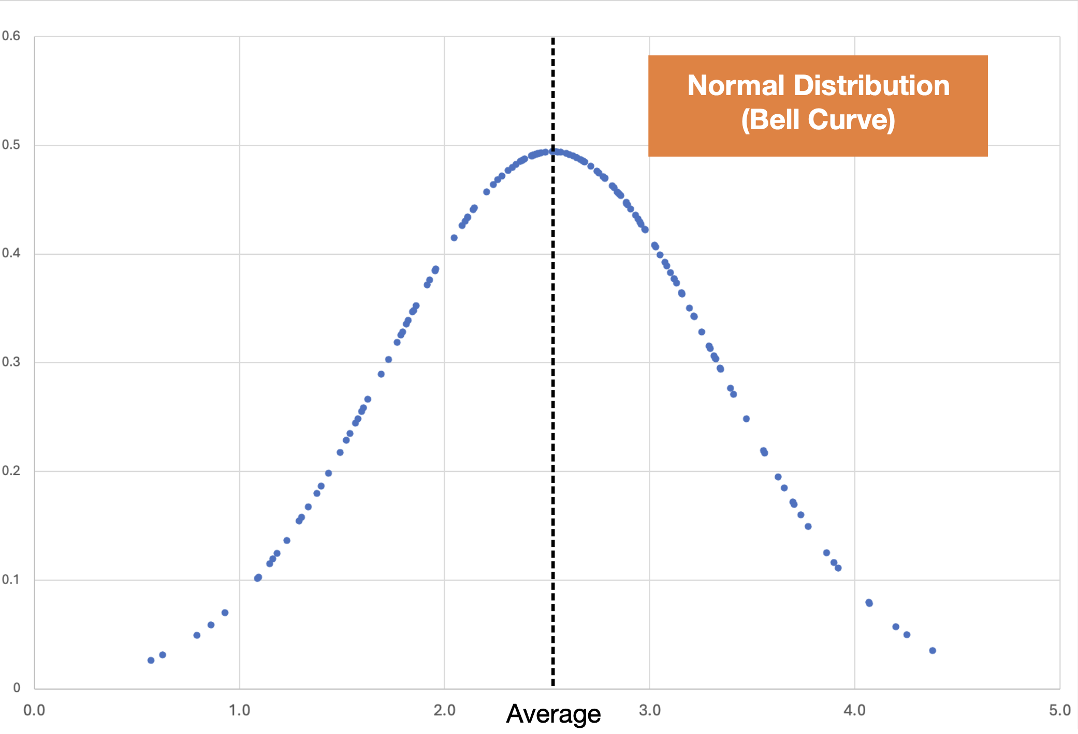

Slide 14
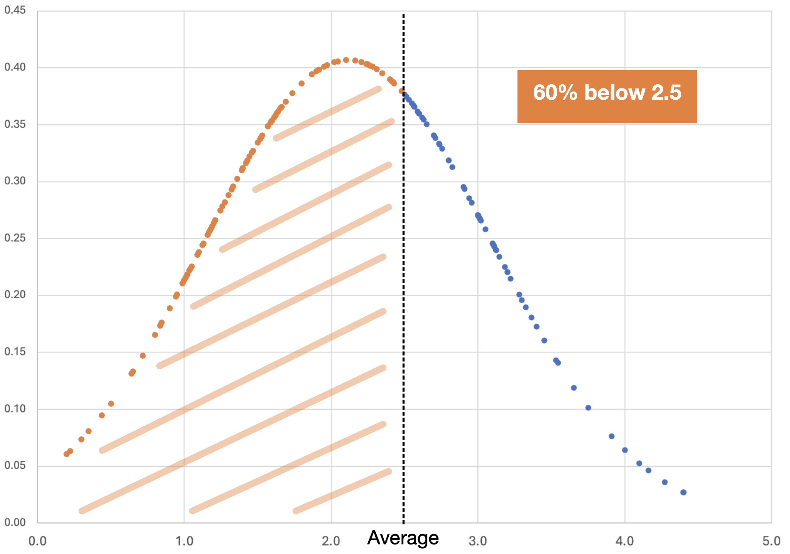
Most Students are Below Average in this Example
This is an Unfair Scale: Too Rigorous

Slide 15
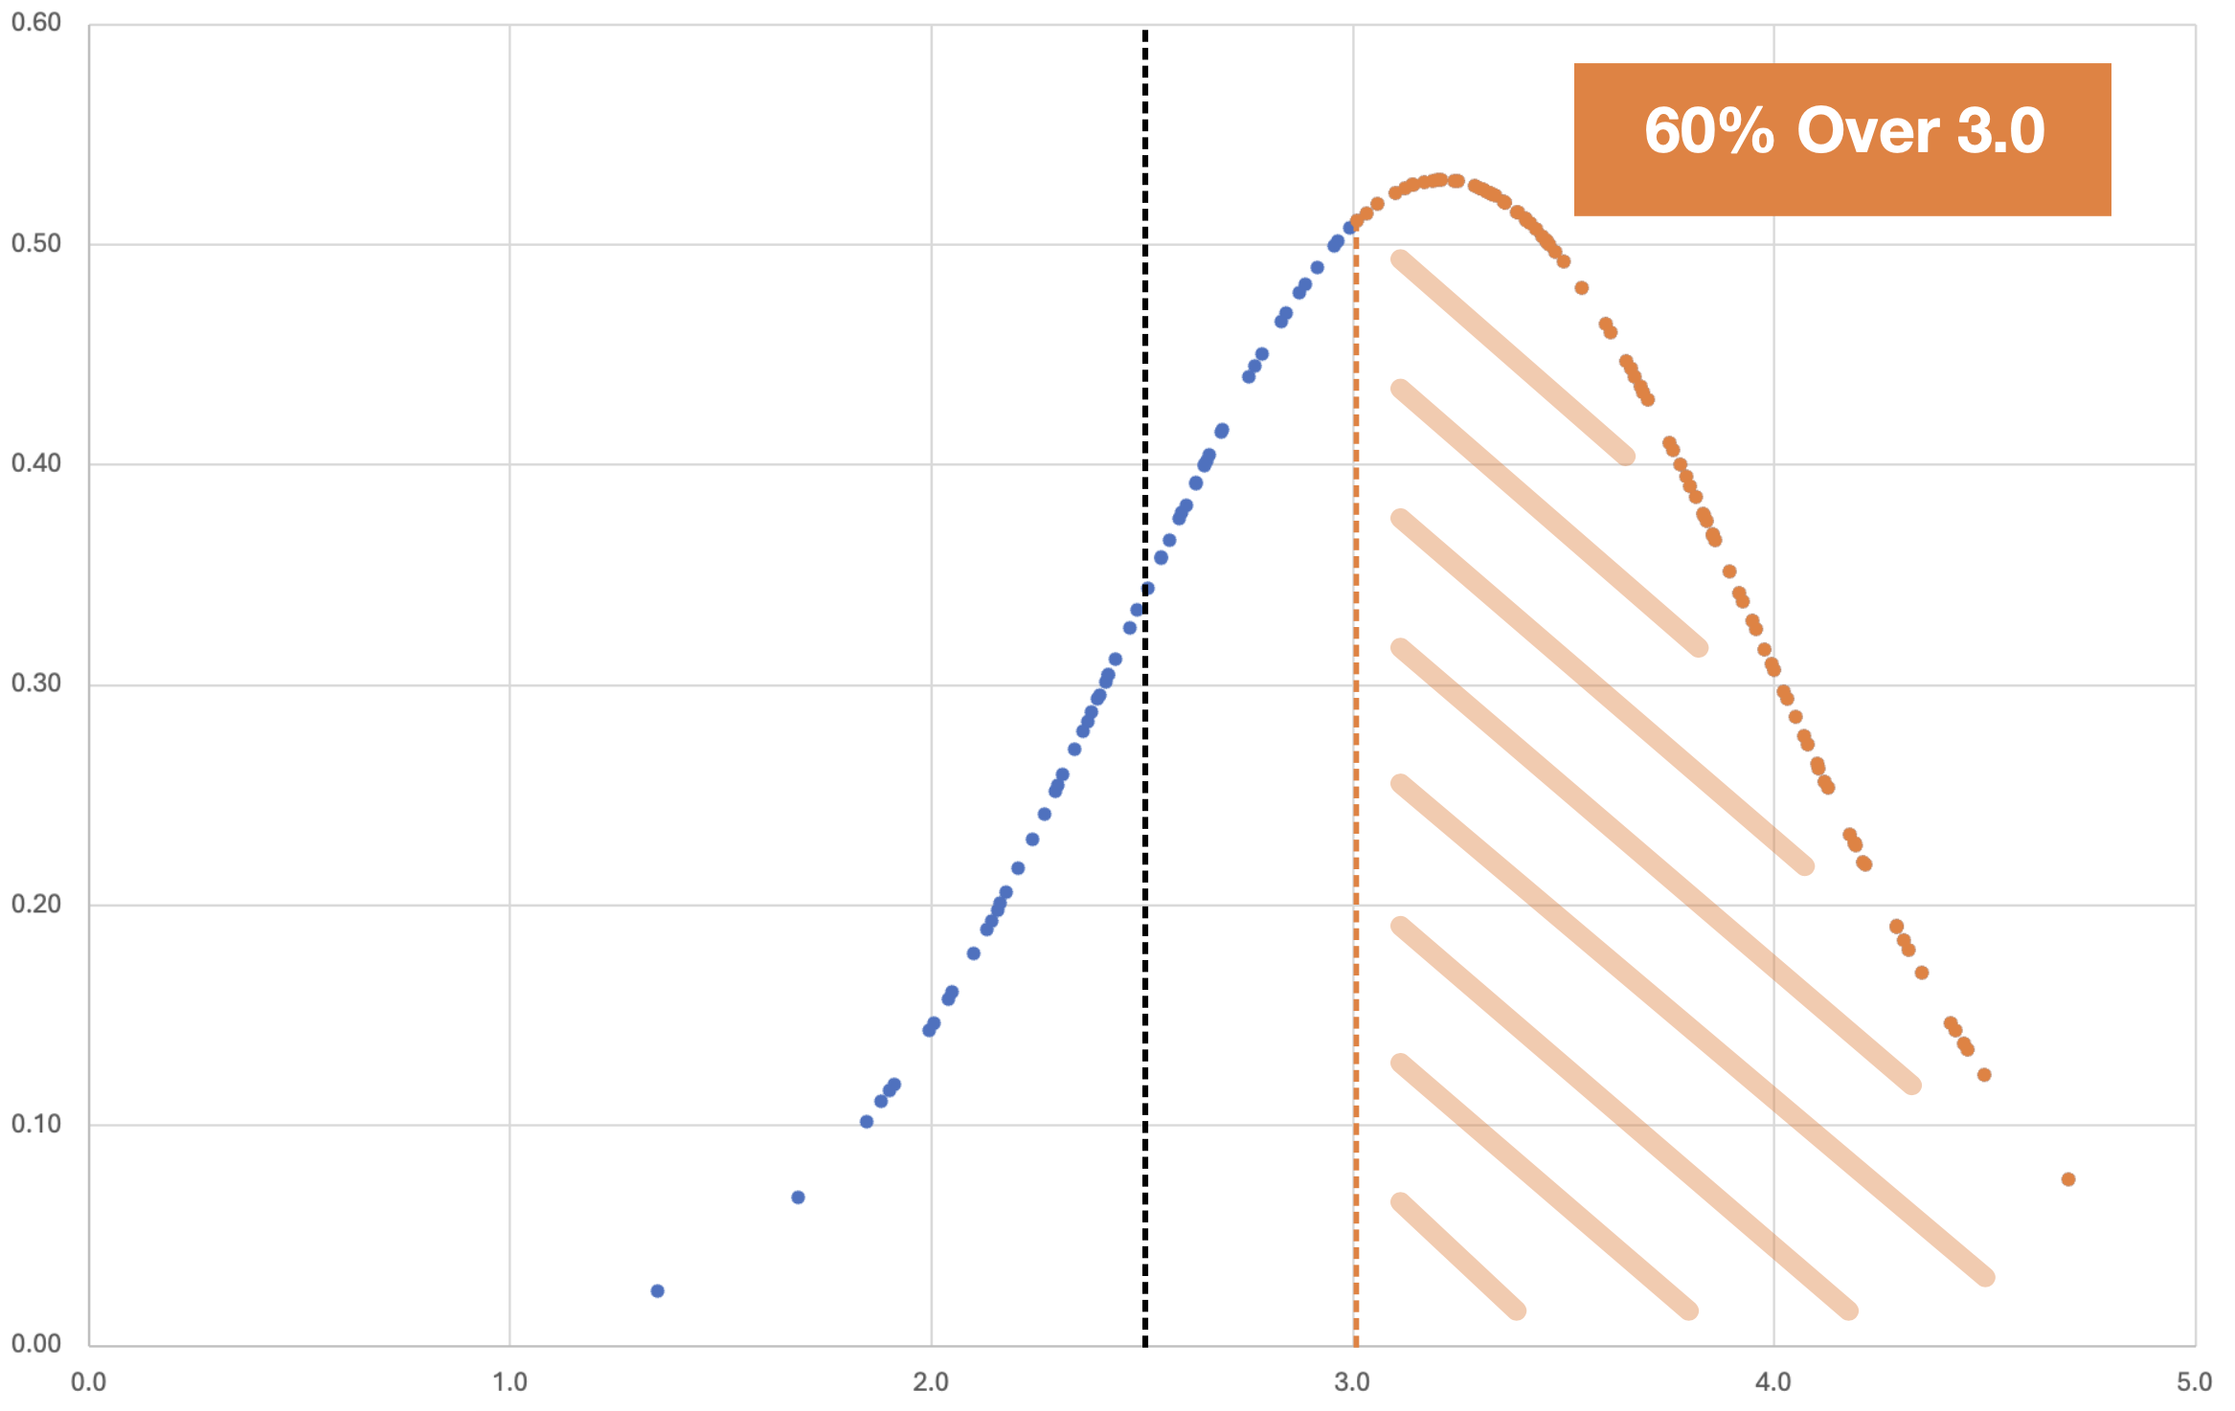
Most Students are Above Average in this Example
Average
Some Would Indicate that Scale is Not Rigorous Enough

Slide 16
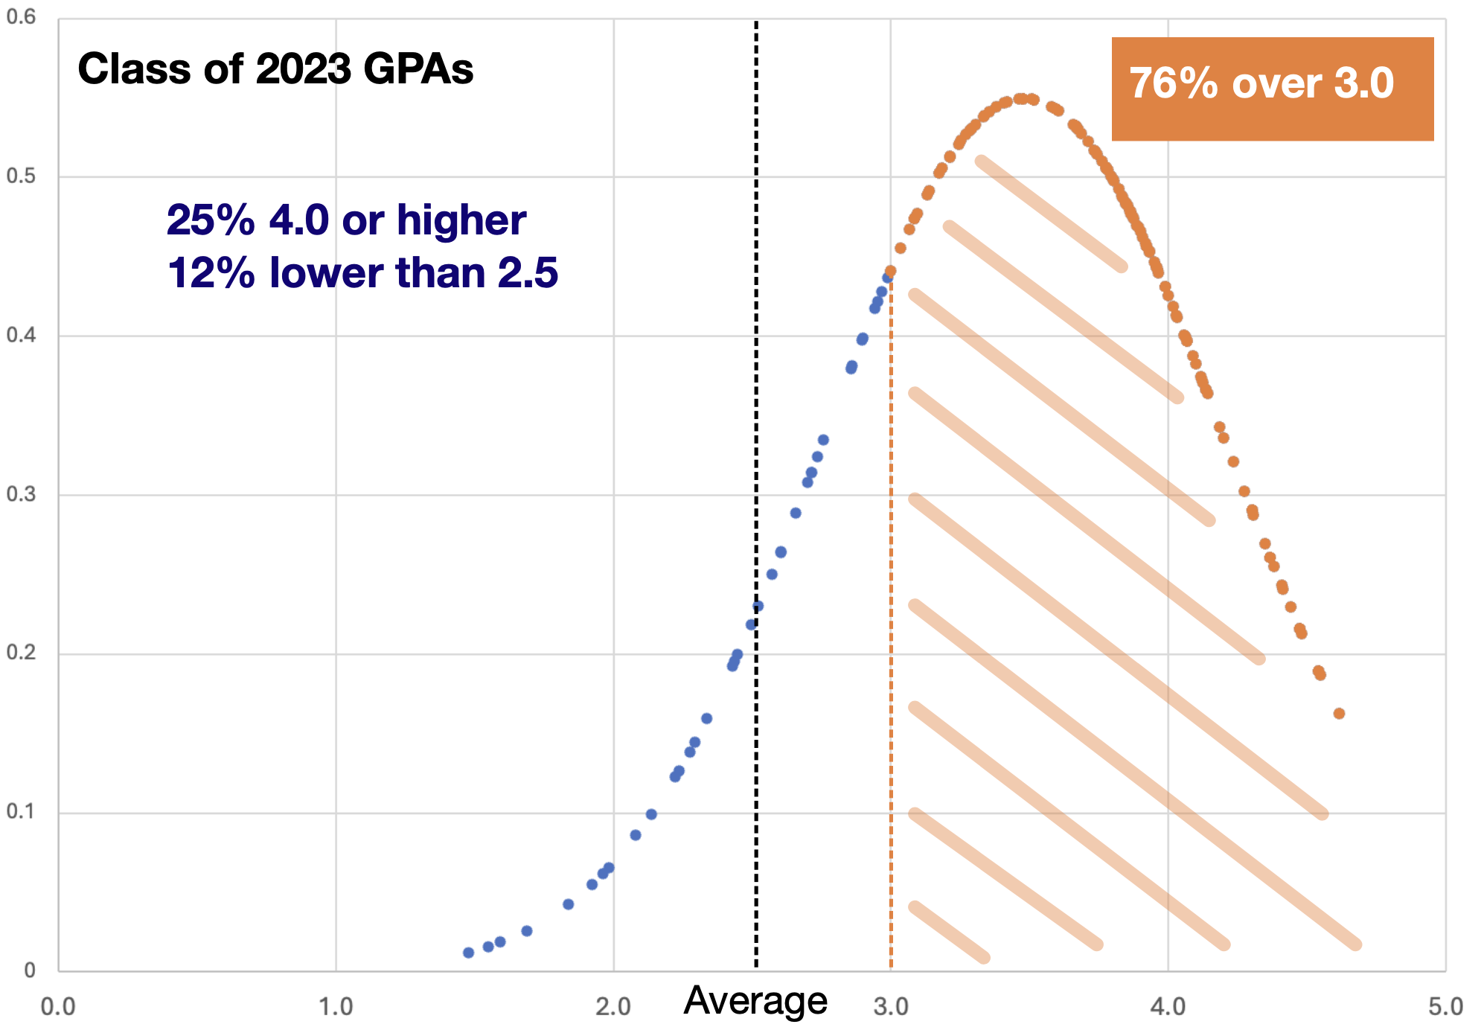

Slide 17
“It's a lot harder to discern who a school's true top students are when there are a huge number of students who share top GPAs. In these cases, it dilutes the impact, and students can be disadvantaged in the admission process. There is a huge performance difference between a student who has a 97 average and a student who has a 91 average, but it would be indistinguishable on a 10-point scale. At selective colleges, having that kind of compression/traffic jam at the top of your class is genuinely counterproductive. Having a perfect (or above perfect) GPA becomes meaningless in that context.”
Meredith Graham, Collegewise Master Counselor and Former Admissions Officer at Cornell University

Slide 18
HTHS CLASS OF 2023 & 2024 SUCCESSFUL ADMISSIONS
University of Virginia
United States Naval Academy
William and Mary University
Syracuse University
Cornell University
Lehigh University
Bucknell University
Dickinson College
George Washington University
University of Pennsylvania
Villanova University
Stevens Institute of Technology
Middlebury College
Northeastern

Slide 19
What are We Trying to Solve?
Is there a way to help students earn more merit aid money without jeopardizing the admissions process for others?
Only changes that will benefit the majority of students, mostly all students, or all students should be considered.
Specifically, what adjustments can help students that achieve below a 2.5 or 3.0 on our current scale (12% and 24% respectively) access more merit aid without jeopardizing admissions for students above a 3.5 GPA?

Slide 21
Process and Time-Line
March- April | High School Administration and Counselors will make and discuss recommendations for best course of action forward to the Superintendent.
May-June | If changes are recommended for board policy they will be shared as a first reading. Following the first reading, parent and community engagement will occur. Feedback will be considered prior to the second reading.
June 2024 | Board Adopts Potential Recommended Changes for Grading Scale

Slide 22
Annual Cycle
  May 1-August 30
  Why/When/How?
  September 1- November 1
Communicate
Implement
Plan/Evaluate
Align Budget and District Goals
Monitor/Adjust
  February 1-April 30
  (Budget/Goals
  Adoption)
  November 1- January 30

Slide 23
2024-2025 Preliminary Budget
2% increase in local tax Levy - $519,000
  $200,000 Shortage in salaries
  $616,000 Increase in special education out of district costs
  $639,000 Increase in special education support services
  $85,000 Increase curriculum/textbooks
  $389,000 Increase in health benefits GAP
  $40,000 Increase in insurance (9.3% increase)

Slide 24
2024-2025 Preliminary Budget
Result: $1.9 million GAP reduced to $1.7 million
  Breakage, supplies reduction, out of district tuition students
Decrease in state aid $800,000
Net result: $2.5 million
  $1.7 million + $800,000
  Initial Reductions of $500,000 yields current deficit of $2 million

Slide 25
2024-2025 Preliminary Budget
3/7 BOE preliminary discussions regarding budget
Discussion: NJ State Senator Beach, Assemblywoman Lampitt, Assemblyman Greenwald
3/14 Special BOE Budget Meeting
3/20 Submitted preliminary budget to county
3/21 BOE meeting
5/2 Public hearing on budget
Before 5/15 notify non-tenured staff
July: Notification of extraordinary aid

Slide 26

QUESTIONS

