Slide 1

2026-2027 Financial Aid
New Jersey High School Students and Families
Presented by:
Dionne L. Hallback, Associate Director of Financial Aid
The College of New Jersey (TCNJ)
On Behalf of:
The New Jersey Higher Education Student
Assistance Authority

Slide 2

The Mission
Since, 1959,The Higher Education Student Assistance Authority is the only State agency with the sole mission of providing students and families with the financial and informational resources to pursue their education beyond high school.
https://hesaa.org/
Higher Education Student Assistance Authority
2
Notes:
HESAA Information Detailed:
Financial aid session
FAFSA Days
Booklets: State and Federal Aid, Financial Aid Dictionary, Student Loan Guide, and Reach Higher the College Planning Booklet.
Handouts: Eight Steps to Apply, Financial Planning Chart, and program brochures are available for free.
REAL $ 101 Financial Literacy on-site Sessions

Slide 3
Financial Aid Application Graduation Requirement:
FAFSA, or if applicable
NJ Alternative App for NJ DREAMERS or an Approved Waiver
New Jersey high school graduation requirement for students in the graduating classes of 2025,2026 and 2027:
  Builds awareness of financial aid resources for New Jersey students to pursue a postsecondary education
  Determines eligibility for both federal (FAFSA only) and state financial aid
  Empowers students to make informed decisions about the college selection process
  Emphasizes that a college degree is both accessible and affordable for many NJ residents
Notes:
Gatekeepers of the financial aid funds.

Slide 4
Goals of Financial Aid Office
Primary goal is to assist students in paying for college and is achieved by:
  Evaluating family’s ability to pay for educational costs
  Distributing limited resources in an equitable manner
  Providing a balance of grants/scholarships and other funds from the family’s own resources, such as savings or wages from school-sponsored student employment.
  Implementing federal and state regulations for their college/university
Higher Education Student Assistance Authority
Notes:
Gatekeepers of the financial aid funds.

Slide 5
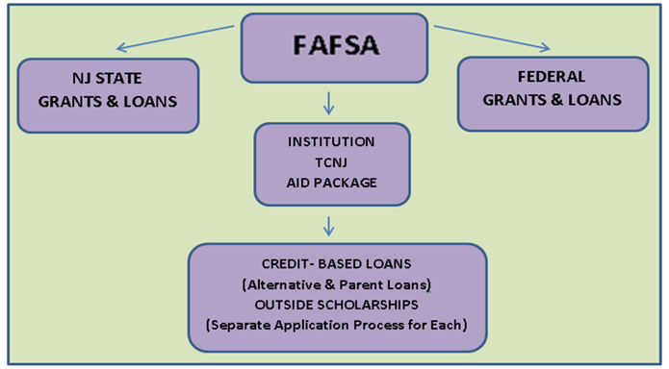
The Free Application for Federal Student Aid
Completion of the FAFSA guarantees evaluation for all types of federal, State and institutional need-based aid.

Slide 6
Sources & Types of Aid
Sources of Aid
The College/University (school-funded aid)
Federal
State of New Jersey
Private Scholarships
      Civic organizations (ex. local Rotary Club), parent’s employer, high school awards
Types of Financial Aid
Grants
Scholarships
_______________________
Paying for College with Student/Family Resource
Loans
School-sponsored student employment
Savings
Factors that may influence institutional aid, particularly merit-based aid
Academics
Athletic Ability
SAT or ACT
Geographic Diversity
AP Courses
Legacy (child of alumni)
Activities
Talent (extracurricular or academic)
Gender/Ethnicity
H.S. Attended
Class Rank
Higher Education Student Assistance Authority
Notes:
Civic organizations

Slide 7
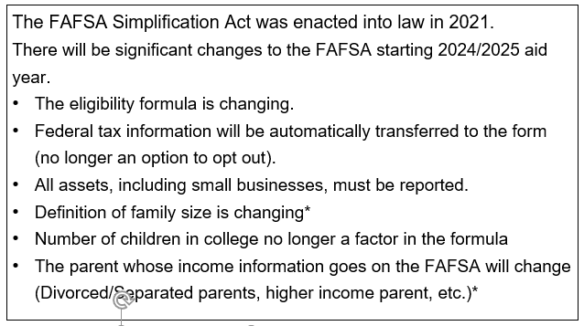
FAFSA Simplification Act
* Federal guidance October 2023

Slide 8
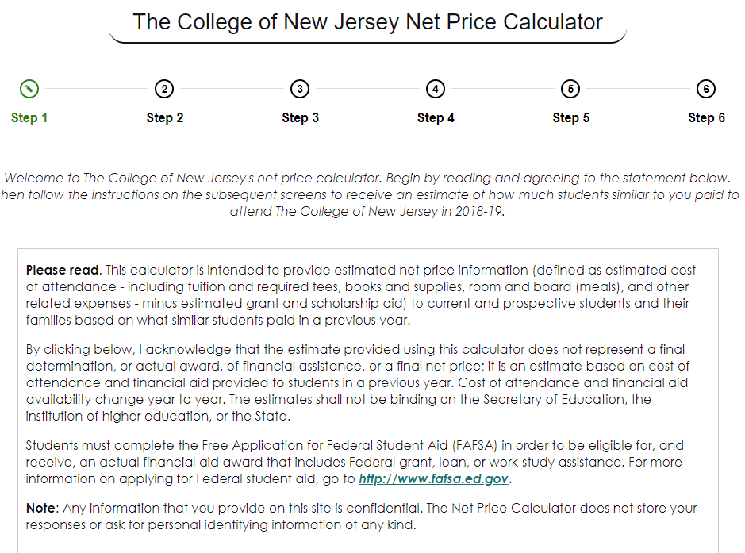
Net Price Calculator
All institutions must have a net price calculator posted on their websites.
Students will be able to estimate the individual net price per institution.
Based on full-time, first degree/certificate-seeking undergraduate students.
Higher Education Student Assistance Authority
Notes:
HESAA also has on the website the NJEI calculator that calculates TAG for estimate purposes only.

Slide 9
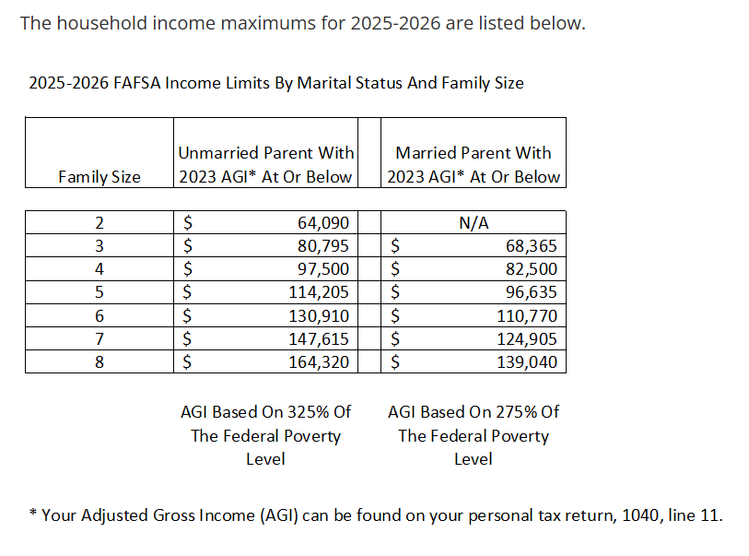
Federal Pell Grant
Please note that the income guidelines listed above are meant as a guide to assist families on their potential eligibility but other factors such as the student’s income and assets reported on the FAFSA may decrease the income eligibility amounts for the household size.
The maximum Pell grant award for the 2025-2026 academic year is $7,395 and the minimum Pell grant award is $740. Your household income would need to be at or below the amounts listed above, based on your family size and marital status, to be eligible for a Pell grant.

Slide 10
Types of Aid - Federal
Grants
Federal Student Aid for Award Year 2025-26
  Pell $7,395 (max award)
  SEOG $4,000 (max award)
  TEACH $3,772 (max award)
. * 2026-27 award amounts subject to change
Higher Education Student Assistance Authority
Notes:
Speaker Notes
PELL- SEOG
Named after senator Pell of Rhode Island, Pell is covered under the Higher Education Act of 1965
Pell is need based and all those with an EFC low enough are eligible so long as he or she has not received a first bachelor’s degree yet or are enrolled in a post baccalaureate program that leads to a teacher’s certification or licensure
Currently, the maximum amount is $5,920 and for 17 - 18. The amount of the award will depend on financial need, cost of attendance, and full time or part time status
The limit on Pell is 12 semesters in duration (roughly 6 years)
SEOG can range from $100 to $4000 – funding is provided by the US Department of Education to institutions to manage. Goes to most needy first and are very limited.
The TEACH Grant As a condition for receiving a TEACH Grant, you must sign a TEACH Grant Agreement to Serve in which you agree to (among other requirements) teach
in a high-need field
at an elementary school, secondary school, or educational service agency that serves students from low-income families
for at least four complete academic years within eight years after completing (or ceasing enrollment in) the course of study for which you received the grant.
Iraq and Afghanistan Service Grants
The Iraq and Afghanistan Service Grant is provided to certain students whose parent or guardian was a member of the U.S. armed forces and died as a result of military service performed in Iraq or Afghanistan after the events of 9/11. May not be eligible for a federal PELL Grant but must meet remaining eligibility requirements.
Max award for 17-18 after 10.1.17 is $5,529.28
https://studentaid.ed.gov/sa/about/announcements/sequestration#iraq-afghanistan

Slide 11
New Jersey State Grants 2025-26 Academic Year (2026-2027 award amounts to be determined July 2026)
Award Type | Award Amounts
Full-Time TAG | $1,280 - $14,404
Part-Time TAG (community college only) | $320-$1,097
EOF (Educational Opportunity Fund) | Up to $3,050 includes college success support
NJ STARS (top 15.0% of high school class junior or senior year) | Tuition Only - community college only
NJ STARS II | Up to $2,500 per year – any NJ 4-year college
Governor’s Urban Scholarship (for top 5.0% of high school junior year) | Up to $1,000 $500 Persistency Bonus
NJ-GIVS (women and minorities) | Up to $2,000 - building trades only
Community College Opportunity Grant (CCOG) | Up to full tuition and approved fees --AGI between $0 and $65,000
Garden State Guarantee (GSG) | Up to full tuition and approved fees --AGI between $0 and $65,000
Summer TAG | Up to 75% of the Fall or Spring TAG amount
 | 2026-2027 award amounts subject to change
2025-2026
Award Amounts
Higher Education Student Assistance Authority

Slide 12
Student’s application must be complete to receive TAG (Tuition Aid Grant) or any other state aid. Students must:
File a FAFSA or New Jersey Alternative Financial Aid Application
Be a U.S. citizen, eligible non-citizen or qualify as an NJ Dreamer
Be a New Jersey resident and attend a New Jersey institution
Be enrolled full-time* in an approved degree program
Demonstrate financial need
Meet all state deadlines for application and document submission
*Part-Time TAG, NJSTARS, CCOG, and EOF awards are available for county college students enrolled in 6-11 credits per semester.
State Grants & Scholarship Requirements
Notes:
EOF (excellent program for financially and economically disadvantaged students)
EOF supports a wide array of campus-based outreach and support services to help program participants succeed and graduate
Benefits
Students enrolled in an EOF program receive financial assistance through semester grants ranging from $299 to $1,024. Family must have a documented history of financial and economic disadvantage - Some schools require that you are a first generation college student.
The amount of the grant varies depending upon financial need, cost of attendance and available funding.
Awards are renewable annually based on continued eligibility.
Tuition Equity Law: DACA & Undocumented students - Complete the NJ Alternative Application if you are not a United States citizen or eligible noncitizen and meet all of the following criteria;
Attended a New Jersey high school for at least three (3) years
Graduated from a New Jersey high school or received the equivalent of a high school diploma in New Jersey
Registered for Selective Service (male students only)
Are able to file an affidavit stating that you will file an application to legalize your immigration status or will file an application as soon you are eligible to do so

Slide 13
NJ Tuition Aid Grant (need based)
$1,280 - $14,404
Students must have a complete Application for TAG (Tuition Aid Grant) and all other state programs. Students must:
File a FAFSA or New Jersey Alternative Financial Aid Application
Be a U.S. citizen, eligible non-citizen or qualify as an NJ Dreamer
Be a New Jersey resident and attend a New Jersey institution
Be enrolled full-time* in an approved degree program
Demonstrate financial need
Meet all state deadlines for application and document submission
*Part-Time TAG, CCOG, and EOF awards are available for county college students enrolled in 6-11 credits per semester. Awards amounts range from $320-$1,097.
  Summer TAG (Tuition Aid Grant) – need based
  Received TAG in the prior Fall or Spring semester
  Award range dependent upon enrollment status
      Full-time, Three Quarter-time, or Half-time
State Grants & Scholarship Requirements
Notes:
EOF (excellent program for financially and economically disadvantaged students)
EOF supports a wide array of campus-based outreach and support services to help program participants succeed and graduate
Benefits
Students enrolled in an EOF program receive financial assistance through semester grants ranging from $299 to $1,024. Family must have a documented history of financial and economic disadvantage - Some schools require that you are a first generation college student.
The amount of the grant varies depending upon financial need, cost of attendance and available funding.
Awards are renewable annually based on continued eligibility.
Tuition Equity Law: DACA & Undocumented students - Complete the NJ Alternative Application if you are not a United States citizen or eligible noncitizen and meet all of the following criteria;
Attended a New Jersey high school for at least three (3) years
Graduated from a New Jersey high school or received the equivalent of a high school diploma in New Jersey
Registered for Selective Service (male students only)
Are able to file an affidavit stating that you will file an application to legalize your immigration status or will file an application as soon you are eligible to do so

Slide 14
EOF (Educational Opportunity Fund)
Award ranges from $200 - $3,050 annually depending on institution
EOF is campus-based and award amounts vary
Must demonstrate educational and economically disadvantaged background
Complete all required EOF tasks with campus EOF Office
Indicate on the admissions application your interest in the EOF Program
Complete all required EOF tasks with campus EOF Office
Summer Program preceding the Fall semester.
Eligibility Chart – Google: NJ Educational Opportunity Fund Program
https://www.nj.gov/highereducation/EOF/EOF_Eligibility.shtml
Types of Aid:
State Grants & Scholarships
Higher Education Student Assistance Authority
Notes:
EOF (excellent program for financially and economically disadvantaged students)
EOF supports a wide array of campus-based outreach and support services to help program participants succeed and graduate
Benefits
Students enrolled in an EOF program receive financial assistance through semester grants ranging from $299 to $1,024. Family must have a documented history of financial and economic disadvantage - Some schools require that you are a first generation college student.
The amount of the grant varies depending upon financial need, cost of attendance and available funding.
Awards are renewable annually based on continued eligibility.
Tuition Equity Law: DACA & Undocumented students - Complete the NJ Alternative Application if you are not a United States citizen or eligible noncitizen and meet all of the following criteria;
Attended a New Jersey high school for at least three (3) years
Graduated from a New Jersey high school or received the equivalent of a high school diploma in New Jersey
Registered for Selective Service (male students only)
Are able to file an affidavit stating that you will file an application to legalize your immigration status or will file an application as soon you are eligible to do so

Slide 15
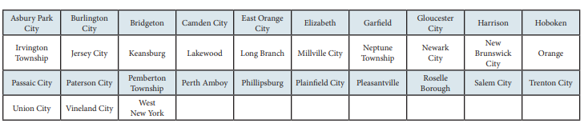
Governor’s Urban Scholarship
    Rank within the top 5.0% of their class at the end of junior year
    Attain a 3.0 GPA at the end of the junior year
    Reside in a designated municipality
    Qualify for a TAG award
Types of Aid:
State Grants & Scholarships
Higher Education Student Assistance Authority
Notes:
EOF (excellent program for financially and economically disadvantaged students)
EOF supports a wide array of campus-based outreach and support services to help program participants succeed and graduate
Must graduate from a traditional public, public charter, county vo-tech or nonpublic school and reside in any of the following townships
GUS - $1,000 annual award – top 5% of HS graduating class
Asbury Park City
Camden City
East Orange City
Irvington Township
Jersey City
Lakewood Township
Millville City
Newark City
New Brunswick City
Paterson City
Plainfield City
Roselle Borough
Trenton City
Vineland City

Slide 16
Types of Aid:
State Grants & Scholarships
  NJ STARS - merit based
    NJ residents who rank in the top 15.0% of their class at either the end of junior or senior year of high school
    Students must attain a cumulative GPA of 3.0 or higher at the start of the third semester at the county college to remain eligible for NJ STARS
  NJ STARS II – merit and need based
    Must have been NJ STARS eligible and have a family taxable income of less than $250,000
    Must earn an associate degree and graduate with a 3.25 GPA or higher
    May receive up to $2,500 annually for a TAG eligible public or private 4-year NJ college or university
Higher Education Student Assistance Authority
Notes:
Governor Christie signed Public Law 2012, Chapter 8 (PL 2012, c.8) into law on May 2, 2012 amending the NJ STARS and NJ STARS II Programs to make them more sustainable.
Limits the amount of the NJ STARS scholarship to tuition only. Budgetary footnote language has limited NJ STARS awards to tuition only since fall 2010 for new program participants.
Eligibility requirements are unchanged.
Must graduate in the top 15.0% of their high school graduating class.
NJ STARS-eligible students must file a FAFSA and complete the State grant record within established State deadlines.
Students may be eligible to receive NJ STARS awards for up to five semesters. Funds are not available to cover summer payments.
NJ STARS-eligible high school graduates may receive awards based on tuition only, after deducting any other federal and/or State grants and scholarships.
Students must attain a minimum cumulative grade point average (GPA) of 3.0 or higher at the start of the third semester of county college enrollment to remain eligible for NJ STARS. Summer courses are included in determining the cumulative GPA.
Students must maintain continuous full-time enrollment unless on a medical leave that is approved by the county college prior to the completion of the semester for which the leave is being granted.
NJSTARS II
Eligibility Requirements as follows:
Earn an associate degree from their home New Jersey county college as an NJ STARS recipient. Must graduate with a cumulative GPA of 3.25 or higher.
Family income (taxable and untaxed income) must be less than $250,000 as derived by the FAFSA
Meet all other program eligibility requirements, including admission into a baccalaureate program at a New Jersey four-year public or private college or university that participates in the TAG program
Complete a FAFSA and the State grant record within established State deadlines
NJ STARS II benefits for non-renewal students were changed by Bill PL 2012, c.8
Non-renewal NJ STARS II students may receive up to $1,250 per semester, paid completely by the State, after all other sources of federal and State grants and scholarships are applied to tuition charges.
Open to all four-year TAG-participating institutions-public or private

Slide 17
Types of Aid:
State Grants & Scholarships
  Governor’s Industry Vocation Scholarship for Women & Minorities
  NJ-GIVS
    Up to $2,000 per year for the cost of enrollment at one of New Jersey’s 18 county colleges, technical /vocational schools, some proprietary schools
    Benefits women and minorities pursuing certificate or degree programs in construction-related fields
    Must be NJ resident and have an AGI < $60,000
    Complete separate application online. Found in the student's NJFAMS account, Apply for Scholarships
    Some of the programs eligible for the scholarship include
      Construction Supervision
      Solar Energy Technology
      Architectural Engineering Technology
Higher Education Student Assistance Authority
Notes:
Complete an NJ – GIVS application at njgrants.org
Eligible certificate or degree program

Slide 18


Slide 19

Types of Aid:
State Grants & Scholarships
  Pays for all or part of the cost of Tuition and Approved fees at a NJ county college
  Must take a minimum of six (6) credits per semester
  Must make satisfactory academic progress
  Complete the FAFSA or NJ Alternative Financial Aid Application each year by the applicable State deadline
Notes:
Complete an NJ – GIVS application at njgrants.org
Eligible certificate or degree program

Slide 20


Types of Aid:
State Grants & Scholarships
  Pays for all or part of the cost of tuition and approved fees at a NJ state college
New Jersey State Colleges and Universities
Must make Satisfactory Academic Progress
Available for students attending full-time in their third and fourth year of enrollment at a public 4-year institution
Must complete the FAFSA or NJ Alternative Financial Aid Application
Higher Education Student Assistance Authority
Notes:
Complete an NJ – GIVS application at njgrants.org
Eligible certificate or degree program

Slide 21

Student enrolls in a bonafide 3 + 1 major/degree program
  Year 1 and Year 2:
    Student completes the first two years at the community college and earns an associate degree
  Year 3:
    Pays community college tuition and fees for the associate degree and the third year of their bachelor’s degree program
  Year 4:
    Attends and pays the four-year institutions tuition
    and fees in the final year of their bachelor’s degree
Must have a complete TAG record to be potentially eligible for TAG, NJSTARS, and/or CCOG
3 + 1 Degree Completion Programs
Higher Education Student Assistance Authority

Slide 22
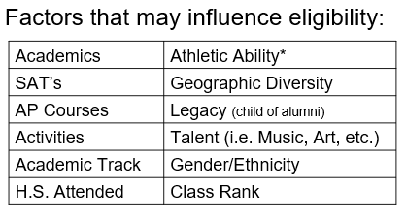
Scholarships
Institutional and Private
Resources:
Library resources
Local businesses,
Civic organizations
Churches
Sororities & Fraternities
Parent’s employer(s)
Websites:
www.hesaa.org
www.fastweb.com
www.collegeboard.org
www.mappingyourfuture.org
www.jlvcollegecounseling.com

Slide 23
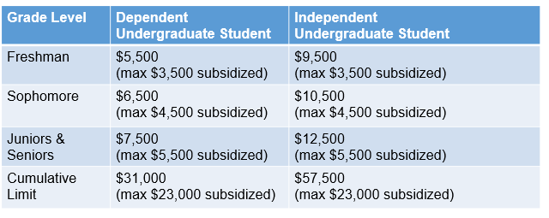
Student Loans
Financing Shortfall Solutions
Federal Direct Loan Program
FDLP are loans only for the student with no credit check, the student qualifies regardless of the household income reported on the FAFSA and repayment begins 6 months after they graduate.
2025-2026 – Interest rate is 6.39% and Origination Fee 1.057%
Notes:
Graduate Stafford loans are now 6%

Slide 24



Credit Based Loans
Checklist regarding private loans:
  1. Who will apply for the loan (student with a co-signer or a parent)?
  2. What type of payment structure do you want?
  Option 1: Immediate repayment
  Option 2: Interest only payments while the student is attending school
  Option 3: Full deferment – not payments until after graduation (higher interest rate)
  3. The loan amount should include the Fall and Spring.
  If you need assistance with buying books, supplies, etc. you include some of
  these cost into the loan. Check with the financial aid office regarding the
  Cost of Attendance for the year.
  4. Begin applying in May – June for the Fall semester.
  5. You must apply every year!
  6. Only borrow the amount you need!

Slide 25
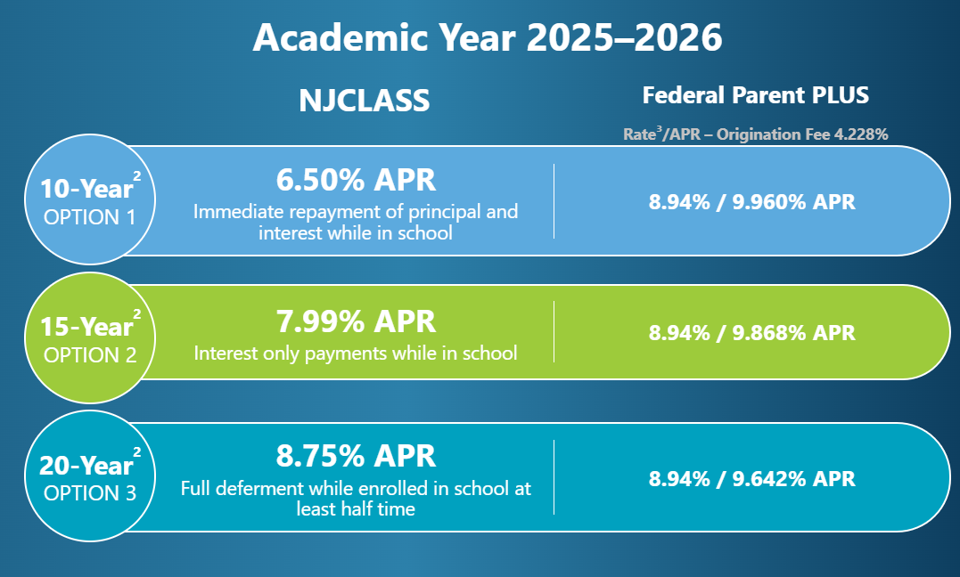
Parent and/or Student can borrow on private educational loans
  Sallie Mae, PNC, Discover, College Ave, others…
  Interest rates and repayments vary by lender
Other Loan Options to Cover the Gap
Borrow up to cost of attendance less other aid
Higher Education Student Assistance Authority
2026 – 2027 interest rates will be determined in June 2026
Notes:
We also offer consolidation programs & a ReFi program that
Consolidation extends the repayment term to 25 – 30 depending on loan balance and takes the weighted average of the loans minus a tiny percentage
The ReFi program is a 10 year repayment term and is based on income, credit score and debt to income ratio (depending on credit score the APR will range from 4.90% to 6.90%
HESAA also now has a Repayment Assistance Program (RAP), which is designed to provide payment relief when all parties of the loan are facing financial hardship
During the RAP period, a payment on eligible NJCLASS loan shall be reduced to 10% fo the total of the household income of all of the parties to the loan that exceeds 150& of the federal poverty guidelines for their family size, with a minimum monthly payment of $5 per eligible loan
Interest that accrues during RAP will be paid by HESAA
RAP is available for NJCLASS loans with applications that were received on or after June 1, 2017 or are to be used for an academic term that begins on or after August 1, 2017
HESAA now also discharges the loan obligation for all parties to a NJCLASS loan in the event of death or total and permanent disability of the student beneficiary

Slide 26
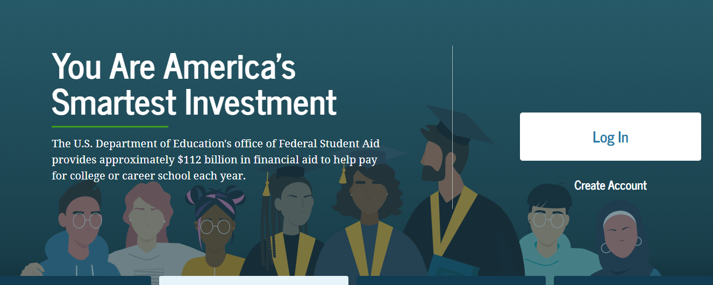


Applications to Access Aid
studentaid.gov
FAFSA
Available October 1, 2025
student.collegeboard.org/profile
CSS Profile
Available October 1, 2025
HESAA.org
NJ Dreamer
Available by October 1, 2025
Higher Education Student Assistance Authority
Notes:
Jules / Sharon – please add screen shot for alt app

Slide 27
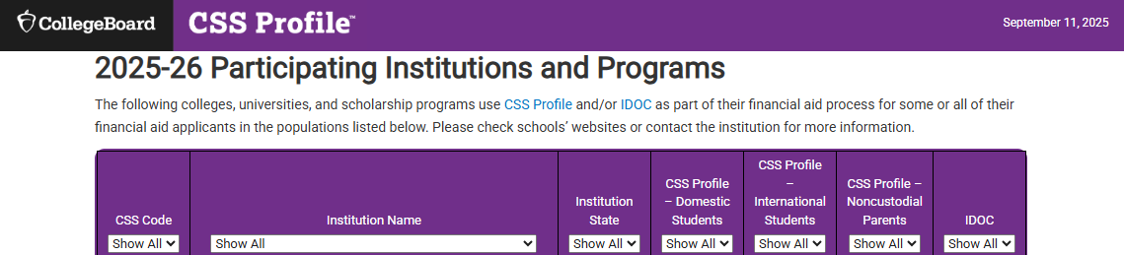
Approximately 400 colleges and organizations use the CSS profile to determine how they will award institutional (school-funded) aid
Available 10/1 each year and collects more comprehensive income, asset, and household information than the FAFSA
Uses prior-prior year income (2024 income for 2026-2027)
Mostly used by independent (private) colleges and universities
Register – Complete Application – Make payment – Submit
No application fee for income under $100,000
All others, $25 for first application and $16 for each additional
Application: CSS Profile
Higher Education Student Assistance Authority
Notes:
Check out http://student.collegeboard.org/profile for a list of institutions that require CSS profile
CSS profile uses institutional methodology formula whereas FAFSA uses federal methodology
The CSS profile is a fee based application. The cost for filing the CSS PROFILE is $25 for the first college, and there is an $16 processing fee for each additional college. This is not the FAFSA. The FAFSA is free.
Can take 45 minutes to 2 hours to complete
Can leave some answers blank but an error will prompt if answer is required but most numeric questions at least require a zero

Slide 28

CSS Profile
Website to apply for profile
https://cssprofile.collegeboard.org/
Website to apply for Noncustodial Profile:
https://cssprofile.collegeboard.org/profile-for-parents
Participating CSS Institutions:
https://cssprofile.collegeboard.org/profile/ppi/participatingInstitutions.aspx
Customer Support - 844-202-0524 | Live Chat Available
Higher Education Student Assistance Authority
20
Notes:
Links are correct

Slide 29
2026-2027 Federal Student Aid ID
The 2026-2027 FAFSA is available now! You must use 2024 income.
*Apply beginning October 1st during your senior year.
Collects family’s personal and financial information used to calculate the student’s Student Aid Index (SAI). The SAI determines eligibility for federal student aid
Used to provide consent to obtain Federal Tax Information and digitally sign the FAFSA
Student and all Contributors must file the FAFSA and create a Federal Student Aid ID (FSA ID) at www.studentaid.gov by clicking on “create account”
Student identifies who the Contributor(s) are and invites them via email to contribute to the FAFSA with an “Invite Code.” Each contributor must have their own separate FSA ID and password and will log in and provide the “Invite Code’ to begin.
Contributors include: Biological Parent, Stepparent, and Adoptive Parent
\
Who Needs an FSA ID?
    If there are two parents who filed taxes jointly, only one parent
    If the parents are divorced/separated, the parent who provided more financial support in the last 12 months
    If married or unmarried/living together but did not file taxes jointly, then each parent will need an FSA ID
Higher Education Student Assistance Authority
Notes:
The FSA id is a higher security login which will connect the student and parent to the FAFSA. The FSA id will also connect the student to the federal student aid website, and the National student loan data base.

Slide 30
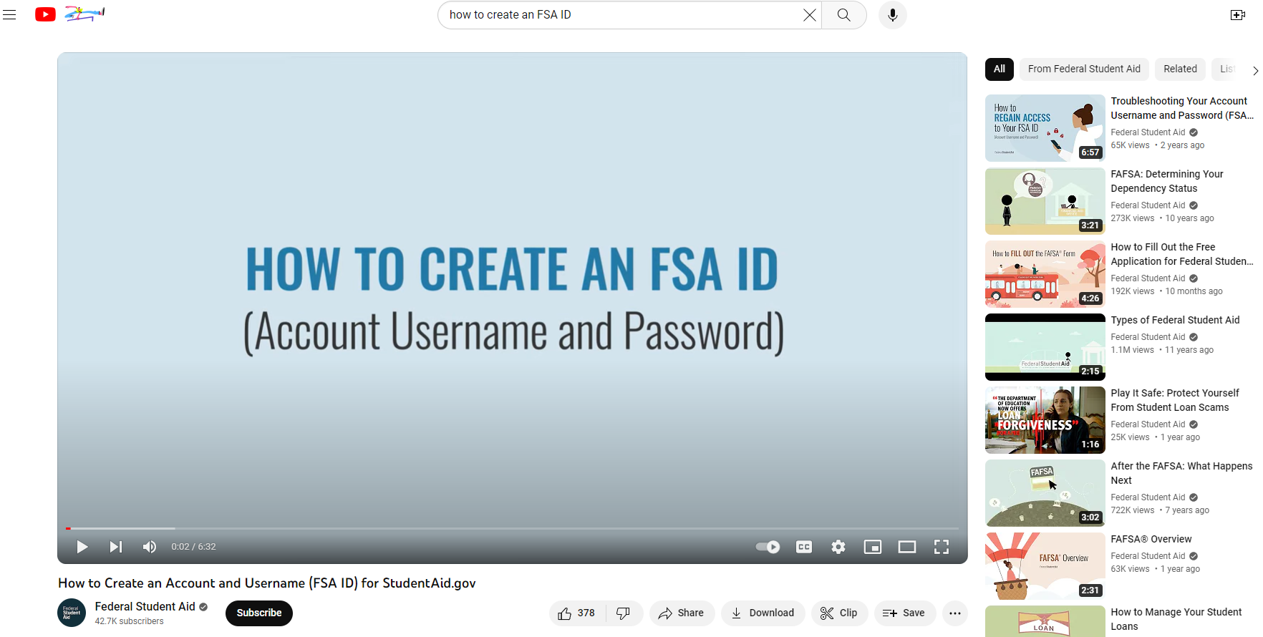
Creating the FSA ID - simplest way, in my opinion:
https://www.youtube.com/watch?v=iTb7hMVtzco&t=4s
Federal
Student Aid ID

Slide 31

Federal Tax Information (FTI)
The IRS will request consent to retrieve your Federal Tax Information (FTI) into the FAFSA
If parents are married or unmarried/living together, but did not file taxes jointly, then both will need to login to provide consent to retrieve federal tax information
Higher Education Student Assistance Authority

Slide 32
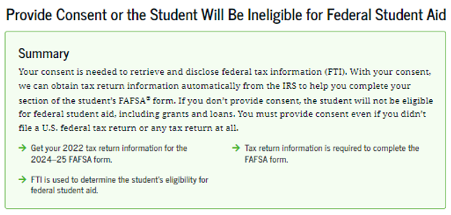
Information Contributors will be instructed to provide Federal Tax Information from their 2024 tax return to be used to determine the student's eligibility for federal student aid for Award Year 2026-27
Federal Tax Information Consent
2022
Get your 2023 tax return information for the
2025-26 form.
Higher Education Student Assistance Authority
Notes:
This

Slide 33
Payment Plan Options
Monthly Payment Plans – offered by the college
  nominal fee
  spread payments over several months
  enroll when the 1st payment starts
  use payment plans to pay the entire balance or part of the balance, it’s your choice!
Higher Education Student Assistance Authority
Notes:
Graduate Stafford loans are now 6%

Slide 34
Key Eligibility
Requirements for FAFSA
The student must have a valid Social Security Number
Must be pursuing a degree, certificate, or other recognized postsecondary credential
Must be a U.S. citizen or eligible noncitizen
New Jersey students who are undocumented and meet the NJ Dreamer qualifications should complete the NJ Alternative Financial Aid Application for state-funded financial aid
Higher Education Student Assistance Authority
Notes:
If you are an eligible noncitizen, write in your eight- or nine-digit Alien Registration Number. Generally, you are an eligible noncitizen if you are (1) a permanent U.S. resident with a Permanent Resident Card (I-551); (2) a conditional permanent resident with a Conditional Green Card (I-551C); (3) the holder of an Arrival-Departure Record (I-94) from the Department of Homeland Security showing any one of the following designations: “Refugee,” “Asylum Granted,” “Parolee” (I-94 confirms that you were paroled for a minimum of one year and status has not expired), T-Visa holder (T-1, T-2, T-3, etc.) or “Cuban-Haitian Entrant;” or (4) the holder of a valid certification or eligibility letter from the Department of Health and Human Services showing a designation of “Victim of human trafficking.”
If you are in the U.S. on an F1 or F2 student visa, a J1 or J2 exchange visitor visa, or a G series visa (pertaining to international organizations), select “No, I am not a citizen or eligible noncitizen.” You will not be eligible for federal student aid. If you have a Social Security Number but are not a citizen or an eligible noncitizen, you should still complete the FAFSA because you may be eligible for state or college aid.
The Selective Service System and the registration requirement for your men, preserves America’s ability to provide manpower in an emergency to the US armed forces Almost all men ages 18 to 25 must register. For more information please visit 222.sss.gov

Slide 35
Key Components of the FAFSA
Parent Contributor Section
Last Name
Date of Birth
Email address
Family size – FTI
Income and Assets
Federal Means-tested benefits
  Medicaid, SSI, SNAP,
  Free or Reduced Lunch
  TANF, WIC, WITC QHP
Business and Farm will be considered as assets in the calculation of the SAI
Child Support received is an asset
Student Contributor Section
Full Name and address
Social Security Number or ITIN Number
Date of Birth
Mobile phone number (optional)
Email address
College/Career plans – 20 Colleges
Student Consent and Assets
FTI (Federal Tax Information)
Student Status: Personal Circumstances
Dependent or Independent Determination
Student Special Circumstances
Student Unusual Circumstances
Social Security Number
Higher Education Student Assistance Authority
Notes:
WHO IS THE PARENT
If your parent was never married and does not live with your other legal parent, or if your parent is widowed or not remarried, answer the questions about that parent.
• If your legal parents (biological and/or adoptive) are not married to each other and live together, select “Unmarried and both parents living together” and provide information about both of them regardless of their gender. Do not include any person who is not married to your parent and who is not a legal or biological parent. Contact 1-800-433-3243 for assistance in completing questions 80-94.
• If your parents are married, select “Married or remarried.” Consistent with the Supreme Court decision holding Section 3 of the Defense of Marriage Act (DOMA) unconstitutional, same-sex couples must report their marital status as married if they were legally married in a state or other jurisdiction (foreign country) that permits same-sex marriage, without regard to where the couple resides. If your legal parents are divorced but living together, select “Unmarried and both parents living together.” If your legal parents are separated but living together, select “Married or remarried,” not “Divorced or separated.”
• If your parents are divorced or separated, answer the questions about the parent you lived with more during the past 12 months. (If you did not live with one parent more than the other, give answers about the parent who provided more financial support during the past 12 months or during the most recent year that you actually received support from a parent.) If this parent is remarried as of today, answer the questions about that parent and your stepparent.
• If your widowed parent is remarried as of today, answer the questions about that parent and your stepparent.

Slide 36
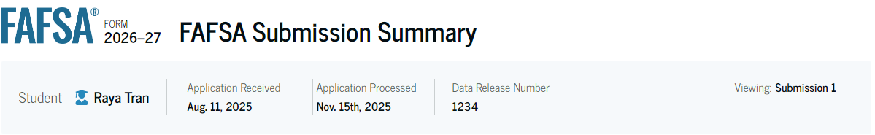
  All Contributors will receive an individual
  FAFSA Submission Summary
FAFSA Submission Summary
  Applicants are instructed to log into “NJFAMS.HESAA.org” to; create a user ID and password.
  In 3-5 business days, students can their check awards and eligibility status and complete any outstanding items on their “To Do” list (There is no separate State Application, only a To-Do List in the state’s NJFAMS system).
  Please note, all notifications will be sent to the student email address listed on the FAFSA.
Higher Education Student Assistance Authority
Notes:
Should be removed but NJ is still on the list for adtl questions.

Slide 37
Federal & State Verification
    School is responsible for verifying information for federal aid except for special circumstances
    HESAA is responsible for verifying information for State aid
    Schools may send request for information by mail or e-mail
    Always check your school financial aid portal and NJFAMS account for required tasks.
    Note: The college and HESAA do not share documentation
    Be sure to meet verification deadlines
Higher Education Student Assistance Authority

Slide 38
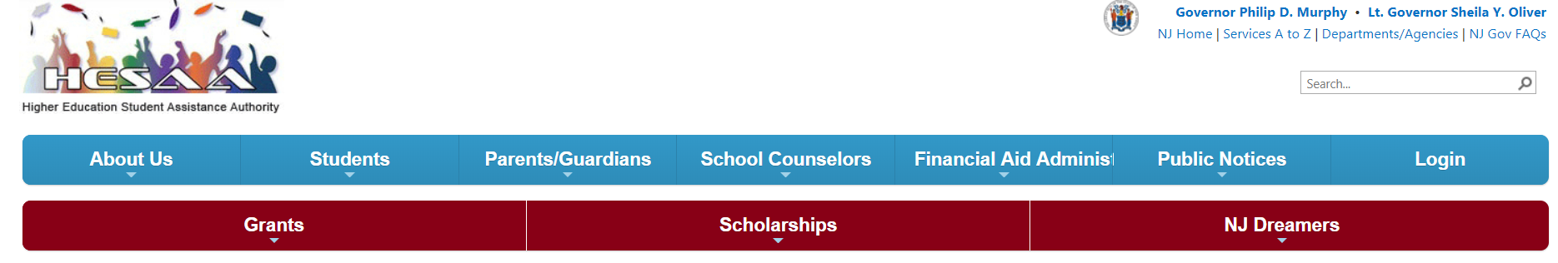
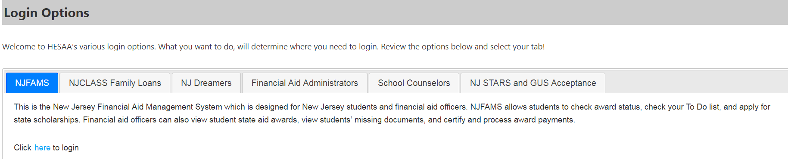
New Jersey
Financial Aid
Management
System - NJFAMS
All students must go to “NJGRANTS.org”
Establish an NJFAMS Account by creating a User ID and Password
Track the status of your State-funded student aid and respond to required tasks on the To-Do List
Higher Education Student Assistance Authority
Notes:
Jules / Sharon – add pic of NJFAMS login slide from NJGRANTS

Slide 39
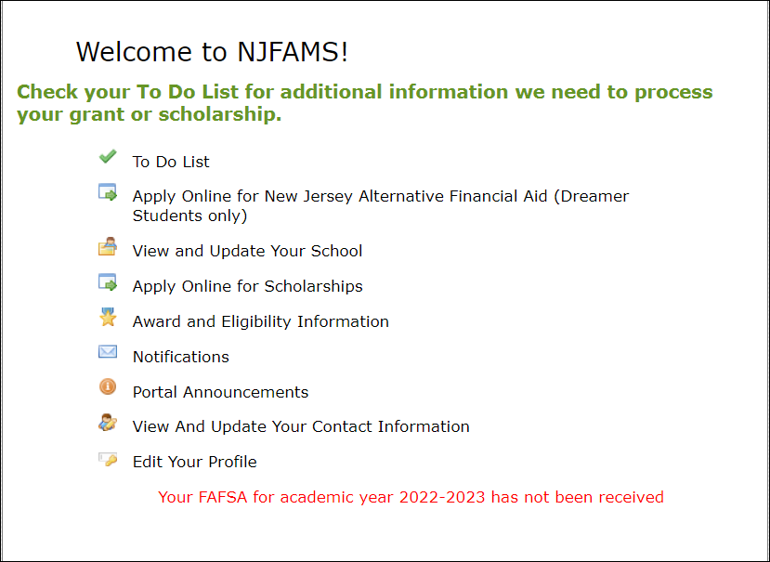
NJFAMS –
Menu
ALL Students must register
Higher Education Student Assistance Authority
Notes:
Jules / Sharon – add pic of NJFAMS login slide from NJGRANTS

Slide 40
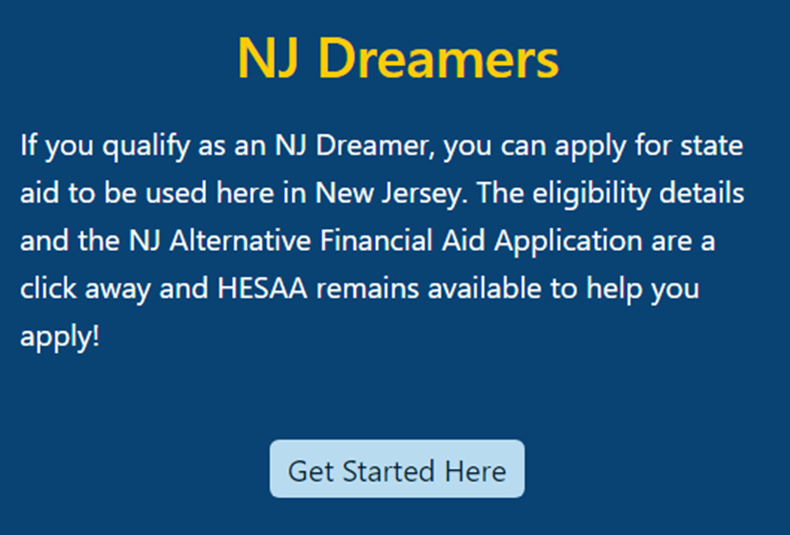
New Jersey Dreamers
Certain students with undocumented immigration status who attended at least 3 years and graduated from a NJ high school and meet other requirements may be eligible for State aid
Application is part of NJFAMS, at https://njfams.hesaa.org
Register for your account by creating a User ID and Password
Login to complete the application by established deadlines
Must meet all other need and/or merit-based eligibility criteria for State student aid
Higher Education Student Assistance Authority
Notes:
Jules / Sharon – add pic of NJFAMS login slide from NJGRANTS

Slide 41
Cost of Attendance
Standard Cost of Attendance
Tuition and fees
Room and board
Books and supplies,
Transportation
Miscellaneous personal expenses
Other Items that may be added to the COA
Loan fees
Study abroad costs
Health insurance – offered by school
Higher Education Student Assistance Authority
Notes:
Unexpected costs
Remediation Classes: extra 1 – 2 semesters
Change in major: 1 – 2 years in addition
Transferring: possible extra semester
Unpaid internships: loss of Summer wages
Study Abroad, Spring break, trips home and
pledging costs
Moving expenses and Summer storage

Slide 42
What Is The Student Aid Index
(SAI)?
SAI is determined by a federal formula that
  Calculates federal Pell grant eligibility
  Used to determine further financial need using the information you supplied on the FAFSA
SAI and Financial Need are guidelines used by
schools to determine student aid offers
Higher Education Student Assistance Authority

Slide 43
Financial Need for Smith Family
College | Community College | State College or University | Private College or University
COA | $8,000 | $30,000 | $60,000
SAI Other Financial Aid | 8,667 1,000 | 8,667 1,000 | 8,667 1,000
Unmet Financial Need | $0 | $20,333 | $50,333
Higher Education Student Assistance Authority
37
Notes:
All examples include approximate tuition, fees (left out new student fee), room and board for academic year.

Slide 44
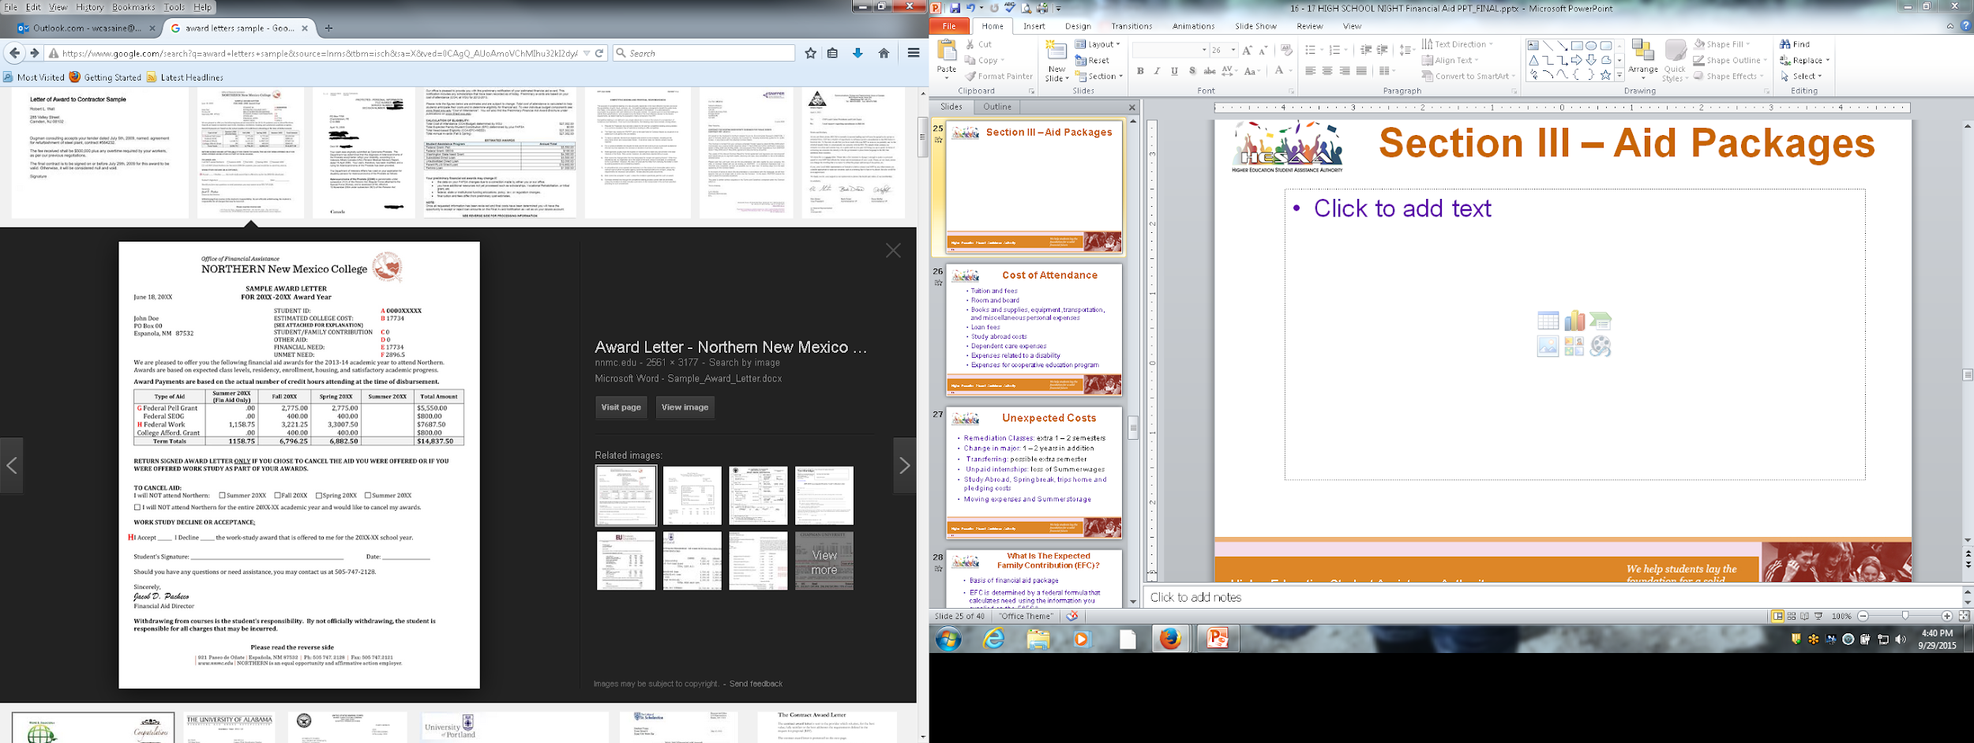
Financial Aid Award Letters
Conditions for institutional aid/scholarships
  GPA, credit requirements
  Evaluated every year, or fixed for 4 years?
Will outside scholarships impact institutional aid
Are scholarships front loaded (i.e. award all scholarships first then other aid)?
Does the school package to need (i.e. award all need-based aid then loans)?
Does the school award merit aid? Need based aid? Both?
Does the school package with Parent loans?

Slide 45
The Cycle of Financial Aid
October - March | Complete FAFSA application, college search, college application process, and CSS Profile
February - May | Schools send financial aid offers
June - July | Schools send Fall semester bills
August | Bills are due
Higher Education Student Assistance Authority
Notes:
CSS Profile is essential for some colleges institutional aid.

Slide 46
Special Circumstances
In certain cases the Financial Aid Office can adjust the income used on the FAFSA to recalculate eligibility. This re-evaluation is done on a case-by-case basis and can vary by institution. Some acceptable conditions are:
  Unemployment
  Reduction in Income
  Disability
  Retirement
  Death of a parent
  Separation/Divorce (after FAFSA is filed)
  Loss of untaxed income or unemployment benefits
  Loss of child support and/or alimony

Slide 47
Where Do I Go From Here?
Obtain and review admission, financial aid materials and deadlines from each school to which you are applying
Meet all application deadlines
  CSS Profile if applicable
  Complete the FAFSA and any other application materials required by the school or your state agency
  NJ State deadlines for high school Class of 2026:
    September 15, 2026 for Fall ‘26 and Spring ’27 ‘semesters
    February 15, 2027 for Spring ‘27 ONLY awards
  April 15, 2026 to renew your financial aid for Academic Year 2026-27
Note: After 1st year, students must renew ANNUALLY by April 15th, if the student received a State TAG award in the current year
Higher Education Student Assistance Authority
Notes:
Deadlines for completing state grant records (tasks, verification, corrections etc…) are on our website as well as deadlines for college code changes, updates, additions and deadlines

Slide 48
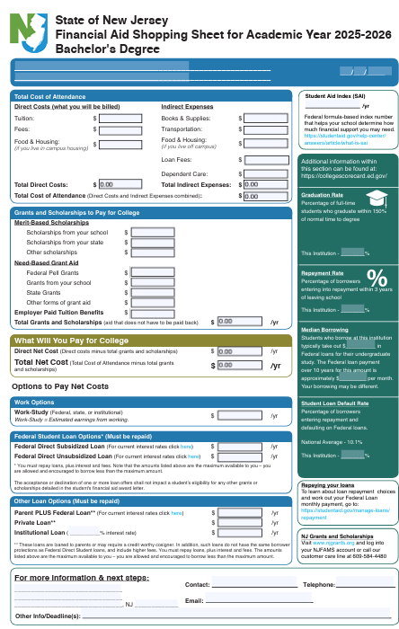
The College Financing Plan
New Jersey Shopping Sheet
Help families with net cost transparency
Separates the Cost of Attendance listing the direct and indirect costs
Grants and Scholarships (no repayment required, “free money”)
Student Net Costs in center box
College coordinated work-study employment
Federal Student Loans
If necessary, alternate loans
Aid Offer must replicate the Shopping Sheet
Higher Education Student Assistance Authority
Notes:
Deadlines for completing state grant records (tasks, verification, corrections etc…) are on our website as well as deadlines for college code changes, updates, additions and deadlines

Slide 49
Other Resources
Outside Scholarships
Campus-Administered Payment Plans
Campus Employment (including school-sponsored “work-study” jobs)
Specialized Campus Opportunities
Residential Advisors
Student Ambassadors
Student Tour Guides
Internships/Co-ops
Higher Education Student Assistance Authority

Slide 50

NJBEST 529 College Savings Plan
HESAA awards a one-time scholarship ranging from
$2,000 - $6,000 to NJBEST beneficiaries who enroll in a New Jersey institution after making contributions to an account for at least 4 years
NJBEST offers a matching grant up to $750 for new accounts
State tax deduction for up to $10,000 in annual contributions to an account
To Learn More: https://www.hesaa.org/pages/NJBESTHome.aspx
Higher Education Student Assistance Authority
Notes:
Resource
www.njbest.com
Speaker Notes
A 529 is a tax advantaged investment plan created for American families to encourage saving for the future higher education expenses of a designated beneficiary
Scholarship is awarded within the first year
Investments grow federal income tax free and withdrawals for qualified higher education expenses are free from federal income taxes
Qualified withdrawals made by New Jersey residents are not subject to New Jersey State Income tax
A 529 can affect the student’s federal financial aid award, however, a maximum of 5.64% of parental assets can have an impact on determining financial aid eligibility where as it is 20% (up to) for students
If a dependent student is the account owner (after July 1, 2009), the available balance is treated as a parental asset
Anything above $25,000 is considered in determining eligibility for State scholarship or grant

Slide 51
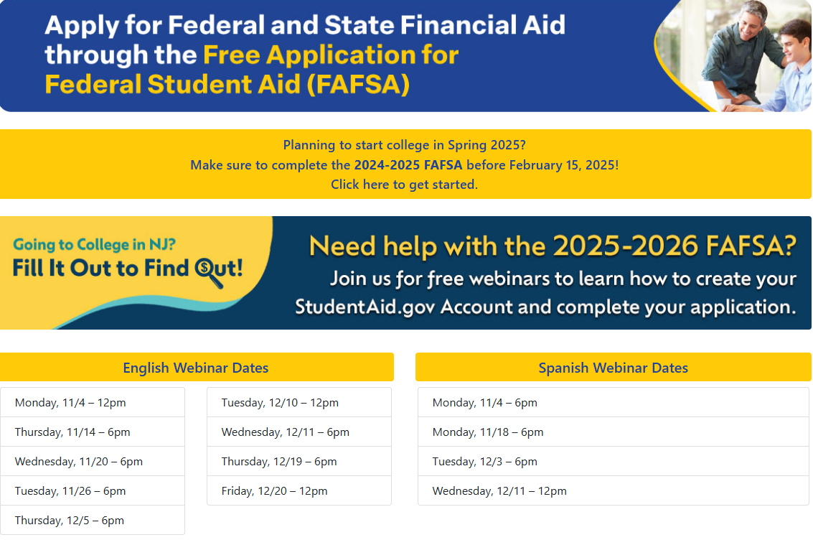
HESAA.org-
Apply for State Aid-
Workshops
& Webinars
Live Webinars
NJ Dreamer Schedule - https://www.hesaa.org/Pages/NJAlternativeApplication.aspx
FAFSA Schedule - https://www.hesaa.org/Pages/FAFSA.aspx

Slide 52
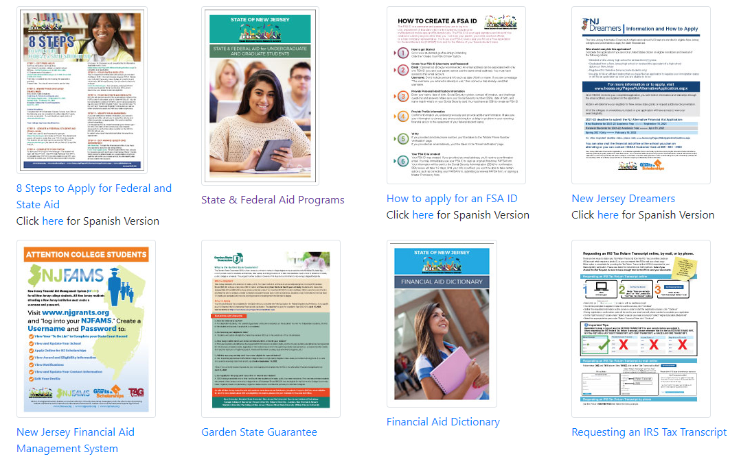
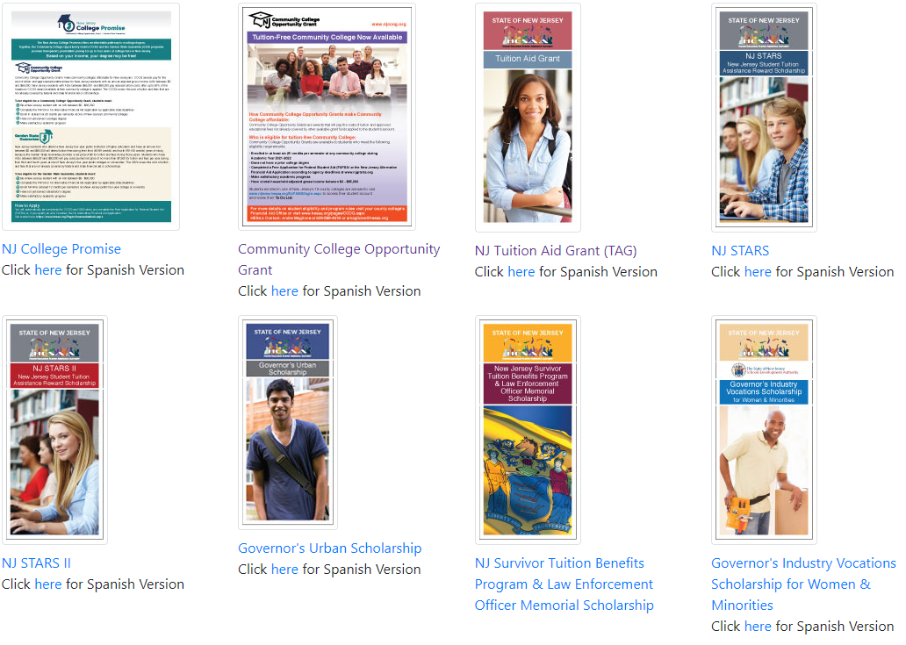
Publications
Higher Education Student Assistance Authority

Slide 53
HESAA Services
Customer Care Center
  Outreach@hesaa.org
  609-584-4480
  Monday – Thursday: 8:30 – 8 and Friday: 8:30 – 5:00
Online Resources
  www.hesaa.org
  www.njgrants.org
  www.njclass.org
  https://njfams.hesaa.org
  www.hesaa.org/pages/financialaidhub
Higher Education Student Assistance Authority

Slide 54


Summary Timeline and Tasks
Now: Register the Federal Student Aid ID (student and parents/guardians) at www.studentaid.gov
Beginning October 1, 2025:
      File the 2026-2027 FAFSA at www.studentaid.gov (the application will use 2023 income information).
      File the CSS profile if your school accepts this independent financial aid application or if a scholarship agency requires this form. Cost: $25 first college, $16 each additional college and free income under $100,000. https://cssprofile.collegeboard.org/
A week after filing the FAFSA create an profile with NJ Higher Education Student Assistance Authority (NJ HESAA) to view eligibility for NJ grants and scholarships at https://njfams.hesaa.org/ (scroll to the bottom to see the NJFAMS box)
Private Scholarships: Continue to research and apply for private scholarships
February 2026 – April 2026: Estimated financial aid award letters are sent to students via their email or letter. Check with the colleges & universities regarding their method of communication.

Slide 55

QUESTIONS?
Thank you
Higher Education Student Assistance Authority

