Slide 1
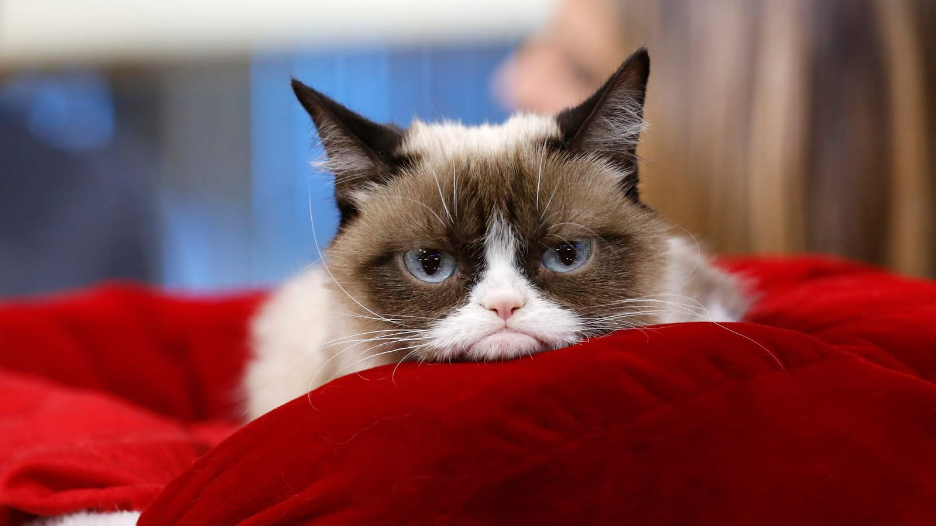
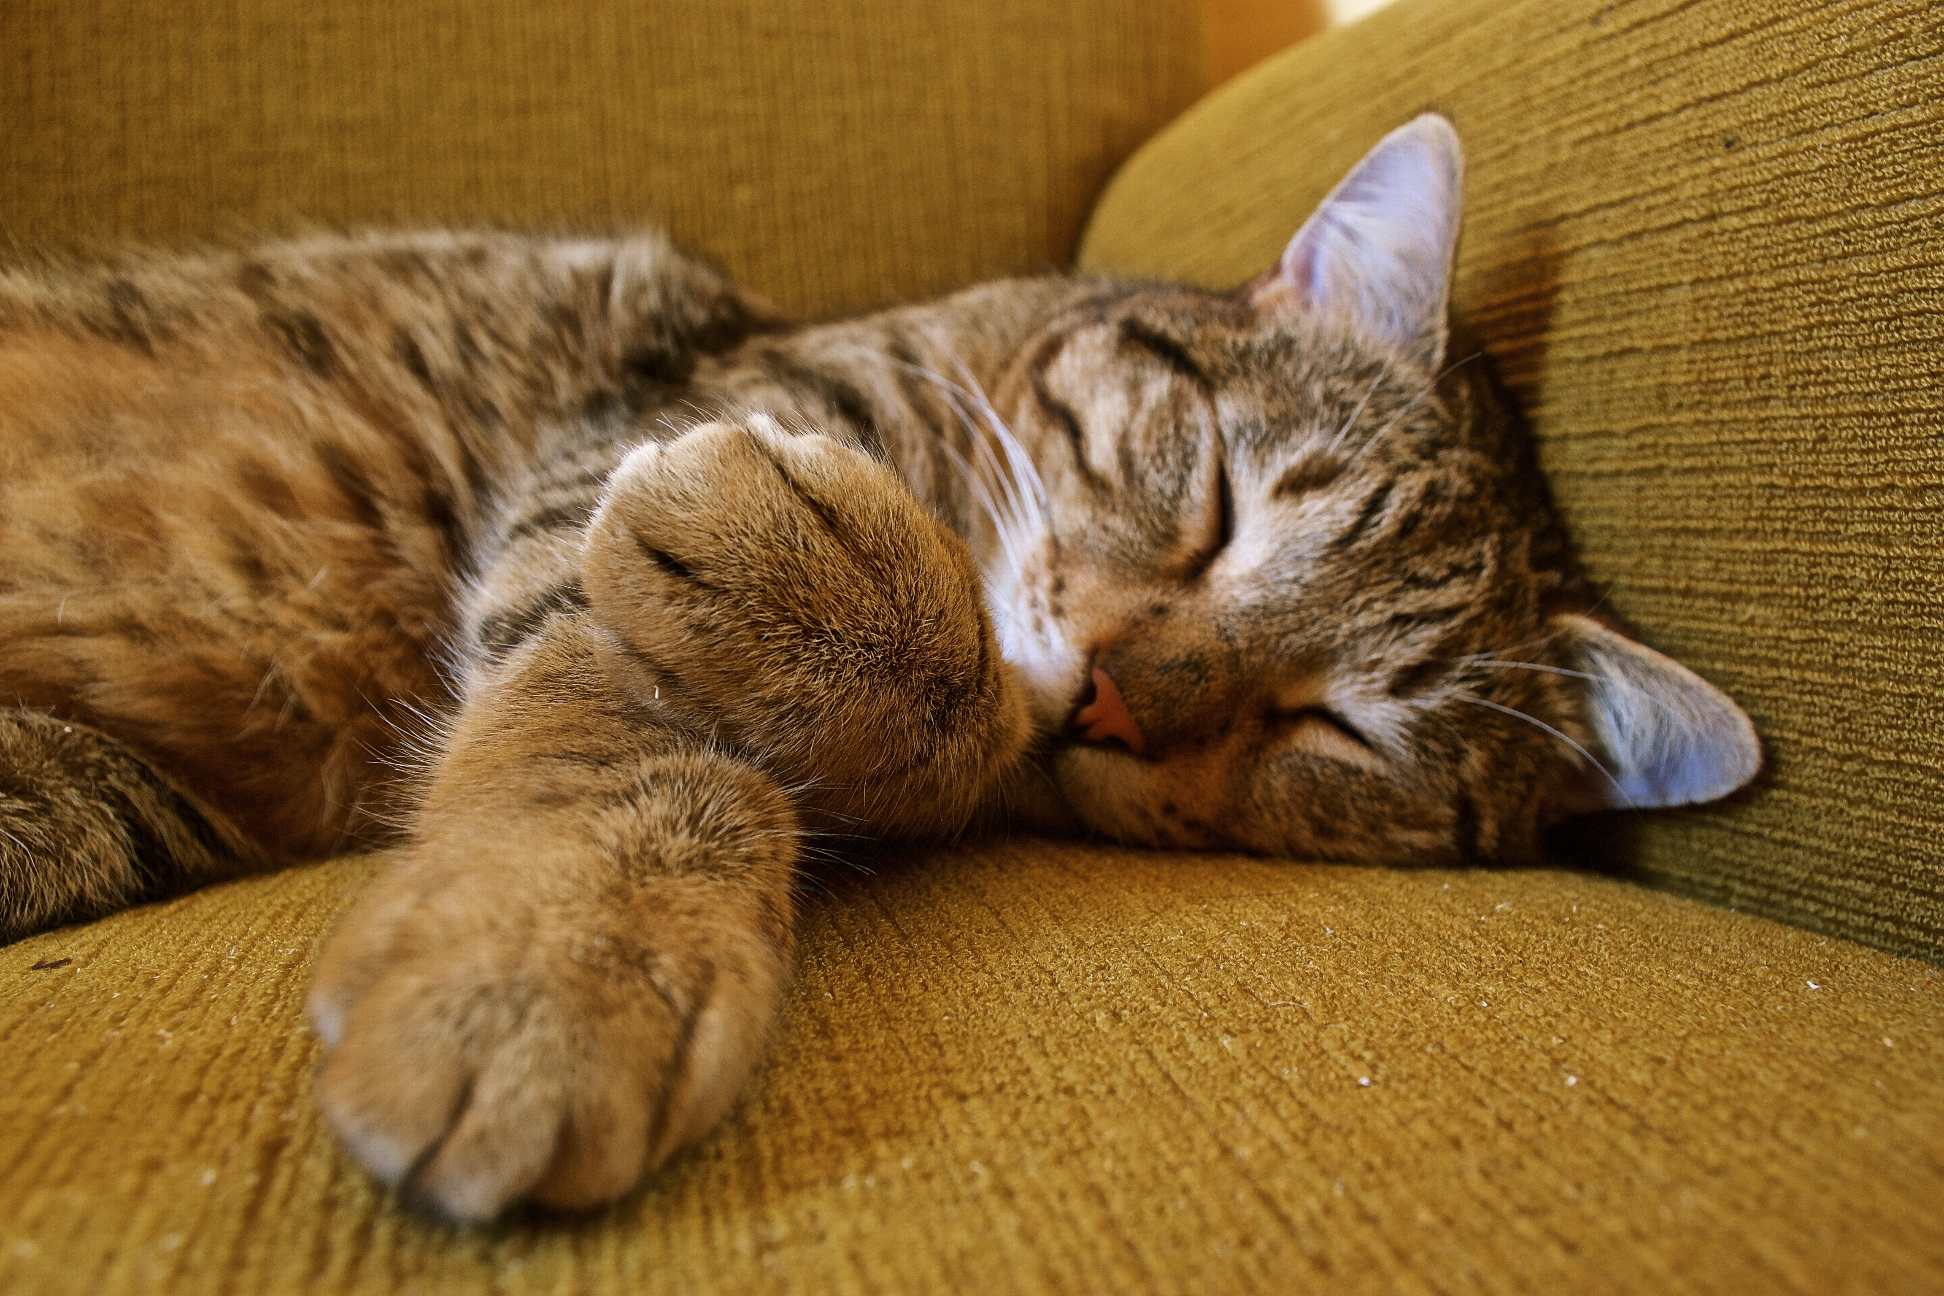

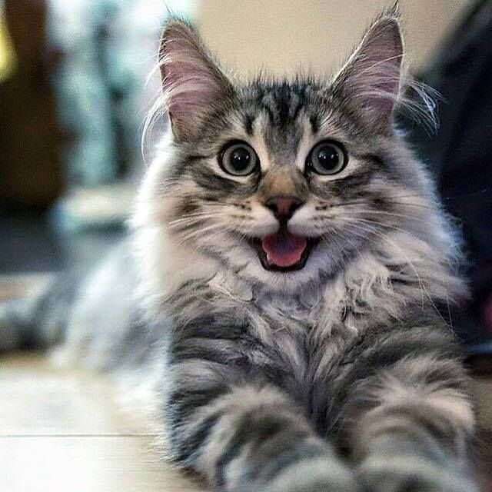
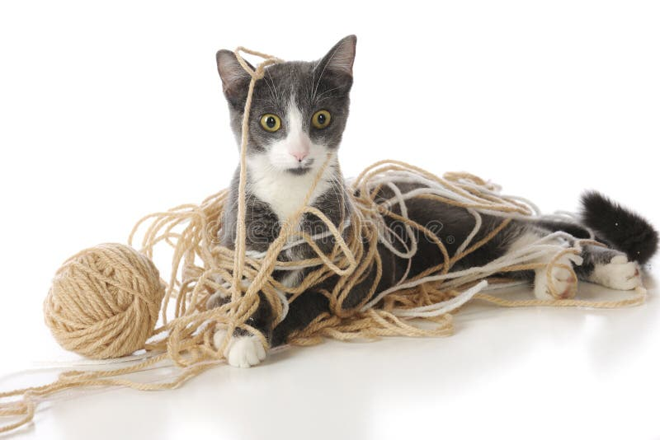
How are you feeling today?
1
2
3
4
5

Slide 2
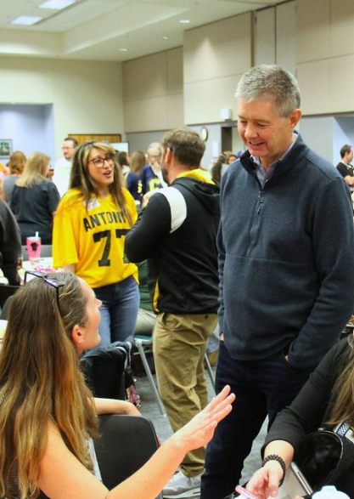
Colorado HSE Community Connect
February 25, 2026
Alena Barczak, CDE

Slide 3
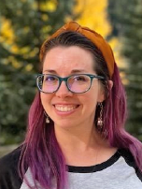
Introductions
Drop your name and organization in the chat!
Alena Barczak, MA
HSE Coordinator
Background in TESOL
Daughter of GED grads

Slide 4
Agenda
11:00 – 11:10 Introductions
11:10 – 11:30 Spotlight: GED
11:30 – 11:40 Alena: Answer submitted questions
11:40 – 12:00 Spotlight: HiSET
12:00 – 12:10 BREAK if desired
12:10 – 12:25 Large Group discussion: fostering engagement and celebration
12:25 – 12:35 Breakouts by type of program
12:35 – 12:50 Share Out
12:50 – 1:00 Closing Thoughts

Slide 5
Norms
Turn cameras on so we can engage as a community
Mute when you’re not talking
Collaborative: here to learn from each other
Ask questions
Judgment-free zone
Ok to break while other publisher is presenting, but consider staying to learn something!

Slide 6
Spotlight: GED

Slide 7

GED Updates / Questions
Liz Lanphear
GED
State Relationship Manager
Natalie Cummins
Pearson
Specialist, Test Center Support

Slide 8
Alena: answering time

Slide 9

Question 1
Q: Does anyone know the limitations on HSE and GED with years? In other words, will scores from 2014 still count? Or does student have to retake tests taken in 2014?
A: Yes, any scores from 2014-present remain valid. Pre-2014 scores do not carry over.

Slide 10
Question 2
Q: I am finding applying for accommodations to be a technical nightmare. I am wondering if this is normal or if there is a process that is working for other people that they can share.
A: Please loop Liz in—she is a great liaison with Pearson to prevent stalling.

Slide 11
Question 3
Q: Are there any plans at the state level for HSE funding for Colorado test takers to reduce the financial barrier?
A: Not that I have heard. This is a challenging budget year, with most proposals that cost money being turned down.
1. The process at CDE works as follows:
  CDE leadership sets priorities,
  →State Board of Education (SBE) approves those priorities,
  →SBE submits them to legislature for consideration
  (some get funded, some don’t)
2. Alternatively, the public (you all) can request legislators invest in HSE funding. If they hear about it, they’re more likely to propose legislation on it.

Slide 12
Question 4
Q: 1) what percentage of jobs in Colorado require a minimum diploma / equivalent? 2) on average, how much more per hour do the jobs pay that require this minimum vs those that don't? 3) list of famous people from the last 10ish years who have received their GED?
A:
34.6% of Colorado jobs require a HS diploma or equivalent – Talent Pipeline Report 2025, page 55
Answered in Liz’s slides
Answered in Liz’s slides and on this blog post (2022)

Slide 13
Spotlight: HiSET

Slide 14

HiSET Updates / Questions
Ashley King
HiSET
Senior HiSET Program Services Rep
Marquetta Vital
PSI Services
HiSET Community Manager

Slide 15
10-minute break
Resume at 11:55PM

Slide 16
Large Group Discussion

Slide 17
Question 1: Resources
What additional resources are various programs using (textbooks, apps, etc.)?

Slide 18
Question 2: Engagement
What do you do to foster engagement in the classroom/program?

Slide 19
Question 3: Celebrations
How do you celebrate HSE students’ accomplishments?

Slide 20
Small Group Discussion

Slide 21
Small Groups: Successes & Challenges
What’s a current challenge you’re experiencing?
What’s going well?
10 minutes
Return at 12:35

Slide 22
Share Out
1-2 Key Takeaways from your group?

Slide 23
Closing Thoughts
Funding options:
Outside funding opportunities list from the Adult Ed office
ProLiteracy grants are open continually
Walmart has some small grants; must have a Walmart nearby
AELA Grant not opening this year
Spring Virtual Tutor Training from Literacy Coalition of Colorado
February 28th (Saturday) 9am to 1pm
For tutors, teachers, administrators, and others in adult foundational education
Free
Training website

Slide 24

Contact
Complete this (short) feedback form to help improve future webinars!
CDE
Alena Barczak
HSE Coordinator
Barczak_a@cde.state.co.us
303-548-8427
GED
Liz Lanphear
State Relationship Manager
Elizabeth.Lanphear@ged.com
913-283-0121
HiSET
Ashley King / Nikki Owens
HiSET Program Services
Use the support form

