Slide 1
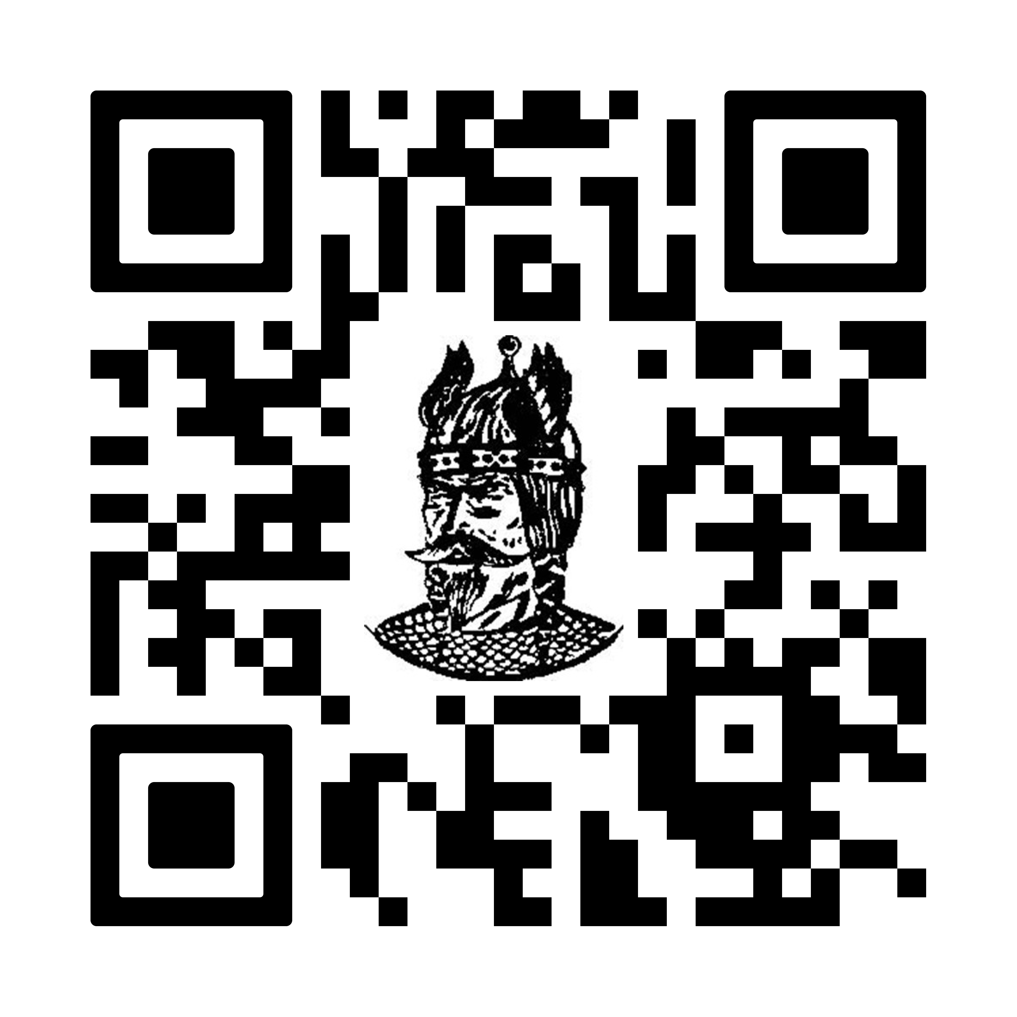
Welcome Rising Vikings
Sign in using QR code!
Class of 2030

Slide 2
Tonight's Program
Counselor Overview of the High School
Guided Tours with PRO Students
Open Forum in the Commons
Speak with high school teachers about potential courses
Chat with students about their extracurricular activities
Talk to athletic representatives about sports

Slide 3
Let's Review Together:
ELHS Community
High School Daily Schedule
Graduation Requirements
Course Selection for next year
Extracurricular Activities
Transition to High School

Slide 4
ELHS Counseling Office
Where Can You Find Information About The Counseling Office?
Like and Follow us on Facebook:
  "East Lyme High School Counseling Office"
Updates in the Weekly Principal Newsletter
East Lyme High School Counseling Website
Class of 2030 School Counseling Google Classroom:
Code: r4bmmlg6

Slide 5
School Counseling Staff
Room A200
In order of Alphabetic Breakdown:
Elizabeth Maiese
David Willis
Jaclyn Sullivan
Christy Bryant
Haley Stites
Nadine Barnes
Administrative Assistant: Ellen Bellos

Slide 6

Additional Support Staff &
Administration
School Psychologists (gr. 9)
Christopher Mountain
Sheryl Shyloski
School Social Workers
Emily Hancock, LMSW
Jaqueline Byrne, MSW
Substance Abuse Coach
Dan Reynolds, CAC
Principal
Henry KYdd
Assistant Principals
Lisa Belisle– Grades 9/12
Julie Shvetz – Grades 10/11
District Director of Campus Safety and Security
Don Hull

Slide 7
The Daily block Schedule
A Day | B Day
A1 | B1
Advisory/Homeroom | Advisory/Homeroom
A2 | B2
A3/Lunch | B3/Lunch
A4 | B4

Slide 8
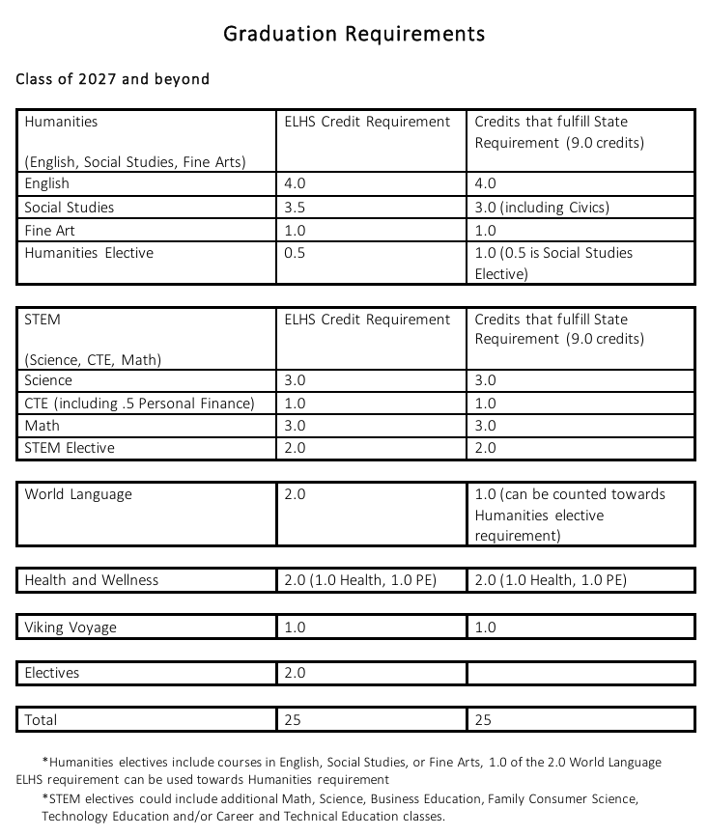
Graduation Requirements

Slide 9
Course Selection

Slide 10
Program of studies:
Electronic Program of Studies
Program of Studies Language:
Course levels
Pre-requisites
Course credit
World Language:
French
Spanish
German
Elective Courses:
Fine Art
Career/Technical Education

Slide 11
Course Levels
Advanced Placement (AP) & Early College Experience (ECE)
AP and ECE classes introduce students to college-level coursework. Only AP Music Theory and AP Environmental Science offered at 9th grade level
Honors Level
Honors classes provide an opportunity for students who are working above grade level, who work independently, and who expect a greater challenge. Only Math and World Language offered at the 9th grade level
Advanced College & Career Prep
Advanced College & Career Prep classes are delivered at grade level but at a greater depth and with more independent learning expectations.
College & Career Prep
College & Career Prep classes provide grade level curriculum with the addition of remediation, scaffolding, or support to work toward course expectations.

Slide 12
How to fill Humanities and Stem requirements
Humanities
Students can select additional electives in English, Social Studies, World Language and Fine Art
STEM
Students can select additional electives in Science, Math, and Career/Technical Education

Slide 13
Sample Freshman schedule
1.0 English 9
1.0 Ancient World History or Modern World History
1.0 Integrated Science
1.0 Math
1.0 World Language
.5 Freshman Wellness/Health
.5 Freshman PE
1.0 Elective Credit
Study Hall
Advisory

Slide 14
Career Concentrations:
Career Concentrations Brochure
What are Career Concentrations?
Career Concentrations at East Lyme High School allow students who are interested in a particular career path to receive a certificate of accomplishment for successfully completing courses that help prepare them for a related career field. Successful completion of a Career Concentration is also recorded on the student’s official transcript.
Why Career Concentrations?
⭐ Learn more about an area to see if you like it!
⭐ Build your resume and help potential employers or admissions representatives understand the depth of your interest.
⭐ Be better prepared to enter a career.
⭐ Be better prepared for courses at a technical school or college.
Students must: ✔ Take the correct sequence of courses.
Earn a ‘C’ or better in each concentration class.

Slide 15

Course Selection Timeline
February: MS received the electronic Program of Studies
February: MS Teacher recommendation conversations started with students – continue through March 3rd.
3/23-3/24 High School Counselors visit Middle Schools and walk students through choosing their electives on Infinite Campus
Elective Choices

Slide 16

Extracurricular activities
Senate & Class Officers​ Jazz Band
National Honor Society​ Best Buddies
Drama Club​ Cultural Awareness Club
Sign Language Club​ Math Team
PRO (Peers Reaching Out)​ Ping Pong Club
GSA​ And Many More!
Key Club ​

Slide 17
Athletics
Wide Variety of Sports offered each season
Students must be registered through Family Id – on school website
Final Forms - Athletic Registration link
FOllow our programs on social media!
Facebook: ELPS Athletics
Instagram: eastlymeathletics
Twitter: @ELPSAthletics
Shop Viking Gear On-Line Year Round - East Lyme High School Sideline Store

Slide 18
Transition to High School: Things to Know
Freshman Wellness: first semester grade 9, health and wellness curriculum including the transition to high school and school supports​
Advisory/Homeroom: daily homeroom, advisory lessons on Wednesdays which cover a wide range of topics​
Attendance: Attendance letters are automatically generated once a student reaches 6 or 12 absences, regardless of whether the absence is excused or unexcused. A meeting with an ELHS Administrator may be required and loss of credit can occur. ​
Homework: part of the student's grade​
Naviance: College and Career Planning
Infinite Campus: Student Information System, live grades​

Slide 19
Transition Timeline for class of 2030
October 2025: Counselors visited MS for an open forum school choice session with students
February: Letter sent to all grade 8 families regarding course selection
February 19, 2026: Rising Vikings Night
February – March 2nd: Course Recommendations with MS teachers
March 23, 24: High School Counselors visit MS to help complete course selection/choose electives with students
March 24-27: Course selections and recommendations distributed to MS students with a signature sheet for parents.
Spring 2026: Athletic Department visit to MS
Spring 2026: Music Department visit to MS – combined concert
August 2026: Freshman Welcome Night
August 2026: Freshman Orientation

Slide 20

Thank you for Coming!
Questions?

