Slide 1

2025-2026
Annual Title I & Family Engagement Meeting
OAKHAVEN HIGH SCHOOL
9/4/2025
PRINCIPAL MOSBY

Slide 2
Why are we here?
The Every Student Succeeds Act (ESSA) requires that each Title I school hold an annual meeting of Title I families in order to:
      inform you of your school’s participation in Title I,
      explain the requirements of Title I, and
      explain your rights as parents and family members to be involved.

Slide 3
Agenda
Welcome & Greetings.................................................................Jocelyn Mosby, Principal
Title One Presentation................................................................Candace Suber, PLC Coach.
Title One Status
Family Engagement Plan
Parents Rights to Know
Reporting Student Progress & PTC
Teacher Qualification
School Improvement Plan
Parent Training and Volunteer
Parent/School Compact
Student Code of Conduct
Dress Code Policy
Cellphone Policy
Parent Survey
Closing Remarks & Additional Meetings................................................................... Jocelyn Mosby, Principal

Slide 4
Why are we here?
What is a Title I school?
What are my rights?
What can Title I funds be used for?
How does our school use Title I funds?
What is the SIP?
What are our schoolwide program goals?
How is parent and family engagement funded?
What is the Parent and Family Engagement Policy?
What is the School-Parent Compact?
What curriculum does our school use?
What tests will my child be taking?
How can I be involved?
Who can I contact for help?

Slide 5
What is a Title I school?
Title I was passed in 1965 under the Elementary and Secondary Education Act (ESEA). It is the largest federal assistance program for our nation’s schools.
Title I schools receive extra funding (Title I dollars) from the federal government. These dollars are used to:
      identify students experiencing academic difficulties and provide assistance to help these students;
      purchase additional staff, programs, materials, and/or supplies; and
      conduct parent and family engagement meetings, trainings, events, and/or activities.

Slide 6
What are my rights?
The families and parents of Title I students have a right, by law, to:
Be involved in decisions made at both the school and district level;
Be provided with information on your child’s level of achievement on tests in reading/language arts, writing, mathematics, and science;
Request and receive information on the qualifications of your child’s teacher and paraprofessionals who are working with your child suberc@scsk12.org and
Request opportunities for regular meetings to formulate suggestions and to participate, as appropriate, in decisions about the education of your child. The school is required to respond to any such suggestions as soon as practicably possible.

Slide 7
What can Title I funds be used for?
In general, Title I funds may be used for:
      smaller class sizes,
      additional teachers and paraprofessionals,
      additional training for school staff,
      extra time for instruction (before and/or after school programs),
      parent and family engagement activities, and/or
      a variety of supplemental teaching materials, equipment, and technology.

Slide 8
How does our school use Title I funds?
In 2025 our school was allotted approximately $245,926 in Title I funding.
We developed a Schoolwide Program, which means we plan to spend our funds on the following:
      Supplemental staff:
        PLC Coach
        Behavior Specialist
        Instructional Coach
      Programs/Materials/Supplies:
        Teacher Supplies, Student Supplies, Family engagement activities
      Teacher Professional Development:
        Content based Professional developments

Slide 9
What is the SIP?
The SIP is the School Improvement Plan. It includes:
      the identification of the school planning team and how they will be engaged in the planning process;
      a needs assessment and summary of academic and non-academic data;
      prioritized goals, strategies, and action steps to help address the academic and non-academic needs of students;
      teacher and staff professional development needs; and
      budgets and the coordination of resources.
The school must include family representatives on our school planning team.

Slide 10
What are our schoolwide program goals?
Increase proficiency rates in ELA, Math, and Science.
Continue to implement more rigorous instruction.
Provide targeted interventions for struggling students.
Increase the percentage of ready graduates.
Continue to develop early post-secondary opportunities (EPSO) and work-based learning programs.
Reduce chronic absenteeism

Slide 11
How is parent and family engagement funded?
Any district with a Title I allocation exceeding $500,000 is required by law to set aside 1% of it’s Title I allocation for parent and family engagement.
Of that 1%, 10% may be reserved at the district for system-wide initiatives related to parent and family engagement. The remaining 90% must be allocated to all Title I schools in the district.
You, as Title I parents and family members, have the right to be involved in how this money is spent.

Slide 12
How is parent and family engagement funded?
In 2025, we received approximately $2550.96 in parent and family engagement funding. We plan to use these funds for:
      Parent and Family Engagement Meeting and Events
        TBD
        Site Based Decision Making Council
      Materials/Supplies
        Food for meetings, supplies for meetings & events.

Slide 13
What is a Parent and Family Engagement Policy?
These plans address how the district and school will implement the parent and family engagement requirements of ESSA. Components should include:
      how parents and families can be involved in decision-making and activities;
      how parent and family engagement funds are being used;
      how information and training will be provided to families; and
      how the school will build capacity in families and staff for strong parent and family engagement.
You, as a Title I parent or family member, have the right to be involved in the development of these plans.

Slide 14
What is a Parent and Family Engagement Policy?
The district Parent and Family Engagement Policy can be found here:
      https://www.scsk12.org/face25/
      Memphis Shelby County Schools official webpage
The school Parent and Family Engagement Policy will be shared at a later date. In addition, the policy can be found here:
      https://www.scsk12.org/face25/

Slide 15
What is a School-Parent Compact?
A school-parent compact is a written commitment that outlines how the entire school community – teachers, families, and students will share the responsibility for improved academic achievement.
The compact must describe how the school will:
      provide high-quality curriculum and instruction;
      hold parent-teacher conferences, annually in elementary schools;
      provide parents with reports on their child’s progress;
      provide parents reasonable access to staff.
      provide parents opportunities to volunteer; and
      ensure regular two-way meaningful communication between family members and staff, to the extent practicable, in a language family members can understand.
You, as a Title I parent or family member, have the right to be involved in the development of the compact.

Slide 16
What is a School-Parent Compact?
The school-parent compact is available on your handout. Please scan the QR code.

Slide 17
What curriculum does our school use?
The Tennessee Academic Standards provide a common set of expectations for what students will know and be able to do at the end of a grade for each subject area.
Tennessee's academic standards form the framework for everything taught at Oakhaven High School.
For more information about Tennessee’s academic standards, see:
      https://www.tn.gov/content/tn/education/instruction/academic-standards.html

Slide 18
What tests will my child be taking?
District EOC courses, English I, English II, Algebra I, Algebra II, Geometry, and Biology
Statewide Dual Credit, Advanced Placement
District Common Assessments

Slide 19
How can I be involved?
We need you! Research has proven that family engagement in education has more impact on student achievement than any other factor.
To get involved with the SIP contact Mrs. Suber via email suberc@scsk12.org or by phone 901-416-2300
To get involved with the Parent and Family Engagement Policy, contact Mrs. Suber via email suberc@scsk12.org or by phone 901-416-2300
To get involved with the School Parent Compact, contact Mrs. Suber via email suberc@scsk12.org or by phone 901-416-2300

Slide 20
How can I be involved?
Attend school events and serve as advisors.
Serve on the Site Based Leadership Team
Use their talents/resources to enhance the instructional program
Become school supporters and advocators
Respond to memos, surveys and questionnaires expressing ideas and concerns
Work directly and indirectly with the Family Engagement Specialist, Dr. Morgan

Slide 21
Who can I contact for help?
For general questions, call the front office at: 901-416-2300
To reach the Principal Mosby call: 901-416-2300
To reach the school counselor, Ms. Linson call: 901-416-9758.
To reach our family liaison, [add name], call: [insert phone number]
To reach your child’s teacher, call the front office or view our staff directory at: https://schools.scsk12.org/oakhaven-hs

Slide 22
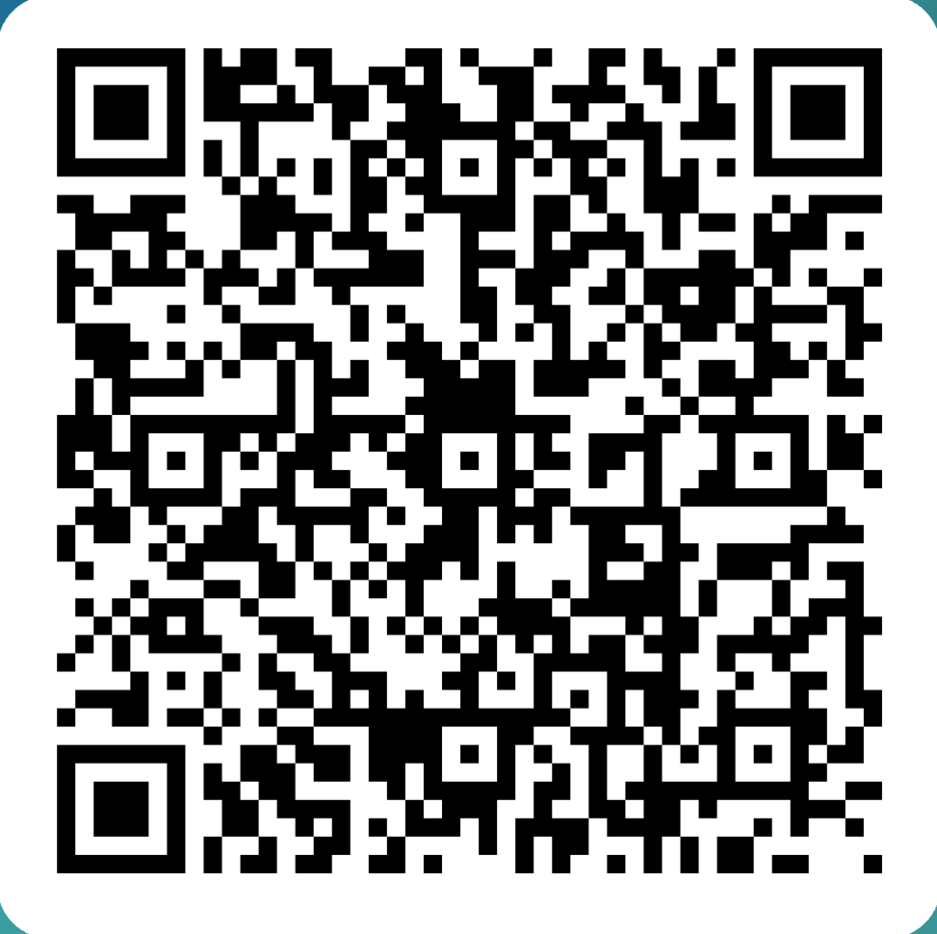
WE JUST WANT TO SAY THANK YOU!
PLEASE COMPLETE THIS SURVEY!

