Slide 1

Teacher Incentive Allotment Overview
2025-2026-Updated

Slide 2
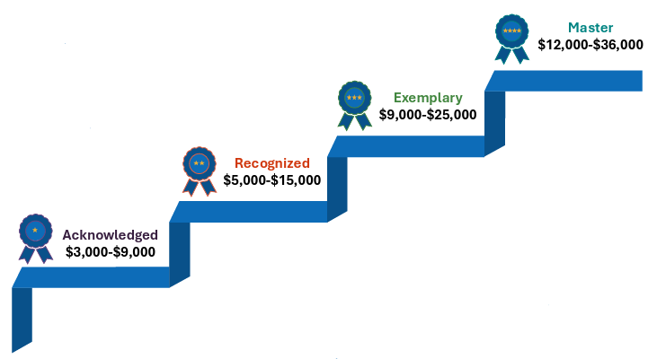

Teacher Incentive Allotment Works with the
Local Designation System
Legislation was passed to allow both certified and un-certified teachers to be designated.
The designation is added to a teacher’s SBEC certificate and is valid for five years. The allotment follows the teacher.
2
2
2

Slide 3
Overview of RYSS Teacher Incentive Allotment
Teachers are designated as Master, Exemplary, Recognized or Acknowledged based on teacher observation and student growth data.
RYSS receives $7,000 - $27,000 per year from the state for every designated teacher they employ.
National Board-Certified teachers earn a designation with funding aligned to the Acknowledged level.
The designated teacher receives 90% of the Teacher Incentive Allotment funds that RYSS receives. The remaining 10% is used by the district for teacher development.
3
3
3

Slide 4
RYSS Theory of Action and Expectations for TIA
The district’s Theory of Action is that by participating in the Teacher Incentive Allotment with a local designation system for teachers it will improve student achievement by:
  focusing on teacher impact on student growth;
  supporting teacher growth;
  increasing retention of the most effective teachers;
  strengthening our current teacher evaluation system; and
  remaining competitive to attract new teachers to our district.
Participating in the Teacher Incentive Allotment for the purposes just stated support the district's Strategic Plan Priority 2 - Strong Teams: Recruit, develop, and retain top talent to create thriving school-based and central office teams.
4
4
4

Slide 5
Background for RYSS TIA
Using data from the 2022-2023 data collection, 24 RYSS teachers were designated for 2023-2024: 3 Master, 8 Exemplary, and 13 Recognized.
Using data from the 2023-2024 data collection, 6 RYSS teachers received new designations, and 3 teachers received higher designations for 2024-2025.
The 2024-2025 data collection is being analyzed now for the 2025-2026 designations and has been sent to TEA for review.
Raul Yzaguirre Schools for Success

Slide 6
RYSS TIA Model for 2025-2026 Data Collection
Weight | Component
45% | T-TESS Observation Score Average for Domains 2 & 3 across scored observations and walkthroughs (Final); no Domain 2 or 3 dimension can be less than a 3
55% | Student Growth
New Student Growth for 2025-2026
2025-2026 Eligible Teaching Assignment/Campus | Pre-Test | Post-Test | Growth Target
Prekindergarten | Circle | Circle | Moving up a performance level or staying on track (see FAQ)
Grade K-3 Reading | I-Ready BOY | I-Ready EOY | % of students meeting >=100% typical growth target
Grade K-3 Math | I-Ready BOY | I-Ready EOY
Grade 4-8 Reading | Prior Year STAAR | Current Year STAAR | STAAR transition table
Grade 4-8 Math | Prior Year STAAR | Current Year STAAR
Algebra I, English I, and English II | Prior Year STAAR | Current Year STAAR
Grade 5 & 8 science, Grade 8 social studies, Biology, and US History | Released STAAR | Current Year STAAR | Target set using variable percentage correct method
Raul Yzaguirre Schools for Success

Slide 7
Released STAAR to STAAR Growth Expectations
To allow for growth even if the student is still in the Did Not Approach category but is moving in the right direction, the district has proposed to the state to use a variable percentage growth model.
This sets higher growth expectations for lower performing students but allows for growth at all levels.
Using the pre‐test's percent of items correct, the growth targets will be set as follows:
  0‐20% correct, 20 percentage point increase;
  21‐40% correct, 15 percentage point increase;
  41‐60% correct, 10 percentage point increase;
  61‐80% correct, 5 percentage point increase;
  81% or higher correct, maintain or >=95%.
7
7
7

Slide 8
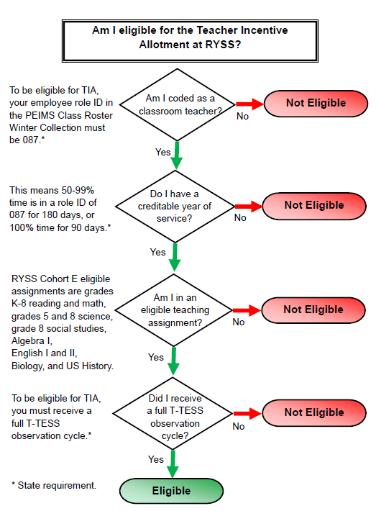
Eligibility Requirements
Must meet basic TEA eligibility requirements.
  See chart on right, eligibility is determined for year of designation which is the year after data collection.
  Must have a growth measure
  Must score “Proficient” or higher in T-TESS Domains 2 & 3 overall and on each dimension.
  Must achieve an average score of 3.48 or higher in T-TESS Domains 2 & 3, where “Proficient” =3.
8
8
8

Slide 9
STEPS 1 and 2: Determine rating for each measure.
Updated Observation Standards:
Final T-TESS rating based on all included observations and walkthroughs in DMAC: Average Score on Domains 2 & 3 with a minimum of 3 on all dimensions of Domains 2 & 3
Updated Growth Standards:
Percent of Students Meeting or Exceeding Growth Expectation as determined by assessment
Rating | District Standard
Acknowledged | 3.5
Recognized | 3.7
Exemplary | 3.9
Master | 4.5
Rating | District Standard
Acknowledged | 50%
Recognized | 55%
Exemplary | 60%
Master | 70%
Raul Yzaguirre Schools for Success

Slide 10
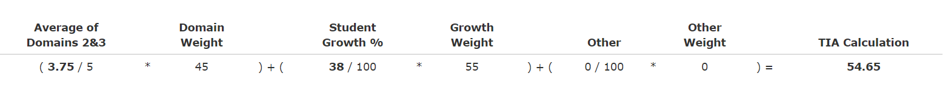
STEP 3: Weight the TTESS and Student Growth measures.
The TTESS average is normalized (score divided by 5) and weighted at 45% and the growth percent is weighted at 55%. For the weighted calculation >90=Master, 80-89=Exemplary, 70-79=Recognized, 65-69=Acknowledged.
DMAC provides these calculations once student growth is entered by the district.
Raul Yzaguirre Schools for Success

Slide 11
STEP 4: Determine overall designation.
To be designated, a teacher must receive a designation label under steps 1-3 with the final designation being the lowest of the three labels. This assures that all standards are met AND weighting was applied. (See Sample Table below.)
Designation | Weighted Score | Percentage Growth | TTESS Final D2D3Avg
Master | 96 | 92 | 5.00
Exemplary | 86 | 80 | 4.63
Acknowledged | 85 | 95 | 3.63
Recognized | 79 | 70 | 4.50
Recognized | 79 | 83 | 3.75
Acknowledged | 76 | 78 | 3.63
No Designation | 79 | 88 | 3.38
Acknowledged | 68 | 63 | 3.75
Acknowledged | 67 | 55 | 4.13
Acknowledged | 65 | 59 | 3.63
Raul Yzaguirre Schools for Success

Slide 12
Projected Teacher Incentive Allotment
Based on 2024-2025 Funding without Acknowledged*
Note: Funding calculated annually by state based on % economically disadvantaged
*Adjusted for 90% payout to teacher, PRIOR to taxes taken out.
12
12
12

Slide 13
Payout
Designated teacher receives 90% of allotment; 10% is maintained at the district level for professional development.
Year 1 payout is one check in August. Years 2-5 are two checks distributed half in May and half in August.
Taxes and deductions are taken out of the checks.
Raul Yzaguirre Schools for Success

Slide 14
TIA Timeline: RYSS
Date | Item
June-August 2025 | Data collection and analysis of 2024-2025 data for 2025-2026 designations.
August/September 2025 | Preliminary 2025-2026 designations provided to administrators and scorecards to teachers for goal setting conferences
October 2025 | District provides 2024-2025 data collection to TEA for review and approval of new designations.
April 2026 | TEA verifies designated teacher eligibility from Winter Class Roster
April/May 2026 | TTU annual survey sent to teachers, administrators evaluating program
May 2026 | TEA provides district with allotment amounts; notifies teachers
May 2026 | District notifies 2023-2024, 2024-2025, and 2025-2026 newly designated teachers of designations and actual payout amounts
May 2026 | Payout Part A to 2023-2024 and 2024-2025 designated teachers
August 2026 | Payout Part B to 2023-2024 and 2024-2025 designated teachers and Payout 1 to new 2025-2026 designated teachers
14
14
14
Notes:
Part

Slide 15
Teacher Incentive Allotment (TIA) Resources
RYSS’s TIA Sharepoint Site: https://tejanocenterorg.sharepoint.com/sites/TejanoCenter then enter “Teacher Incentive Allotment” in the search bar
TEA’s TIA Site (https://tiatexas.org)
Carla Stevens, TIA Project Team Lead
Carla.Stevens@Tejanocenter.org

