Slide 1

District-wide
ES to MS Transition Night
6TH GRADE
Welcome to Middle School
District Counseling Dept.
March 5, 2026

Slide 2

Welcome & Greetings
Ms. Washington– CMS
Ms. Robinson– EMS
Ms. Key – MMS
Ms. Perrymond– DMS
Ms. Fallon – District Office
Dr. Meng – Fine Arts
Ms. Thomas – Support
Dr. Rowles – Athletics
Mr. Allen – Nutrition

Slide 3
Our plans for this evening
To provide tips to ease the transition from elementary school to middle school
To explain the middle school day and schedule
To acquaint you with Infinite Campus and discuss the communication tools the district uses
To familiarize the student and family with key elements to prepare them for Middle School

Slide 4

Fine Arts Program – Dr. Meng
CMS – Art, Band, Chorus, Guitar
DMS – Art, Band, Chorus, Orchestra, Theatre, Dance
EMS – Art, Band, Chorus
MMS – Art, Band, Chorus, Theatre
Notes:
Middle School is the time to start playing an instrument to give you the opportunity to move on to Marching Band, orchestra, and other band ensembles in high school.
Fine Arts courses give you the opportunity to participate in exhibits and competitions where you can win awards and prizes.
Fine Arts courses give you the opportunity to travel to events in your chosen area.
Fine Arts groups are Family!! Many Fine Arts students grow very close as they develop skills in communication, creativity, collaboration and critical thinking.
The Fine Arts teach discipline and professionalism in all areas.

Slide 5






A whole new world!
Football
Flag Football
Softball
Basketball
Track
Wrestling
Volleyball
Cheerleading
School Pride
Eligibility ​
RankOne ​
Tickets from Go Fan​
Embody "Student Athlete"
Dr. Kechia Rowles
District Athletic Director

Slide 6

Lunch at Middle School
Larger Variety
Lunch ID
Basic Social Time
Parents download “My School Bucks App” to add funds for ala carte purchase
Breakfast & Lunch at no cost next school year
View monthly lunch menu online RCPS website -> Under Departments, Community Impact, click School Nutrition
Salads, Pizza and hot lunch selection everyday
Memorize the last 5 digits of your Student ID
Time to sit and talk with friends, respectfully

Slide 7

Learning Support
Tracey Thomas
Exceptional Children
Services
Coordinator

Slide 8
What 5th graders are
…excited about
…nervous about
more freedom
having more than more teacher
after school clubs/activities
meeting new friends
new classes/experiences
social time lunch
combination locks
finding their way around school
having more than one teacher
the amount of homework
the lunchroom
meeting new people

Slide 9


Slide 10

How do you combat those fears?
Develop good study habits ​
Don’t wait until the last minute to do your work ​
Join Clubs ​
It’s okay to meet new people ​
Be social ​
Monitor your grades ​

Slide 11

How parents can help:
Understand it is normal for your child to be nervous; it is also normal for you to be nervous.
Help your child manage homework time
Show interest in your child’s studies – talk daily about what they are doing in school
Discuss ideas and feelings about school, studies, and activities.
Sign up for Parent Square
Organize a study area with supplies handy
Notes:
“The transition to middle school may be one of the toughest transitions during childhood, for both parents and kids” (Brown, 2004).

Slide 12

How parents can help:
Be sure your child attends school regularly and on time
Read all information coming from the school district
Contact teachers and counselors periodically
Know your child’s friends
Make it clear that they must follow school rules
Encourage them to get to know their school counselor
Make sure they have a good night’s sleep
Notes:
“

Slide 13

Social Media
Social Media is widespread among middle school students
It’s a personal parental decision
Make sure your kids think before they post
Remind them that everything can be seen by a vast invisible audience
They need to know that kindness counts

Slide 14

Big Differences:
More independence
More expected of you
More self-advocacy needed
Social skills
More classes
They will change classes each class period
More teachers
More opportunities
Homework is very important!

Slide 15





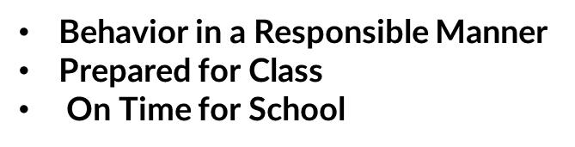
Appropriate Behaviors for Middle School

Slide 16
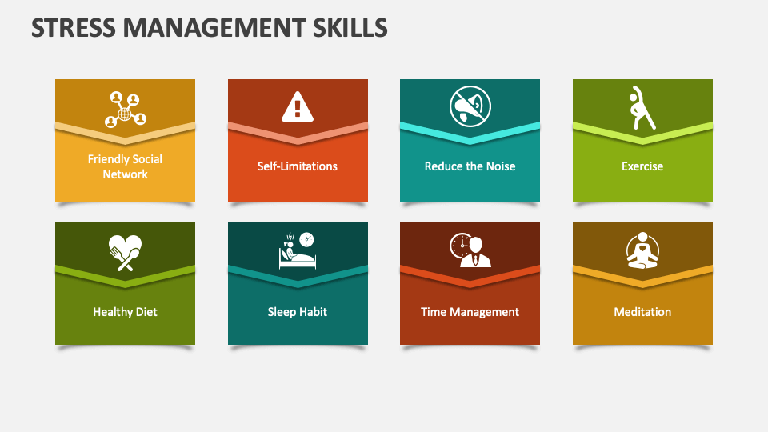

Slide 17




Understanding the Class Schedule
M Day (Mondays – All classes)
A Day (Tuesdays & Thursdays)
B Day (Wednesday & Fridays)
Typical 6th Grade Schedule
  Homeroom
  Study Skills
  Math
  ELA
  Science
  Social Studies
  Connections
  Connections

Slide 18
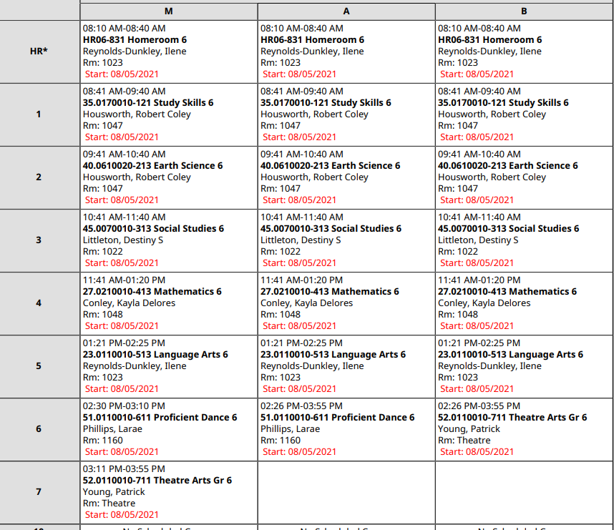
Sample 6th Grade
Schedule

Slide 19


Grading & Tests
Grades for fall classes and grades for spring classes
Part A or the first half of your classes in the fall (Aug – Dec)
Final exams for all classes in December
Part B or the second half of your classes in the spring (Jan – May)
Final exams in May
Students will take GA Milestone exams in April and/or May
Notes:
Milestone Course – Coordinate Algebra and Biology

Slide 20




Communication with RCPS
Infinite Campus
Parent Square
Social Media
Email/Calls from District and Principals
Parents can receive messages from the school via IC
Receive messages from the district, teachers and school
School page, PTA, Disctrict pages
Ensure you have the correct email address and phone on file via IC

Slide 21
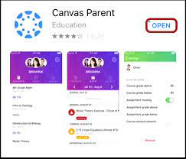

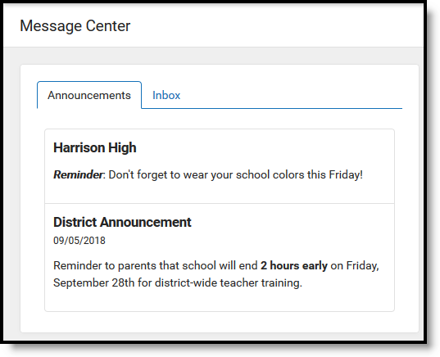
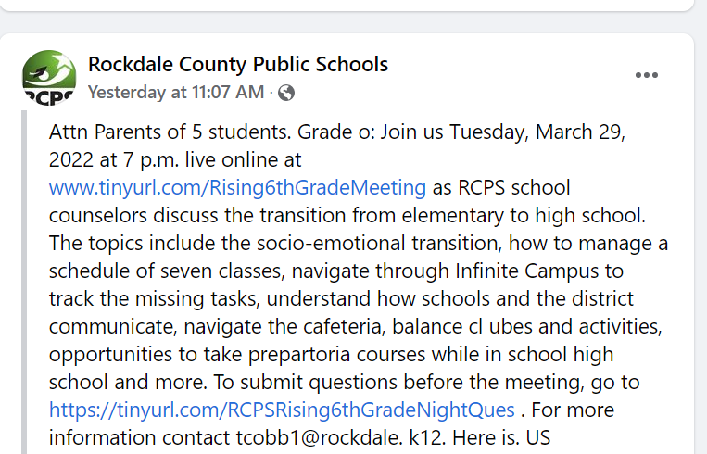
Notes:
Remind
Parent Canvas
Infinite Campus – Parent View Message Center
Phone, Email,

Slide 22
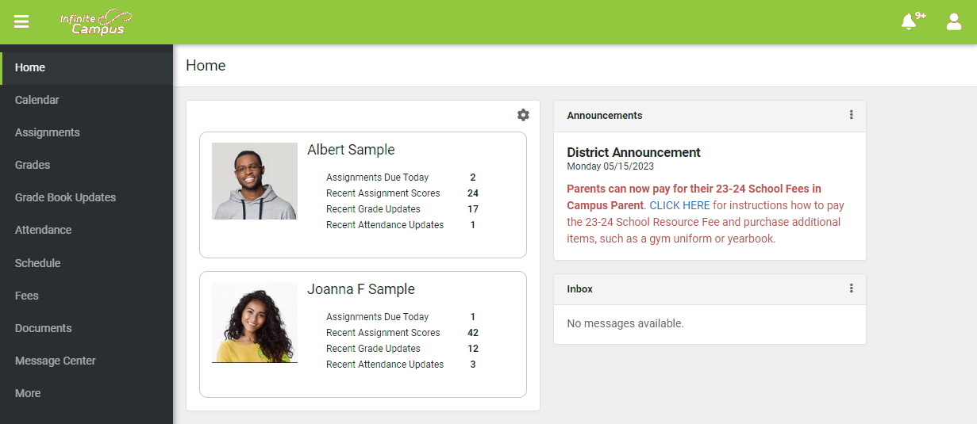
Notes:
As a district we utilize Infinite Campus as our Learning Management System. This is where teachers input grades, attendance, etc. As parents you should already have an infinite campus account. This is how you enroll your students and update their information each year. From the parent portal you can check on their assignments, attendance to each class, and their schedule of courses. You can also see if your student is missing any work in classes. District announcements are also posted to the home page

Slide 23
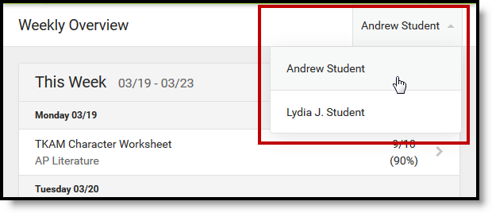
If you have more than one student – there is a dropdown in
the upper right-hand corner to make your view student specific

Slide 24
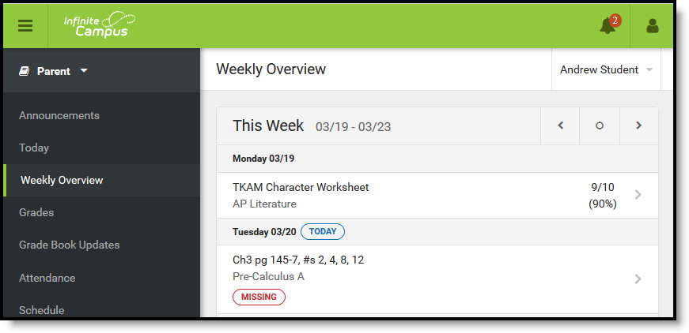
Parent’s View in Infinite Campus
Notes:
Weekly Overview will provide you with and overview of the assignments that are currently due. You can look at previous weeks, as well as look forward to future weeks by clicking Previous or Next

Slide 25
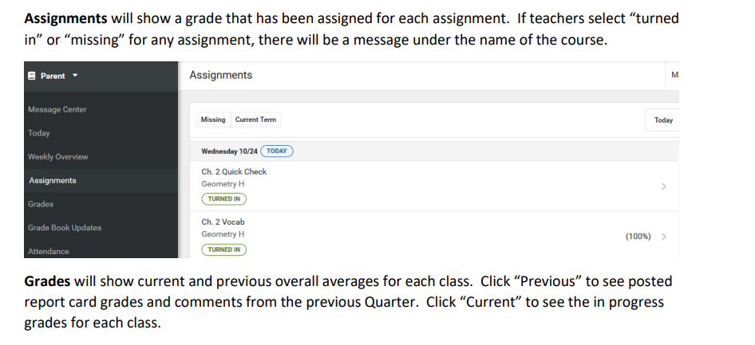
Available to Parents in Infinite Campus

Slide 26

Additional Information
Visit the RCPS website www.rockdaleschools.org
Click Schools and find your future Middle School –becoming acquainted with all you can
Visit the site often – information will be posted there about the upcoming school year
Students: talk with your parents about Middle School
Families: read the District Parent Handbook

Slide 27

Follow All of Us on Social Media
Rockdale County Public Schools
Facebook: @rockdaleschools
Instagram: @rockdaleschools
Twitter: @rockdaleschools
YouTube: @rockdalecountypublicschools
School Counselors
Facebook: @RCPSCounselors

Slide 28


Dance & Cheer Tryouts are in May

Slide 29


Cheer
Interest meeting
April 21st
4:30pm –5:30pm
Conyers Middle School
Cheer try-outs
April 30-May 2nd
4:30pm –6:00pm

Slide 30



Edwards Middle
March 25-28
4:10pm –6:00pm
If a student wishes to participant in band or chorus, permission slips must be returned to the school counselor by April 4. Forms will be available Monday, March 10 at the elementary schools.

Slide 31


Transition Field Trip Date
March 24th
All elementary school students with a signed field trip form will be able to visit their future Middle School on March 24th

Slide 32
Stay Tuned for additional Middle School
Transitional Activities

Slide 33

Thank You for Attending
We have a few minutes for Q & A
For school specific questions please go to the middle school website
Please complete the evaluation for this workshop:
https://tinyurl.com/Rising6thEVAL26

