Slide 1

Budget structure presentation

Slide 2
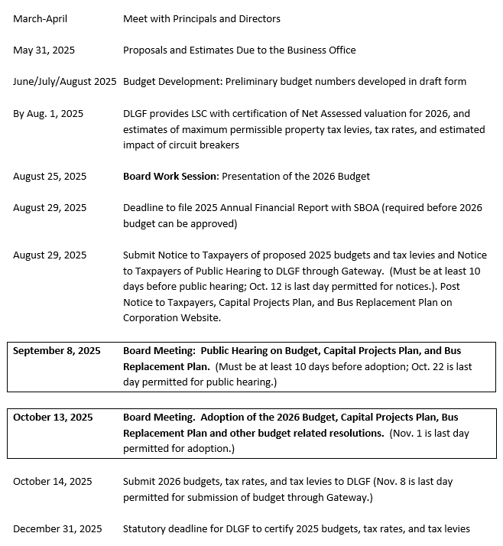
Adoption timeline

Slide 3

Fund structure – 2019-Present
Education Fund Operations Fund Debt Service Fund
Rainy Day Fund

Slide 4
Education Fund
Expenditures
Revenue Streams
Instructional costs
Teacher Salary & Benefits
Educational Support Staff Salary & Benefits
Principal Salary & Benefits
Curriculum Office Staff Salary & Benefits
Instructional Supplies
Principal’s Supply Lines
Technology
GLCA Tuition
GLASS
Curricular Materials
State Tuition Support

Slide 5
Education Fund expenditures by category

Slide 6
Operations fund
Expenditures
Revenue Streams
Operational Costs
Board of School Trustees Salary & Benefits
Superintendent’s Office Salary & Benefits
Business Office Staff Salary & Benefits
Human Resource Office Salary & Benefits
Maintenance Salary & Benefits
Custodial Salary & Benefits
Transportation Salary & Benefits
Contracted Services
Operational Supplies
Maintenance Projects
Property and Casualty Insurance
Technology
Buses
Local Property Tax
Financial Institutions Tax
Commercial Vehicle Excise Tax
License Excise Tax
Facility Rental
Indirect Costs
Transfer from Education Fund

Slide 7
Operations fund expenditures by category

Slide 8
Debt service fund
Expenditures
Revenue Sources
Debt Payments
  General Obligation Bonds
  First Mortgage Bonds
Local Property Tax

Slide 9
Rainy Day fund
Expenditures
Revenue Sources
Reserved for Emergencies
None
Fund Transfers as approved by the Board of Trustees

Slide 10
Conclusion
Each Fund is separate from the other with their own revenue source and dedicated expenditures.
Roughly 80%, by dollar expenditure, of the overall budget is spent on salary and benefits.
The Education Fund is by far the largest and is for instructional expenses.
The Operations Fund is much smaller and is for operational expenses.
The Debt Service Fund is used to pay off debt issued for building and technology improvements.
The Rainy Day Fund is reserved for emergencies and has no revenue source to replenish it.

Slide 11
Thank you

