Slide 1

Common App Overview
A step-by-step guide for high school students
Spring 2026
Assistant Director of Admissions
Purdue University
slandorf@purdue.edu

Slide 2
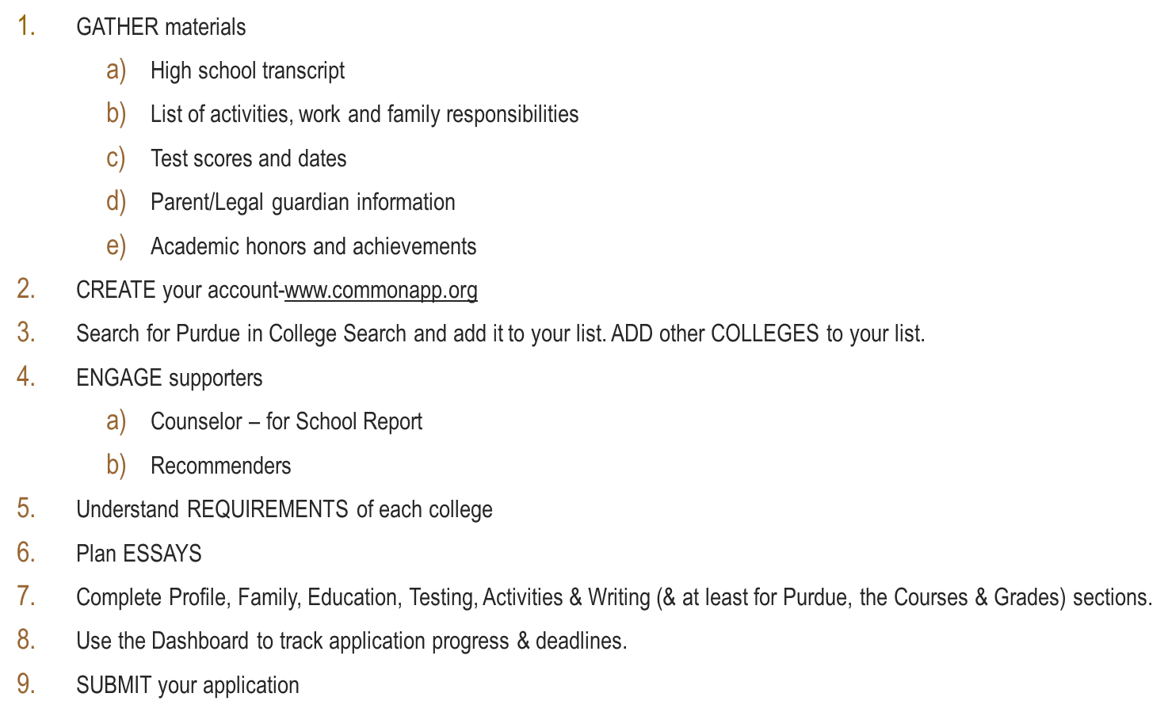
Common App Steps

Slide 3

Notes:
This is the first page you’ll see when you go to commonapp.org

Slide 4
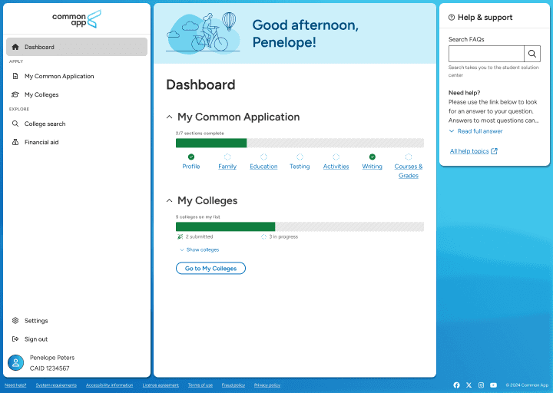
Common App Dashboard
Notes:
The Dashboard is your home base in the Common App. Here you can see the status of your application, track your progress, and access your list of colleges. Purdue recommends checking this page often.

Slide 5
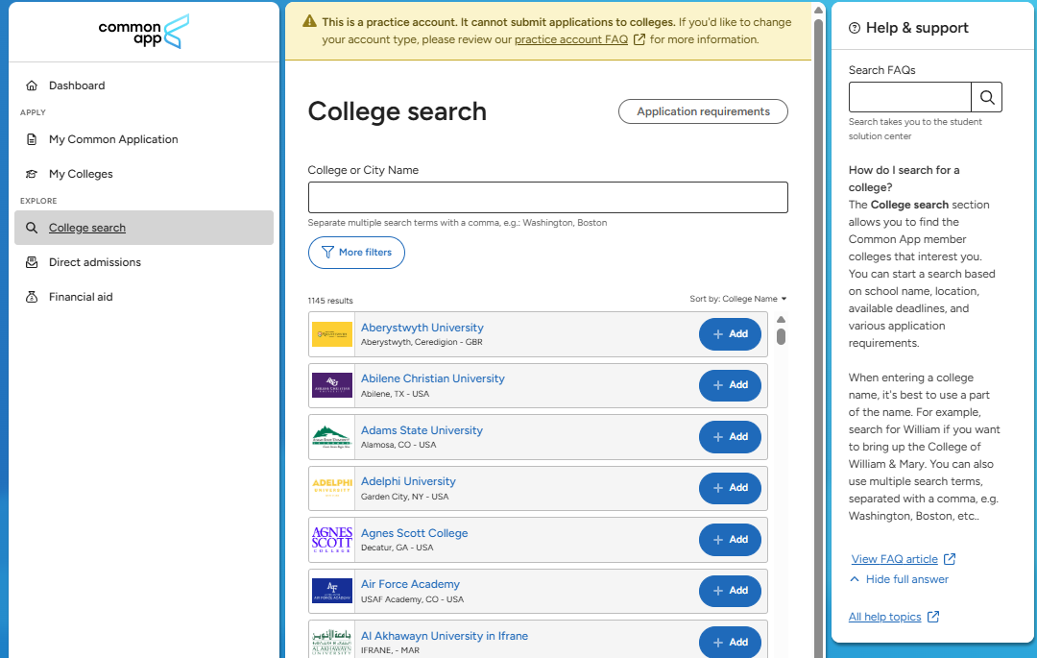
Exploring Colleges
Notes:
The College Search tool helps you explore different institutions. You can filter by location, majors, or other preferences. On the right side , just above the listed colleges, the ‘Sort by’ options include College name & Distance. Students should use this feature to build a balanced college list.

Slide 6
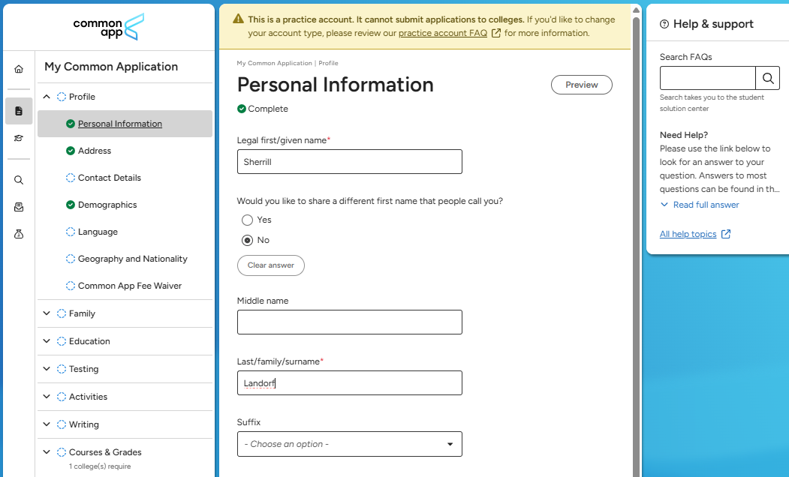
Profile & Application Sections
Notes:
As you finish all required entries of each section, it will indicate completion with the green check-marked circle.

Slide 7
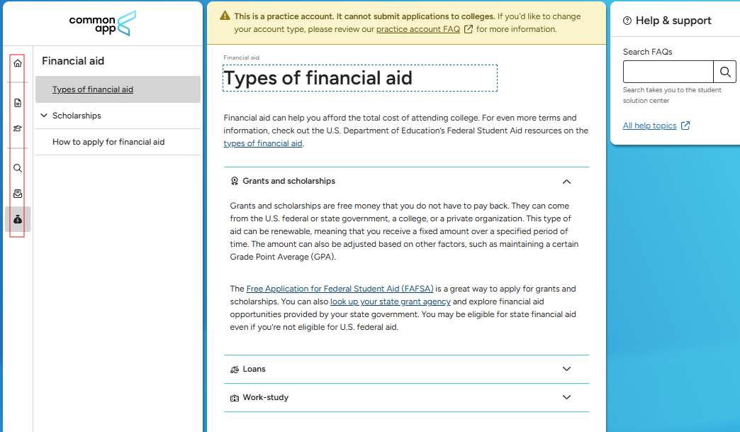
Navigation Icons & Financial Aid Resources
Notes:
Note the navigation icons are on the left side of the page – outlined in red. There are several financial aid resources within the Common App

Slide 8
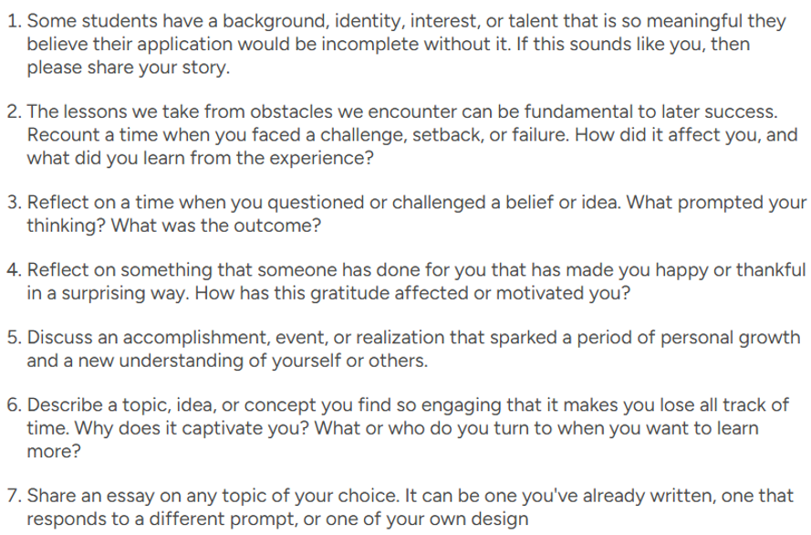
Common App Essay Prompts
Notes:
Current for high school seniors applying in Fall of 2026 (planning to enter college in Fall 2027)

Slide 9
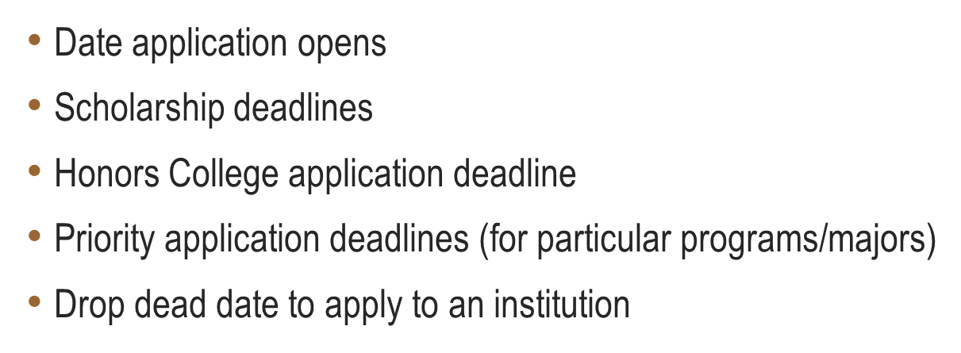
Important Dates

Slide 10
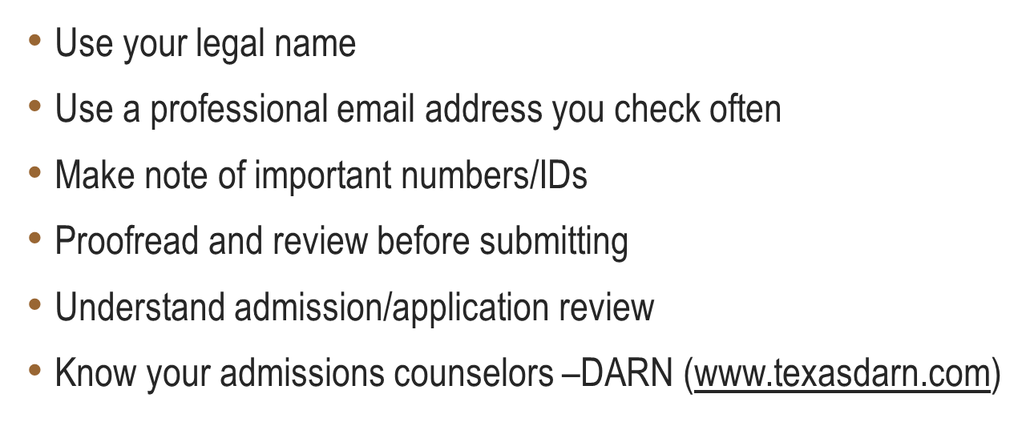
Tips & Best Practices

Slide 11

Thank you!
Sherrill Landorf
Assistant Director of Admissions
Purdue University
slandorf@purdue.edu

Slide 12

Ready to Apply?
Start your journey at Purdue University by completing your application through the Common App.
Notes:
Encourage students to take the next step and apply to Purdue through the Common App. Remind them that the admissions office is available to answer any questions by email, phone, or through the website.

