Slide 1

Notes:
Opening
Placeholder only, use for entry.
Welcome everyone! My name is Aysia Nguyen, I am one of the Dallas-Fort Worth area admissions counselors for The University of Texas at Austin, serving students and families across the DFW through their admission journey to joining the Longhorn family!

Slide 2

Notes:
We are the #1 Public University in the State of Texas and #7 Public University in the U.S. and with state of the art facilities, faculty, and staff, we are dedicated to creating an impact through different areas of study, transforming lives for the benefit of society.

Slide 3

Notes:
Longhorn Academics
Stop and ask engaging questions, ask what they are interested in studying, etc.
With over 170 majors within 15 colleges and schools on campus, you are bound to find a major that is right for you.

Slide 4

Notes:
Here are all of our colleges and schools, some ranking as top programs in the nation including programs within our Cockrell School of Engineering, McCombs School of Business, and Moody College of Communications

Slide 5
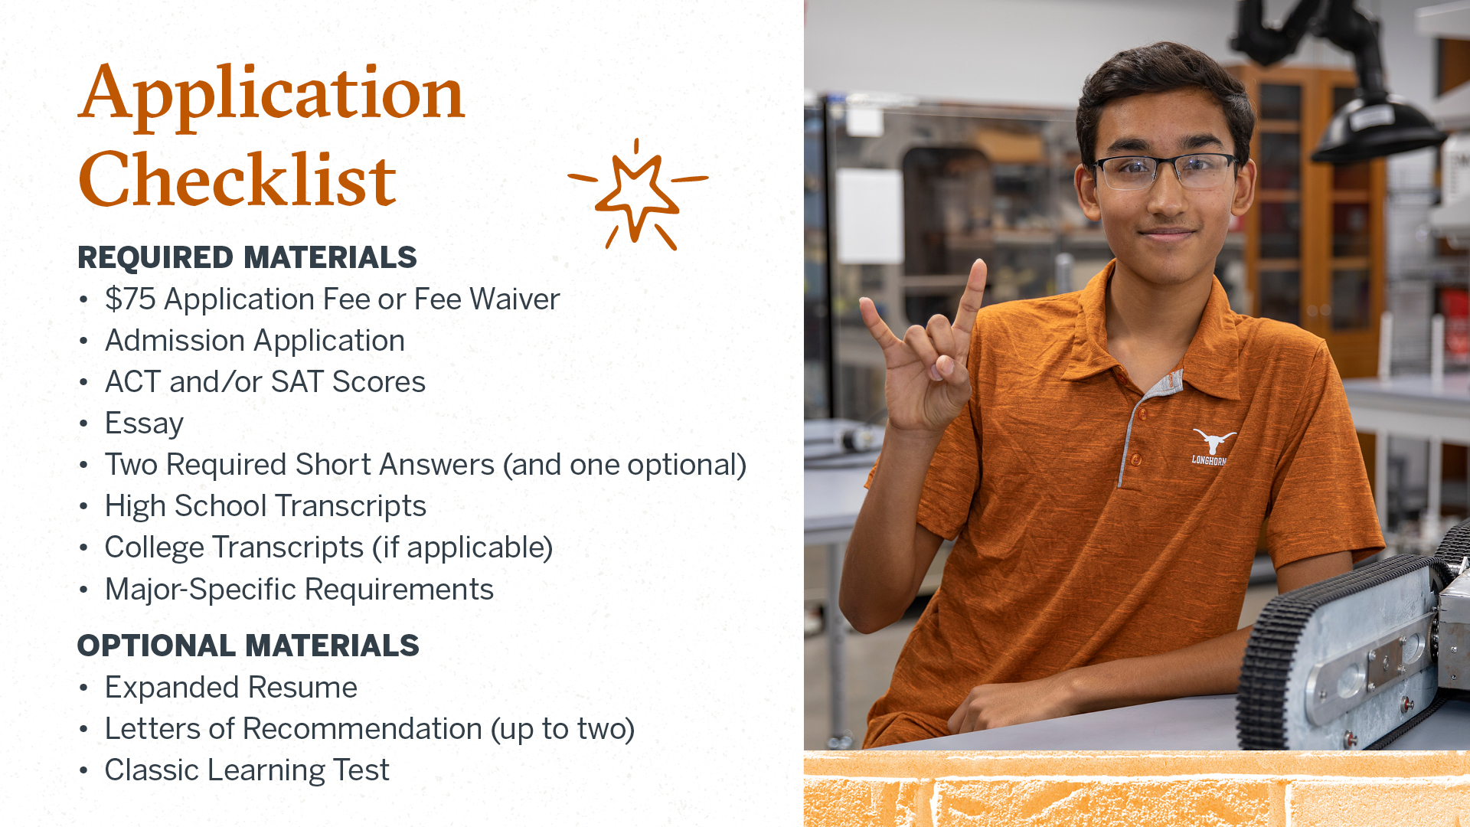
Notes:
Slide - With your online application, you’ll also need to make sure to submit your required materials [three short answers, essay, high school transcript + class rank, college transcript (if applicable), and any major-specific requirements]
The main essay prompt will provide greater flexibility in topic choice and enable students to leverage responses used on other applications, while expanding opportunity for a more personalized response.
Share an essay on any topic of your choice. It can be one you've already written, one that responds to a different prompt, or one of your own design.”
Will maintain the currently used major-related question, while creating a new prompt that allows students to highlight a specific activity of their choice.
Letters of Rec are optional (no more than two). Applicants submitting letters of recommendation will be strongly encouraged to provide those letters from sources outside of their high school.
Also have optional materials—letter of recommendation (up to two) and expanded résumé. Can choose to submit none, both, or one of those materials.
After submitting your application, you’ll be able to access MyStatus, our online admissions portal, where you can check the status of your application, submit materials via Document Upload, and apply for honors/housing

Slide 6

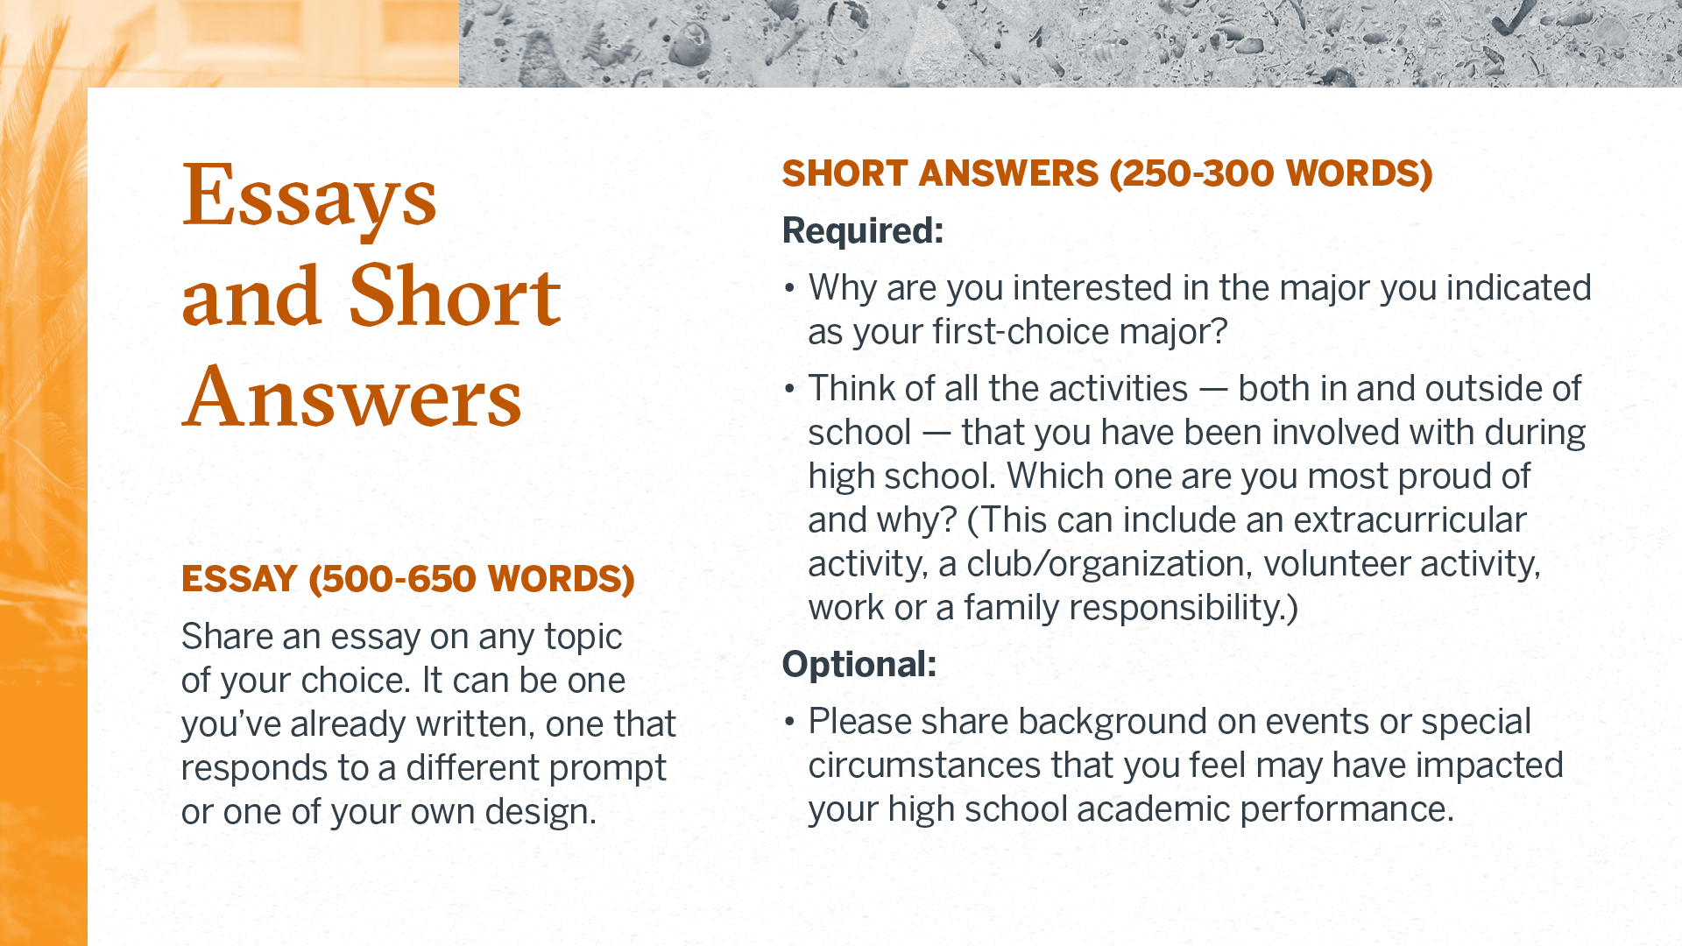
Notes:
Slide – Apply for admission
Can apply using the Common App or ApplyTexas. We don’t have a preference. Submit the app that works best for you.

Slide 7

Holistic Review
Class rank (if applicable)
Strength of academic background
Test scores
Record of achievements, honors, and awards
Special accomplishments, work and service both in and out of school
Essays
Recommendations (although not required)
Competitiveness of the major you applied to
Notes:
Our holistic review process allows applicants to share their individual experiences and show what qualities they can bring to the Longhorn family based on any information they choose to provide in the application. Each student has a different story to tell and each application can be a little different because we recognize that students have had a variety of opportunities throughout their high school career. No specific class rank, test score, or other qualification by itself—other than automatic admission—ensures admission.
Connecting each of your experiences to those you wish to have on campus and in your desired major can provide background into what makes you a competitive applicant but, because holistic review considers so many different factors, there is no right or wrong way to convey your story in this process.

Slide 8
High School Prerequisites
Language Arts – 4 Credits Required
Mathematics – 3 Credits Required, 4 Credits Strongly Recommended
Science – 2 Credits Required, 4 Credits Strongly Recommended
Social Studies – 3 Credits Required, 4 Credits Strongly Recommended
Foreign Language – 2 Credits Required
Physical Education – 1 Credit Recommended
Fine Arts – 1 Credit Recommended
Electives – 6 Credits Recommended
Calculus Readiness

Slide 9

Notes:
Admissions Contact Us
For those located in Texas, we have regional offices in the Dallas, Houston, and McAllen area. These are great resources for learning more about UT and receiving guidance as you apply.

