Slide 1

Cambridge K-12 Pathway and Magnet Program Plan
04/01/2026
Notes:
Instructions – Add the title and date to the first page of your School Board Meeting presentation.
All slide layouts that are approved to use are built within this presentation template. DO NOT use the “Designer” tool when creating your presentation.

Slide 2

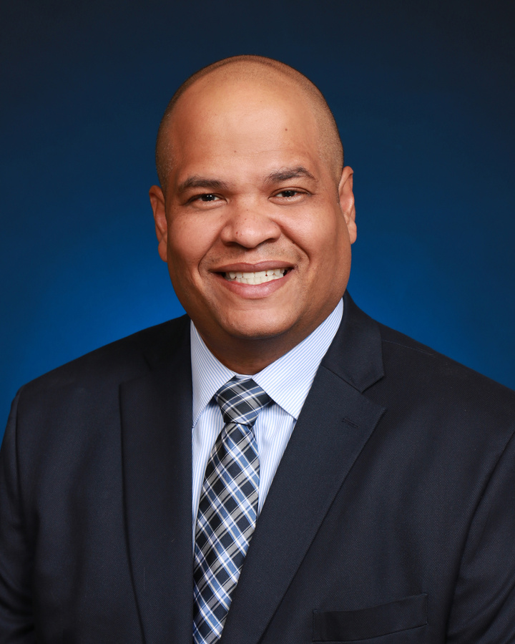
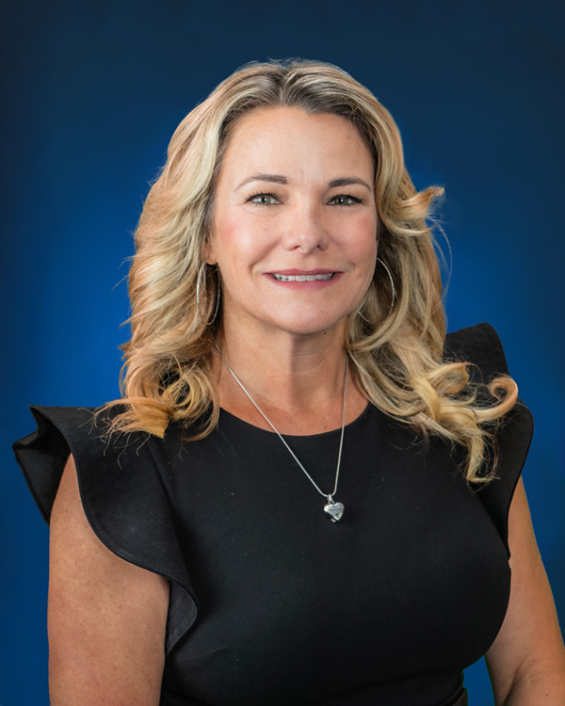
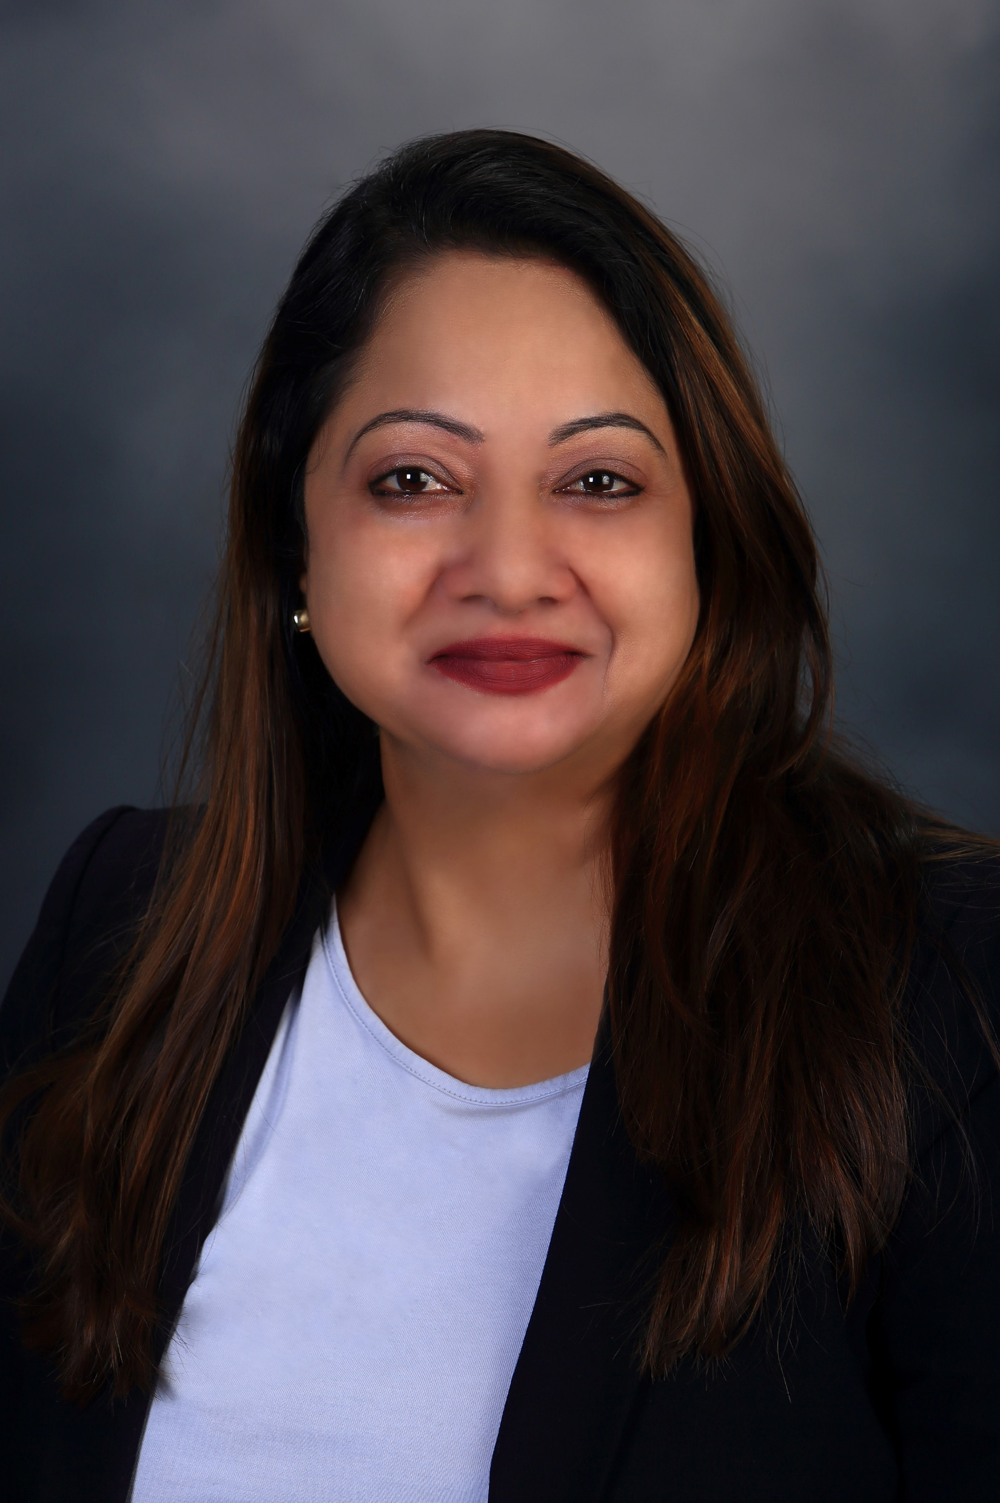
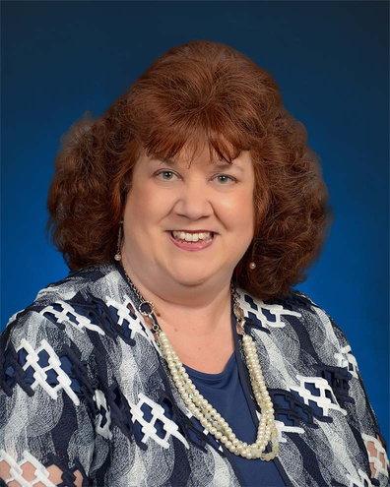
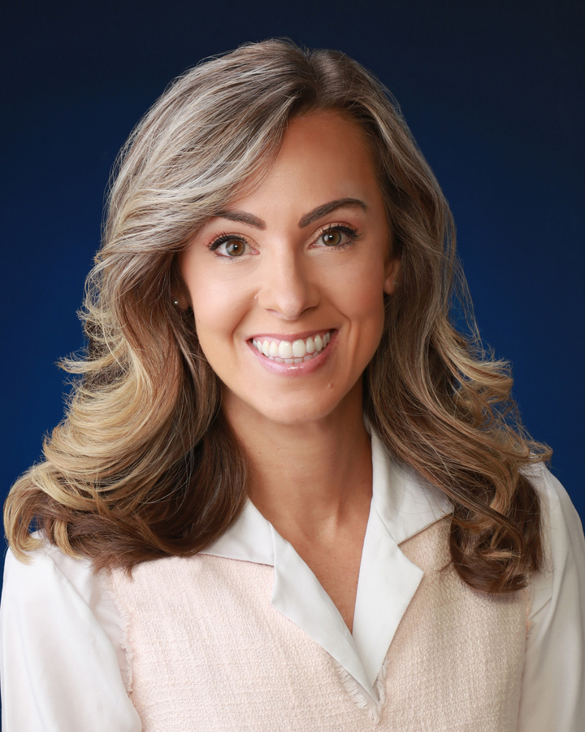
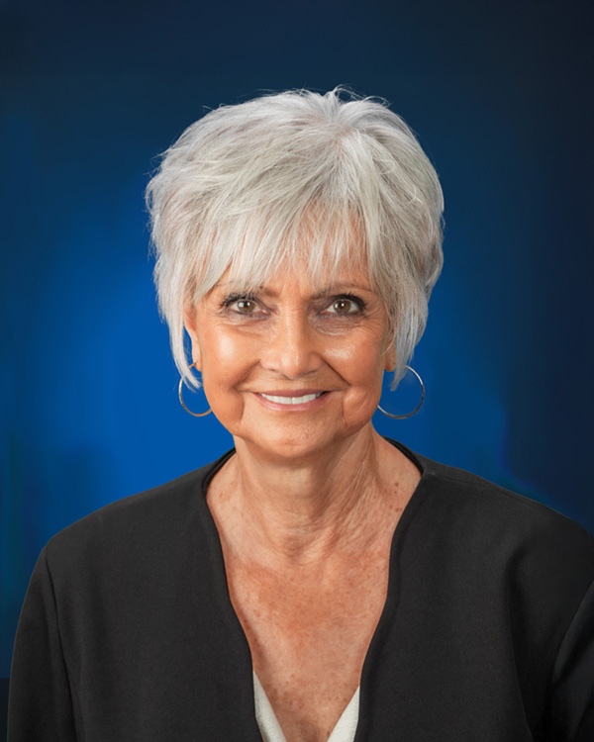
School
Board
Ruben Colón
Krista Goodrich
Board Chair
District 5
Vice Chair
District 2
Jamie Haynes
Jessie Thompson
Donna Brosemer
Dr. Carmen J. Balgobin
Board Member
District 1
Board Member
District 3
Board Member
District 4
Superintendent of Schools

Slide 3
This presentation aligns to the following goals as part of the Volusia County Schools 2024-2027 Strategic Plan:
Goal: All Students will engage in high levels of learning EVERY day.
  Guardrail 1: Recruit, support, develop and retain high-quality staff.
  Guardrail 2: Provide conditions that enhance student learning.
  Guardrail 3: Improve operational efficiency and maximize resources to support student learning.
  Guardrail 4: Ensure high-quality community engagement with all stakeholders.
Notes:
Please highlight the goal(s) your presentation supports in yellow. An updated version of the Strategic Plan slide will be shared once the new Strategic Plan is Board approved.

Slide 4

Cambridge Implementation Plan
2026 – 2029
Development of key skills:
Critical thinking and inquiry-based learning.
Communication and collaboration.
Independent learning habits.
Elementary to High School pathway to AICE, AP, IB programs.
Middle school Global Perspectives course emphasizes cohesive student learning & teaching approach.
Cambridge now allows high school 9th grade AICE exams to count toward AICE Diploma. This supports students earning an AICE Diploma prior to completing high school.

Slide 5

Cambridge Impact
Supports the VCS 3 Pillars: READING, INNOVATION, & CTE
Success Across Advanced Academic Pathways
Helps to increase AP, IB, and AICE Pass Rates
Increase Teacher Retention
Increase Enrollment
Equity and Access

Slide 6
Cambridge Lower Secondary
Journey
Cambridge Lower Secondary Course
Middle schools will offer LOWER SECONDARY GLOBAL PERSPECTIVES to participating sixth and seventh grade students.
Benefits of Middle School Implementation
Research says that the earlier students start to develop and practice their skills, the greater the impact on their learning.
Future Benefits (FSU Study)
Cambridge students at FSU graduate at significantly higher rates than their peers—90% within four years and 98% of grades earned in courses were passing (C or higher)

Slide 7

Cambridge Lower Secondary
Journey
6th grade (Stage 7), 7th grade (Stage 8), and 8th grade (Stage 9)
The rigor and learning process increases at each stage, but the core framework remains and provides cohesion between grade levels.
Making Connections
Making international connections and analyzing consequences.
Problem Solving
Developing multiple solutions to solve issues.
Evaluation
Evaluating source material and evaluating arguments
Reflection
Personal Contribution: to teamwork and areas for improvement.
Research
Determine relevant information related to research questions.
Analysis
Identifying various perspectives and their validity.
Collaboration
Cooperation and Engaging in Teamwork
Communication
Presenting information and arguments.

Slide 8
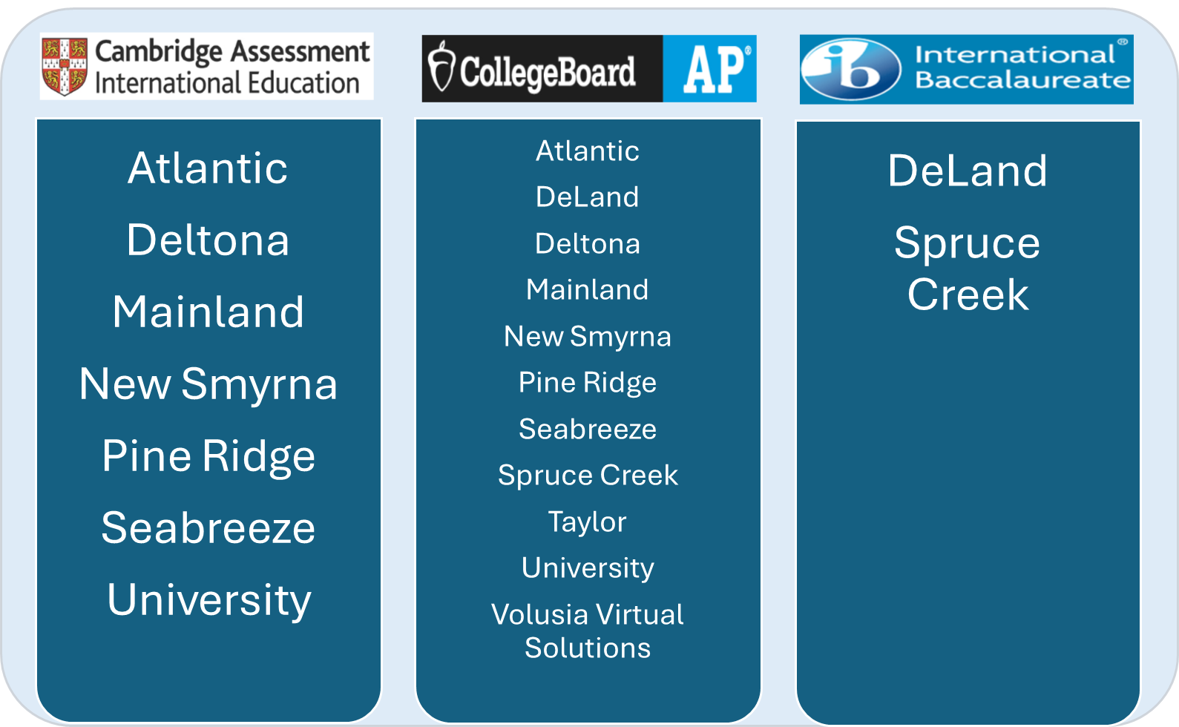
Current Advanced Programs

Slide 9
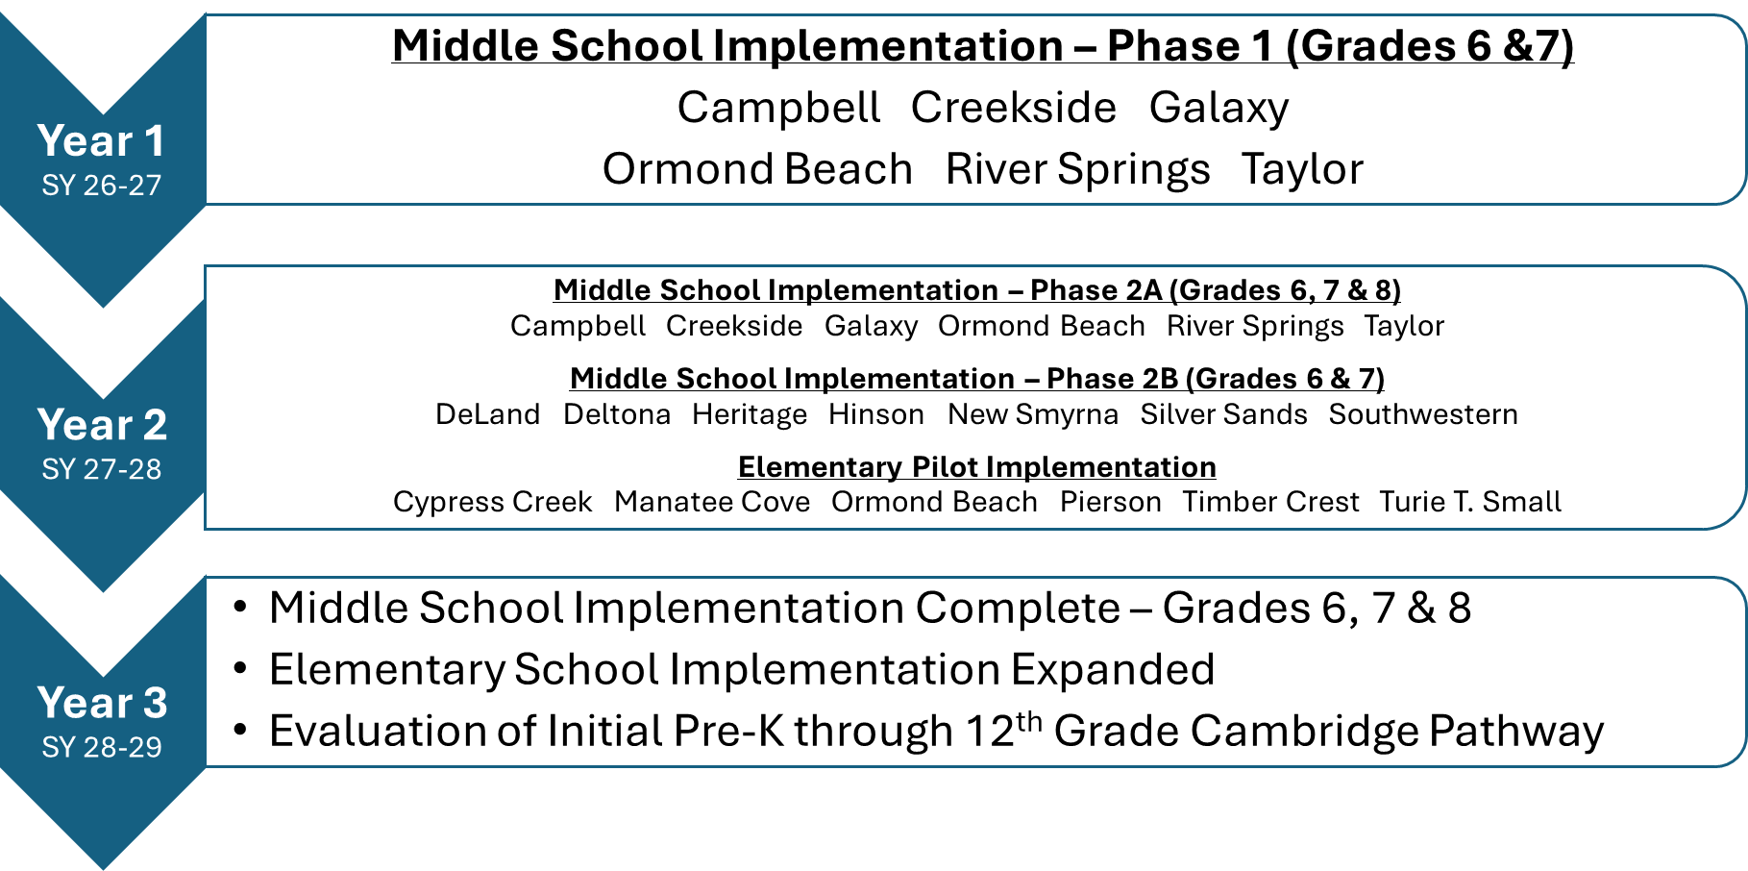

Overview: 3-Year Implementation Sequence

Slide 10
2026-2027 Year 1 (6 MS & 1 HS)
6th & 7th grade
Middle School | District / Board Member
Campbell Middle School | District 2 / Goodrich
Creekside Middle School | District 3 / Thompson
Galaxy Middle School | District 5 / Colón
Ormond Beach Middle School | District 4 / Brosemer
River Springs Middle School | District 1 / Haynes
T. Dewitt Taylor Middle-High School | District 1 / Haynes

Slide 11
2027-2028 Year 2 (6 ES & 7 MS)
Elementary Schools | Middle Schools
Turie T. Small Elementary (Year 2) ?? | Campbell Middle (Year 1)
Cypress Creek Elementary (Year 2) ?? | Creekside Middle (Year 1)
Timbercrest Elementary (Year 2) ?? | Galaxy Middle (Year 1)
Ormond Beach Elementary (Year 2) ?? | Ormond Beach Middle (Year 1)
Manatee Cove Elementary (Year 2) ?? | River Springs Middle (Year 1)
Pierson Elementary (Year 2) ?? | T. Dewitt Taylor Middle-High (Year 1)
 | DeLand Middle (Year 2)
 | Deltona Middle (Year 2)
 | Heritage Middle (Year 2)
 | Hinson Middle (Year 2)
 | New Smyrna Beach Middle (Year 2)
 | Silver Sands Middle (Year 2)
 | Southwestern Middle (Year 2)
KEY
Blue – Previous Year Schools
Black – New Schools

Slide 12
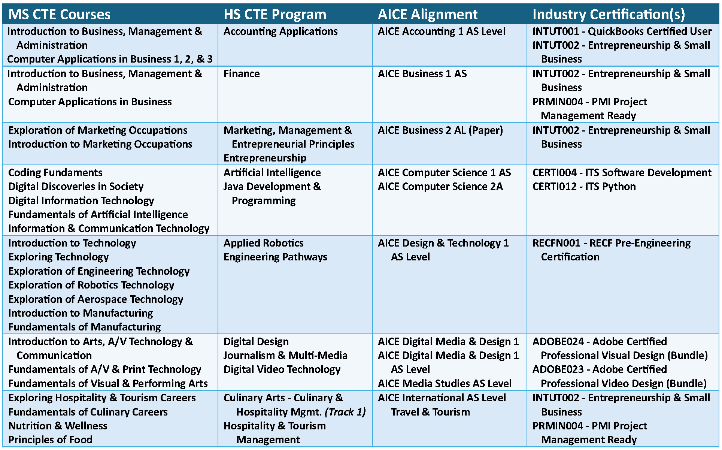
Career & Technical Education
Career Pathway to AICE Alignment

Slide 13
Magnet Program Impact
What Magnet Programs Do
Spark student interest and motivation
Connect learning to real-world skills
Promote creativity, critical thinking, and problem solving
Build school pride and family choice
Expand access to innovative learning opportunities
Supports Our Three Pillars:
  Reading – Literacy embedded across all themes
  Innovation – Hands-on, modern, student-centered learning
  Career Technology Education – Early exposure to career pathways and workforce skills
Impact: Meaningful learning. Stronger engagement. Positive student outcomes.

Slide 14
Edith I. Starke Elementary:
STEM + Arts Magnet
Key Highlights
  This magnet is going on its 2nd year
  3rd Grade will be added on next year
  A STEM Special Area Teacher will be added to the schedule, enhancing STEM instruction
Career & Technical Education: Career Pathway to AICE Alignment
Elementary Magnet Programs | MS Courses | CTE Program | AICE Alignment | Industry Certification(s)
Edith I. Starke STEM + Arts Magnet Program | Introduction to Technology Exploring Technology Exploration of Engineering Technology | Applied Robotics Engineering Pathways | AICE Design & Technology 1 AS Level | RECFN001 - RECF Pre-Engineering Certification

Slide 15

Tomoka Elementary:
Gifted Academy Magnet
Key Highlights
  This academy will serve over 100 students in K-5th grade
  Enhanced curriculum will be provided too all gifted and high achievers
Career & Technical Education: Career Pathway to AICE Alignment
Elementary Magnet Programs | MS Courses | CTE Program | AICE Alignment | Industry Certification(s)
Gifted Academy Magnet Program

Slide 16
Volusia Pines Elementary:
Technology and Innovation Magnet
Key Highlights
  This magnet will provide relevant digital literacy and technology enhanced instruction for K-5!
Career & Technical Education: Career Pathway to AICE Alignment
Elementary Magnet Programs | MS Courses | CTE Program | AICE Alignment | Industry Certification(s)
Technology and Innovation | Coding Fundaments Digital Discoveries in Society Fundamentals of Artificial Intelligence Information & Communication Tech. | Artificial Intelligence Java Development & Programming | AICE Computer Science 1 AS AICE Computer Science 2A | CERTI004 - ITS Software Development CERTI012 - ITS Python

Slide 17

Turie T. Small Elementary:
Visual and Performing Arts Magnet
Key Highlights
  This new magnet program will be the first on the East side of the county, providing opportunities for students to be on stage and show off their talent!
Career & Technical Education: Career Pathway to AICE Alignment
Elementary Magnet Programs | MS Courses | CTE Program | AICE Alignment | Industry Certification(s)
Visual & Performing Arts | Exploring 2D/3D Art, 2D/3D Studio Art 1-3 Creative Photography Digital Art and Design 1-3 Dance 1-4 Theatre 1-4. Acting 1-2 Introduction the Technical Theatre Theatre Design and Production | Fundamentals of Visual & Performing Arts Digital Media/Multi-Media Foundations

Slide 18
Edgewater / George Marks / Osteen:
Agriculture Magnets
Key Highlights
  George Marks and Edgewater already have Agriculture as Special Area
  Adding Osteen will bring more of that knowledge to the Deltona area!
  All 3 schools have a fantastic pattern for FFA!
Career & Technical Education: Career Pathway to AICE Alignment
Elementary Magnet Programs | MS Courses | CTE Program | AICE Alignment | Industry Certification(s)
Agriculture Magnet Program | Exploration of Agriscience Introduction to Agriscience Orientation to Agriscience | Animal Science & Services Agri-technology Veterinary Assisting | N/A (there are no AG AICE courses at this time) | Agriculture Associate Agri-technology Specialist AEST Animal Science

Slide 19
Discovery / Freedom / George Marks / Holly Hill / Pierson / Spirit Elementaries:
Dual Language Magnets
Key Highlights
Career & Technical Education: Career Pathway to AICE Alignment
Students Served | Discovery | Freedom | George Marks | Holly Hill | Pierson | Spirit
‘25-’26 | VPK – 1st | K – 2nd | K / 1st | VPK – 2nd | VPK / K | VPK – 3rd
‘26-’27 | VPK - 2nd | K – 3rd | K – 2nd | VPK – 3rd | VPK – 1st | VPK – 4th
Elementary Magnet Programs | MS Courses | CTE Program | AICE Alignment | Industry Certification(s)
Dual Language | ASL Beginning/Intermediate German/Spanish Beginning/Intermediate Spanish 1,2, Advanced Spanish for Spanish Speakers: Beg/Int/Adv, 1-2 | Introduction To Arts, A/V Technology & Communication – Exploratory Fundamentals of A/V & Print Technology - Exploratory

Slide 20
Contact Information
Dr. Tamara Baker-Drayton – Executive Director of Secondary Schools
Phone Number: ext. 20228
Email Address: tlbakerd@volusia.k12.fl.us
Robert Milholland, Coordinator – Social Studies & Advanced Programs
Phone Number: ext. 20315
Email Address: rpmilhol@volusia.k12.fl.us
Bill Lastowski, Resource Teacher – Advanced Programs
Phone Number: ext. 76470
Email Address: wmlastow@volusia.k12.fl.us

Slide 21
Contact Information
Kristy Castellanos – Executive Director of Elementary Schools
Phone Number: ext. 20217
Email Address: kjcastel@volusia.k12.fl.us
Anna Barsanti-Ventura – Magnet Programs Specialist
Phone Number: ext. 20622
Email Address: ambarsa1@volusia.k12.fl.us
Kristin Pierce, Coordinator – CTE
Phone Number: ext. 20642
Email Address: kbpierce@volusia.k12.fl.us

