Slide 1









READY,SET,
KINDERGARTEN!
Welcome Panthers!
Welcome to Your Readiness Guide

Slide 2

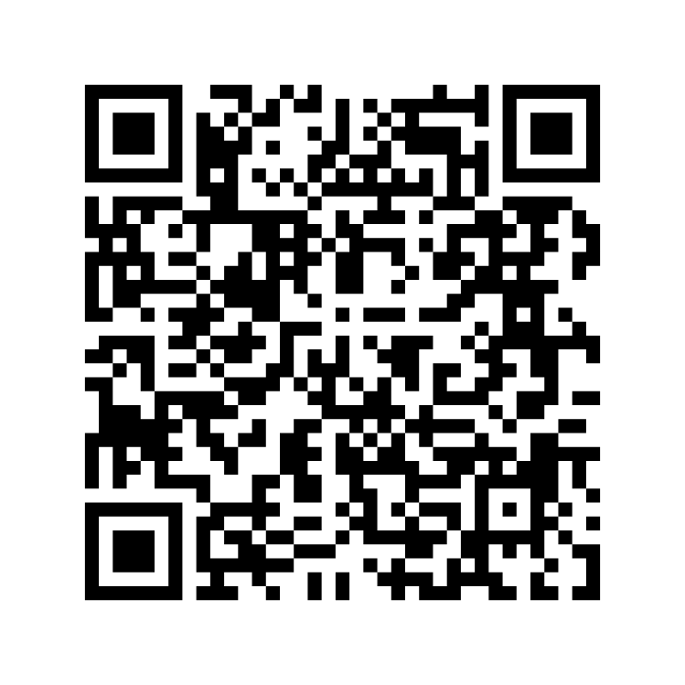

SIGN UP
Kindergarten Ready, Set, Go
Welcome
Kindergarten Screening Sign Up
If you haven’t done it yet, please sign up for the kindergarten screening by scanning the QR code on the screen or in the pamphlet. It’s a great chance for your child to meet some of our team members one-on-one, and it helps us create class lists with care.

Slide 3



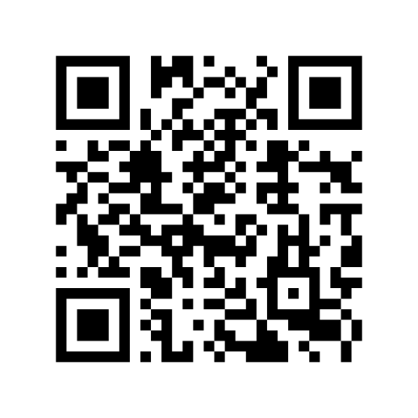
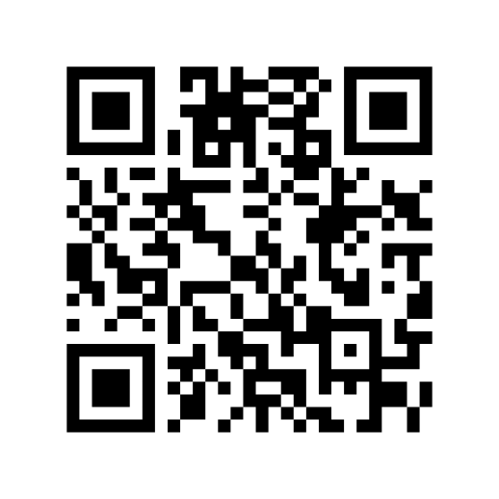
While Your Phone is Out...
Scan the QR codes for direct links to our website and be sure to bookmark them for future reference! Also available on pamphlet.
Pasadena Fundamental
Facebook PTA
Pasadena Website

Slide 4
KINDERGARTEN READY, SET, GO
What is Kindergarten Readiness?
Helpful Links On Ready Set Kindergarten
Check Out Our Ready, Set, Kindergarten Link for Helpful Mini-Assessments and Guides for Getting Ready For Kinder Independence.
Using the QR Code
  Scan the QR code for the Pasadena Fundamental website.
  Scroll down to find the “Ready, Set, Kindergarten”image.
  Click on “more...”.
  Remember that all links are located at the very bottom, and you will need to download some of them.
or Browser:
  Open any internet browser and search for “Pasadena Fundamental Elementary School”.
  Click on the link featuring the PCSB icon.
  Scroll down to the “Ready, Set, Kindergarten” image and select “Discover more”

Slide 5


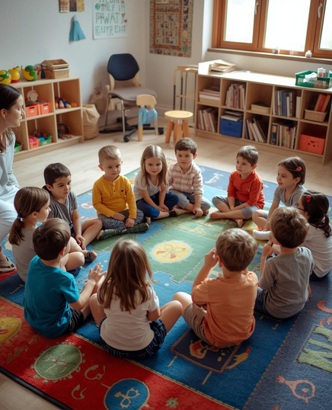
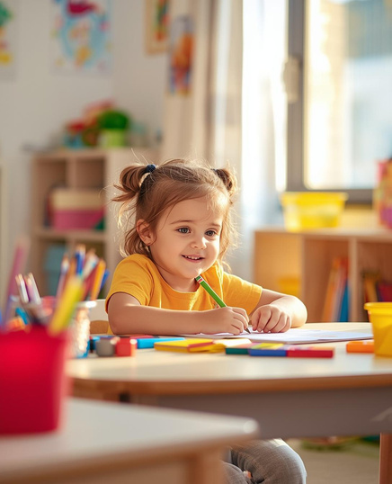
KINDERGARTEN READY, SET, GO
What is Kindergarten Readiness?
Understanding Readiness
Kindergarten marks an important milestone in your students' lives and represents a major transition for families. To ensure your student is set up for success this August, preparing for success starts now.
Early Math
Social
Emotional
Early Literacy

Slide 6



KINDERGARTEN READY, SET, GO
Readiness Checklist:
Social Skills
Early Math and Literacy
Independence
  I am capable of sharing with others.
  I understand how to win and lose games gracefully.
  I can patiently wait for my turn with a variety of activities.
  I am able to follow multi-step instructions.
  I know how to identify and write the letters in my name.
  I know and can write some letter names and sounds.
  I can count and write to 10.
  I know some shapes (circle, square, rectangle, triangle)
  I know my colors.
  I can get dressed on my own.
  I can put on my shoes,coat,and backpack
  I can use the bathroom independently with good hygiene practices everytime.
  I can zip and pack my backpack.
  I can open my snacks and refill my water bottle.

Slide 7

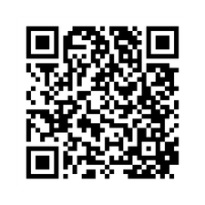
KINDERGARTEN READY, SET, GO
Early Literacy with UFLI
We implement the UFLI curriculum in our early literacy program, and it’s remarkable what this program can achieve in just a few months! As an added benefit, they provide a Parent Resource Hub on their website, which can assist you in helping your child learn to read, write, and flourish quickly. Please don’t hesitate to access these resources over the summer if you believe your child could use some additional support.
https://ufli.education.ufl.edu

Slide 8









STANDARDS
Math
Alphabet
Writing
  Student knows the name,sound, and letter formation of all uppercase and lowercase letters.
  Count to 100
  Count and match numbers to different amounts.
  Count by 10's
  Count backwards from 20
  Understand one more, one less, two more two less....etc..
  Perform addition and subtraction within 20.
  Solve simple addition and subtraction word problems.
  Identify and describe 2D and 3D shapes.
  Understand and apply non-standard units of measurement
  Student can write a simple story with a capital letter,finger spaces, and punctuation.
  Can spell kindergarten sight words.
Motor Skills
Reading
Students can:
  Properly hold and use all writing instruments.
  Cut and glue with independence and precision.
  Student can read a level D text. or higher. AKA a small book with words they can sound out and words they can only know from mastering
phonic rules.

Slide 9





KINDERGARTEN READY, SET, GO
Sample Kindergarten Schedule
Morning Meeting: 8:30-8:50
Phonics and Literacy Centers: 8:50-9:50
Recess and Lunch: 10:00-11:00
Reading,Writing and Intervention: 11:00-12:00
Science:12:00-12:30
Math: 12:30-12:55
Specials: 12:55-1:45
Snack:1:45-2:00
Math:2:00-2:30
Time to Go Home!
20 Minutes
30 Minutes
Specials
3 Days a Week
1 Day a Week
1 Day a Week

Slide 10






TIPS FOR PARENTS
Routines
Read Daily
Encourage Play
Establish consistent morning and bedtime routines now to help your child feel secure and prepared for the school days ahead.
Spend time reading together every day. This builds vocabulary, listening skills, and a love of learning.
Support imaginative and active play. Exploration through play develops problem-solving and social skills.
Communicate
Be Positive
Be sure to regularly check the school's website to stay informed about any updates or significant events on the horizon.
Talk positively about school. Build excitement and confidence by celebrating small achievements and new experiences.

Slide 11
KINDERGARTEN READY, SET, GO
Explore Options for Before and After School Care
There are numerous excellent options available! Our students currently benefit from:
  R-Club, which provides before and after school care on campus.
  American Mixed Martial Arts
  Pasadena Community Church, offering after school care only along with pick-up services.
However, there are plenty more options to explore! Begin devising a plan now to secure your spot if you know it will be needed!

Slide 12

Q&A
Please remember that all registration paperwork must be finalized by April 27th with the office, and all other requirements need to be completed by April 30th. If you have any questions regarding registration, please call the number and extension listed on the pamphlet.

