Slide 1







JHS Post High School Planning Presentation

Slide 2


What this presentation will cover
How to view your graduation requirements and what do they mean?
Options for post high school (it's ok to not know)​
✓ What are my options​?
✓ Where to find resources for these options?
Things to have on your radar for 2 and 4 year college
Post High School Planning ​
&
Contact information
Senior Year Timeline​ * FAFSA/Financial Aid​
SAT/ACT​ * Scholarships

Slide 3


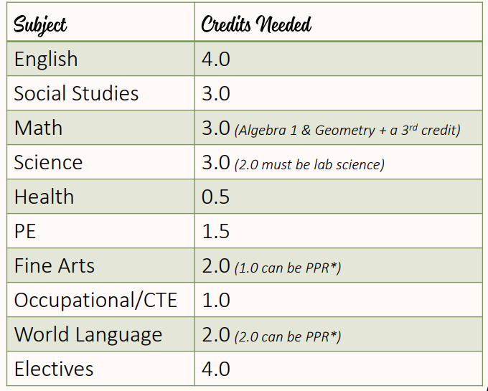
Graduation Requirement Review
Important Notes:
  You want to be entering your senior year with a minimum of 17 credits.​
    If you enter senior year with 17 credits, you will need to pass all 7 classes next year to reach your 24 credits​.
  If you are not entering into your senior year with 17 credits options such as summer school will be available to you (more information to come)​.
  If you have questions or are concerned about your graduation status, please contact your counselor via email​.
  Follow the link to the right for detailed instructions on how to view your graduation requirements!
CLICK HERE:
GRADUATION REQUIREMENTS ON SKYWARD ​
English Class | Laredo York Primary School

Slide 4


Additional Graduation Requirements
In addition to earning 24 credits in the specific areas of study, students need to make sure these 3 things are completed before they can graduate:
  High School and Beyond Plan
  Washington State History
  Graduation Pathway

Slide 5


High School and Beyond & Wa St History
High School and Beyond
Washington State History
✓ You have already been working in this through out high school.
✓ There is a Senior Year portion that will be completed next year
✓ Helps students find what they are interested in for future plans
✓ Helps students build resumes
✓ This should have been completed in middle school.
✓ If you have not completed this talk with your counselor about alternative ways to complete this.
✓ If you enrolled with JHS your Junior year, this requirement might be able to be waived.

Slide 6
Graduation Pathway
Graduation Pathway Options
SBA AND OTHER TESTS
Dual Credit
CTE PATHWAY
✓ Student may meet this graduation pathway option by completing a sequence of CTE courses, which align with the student’s High School and Beyond Plan. Satisfying this graduation pathway option meets requirements in both English and math.
✓ A course that is used as part of a CTE sequence may also be used to meet subject area graduation requirements in CTE or in other subject areas through CTE course equivalencies.
To meet this pathway students must complete a 2-credit sequence of courses
See next slide for more details
✓ State Assessment: Meet or exceed the graduation scores in the Smarter Balanced Assessments (SBA) in English language arts (ELA) and mathematics or in WA-AIM (Washington Access to Instruction & Measurement).
✓ AP/Cambridge: For both ELA and math, earn a 3 or higher on certain Advanced Placement (AP) or an E on certain Cambridge International exams, or pass the course with at least a C+.
✓ SAT/ACT: Meet or exceed the graduation scores set by SBE in the math and ELA portions of the SAT or ACT.
✓ Armed Services Vocational Aptitude Battery (ASVAB): Meet standard on the ASVAB by scoring at least the minimum established by the military for eligibility to serve in a branch of the armed services.*
✓ Students must earn at least one high school credit in English and one high school credit in math to meet this graduation pathway option. Dual credit courses that qualify for this pathway are courses that meet core high school graduation credit in English and math, and that allow students to earn college credit at the 100-level or higher (the college course number must be 100 or higher). Dual credit programs include:
✓ College in the High School
✓ Running Start
  ✓ Career and Technical Education (CTE) Dual Credit
Or
Or
English Class | Laredo York Primary School

Slide 7
How To Fulfill the CTE Pathway Option
Student's must earn 2.0 credits in the same course of study defined below:
Business and Marketing
Skilled Art
Business & Marketing Foundations (1)
Microsoft Office Specialist I (.5) Personal Finance (.5)
Retail Operations (1)
Business & Marketing Management (1)
AP Computer Science Principals (1)
AP Computer Science A (1) Leadership Development (1) Leadership Project Management(1)
AP Statistics (1)
Photography 1A (.5)
Photography 1B (.5)
Photography 2A (.5)
Photography 2B (.5)
Digital Design I (.5)
Technical Theater (1)
Yearbook I (1)
WANIC
Classes from WANIC also can count towards completing your CTE Pathway
STEM
Human Services
​
Architecture & Engineering I (1) ·
Architecture & Engineering II (1)
Engineering & Computer Science (.5)
Material Science I (1)
Material Science II (1)
ASL I (1)
ASL II (1)
Child Development I (.5)
Psychology (.5)
AP Psychology (1)
Teacher Academy (1)
Food Science (.5) Culinary Arts I (.5) Culinary Arts II (.5)
English Class | Laredo York Primary School

Slide 8



If you don't have a plan, that is okay!!
Not sure what you want to do after high school? Try these steps:
✓ Go through this resource
✓ Make an appointment with
the College and Career Center
✓ Fill out the FAFSA (explained later in this resource) no matter what!!
We're Here to Help!
  Unsure of what you want to do after high school? THAT IS TOTALLY FINE!!​
  Want to go to college but worried about cost? Don't write it off, there are different ways to pay for school​
If you feel there are any barriers to reaching your goals (college, work, gap year etc.) or are confused about the process please contact the CCC or your counselor​
English Class | Laredo York Primary School

Slide 9



Options After High School
Military Service
GAP YEAR
APPRENTICESHIPS
✓ Different services have different standards and characteristics based on the function they serve within the Department of Defense.
✓ Making the decision to explore and potentially choose how you serve and with which branch is a very big but rewarding responsibility.
  Click here: Military Guide
✓ Typically a year-long break before or after college/university.
✓ In this year students should engage in various educational and developmental activities, such as community service or some type of regular work.
Click here: Info about Gap Years
✓ Imagine getting paid to learn a trade skill that will be financially and professionally rewarding
✓ Gives you the chance to earn money immediately in the workplace.​
  Click here: Career Oppurtunities
English Class | Laredo York Primary School

Slide 10

More Options for After High School
Two Year and Technical Colleges
Four Year University
✓ A 4-year college program is an undergraduate degree program that leads to a bachelor's degree in a specific area of study.
✓ Students pursue a bachelor's degree to prepare for a profession, graduate study or both.
Click here: College Planning 101
✓ Attend a smaller school
✓ Stay local
✓ Save money & transfer
✓ Need a 2-year degree for your career
We have incredible 2-year schools in our area!
Click here: Wa St Community and Tech Colleges

Slide 11



Still not sure school is right for you???
  The High School and Beyond Plan or Xello is a great tool for exploring colleges. ​
    Click here: Access to Xello​
  Questions about Xello? Contact Mrs. Hasslinger via email at Ahasslinger@lwsd.org
  Another great tool is a personalized college search ​
    Click here: Personalized College Search
English Class | Laredo York Primary School

Slide 12

Important items for students interested in 2 or 4 year college​
Senior Timeline
FAFSA/Financial Aid
Scholarships
✓ Check out the link below to for a monthly checklist for your Senior Year and even the Summer before your Senior year!
Click here: Senior Year Timeline
✓ Everybody should apply for Financial Aid (FAFSA) on December 1st
✓ Completing college applications and filling out the FAFSA (Free Application for Federal Student Aid) go hand-in-hand!
✓ Financial aid is funding to help you pay for college: scholarships, grants, loans and work-study! Some of these options do not need to be paid back!
Click here: How to fill out the FAFSA
There are thousands of dollars in scholarships awarded to students every year.
✓ Create an account with the WashBoard to start the search
✓ Visit the College and Career Center
Click here: WashBoard Scholarship Search
English Class | Laredo York Primary School

Slide 13
Letters of Rec and Transcripts
Transcript Info:
✓ Applying to college through CommonApp - transcripts will be automatically uploaded
✓ Unofficial transcripts can be download yourself from Skyward
✓ All other requests for transcripts must be submitted via the Transcript Request Form on our website
Not all Universities require Letters of Recommendation!!
Did you know:
✓ Letters do not have to come from your counselor!
✓ Ask someone who really knows you and can speak to your academic performance in the classroom.
For example: If you want to pursue a degree in a science field the best person to ask might be your science teacher.
English Class | Laredo York Primary School

Slide 14



Post High School Planning Info
CLICK ON THE LINKS
BELOW
Apprenticeship
Military
Apprenticeship Page
Grad Pathways
Financial Aid
Full JHS Junior Handbook
Military Page
Grad Pathways
Financial Aid
Full JHS Junior Handbook
Gap Year
Grad Pathways
Financial Aid
Full JHS Junior Handbook
Two Year/Technical College
Four Year University
Grad Pathways
Senior Year Timeline
Financial Aid
Scholarships
SAT vs ACT
Test Prep
Full JHS Junior Handbook
Grad Pathways
Senior Year Timeline
Financial Aid
Scholarships
Full JHS Junior Handbook
English Class | Laredo York Primary School

Slide 15
Who to contact for what.....
Transcript Request:
Help with the College Search, Applications, Filling out the FAFSA, finding out about Scholarships and other Post High School options:
To talk about if you are making the right after high school decision for you:
Under the Academics Tab of the Main JHS Website
Please also note 2 important things for CommonApp:
  The Counselor Recommendation is different from a Letter of Rec
  Mid Year Reports/Grades will be uploaded to your CommonApp Profile once S1 grades are finalized
Students please make an appointment with your counselor using the QR codes posted around the school.
✓ Please contact the CCC
✓ Financial aid is funding to help you pay for college: scholarships, grants, loans and work-study!
English Class | Laredo York Primary School

