Slide 1
BUSD
Child Nutrition Services (CNS) Update
Presented by: Stacy Spector
Chief Administrative Officer
March 10, 2026

Slide 2
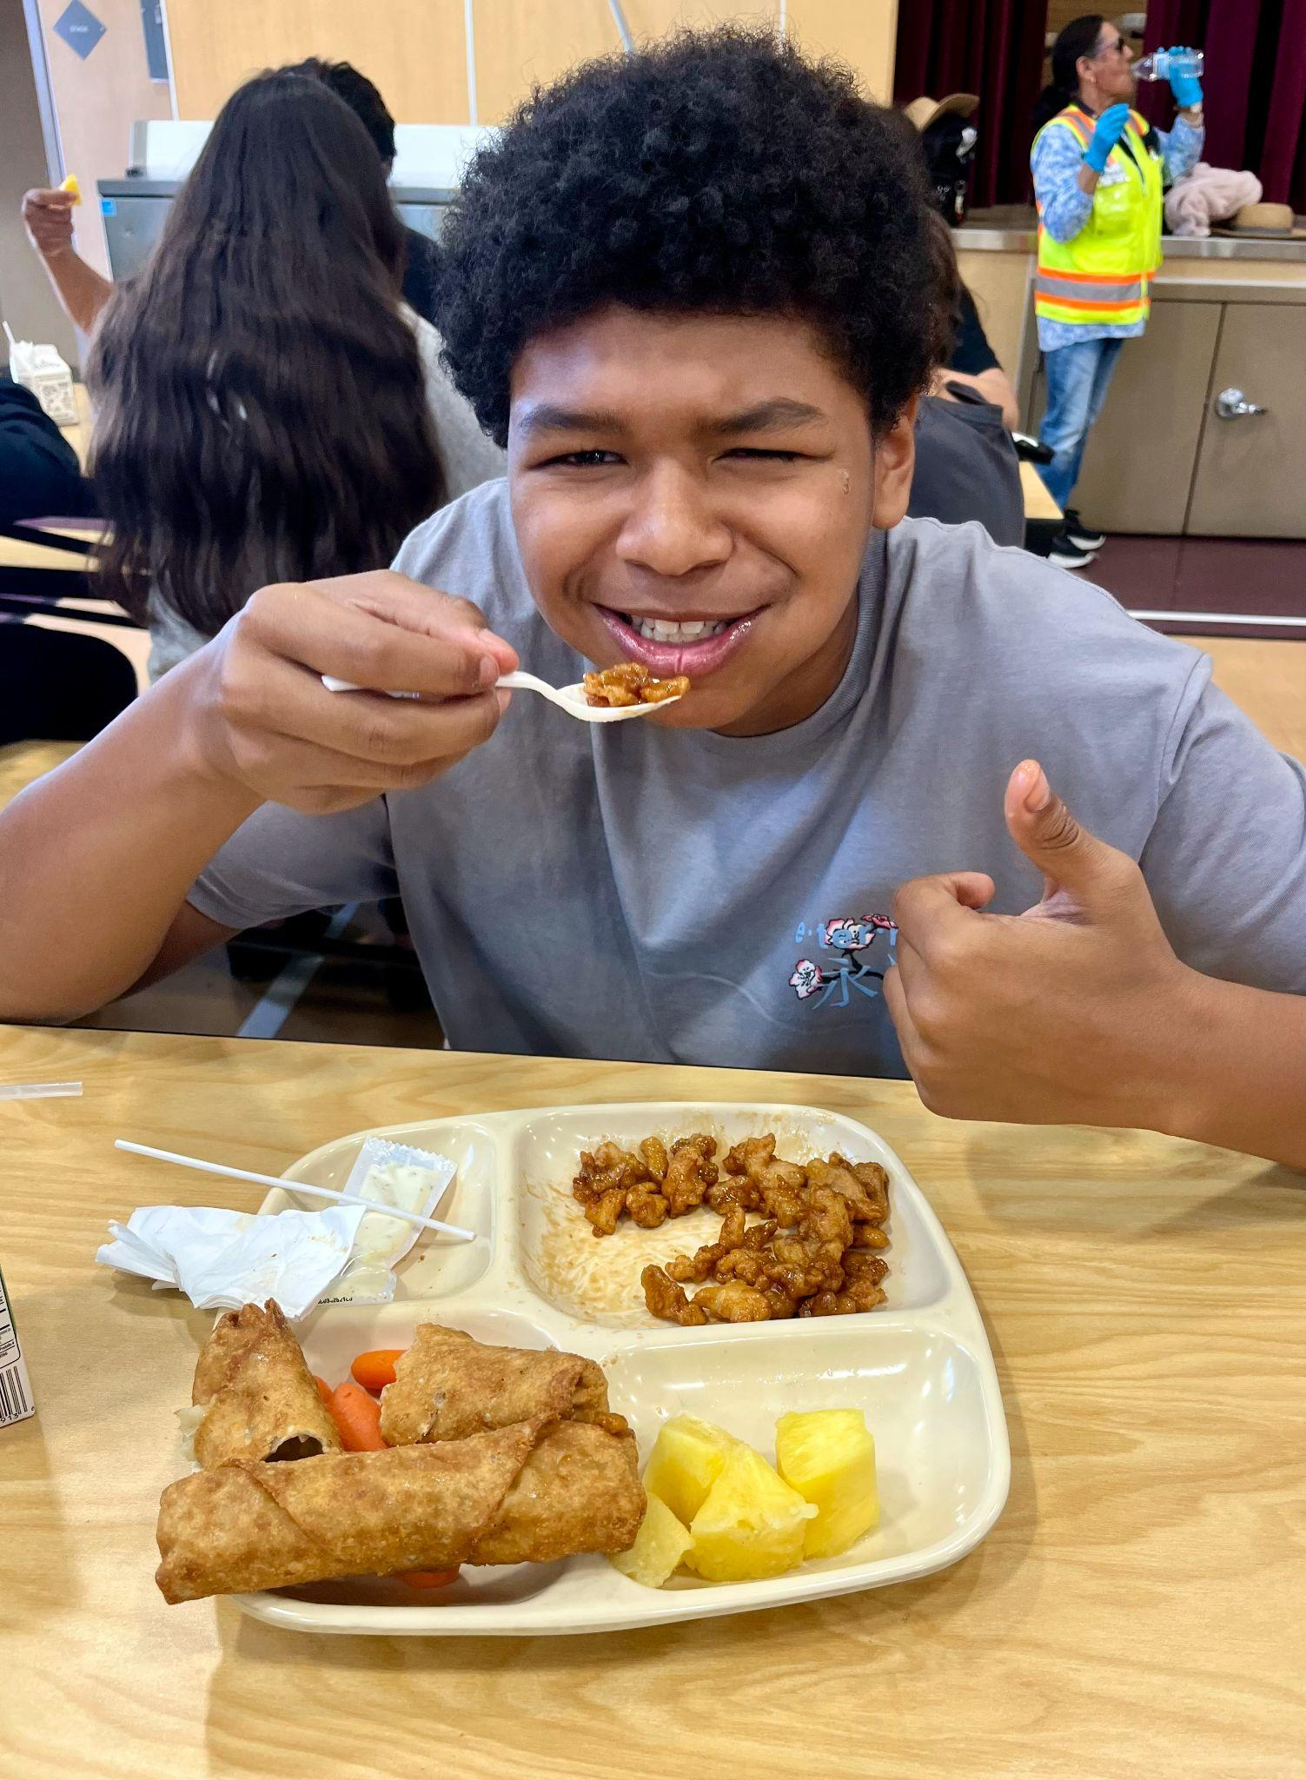
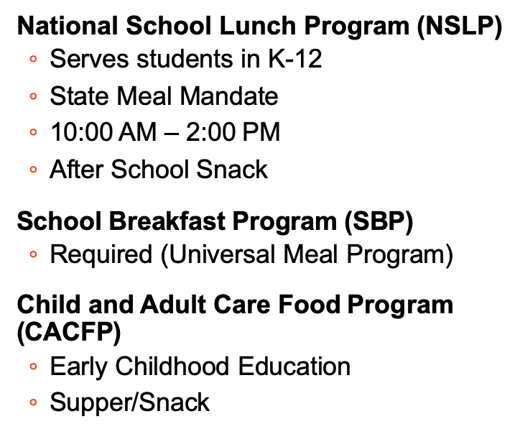
CNS Meal Programs

Slide 3
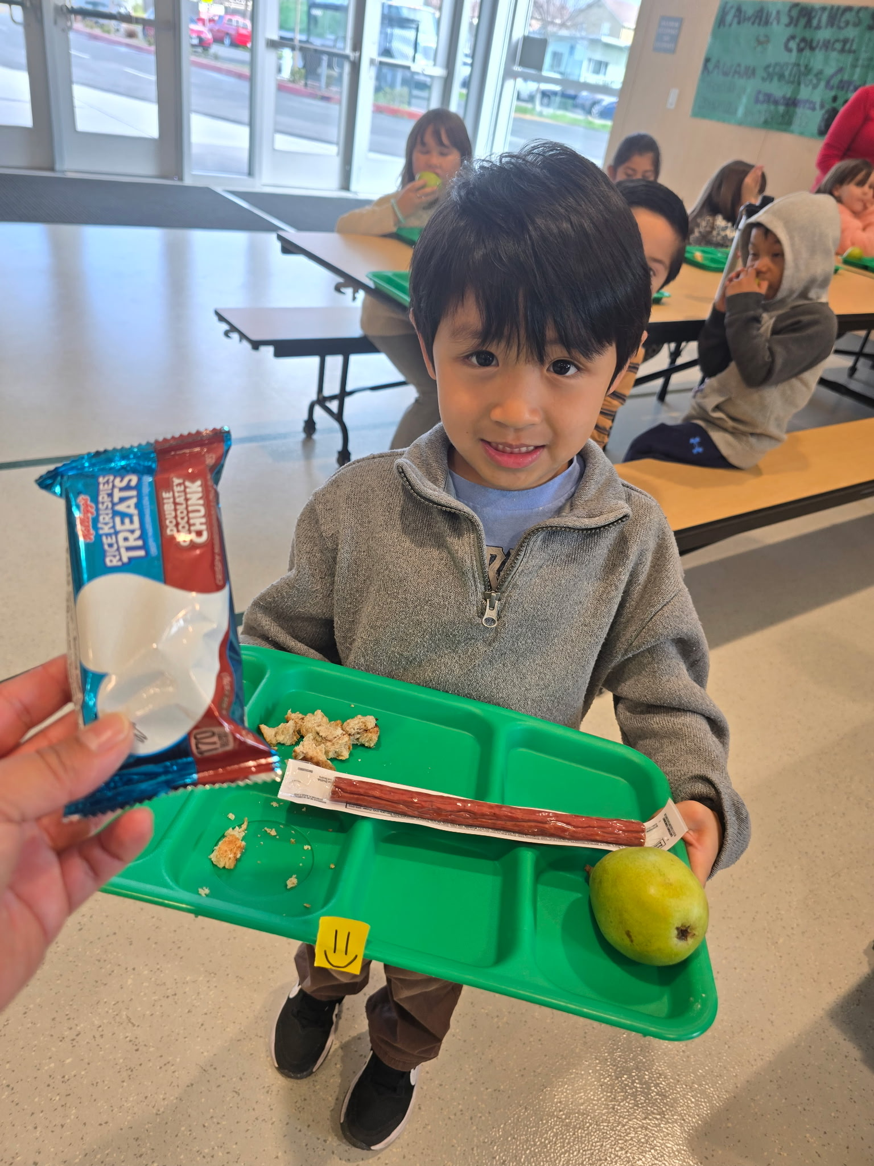
Program Highlights
Dedicated, Collaborative, Problem Solving staff at all 4 schools
Increased Professional Development & Training
Expanded Sonoma Food Runners Donation Program (1100+ pounds)
Modified Share Table Use for “snack”
41,511 Meals served (including field trips)
$1,002,260.09 reimbursed (August-December)
3 % Increase from 79%-81% in Alternative Income Forms Entered
New ovens & Dishwashers at BELL, MEAD, TMNT
Creative Meal Research & Development (April Fools)

Slide 4
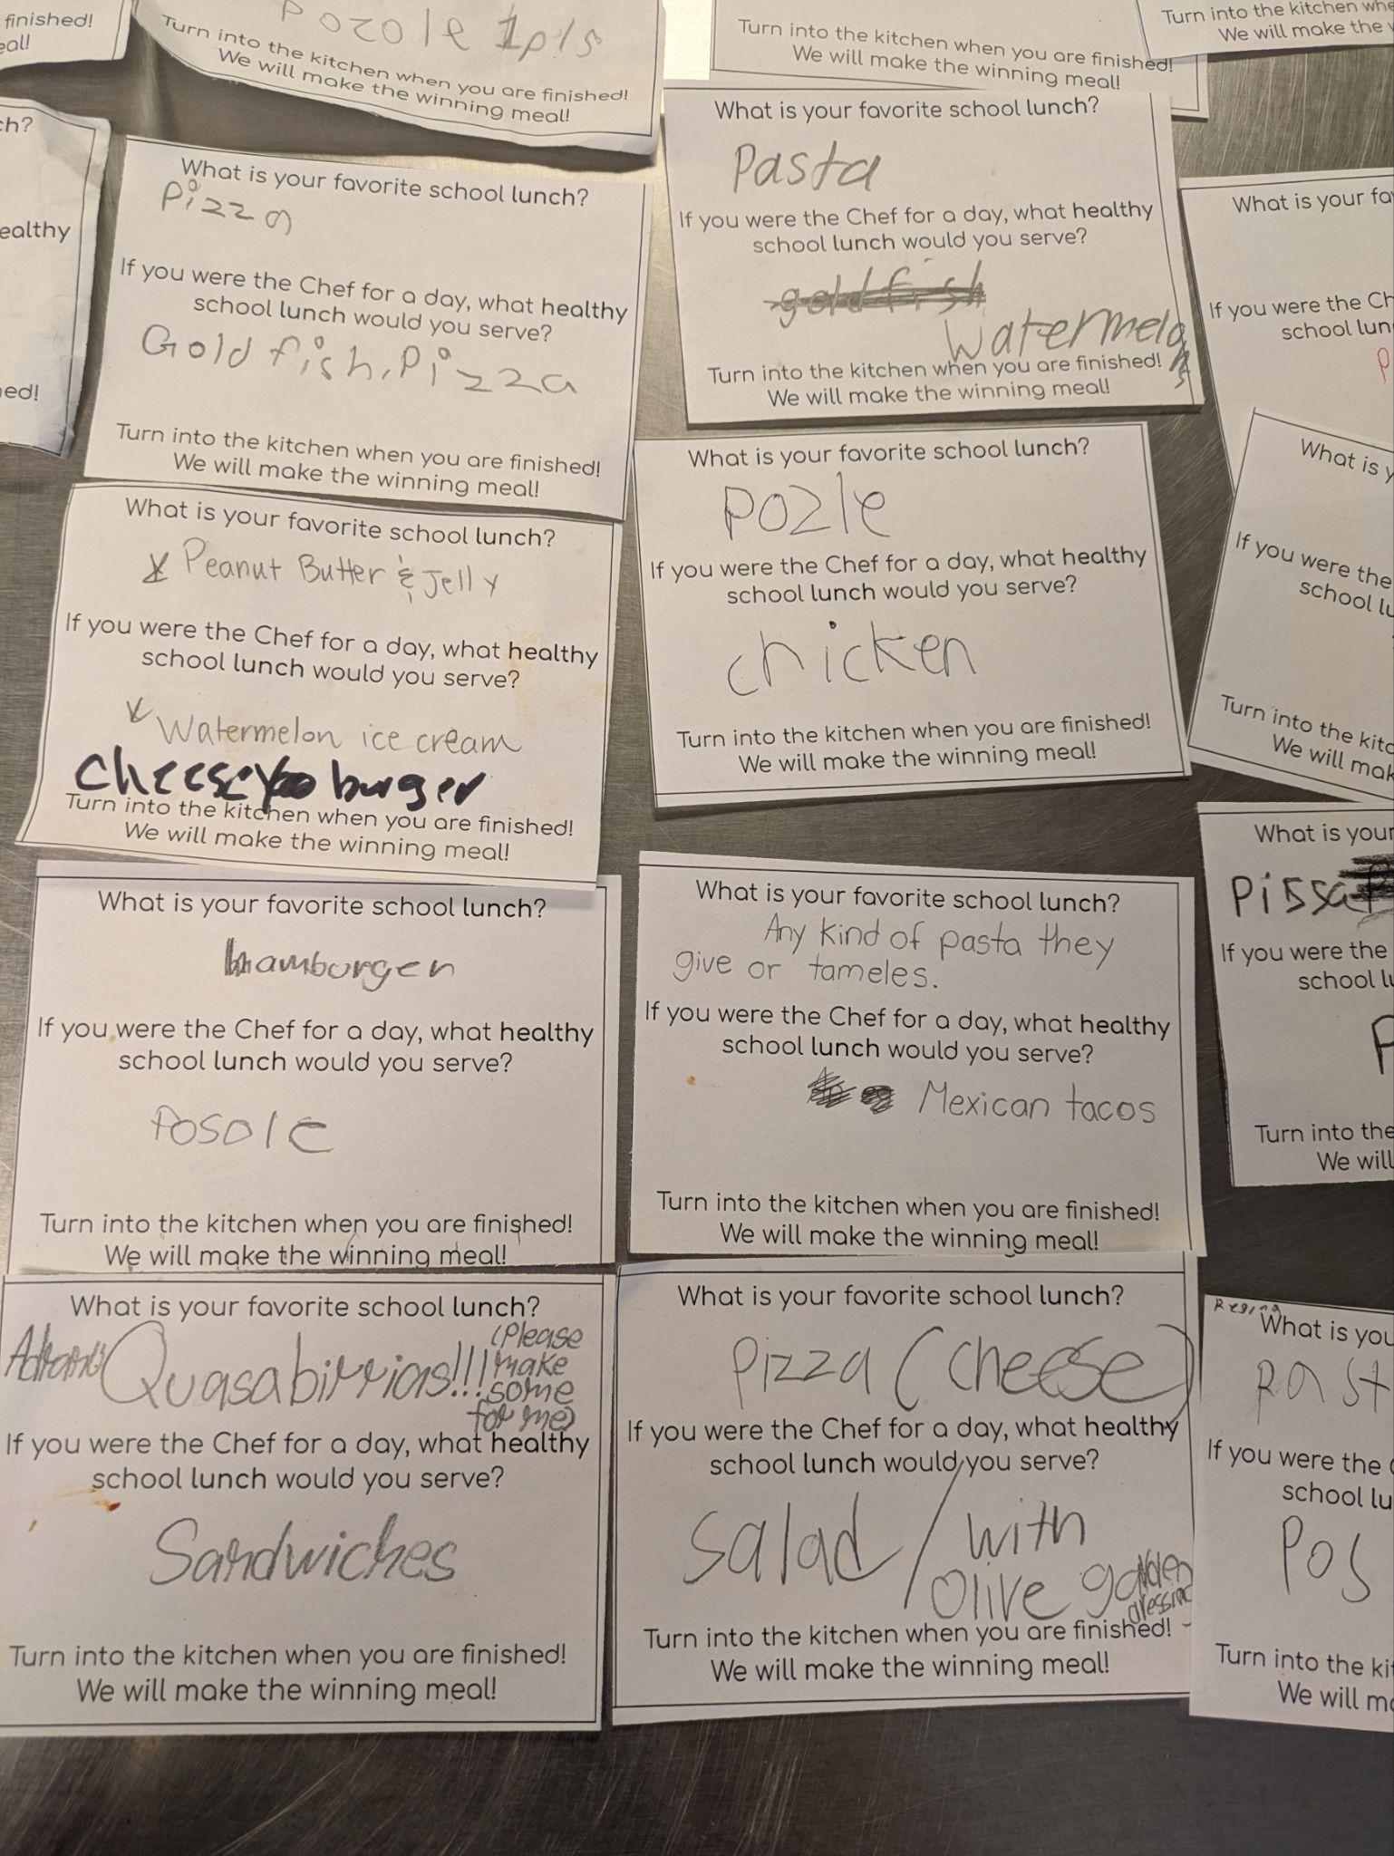
Program Highlights
Compliance Standards Met:
Health Inspections
Audit
Program Verification Reports
Grant applications:
Kitchen Infrastructure and Retention and Recruitment Grants
School Breakfast Program (SBP) and Summer Meal Programs (SMP) Start-up and Expansion Grants.

Slide 5
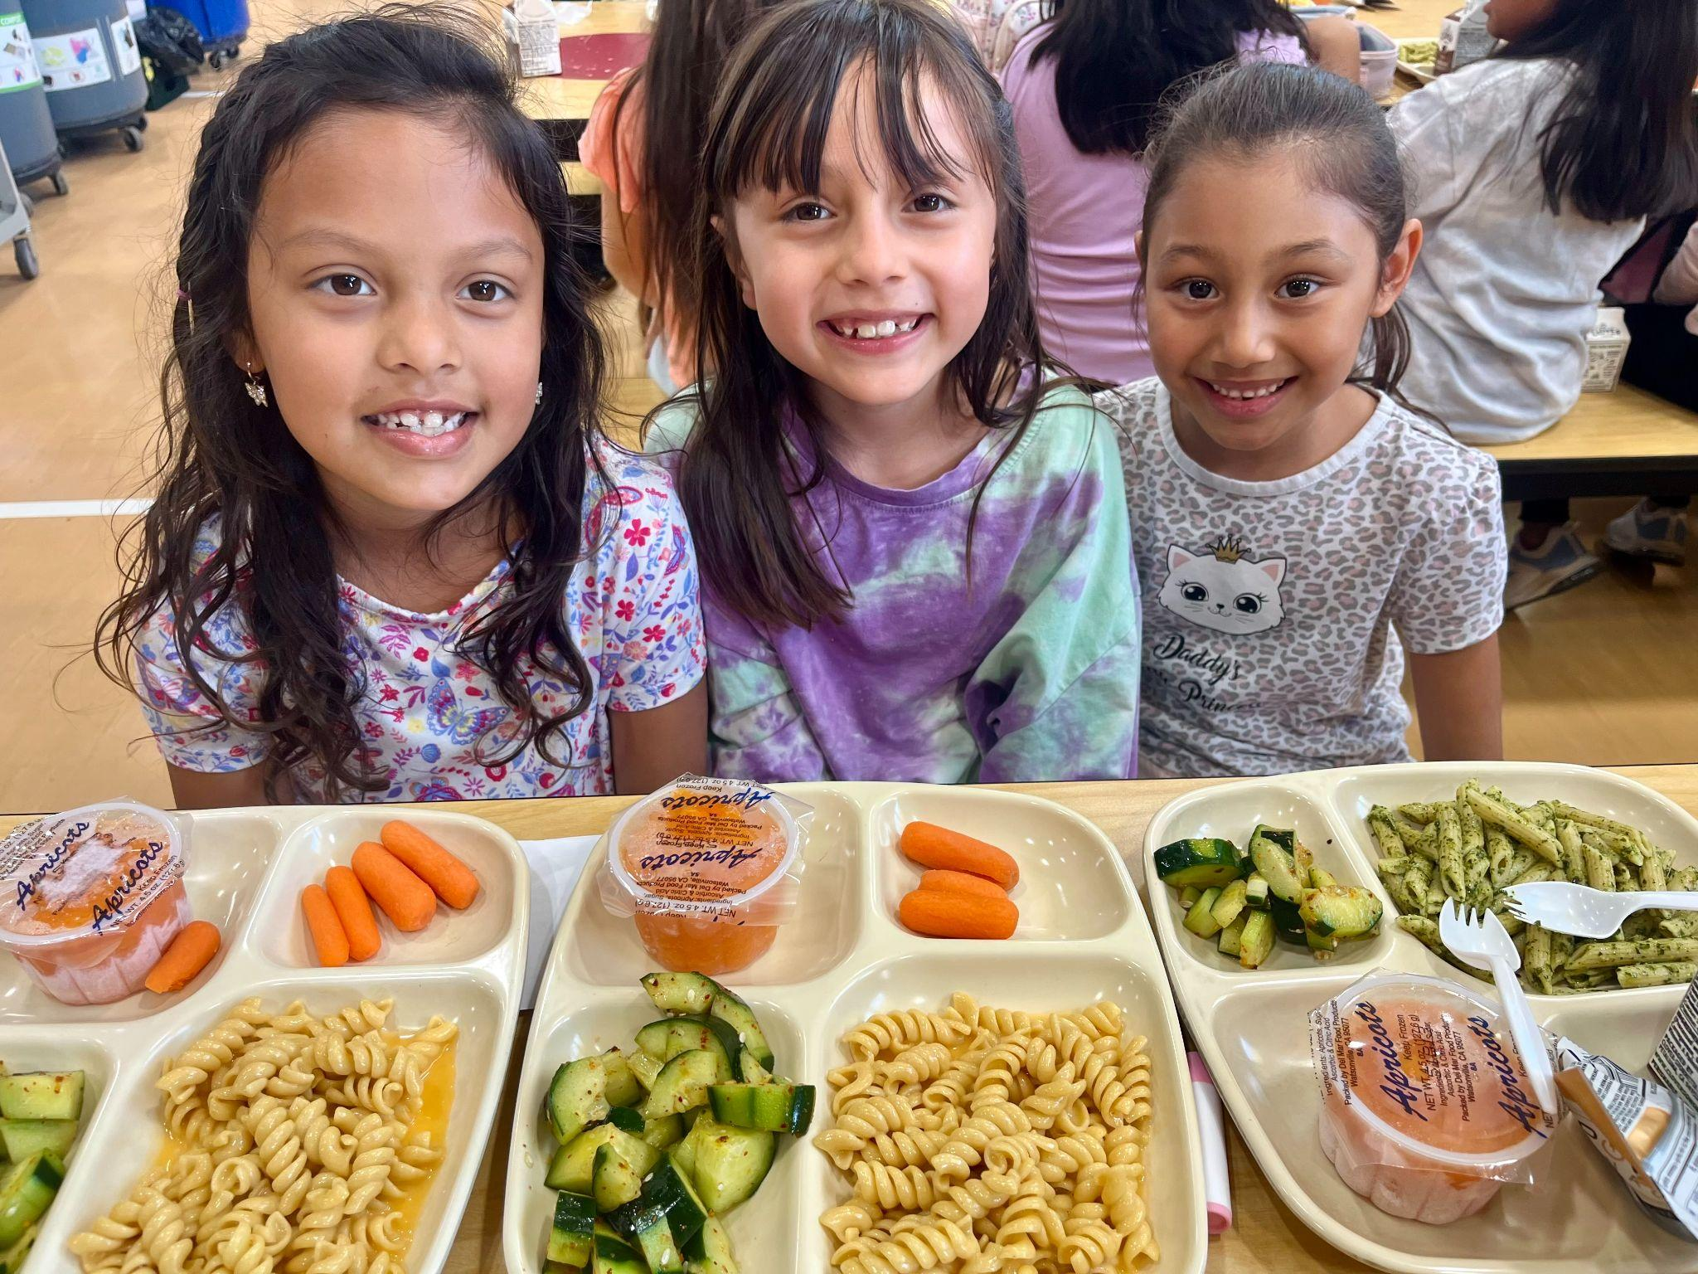
Student Preferences
The Menu Drives Everything
Demographic
Cultural Diversity
Experience
Student Needs
Allergies
Medical Diets
Religious Diets
Student Welfare
Health & Safety
Skill of Labor
Equipment & Supplies
Notes:
Here are the top 3 changes for SY2022-23:
Low-fat flavored milk will be allowed to be offered. Previously, only fat-free flavored milk was allowed to be offered.
Sodium will remain at the current target level. Previously, the target level was to become more strict which would have limited our menu options.
At least 80% of our weekly grains must be whole grain-rich. Previously, the regulation was 100% of grains must be whole grain-rich.
As of July 7th, 2022, FNS does not plan to issue a nationwide waiver for nutrition standards. Our school district will be required to make our best efforts at achieving these standards.

Slide 6
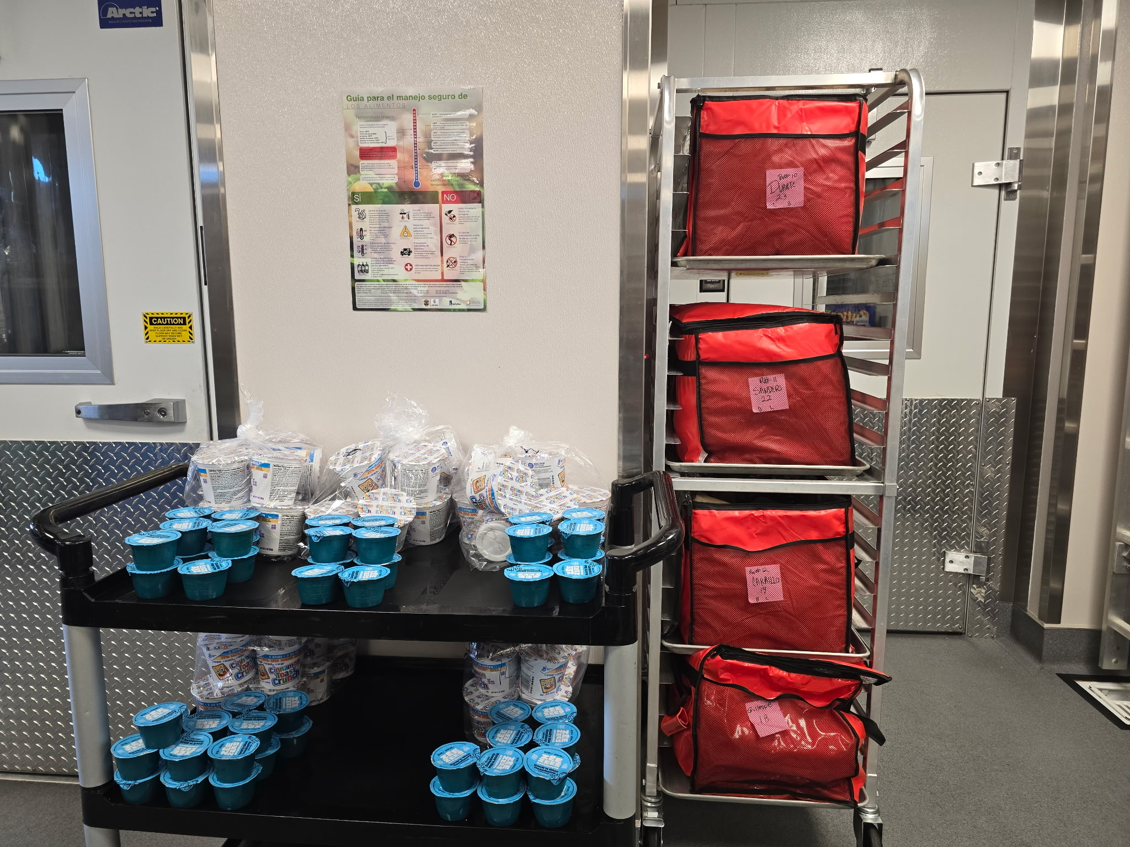
Program Challenges
Increased labor costs
specialized personnel needed for compliance
hands/time/capacity
Supply chain disruptions
tarifs, weather, production, delivery
Funding and procurement
Insufficient Reimbursement Rates
No COLA

Slide 7
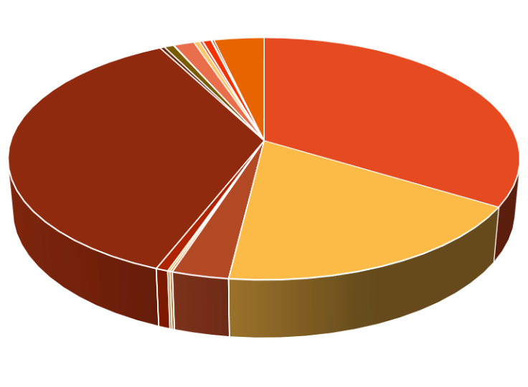
Program Expenses
Child Nutrition Services is a reimbursable program only
Labor/Benefits: 60-65% of expenses
State COLA is not provided to CNS
OTHER COSTS:equipment, supplies,
indirects, utilities, training
LABOR
FOOD
BENEFITS

Slide 8
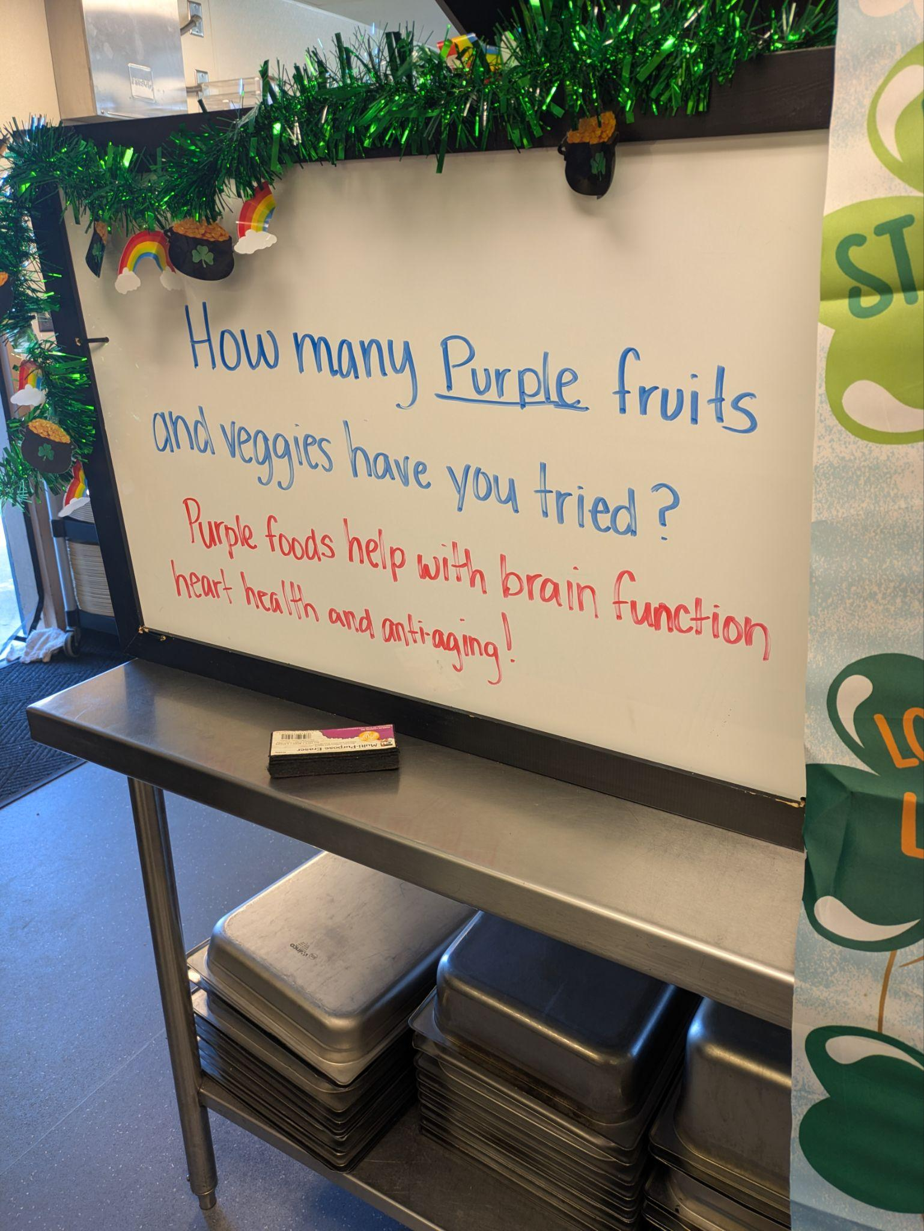
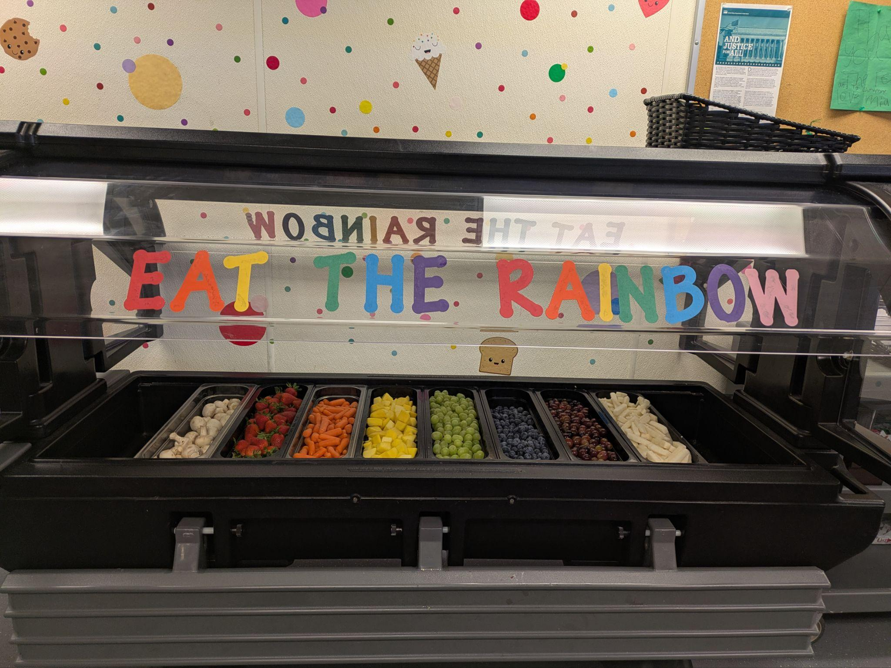
Program Opportunities
Leadership/staff stability
Growth of Scratch Cooking
Renewing Provision 2
Initiating Wellness Committee

Slide 9
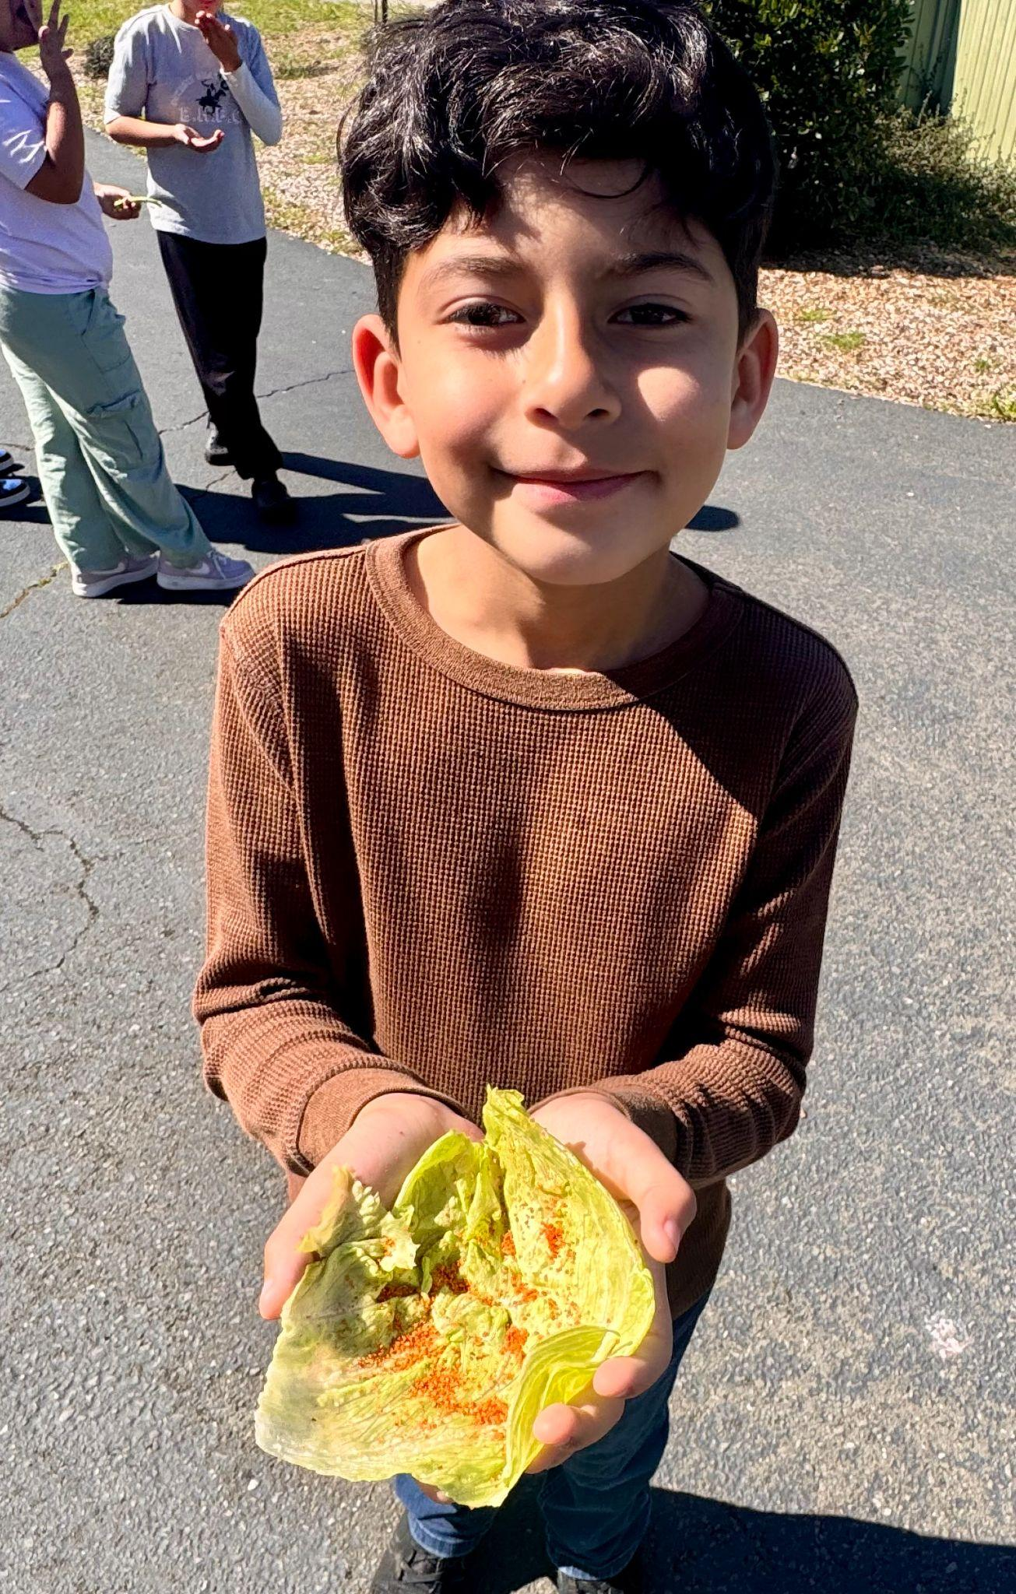
3 Ways to Improve Service
“Selling food vs. serving food”
Increased line service & participation
Brand Identity & Standards
1
Strategic Planning
2
Cafeteria Makeovers
3
Equipment Replacement

Slide 10
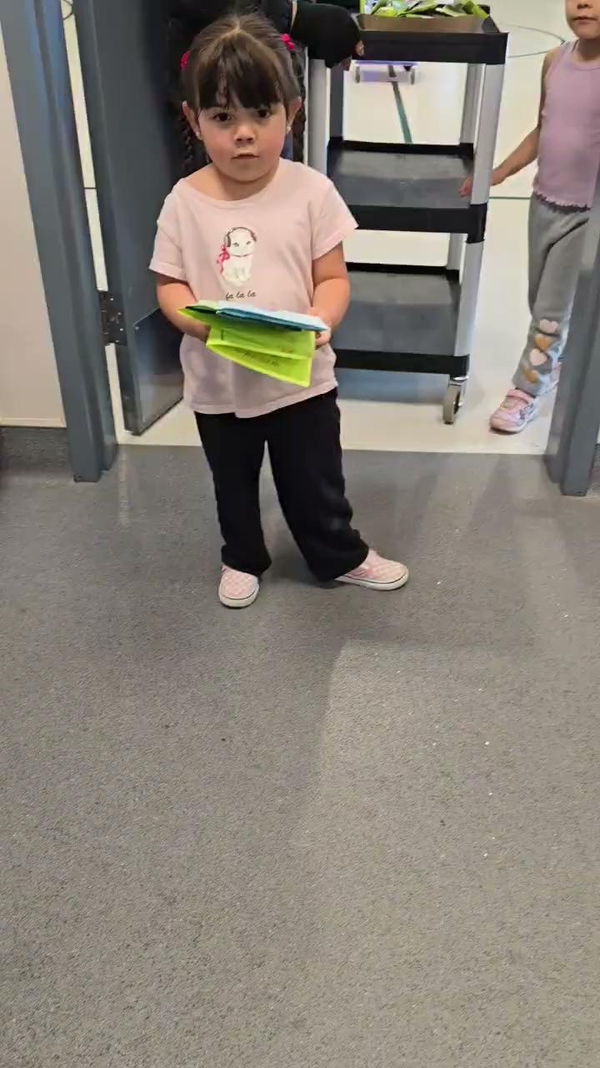
Thank
You!

