Slide 1

Dual Credit
Joliet Township High School:
2026-2027 School year
Notes:
Sarah Loomis sarah.loomis@jjc.edu

Slide 2


Today's Dual Credit Presentation is:
Targeted @
NOT Included Today
Math: Dual Credit – JJC
English: Dual Credit – JJC
CTE: Dual Enrollment - JJC
Science: Dual Credit – JJC
Applied Life: Dual Credit – JJC
Contact Pat O’Neil poneil@jths.org for information
CTE: Dual Credit - JJC
CTE: Dual Credit – USF
CTE: Dual Credit – Lewis
CTE: Dual Credit – COD
Information regarding these dual credits is presented to students in the class and on the JTHS Website
Contact Chris McGuffey cmcguffey@jths.org for information
Notes:
Chris
Agenda 1) General Dual Credit info. 2) Breakup into groups.
Much dual credit at JTHS: Today’s focus is on…..

Slide 3

Welcome to Dual Credit
As a Dual Credit student, you will have the opportunity to experience life as a college student while still in high school. However, this also means you now have the responsibilities that are part of college life.
This presentation is designed to help familiarize you with the Dual Credit program at JTHS, your responsibilities as a student, and the resources available to help ensure your academic success.

Slide 4


What is Dual Credit?
The Dual Credit program is a partnership between JTHS and JJC, USF, Lewis, and COD. High school students can earn both high school and college credit upon successful completion of Dual Credit courses.
See JTHS Dual Credit Website for more information.
Notes:
JTHS is proud to partner with JJC, USF and other community partners to bring these offerings to our studnets and families.
Dual credit programs target juniors and seniors with early college credit opportunities.
After successful completion of these classes, students will earn graduation credit towards their high school transcript
& credit at their university, college, or trade school.

Slide 5

Benefits of Dual credit
Earn College Credit Prior to High School Graduation
Reduces overall college costs
Students are considered JJC students and therefore granted access to JJC resources and activities on campus.
Students can take dual credit courses as part of the regular school day.
Dual credit courses help prepare students for the transition to college by engaging them in college-level work.
Notes:
SKIP

Slide 6

Cost After Graduation
Credits | JJC Tuition Cost | # of Students
1 | $174 | -
2 | $348 | 1
3 | $522 | 158
4 | $696 | 31
5 | $870 | 44
6 | $1,044 | 18
7 | $1,218 | 11
8 | $1,392 | 8
9 | $1,566 | 25
10 | $1,740 | 9
11 | $1,914 | 1
12 | $2,088 | 7
13 | $2,262 | 8
14 | $2,436 | 9
15 | $2,610 | -
16 | $2,784 | 1
~60 | Associates Degree
~120 | Bachelors
23-24 Dual Credit Data
Cost to HS Students = $12 /Credit Hour
Or less if you qualify for Free/Reduced Lunch
Notes:
Chris

Slide 7
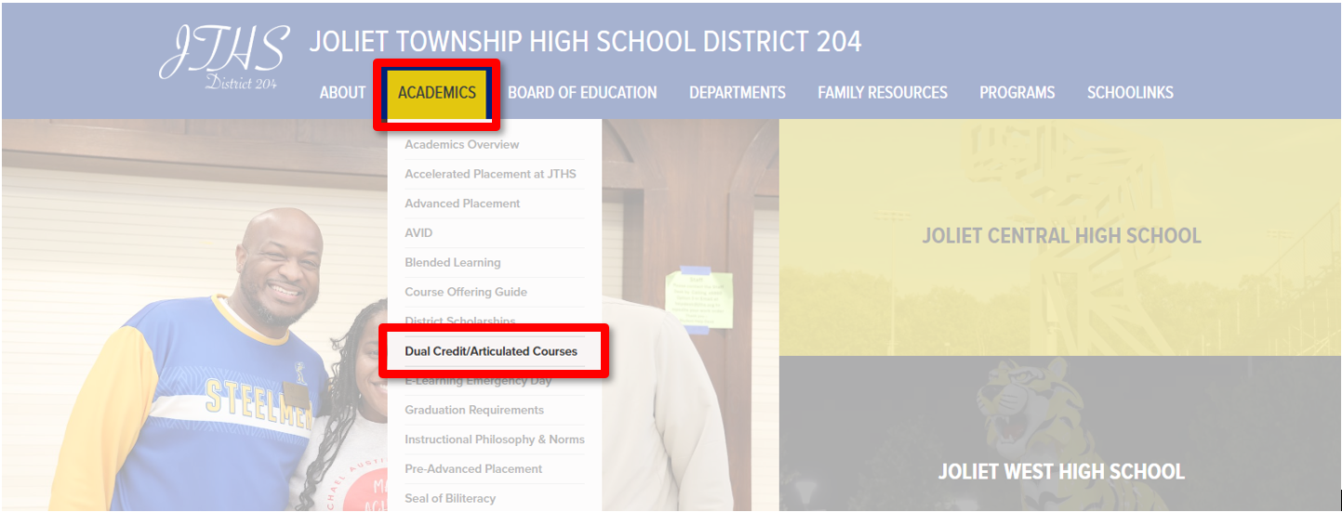
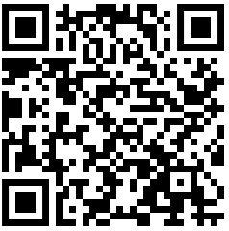
Website: jths.org/academics/dual-credit-articulated-courses
Scan Me

Slide 8
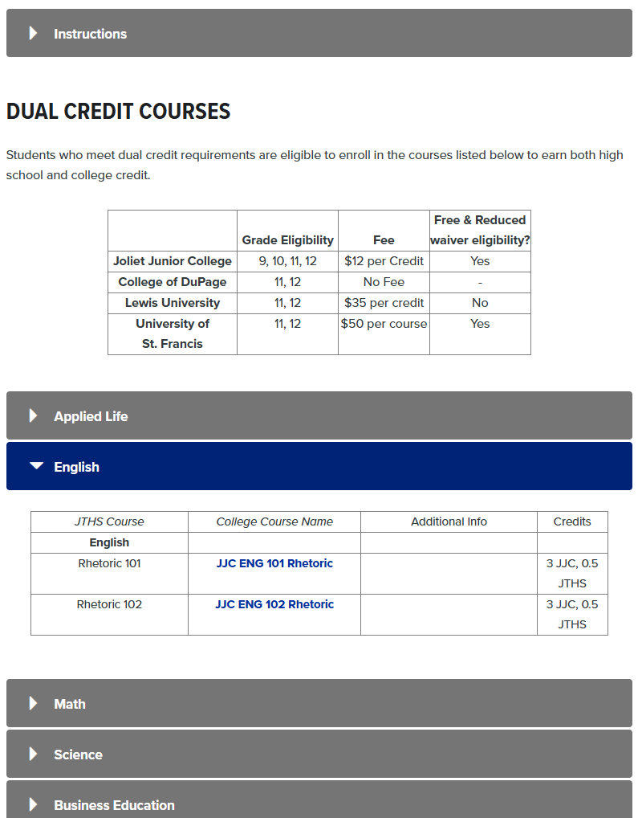

Slide 9
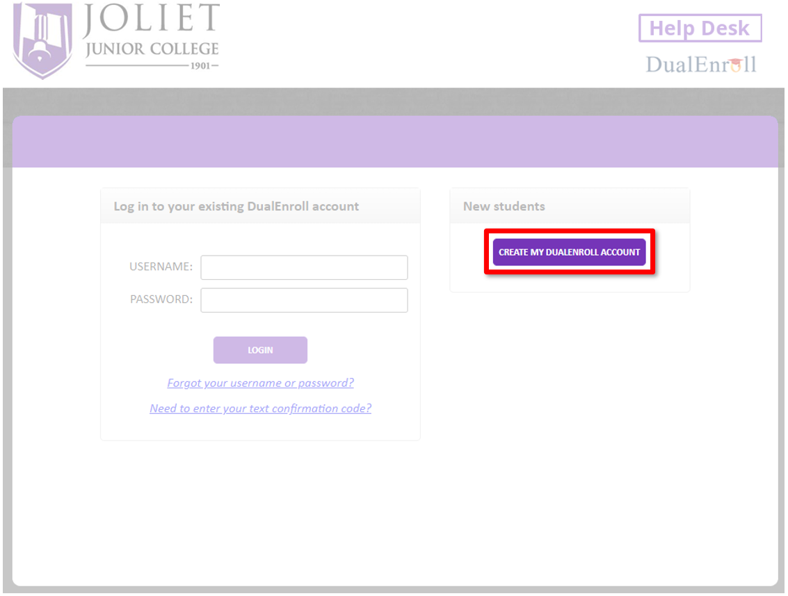
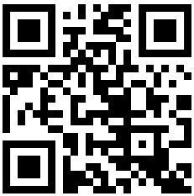
JJC Dual Enroll
Start by creating your student ID number through Dual Enroll
Website: jjc.dualenroll.com

Slide 10
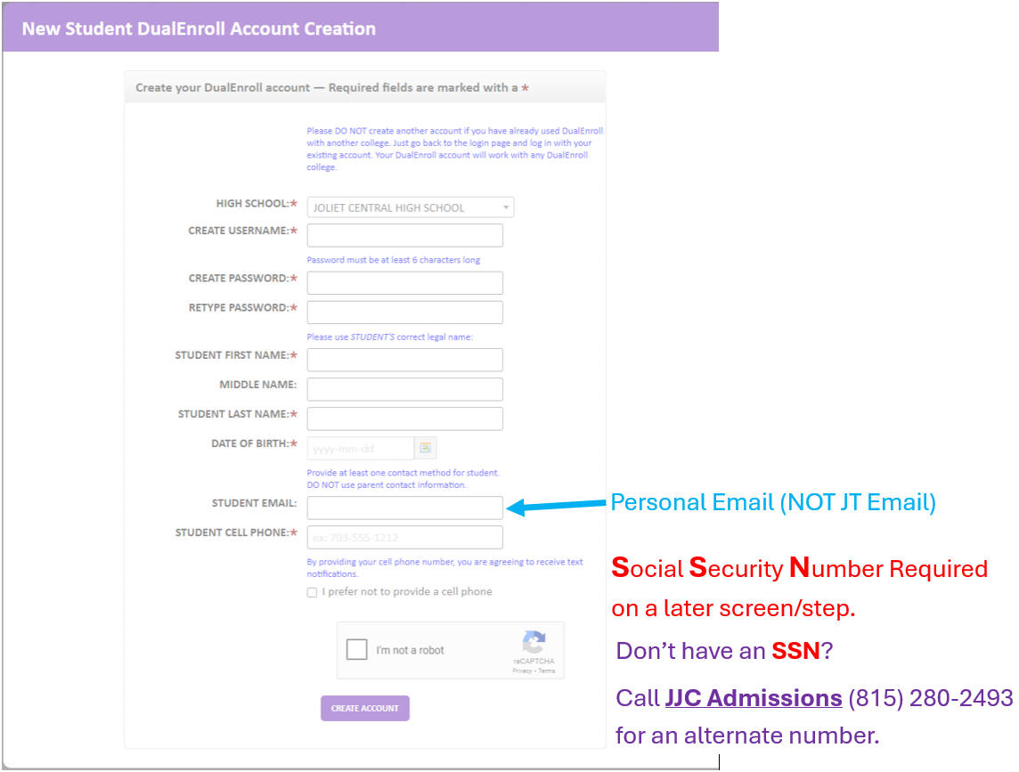

Slide 11
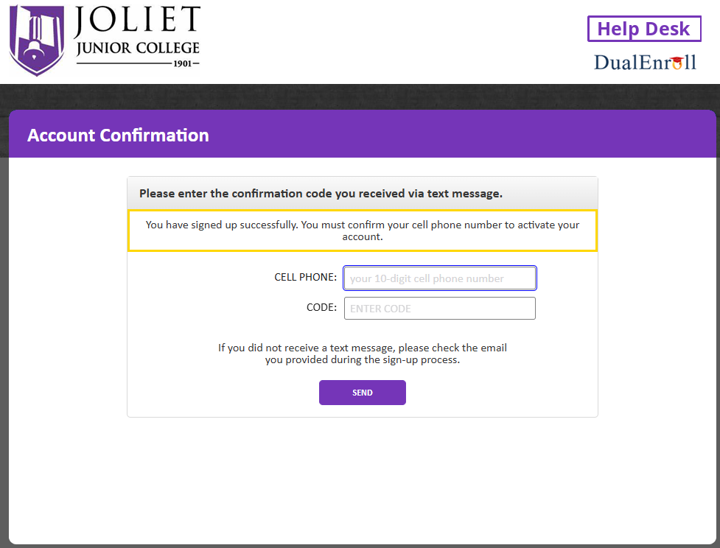
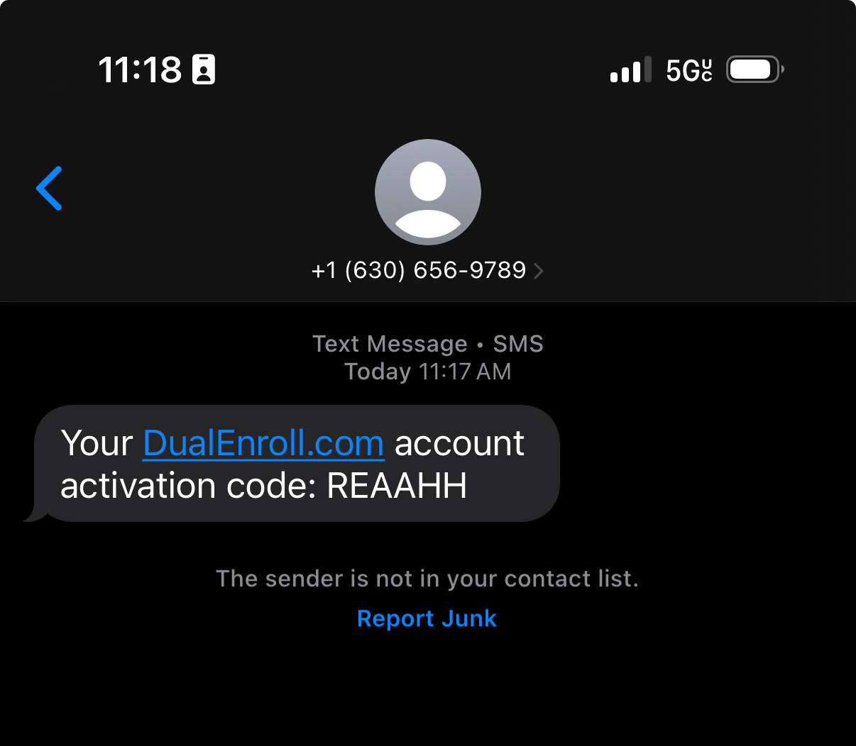

Slide 12
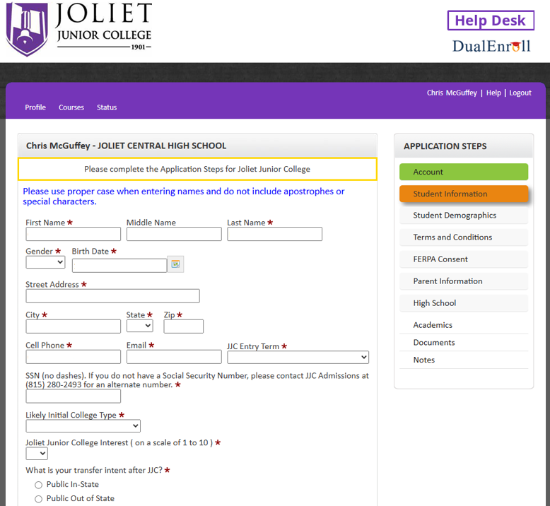

Slide 13
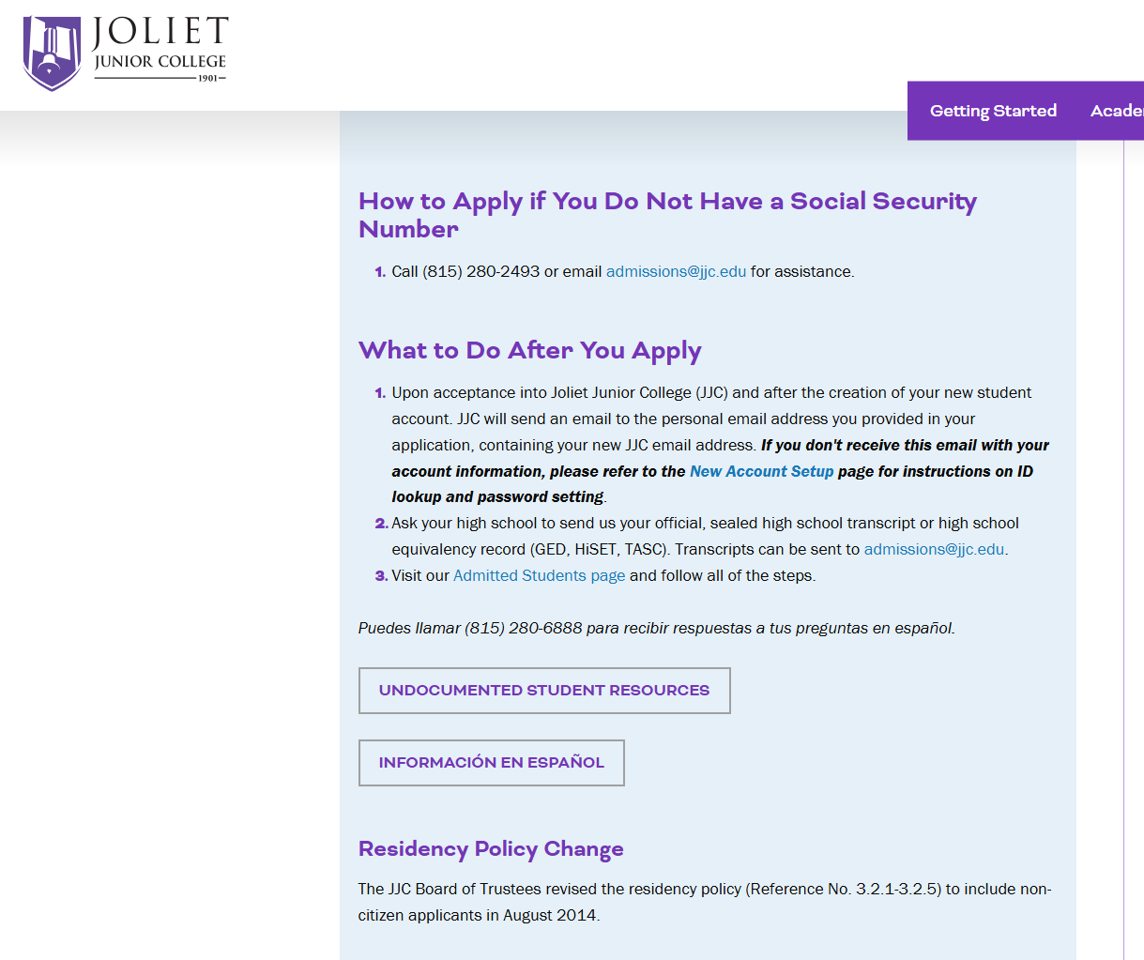
Don’t have a Social Security #?
JJC Still welcomes undocumented students to apply
jjc.edu/getting-started/admissions
*Joliet Central Students: If you need assistance, see Ms. Martinez in the College and Career Center in room 279

Slide 14
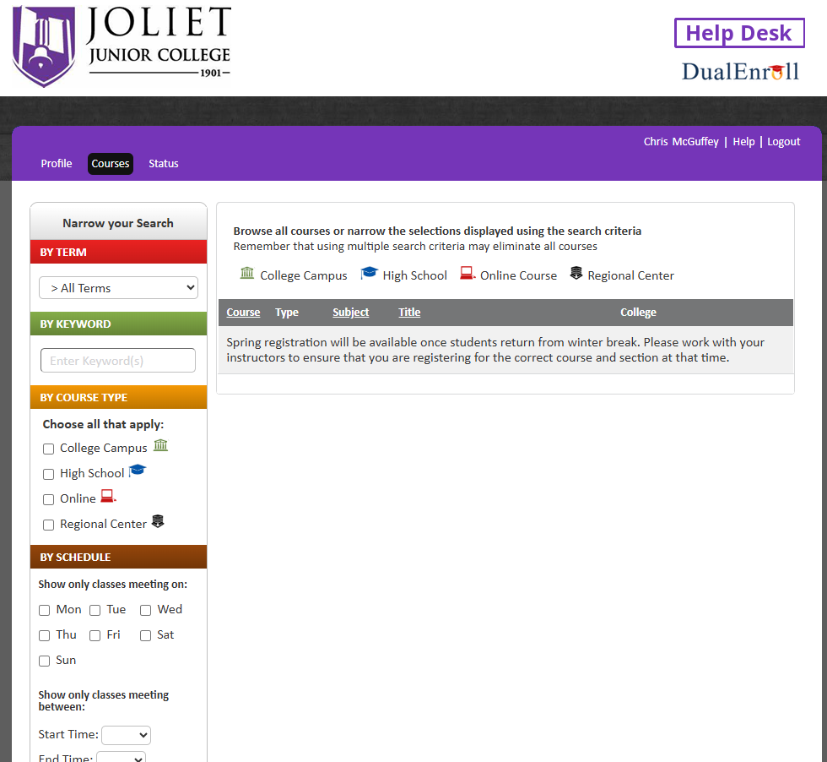
Clarification
Register for a JJC ID#
Dual Enroll Account ONLY
DO NOT Register for Class.
This will come later

Slide 15
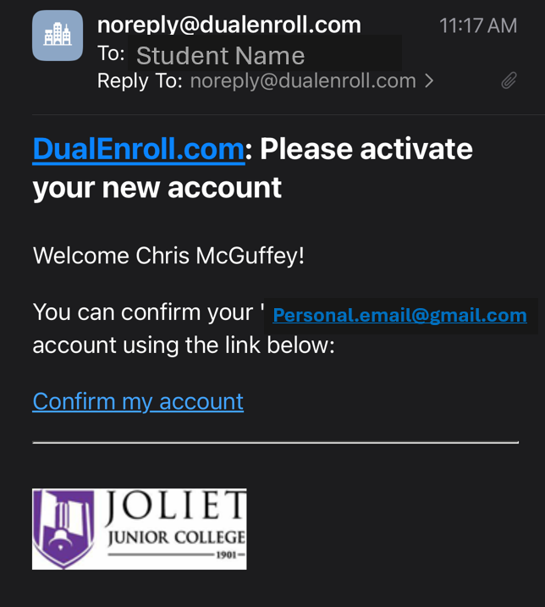
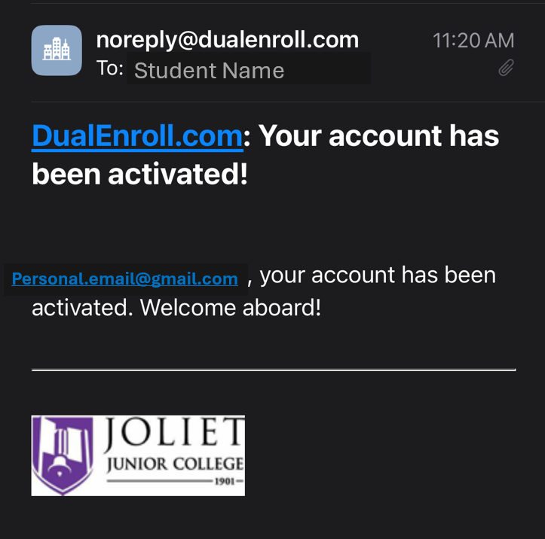
Check your Personal Email for activation

Slide 16
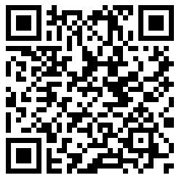
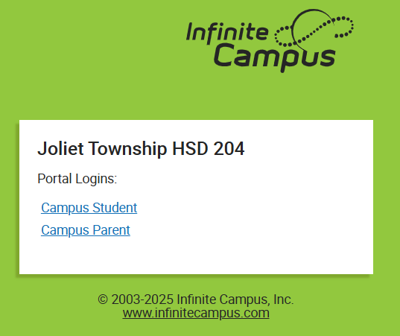
Look up your Scores: PSAT10, SAT, ACT
In Infinite Campus
Students can confirm their placement scores in Infinite Campus Student Portal
Website: jolietil.infinitecampus.org/campus/portal/joliet.jsp

Slide 17
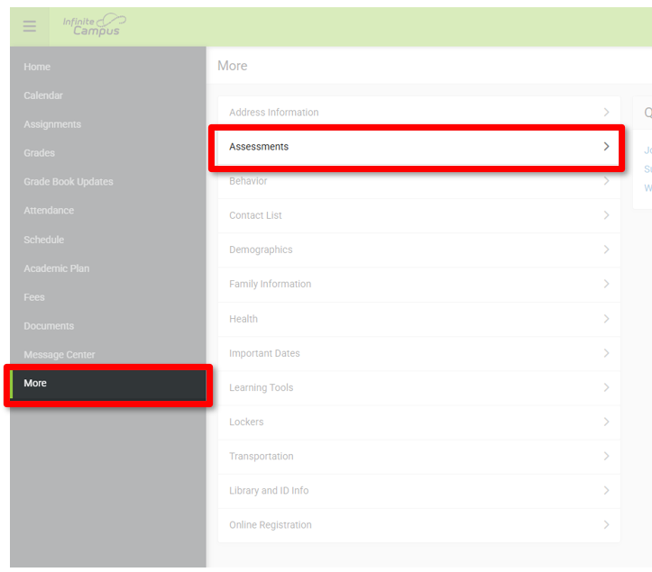
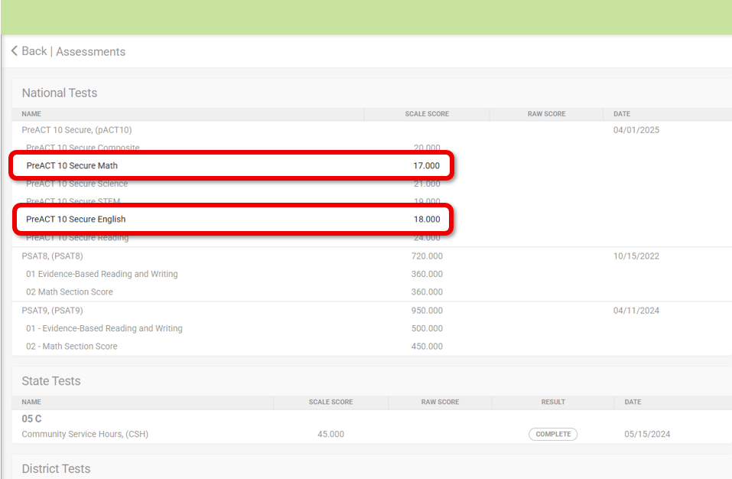
Look up your Scores: PSAT10, SAT, ACT
In Infinite Campus

Slide 18
Senior Year English:
Dual Credit Rhetoric 101/102
Must meet the prerequisite requirements o ACT score of 19 or higher, or take the Accuplacer (Accuplacer at JJC-Placement Testing) There will be testing at Central and West!
Rhetoric 101 – First Semester
Rhetoric 102 – Second Semester
To receive dual credit from JJC you must receive a C or better to earn credit
All books and materials are supplied by your Rhetoric teachers.
Notes:
Sharon

Slide 19

Senior Year English: Dual Credit English 101
ACCUPLACER | ACCUPLACER
READING | 246-300
WRITING | 5-8
ACT
English | 19 or higher
PSAT10/SAT
Evidence-Based Reading and Writing | 480 or higher
Notes:
Sharon

Slide 20
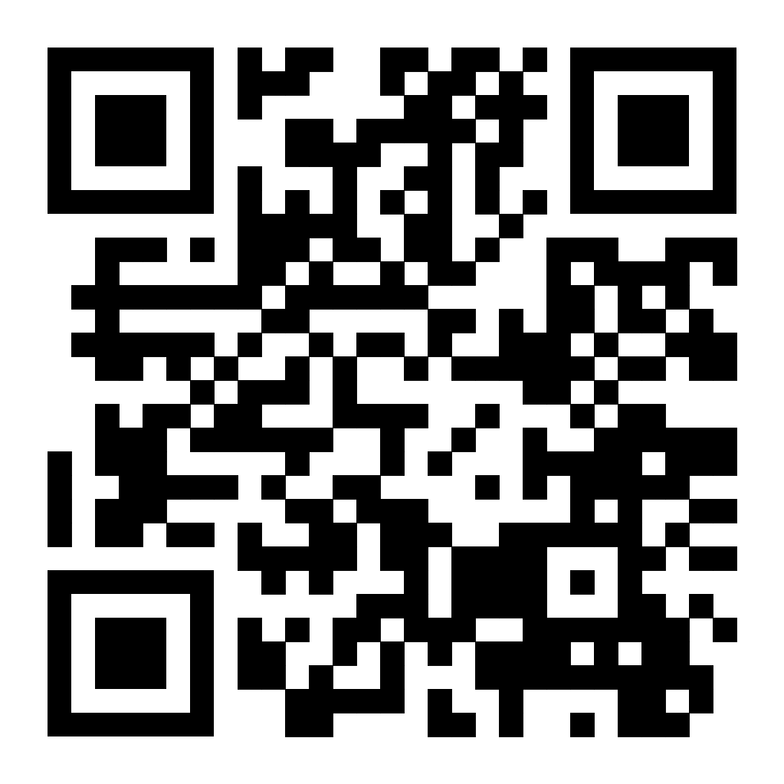
Accuplacer Placement Testing AT Schools
Joliet Central on Monday, April 20th in the Lower Library
  Session #1 8:30 am – 10:30 am
  Session #2 10:30 am – 12:30 pm
  Session #3 12:30 pm – 2:30 pm
Joliet West on Tuesday, April 28th and April 29th in the Library
  Session #1 8:30 am – 10:30 am
  Session #2 10:30 am – 12:30 pm
  Session #3 12:30 pm – 2:30 pm
To Sign Up use this Google form
Test Sign up
Students will need their JJC ID Number and JJC Email Address

Slide 21
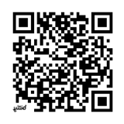
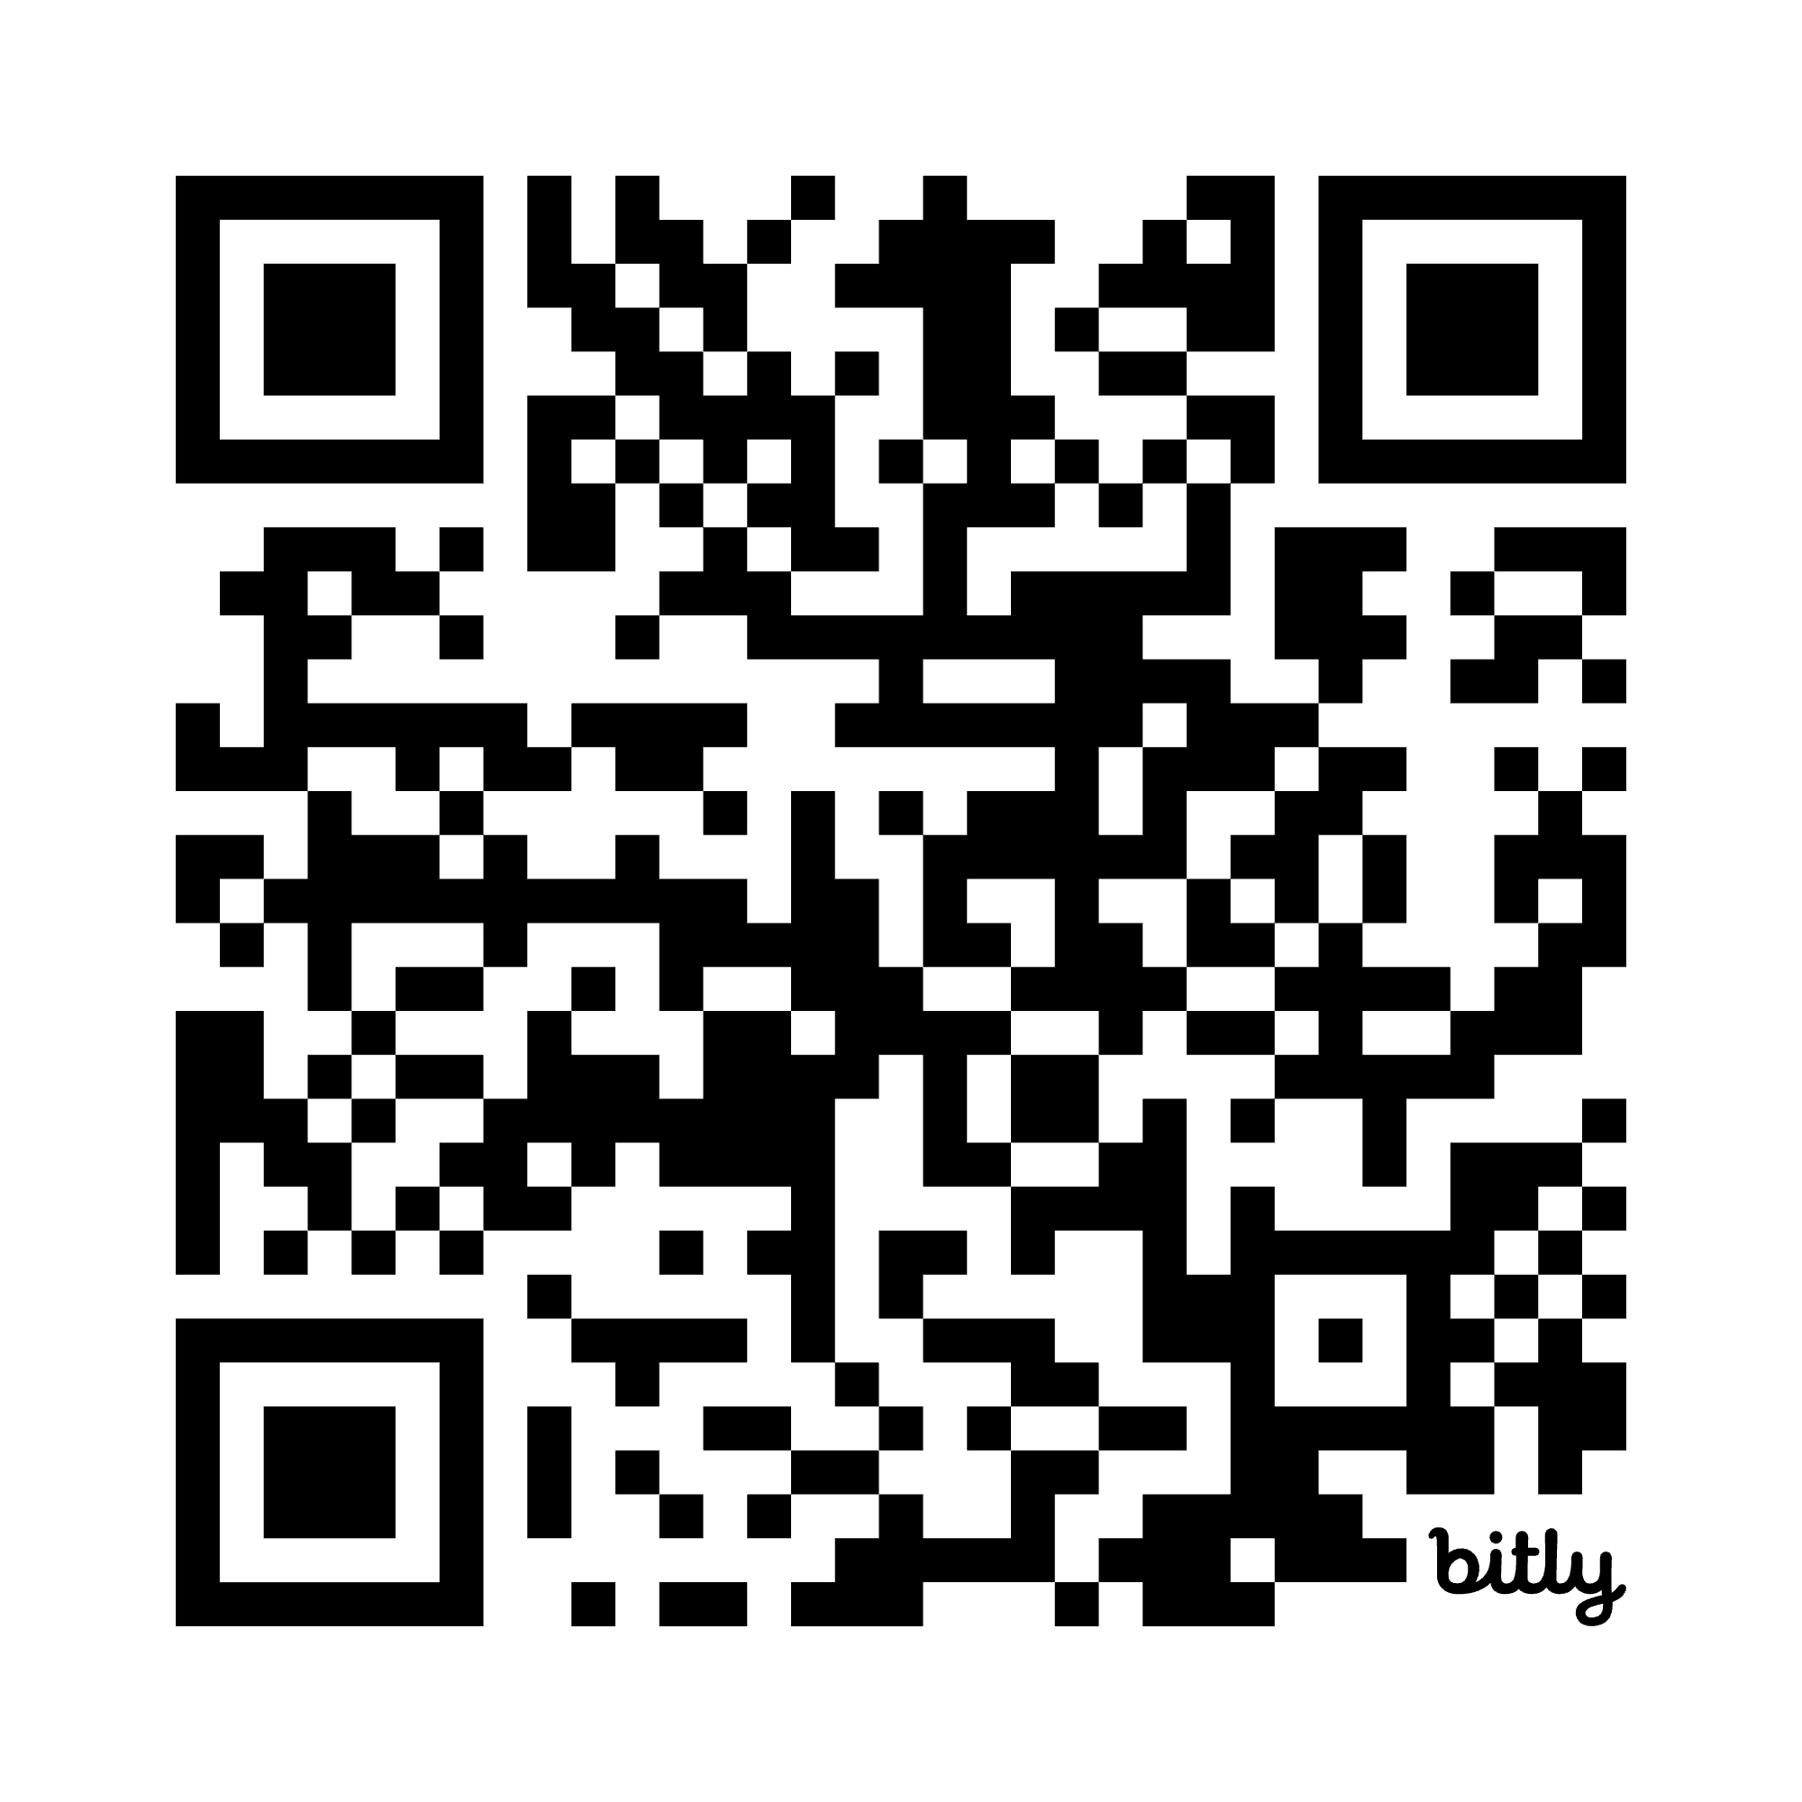
Math Dual Credit Opportunities
2026-2027 School Year
Steps to Complete before 5/11/2026 Deadline:
1. Complete the JJC Dual Enrollment Online application:
https://jjc.dualenroll.com/login OR
2. Sign up for the ALEKS Math Test at
your home campus using this link:
bit.ly/46lc6Md
OR
3. Send qualifying score via email to:
Mrs. Nicole McMorris
JTHS High School District 204
Curriculum Director for Math
Email: nmcmorris@jths.org / Phone: (815) 774-1611
AP Statistics/Math 128
Honors Pre-Calculus/Math 142
AP Calculus/Math 170
Notes:
Nicole

Slide 22
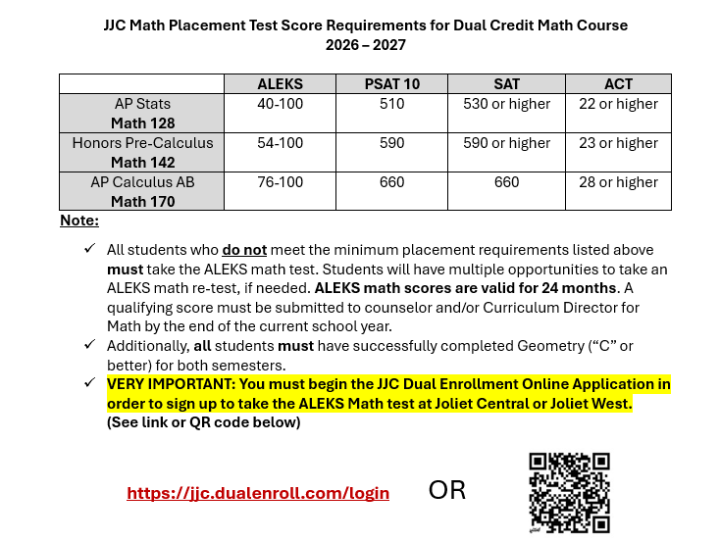
Math: Dual-Credit
Notes:
Nicole

Slide 23
ALEKS Math Placement Testing AT Schools
Link to sign up for ALEKS
Math Testing at your campus: bit.ly/46lc6Md
Joliet West on Monday, May 4, 2026
  Session #1 8:30 am – 10:30 am
  Session #2 10:30 am – 12:30 pm
  Session #3 12:30 pm – 2:30 pm
Joliet Central on Tuesday, May 5, 2026
  Session #1 8:30 am – 10:30 am
  Session #2 10:30 am – 12:30 pm
  Session #3 12:30 pm – 2:30 pm
OR:
Scan this QR Code
VERY IMPORTANT: You must have your JJC ID # and JJC email address to sign up for ALEKS Testing

Slide 24
Career and Technical Education Dual Enrollment Programs
Seniors ONLY
Senior Year & 16 Years of Age
Off-site class/training
  Reliable Transportation required NOT provided by JTHS
Applications required Exception: Cosmetology
Multiple Classes or Parts
Full Year program Exception: NA101 is 1 Semester
College Expectations
No tuition cost for students Exception: Cosmetology
Additional expectations vary per program
  Including but not limited to; uniforms, background check, Saturday trainings, blended/remote class, clinical experience, COVID-19 Vaccination

Slide 25
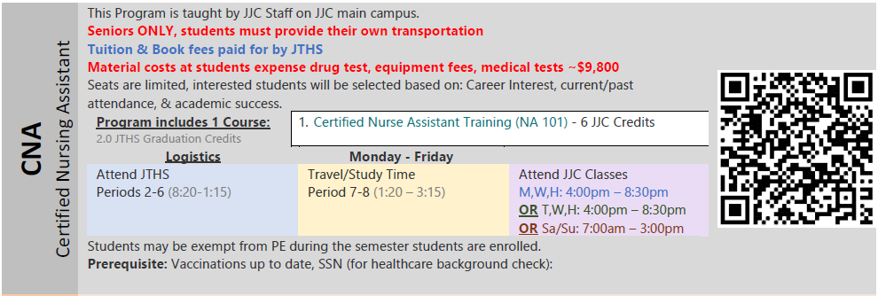
Certified Nursing Assistant

Slide 26
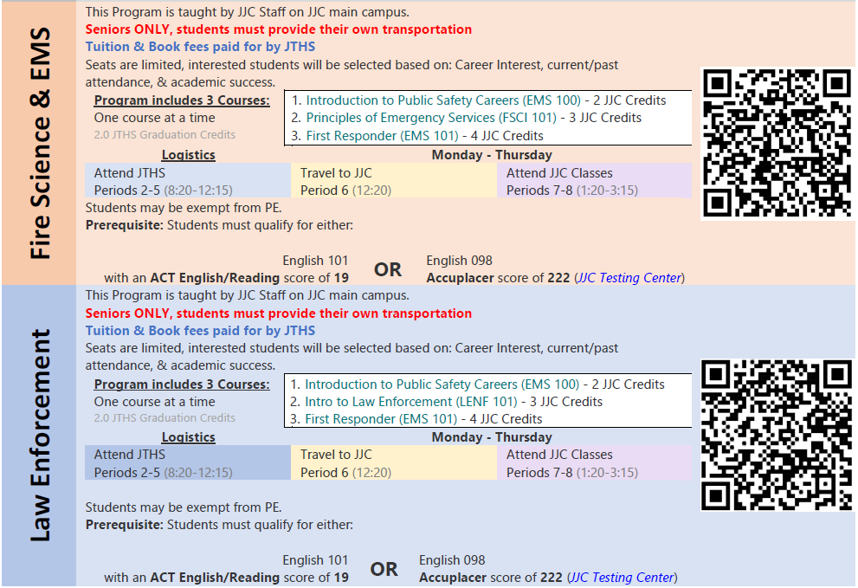
Fire Science & Law Enforcement

Slide 27
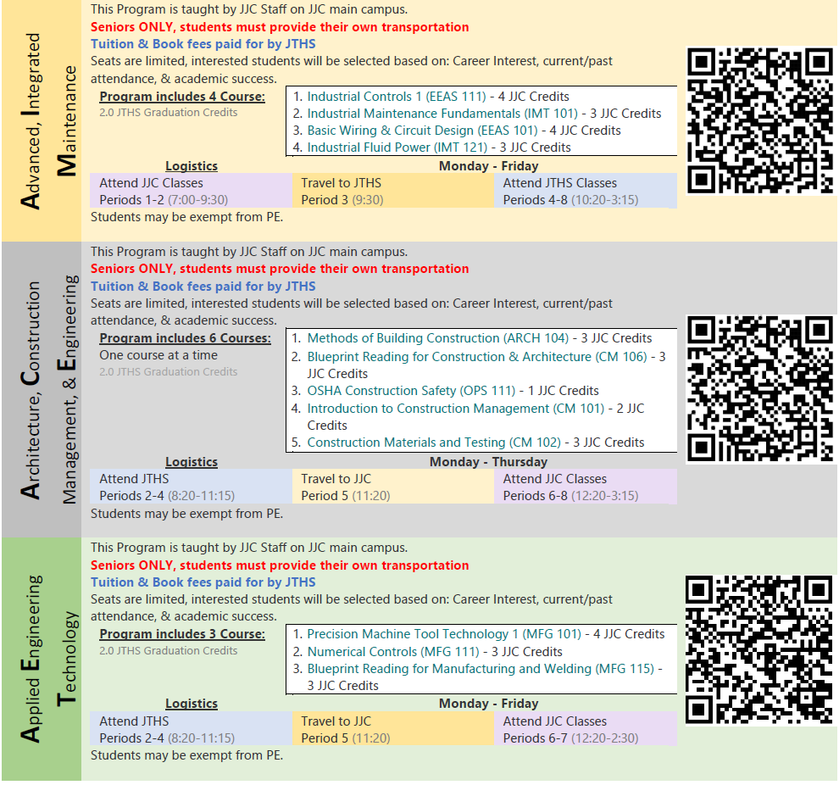
3x Technical Program

Slide 28


