Slide 1

Understanding and Using
The Disposal Authorization
The School District of Escambia County
Records Management

Slide 2



Introduction
The Disposal Authorization is an important tool in managing your work-related records.

Slide 3
Overview
Florida Public Records Law (Chapter 119, F.S.) regulates the destruction of public records.
The state has established minimum retention requirements for records.
The Disposal Authorization helps you comply with these requirements.

Slide 4

What is a Public Record?
Public records are not limited to paper documents.
A public record is any record, regardless of physical form, characteristics, or means of transmission, made or received in connection with the transaction of school district business.

Slide 5
What is a Retention Requirement?
A retention requirement is a guideline setting the minimum amount of time you are required to keep a series of records.
The state publishes schedules containing retention requirements for different records. These schedules can be found at: http://dlis.dos.state.fl.us/recordsmgmt/gen_records_schedules.cfm

Slide 6
What is the Disposal Authorization?
The Disposal Authorization is a form listing the dates of records eligible for discard and giving permission for their discard.
It also is used to report the volume of records discarded, in accordance with state regulations.

Slide 7

Disposal Authorization (cont.)
It provides an audit trail for records that can be used in responding to public records requests and subpoenas.

Slide 8
Disposal Authorization Form
The Disposal Authorization form is used by schools and departments to list records discarded throughout the year.
A copy of the completed form is maintained on site three years for audit inquiries.
Records Management retains the
record copy of the form permanently.

Slide 9
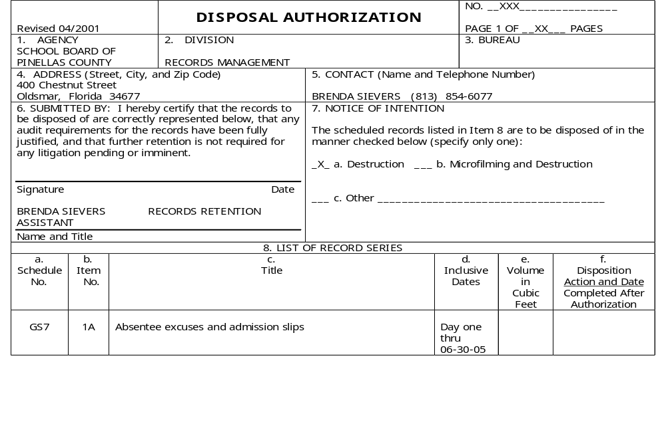
Understanding
The Disposal Authorization
SAMPLE

Slide 10

The best way to understand the Disposal Authorization is to look at its different parts:
a. Schedule No.
b. Item No.
c. Title
d. Inclusive Dates
e. Volume in Cubic Feet
f. Disposition Action and Date

Slide 11
Schedule No.
8. LIST OF RECORD SERIES
a. Schedule No. | b. Item No. | c. Title | d. Inclusive Dates | e. Volume in Cubic Feet | f. Disposition Action and Date Completed After Authorization
GS7 | 1A | Absentee excuses and admission slips | Day one thru 06-30-05
 | 1B | Duplicates (OSA) | Day one thru 06-30-05
GS7 | 110A | Abuse/neglect records | Day one thru 06-30-03
 | 110B | Duplicates (OSA) | Day one thru 06-30-05
SAMPLE

Slide 12
Schedule No.
The schedule number identifies the state publication in which a records retention requirement is published.

Slide 13
Item No.
8. LIST OF RECORD SERIES
a. Schedule No. | b. Item No. | c. Title | d. Inclusive Dates | e. Volume in Cubic Feet | f. Disposition Action and Date Completed After Authorization
GS7 | 1A | Absentee excuses and admission slips | Day one thru 06-30-05
 | 1B | Duplicates (OSA) | Day one thru 06-30-05
GS7 | 110A | Abuse/neglect records | Day one thru 06-30-03
 | 110B | Duplicates (OSA) | Day one thru 06-30-05
SAMPLE

Slide 14
Item No.
The item number identifies a specific records retention requirement in a state schedule.
Because of state reporting requirements, we track records by their schedule and item numbers.

Slide 15
Title
8. LIST OF RECORD SERIES
a. Schedule No. | b. Item No. | c. Title | d. Inclusive Dates | e. Volume in Cubic Feet | f. Disposition Action and Date Completed After Authorization
GS7 | 1A | Absentee excuses and admission slips | Day one thru 06-30-05
 | 1B | Duplicates (OSA) | Day one thru 06-30-05
GS7 | 110A | Abuse/neglect records | Day one thru 06-30-03
 | 110B | Duplicates (OSA) | Day one thru 06-30-05
SAMPLE

Slide 16
Title
The title is the name assigned to a group of records by the state.
Because of reporting requirements, we use the state-assigned records title in the Disposal Authorization. This title can differ from the one used in the school district.

Slide 17
Inclusive Dates
8. LIST OF RECORD SERIES
a. Schedule No. | b. Item No. | c. Title | d. Inclusive Dates | e. Volume in Cubic Feet | f. Disposition Action and Date Completed After Authorization
GS7 | 1A | Absentee excuses and admission slips | Day one thru 06-30-05
 | 1B | Duplicates (OSA) | Day one thru 06-30-05
GS7 | 110A | Abuse/neglect records | Day one thru 06-30-03
 | 110B | Duplicates (OSA) | Day one thru 06-30-05
SAMPLE

Slide 18
Inclusive Dates
The inclusive dates are the dates of records eligible for disposal. For example, if the inclusive dates are
Day one
thru
06-30-03
records dated through June 30, 2003 can be discarded. Records dated after June 30, 2003 must be retained.

Slide 19
Inclusive Dates (cont.)
The record date can be the date a record was:
  Created (such as a security tape)
  Received (such as correspondence)
  Closed (such as a case file)

Slide 20
Volume in Cubic Feet
8. LIST OF RECORD SERIES
a. Schedule No. | b. Item No. | c. Title | d. Inclusive Dates | e. Volume in Cubic Feet | f. Disposition Action and Date Completed After Authorization
GS7 | 1A | Absentee excuses and admission slips | Day one thru 06-30-05
 | 1B | Duplicates (OSA) | Day one thru 06-30-05
GS7 | 110A | Abuse/neglect records | Day one thru 06-30-03
 | 110B | Duplicates (OSA) | Day one thru 06-30-05
SAMPLE

Slide 21
Volume in Cubic Feet
The volume in cubic feet is the volume of records discarded.
Annually, Records Management reports to the state the total volume of records disposed of by the school district over the previous year.

Slide 22
Disposition Action and Date
8. LIST OF RECORD SERIES
a. Schedule No. | b. Item No. | c. Title | d. Inclusive Dates | e. Volume in Cubic Feet | f. Disposition Action and Date Completed After Authorization
GS7 | 1A | Absentee excuses and admission slips | Day one thru 06-30-05
 | 1B | Duplicates (OSA) | Day one thru 06-30-05
GS7 | 110A | Abuse/neglect records | Day one thru 06-30-03
 | 110B | Duplicates (OSA) | Day one thru 06-30-05
SAMPLE

Slide 23
Disposition Action
Disposition Action indicates the method of discard used. Some methods of discard include:
  Shredded
  Recycled

Slide 24
Disposition Date
Disposition date is the actual date of a record’s discard. This is an important part of the audit trail. It may be referenced when responding to subpoenas and public records requests.

Slide 25
Using the Disposal Authorization
GS1-L | 189A | Access control records |  | Day one thru 06-30-05
 | 189B | Duplicates (OSA) |  | Day one thru 06-30-05
SCH 47 | 1A | Access log: student educational records
 | 1B | Duplicates (OSA) |  | Day one thru 06-30-05
9. DISPOSAL AUTHORIZATION: Disposal for the above listed records is authorized. Any deletions or modifications are indicated. _________________________________________________ Records Custodian or Designee Date |  |  | 10. DISPOSAL CERTIFICATE: The above listed records have been disposed of in the manner and on the date shown in column f. _________________________________________________________ Signature Date _________________________________________________________ Name and Title _________________________________________________________ Witness NOTE: Upon disposition retain this form for your records.
SAMPLE
SCHOOL OR DEPARTMENT NAME:______________________________________________________

Slide 26
Using the Disposal Authorization
Many people in your school or department will have records eligible for discard. Be sure to include all their records when completing the form.
Use the Disposal Authorization to report the volume of records discarded in your school or department.

Slide 27
Reporting Steps
Identify obsolete records eligible for discard, in your school or department.
Estimate the volume of records destroyed.
Enter the records volume, disposition action, and date on the form.

Slide 28
Reporting Steps (cont.)
Complete the Disposal Certificate on the front of the form.
Note the name of your school or department in the space provided on the bottom of page 1.
Return the form to Records Management keeping a copy for your files.

Slide 29
Identify Eligible Records
If you are not sure which is the correct record title, the General Records Schedule lists the different titles and includes definitions. Or, contact Records Management for assistance.

Slide 30
Estimate Volume Destroyed
Volume destroyed is reported in cubic feet.
  letter size file drawer = 1.5 cu. ft.
  legal size file drawer = 2 cu. ft.
  records storage box = 1 cu. ft.
  express smaller volumes in inches,
  e.g. 2-inch file.

Slide 31
Enter Records Volume, Action, and Date on Form
If no records were destroyed, you may write “No Records Destroyed” across the front of page 1. Remember:
  This certifies that you can produce, on request, any records that were created, received, or closed in your school or department over the past year.
  The information entered on the Disposal Authorization may be used in responding to subpoenas, auditors, and public records requests.

Slide 32
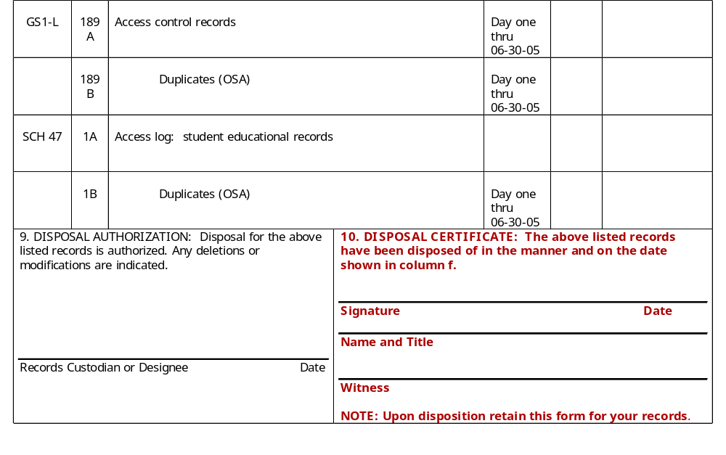
Complete Disposal Certificate
SAMPLE

Slide 33
Complete Disposal Certificate
The school principal or department head and a witness sign in the space provided in Box 10 on page 1 of the form.
Don’t forget to note your school or department name at the bottom of the page!

Slide 34
Important Points to Remember!
The Disposal Authorization helps you comply with the requirements of the Florida Public Records Law.
For effective and efficient operations, you should discard obsolete records as soon as they are eligible for disposal.

Slide 35
Important Points to Remember!
Confidential records must be destroyed in a way that protects the confidentiality of the information.
Stating that records were legally destroyed is an acceptable response to a request for records.

Slide 36

????Questions????
For more information, or to provide feedback on this guide, contact Records Management by email to: akehoe@ecsdfl.us

