Slide 2
Announcement: An optional building and site walk-through will be available to bidders on Friday, April 6 at 9:00 AM. Access to the building will be provided by Jeff Murren, Director of Buildings and Grounds. Mr. Murren can be contacted at murrenj@cvcolonials.org

Slide 3
1
PROJECT OVERVIEW
2
SCOPE REVIEW
3
BIDDING REQUIREMENTS
4
QUESTIONS

Slide 4
1 PROJECT OVERVIEW

Slide 5
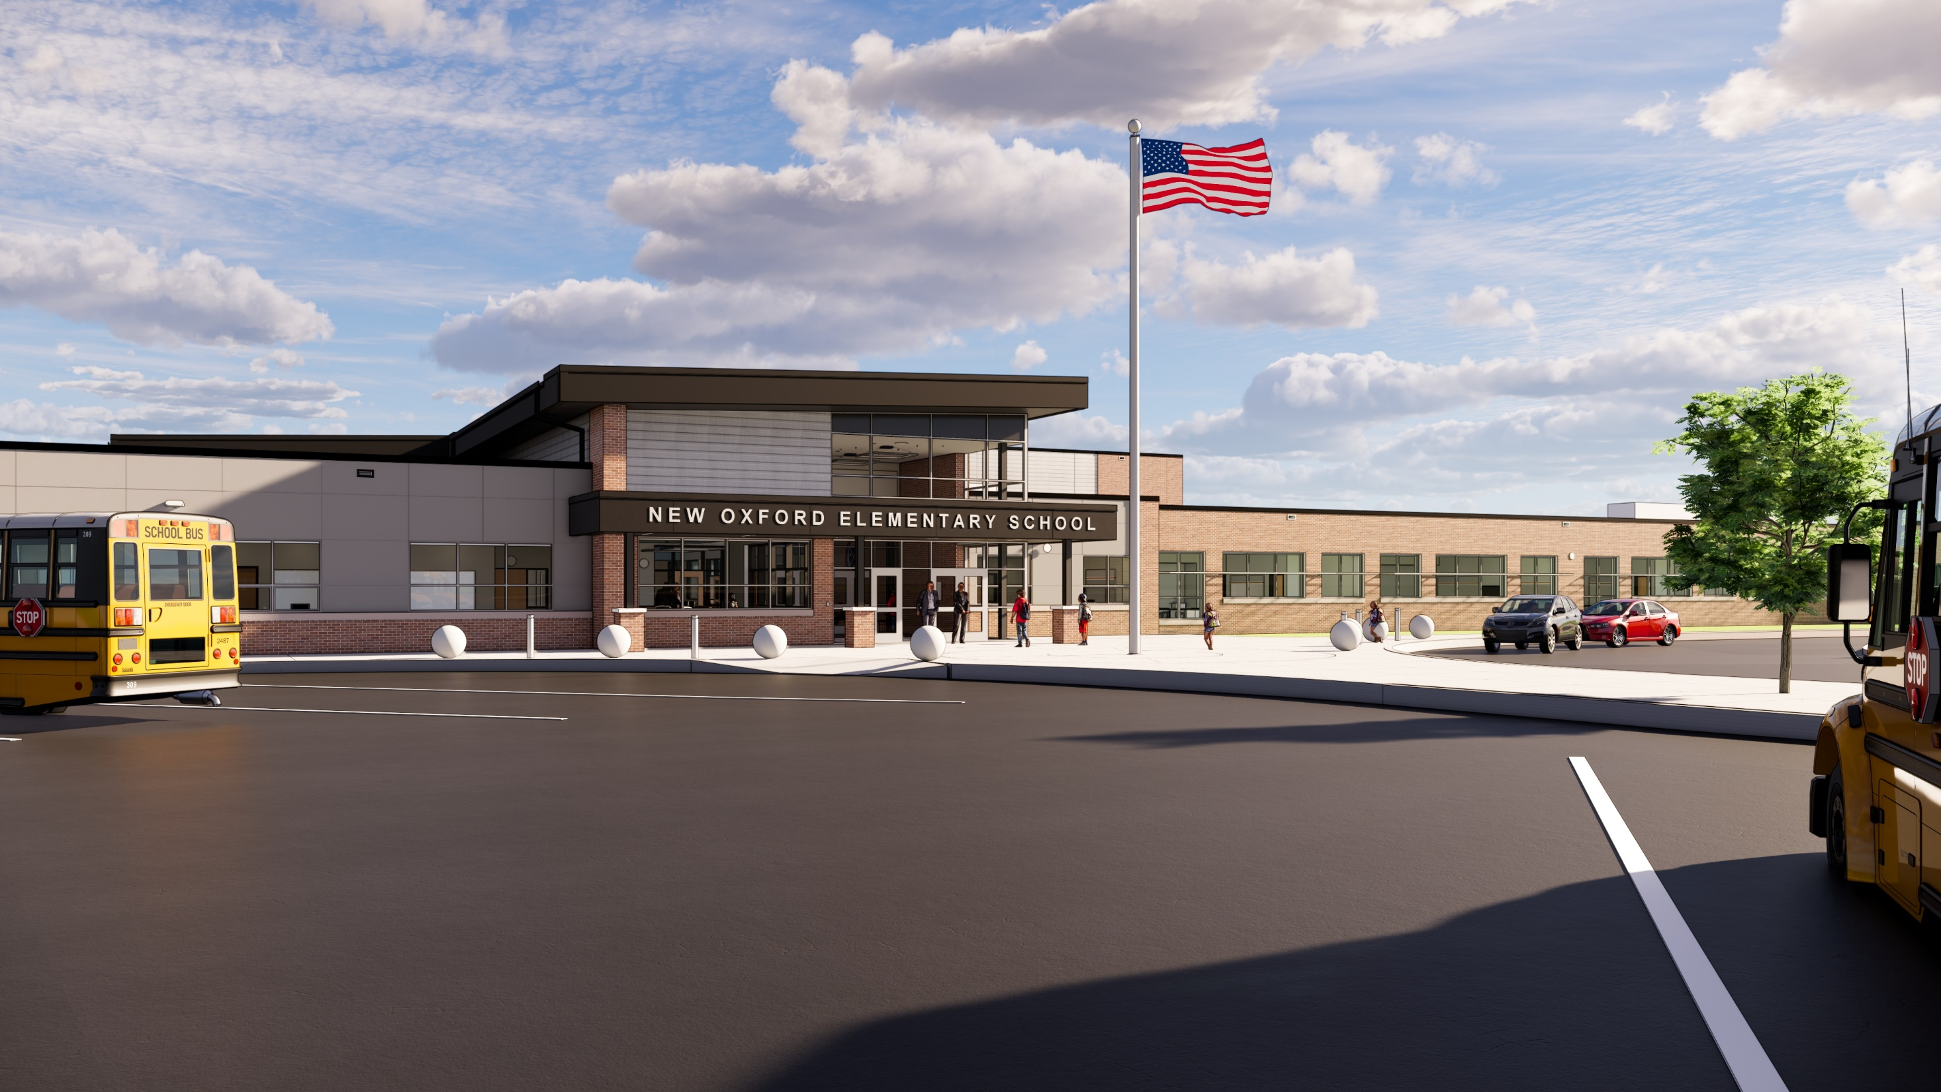
PROJECT OVERVIEW
Introductions
Owner: Conewago Valley School District
Superintendent: Dr. Sharon Perry
Business Manager: Scott Fraser
Principal: Chris Cobb
Director of Building and Grounds: Jeff Murren
Construction Manager: Fidevia Construction Management
Director of Preconstruction: John Michel
Project Coordinator: Madeline Landis
Architect: Crabtree Rohrbaugh & Associates
Principal: Anthony Colestock
Project Architect: Connor Phiel
Construction Administrator: Kevin Bevenour
Engineers: K&W Engineers, Civil
Landscape Architect: Jeff Shyk
Moore Engineering – MEP
HVAC Engineer: Bob Potter
Electrical Engineer: Larry Cronin
Plumbing Engineer: Michael Hunt
Barry Isett & Associates – Structural
Structural Engineer: Ross Sotak

Slide 6
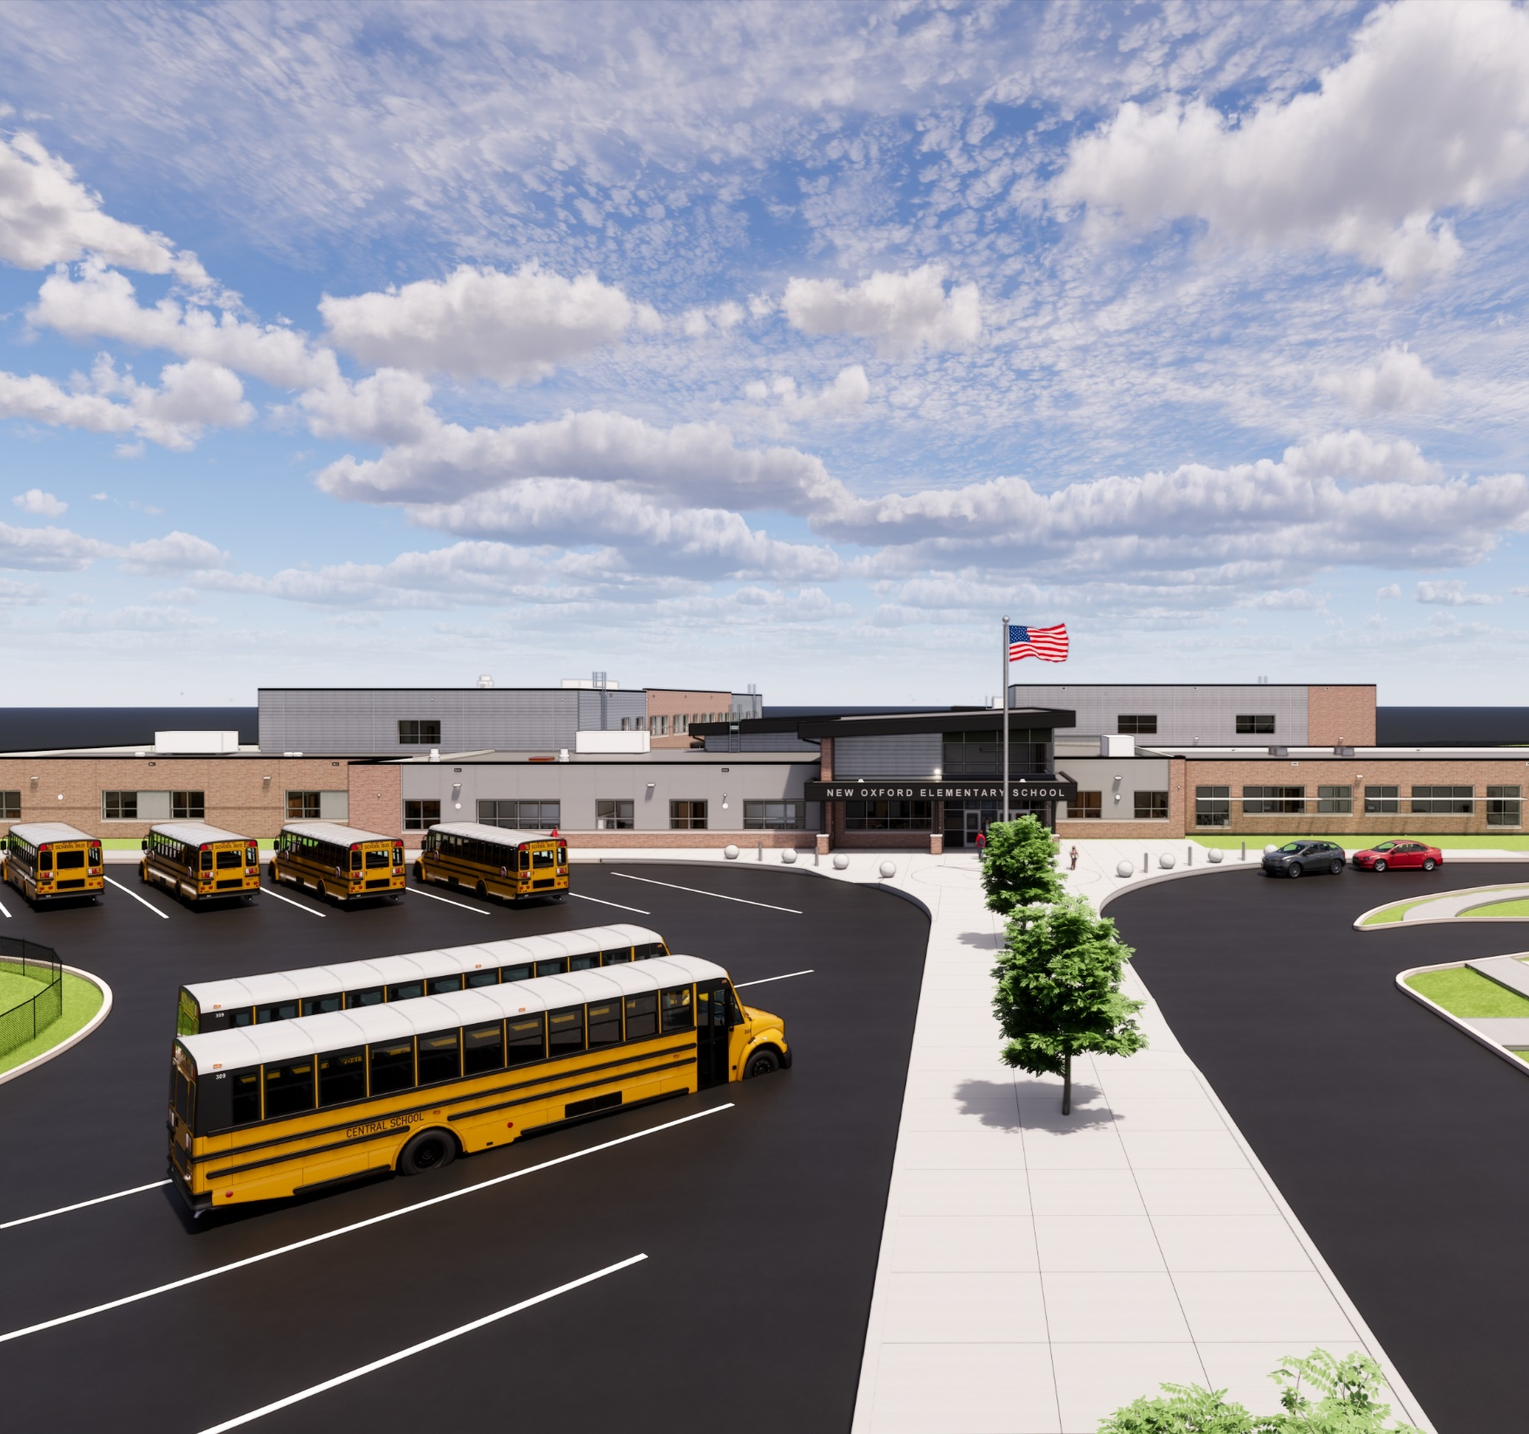
PROJECT OVERVIEW
Project Milestone Dates
Bid Opening
  April 23, 2026
Intent to Award
  May 11, 2026
Notice to Proceed: Start of Construction
  Early-June 2026
Substantial Completion
  August 11, 2028
  December 22, 2028 – Site & K-wing addition

Slide 7
2 SCOPE REVIEW

Slide 8
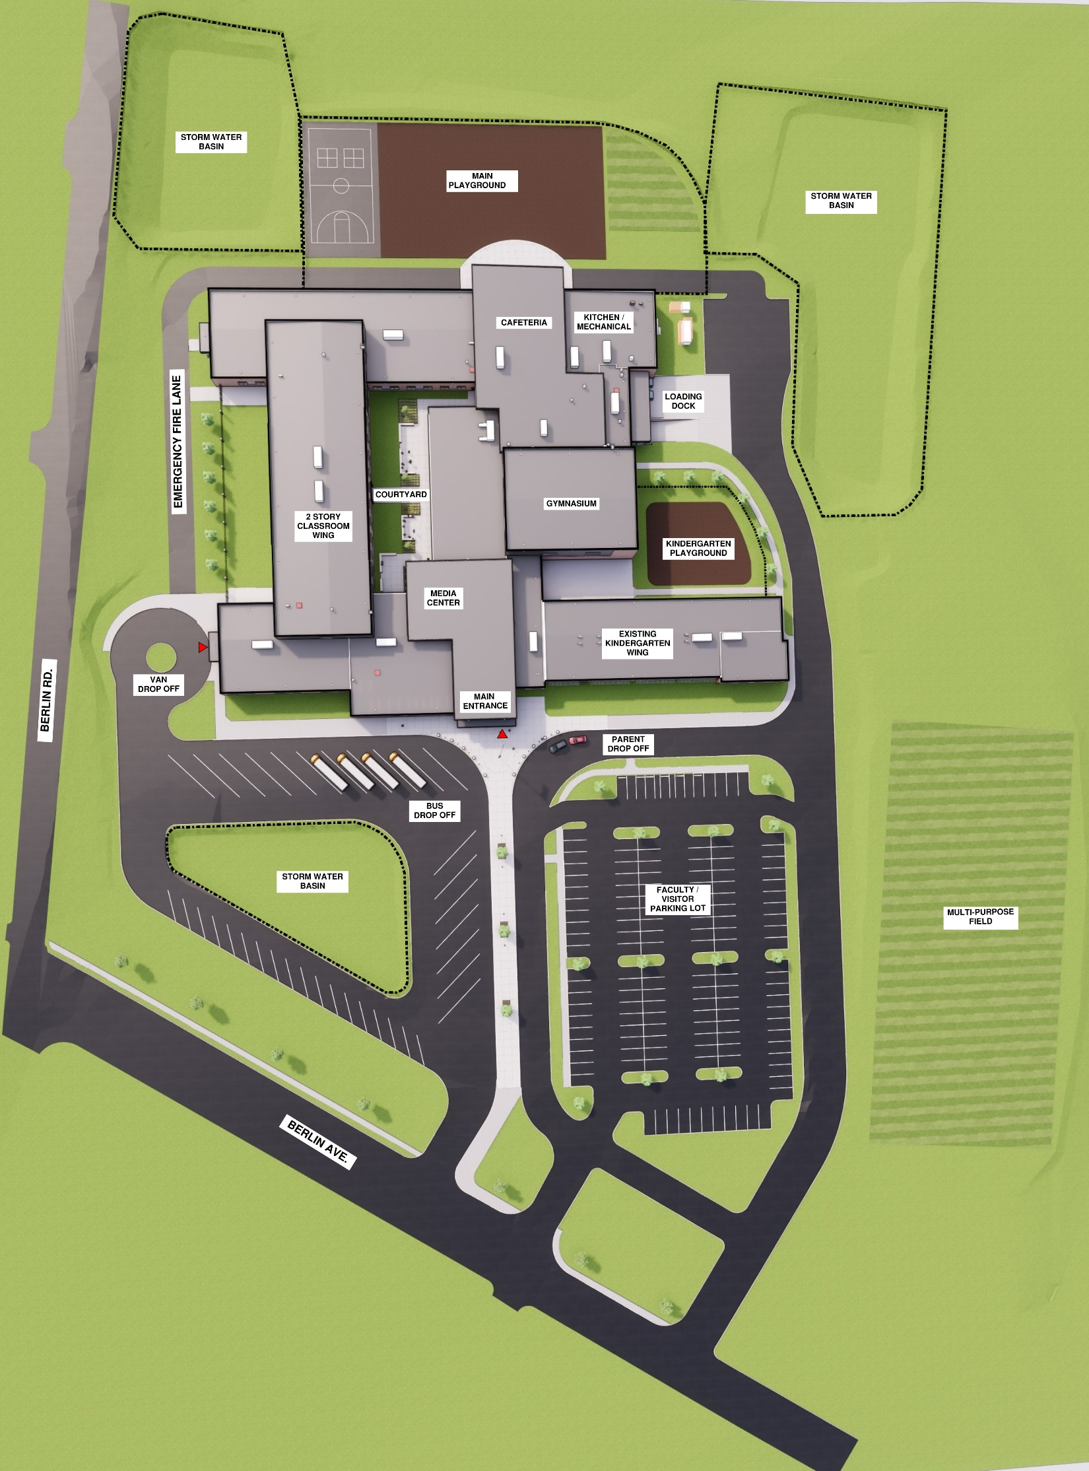
  SCOPE REVIEW
  Site Plan
11
9
11
7
10
8
LEGEND
Main Entrance
Existing Kindergarten Wing
Separate Bus Drop-Off
Parent Drop-Off
Staff & Visitor Parking
Van Drop-Off
Service Drive / Loading Dock
Courtyard
Play Area
Kindergarten Play Area
Stormwater Basin
Multi-Purpose Field
2
4
12
1
5
3
6
11

Slide 9
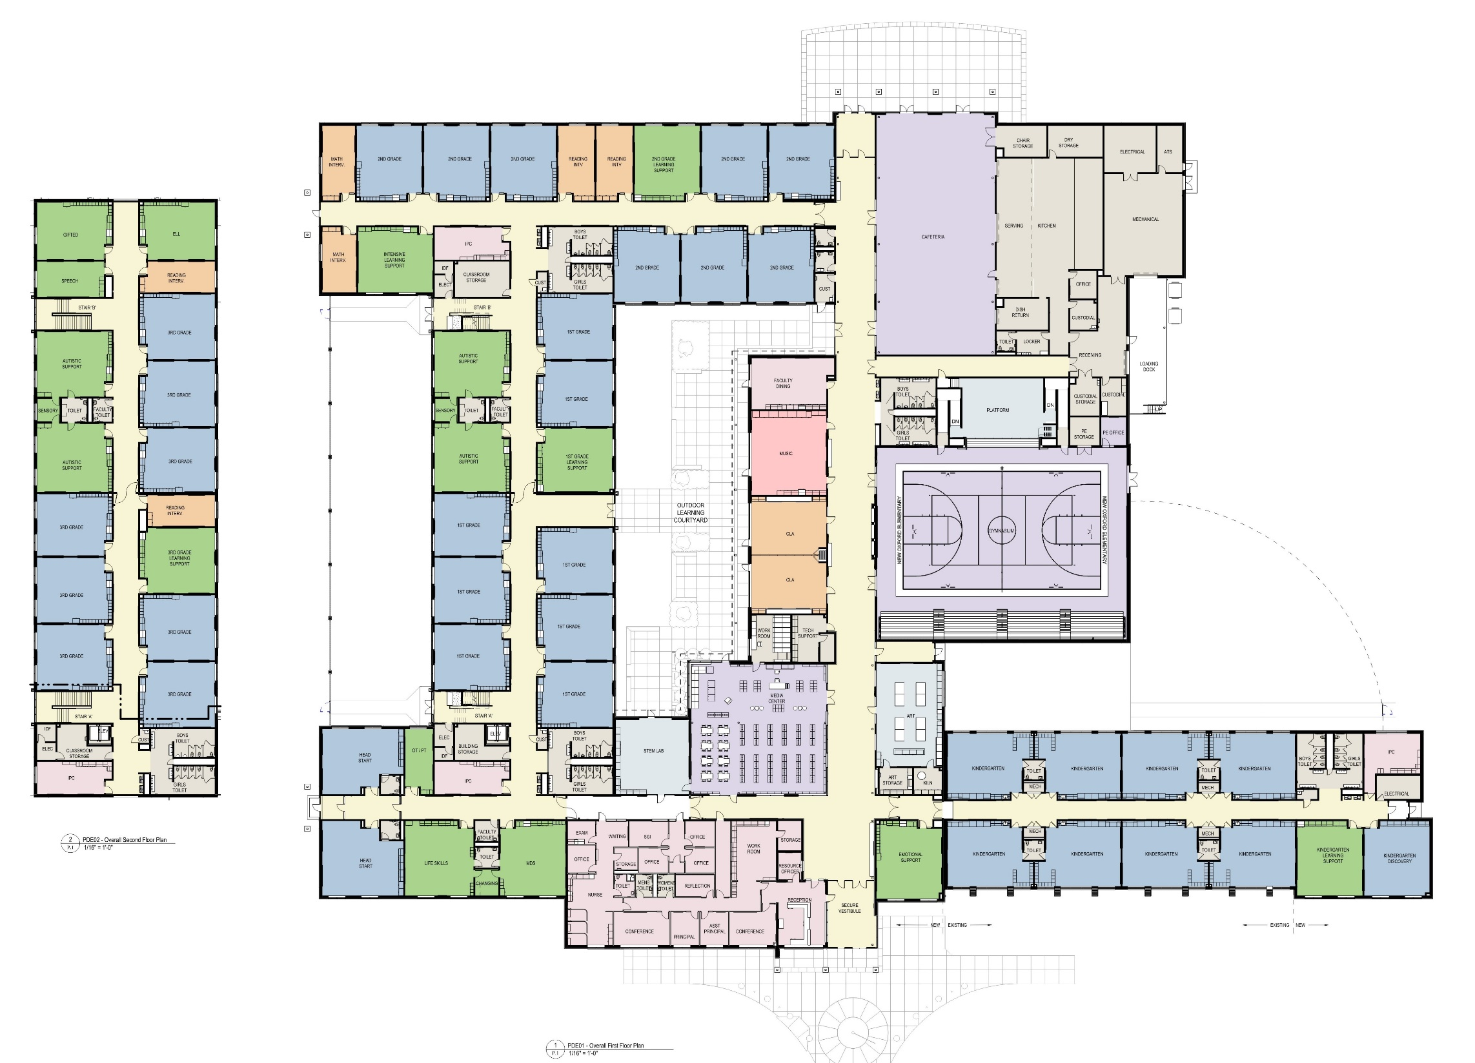
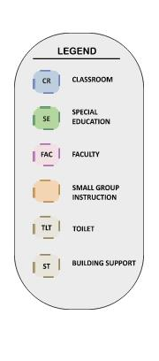
FLOOR PLAN
First Floor
SCOPE REVIEW
Grades K – 3rd
Kindergarten Wing Renovation – 12,000 SF
New Construction – 114,000 SF
  1 & 2 Story Classroom Wings
  New Main Street – Admin, Media Center, Gym, Cafeteria/Kitchen and Specials
2B Non-Combustible Construction
Load Bearing Masonry Construction
Steel Frame Core in Lobby, Media Center, Cafeteria & Gymnasium
Steel Joists & Steel Deck for Floor & Roof Construction
Roof Construction (EPDM w/ 6” Polyiso Insulation)
  Exterior Walls (CMU back-up)
    With Brick Veneer & Metal Panel System
Variable Air Volume Air Handling Units
Fully Sprinkled Fire Protection System
TAB & Commissioning provided by District
Existing Kindergarten Wing

Slide 10

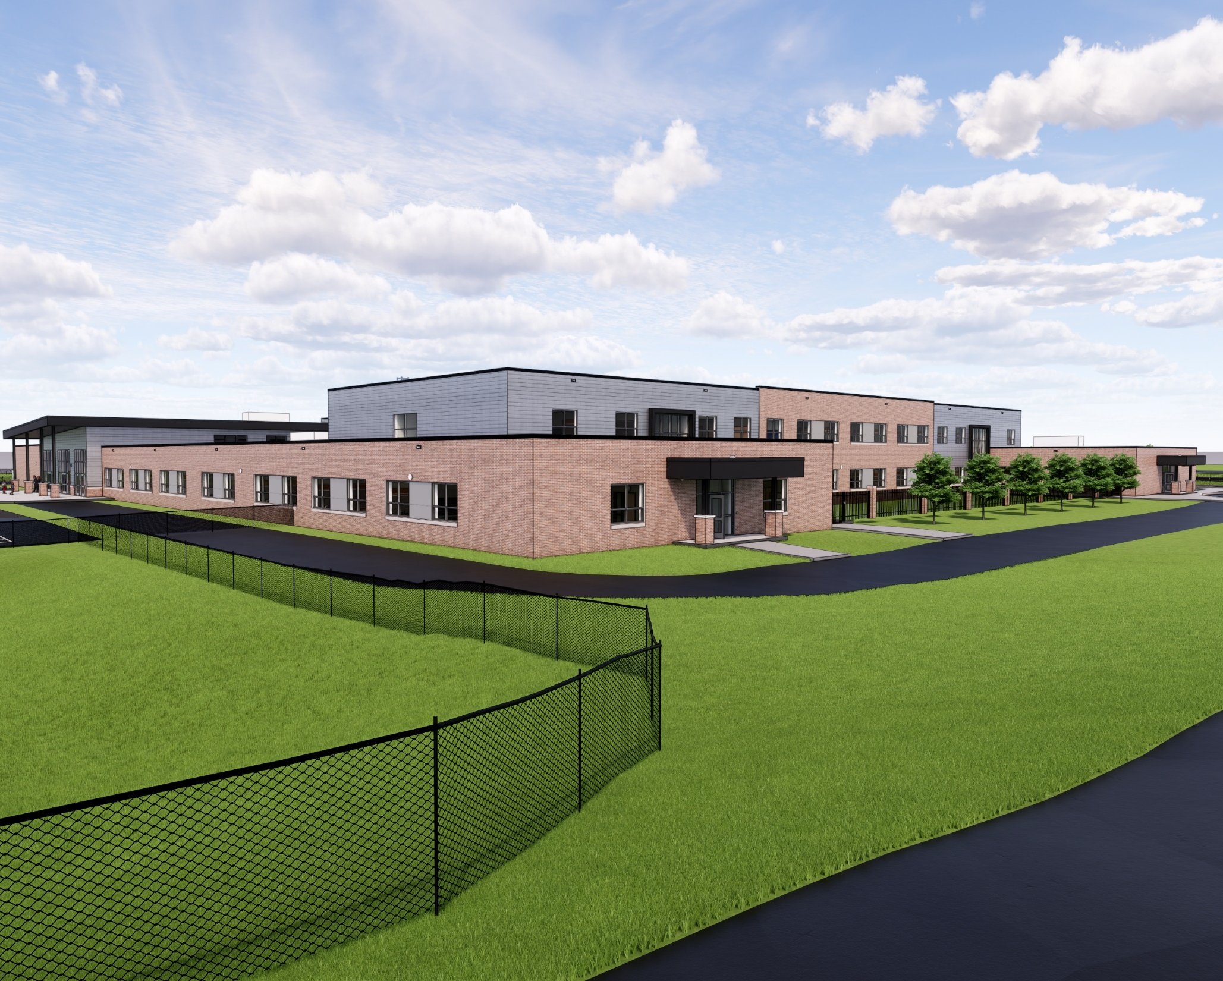
FLOOR PLAN
Second Floor

Slide 11
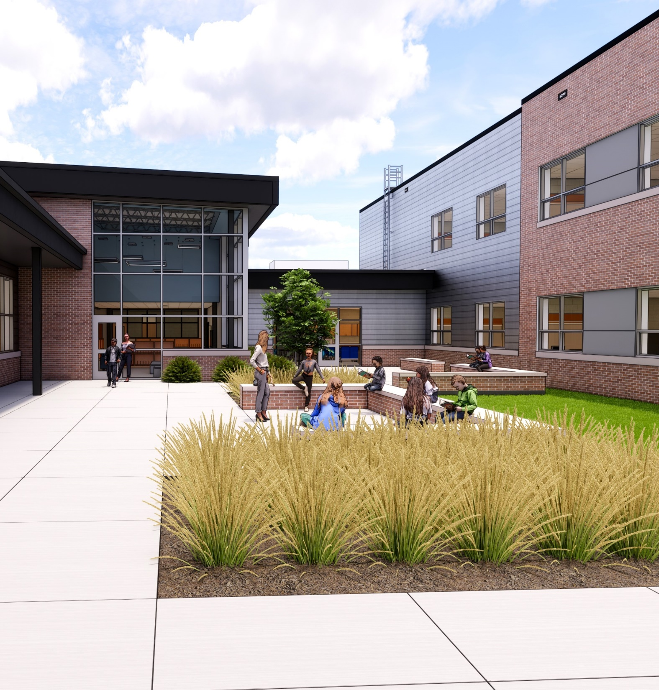
  SCOPE REVIEW
  Alternate Bid Summary
General Construction
Unclassified Excavation – ADD
EPDM Roofing – 30 Year Warranty – ADD
HVAC Construction
Johnson Controls HVAC Equipment – DEDUCT
Carrier HVAC Equipment – DEDUCT
Cook Ventilation Equipment – DEDUCT
Penn Ventilator Ventilation Equipment– DEDUCT
Captiveaire Ventilation Equipment– DEDUCT
Plumbing Construction
Unclassified Excavation - ADD
Electrical Construction
Unclassified Excavation – ADD
Site Construction
Unclassified Excavation - ADD

Slide 12
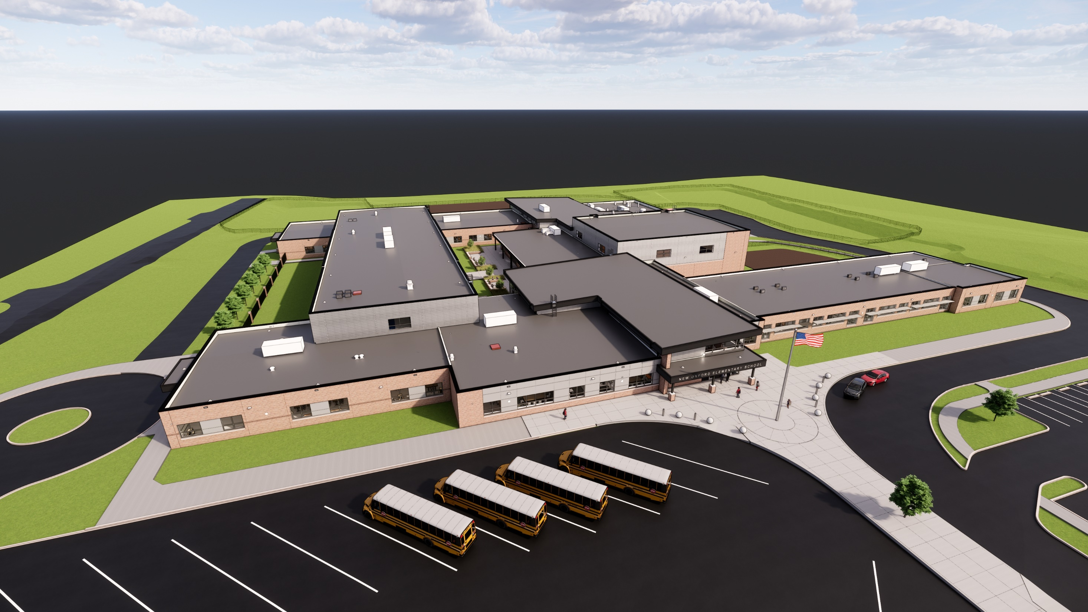
Aerial View
* Renderings are for Orientation only, images generated during design prior to Final Construction Documents, CD’s take precedence.

Slide 13
Aerial View Of New Main Entrance
*Exterior Renderings are for Orientation only, images generated during design prior to Final Construction Documents, CDs take precedence

Slide 14
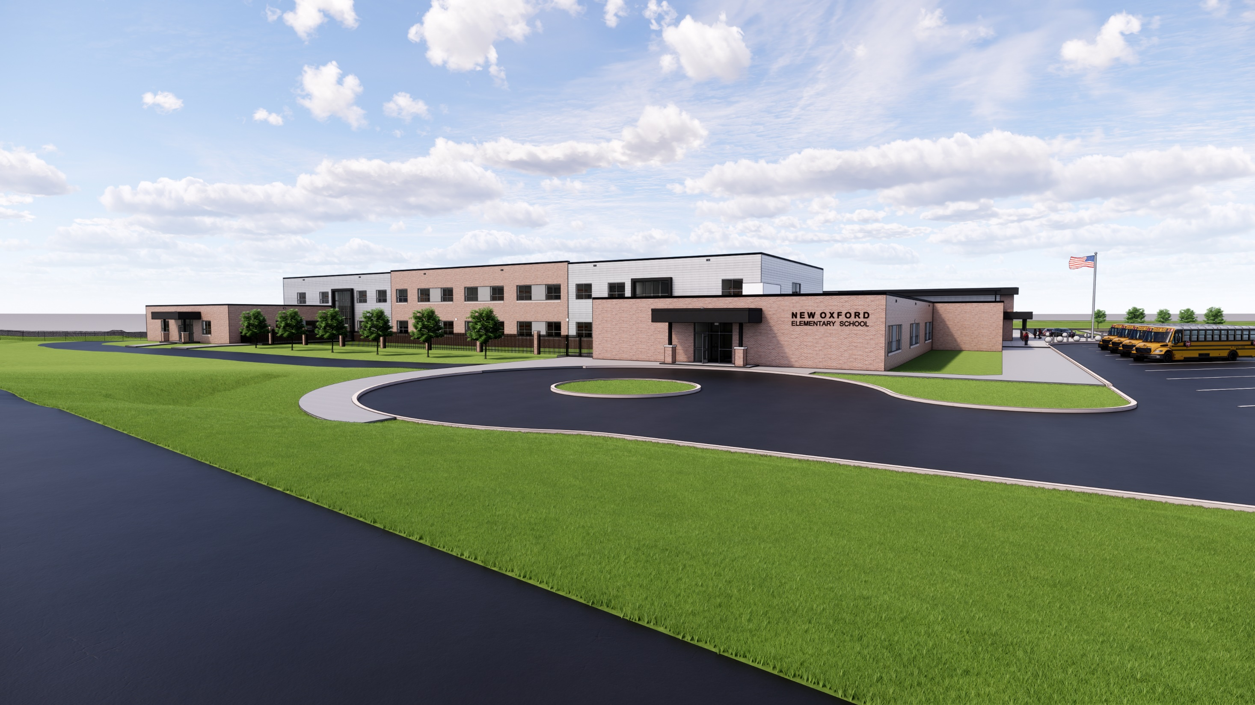
View from Berlin Road
*Exterior Renderings are for Orientation only, images generated during design prior to Final Construction Documents, CDs take precedence

Slide 15
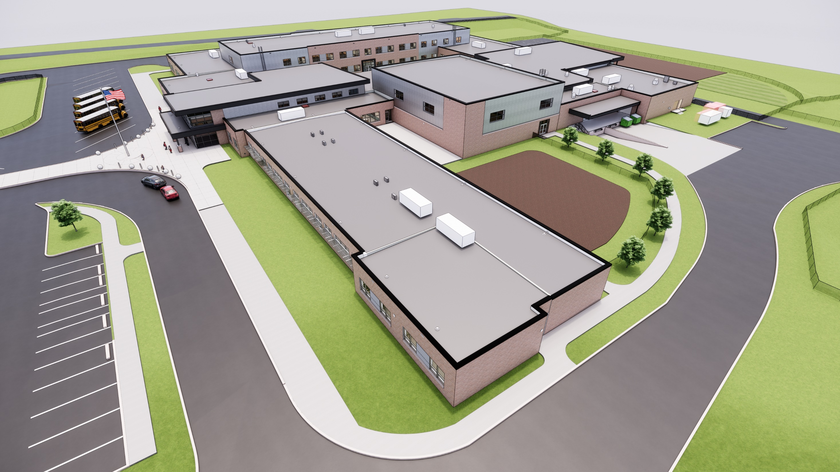
Aerial View of Existing Kindergarten wing and addition
*Exterior Renderings are for Orientation only, images generated during design prior to Final Construction Documents, CDs take precedence
Existing Kindergarten Wing

Slide 16
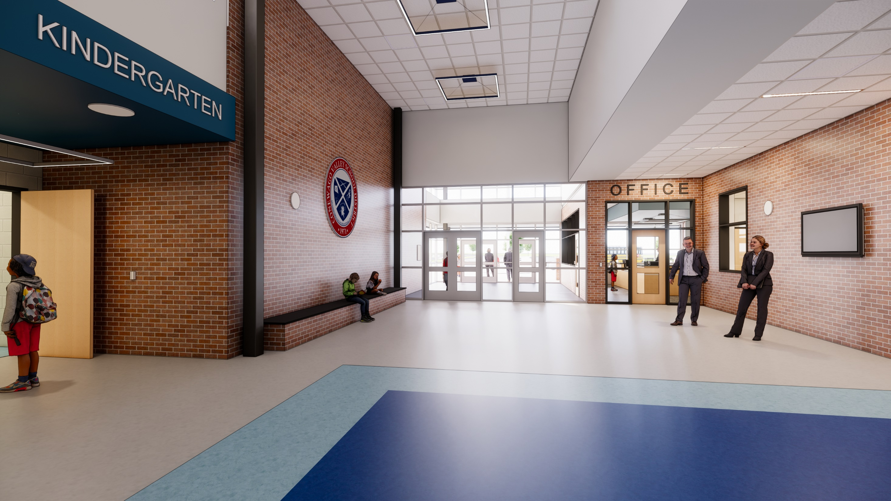
Main Lobby
*Exterior Renderings are for Orientation only, images generated during design prior to Final Construction Documents, CDs take precedence

Slide 17
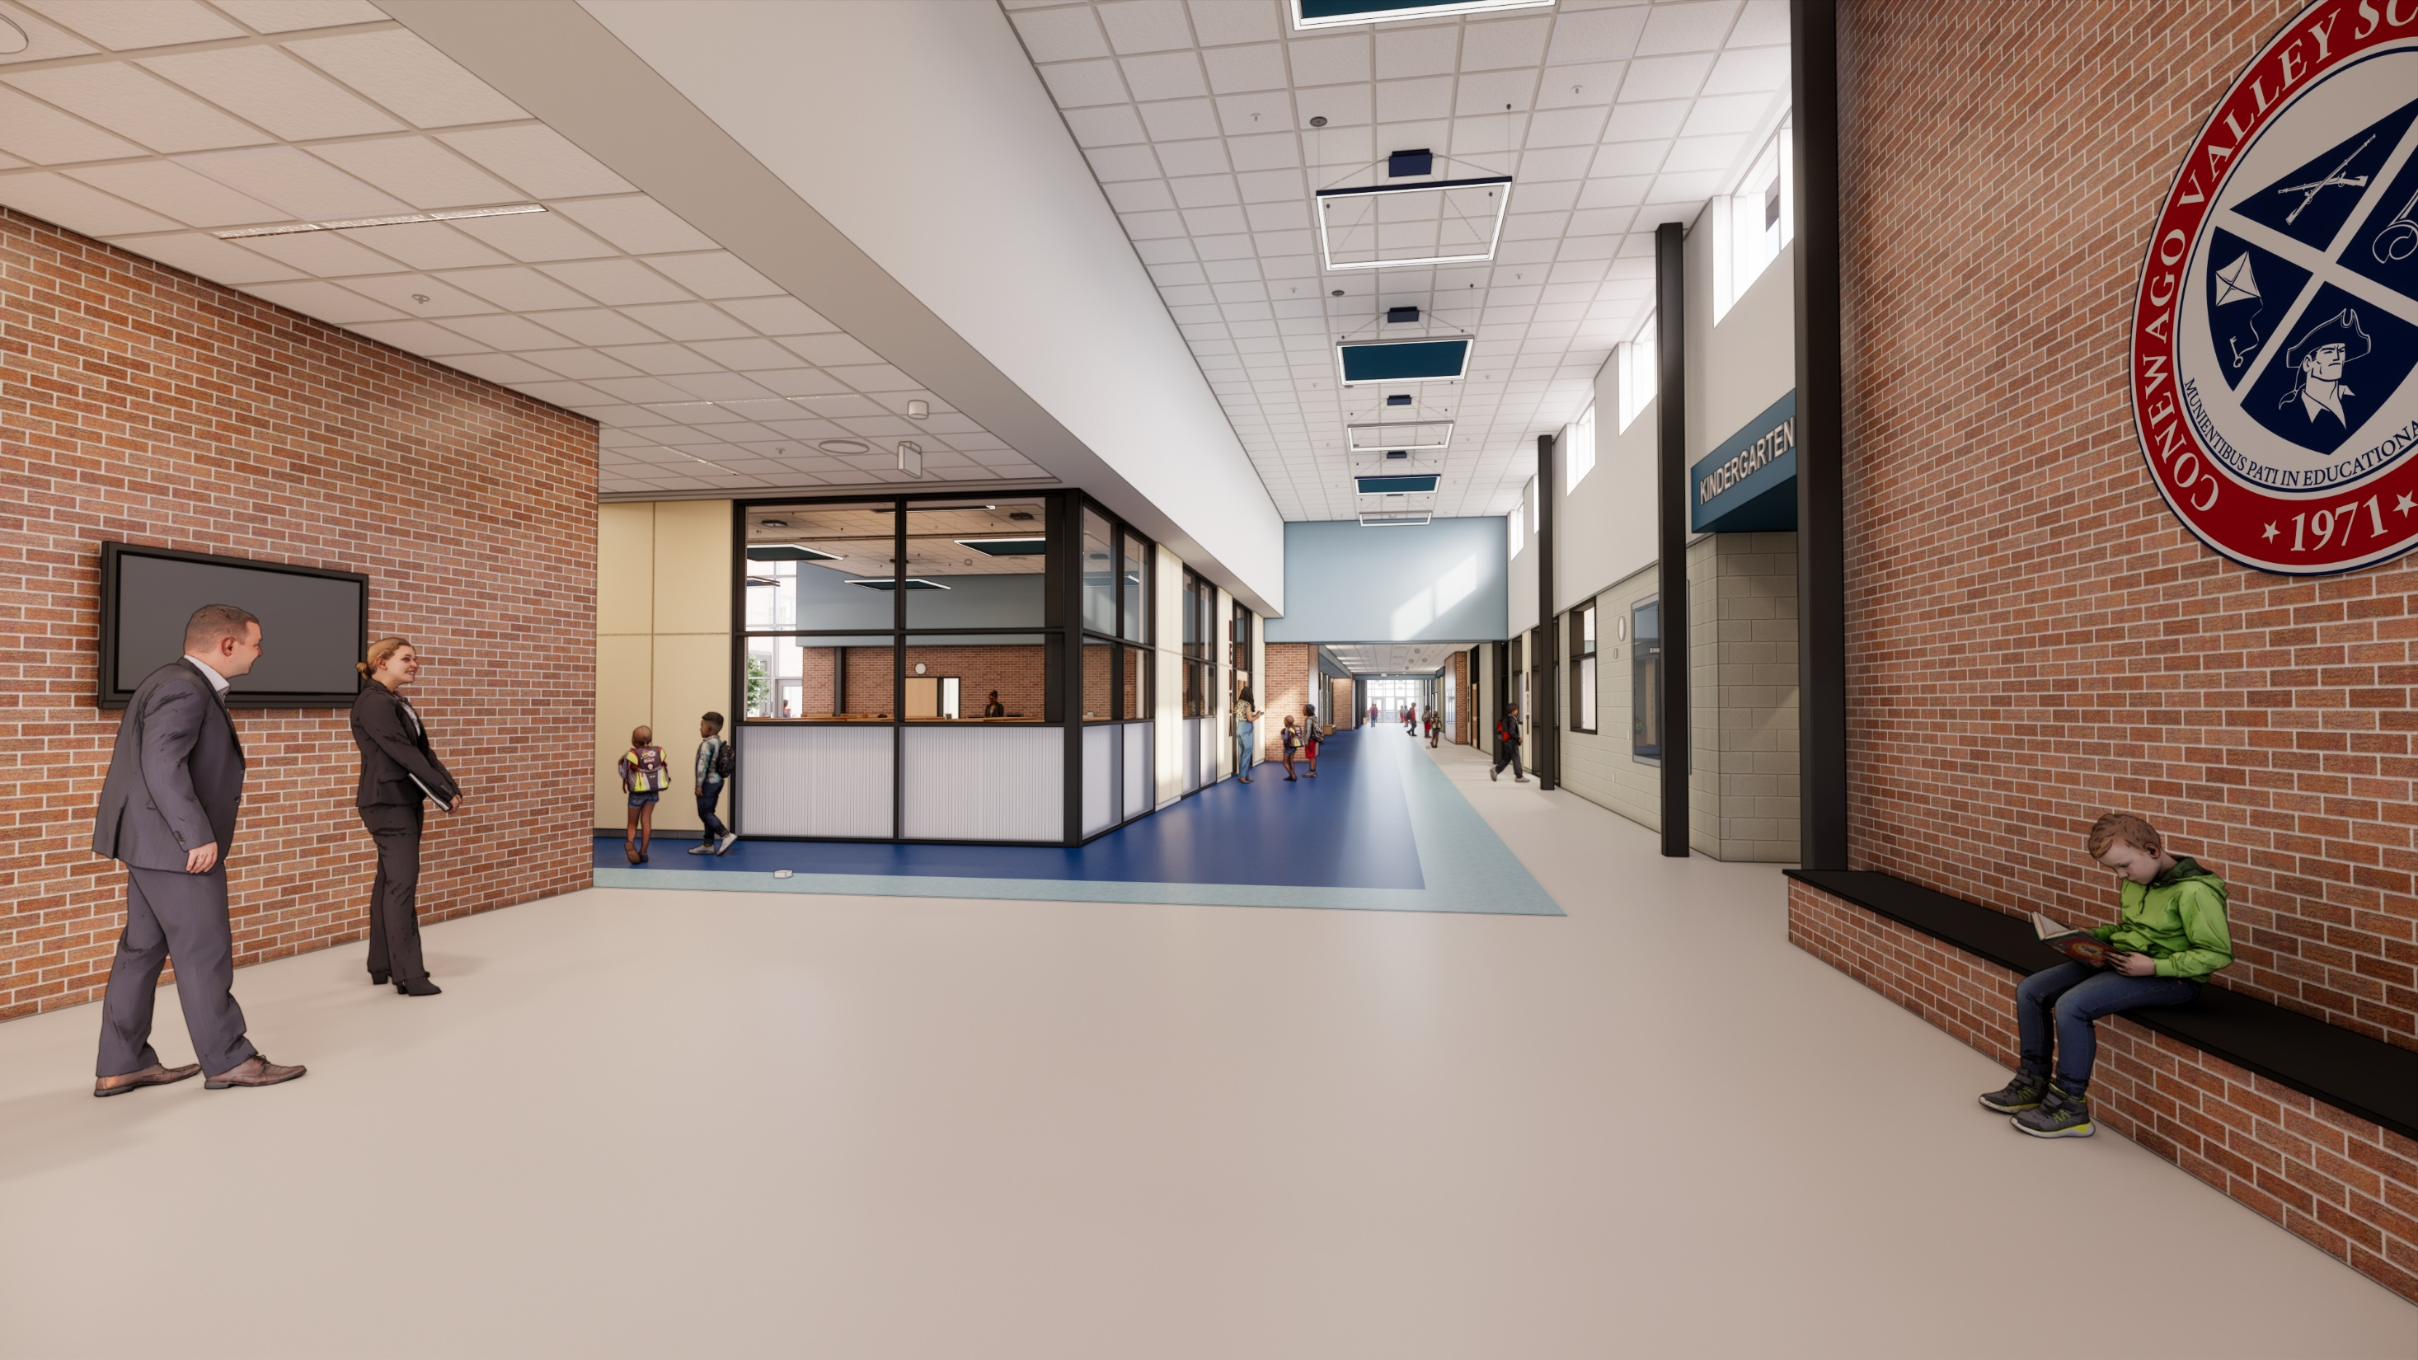
Main Lobby
*Exterior Renderings are for Orientation only, images generated during design prior to Final Construction Documents, CDs take precedence

Slide 18
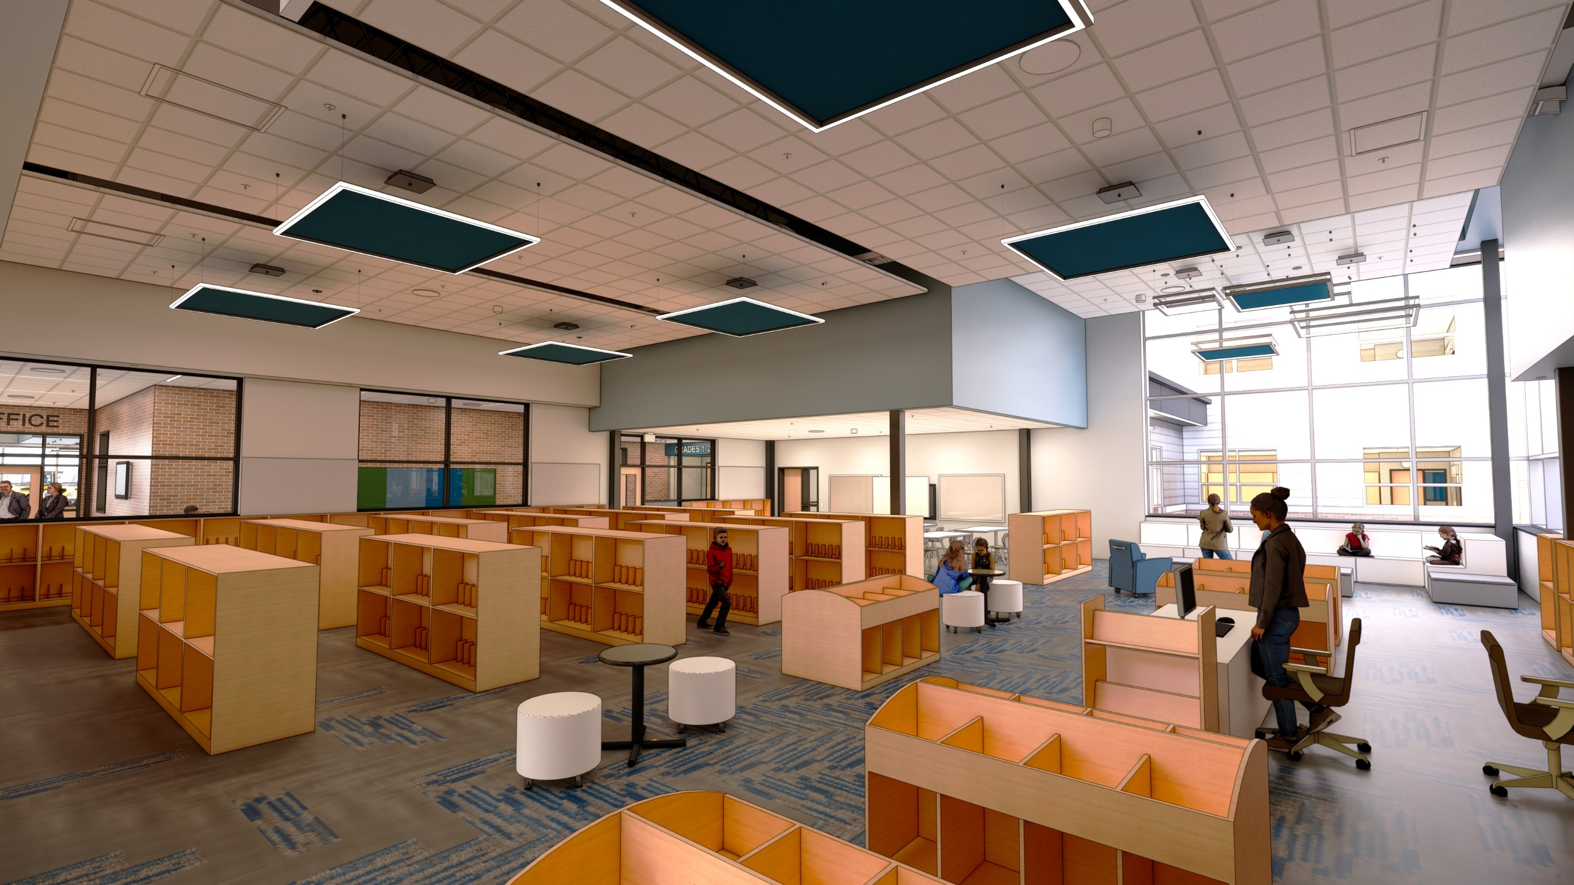
Media Center
*Exterior Renderings are for Orientation only, images generated during design prior to Final Construction Documents, CDs take precedence

Slide 19
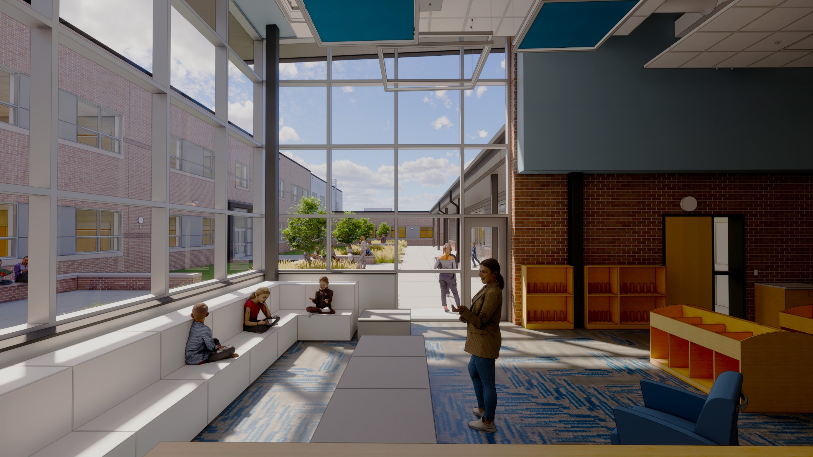
Media Center
*Exterior Renderings are for Orientation only, images generated during design prior to Final Construction Documents, CDs take precedence

Slide 20
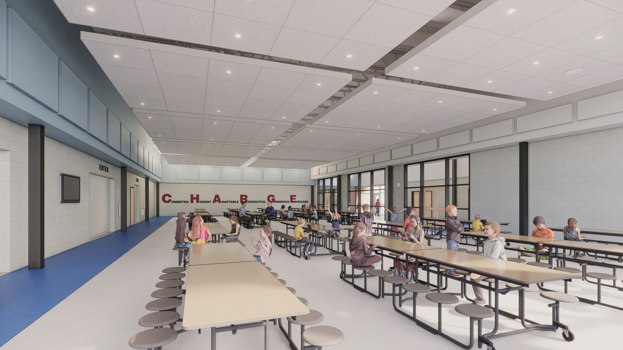
Cafeteria
*Interior Renderings are for Orientation only, images generated during design prior to Final Construction Documents, CDs take precedence

Slide 21
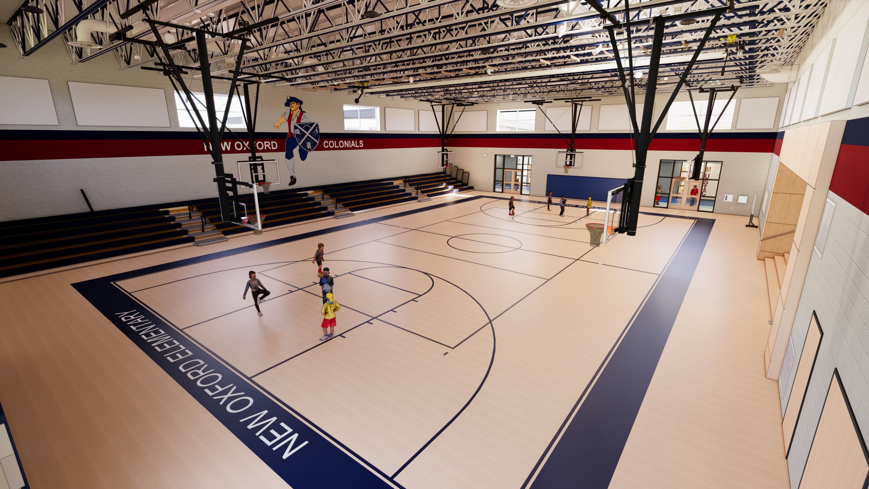
Gymnasium
* Interior Renderings are for Orientation only, images generated during design prior to Final Construction Documents, CD’s take precedence.

Slide 22
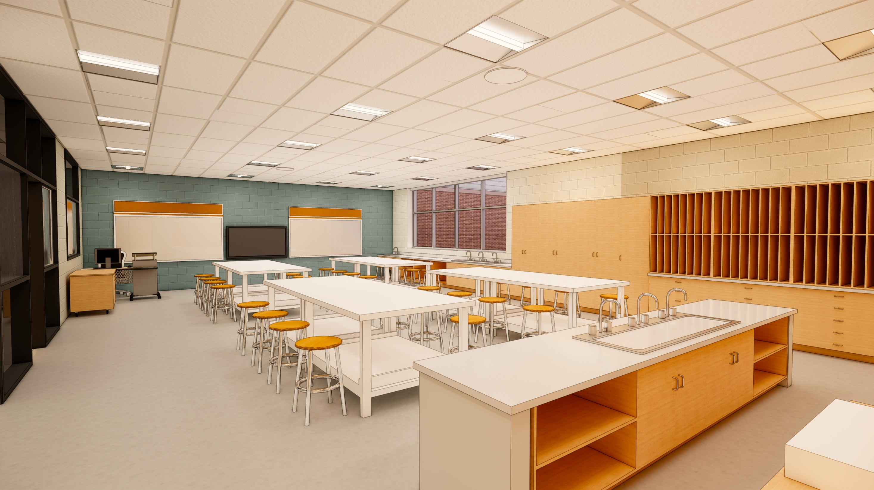
Art Classroom
* Interior Renderings are for Orientation only, images generated during design prior to Final Construction Documents, CD’s take precedence.

Slide 23
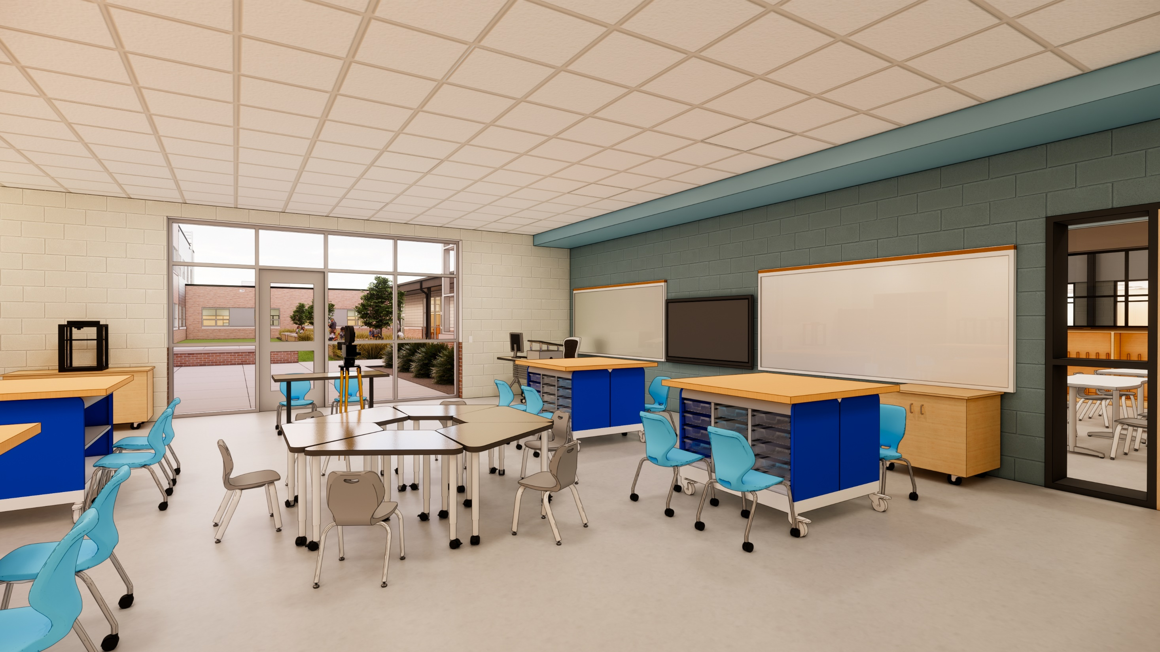
STEAM Classroom
* Interior Renderings are for Orientation only, images generated during design prior to Final Construction Documents, CD’s take precedence.

Slide 24
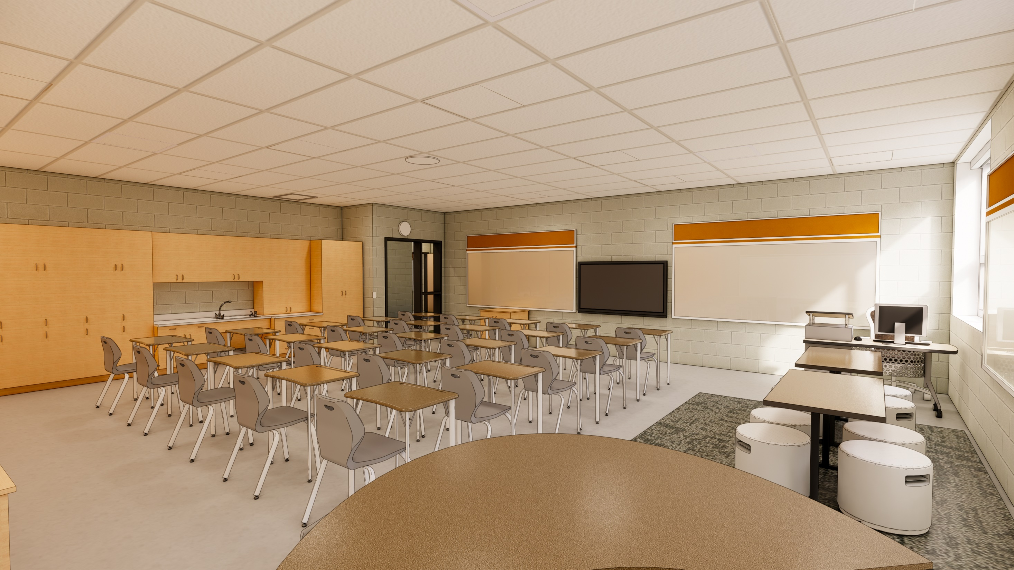
Typical Classroom
* Interior Renderings are for Orientation only, images generated during design prior to Final Construction Documents, CD’s take precedence.

Slide 25
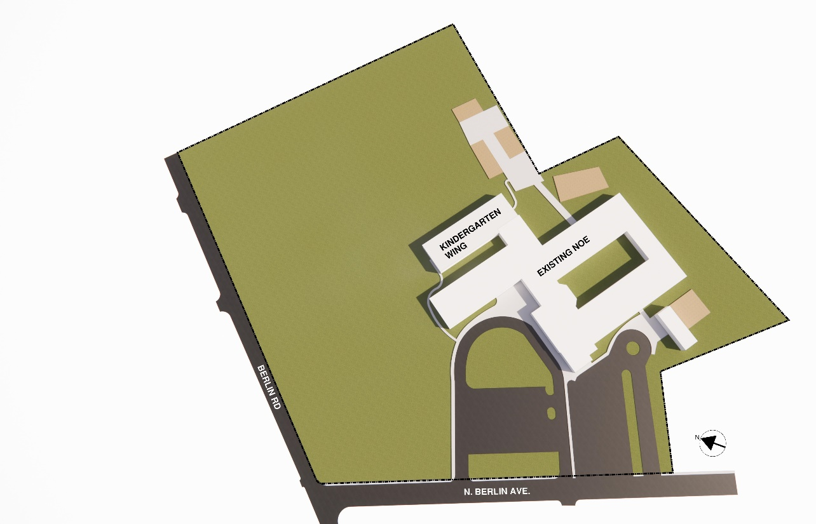
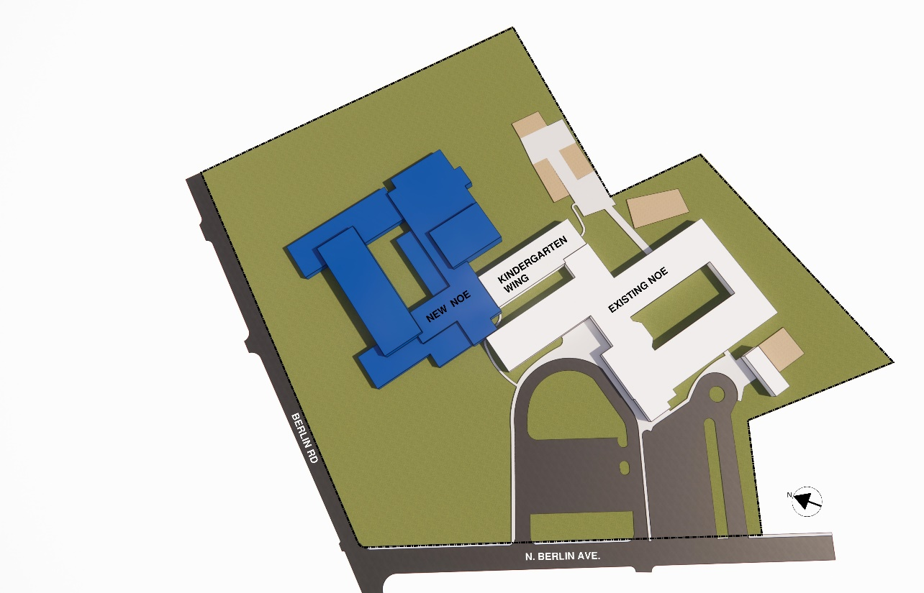
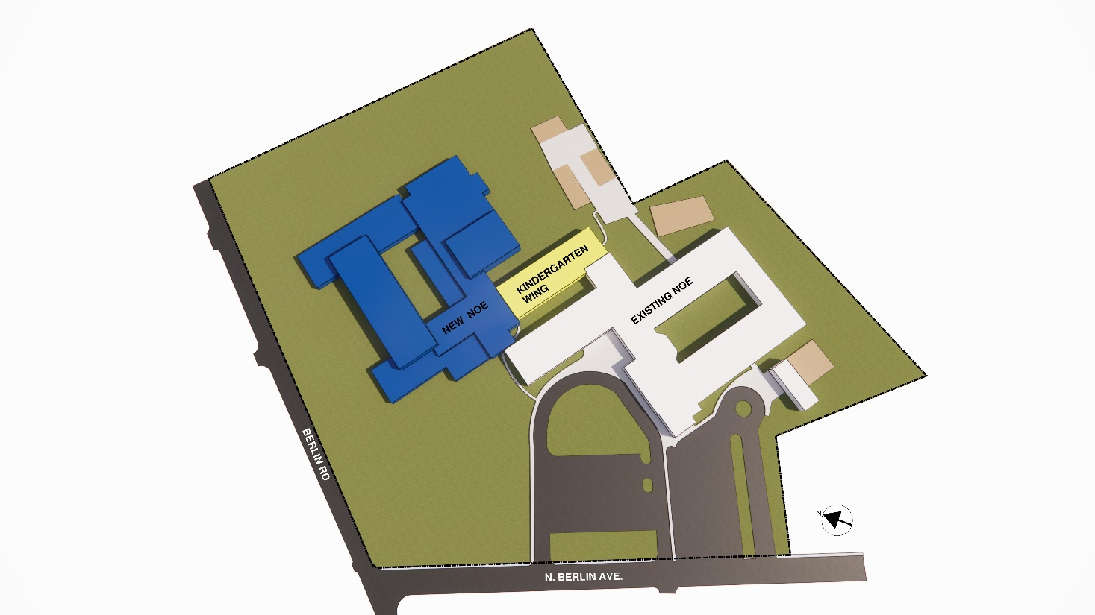
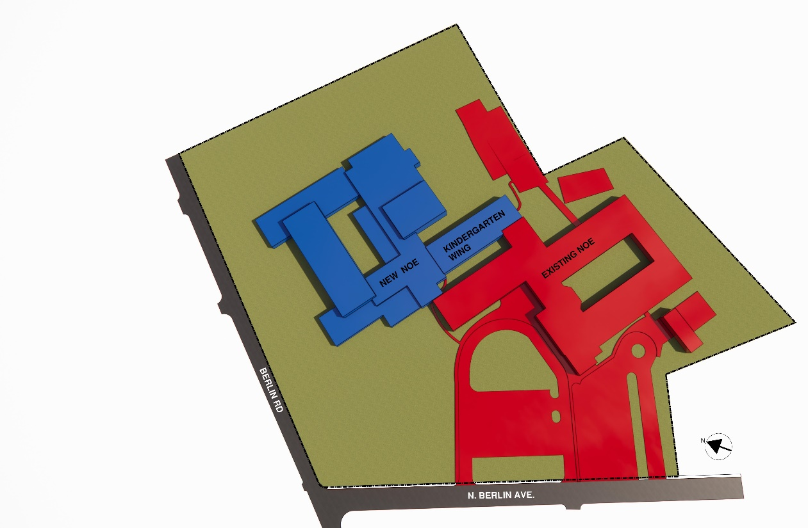
June 2026 – Aug 2028:
New 114,000 Addition
Construction
Sequencing
Existing Conditions
PHASING PLANS
Logistics:
  Refer to Drawing SL1.1 for laydown, job trailer and contractor parking
2. June 2028 - Aug 2028:
Kindergarten Reno
Bus Drop-off
3. June 2028 - Dec 2028:
Asbestos Abatement
(by others)
Building Demo
Kindergarten Add
Parent Drop-off
Parking Lot
Multi-Purpose Field

Slide 26
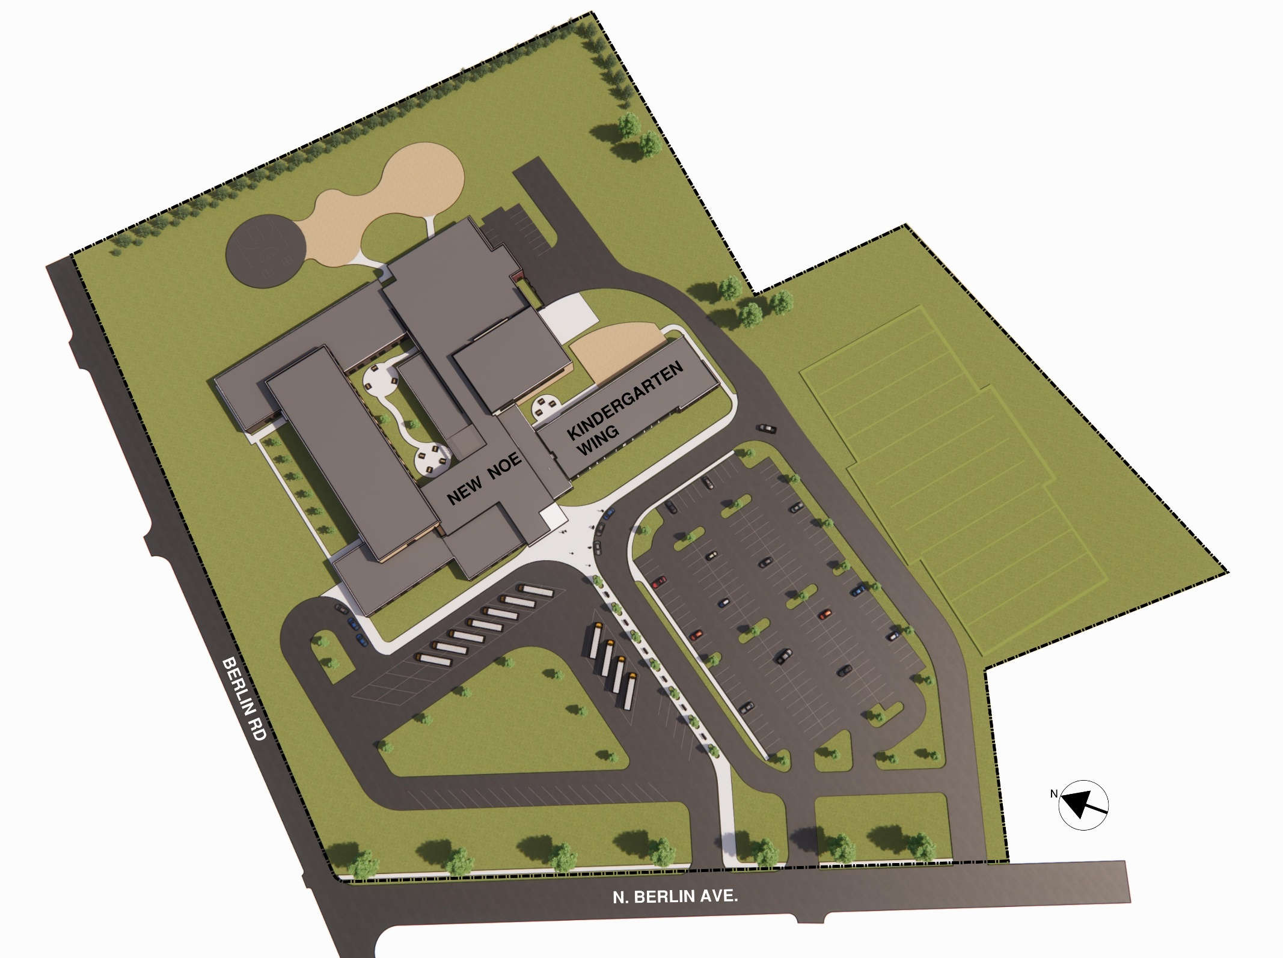
Site & Building Construction
Final Completion

Slide 27
3 BIDDING REQUIREMENTS

Slide 28

BIDDING REQUIREMENTS
DRAWINGS AND BID COMMUNICATION:
Bidders may obtain bidding documents in hard copy and/or .pdf electronic format.
Plans and Specifications
  Printed copies - $500.00
  Electronic copies – No Charge
Submit requests to bidding@cra-architects.com. Mail checks to Crabtree, Rohrbaugh & Associates, 401 E. Winding Hill Rd., Mechanicsburg, PA 17055
The following information shall be furnished by bidders when obtaining bidding documents:
Bidder’s mailing address
Name of Bidder’s representative
Bidder’s telephone number
Bidder’s facsimile number
Bidder’s email address (email address used to submit the .pdf’s)
Bidding documents requested, by Contract and Contract number
Bidding documents may be viewed at BX noted in the advertisement. It is highly recommended to purchase drawings and don’t rely on BX.
Submit Bid RFI’s to bidding@cra-architects.com

Slide 29
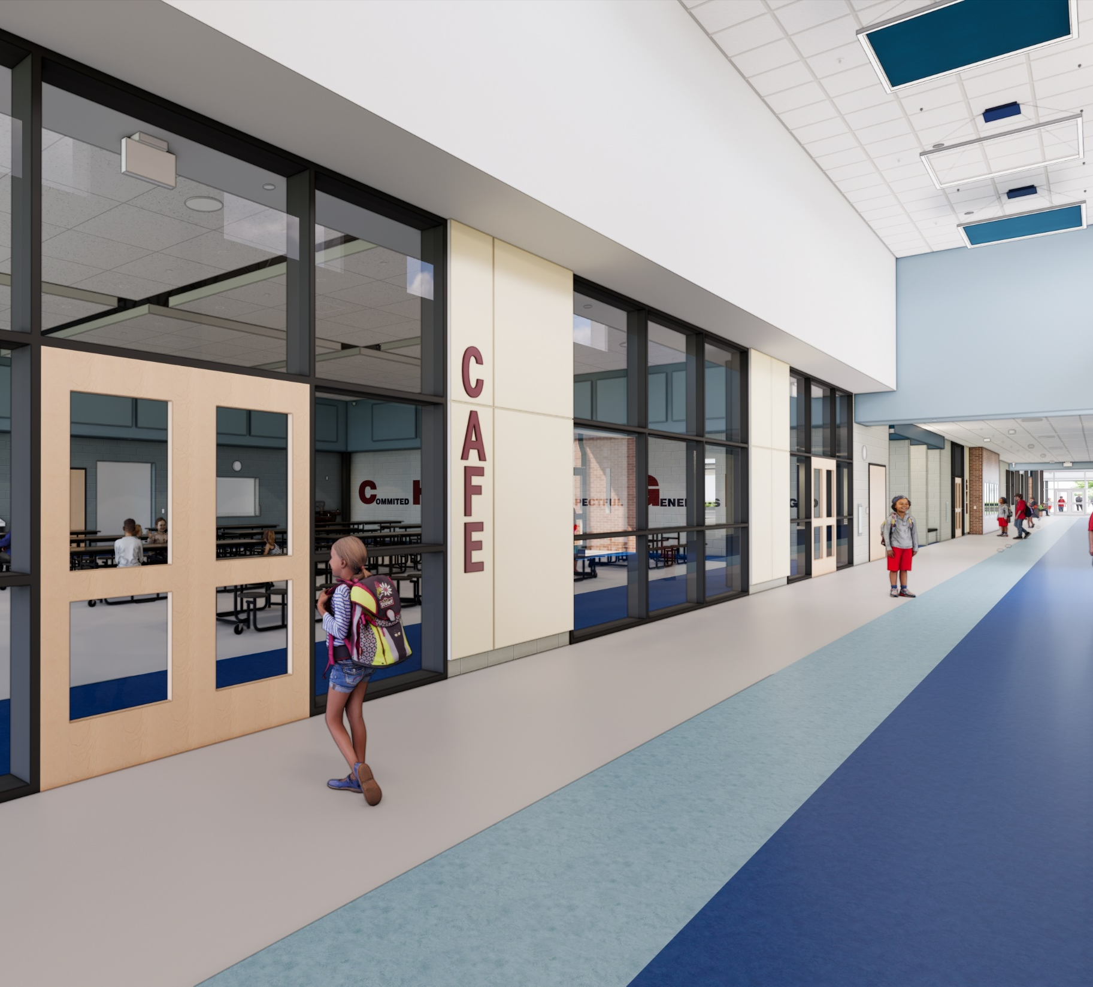
BIDDING REQUIREMENTS
Key Dates
Site Visits contact Jeff Murren @
murrenj@cvcolonials.org
Addenda are anticipated to be issued weekly on Mondays (March 30 April 6, 13 & 20)
Final Request for Information (RFI’s) are due within 5 business days of Bid Opening (April 16)
Last Addenda issued 2 days prior to Bid Opening (April 21) – Revised Bid Forms
Bid Opening on April 23, 11 AM @ Conewago Valley School District Administration Office

Slide 30
BIDDING REQUIREMENTS
ADVERTISEMENT FOR BID
Notice is hereby given that sealed bids for construction of Additions and Renovations to New Oxford Elementary School, 116 North Berlin Avenue, New Oxford, Pennsylvania 17350 will be received at the Administrative Offices of the Conewago Valley School District, 130 Berlin Road, New Oxford, PA 17350 until 11:00 A.M., prevailing time, on April 23, 2026. Bids must be submitted to the attention of Scott Fraser, Business Manager. Bids shall be submitted in sealed envelopes bearing the name of the Bidder and shall be clearly marked “New Oxford Elementary School”. Bids will be publicly opened and read aloud immediately after the scheduled closing time for receipt of Bids. Bids received after the above-referenced date and time shall be returned to the Bidder unopened.

Slide 31
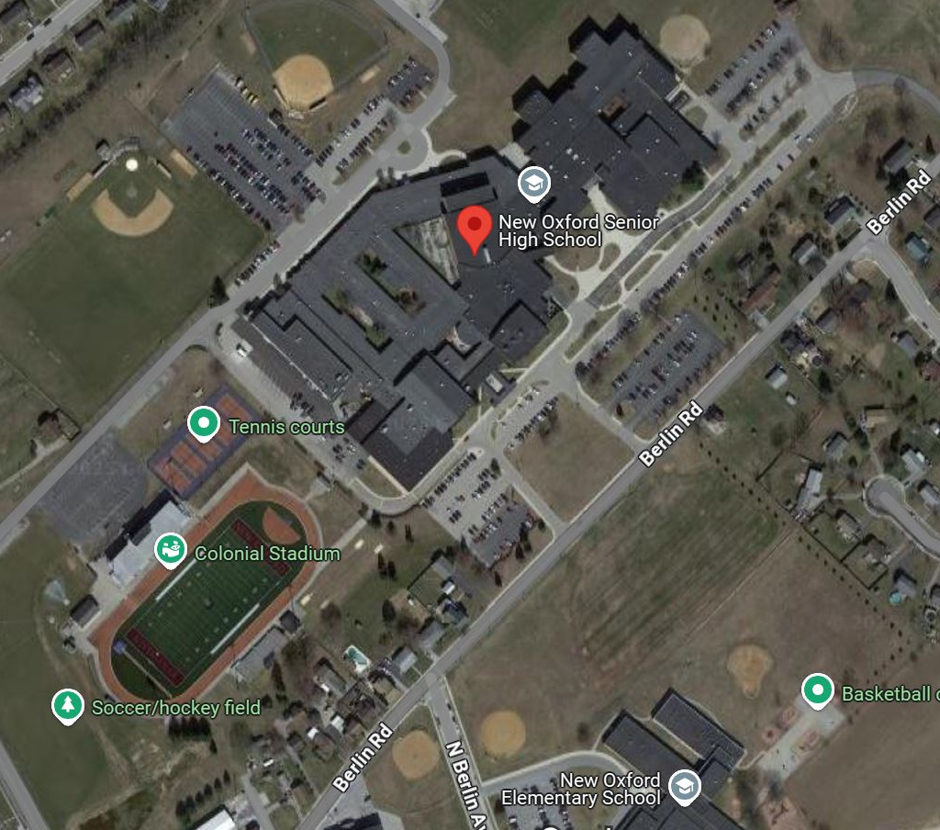
BIDDING REQUIREMENTS
Bid Drop Off Location
WHEN
Thursday, April 23, 2026
Doors closed and no bids accepted after 11:00 AM. District’s clock will serve as official clock for bid submission
WHERE
Conewago Valley District Administration Office
130 Berlin Road
New Oxford, PA 17350
BID OPENING
Public Bid Opening will begin promptly at 11:00 AM in the Board Room.

Slide 32
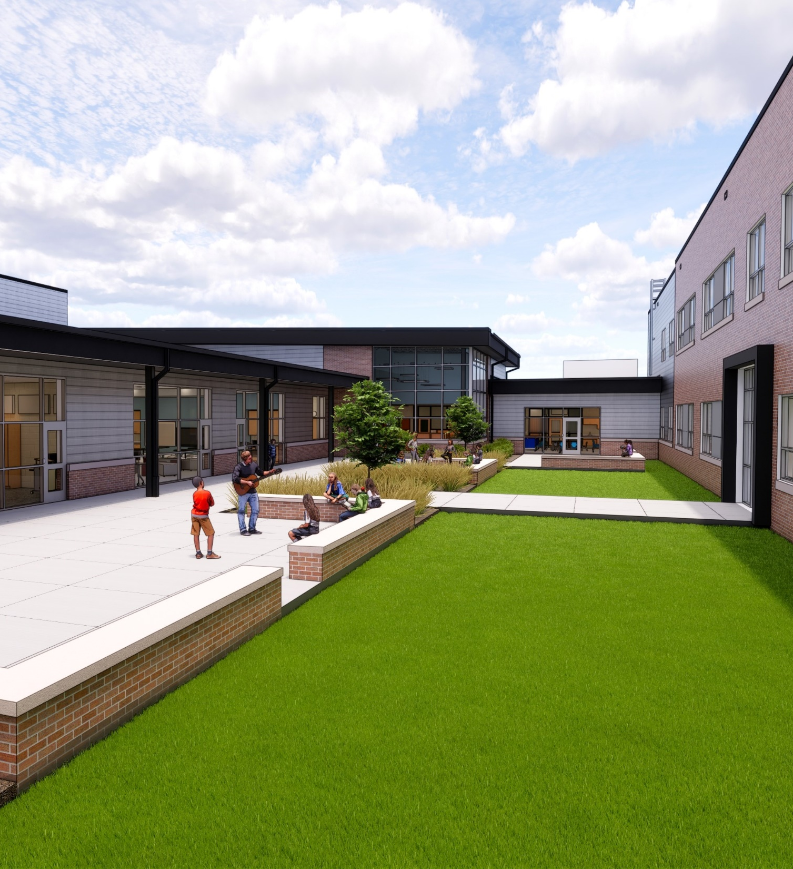
BIDDING REQUIREMENTS
Bid Forms
Alternates
  As Indicated
  Failure to enter an amount or “No Change” or the value of “$0” or “Not Applicable” for an Alternate shall be construed to mean that no change in the Base Bid is required.
Unit Prices
  Refer to Specification Section 012200 Unit Prices
Include with (2) copies of Bid Form:
  (2) Copies Bid Bond
  (2) Copies Non-Collusion Affidavit
  (2) Copies Compliance with 111 of the Public School Code
  (2) Copies Non-Discrimination Affidavit
  (2) Copies Workers Compensation Affidavit
  (2) Copies Bidder’s Qualifications, AIA Document A305
Refer to Front End Specification for additional info and Bid Forms
You will be bidding as a Prime Contractor to the CVSD.

Slide 33
BIDDING REQUIREMENTS
Additional Information
BID DOCUMENTS
All bidders are required to familiarize themselves with the site, building, and all bidding documents including General Conditions and Requirements, Bid Package Descriptions, Temporary Facilities, etc. Submission of bid acknowledges that bidder has done so. All subcontractors and suppliers should familiarize themselves with the bid package descriptions found in the Specification Sections so they can direct their quotations to the correct Prime Contractor.
INSURANCE
Contractors will be required to submit and maintain insurance in accordance with the General Conditions. Paragraph 11 - Insurance: The School District and Architect shall be named as additional insureds.
BID SECURITY/BONDS
Bid security or bid bond in the amount of 10% of base bid shall be included with each proposal copy.
WAGE RATES
Project is subject to Pennsylvania Prevailing Wage Act. Certified payrolls will be required on a monthly basis with applications for payment. Current rates are included in the specifications.
TAXES
Bidders are directed to review the PA Tax Exempt Entities, Section 000860. Contractors will be responsible for sales tax, consumer, and use taxes as required by law. Contractors are directed to the PA. Sales & Use Tax Guide to determine which items are taxable/tax exempt. The Conewago Valley School District reserves the right to pursue sales tax paid to the State in error.

Slide 34
BIDDING REQUIREMENTS
Additional Information
PERFORMANCE/PAYMENT/BONDS
Successful contractors will be required to provide Performance and Payment Bonds. Performance, Payment and Bid Bonds must be submitted on forms provided in the documents. Surety companies must be legally authorized to do business in the State of Pennsylvania and must be listed in the latest U.S. Treasury Department Circular 570.
SUBSTITUTIONS
All substitutions must be submitted to the Architect no later than 60 days after the intent to award contracts is issued. Contractors are directed to use “Substitution Request Form” found in Section 012500. Unless materials have been accepted by Addendum, materials and equipment shall be furnished and installed as per the specifications.
MISCELLANEOUS ISSUES
NO FIREARMS, SMOKING OR USE OF ILLEGAL DRUGS OR TOBACCO PRODUCTS ON SCHOOL PROPERTY.
THE USE OF PROFANITY, PLAYING OF RADIOS OR ANY OTHER TYPE OF PERSONAL LISTENING DEVICES IS PROHIBITED.
Act 34, 82 and 168 Employee Background Check and Criminal History Reports will be required for all contractor employees and subcontractor employees working onsite. Contractors were instructed that once they are notified of intent to award that they should file with the Pennsylvania State Police for all criminal history reports for employees to be assigned to the project.

Slide 35
BUDGET
General Construction $21,200,000
Mechanical Construction $6,000,000
Plumbing Construction $2,900,000
Electrical Construction $5,300,000
Site Construction $5,700,000

Slide 36
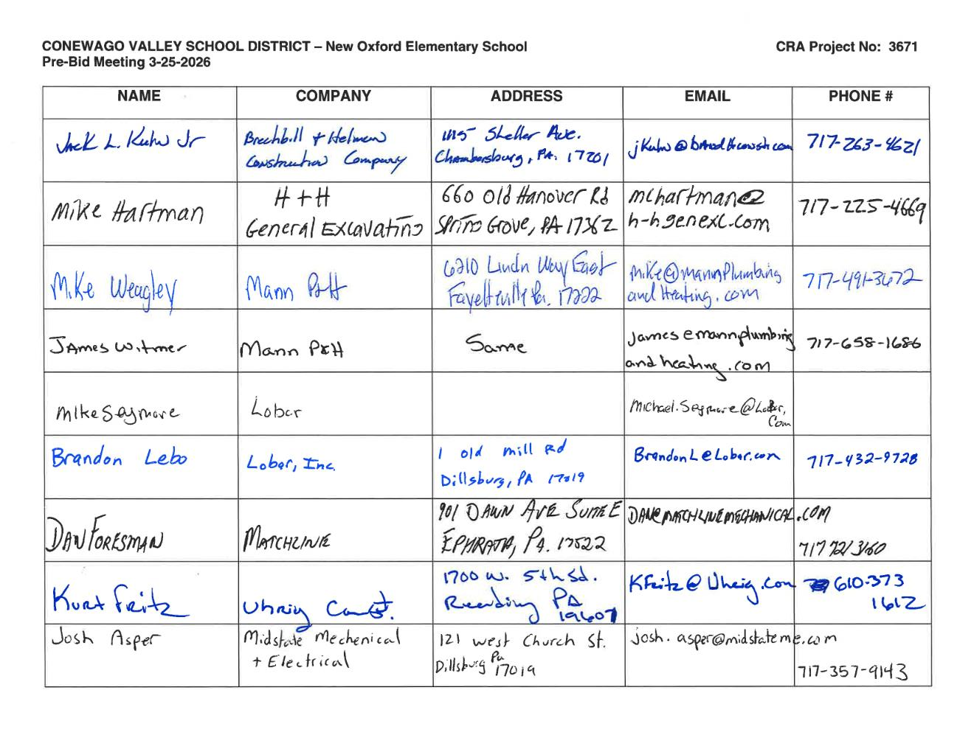

Slide 37
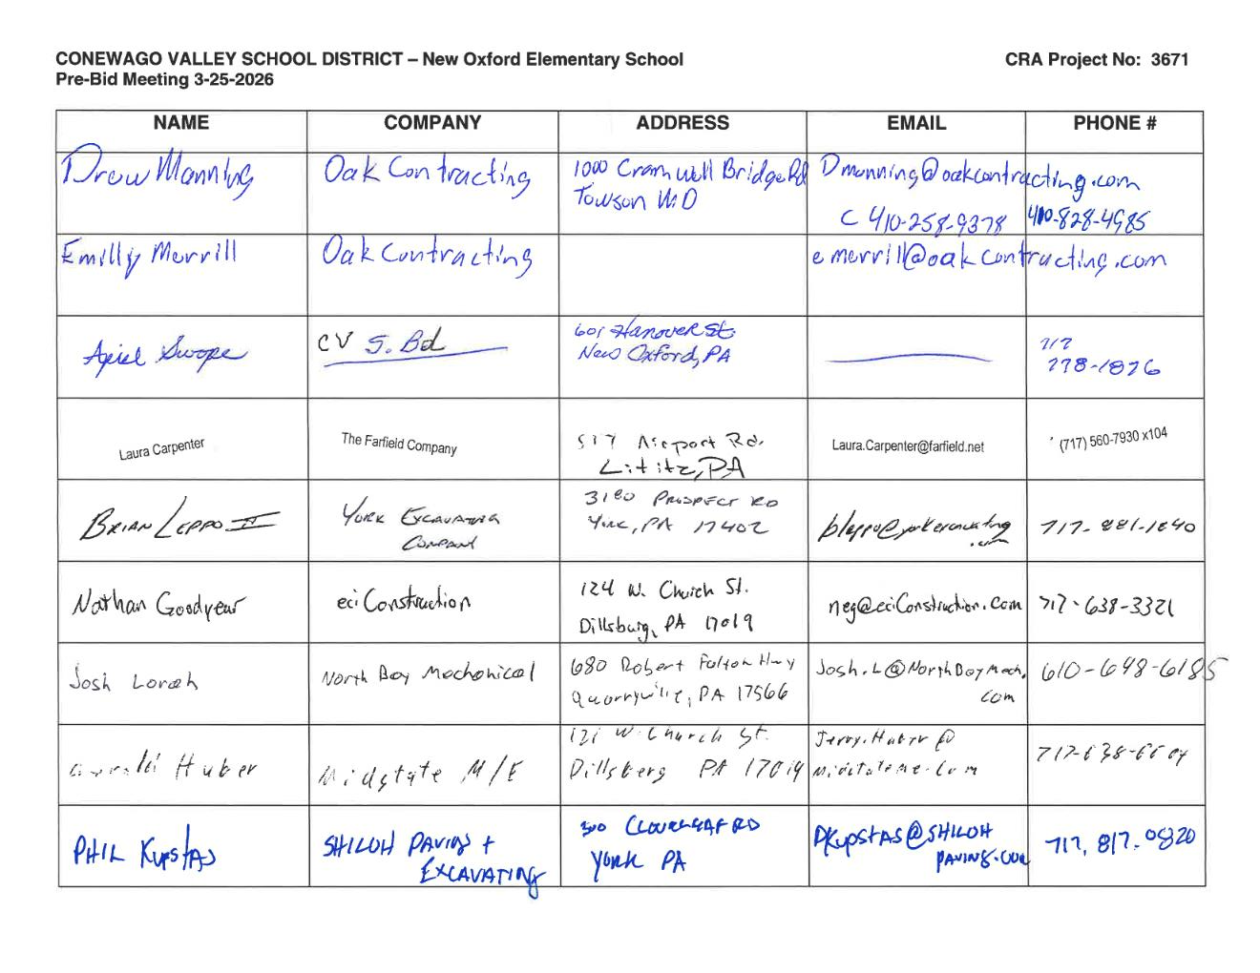

Slide 38
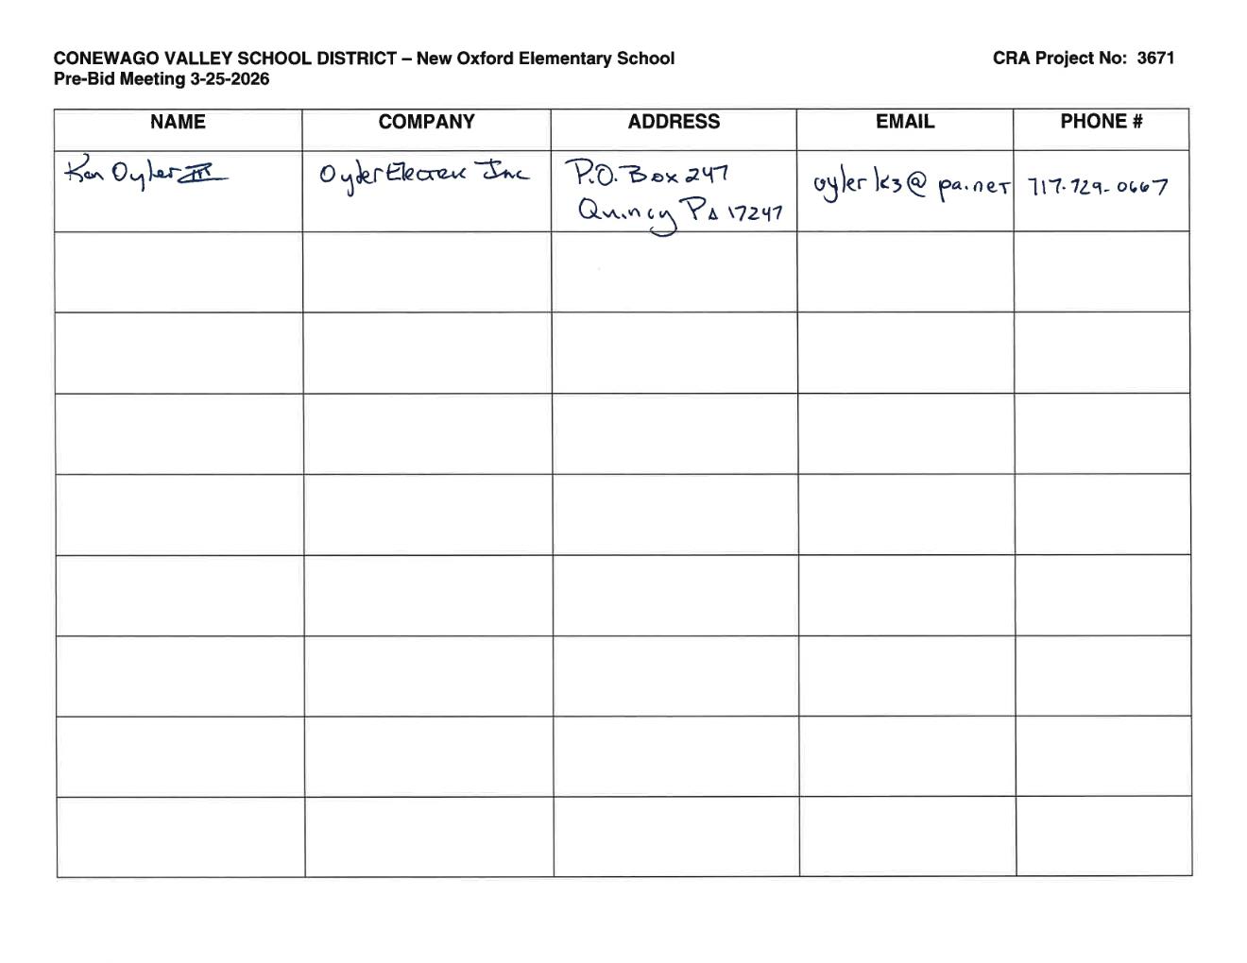

Slide 39
QUESTIONS?

