Slide 1
AP EXAMS
May 4-15, 2026

Slide 2
Digital/hybrid AP Exams
Most exams will be given digitally on the Bluebook app. (The same app used for PSAT and SAT exams) Therefore, you will either be on your Chromebook OR a desktop computer for your exam.
If you are testing on your Chromebook, you will need to bring it FULLY CHARGED and with your charging cord on test day.
You MUST know your Collegeboard log in on the day of the exam - we do not have it and you won’t be able to access it on your phone or from a password manager. MEMORIZE IT!
Hybrid exams will view all exam questions in Bluebook but answer free-response questions in a paper booklet.

Slide 3
EXAM FORMATS
FULLY DIGITAL
Computer Science Computer Science A Principles
English Language English Literature
US Government US Comparative Gov
Human Geography Seminar
World History US History
Euro History Psychology
Art History Environmental Science
HYBRID
Biology
Micro/Macroeconomics
Chemistry
Statistics
Calculus AB/BC
Physics C
Physics 1
Paper/Pencil
(You will still need your Chromebook for the speaking portion of the exam)
Spanish Language
French Language
Music Theory

Slide 4
What will you be testing on?
Chromebook
Euro History World History
Human Geo US History
US Gov Psych
English Lit Art History
Comparative Gov
Spanish, French, Music (for recording portion only)
Desktop
Biology Economics
Computer Sci A Computer Sci P
Statistics Calculus
Seminar Env. Science
Physics C Physics 1
Chemistry English Language
Studio Art (submission)

Slide 5
TAKING YOUR AP EXAMS
Please be sure to check your exam start times. Please note: Morning exams require you to be there by 7:30, Afternoon exams by 11:30 unless otherwise noted.
You may need to arrange for alternate transportation on those days if your bus gets you here after 7:30. ALSO - exams go past the end of the school day, so you may need to take the late bus.
NO EARLY DISMISSALS - you may not leave an exam early so please notify employers, coaches, etc. of your exam schedule.
Lunches - morning testers will make it to their lunches. Afternoon testers, please bring something to eat during 4th period BEFORE your exam, as you will be in testing during all of the lunches.

Slide 6
On Testing Day, Students Should Expect to:
Start on time! Be at your testing site by either 7:30 am or 11:30 am. We will not wait for you.
Be prepared with a charger if you are on a chromebook, an approved calculator if applicable, snack or water for breaks if you so wish.
Turn off all devices! All cell phones should be left in your locker. If you do choose to take a chance and bring it in, it MUST be turned off and stored at the front of the exam room. You may not be wearing a smartwatch as well.
All bags, books, etc. need to be placed at the front of the room and CANNOT be accessed until after the exam.
Stay the ENTIRE length of the exam. Some exams may run past 3:30. We cannot let you leave earlier. MAKE SURE you let your employers or coaches know well in advance that you may be late to work/practice/game, etc.

Slide 7
Seating
Per College board guidelines, students may not choose their own seats. Therefore, you will need to find your name on a placecard OR AP label sheet when you get in the room.
When you find your seat, get logged into Bluebook first thing. Proctors will proved the Room Code and the Start Code for you.

Slide 8
Late testing exams
Students are expected to take their AP Exams on the initial date of the exam. DO NOT assume you can take a late test until speaking with the AP Coordinator.
In order to be scheduled for Late testing (it is NOT a “make-up”), students must contact Mrs. Favorito ahead of their test date. Late testing exams are scheduled on very specific dates and times. As per the College board, you may be charged a $40 late testing fee.
In the case of illness or medical emergency, a parent email or medical documentation is required.

Slide 9
THINGS TO DO!
Seniors- Request your AP scores be sent to the college you will be attending. You get ONE free score report and it must be requested by June 20, 2025. If you put one in now, you can absolutely change it as long as it’s before 6/20/26
Practice using the testing platform in the Bluebook App!
MEMORIZE YOUR USERNAME AND PASSWORD! You must know it for the exam. If you don’t, we can’t help you, and you will forfeit your exam. This is NOT an approved reason for a late exam.
Check the AP Exam schedule to see when your exam is, if you are on a Chromebook or Desktop, and make the appropriate arrangements for transportation.
QUESTIONS? Ask Mrs. Favorito or Mrs. Ross (AP Coordinator): jfavorito@dvsd.org

Slide 10
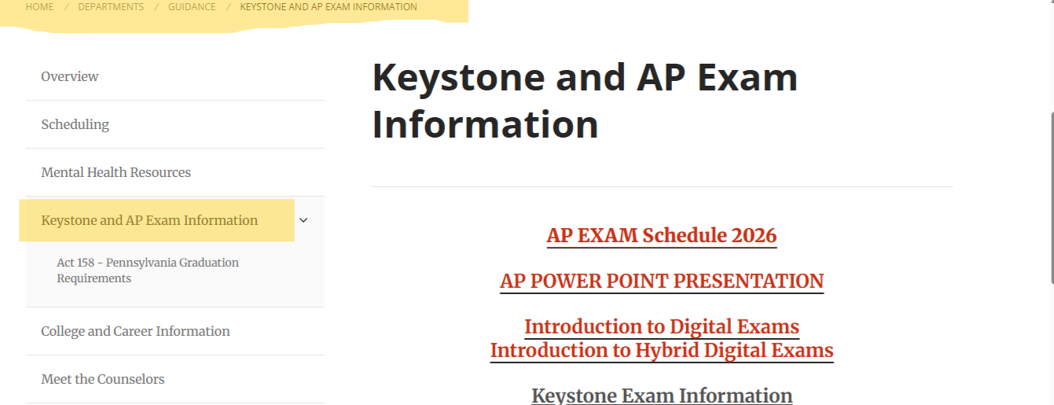
WHERE TO FIND THIS INFORMATION:

