Slide 1
Frewsburg Central School District
2026-2027 Budget Workshop #2
March 12, 2026
Lynda Quick
Jerome Lee Yaw

Slide 2

Reminder
Budget Development Process

Slide 3
Budget Development Process
Budget Workshop #1
Department Budgets
Athletics
K-12 General
MS/HS Admin/Misc
Elementary Buildings/Grounds
Transportation
Debt Service
State Aid (Based on Gov’s Proposal)
Budget Workshop #2
Salaries
Fringe Benefits
BOCES
Special Education
Revenues

Slide 4
Salaries
Final 2025-26 Budget | Proposed 2026-27 Budget | Change from Prior Year
$10,163,027 | $10,027,338 | ($135,689)

Slide 5
Fringe Benefits
Final 2025-26 Budget | Proposed 2026-27 Budget | Change from Prior Year
$4,719,033 | $5,202,046 | $ 488,013

Slide 6
BOCES
Final 2025-26 Budget | Proposed 2024-25 Budget | Change from Prior Year
$3,894,673 | $3,790,256 | ($104,417)

Slide 7
Special Education
Final 2025-26 Budget | Proposed 2026-27 Budget | Change from Prior Year
$477,557 | $483,000 | $5,443

Slide 8
Revenues
 | Final 2025-26 | Proposed 2026-27 | Change
Tax Levy | $ 6,369,828 | $ 6,497,225 | $ 127,397
Local Revenues | $ 191,078 | $ 191,078 | $ 0
State Aid | $ 16,232,774 | $ 16,703,445 | $ 470,671
Medicaid | $ 20,000 | $ 20,000 | $ 0
Fund Balance | $ 780,000 | $ 880,000 | $ 100,000
Total | $ 23,593,680 | $ 24,291,748 | $ 698,068

Slide 9
Considerations
Summary of Reductions
1.0 FTE Assistant Principal
1.0 FTE Cleaner
2.0 FTE Special Ed Teachers
(through attrition)
1.0 FTE Secondary Math Teacher (through attrition)
3.0 FTE Teacher Aides
0.5 FTE Secretary
(Plus associated reduction in benefits)
Notes:
This slide was moved from last year’s budget workshop #1 to here because of the cuts in TAs

Slide 10
Draft
Budget
Scenarios

Slide 11
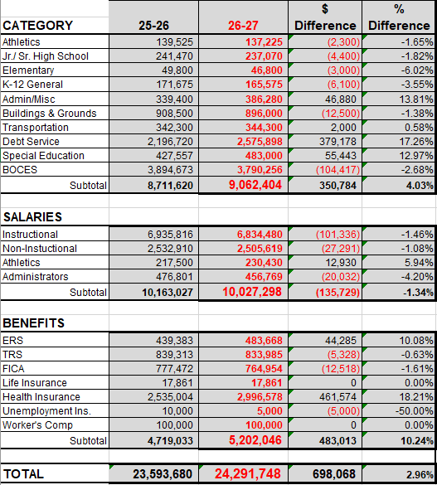

Slide 12

April 1
Final Legislative Budget Due
April 16
Board Approval- Final Budget
April 30
Budget Available to the Public
May 7
Budget Public Hearing 6:30
May 19
Budget Vote
Final Budget will be based on the allowable 2.00% tax levy increase

Slide 13

Questions

