Slide 1
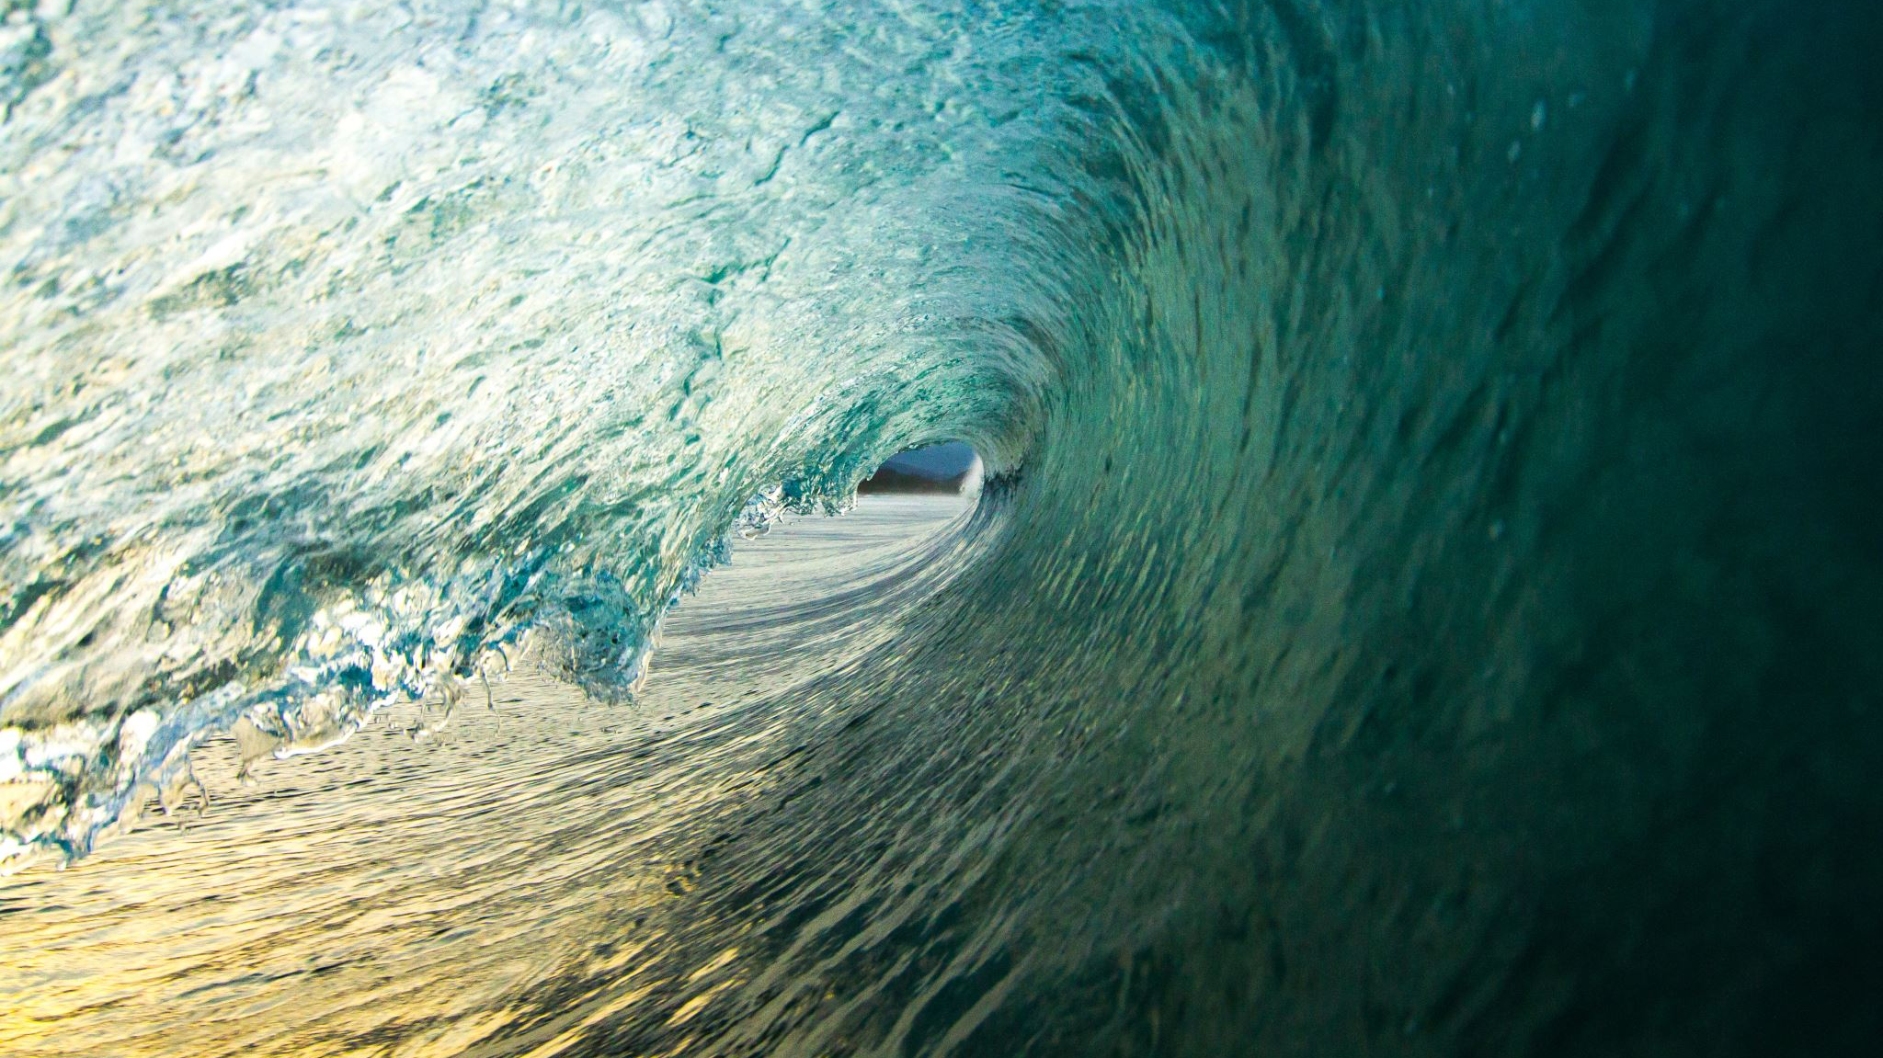
Wave Skills/Check the facts
Mrs. Rigaglia
Ms. Pappas

Slide 2
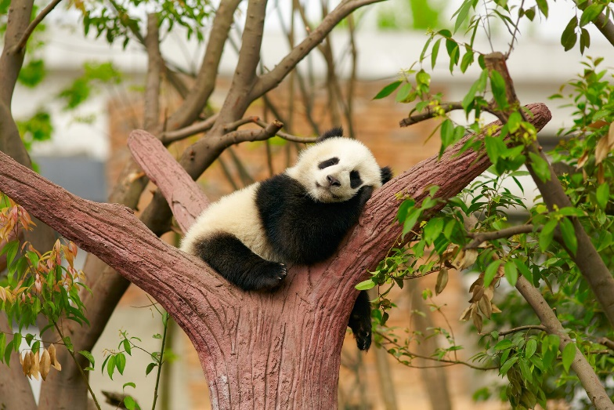


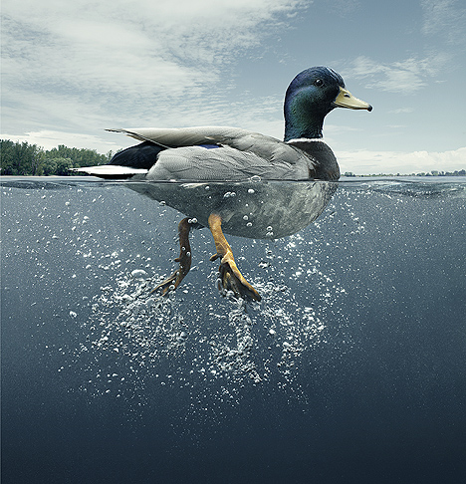


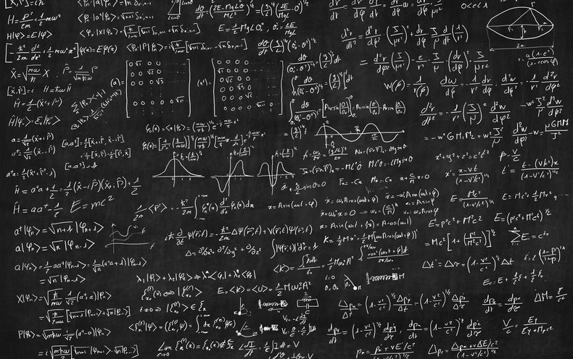
Notes:
https://www.scientificamerican.com/article/the-top-unsolved-questions-in-mathematics-remain-mostly-mysterious/
https://www.alamy.com/manhattan-new-york-usa-united-states-america-times-square-advertising-image64034417.html
https://www.digitaldealer.com/latest-news/friday-whats-weekend-looking-like/
https://www.ignatianspirituality.com/god-in-the-mess/
https://www.google.com/search?q=peaceful&rlz=1C1GCEU_enUS821US821&sxsrf=AOaemvLukT8KeKWjOFZFlxLSJKdpMxKeRQ:1634298780849&source=lnms&tbm=isch&sa=X&sqi=2&ved=2ahUKEwibx6eyrczzAhUllmoFHe4iB9oQ_AUoAXoECAEQAw&biw=1912&bih=929&dpr=1#imgrc=qn_Q4h0Z-Hye-M
https://www.stevonlewis.com/blog/duck-analogy

Slide 3
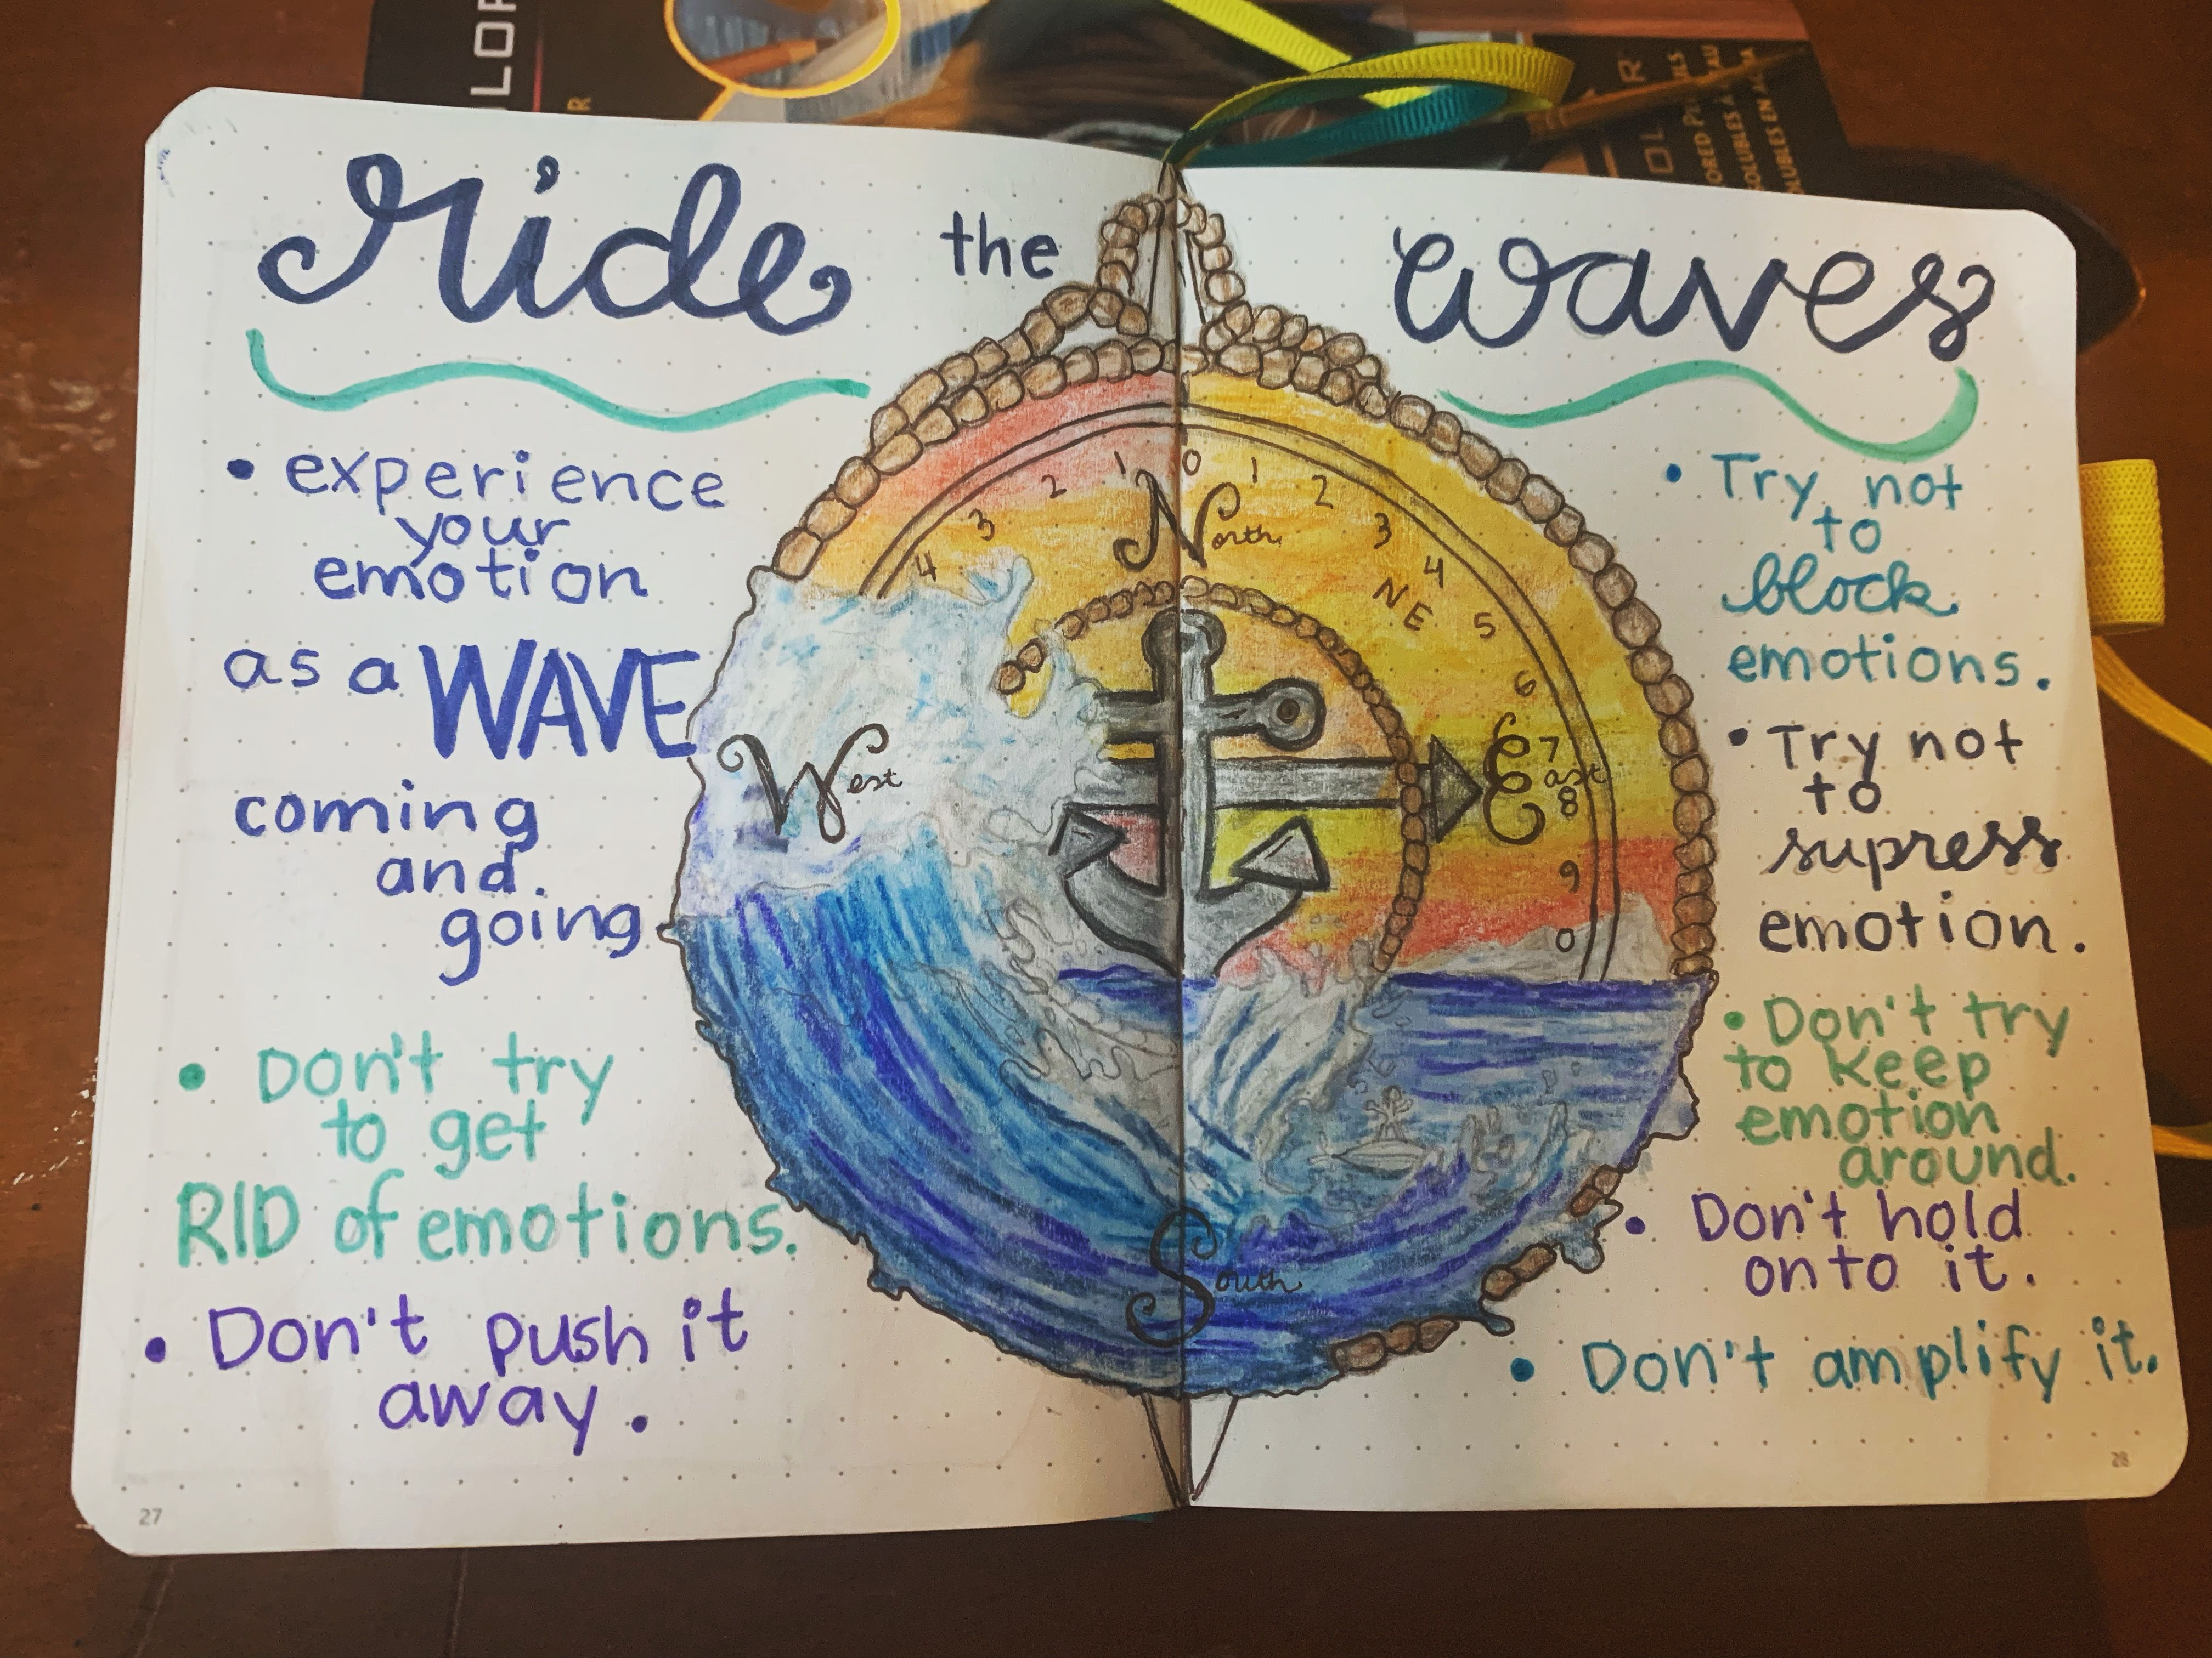
Main Ideas:
Allow selves to experience emotions like a wave being mindful of how they begin, build to a peak and go down, without trying to control them
Why should we also pay attention to our emotions rather than push them away?
It is important to tolerate emotions. The focus is on how to tolerate and experience emotions by focusing on them.
A moderate amount of anxiety for example can be beneficial in motivating us and increase tolerance of emotion.

Slide 4
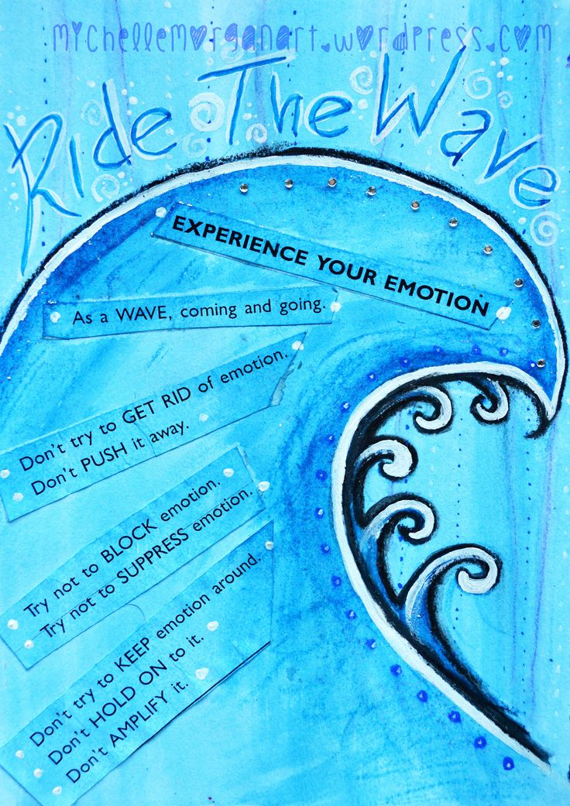

Slide 5
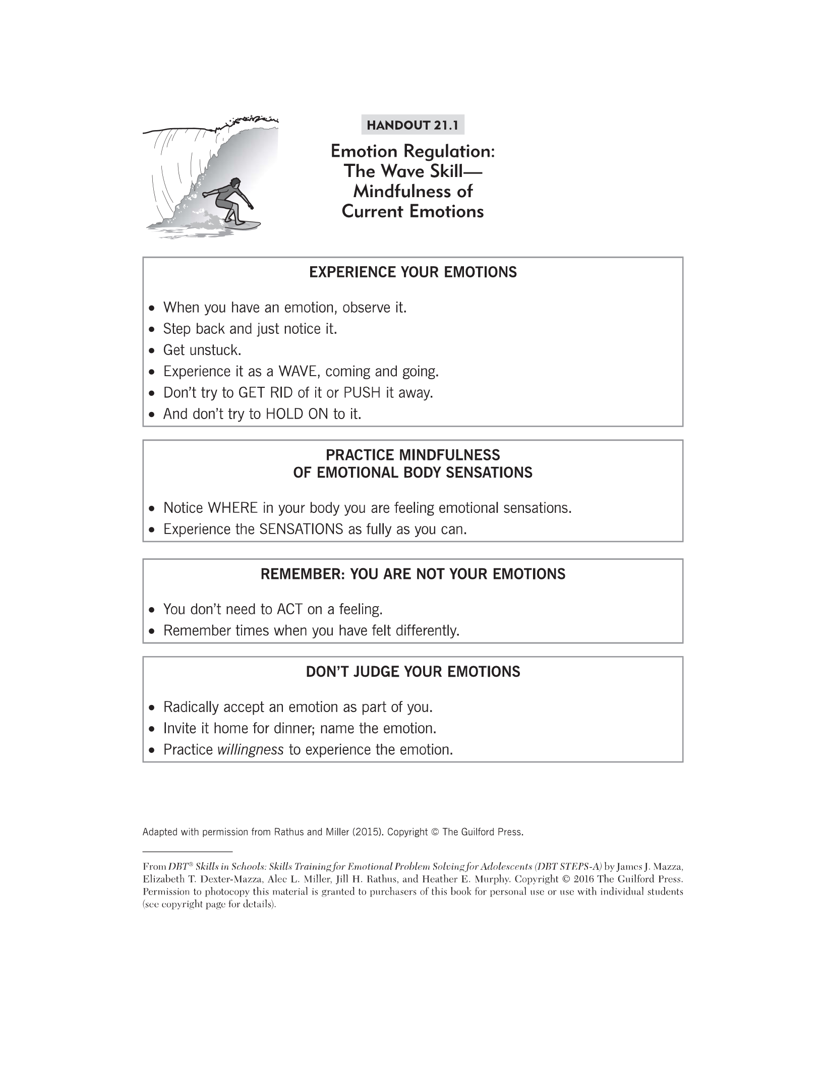
Review handout 21.1

Slide 6
Experience Emotions
Have you ever experienced an intense emotion and first reaction was to push it away or distract?
What happened when you tried to push it away? What is helpful in short-term? Long-term?
At times, its useful to distract from emotions but not ALL the time.
Think of emotions like waves, let them flow. You will find most of the time these emotions are manageable. The key is to allow yourself to experience them when appropriate (ex: taking test and breakup)

Slide 7
DBT
https://www.youtube.com/watch?v=MDYXP_zyu_Y

Slide 8
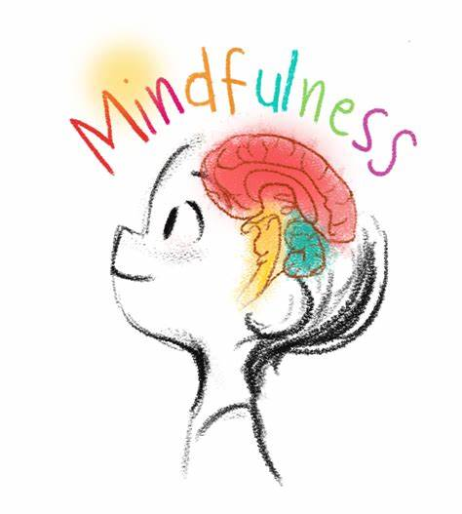
Handout 21.1
Mindfulness to current emotions is about learning to allow the pain.
By being able to describe these emotions we can have an easier time problem solving. The more we allow to experience the emotions we train our brain to not fear them.
Being mindful can begin to challenge some of these myths

Slide 9
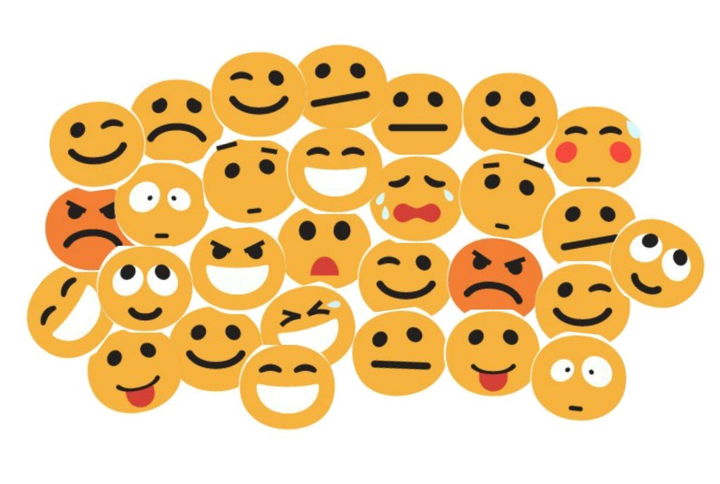
Emotion Sensations
1. When you are anxious, where do you feel it in your body?
2. When you are sad, where do you feel it in your body?
3. When you are excited, where do you feel in your body?
4. When you are angry, where do you feel in your body?
Do you always like those sensations? Most of the time it's the physical sensations that make us uncomfortable. Learning to experience those symptoms it builds our tolerance like a wave.

Slide 10

ACCEPTANCE
Remember: You are not your emotions
You can have an emotion and tolerate the urge to act on it.
Allowing yourself to accept your emotions you decrease emotional suffering. We can embrace these emotions and not be afraid of them. Emotions are inevitable so we must learn to experience them not push them away.

Slide 11
Activity: MINDFULL COUNTING

Slide 12
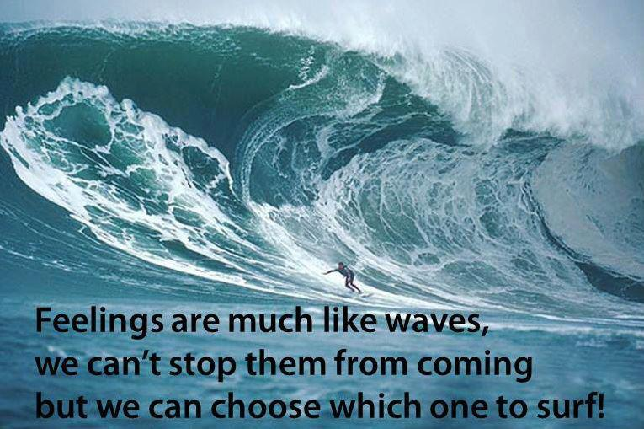

Slide 13
What is an Emotional Response
What is emotional regulation in DBT?
Emotion regulation is a dialectical behavior therapy (DBT)
skill to help us understand the function of emotions, the action urge that accompanies each emotion, and whether to heed or oppose these urges.

Slide 14
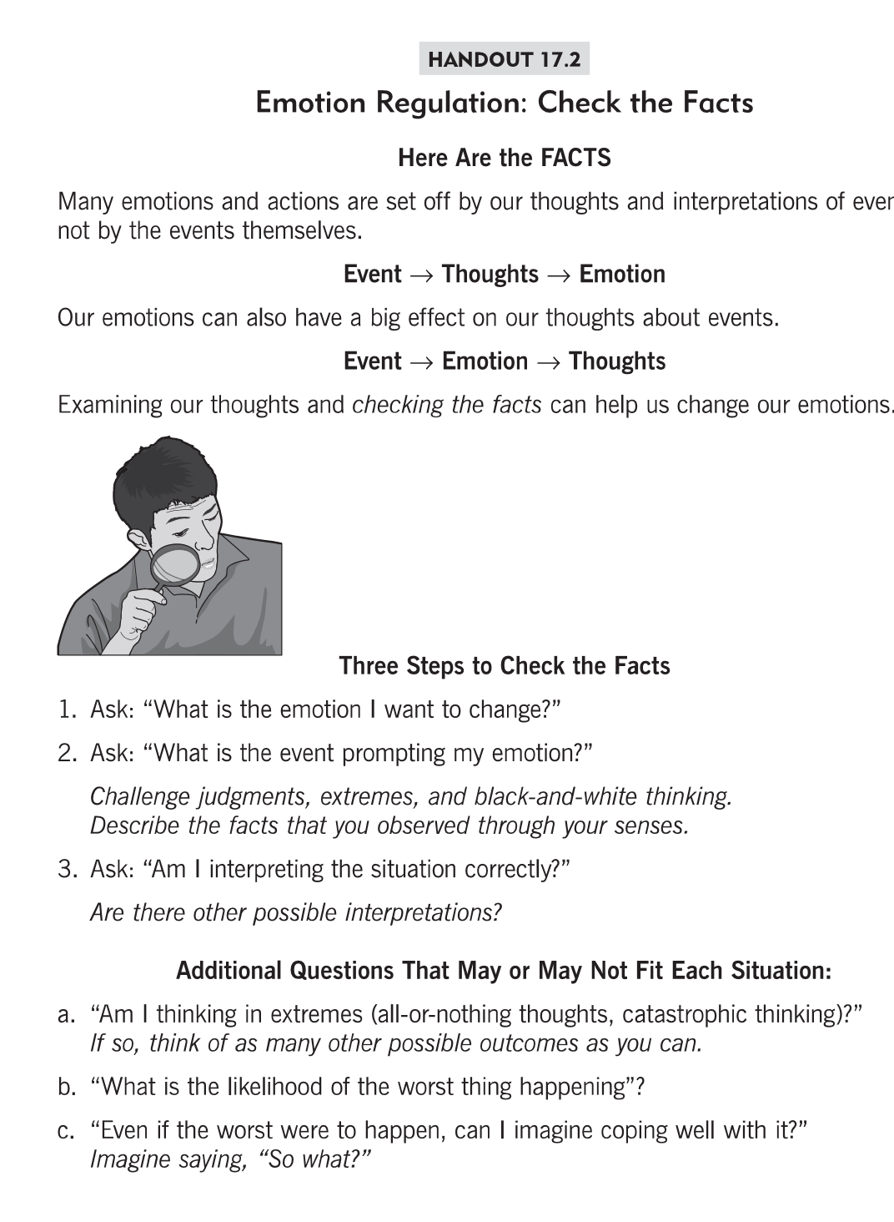

Slide 15
Example for discussion
I say hello to Jen in the hallway, and she does not say hello back.
Questions to ask yourself to check the facts:
What is the emotion I want to change?
What is the event prompting my emotion?
Am I interpreting the situation correctly?
Am I thinking in extremes? (all or nothing thinking, catastrophic thinking, mind reading, fortune telling, etc)
What is the worst thing that could happen? How likely is that to happen?
Even if the worst thing were to happen, can I imagine coping well with it?

Slide 16

Intro to 2nd Main Idea
OPPOSITE ACTION
Every emotion has an action urge and by changing the action/behvaior, we can also change the emotion
Typically, emotions lead to behavior (action urge)
  Anger ---> Attack
  Sad ---> Withdraw
  Scared ----> Avoid
Can others share examples of when you have had these emotions and accompanying action urge?

Slide 17
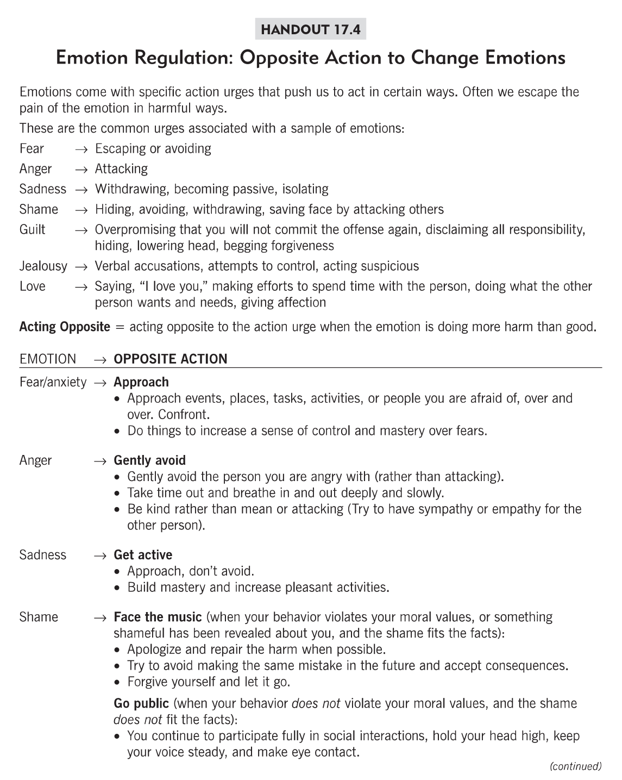

Slide 18
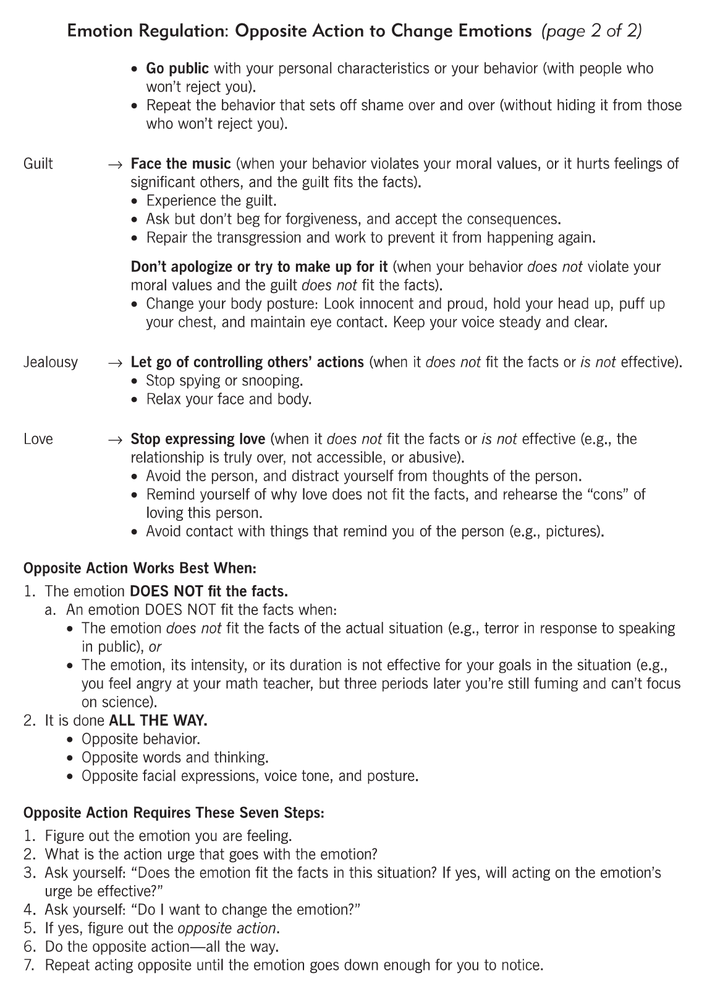

Slide 19
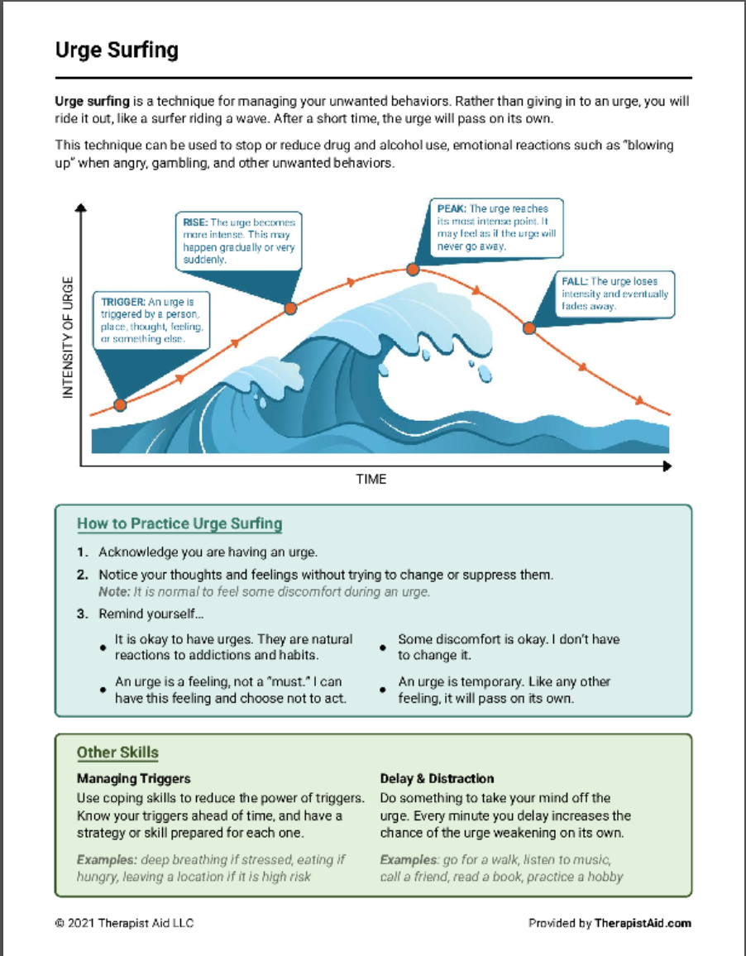

Slide 20
Small Group Activity
Fact or Feeling?”
Divide class into groups
Each group gets a statement.
Task: Decide which are facts and which are feelings/thoughts.
Then rewrite statements into balanced, fact-based ones.
Notes:
Examples:
“She ignored me at lunch.” → “She didn’t say hi when I walked by.”
“Everyone hates me.” → “Two friends didn’t respond to my text yet.”
Add a fun element: use whiteboards or sticky notes, and have each group share one rewrite aloud.
Teacher tip: Encourage laughter and creativity — it keeps the emotional content light but meaningful.

Slide 21
Class exercise: Eye contact with a partner
I want each of you to notice physical sensations in your body, notice urges and do not act on them.
Stand up 6-12 inches of space between you and partner. Hold eye contact throughout the exercise.
Observe the emotions that arise, notice urges to smile laugh and tolerate without acting on them.
Have students maintain eye contact 1-2 minutes
When finished have students share their experience/observations

