Slide 1

WELCOME
What will you need?
WRITING UTENSIL
PIECE OF PAPER
OPEN MIND

Slide 2
CAN TWO OPPOSITE THINGS BE TRUE AT THE SAME TIME?
Notes:
Can two seemingly opposite things be true at the same time?
I want you to remember this question whether that be writing it down or taking a mental picture

Slide 3

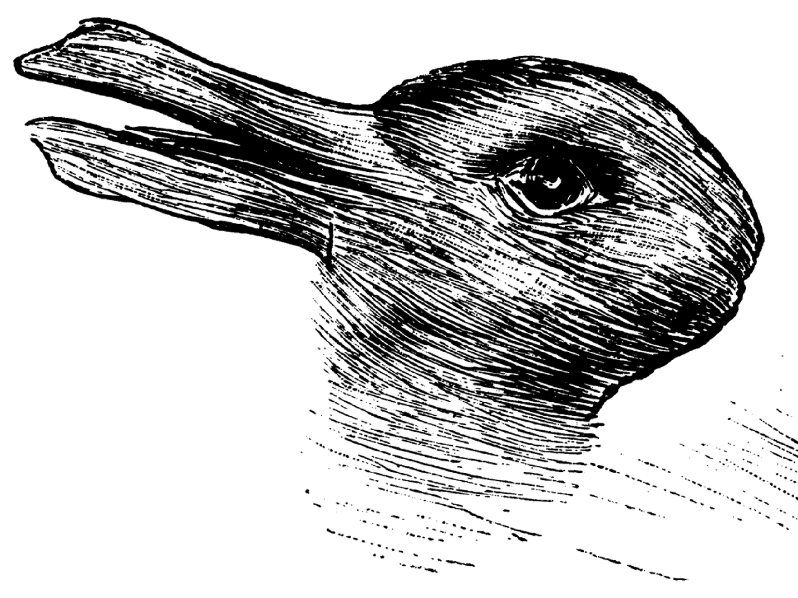
Notes:
quietly and independently write down what you see...

Slide 4

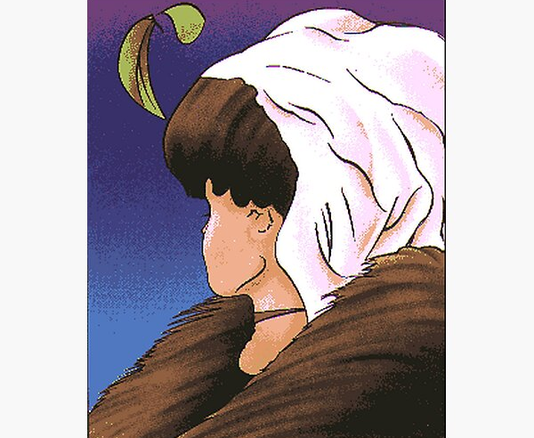
Notes:
Now, working with the person or people near you talk to each other about what you see. If you do not see the same thing, explain to your partner or partners what you do see.
All here in the same moment under the same conditions..
Why might I see something different than Mr. Clearly or Ms. Scavelli?
touch on perspectives

Slide 5
Dialectical thinking means seeing more than one side of a situation—understanding that two opposite things can both hold truth.

Slide 6

BENEFIT
NAVIGATING OUR
FEELINGS
IT REDUCES EMOTIONAL EXTREMES
IT PROMOTES ACCEPTANCE AND FLEXIBILITY
IT HELPS US SEE THE BIGGER PICTURE
IT BUILDS EMOTIONAL RESILIENCE
Notes:
Today we’re going to learn how two things that seem opposite can both be true — and how that kind of thinking can make life and relationships a lot easier.
1. When people think in “all-or-nothing” terms — like “This is a total disaster” or “I always mess up” — their emotions can swing to the extremes (intense sadness, anger, or anxiety).
2. This allows someone to experience emotions without fighting them. When we stop labeling feelings as “good” or “bad,” we manage them more effectively and move through them faster.
3. When we hold two truths at once — like “I’m hurt” and “They didn’t mean to hurt me” — it helps us respond thoughtfully instead of impulsively.
We gain perspective, which keeps emotions from taking over our decision-making.
4. Dialectical thinking trains the brain to handle contradictions without shutting down or overreacting.
It helps someone think,
“This is hard and I can handle it.”
That mindset supports coping, emotional regulation, and long-term resilience.
Dialectical thinking helps you balance your emotions instead of letting them control you. It’s like finding the middle ground between feeling everything too strongly and not feeling anything at all.

Slide 7

Notes:
Have you ever had mixed feelings about something? Describe what that was like

Slide 8
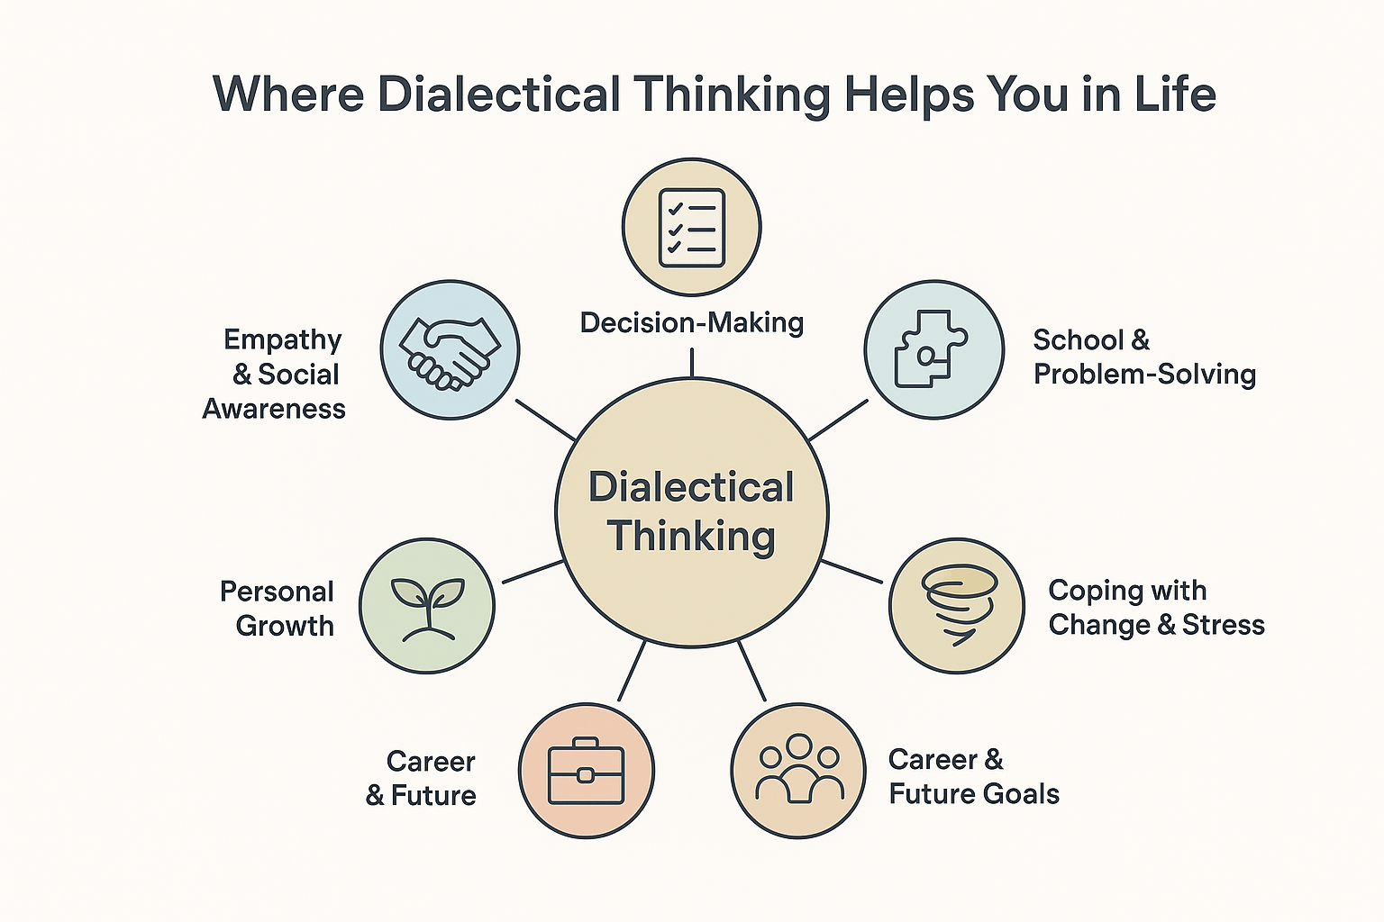
Notes:
Dialectical thinking doesn’t just help with emotions- it helps in nearly every part of life.
Decision-Making
Helps you see both sides of a choice so you can decide wisely instead of impulsively.
School & Problem-Solving
Encourages flexible thinking and creativity when facing challenges.
Coping with Change & Stress
Reminds you that “This is hard and I can handle it,” building resilience.
Career & Future Goals
Balances teamwork with independence and supports good communication.
Personal Growth
Lets you appreciate your strengths and work on areas for improvement.
Empathy & Social Awareness
Helps you understand different viewpoints and connect respectfully with others.

Slide 9





Steps to Become a Dialectic Thinker
Notice
“Either/Or” thinking
Validate opposing perspectives
Reframe with “Both/And”
langauge
Balance acceptance and change
Practice Mindfulness
Notes:
1. Notice “Either/Or” Thinking Look for thoughts like: “I always mess up.” “You’re either with me or against me.” “If I’m sad, I can’t be happy.” 👀 Goal: Catch those “all-or-nothing” words — always, never, totally, should.
2. Reframe with “Both/And” Language Instead of: “I failed that test, I’m dumb.” Try: “I failed that test, and I can study differently next time.” 🧠 Why it helps: Adds flexibility and reduces self-judgment. 🌈
3. Validate Opposing Perspectives Dialectical thinkers say: “I see your point, and I also see it differently.” Why this matters: Builds empathy Reduces conflict Keeps communication open
Balance Acceptance and Change You can accept your situation and work to improve it. Examples: “I accept who I am, and I’m growing.” “This is hard, and I can handle it.”
5. Practice Mindfulness Pause before reacting.
Ask: “What else might be true?” Notice: “Part of me feels ___, and another part feels ___.”

Slide 10

Notes:
Rachel: I want to be close to you, and I also want to have my own space and identity.
Ross: I value the stability and comfort of our relationship, and I understand that change and growth are natural for both of us.
Mr. incredible: We’re a strong family unit, and I have individual needs, desires and identity that matter too.
Mrs. Incredible: We want to stay safe, and sometimes taking calculated risks helps us grow and protect what matters.

