Slide 1
Radical Acceptance

Slide 2

Mindfulness
Be present in the moment
Be where your feet are
Helps us to notice and label our emotions, thoughts and urges
Focus your attention on one task

Slide 3
Let’s Practice
Mindfulness
Each student needs a writing utensil and piece of paper
For 1 minute draw a dog on the paper on top of your head without looking
1 Minute

Slide 4
Radical Acceptance
the skill of acknowledging and Accepting the things you cannot change

Slide 5


Slide 6
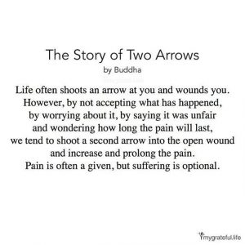
Notes:
What are some examples of “wounds” for teenagers?

Slide 7
Pain is inevitable but suffering is optional
Notes:
Pain = a breakup, failing a test, pet death, trauma are inevitable
Suffering is optional

Slide 8
Radical Acceptance is the skill of accepting the things you cannot change
Radical = complete and total accepting in mind, heart and body
Acceptance = seeing reality for what it is, even if you don’t like it

Slide 9
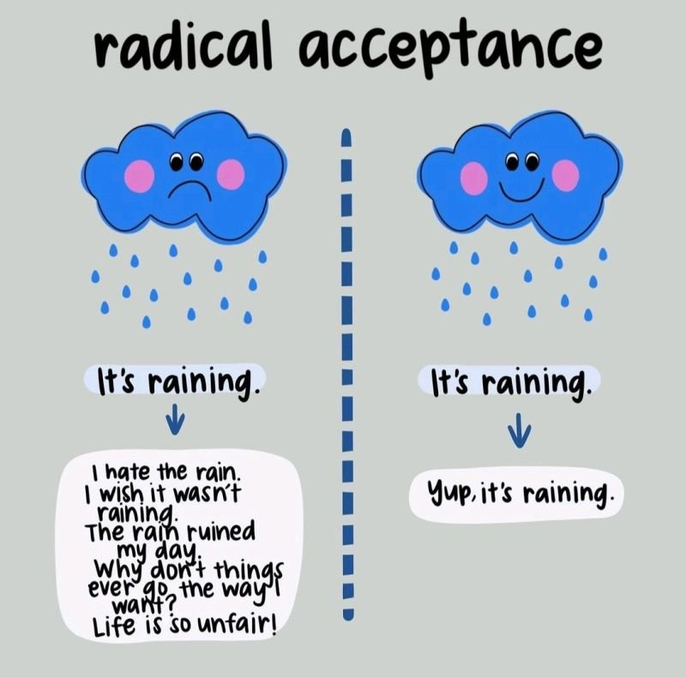

Slide 10

Which Path to Take?
Radical Acceptance (Growth)
Suffering
Obstacle
Notes:
After describing the two paths – turn and talk with your partner about the paths
Throughout all these experiences we get to an obstacle and based on your self talk and actions it can lead to two different options – suffering or growth
Talk about suffering and then life events that are out of our control - not being asked to prom, you see your crush talking to someone else, not making varsity, not getting lead role in the play
Depending on your mindset can be a learning opportunity or you can suffer
You can go down the path of suffering – that could drugs and alcohol
Or you can go down the path of growth

Slide 11
Scenarios
You failed chemistry quarter 1 and now cannot play basketball until your grades improve
Your ex-boyfriend/ex-girlfriend broke up with you and now is dating someone else
“I am never going to get into college”
“Nobody will ever date me again”
You audition for a leading role in the play and you do not get it
Your parents tell you there is a family party this Friday that you must go to, this means you will miss the homecoming dance and game
“I am not a good enough performer”
“I am the only kid who is not allowed to go”
Notes:
What are some thoughts or internal dialogue someone might have in these scenarios?

Slide 12
What does Radical Acceptance sound like?
  I might not like it but this is what happened
  This situation is only temporary
  I’ve dealt with difficulties before and I can deal with this
  It’s okay to feel anxious, upset, or mad. I can still deal with this effectively
  I won’t stress over the things that I can’t change

Slide 13




Solutions to any obstacle:
SOLVE IT
Change how you Feel
Accept It
Stay Miserable
(or possibly make things worse)

Slide 14
Mental Health Support Staff
Located in the Counseling Center
Counselors
Mr. Carino, Ms. Cawley,
Ms. Pappas, Ms. Tracy & Ms. Rivero
Psychologists
Ms. Candido, Ms. Schafranski &
Ms. Conlin-Osoria
Social Workers
Ms. Rigaglia & Ms. Scavelli
Student Assistance Counselor Ms. Pereira

