Slide 1

Hanford Elementary School District
Parent Advisory Committee:
March 17, 2026

Slide 2
Welcome & Introductions
Welcome to PAC Meeting #3
  Name
  School You Are Representing
  What Grade Your Child is in
  Public Comments
  Approve Minutes from Meeting #2
    Motion:_______ 2nd:_________

Slide 3

Local Control Accountability Plan (LCAP)
Hanford Elementary
Continuing to Understand the LCAP

Slide 4
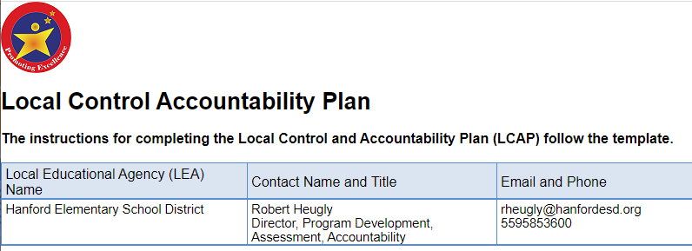
The Local Control Accountability Plan (LCAP)
Plan Summary
  General Information
  Reflections: Annual Performance
  Reflections: Technical Assistance
  Comprehensive Support & Improvement
Engaging Educational Partners
  Who are they
  Process for Engagement
  How LCAP is influenced by feedback
Goals and Actions
  Measuring and Reporting Results
    The data and evidence that leads us toward planning an action, program or service
  Goal Analysis
    Reporting of how we did implementing our planned actions (toward the end of the year)
  Actions and Expenditures
    The specific programs and services we plan to provide for students and the estimated cost of each action.
  Learning Recovery Emergency Block Grant
    One-time funds to support academic learning recovery and staff and pupil social and emotional well-being through 27-28.
Increased or Improved Services
  Required Descriptions
    A discussion/report of how our planned actions increased or improved services for students who are low-income, English learners, or foster youth

Slide 5
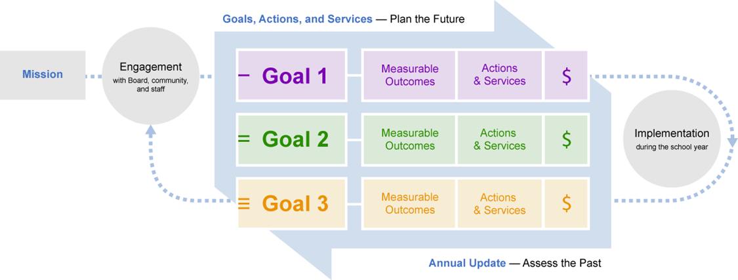
Recall that we have our LCAP goals and we have things that we can measure to help us determine whether we are making progress toward meeting our goals.
The California School Dashboard provides us with a set of items that we measure to help us determine progress toward our goals.

Slide 6
The Local Control Accountability (LCAP) Goals
1
Students will receive a broad educational program that includes English language arts, mathematics, science, history, visual and performing arts, and physical education
All students will make progress toward proficiency on the state adopted standards and English learners will make progress learning the English language.
The district will support teachers and staff with professional development, training, and collaboration time.
Students will learn in a safe, well-maintained school where they are supported, engaged, and connected to their school.
Communication between schools and home will be regular and meaningful.
Students at Community Day School will learn in a safe, well-maintained school where they are supported, engaged, and connected to their school.
2
3
4
5
6

Slide 7

LCAP Goal 4:
Supports for Students
Students will learn in a safe, well-maintained school where they are supported, engaged, and connected to their school.
State Priority 6: School Climate as measured by:
  A. Pupil suspension rates (LREBG)
  B. Pupil expulsion rates
State Priority 5: Pupil Engagement as measured by:
  A. School attendance rate (LREBG)
  B. Chronic absenteeism rates (LREBG)
  C. Middle school dropout rates
  C. Other local measures, including surveys of pupils, parents, and teachers on the sense of safety and school connectedness
State Priority 1: Basic Services addresses the degree to which:
  C. School facilities are maintained in good repair

Slide 8
LCAP Goal 4 - Actions
Action Title | Action Description | Budgeted Expenditures
Action 4.1 Coordination of Student Support | Direct supports for students, from professionals within and outside of the district, are coordinated so that students in need receive timely and effective programs and support. 33% Learning Directors Assistant Superintendent of School Climate, Child Welfare and Attendance Supplies/Materials (for School Climate Child Welfare and Attendance) Supplies/Materials for Foster Youth School Social Workers (Some funded through LREBG Funding) SARB | $1,112,410 LREBG Funding $333,404
Action 4.2 Health Professionals (Physical/Mental/Social/Emotional) | School health professionals and counselors provide direct services to students to promote well-being and health and intervene with actual and potential health problems. School Nurses (RNs) (Some funded through LREBG Funding) School Nurses (LVNs) School Nursing Supplies/Materials Elementary Counselors (Some funded through LREBG Funding) Junior High Counselors (Some funded through LREBG Funding) Psychologists (Some funded through LREBG Funding) RSP & SDC Teachers (Some funded through LREBG Funding) | $2,727,995 LREBG Funding $2,186,055

Slide 9
LCAP Goal 4 – Actions (Continued)
Action Title | Action Description | Budgeted Expenditures
Action 4.3 School Support Staff | Additional support staff provides direct services to students to promote a positive school climate, good citizenship, and school safety. Student Specialists (One at each elementary school) Vice Principals (One at each Junior High) School Resource Officers (not district employees) Yard Supervisors at each school Community Day School (CDS) *CDS Principal/Youth Development *CDS Teachers *CDS Specialist *CDS Aides *Supplies | $3,535,370
Action 4.4 | On Next Page
Action 4.5 Transportation | Elementary students who live 3/4 mile or more from school, and/or junior high students who live one mile or more from school will be provided with transportation to and from school. | $500,000

Slide 10
LCAP Goal 4 – Actions (Continued)
Action Title | Action Description | Budgeted Expenditures
Action 4.4 School Site Allocations to be Prioritized by each School's Site Council to support the lowest performing student groups in both Chronically Absent and Suspension who scored red on the CA Dashboard. | School Site Allocations to be Prioritized by each School's Site Council to support the lowest performing student groups in red on the CA Dashboard. To address the low performing schools in a district and student group reds on the 2024 CA Dashboard (see “An explanation of why the LEA has developed this goal”) and identified in the metrics appendix, including Students with Disabilities (SWD) subgroup (DA subgroup), each school will take the following actions to address the student group(s): Schools will conduct weekly outreach to students that are chronically absent, School site team (Student Specialist, Counselor, VP, and teachers) will work with and Instructional Leadership team to learn together using an inclusive, improvement model. They will be responsible to monitor SPSA actions and outcomes and identify next steps. Schools will conduct weekly MTSS grade-level teams to analyze data and provide timely behavioral interventions for students as well as monitor attendance. Teachers participate in Culturally Responsive training to establish a culture of learning in their classrooms. MTSS Team to report out during Instructional Cabinet, which consists of School Site Admin and District Admin. School site team (Student Specialist, Counselor, VP, and teachers) will work with and District Support Team to learn together using an inclusive, improvement model. They will be responsible to monitor SPSA actions and outcomes and identify next steps to improve positive behavior and increase student engagement. | $3,131

Slide 11

LCAP Goal 5:
Parent Engagement & Communication
Communication between schools and home will be regular and meaningful.
State Priority 3: Parental Involvement addresses:
  A. The efforts the school district makes to seek parent input in making decisions for the school district and each individual school site
  B. How the school district will promote parental participation in programs for unduplicated pupils
  C. How the school district will promote parental participation in programs for individuals with exceptional needs.
State Priority 4:
  A: Pupil Achievement as measured by CAASPP Data for ELA & Math

Slide 12
LCAP Goal 5 – Actions
Action Title | Action Description | Budgeted Expenditures
Action 5.1 Parent/Family Communication | The District and school sites will provide parents with conferences, report cards, and other means of communication regarding students' progress. | $0
Action 5.2 Parent Involvement Activities | School sites and the district will provide parents with a variety of informational, training/educational, and social activities. Parent Liaison Parent Education Parent Académies Parent Supplies | $337,510
Action 5.3 Required Committees | The district and school sites will maintain the required committees for parent input. | $0

Slide 13

LCAP Goal 6:
Supports for Students – Equity Multiplier
The students at Community Day School will learn in a safe, well-maintained school where they are supported, engaged, and connected to their school.
Priority 6: School Climate as measured by:
  A. Pupil suspension rates, including SED students at CDS
  C. Other local measures, including surveys of pupils, parents, and teachers on the sense of safety and school connectedness

Slide 14
LCAP Goal 6 – Actions
Action Title | Action Description | Budgeted Expenditures
Action 6.1 Student Support – CDS Equity Multiplier Funding | Direct support for students, School health professionals, Counselors, Psychologists, and other professionals within and outside of the district, are coordinated so that students in need receive timely and effective programs and support. CDS Counselor/Psychologist | Equity Multiplier Funding $56,714

Slide 15
California School Dashboard
The California School Dashboard is comprised of both Local Indicators and State Indicators
These indicators are part of the data that we can analyze to help us determine progress toward out goals.
State Indicators
Local Indicators
Test Scores in ELA and Math
English Learner Progress
Chronic Absenteeism
Suspension Rate
Implementation of State Standards
Access to a Broad Course of Study
Teacher Credentialing, Instructional Materials, Facilities
Parent Engagement (Surveys)
School Climate (Surveys)

Slide 16
Hanford Elementary School District
Status indicators
Results of the English Language and Literature and Mathematics tests
English student progress

Slide 17
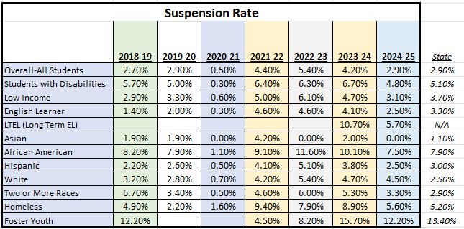
Suspension Rate
Baseline

Slide 18
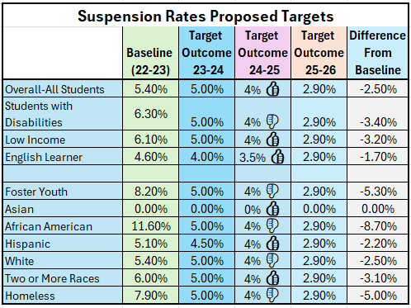
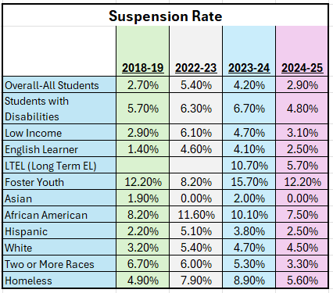
Suspension Rate Proposed Target

Slide 19
State Suspension Rate: Conclusions/Discussion
Discussion
Recommendations
Approve Recommendations
  Motion to Approve:
  Second:
  Vote
  All in favor?

Slide 20
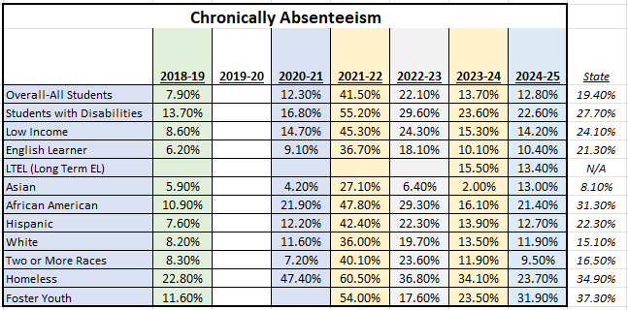
Chronic Absenteeism
Baseline

Slide 21
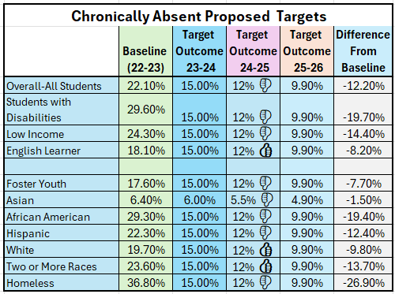
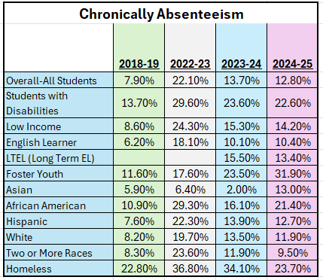
Chronic Absenteeism Proposed Targets

Slide 22
State Chronic Absenteeism Rate : Conclusions/Discussion
Discussion
Recommendations
Approve Recommendations
  Motion to Approve:
  Second:
  Vote
  All in favor?

Slide 23
Goal #4: LCAP Programs and Services
The programs and services in the LCAP that support students’ health and social-emotional wellbeing are designed to reduce or eliminate the barriers that keep students from coming to school every day or distract them from being focused on learning. They are designed to support good behavior and attendance.

Slide 24
Goal #4: LCAP Programs and Services
Learning Directors (Coordinates support for students at school sites)
Assistant Superintendent of School Climate, Child Welfare and Attendance
5 School Nurses (RNs)
11 School Nurses (LVNs) (One per school site - full-time)
12 School Counselors
  One counselor at each elementary school
  Two counselors at each junior high
  (Three counselors funded in LCAP and two junior high)
8 Student Specialists & 2 Vice Principals
2 School Resource Officers
Community Day School

Slide 25
Goal #4: LCAP Programs and Services: Conclusions/Discussion
Discussion
Recommendations
Approve Recommendations
  Motion to Approve:
  Second:
  Vote
  All in favor?

Slide 26

Hanford Online Charter
Hanford Elementary will be joining the Hanford Joint Union High School
District’s Online Charter School – Hanford Online Charter School located
at 823 W. Lacey Blvd.
Hanford Elementary will serve students in grades K – 8
Hanford Joint Union will continue to serve students in grades 9 – 12
Hanford Elementary Online Charter
  Opening planned for the 2026–2027 school year
  California State Board of Education is considering the HESD petition during
  an upcoming SBE Meeting
  Instruction by credentialed Hanford Elementary teachers
  Standards-based curriculum aligned with HESD pacing and assessments

Slide 27


Slide 28
PAC Meeting Schedule 2025-2026
Training Session #1 | October 28, 2025
Training Session #2 | November 18, 2025
Meeting 1 | December 16 9, 2025
Meeting 2 | February 3, 2026
Meeting 3 | March 17, 2026
Meeting 4 | May 12, 2026

Slide 29
Thank You!!!
Adjourn PAC Meeting #3
Next PAC Meeting
  Tuesday, May 12th @ 9:00 am

