Slide 1


Navigating Social Media
& Screen Time
Presented by:
Partnership for Community Wellness

Slide 2
LET’S BE SMART
ABOUT SMARTPHONES
    The brain has 3 major growth spurts in life.
    Birth to 25 years.

Slide 3

Brain Development
The Three Major Brain Growth Spurts:
  Birth to ~9 years, focusing on foundational connections),
  Adolescence (~9 to 32 years, enhancing efficiency and complex thought),
  and a surprising third one in parenthood, triggered by caregiving to create "parental neuroplasticity" for threat detection and empathy. These periods involve massive neural reorganization, especially synaptic overproduction and pruning, making learning rapid and foundational.
  Key Brain Growth Periods for Kids and Teens:
  Early Childhood (Birth to ~9 years):
    Rapid formation of neural connections (synapses), exceeding adult numbers.
    Focus on foundational skills like walking, talking, emotional regulation, and social understanding.
    A process of "synaptic pruning" refines these networks, making them more efficient.
  Adolescence (Around 9 to 32 years):
    Continual growth of white matter (nerve fibers) for faster communication between brain regions.
    Major rewiring, boosting coordination, cognitive performance, and preparing for adult thinking.
    This is when many mental health conditions first emerge due to intense remodeling.

Slide 4
Three Things Science Tells us About the Adolescent Brain
It has:
  A hunger for human connectedness
  An appetite for adventure and
  A desire for data

Slide 5
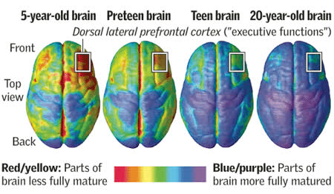
The Adolescent Brain…
Source: National Institute of Mental Health; Paul Thompson, Ph.D., UCLA Laboratory of Neuro Imaging

Slide 6
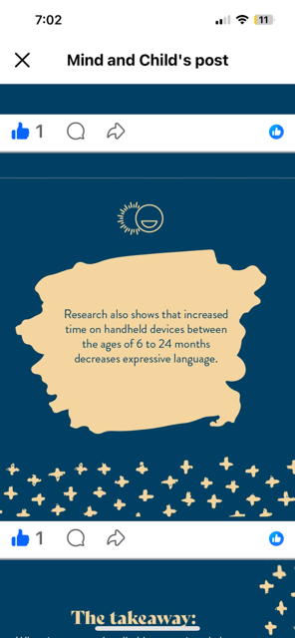

Slide 7
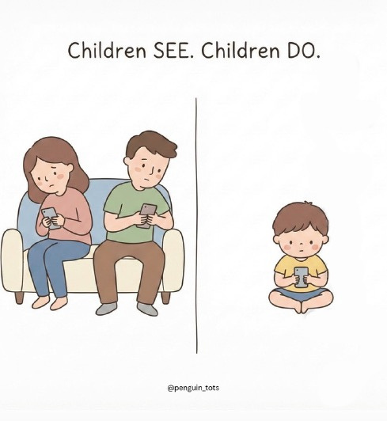
Modern Parents Guide
The toddler brain is not built for watching.
It's built for relating.
Speech comes from connection, not content.
Your child learns to speak by watching your face.
By hearing your tone. By taking turns.
That’s what wires language into the brain.
This is called serve and return.
You speak.
They respond.
You celebrate their effort.
But a screen doesn’t serve. And it doesn’t return.
A screen speaks but never listens.
And when a screen replaces your face,
The brain doesn’t know what to mirror.
So it doesn't.

Slide 8
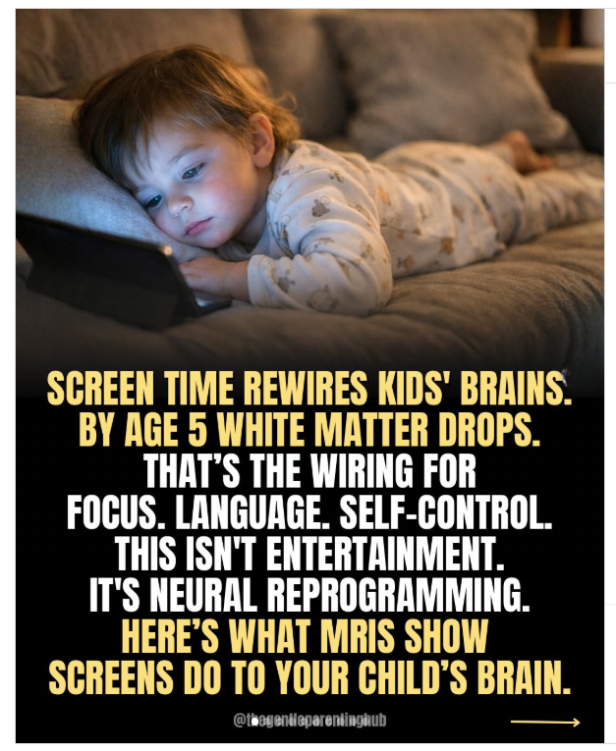

Slide 9
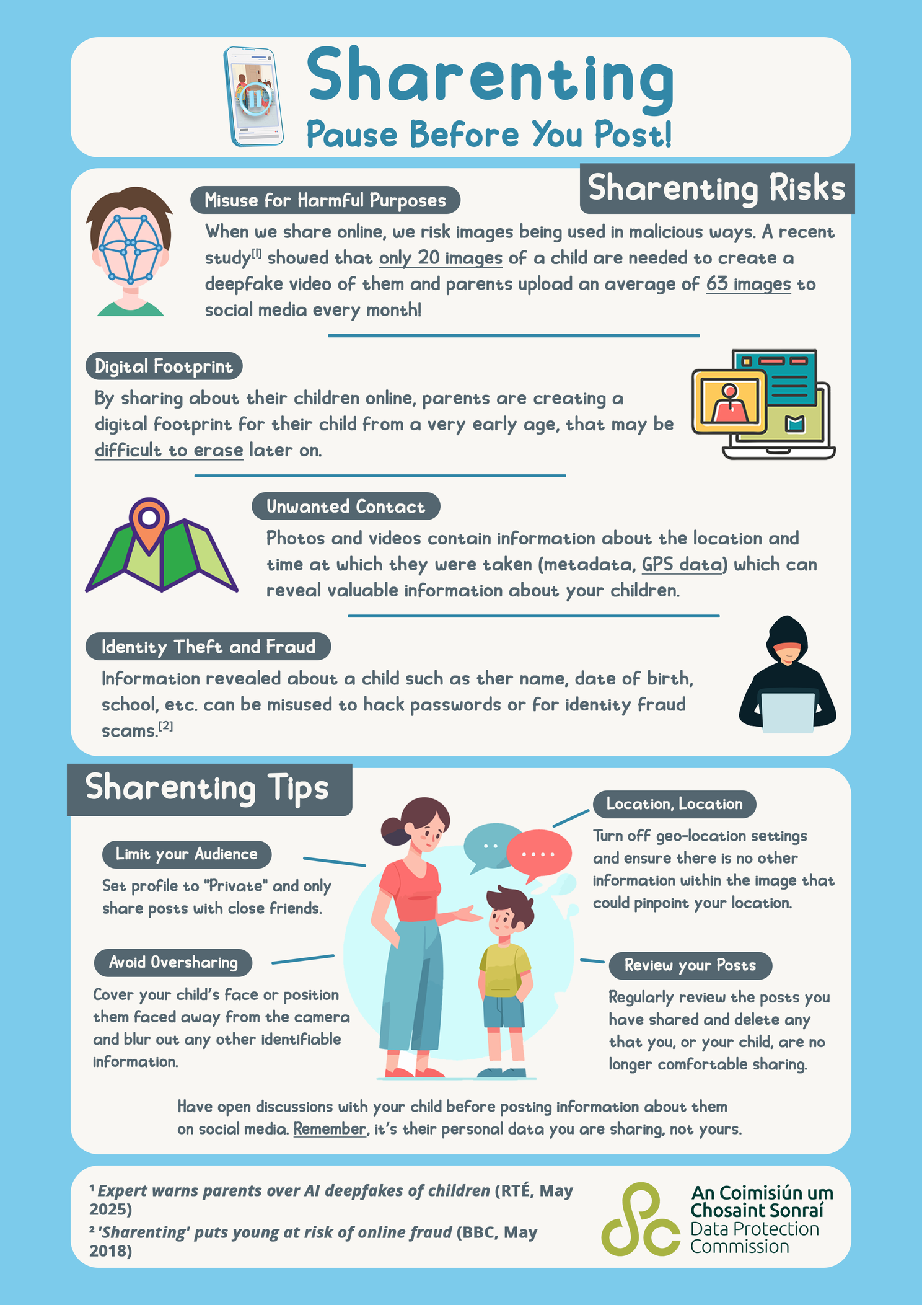

Slide 10
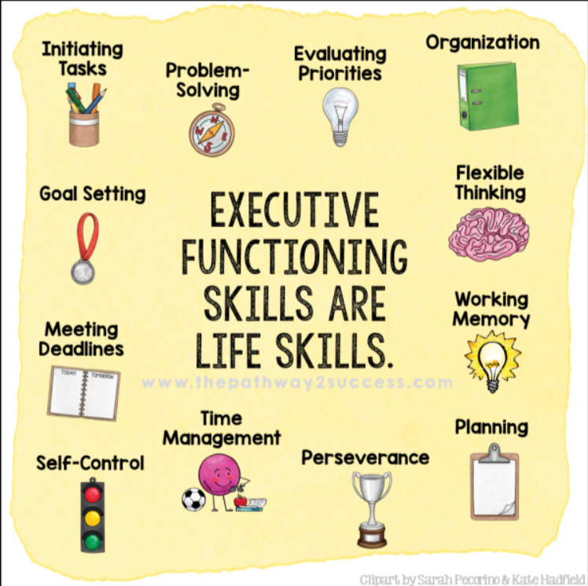

Slide 11
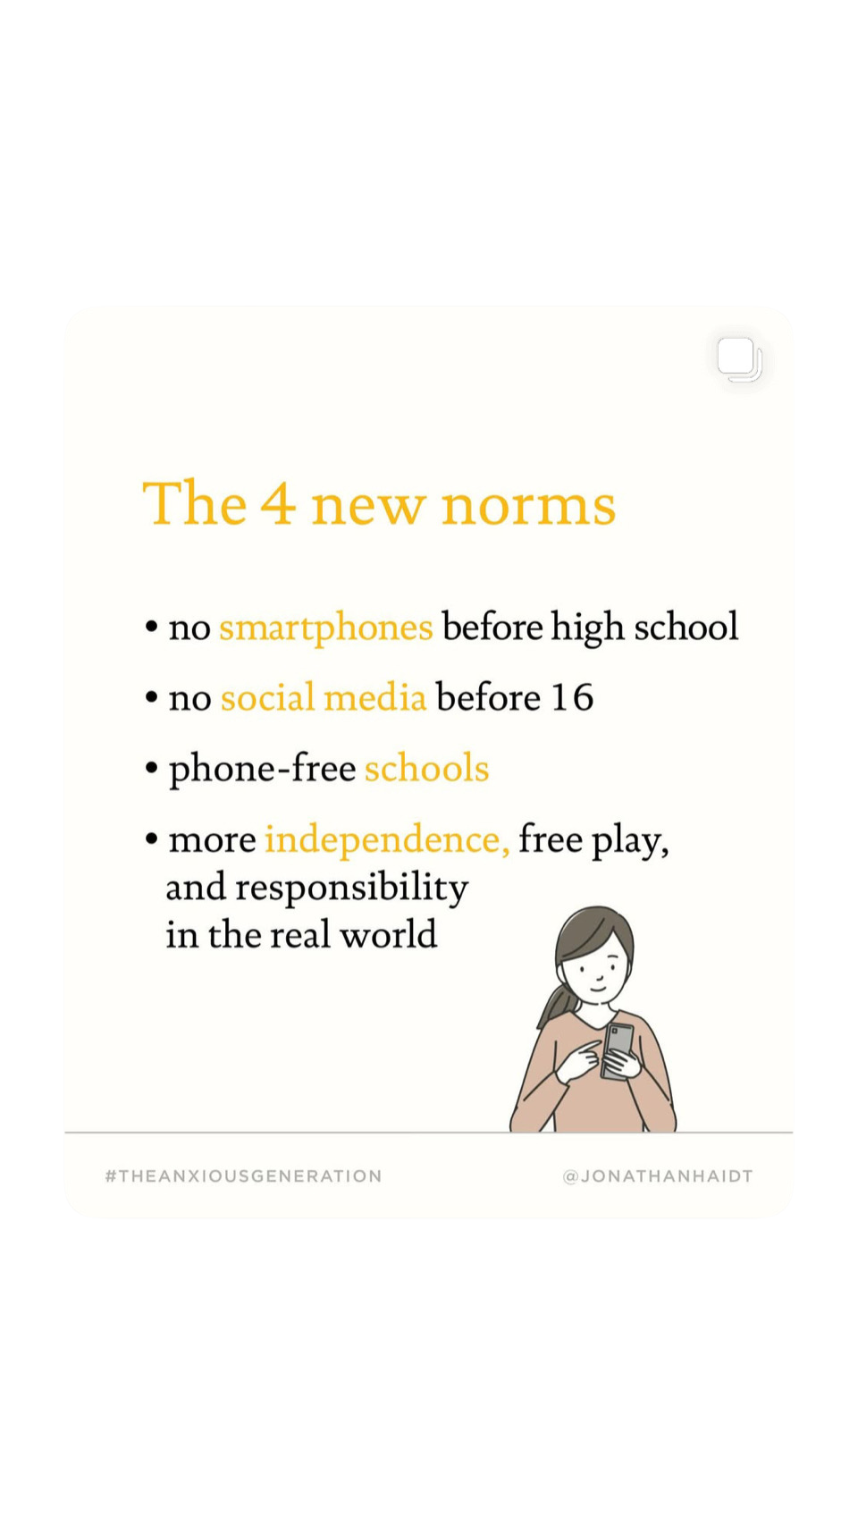
What would be best for our children and teens is if this could become the New Norm.

Slide 12
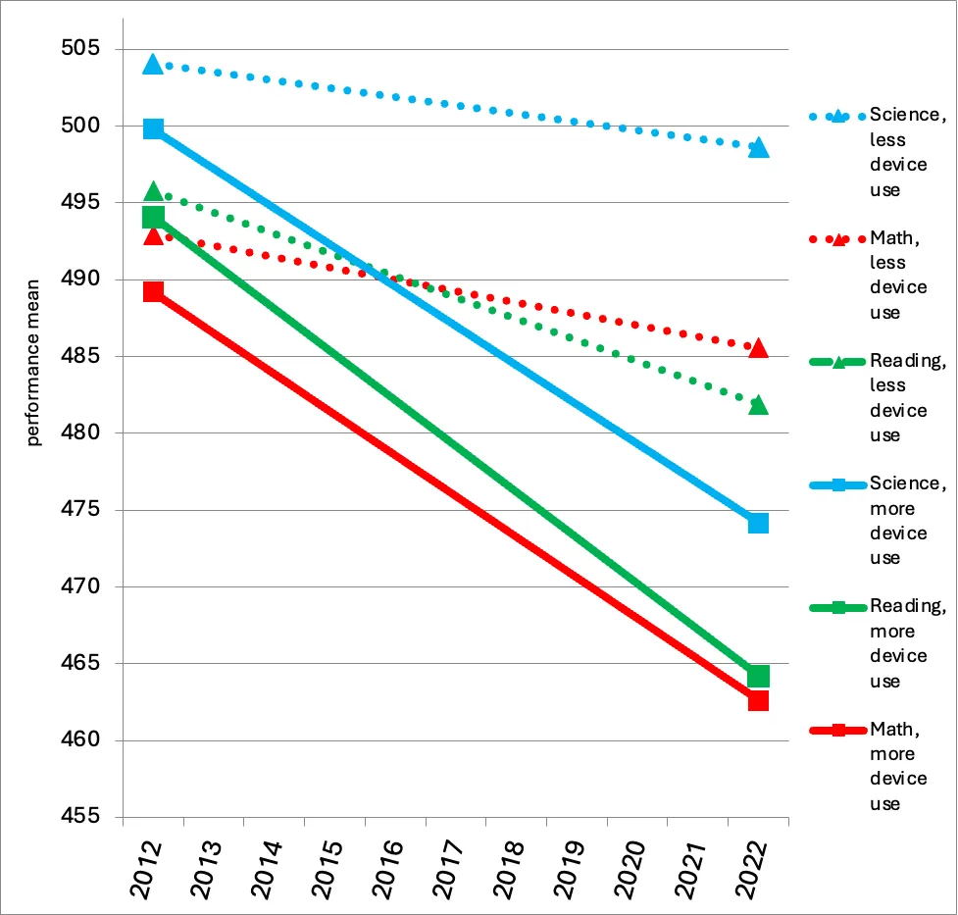
Figure 1: Scores on standardized tests of math, reading, and science for 15- and 16-year-olds in 36 countries, by low or high use of electronic devices for leisure during the school day. Note: Controlled for GDP per capita. Source: Twenge (2025) using data from PISA.

Slide 13
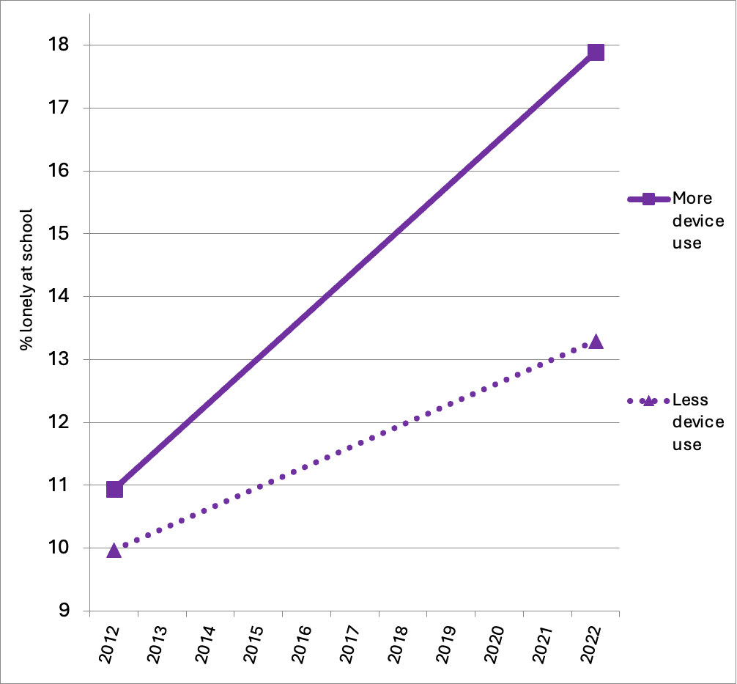
Figure 2: Feelings of loneliness at school among 15- and 16-year-olds in 36 countries, by low or high use of electronic devices for leisure during the school day. Note: Controlled for GDP per capita. Source: Twenge (2025) using data from PISA.

Slide 14
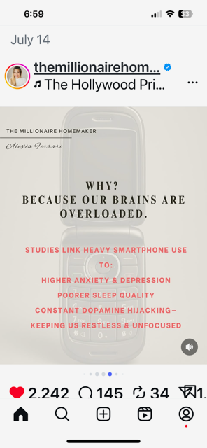
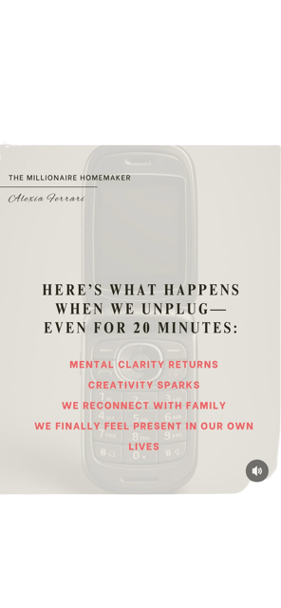
CHANGE - More on Kids, their Brains and the Digital World

Slide 15

THE IMPORTANCE OF SLEEP
    Going to bed with phones/tablets is hurting health & happiness.
    51% of teens sleep less than 7 hours a night.
    Even unused devices in bedrooms nearly double the odds of poor sleep.
    The Screen-Free Sleep Campaign empowers parents to replace devices with simple alarm clocks.
    Virginia Tech researcher Dr. Abhishek Reddy has found that “suicide attempts in adolescents are significantly more likely to occur during nighttime hours and in the context of recent screen use.”

Slide 16

DANGER: SCREENS ALL THE TIME & ESPECIALLY AT NIGHT
    Interrupts natural growth & focus
    Too much - reduces attention & memory
    Kids need a REAL world, with play and connection
    Research - increase of ADHD symptoms, depression, anxiety, & suicide in youth

Slide 17







Social Media & Messaging Apps
    YouTube
    WhatsApp
    Discord
    Facebook Messenger
    Instagram
    SnapChat
    TikTok
    Spotify
    Twitch
    Twitter (X)
    Group Texting

Slide 18





DANGERS OF VIDEO GAMES
Mental & Emotional Health Risks:
  Aggression & Desensitization: exposure to violent games can increase aggressive thoughts and decrease empathy.
  Anxiety & Depression: excessive gaming is linked to higher risks of anxiety and depression, often exacerbated by social isolation.
  Impulse Control & Focus: can hinder prefrontal cortex development, leading to poor impulse control, emotional regulation issues, and attention problems

Slide 19


Online Gambling and Teenage Boys
A new study reveals that more than a third of teenage boys between the ages of 11 and 17 have admitted to online gambling in the past year.
Additionally, the study found that 60 percent of 11 to 17 year olds are seeing ads for gambling on YouTube and social media, information pushed to them in their feeds.

Slide 20
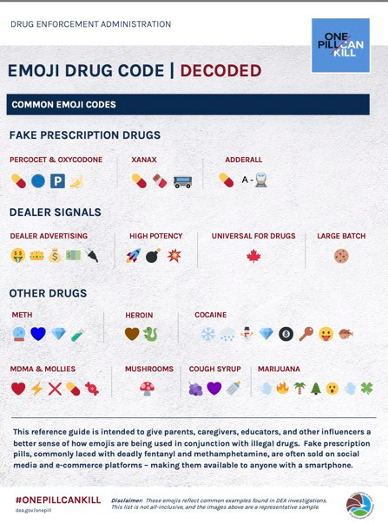
EMOJIS
    Emojis can symbolize drug use.
    Use Emoji Drug Code
    Check messages

Slide 21
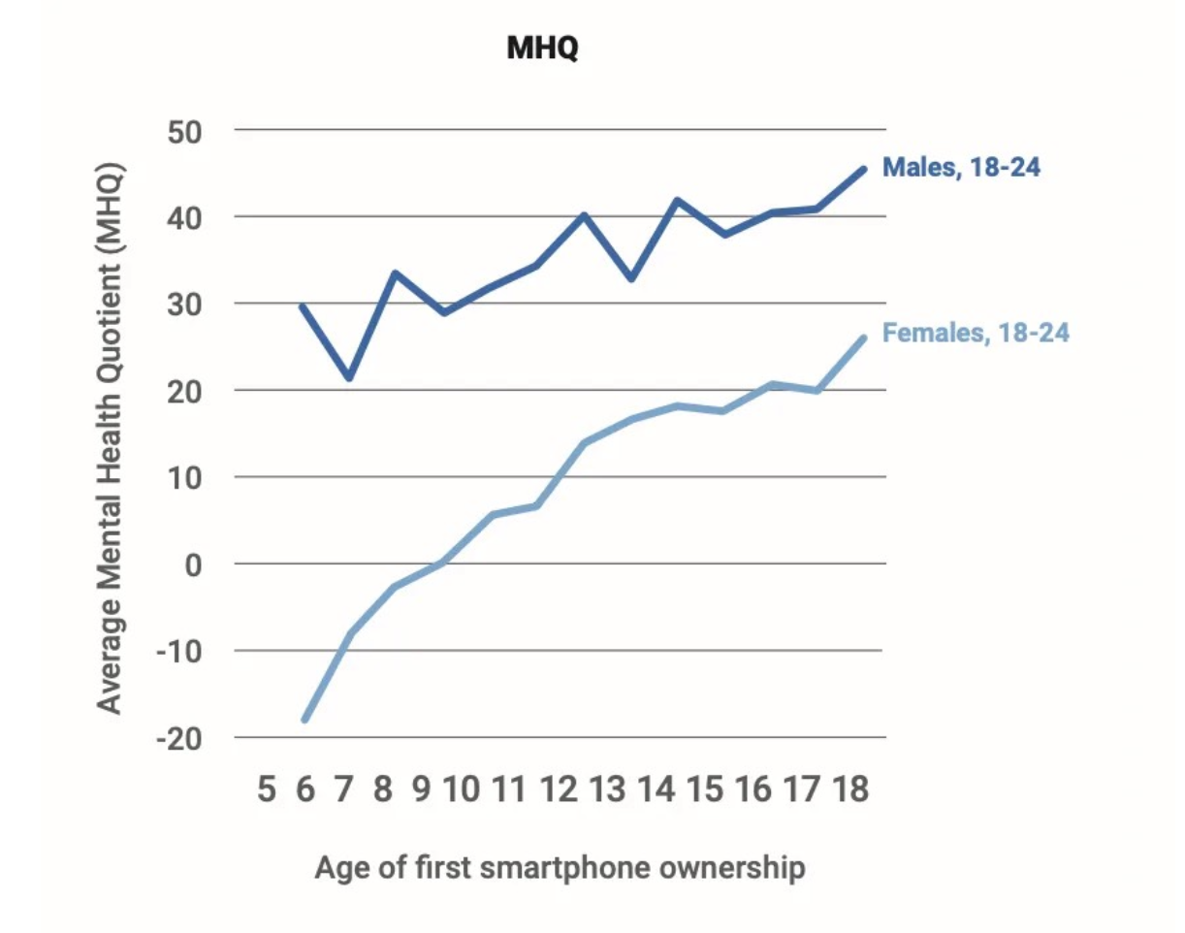
BEST AGE FOR A
SMARTPHONE OR TABLET
As age of first smartphone goes up, so does the mental health reported by young adults, assessed by the MHQ.
Data from SapienLabs.org.

Slide 22
Phones for Kids
Top Dedicated Kids' Phones (High Restrictions)
  Gabb Phone 4/4 Pro: Designed for ages 9–18, these offer talk/text with optional approved apps, no social media, and kid-safe music streaming.
  Pinwheel: Uses modified Android devices (Samsung, Motorola) with a "caregiver portal" allowing parents to curate apps and contact lists.
  Troomi: Focuses on safety for ages 10-11+, allowing parents to add kid-friendly apps as they get older.
  Gabb Watch 3e: A GPS-tracking smartwatch for younger kids (ages 5-12) with calling/texting to approved contacts.
Monitored Smartphones (Moderate/High Control)
  The Bark Phone: Built on a Samsung Galaxy, this offers deep, AI-driven monitoring of texts, apps, and photos, alerting parents to potential issues without requiring them to read every message.
  Aqua One (by Cyber Dive): Built on the Google Pixel platform, it focuses on allowing parents to monitor activity and provides a "nude image prevention system".
  iPhone (with Screen Time/Family Sharing): Best for older, responsible kids/teens, using native Apple controls to limit apps, content, and screen time.

Slide 23
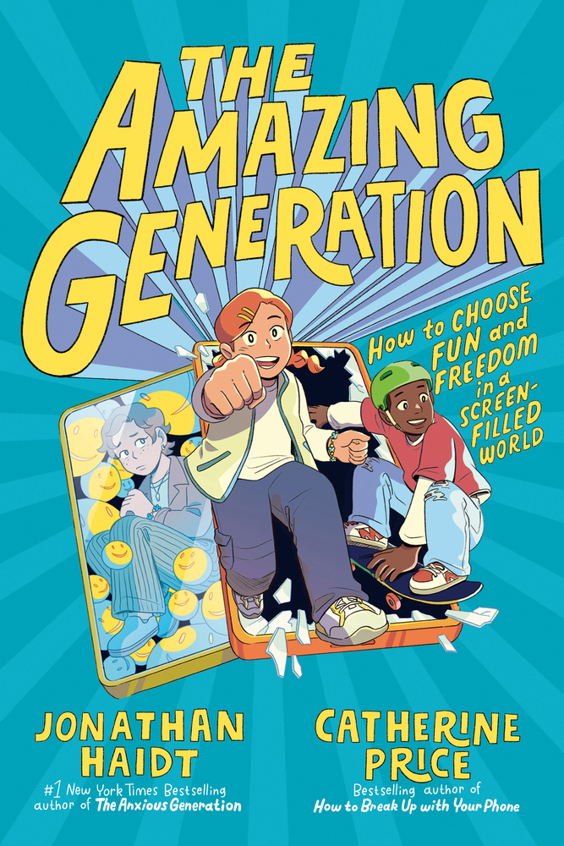
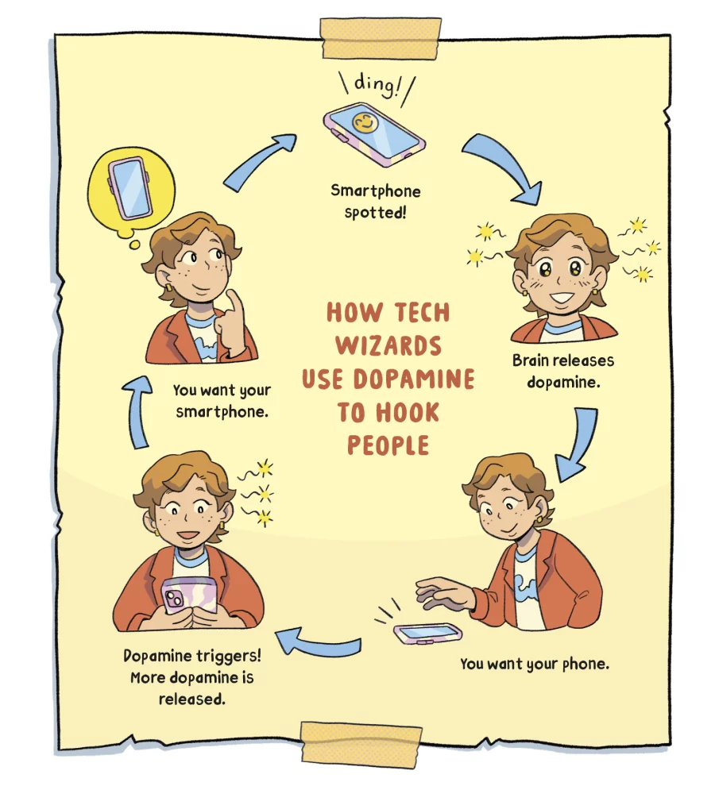

Slide 24


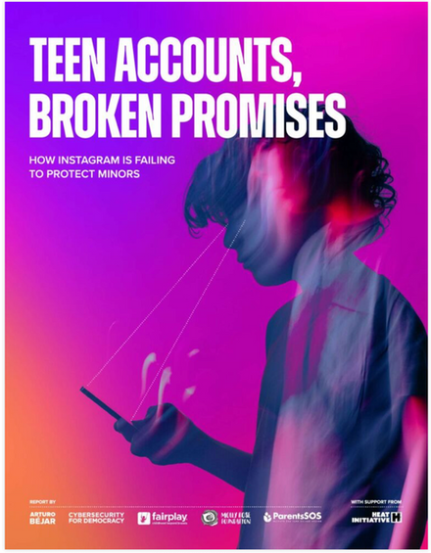

RESOURCES
Common Sense Media
Bark.us
Talk, They Hear You (app)
The Social Dilemma
Can’t Look Away film
Screen Strong.org
The Anxious Generation (book)
Reset Your Child’s Brain (book)

Slide 25
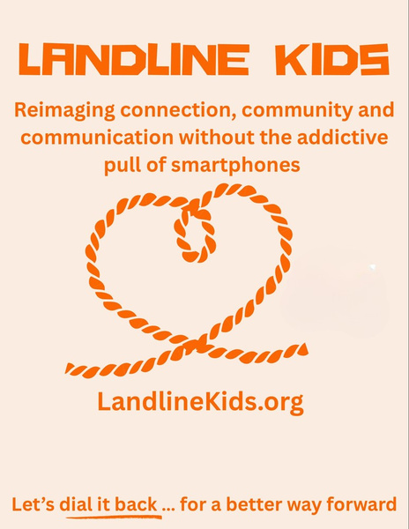


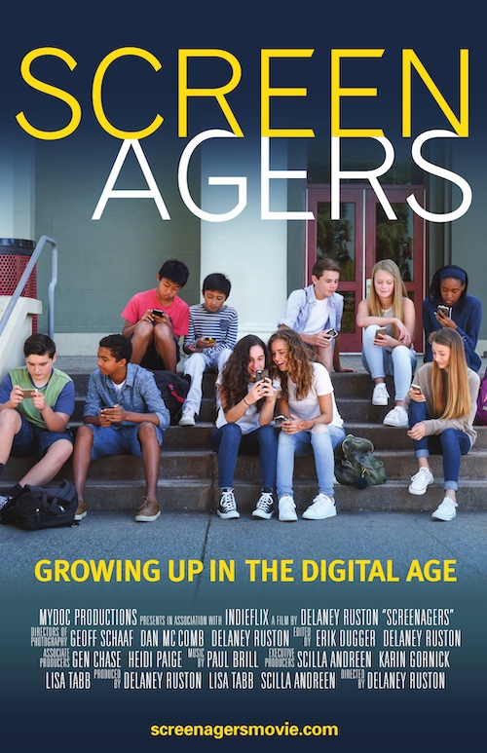



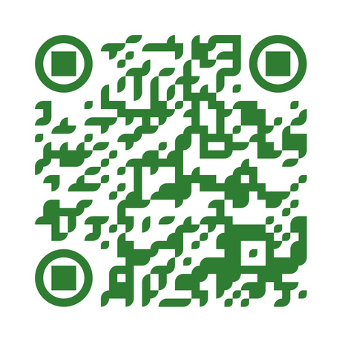
CALL TO ACTION

Slide 26
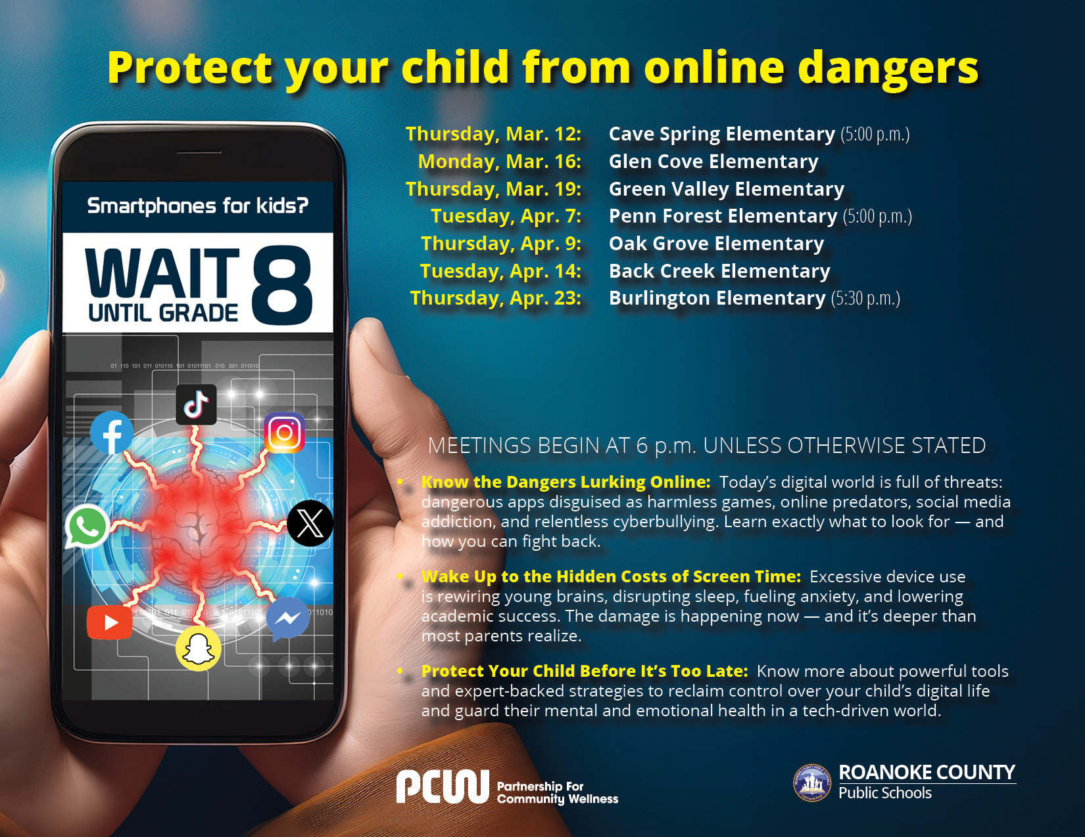

Slide 27
www.rcps.us/waituntil8

