Slide 1
Professional Learning Meeting Agenda – 3/16
MEVA Mission and Vision Review.
Updates.
Universal Design for Learning (UDL): The MEVA virtual classroom.
Other and our next Professional Learning (PL) Meetings is on Monday, March 23rd via Zoom at 3:00 pm.

Slide 2
MEVA Mission and Vision
School Mission:
Maine Virtual Academy’s (MEVA) mission is to develop each student’s full potential with learner-centered instruction, research-based curriculum and educational tools and resources to provide a high-quality learning experience for grade 7-12 students who are in need of alternative educational options. MEVA will develop an Individualized Learning Plan (ILP) with specific learning goals to meet each student’s needs. MEVA’s rigorous curriculum is aligned to the eight Maine content areas, the Maine Learning Results, the Common Core State Standards and the Next Generation Science Standards.
School Vision:
MEVA will be a leading 21st century public charter school in Maine and will improve student learning outcomes through individualized instruction, as evidenced by student academic proficiency, student academic growth, post-secondary readiness, and the demonstration of 21st century skills such as critical thinking, problem solving, and self-direction. MEVA will empower students to acquire the academic and life skills needed to succeed in post-secondary education and career opportunities. Our graduates will be prepared for college or other postsecondary career training opportunities.

Slide 3
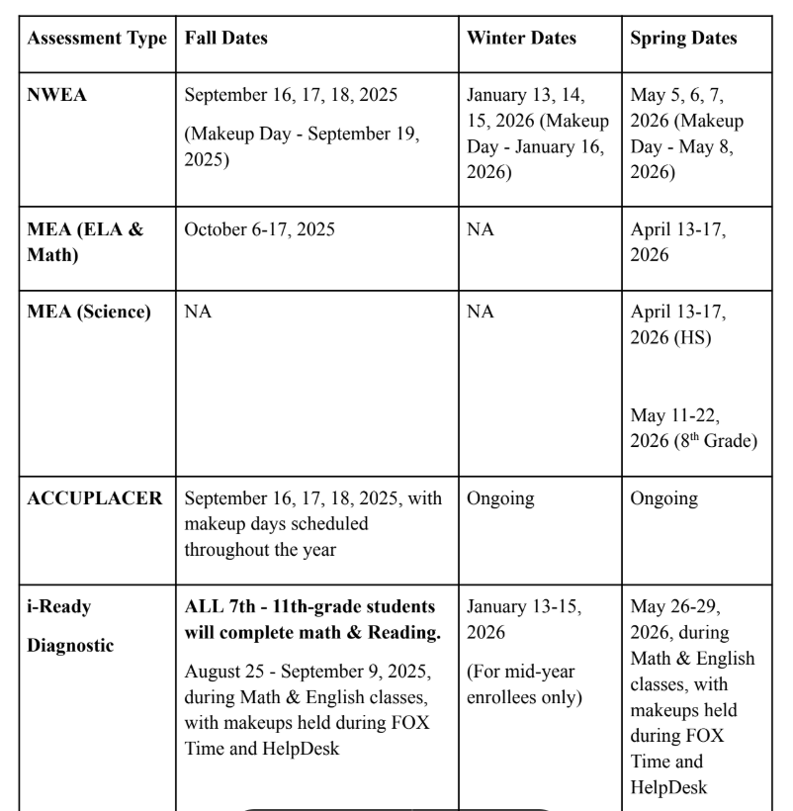
New SY2025/2026 Updated Assessment Calendar

Slide 4
Upcoming Professional Learning Meetings
March 23rd – Final UDL training.
March 30th – Updates.
April 6th
April 27th – Faculty work session; no meeting.
May 4th
May 11th
May 18th
June 1st – Final meeting for SY-2025/2026.

Slide 5
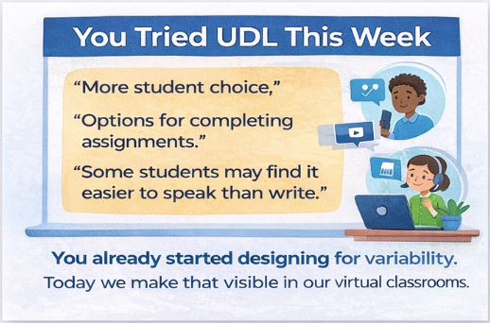
Notes:
You already started designing for variability.
Today we make that visible in our virtual classrooms.
You asked for:
Time-saving planning strategies
Keeping rigor consistent
We are going to emphasize: small adjustments, quick wins, and virtual classroom structure
Small shifts = big access gains

Slide 6
UDL: The MEVA Virtual Classroom
March 16, 2026
Focus: Making UDL visible in synchronous and asynchronous settings
Outcome: Improve one lesson for virtual accessibility and engagement

Slide 7
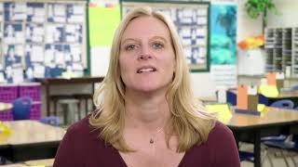
Virtual Reality Check
Teachers reported these same barriers in last week’s survey.
Common patterns in online classes:
Uneven participation
Passive engagement
Direction confusion
UDL helps us design for this variability
Notes:
Some barrier examples teachers reported in last week’s Exit ticket:
Students avoid writing-heavy tasks
Students disengage in live sessions
Students struggle to navigate assignments

Slide 8
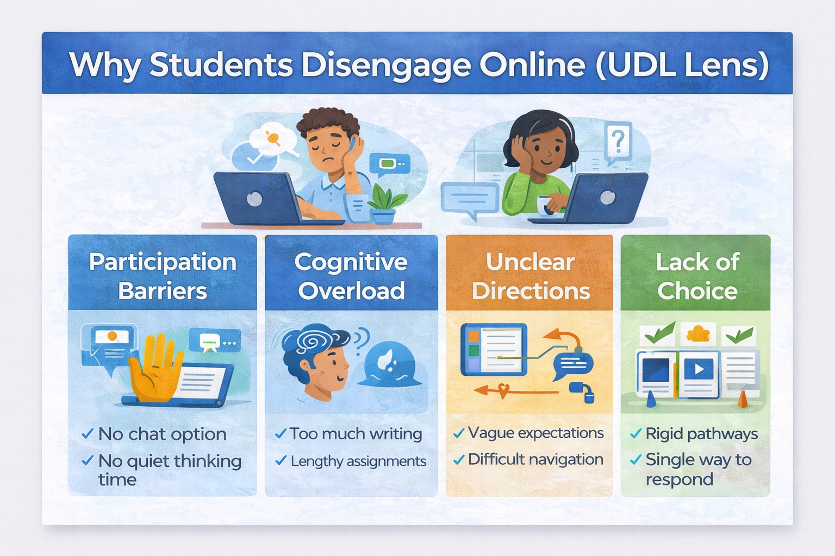




Which one do you see most in your classes?
Respond with a reaction:
Participation barriers
Cognitive overload
Unclear directions
Lack of choice
Notes:
When students disengage online, we often assume it’s motivation. But through a UDL lens, disengagement is often a design signal.
Participation Barriers: no chat option, no think time
Cognitive Overload: too much writing, long assignments
Unclear directions: vague expectations, navigation confusion
Lack of choice: one rigid pathway
UDL helps us design before students struggle.
Which one do you see most in your classes?
Reaction icons: Participation barriers (clapping hands), Cognitive overload (thumbs up), unclear directions (heart), lack of choice (wow face)

Slide 9
The Three UDL Principles in Virtual Classrooms
Engagement
(Why)
Representation
(What)
Action & Expression
(How)
Notes:
Don - Engagement (Why)
How we motivate and sustain participation
At MEVA looks like:
Choice of topic or pathway
Multiple participation options
Relevant, authentic tasks
Representation (What)
How students access information
At MEVA looks like:
Video + text directions
Modeling and examples
Chunked content
Action & Expression How)
How students demonstrate learning
At MEVA looks like:
Structured product options
Scaffolded responses
Flexible submission formats

Slide 10
High-Impact Moves: Live Sessions
Chat + voice + visual participation options
Guided notes or scaffolded supports
Think time before responses
Goal: Multiple pathways to participate
Teacher-tested strategies
Based on last week’s responses:
Allow voice or chat responses
Provide scaffolded note templates
Give response think time before calling on students

Slide 11
High-Impact Moves: Asynchronous
Video + text directions
Chunked instructions
Modeled examples
Embedded accessibility supports
Small shifts → big access gains
Notes:
Why this matters:
Teachers reported barriers like:
Too much writing
Navigation confusion
Difficulty applying learning
UDL addresses these before students struggle

Slide 12
Barrier vs. Skill Gap (Critical UDL Lens)
Before assigning intervention support, ask:
Access Barrier?
Skill Gap?
Notes:
Don - Access barrier?
Unclear directions
Format mismatch
cognitive overload
Navigation confusion
→ Tier 1 UDL fix
Skill gap?
Missing prerequisite knowledge
Persistent academic difficulty
Needs targeted intervention
→ MTSS/FOX Time support
For Example:
Student doesn’t submit writing assignment.
Before assigning intervention ask:
Barrier? Student can explain verbally but struggles with writing.
Skill gap? Student lacks understanding of the content.
UDL fix - allow audio explanation

Slide 13
Barrier vs. Skill Gap (Critical UDL Lens)
Definitions from Google AI Overview:
Access Barrier
An online access barrier is any digital, technical, or design obstacle that prevents individuals—particularly those with disabilities—from effectively accessing, navigating, or interacting with web content, applications, or digital platforms. These barriers create unequal experiences, mirroring physical obstacles in digital spaces.
Skill Gap
An online school's skills gap refers to the disparity between the practical abilities a student possesses and the mastery required to meet specific academic or, increasingly, workforce-ready standards. In the context of online education, this often represents a, "shortfall" where students have acquired knowledge but lack the proficiency to apply it, or where the virtual curriculum has failed to keep pace with necessary, in-demand skills.
Notes:
Don - Access barrier?
Unclear directions
Format mismatch
cognitive overload
Navigation confusion
→ Tier 1 UDL fix
Skill gap?
Missing prerequisite knowledge
Persistent academic difficulty
Needs targeted intervention
→ MTSS/FOX Time support
For Example:
Student doesn’t submit writing assignment.
Before assigning intervention ask:
Barrier? Student can explain verbally but struggles with writing.
Skill gap? Student lacks understanding of the content.
UDL fix - allow audio explanation

Slide 14
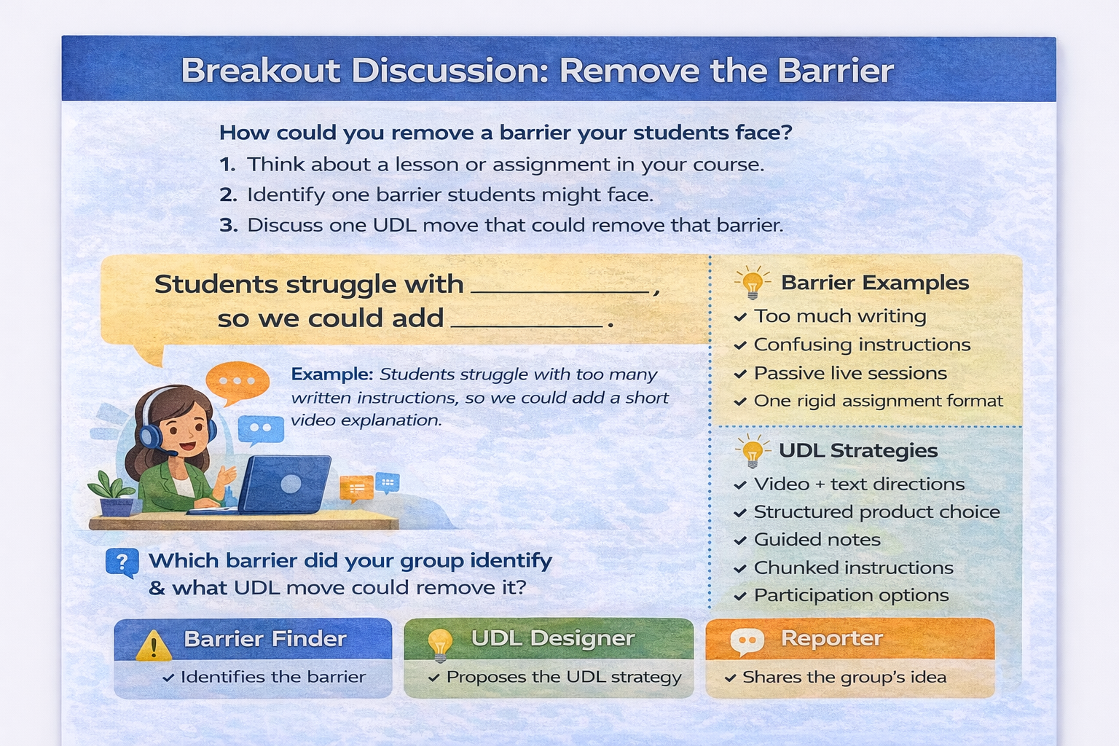
Notes:
Before we look at specific strategies, let’s practice identifying a barrier in our own courses. In breakout rooms, discuss one barrier students might face in a lesson or assignment and one UDL move that could remove it.
We are going to be broken into groups of three, discuss a barrier, a UDL strategy, and decide who will report out. It will be interesting to see if we identify some of the same barriers within our groups. We will take about 7-8 minutes for this activity.

Slide 15
High-Impact UDL Moves in Brightspace
Quick wins teachers can implement tomorrow:
Add video & text directions to key assignments
Provide a simple choice board for major products
Chunk long instructions into steps
Use release conditions to scaffold support
Small design shifts → big access gains

Slide 16

The Online Engagement Ladder
Demonstrating Learning
Flexible product options
Varied ways to respond
Rubrics or targets
Thinking
Demonstrating
Learning
Chat, voice, and visual communication
Live scaffolded notes
Student Engagement Goes Up
Thinking
Participating
Chat, voice, and visual communication
Participating
Modeling and examples
Passive
Passive
Sense of belonging
Video or text instructions
Notes:
Engagement online isn’t just about turning cameras on. It’s about moving students up the engagement ladder.
Passive:
Watching
Listening
Participating
Chat
Quick responses
Thinking
Guided notes
Discussion
Demonstrating learning
Flexible products
Explaining thinking

Slide 17
What UDL Looks Like in MEVA Classrooms
In live sessions:
Multiple participation pathways (chat, voice, visual)
Clear modeling and guided supports
In asynchronous courses:
Flexible product options with common rubric
Accessible, chunked directions
Supports embedded before struggle

Slide 18
Fast UDL Wins for Busy Teachers
You don’t need to redesign your course.
Start with one small change:
Add a second product option
Add video directions
Chunk long assignments
Provide an example model
Small design changes can remove big barriers.

Slide 19
Course Makeover Sprint
Choose ONE:
Improve a live lesson
Revise a Brightspace assignment
Add multimodal directions
What barrier might this remove?
Too much writing
Direction confusion
Passive participation

Slide 20
Simple Example: One Rubric, Multiple Products
Learning Goal: Explain how human activities impact ocean ecosystems.
Product Choices:
A written paragraph
A short video explanation
A diagram with labels
A slide presentation
Example Rubric (Same for All Products)
Criteria | Meets Expectations | Developing | Beginning
Understanding of the concept | Clearly explains how human activity impacts ecosystems | Shows partial understanding | Shows limited understanding
Use of evidence/examples | Uses accurate examples or evidence | Uses some examples but unclear | Few or incorrect examples
Communication of ideas | Ideas are clear and organized | Ideas somewhat clear | Ideas difficult to understand
Notes:
A common question teachers ask is:
“If students create different products, how do I grade them fairly?”
The answer is: the rubric measures the learning goal, not the format.

Slide 21
Implementation Commitment
This week I will:
Add a second way students can participate
Add multimodal directions
Add structured product choice
Chunk a long assignment
Please complete the Week 3 Exit Ticket

Slide 22
Other
Other topics and/or questions? Look for the Teacher/Staff Panorama School Climate Survey, launched at 3:19 pm today.
March 20th is students’/teachers’ vacation day. Please cancel all your live sessions.
Other and our next Professional Learning (PL) Meeting is on Monday, March 23rd via Zoom at 3:00 pm.
April Break is April 20th – 24th. Please cancel all your live sessions.
MEVA virtual high school graduation on Friday, June 5th at 2:00 pm. MEVA virtual eighth grade recognition ceremony on Friday, June 12th at 11:00 am.
Looking ahead, the Last Day of School is June 12th.
PL Meeting Materials are posted at: https://www.mainevirtualacademy.org/essaesserlau-elresources/meva-professional-learning-pl-meeting-materials
Thank you for all that you do to support your collegues, your students, and their families.

Slide 23
SY-2025/2026 Panorama Survey Action Plan
Target Rigorous Expectations (Students): Overall, how high are teachers’ expectations of you?
Action Plan (Students): Have a healthy competition in class. From Panorama Playbook “Creating a competition around issues such as homework completion, note-taking, or talking during class is an effective way to motivate students to change behavior for the better. This move works to establish routines and increase engagement in what might otherwise be less-exciting activities.”
Target School Climate (Teachers): On most days how enthusiastic are students about being at school?
Action Plan (Teachers): Increase training on how to encourage student engagement in the virtual setting.
Target Feedback and Coaching (Teachers): How often do you receive feedback on your teaching? How much feedback do you receive on your teaching? How much do you learn from the teacher evaluation processes at your school?
Action Plan (Teachers): Increase teacher/peer observations and feedback through peer observations and presentations at department meetings.
Target Professional Learning (Teachers): Through working at your school, how many new strategies for your job have you learned?
Action Plan (Teachers): Increase targeted professional learning/training at weekly Professional Learning (PL) Meetings (formerly Process Improvement Meetings).

