Slide 1

Panther Baseball
2026

Slide 2
Introduction of the Coaches
Varsity - Dean Schwirtz
Varsity Assistant Coach- Colt Trebesch
Volunteer Assistant- Josh Otto-Fisher, Dave Wendlandt and Chad Christensen
JV - Dave Sell
C Team/9th Grade - Paul Lemke
8th Grade - Eric Anderson
7th Grade – Kjel Johnson

Slide 3
First week of Practice for Grades 9-12
Arm Care Week is March 9-13.
Players are given one week to condition their arms
Practice on these days will be in the Morings at 7:20am. Followed by baseball camp after school each day.

Slide 4
Location of Indoor Practices and Times
Varsity and JV will practice indoors at the High School.
3:20 to 5:30
1st Day of Official Practice is March 16th at 3:20.(High School)
C Team/9th grade will practice with grades 10-12.
3:20 to 5:30
1st Day of Practice is March 16th at 3:20.
7th and 8th grade will practice at the High School/Field House.
3:30 to 5:15 on Mondays, Tuesdays, Thursdays and Fridays.
1st Day of Practice will be March 16th.
Some players will practice with varsity on Wednesdays. Coaches will let you know. This should not interfere with religion.

Slide 5
Location of Outside Practices.
Varsity, JV and 9th will practice at Vollmer Field Glencoe 3:30-5:30/6:00.
Players should catch a ride with upper classmen.
7th and 8th grade will practice behind the High School Fields A11 and A12
Players should have clothes each day to go outside from the 1st day of practice. Over dress!

Slide 6
Location of Home Games
Varsity – Volmer Field in Glencoe
JV - Bluejay stadium in plato
9th - bluejay stadium in plato and Field 11
8th-Glencoe Silver Lake High school Field 11
7th-Glencoe Silver Lake High School Field 12

Slide 7
Information on Practices
Players must be to practice on time.
Being late is not acceptable.
Coaches will determine consequences.
If a player is injured they are expected to attend practice.
Injuries will be treated differently than unexcused absences.

Slide 8
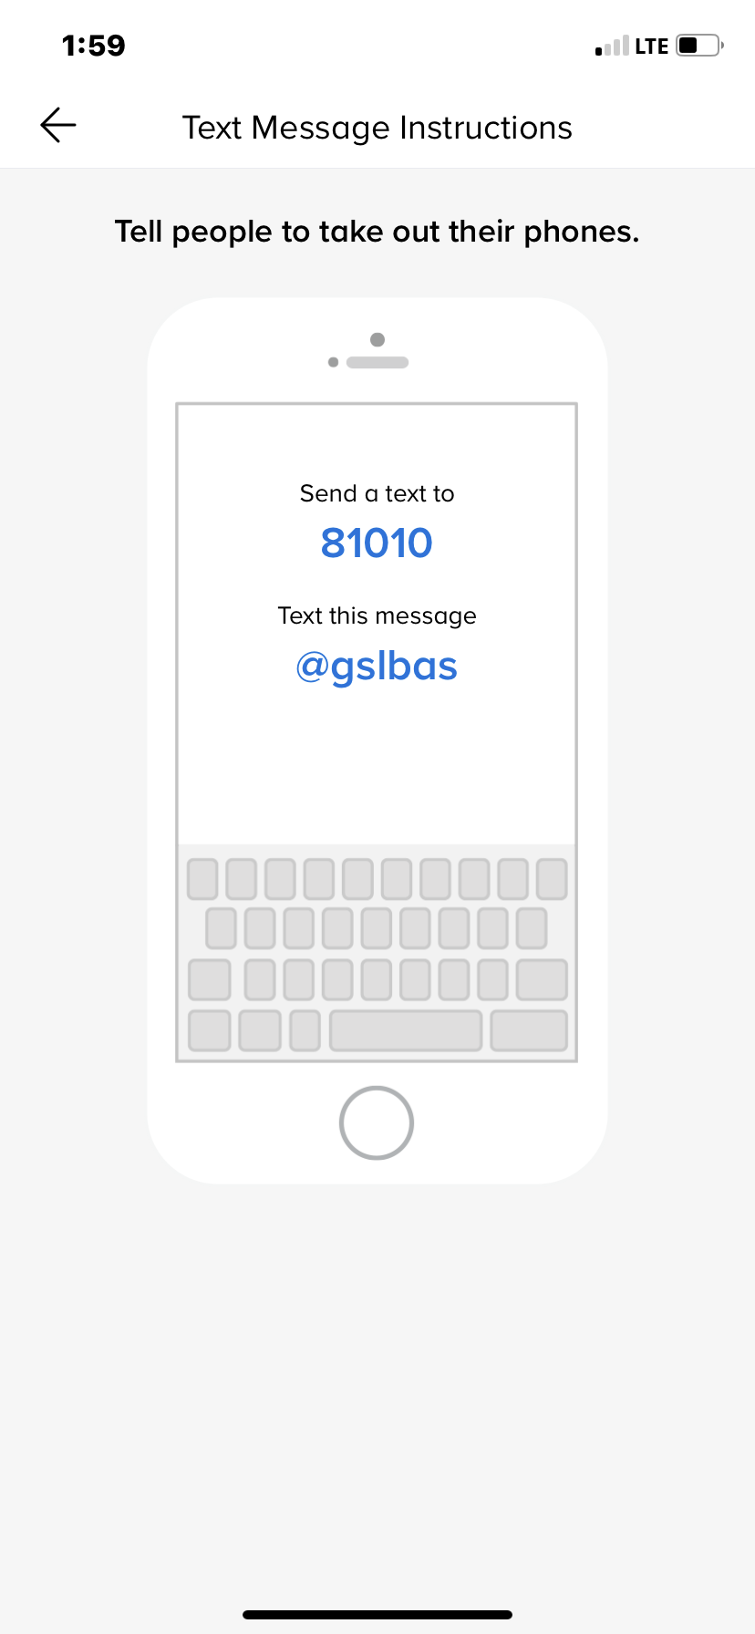
Players
Please Join the
Remind App
Send a text to: 81010
Text this message: @gslbas

Slide 9
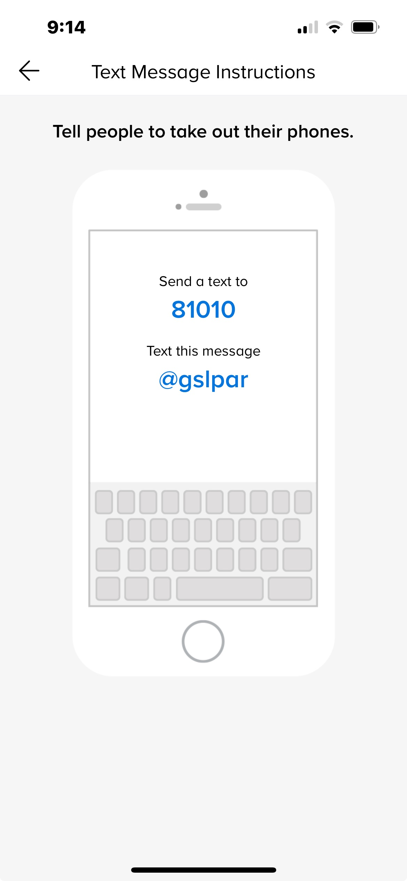
Parents
Please Join the
Remind App
Send a text to: 81010
Text this message: @gslpar

Slide 10
Playing Time
Varsity-No guaranteed playing time.
JV-Will be made up of juniors, sophomores and possibly freshman. No guaranteed playing time.
C Team Grade-Will receive some playing time every other game.
7th and 8th Grade/Junior High
Will receive close to equal playing time.

Slide 11
Bus
1. Riding the bus is a privilege.
2. Players will need to sign the Score book or have a permission slip/form for the coach to ride home with their parent

Slide 12
Playing time Questions
Player should talk to the coach first.
Should be done after a practice or a scheduled time.
Not after a game.
Player should think about what he wants to discuss.
If player is not satisfied with this meeting we will set up a meeting with the player, parents and coaches.
If the situation is not solved a meeting with the player, parents, coaches and Mr. Foss will take place.
Keep in mind what is best for the team.

Slide 13
End of Season Roster
The end of the season roster will be different from the regular season roster.
We will have the best suitable players on the playoff roster at season end regardless of age.
Grades play a big part of this!

Slide 14
Grades
If a student received a F in one or more classes at the end of the trimester, the student will be ineligible to compete in any events for a period of two (2) weeks or two (2) events whichever is longer. These two (2) weeks will be carried over to the next season if it is not completed during the season in progress, i.e. spring grades carry over to fall sports. If a contest or activity takes place during the student contact day, any ineligible student is required to be in school. All decisions concerning academic eligibility are subject to final administration approval.
If a student received a F in one or more classes at the the Mid-trimester they must sit until their grade is at a D- or higher. Player must sit at least one game before they are able to play.

Slide 15
Equipment
Shoes-Black-Gray-Purple-White-School Colors
Socks-Black
Metal or Plastic cleats may be worn for all levels.
Glove-Stay away from the gray gloves or light colored.
Undershirts-Should be Black
Caps- Black P Cap Sold in the activities office. Cost is $25
Players may wear evo shied protection. Must be school colors.
Helmets are solid black in color if you purchase your own helmet.
Sweatshirts or sleeves-Panther baseball Gear if Possible.
Players need to purchase their own baseball pants. Gray with black pin stripe

Slide 16
GSL Baseball Clothing from BSn
Good Sites to buy equipment
Bats
CLOSEOUTBATS SALE: Easton Softball Bats & Baseball Bats; DeMarini, Louisville Blemished Bats & Closeouts
Everything for baseball https://www.baseballsavings.com/?srsltid=AfmBOoqSmmpouqxXE8EaE8L9jYQqt-2aEslvh466WK_AzjF1cHcNo-gK https://www.baseballexpress.com/?srsltid=AfmBOoqBZwY-iDBXp26jI3SYLZfw0DkXMt9F8K0zdlF95SBN43oy2KsR

Slide 17
Panther Baseball expectations
1. We always run on and off the field.
2. We always are dressed when we get off the bus with jerseys tucked in. Put your spikes on in the dugout.
3. We always leave the field, dugout and bus looking better than when we arrived.
4. Hair is tucked in under our baseball cap.
5. Next play attitude.
6. Parents lead by example. Coaches will have the conversations with the umpires.
7. You must have the grades to play.

Slide 18
#NEVER SETTLE #BE THANKFUL

