Slide 1
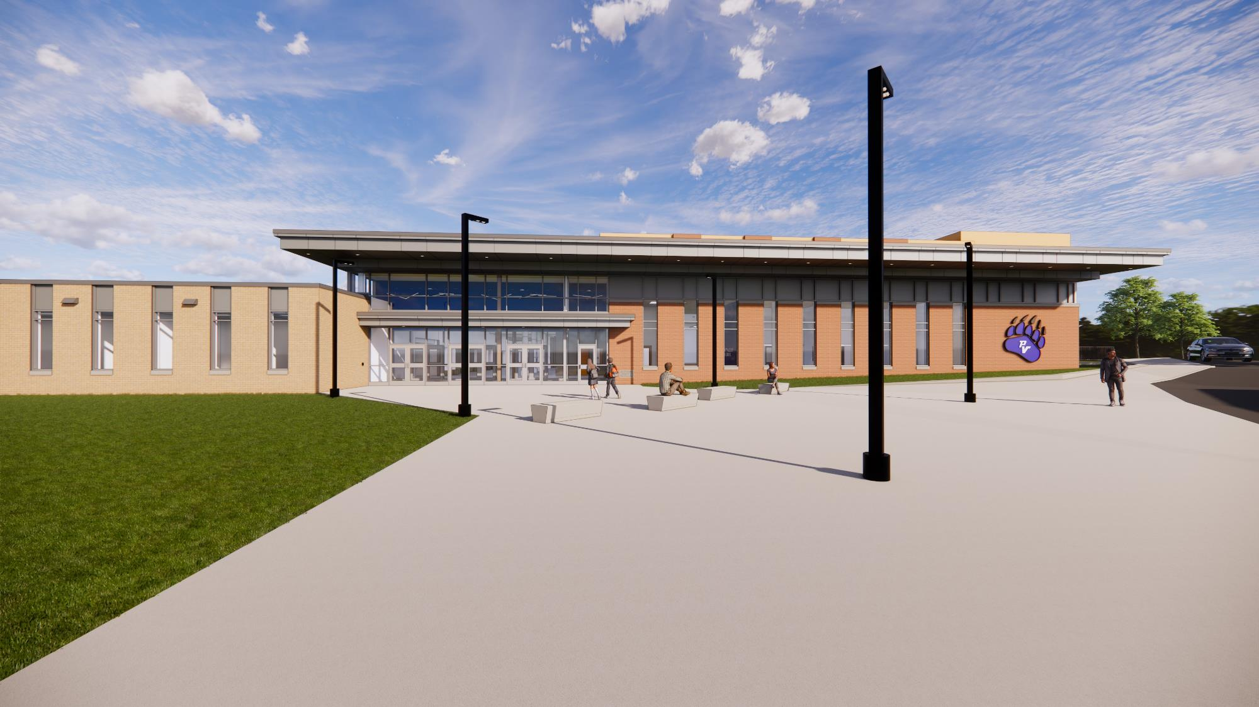



Pleasant Valley School District
High School Renovations and Additions
February 12, 2026, Project Update

Slide 2

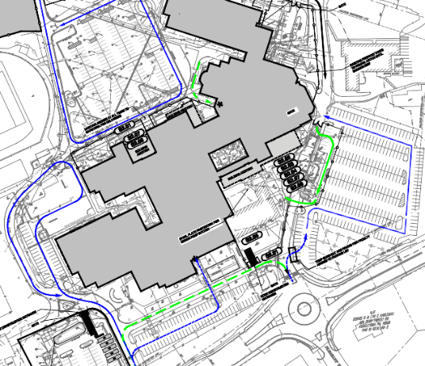
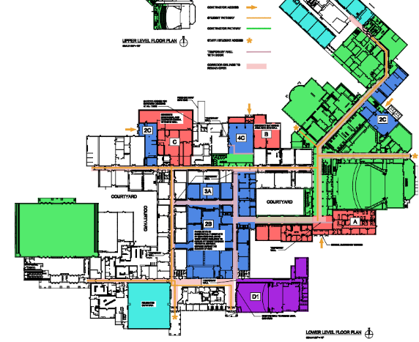
Current Phases of Construction
Building Phases: A, B, C, 2B, 2C, 4C, D1, 3A
Site Phase 2

Slide 3

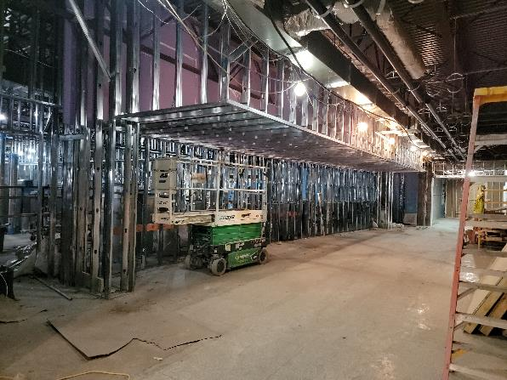
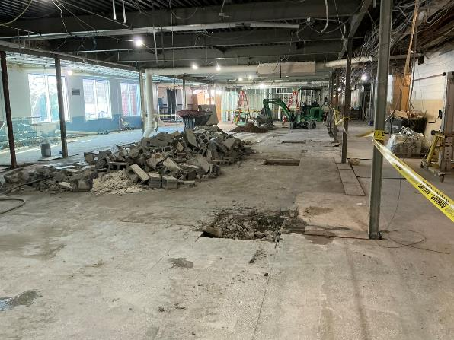
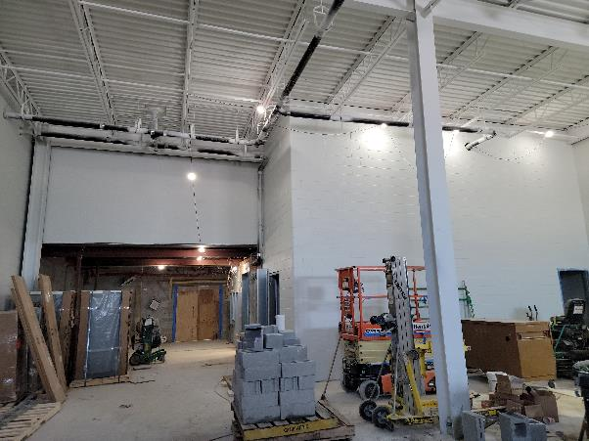
Interior Construction Activities
Demolition of existing interior classroom and corridor walls in area E complete.
Installation of drywall continues in new admin addition.
Installation of above ceiling MEP equipment continues in new admin addition & STEAM
Installation of interior CMU partition walls and equipment layout continues in new mechanical room.
Installation of new structural components continues in area E.

Slide 4
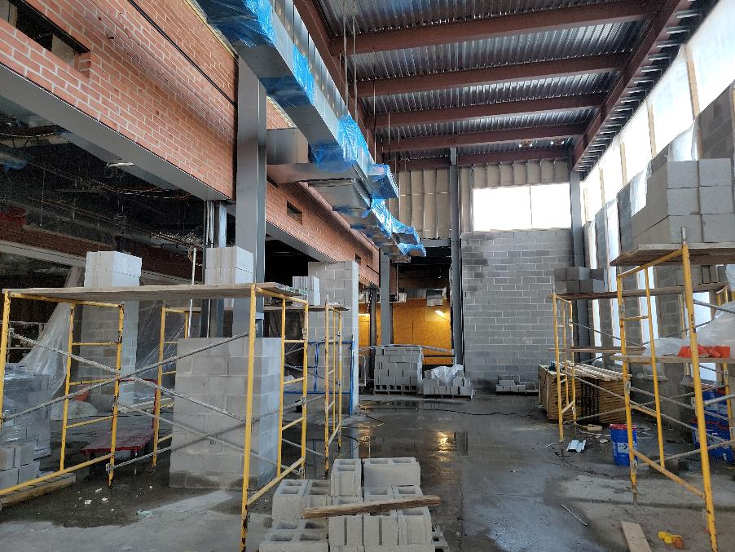
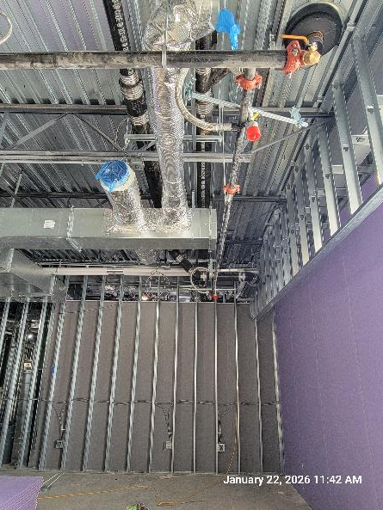
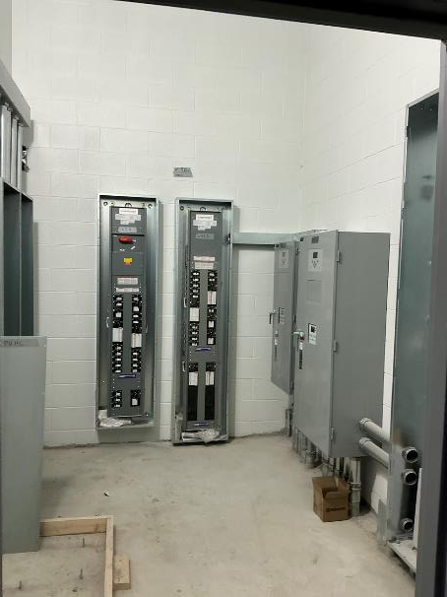
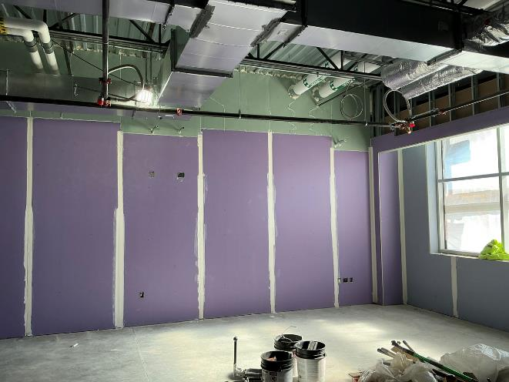
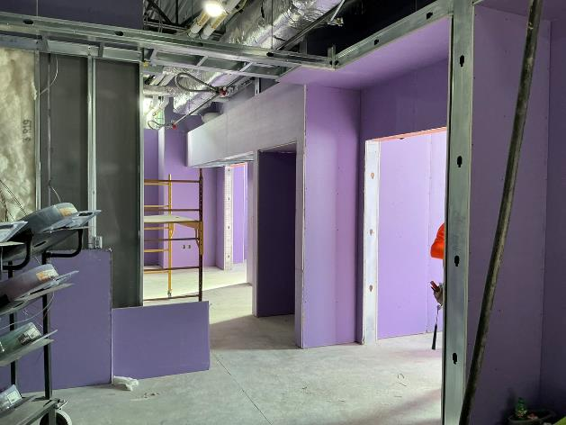
Interior Construction Activities

Slide 5
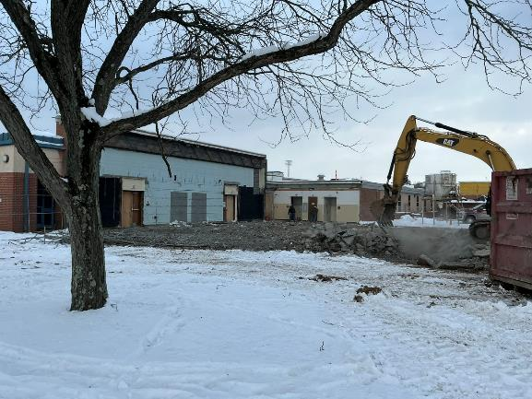
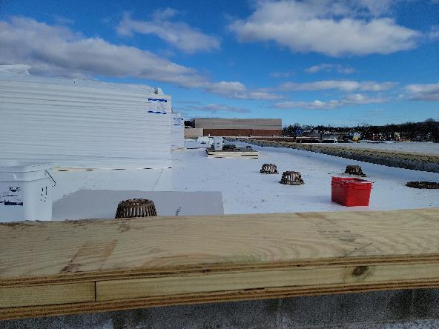
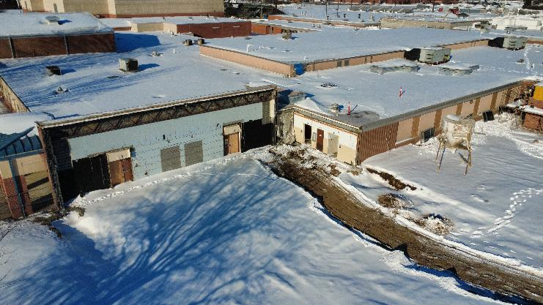
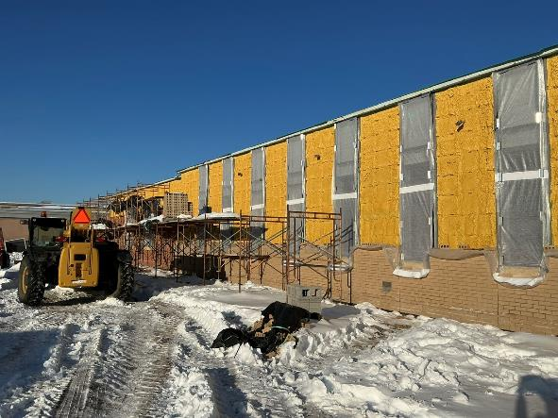
Exterior Construction Activities
Exterior window frame installation began in admin addition.
Roofing progresses mechanical and cafeteria additions.
Exterior brick veneer continues around admin addition.
Exterior sheathing completed around cafeteria addition.
Demolition of old auditorium, corridor and classrooms are completed.
Preparation for future site utilities has started.

Slide 6
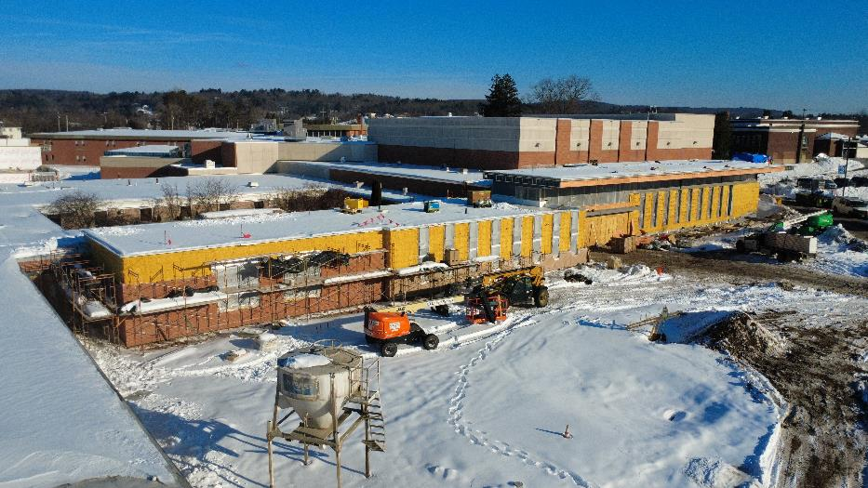
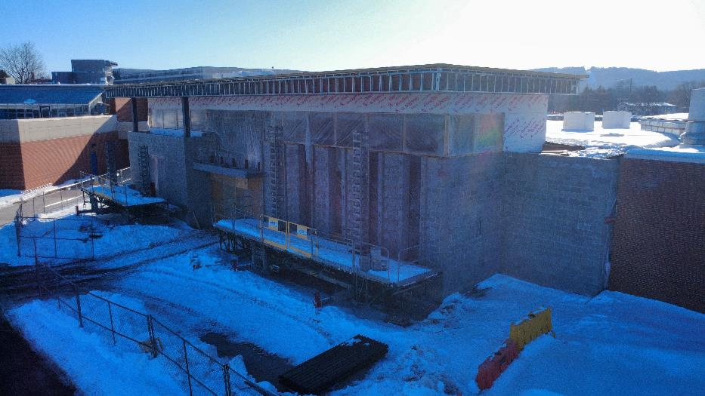
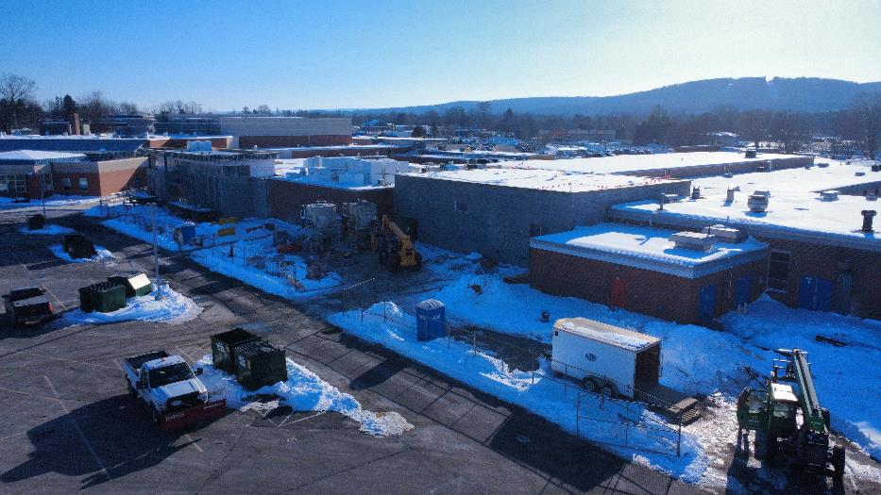
Exterior Construction Activities

Slide 7
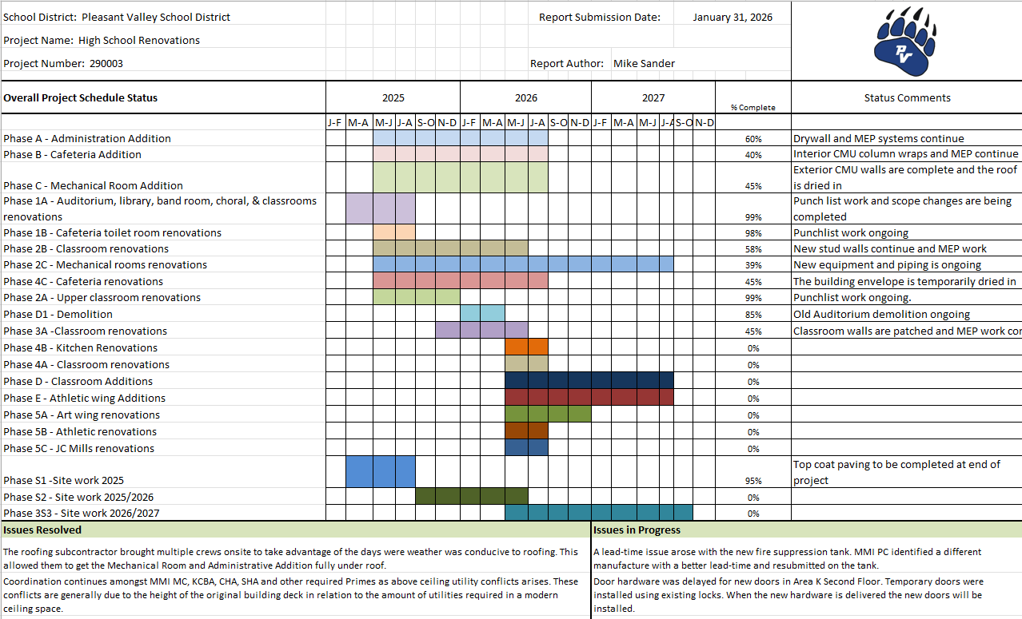
Progress Update

Slide 8
Next Steps
Roof work and expansion joints around mechanical and cafeteria additions.
Exterior brick work and windows in admin addition.
Interior drywall and finishes in admin addition.
Interior cmu walls for area E offices and classrooms.
Mechanical room layout and equipment installation
Coordinate with PVSD:
  PVSD technology and furniture install in new spaces.
  Future traffic plans for 26/27 school year.

