Slide 1
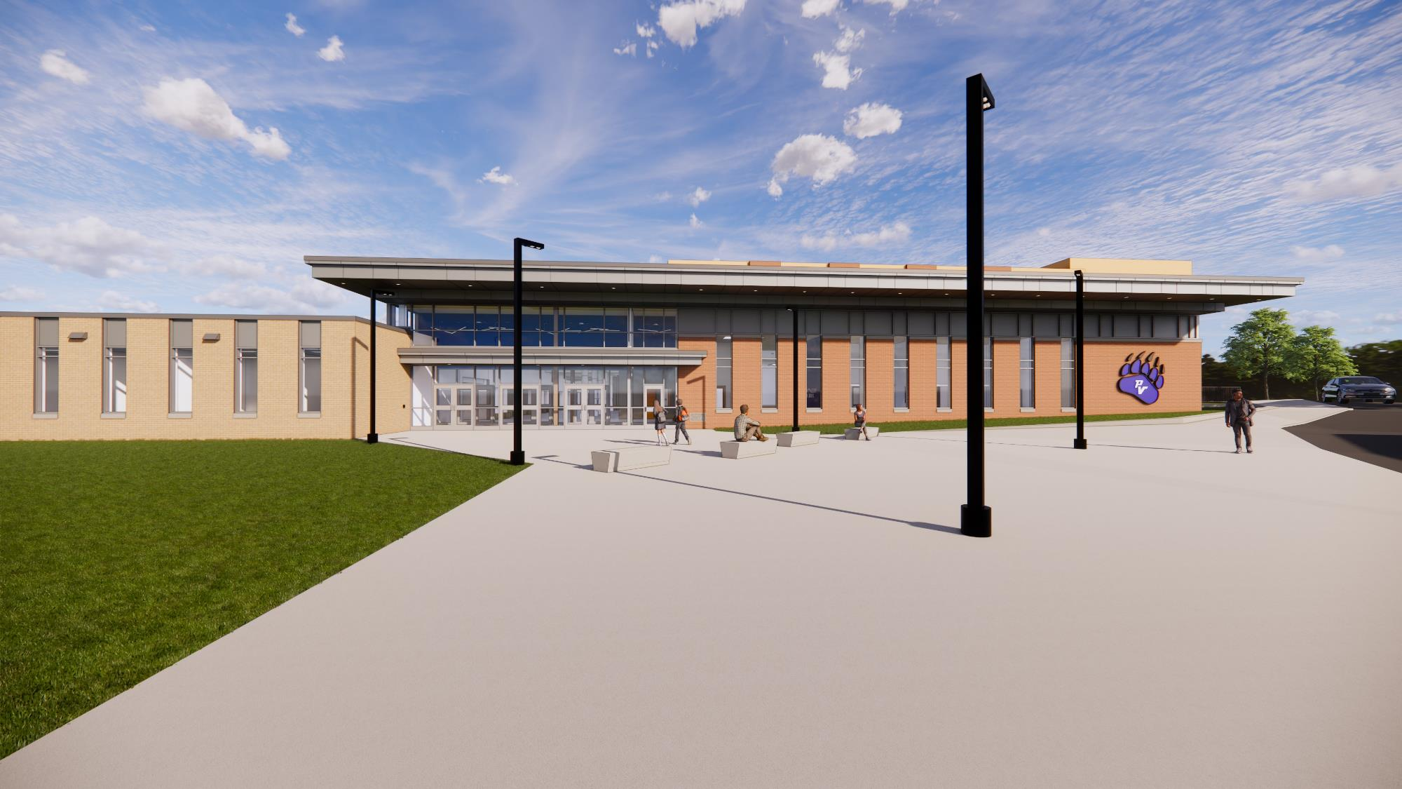



Pleasant Valley School District
High School Renovations and Additions
March 12, 2026, Project Update

Slide 2

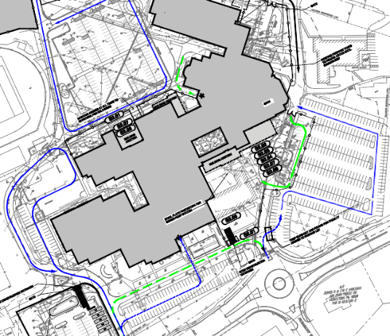
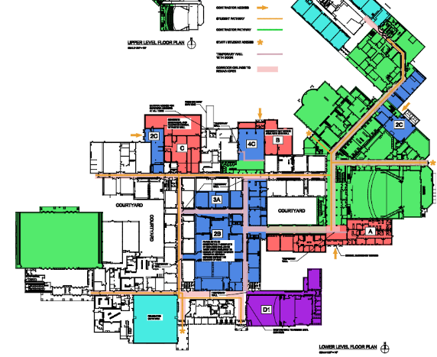
Current Phases of Construction
Building Phases: A, B, C, 2B, 2C, 4C, D1, 3A
Site Phase 2

Slide 3

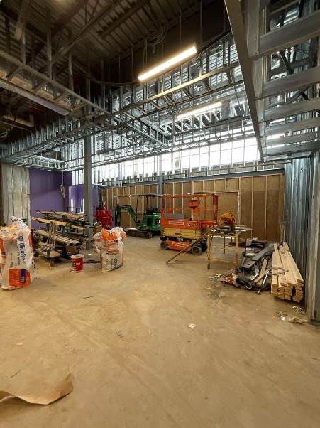
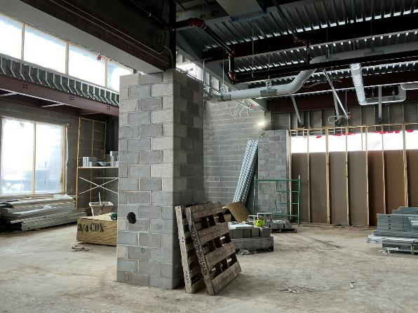
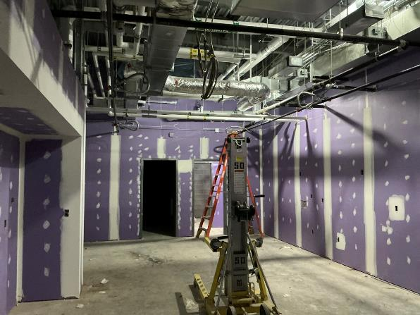
Interior Construction Activities
Installation of interior stud and cmu walls continue in areas D, E, F and the cafeteria.
Installation of above ceiling MEP rough-in and equipment continues in admin & STEAM
Installation of ceiling grid started in admin addition
Painting, wall tile, and finishes started in admin addition
Installation of mechanical equipment in new mechanical room
Duct work and piping continues from new roof top equipment

Slide 4
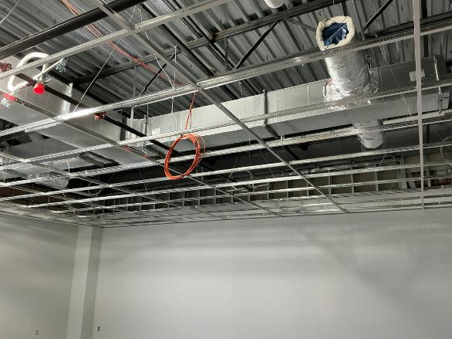
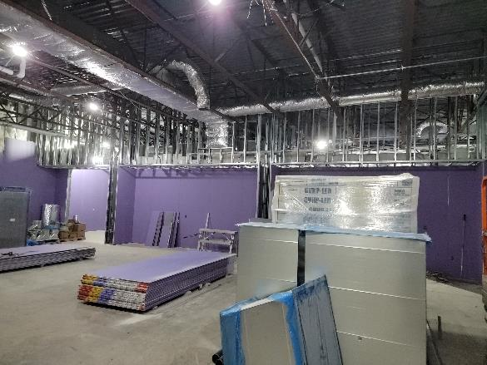
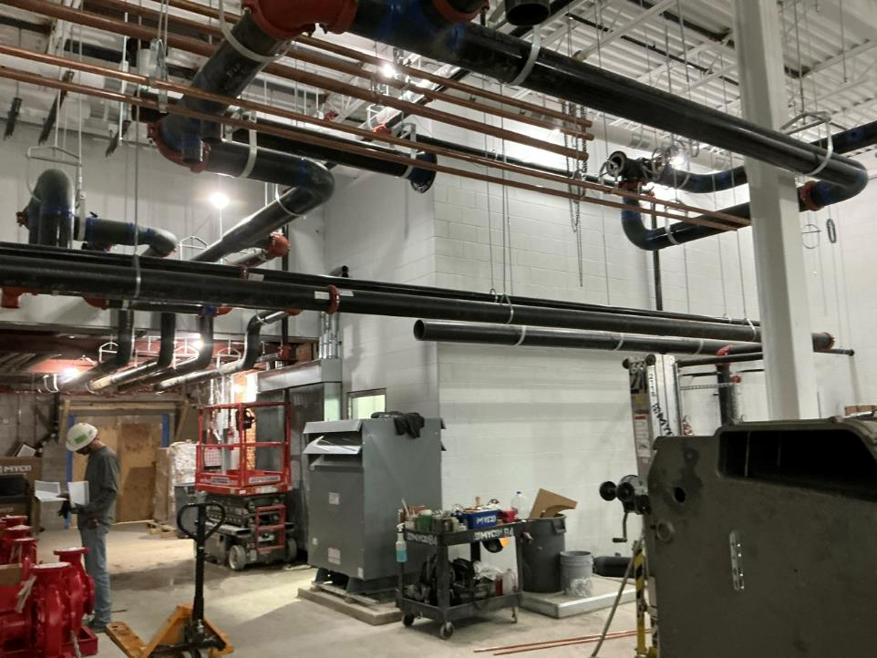
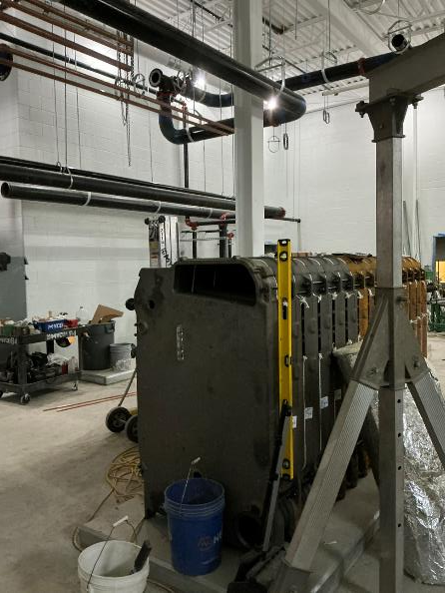
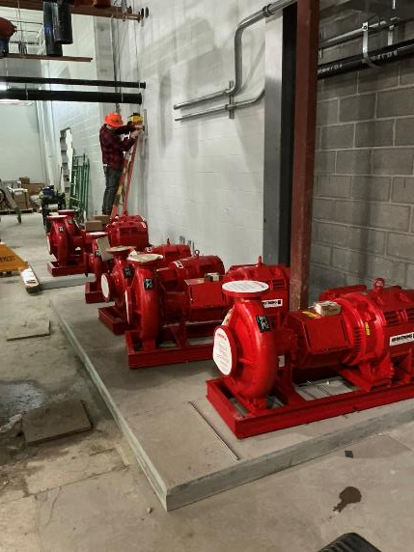
Interior Construction Activities

Slide 5
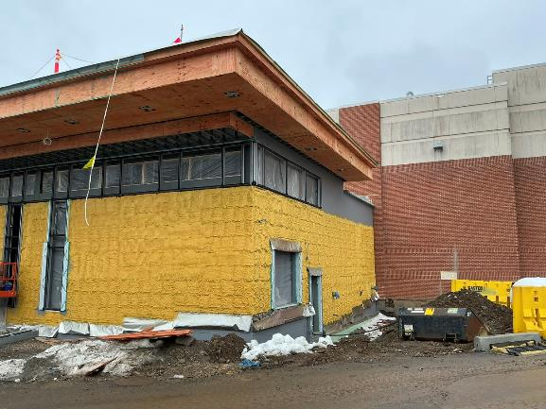
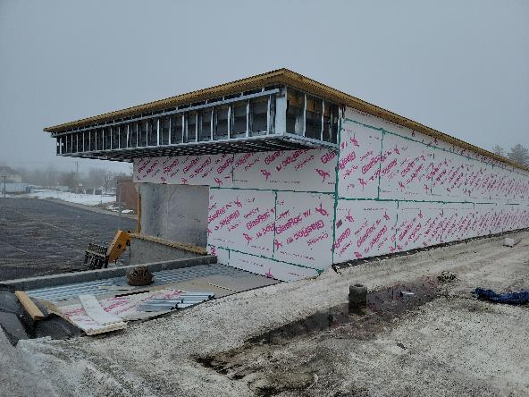
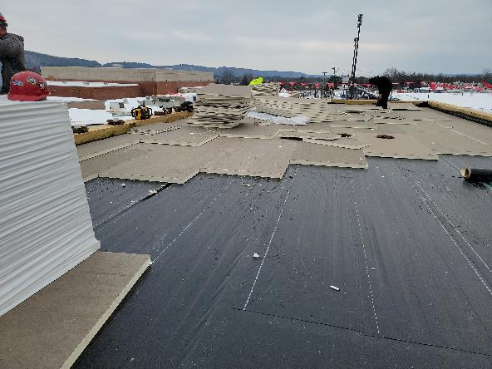
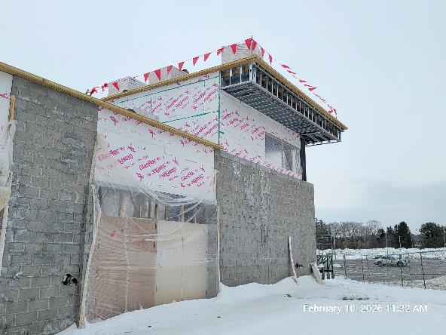
Exterior Construction Activities
Exterior finishes including brick continues on admin addition.
Roofing installation continues above cafeteria.
Spray AVB and insulation continue at mechanical addition
Exterior soffit framing and sheathing continue at cafeteria.
Installation of windows continues at admin addition.
Layout and coordination for future site utilities continues.

Slide 6
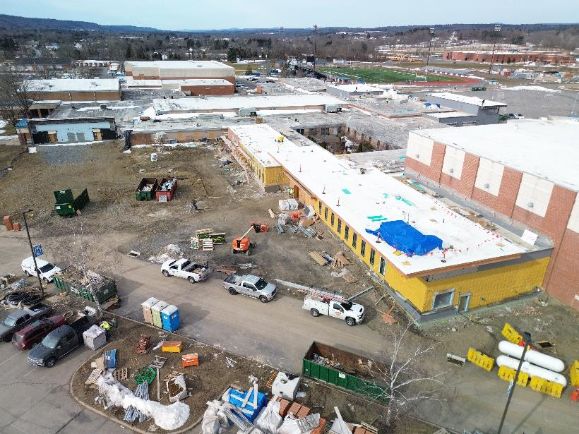
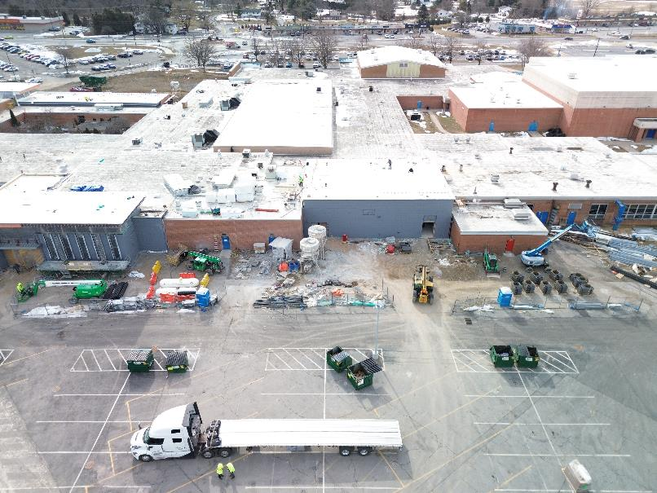
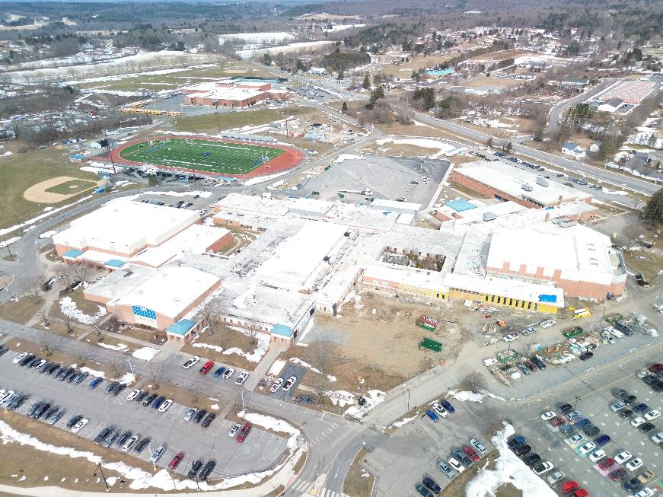
Exterior Construction Activities

Slide 7
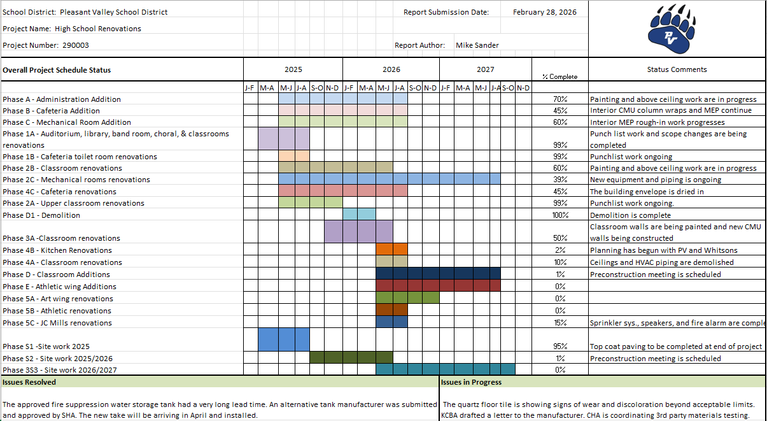
Progress Update

Slide 8
Next Steps
Roof and masonry work above mechanical room.
Exterior brick work and windows in admin addition.
Interior finishes including wall tile, paint, and ceiling grid in admin addition and STEAM.
Overhead rough-in of MEP for areas E and F.
Mechanical equipment installation.
Coordinate with PVSD:
  PVSD technology and furniture install in new spaces.
  Future traffic plans for 26/27 school year.

