Slide 1
FPS FAMILY ACADEMY:
FAMILY ENGAGEMENT

Slide 2
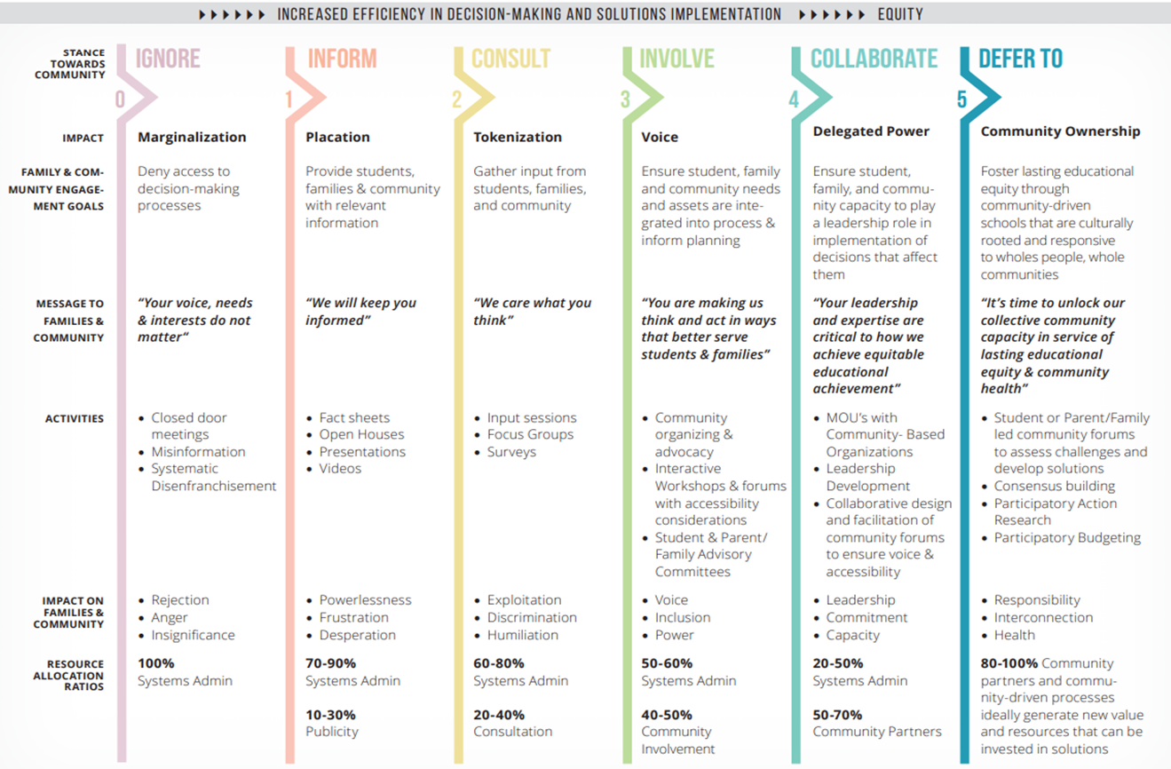
Family Partnership Spectrum

Slide 3
Family and Community Partnerships
GOAL 2: EXPAND OPPORTUNITIES FOR FAMILES/CAREGIVERS TO BE INVOLVED IN THEIR CHILD’S EDUCATIONAL EXPERIENCE
Schools provide families meaningful opportunities to support their child's academic experience.
Schools/district work with families to increase participation in school activities (volunteer, events, enrichment).
Schools/district provide opportunities to provide advocacy, input and leadership in matters pertaining to their child's education and wellbeing.

Slide 4
FPS Resources
• FPS Empowerment Guide
ParentSquare Communication
• Student Led Conferences
• Volunteering
• Surveys/Focus Groups/Town Halls
• PTA/PTO/Advisory Committees
• Parenting Classes

Slide 5
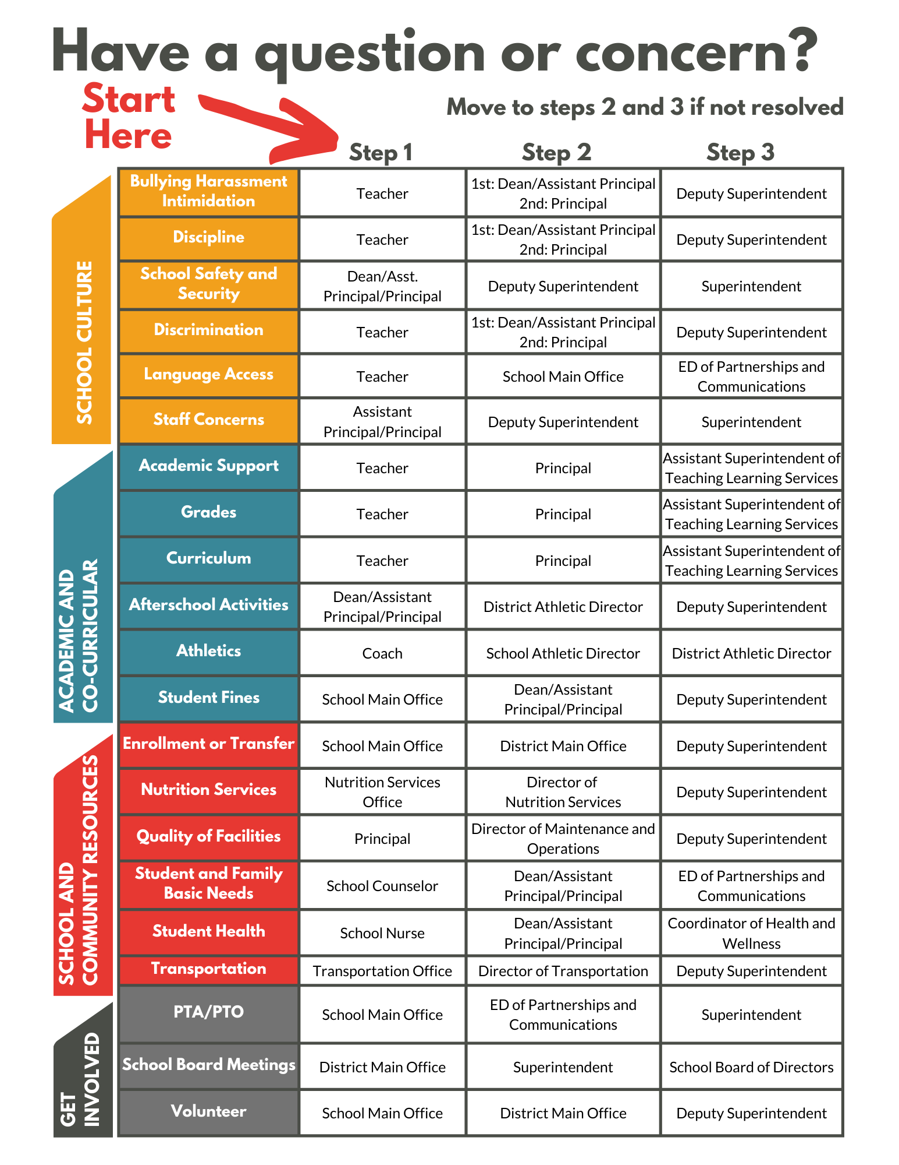
Empowerment Guide

Slide 6


Volunteering
School
Athletics
Student/Staff
Questions? Contact:
Kamesha Herd
District Volunteer Coordinator
volunteers@fpschools.org
(253) 298-3009

Slide 7
Advisory Groups
Brookdale PTO
Central Avenue PTO
Collins PTA
Midland Elementary PTO
Franklin Pierce HS Booster Club and Parent Partnership Committee
Washington HS Family Partnership Committee
Dual Language Advisory Committee
Superintendents Advisory Committee
Teaching and Learning Services Instructional Materials Committee

Slide 8
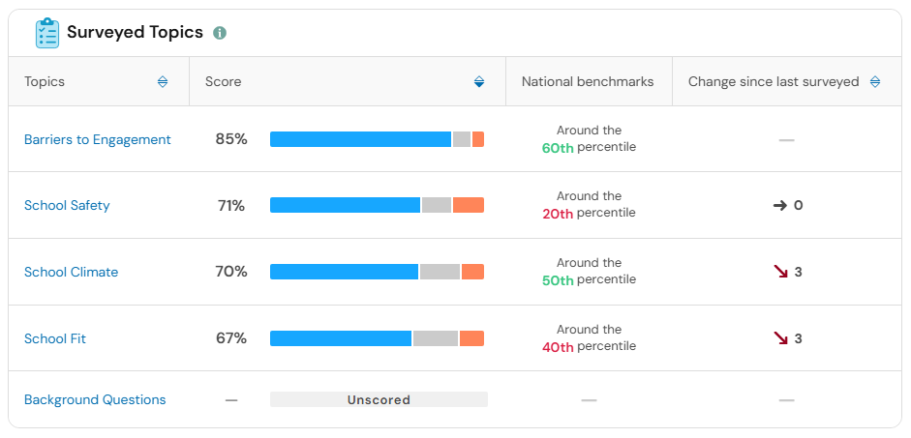

Family Feedback

Slide 9


Parenting Classes

Slide 10
QUESTIONS?
¿PREGUNTAS?

Slide 11

UPCOMING SESSIONS
February 9: Standards-Based Grading and Culturally Responsive Education
March 16: Nutrition Services and The Farm

