Slide 1



ELHS Junior Planning
Presentation
East Lyme High School Counseling Department
Notes:
Welcome to our presentation on post-secondary planning, a process that plays a crucial role in shaping the future of our students. Whether you are considering college, technical programs, the military, or entering the workforce, the journey toward life after high school can feel both exciting and overwhelming. At East Lyme High School, the Counseling Department is here to support you every step of the way. From exploring options and setting goals to navigating applications and deadlines, we are committed to providing personalized support and resources to ensure each student finds their best path forward. This presentation will walk you through the process of the career and college searches, share key milestones, and highlight how we can partner with you to make post-secondary planning a clear and manageable experience.

Slide 2
School Counselors
Visit: East Lyme Public Schools: Home
East Lyme High School
School Counseling
College and Career
Naviance Student
https://student.naviance.com/eastlymehs
Be sure we have your correct email address on Naviance!
Elizabeth Maiese: A-Cha
David Willis: Che-Ga
Jaclyn Sullivan: Ge-Ko
Christy Bryant: Kr-Os
Haley Stites: Ot-R
Nadine Barnes: S-Z
Notes:
Listed here, are our dedicated counselors here at East Lyme High School, who are committed to guiding you through every step of your high school journey, including the post-secondary planning process. Each counselor supports students based on their last names, ensuring personalized attention and support throughout your time here.
Communication is a key part of what we do, and we want to ensure students and families feel informed and connected.
Our website is a valuable hub for information on deadlines, resources, and opportunities.
Follow our Facebook page for updates, announcements, and reminders to keep you on track.
And most importantly, we utilize Naviance, our post-secondary planning software. Every student has a Naviance account and is encouraged to explore its many tools and resources, such as resume building, college searches, and career assessments. Naviance is central to the post-secondary planning process, so we strongly recommend students logging in regularly to stay organized and informed.
Our team is here to guide you, answer your questions, and support you as you plan for your future.

Slide 3
About This Presentation
What Has Been Done
What Is Happening Now
What Are the Next Steps
A look into the Post-Secondary Planning Process
Notes:
Welcome to an overview of the post-secondary planning process. In this presentation, we'll discuss what has been done so far, what is currently happening, and the steps that lie ahead. Up until now, a student's relationship with their counselor may have primarily revolved around academic scheduling or addressing social-emotional needs. However, as we delve into planning for life after high school, we introduce an additional layer of support and guidance. This process marks a significant transition, where we work collaboratively to help students define and achieve their goals for the future.

Slide 4

WHAT HAS BEEN DONE

Slide 5
FRESHMAN/SOPHOMORE YEAR
Grade 9
October-November:
Took PSAT 9
Grade 10
February - May:
February – April:
Registered on CollegeBoard
February-May:
Individual meetings to review Course Selections and Recommendations
Individual meetings to review Course Selections and Recommendations
Classroom Lessons
Career Interest and Personality Inventories on Naviance
Notes:
Grade 9 students began their journey with the PSAT 9 in October or November, providing an introduction to standardized testing and insight into their academic strengths. They also registered on CollegeBoard, setting the foundation for future college and career exploration. From February to May, counselors met individually with students to discuss course selections and recommendations, ensuring their schedules aligned with their interests and academic goals.
In Grade 10, the focus expanded further. Between February and April, students participated in classroom lessons and completed career interest and personality inventories using Naviance, helping them explore potential career paths and understand their unique strengths. From February to May, we continued the individual meetings to review course selections and recommendations, maintaining a personalized approach to each student's academic planning

Slide 6

What is Happening Now

Slide 7
CURRENT DISCUSSION TOPICS:
Course Selection
Standardized Tests
Meet With Your Counselor
Preparing to Apply/Explore
How Naviance Can Help
Exploring Careers and Majors
7
Notes:
As we look ahead to post-secondary planning, it's essential for current juniors to begin having meaningful conversations at home about several key topics. Each of these areas brings its own value and purpose to the planning process.
First, Course Selection—discussing academic choices ensures students are building a transcript that aligns with their future goals.
Next, Exploring Careers and Majors—these conversations can help students identify interests and potential career paths.
Standardized Tests are another important topic—talking about preparation and timelines ensures students are on track for success.
We also encourage students to Meet with Their Counselor to deepen the planning process and receive personalized guidance.
Preparing to Apply and Explore involves researching colleges, programs, and other opportunities. Finally, understanding How Naviance Can Help will equip students with tools to navigate this exciting journey.
These discussions provide a strong foundation for students to approach the next few months.

Slide 8

Junior Year
Important Dates to Plan For
March - April
Individual Meetings
Review Course Selections and Recommendations
Review individual Post-Secondary Plans
Set a timeline for the application process
Wednesday, April 2
School Day SAT Scheduled
April 13-17
School Vacation (great time to work on College Research)
Saturday, April 5 June 14, & July 12
ACTs are NOT offered at ELHS
May 4 – May 15
AP Test Dates: May 4 -May 15 (check CollegeBoard.org for updates)
Saturday, March 16, May 2, & June 6
SATs offered at ELHS
Notes:
Spring is a busy and important time for our juniors as they continue preparing for their post-secondary plans. From March to April, counselors will hold individual meetings to review course selections, provide recommendations, and discuss personalized post-secondary plans. During these meetings, we'll also set a timeline for the application process to ensure students stay on track.
Looking ahead, mark your calendar for key dates:
In March. the School Day SAT is scheduled—a valuable opportunity for juniors to take the SAT for free in a familiar environment.
During April school vacation, it is a great time for students to dive into college research.
For those planning to take the ACT, it will be offered here at ELHS in April, June, and July
Additionally, SATs are available in March, May, and June
Finally, AP Test Dates are also scheduled in May. Be sure to check CollegeBoard.org for specific updates and schedules. These are all critical steps in preparing for life after high school.

Slide 9

ELHS COURSE SELECTION

Slide 10
Course Recommendations & Class Selection
February
Teachers meet with students individually to discuss core class recommendations for next year
Wednesday, February 12th – Graduation Requirements, Career Concentrations, Program of Studies review and Course Selection overview in Advisory
March
Wednesday, March 5th - Grades 9-11 Student Course Selection in Advisory
Thursday, March 6th- May 2nd- School Counselors meet with Grades 9-11 for Course Planning
Late Spring
May– Master Schedule is created and course recommendations will be made available electronically
Summer – Schedules finalized and made available online
Notes:
To ensure juniors have access to the best course options, the following timeline outlines key dates for receiving course recommendations and selecting classes. Staying proactive during this process is crucial for purposeful academic planning.
In February, students will participate in advisory sessions that provide an overview of graduation requirements, an introduction to Career Concentrations, and guidance on the Course Selection process. During this time, teachers will meet individually with students to recommend core classes for the upcoming year and input these recommendations into Infinite Campus. Later in the month, students will review the Program of Studies and receive a step-by-step overview of the course selection process. These sessions aim to familiarize students with available resources, help them understand course offerings, and enable purposeful planning for the year ahead.
In March, during the first week, students will select their elective courses in Infinite Campus during Advisory. Following this, they will schedule individual meetings with their school counselor to finalize course planning. For juniors, this meeting will also include discussions on post-secondary planning. These meetings can be scheduled electronically, and students should plan for the meeting to occupy a significant portion of their study hall or available block. Parents are welcome to attend these sessions via Zoom if invited by their student.
In May, the Master Schedule will be created, and course recommendations will be available online. Finalized schedules will be accessible online during the summer.

Slide 11
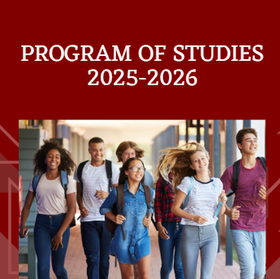

Program of Studies
Electronic
Accessible
Simplified

Slide 12
Career Concentrations
What are Career Concentrations?
Career Concentrations at East Lyme High School allow students who are interested in a particular career path to receive a certificate of accomplishment for successfully completing courses that help prepare them for a related career field. Successful completion of a Career Concentration is also recorded on the student’s official transcript.
Why Career Concentrations?
⭐ Learn more about an area to see if you like it!
⭐ Build your resume and help potential employers or admissions representatives understand the depth of your interest.
⭐ Be better prepared to enter a career.
⭐ Be better prepared for courses at a technical school or college.
Program Requirements
Each concentration has a minimum credit requirement that consists of both required courses and elective courses.
Students must:
✔ Take the correct sequence of courses as outlined in this brochure and the Program of Studies.
✔ Earn a ‘C’ or better in each concentration class. Grades are checked at the end of Quarter 3.
✔ Complete the application on Google Classroom in your senior year (code: v6cf64c) - please do NOT enter the Google Classroom until your senior year.
Click Here for the Brochure!
Applications are on Google Classroom: v6cf64c
Career Concentrations will be recognized on the transcript!

Slide 13

CAREER CONCENTRATIONS
Performing Arts*
Visual Arts
Hospitality*
Broadcasting*
International Studies
Manufacturing
STEM
World Languages
Business*
Education
Print/Digital Communications*
Computer Science
Public Safety*
Allied Health*
Notes:
While there are many driving forces to what students choose for classes, teacher recommendations, friends, and career concentrations all play a part in course selection
Review Career Concentrations – interdisciplinary

Slide 14

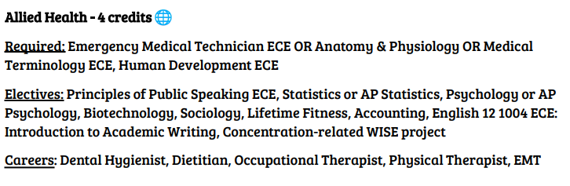
Career Concentration Example

Slide 15

Exploring Careers and Majors:
Beginning the Post-Secondary Search

Slide 16

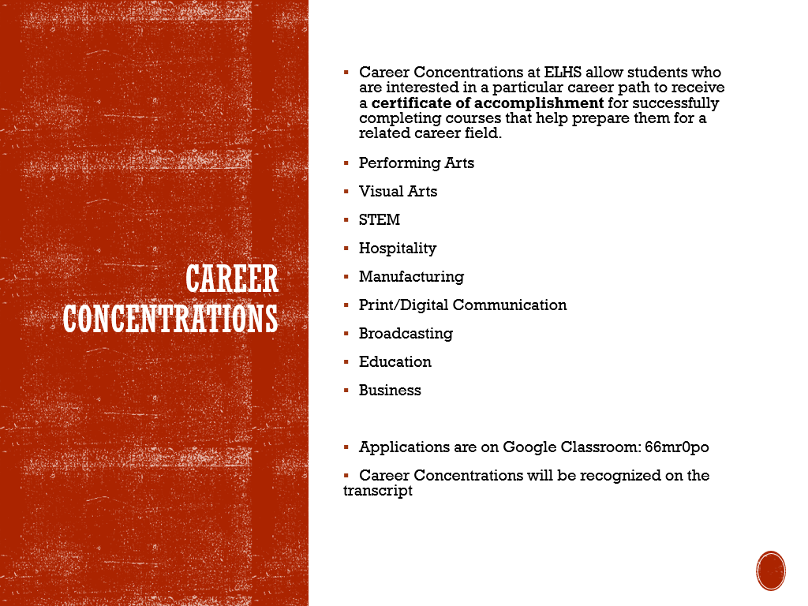
Exploring Post-Secondary Options
College: 2- or 4- year degrees
Technical School
Apprenticeship
Work/Career
Military
Gap Year

Slide 17

Exploring Careers and Majors
Those who are not sure about their plans should:
Research possible careers/majors
Complete the Personality Inventory or Career Interest Inventory on Naviance
Review the Occupational Outlook Handbook and other career resources
Talk to their parents, school counselors, and teachers
Consider the ASVAB Senior Year
Research with an open mind!
While some students know exactly what they want to do for a career and what they will choose as a major in college, most do not.
Relax! -- many students apply 'undeclared' and most students change their major at least once in four years of college
This Photo by Unknown author is licensed under CC BY-SA.

Slide 18

Helpful Career Resources
Occupational Outlook Handbook
Career One Stop
mySkills myFuture
My Next Move

Slide 19

Armed Services
Representatives from Armed Services and Apprenticeship Programs offer lunch sessions.
Senior year – Fall Armed Services Information Session and December ASVAB testing
Spring Armed Services Information Session

Slide 20

Standardized Tests

Slide 21

Testing Timeline- School Based
Grade 9:
October- PSAT9
Grade 10:
March- PSAT10
Grade 11:
October- PSAT
March 6th- School Day SAT

Slide 22
PSAT- Grade 11
October -
PSAT test
Mid December-
Scores were released online
September 2024 -
Schools notified about National Merit selection

Slide 23

Standardized Test Prep
Khan Academy
instructional videos
Helps empower learners to study at their own pace in and outside of the classroom.
PSAT and SAT scores can be reviewed and practice can be done on Khan Academy
practice exercises

Slide 24

What are the Next Steps?
Meet with your School Counselor!

Slide 25

Junior Planning Meeting:
Meetings are Individualized!
Unique Future Plans
Ready to explore at different times
Many need help and direction exploring

Slide 26
How to Schedule a Junior Planning Meeting
March through early May through Calendly link posted on Google Classroom
We welcome parents/guardians to join via phone/zoom if they are able to!

Slide 27
Junior Folders
Junior Year Checklist
Transcript
Common App Info
Letters of Rec – How to
College Search Chart
FAFSA Info

Slide 28

Planning to Apply to College?

Slide 29

Common Questions
How do I raise my GPA?
Is Junior Year the 'Most Important Year'?
Is there one school that is 'THE One' for me?
How do I pick a school when I don't know what I want to do?
Is Senior Year important if they don't use my GPA?
Do I need to take all AP and Honors classes to get into a school?

Slide 30
What information are the colleges asking for?
(Picking the right classes for Senior Year)
Strength in Subjects (transcript)
  (4-5 Core Courses/Year)
Grade Point Average (GPA) - challenging, but appropriate classes
SAT I or ACT scores/possibly SAT Subject Tests
Admissions Essay/Interview
Recommendations
Caliber of high school curriculum
Meaningful activities/resume
30

Slide 31
College Credit Programs
Program Name | Three River’s College and Career Pathways (CCP) | College Board’s Advanced Placement (AP) | UCONN Early College Experience Classes (ECE)
Registration/ Enrollment Deadlines (23-24 SY) | End of September | Beginning of October | End of September
College Credit | Classes on ELHS transcript and separate TRCC transcript | Test Score Results AP Credit Policy | Classes on ELHS transcript and separate UCONN transcript
Credits Granted | Request transcript to be sent to attending school in June | Send AP Scores from College Board website to attending school | Request transcript to be sent to attending school in June
*For additional information on College Credit Programs please refer to the Program of Studies on the ELHS website, under Counseling

Slide 32
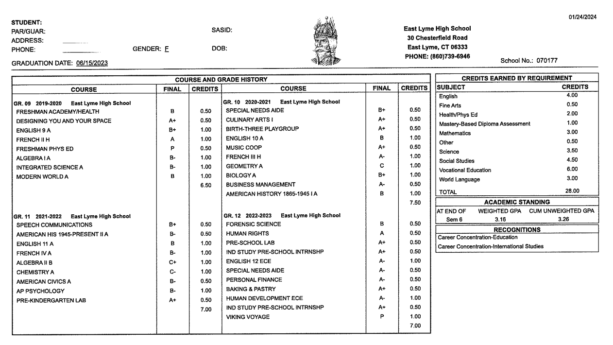

Slide 33
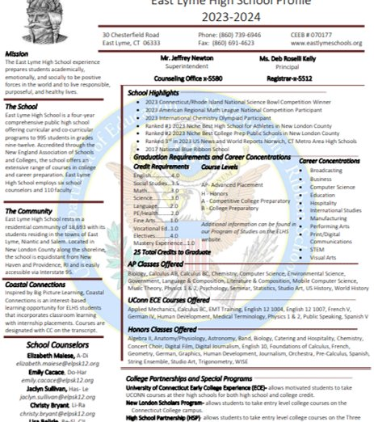
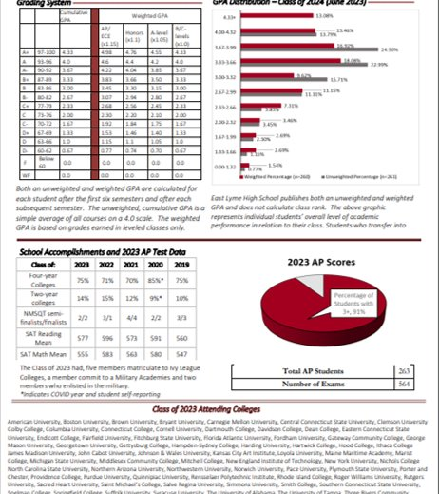
ELHS School Profile

Slide 34

Naviance
What do I want to do?:
Do What You Are
Career Interest Inventory
How do I find a college?
College Search
College Super Match
Other useful resources and Links:
NCAA
Military Academy information
Financial Aid information
Career Interest Profiler

Slide 35
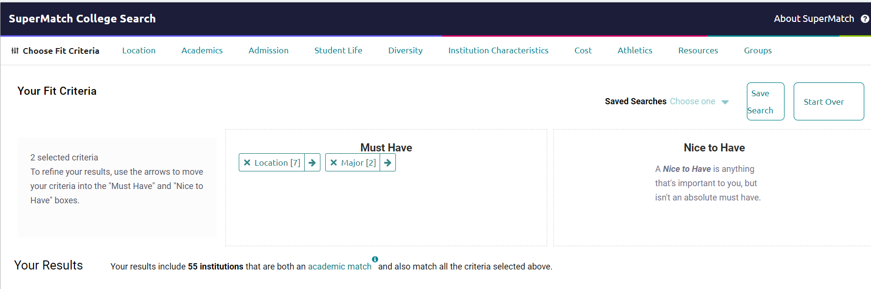
Supermatch College Search
Select a few basic criteria
  Location – states interested in attending school
  Academics – majors you may be interested in
  1 or 2 other things (if you want)
You can use your results from the CIP to guide your search (majors, career interest, etc.)
Click Colleges
  Supermatch College Search

Slide 36
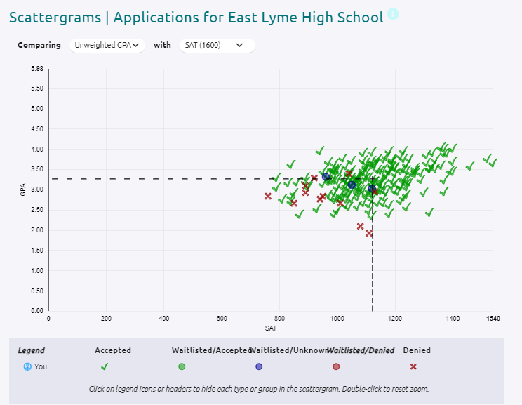
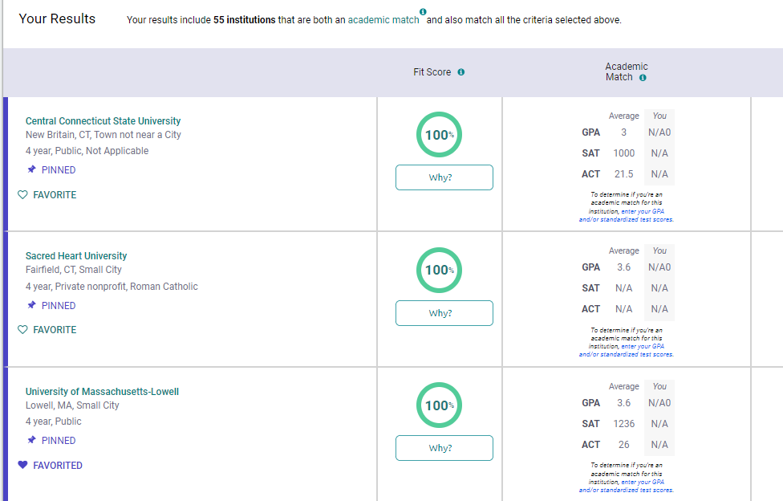
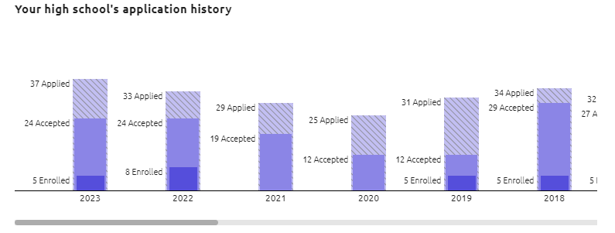
All the information!

Slide 37
HELPFUL RESOURCES
Continue to check:
ELHS Counseling Website
Class of 2026 ELHS Counseling Office Google Classroom Page
February 29th, 2024 – Financial Aid Planning Presentation
Principal's Newletter

