Slide 1



HOPEWELL MIDDLE SCHOOL
RISING 6TH GRADE
Parent Night
2026
Notes:
LeMoyne

Slide 2

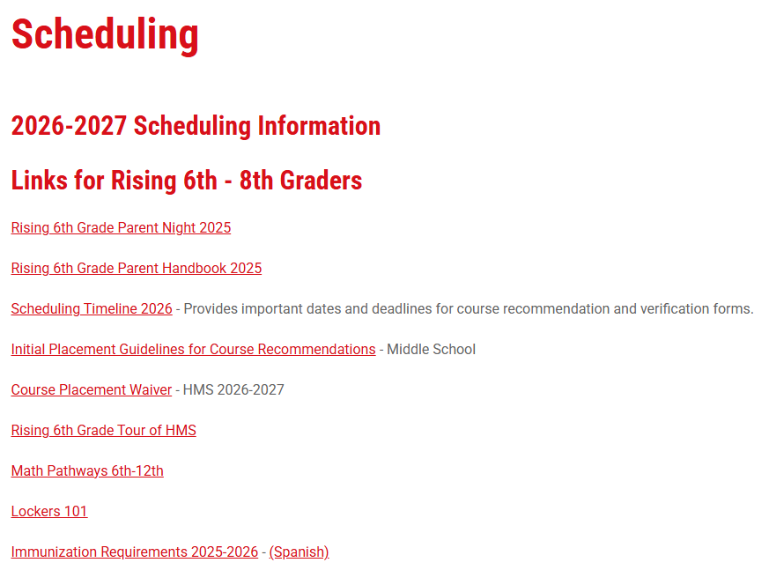


VISIT THE HMS WEBSITE
Notes:
LeMoyne

Slide 3

ADMINISTRATIVE STAFF
Michael LeMoyne Principal
Stephanie Sosebee 6th Grade Assistant Principal
Amy Cousin 7th Grade Assistant Principal
Janelle Consola 8th Grade Assistant Principal
Fred Johnson 6th Grade School Counselor
Notes:
LeMoyne

Slide 4
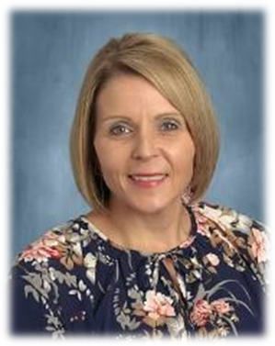
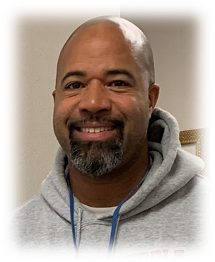
6TH GRADE SUPPORT
Stephanie Sosebee
6th Grade Assistant Principal
sosebees@fultonschools.org
Fred Johnson
6th Grade School Counselor
johnsonf2@fultonschools.org
Notes:
LeMoyne

Slide 5





PROJECTED 6TH GRADE ENROLLMENT
Alpharetta Elementary - 20 Birmingham Falls – 38
Cogburn Woods – 150
Manning Oaks – 121
Summit Hill – 82
Notes:
LeMoyne

Slide 6
SCHOOL GOVERNANCE COUNCIL
Parents of rising 6th grade students are eligible to run for open positions this spring.
Notes:
LeMoyne

Slide 7


PTA: HELPING MUSTANGS SUCCEED
Grade Level Educational Programs
Grade Level Social Activities
Family Events
Staff Appreciation Events
Teacher Mini-Grants for Classroom Enrichment
Reflections Program
Notes:
PTA

Slide 8
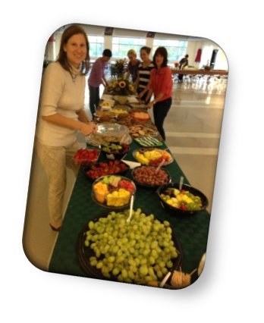
PTA COMMUNICATIONS
Website:
      Link from school website
      URL: https://hopewellmspta.membershiptoolkit.com
Monthly Newsletter: "Mustang Mailer“
Facebook:
      @HopewellMSPTA
      https://www.facebook.com/HopewellMSPTA
Instagram:
    @HMSMustangs
    https://www.instagram.com/hmsmustangs/
Notes:
PTA

Slide 9
GET INVOLVED
Please support Hopewell PTA!
Interested in serving on our Board, volunteering, or want more information?
Email info@hopewellmspta.com
Website https://hopewellmspta.membershiptoolkit.com
Notes:
PTA

Slide 10
BACK TO SCHOOL INFO
Join PTA ONE WEEK BEFORE Information Day!
Check-in with PTA online in mid-July
        Top Locker Incentive
        Carpool Raffle
Notes:
PTA

Slide 11
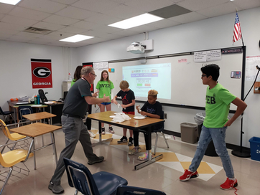
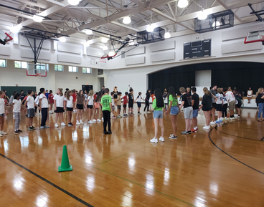
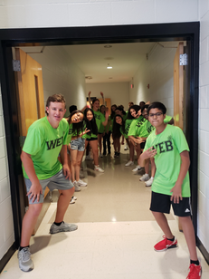
W.E.B.
W.E.B. stands for “Where Everybody Belongs.” It is a middle school orientation and transition program designed to help sixth graders connect with the school. The move to middle comes with significant changes, and the W.E.B. program can address this in multiple ways. The goal of a WEB Leader is to check in with students regularly throughout the year during formal and informal W.E.B. and school events, acting as a friend, leader, and mentor. It has been shown that when students feel a connection to their school, they are more successful, and they are less likely to become victims of bullying. During the spring, rising 8th grade students apply and are selected to be W.E.B. Leaders for the rising 6th grade class!
Notes:
Sosebee

Slide 12

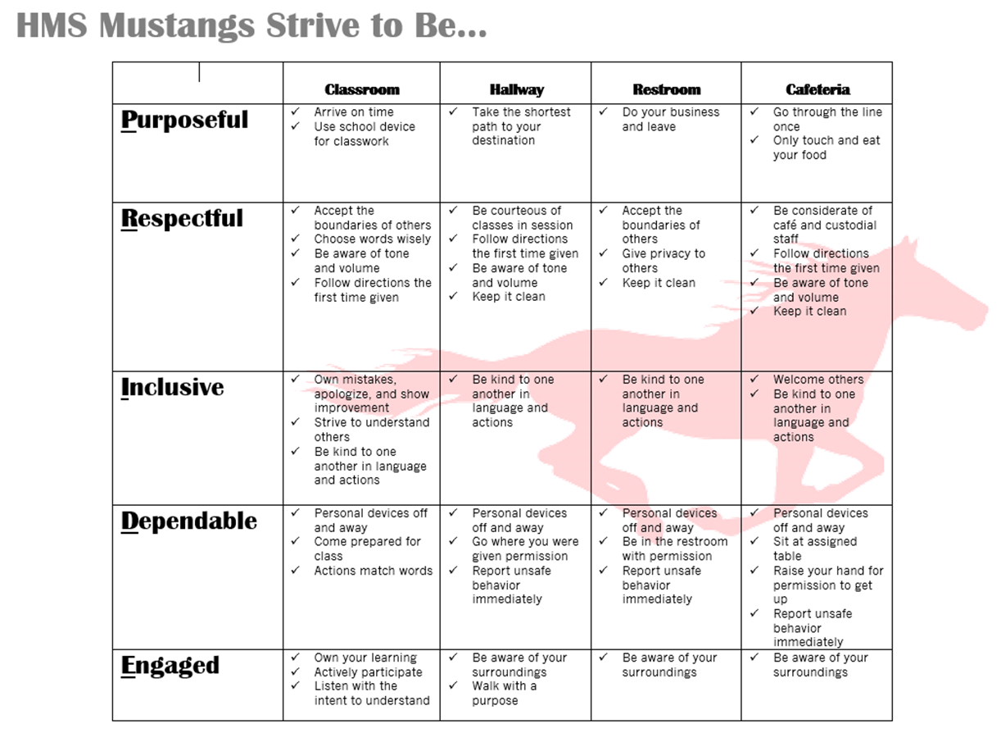
P.R.I.D.E.
Notes:
Sosebee

Slide 13
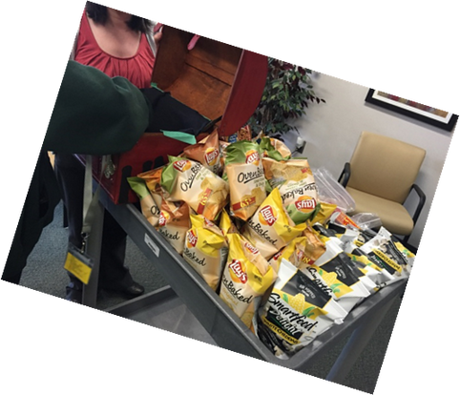

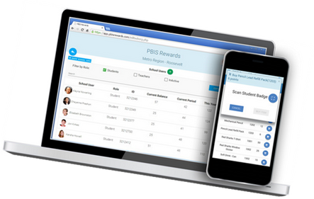
PBIS REWARDS
PBIS Rewards is an on-line system we use to recognize our students when they exhibit positive behavior. Students are awarded “PRIDE Points” during class and can exchange their points for items or participation in events. We also have the Mustang PRIDE Mart (school store) that operates Tuesday, Wednesday and Thursday mornings.
Notes:
Sosebee

Slide 14
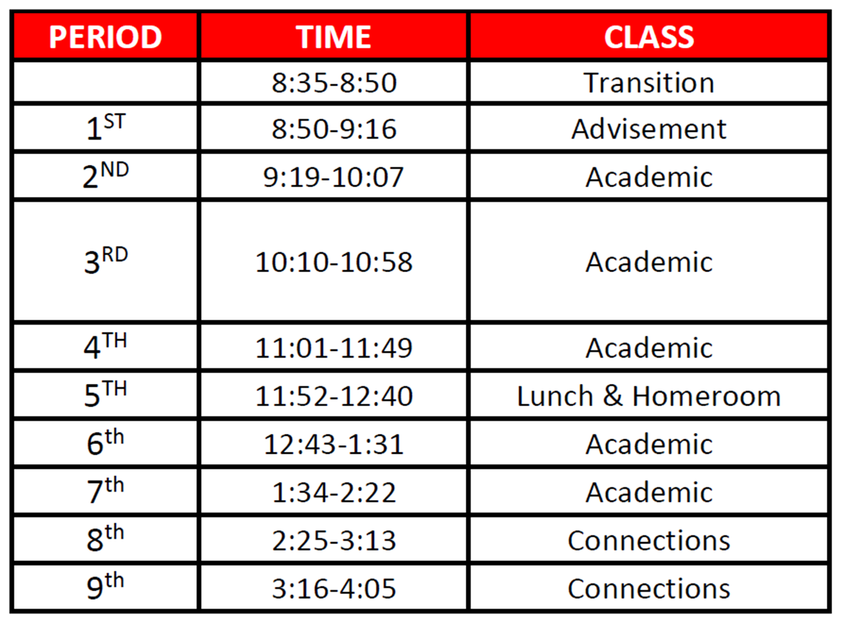
6TH GRADE BELL SCHEDULE
Notes:
Sosebee

Slide 15

DISTRICT-ISSUED DEVICES
At HMS, all students at HMS are currently assigned a personal device/laptop. Teachers are encouraged to incorporate strategies, develop activities, and structure classrooms so that students are using digital resources some of the time, not necessarily every day, to enhance their learning experience.
Students will receive a device and bag so that their device can be safely carried when in the hallways and moving throughout the building. Please reiterate the importance of your students taking care of his/her device. The amount of damage to students' devices has been significant and many times we cannot replace them quickly.
Notes:
Sosebee

Slide 16


PERSONAL ELECTRONIC DEVICES
Students are not permitted to utilize personal devices (cell phones, Smart Watches, tablets, personal laptops, Meta glasses, headphones, etc.) during the school day. We expect students to leave these objects at home (if possible) or in their lockers.
If they need to communicate with you, they should ask for permission to go to the front office and make a call.
Notes:
Sosebee

Slide 17

COURSE RECOMMENDATIONS
Recommendations for sixth grade courses are made at the student’s elementary school according to the placement criteria established by Fulton County.
Notes:
Sosebee

Slide 18
COURSE VERIFICATIONS
We will conduct two course verifications:
1st: February 27 (sent home and viewable online)
2nd: March 20 (only online)
Parents may make the following adjustments to the verifications:
  A change from an advanced course to an on-level course
  A change in World Language selection (French/Spanish)
  A request for a change in the Performing Arts option
All changes must go through the Microsoft Forms link!
Notes:
Sosebee

Slide 19
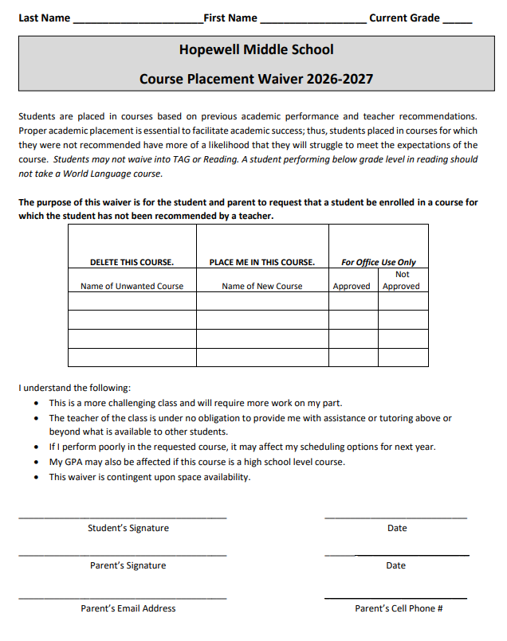
If you wish for your student to take a higher course level for which he/she was not recommended, you will need to provide a signed
COURSE WAIVER.
Students may not waive into
TAG courses.
TAG placement occurs by testing only.
Notes:
Sosebee

Slide 20
TAG SPECIFICS
• The middle school TAG program is completely different than elementary school. There are no “pull out” classes.
• Science and SS are the only TAG classes.
• Students that are noted as gifted will be placed on a .2 (TAG) roster for Math and ELA. Please note, these are not TAG courses but will be taught by a certified TAG teacher.
• TAG is not a “one size fits all” program. Gifted students are not simply placed in every TAG course.
• Rising 6th grade students must meet district eligibility requirements for TAG Science and SS. Your gifted student may be in both, one, or neither of these courses based on their data/scores.
• You should contact your elementary school with questions on eligibility.
Notes:
Sosebee

Slide 21
If you have any questions about course placement, please direct them to your home elementary school through
May 22, 2026.
After this date, you may direct your questions to HMS.
Notes:
Sosebee

Slide 22
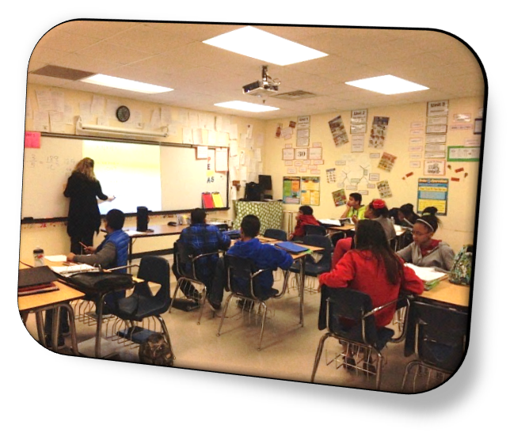
ACADEMICS
CORE COURSES
Math
Science
Social Studies
Language Arts
World Language OR Reading
*Remedial Math or Reading may also be provided for additional support for identified students.
Notes:
LeMoyne

Slide 23
LEVELS OF INSTRUCTION
The following course levels are offered for 6th grade courses:
  On-Level
  Advanced (ELA & Math)
  Accelerated (7th Grade)
  Team-Taught
  Resource
  TAG (Science and Social Studies)
Notes:
LeMoyne

Slide 24
LEVELS OF INSTRUCTION
The On-Level, Team-Taught, and Resource courses cover all GSE standards.
Typical Advanced courses cover all GSE standards and are more rigorous and faster-paced than the On-Level course.
Accelerated courses are for students that are working a year or more ahead.
Notes:
LeMoyne

Slide 25

MATH
  Math 6, Team-Taught, and Resource courses cover all grade 6 math standards.
  Math 6 Advanced covers all grade 6 standards with several 7th grade standards embedded.
  Math 7 Advanced would be a course for students on an accelerated track and course covers all grade 7 math standards with several 8th grade standards embedded.
COURSES
Math 6
Math 6 Advanced
Math 7 Advanced
Team-Taught
Resource
*Remedial Math or Reading may also be provided for additional support for identified students.
Notes:
LeMoyne

Slide 26
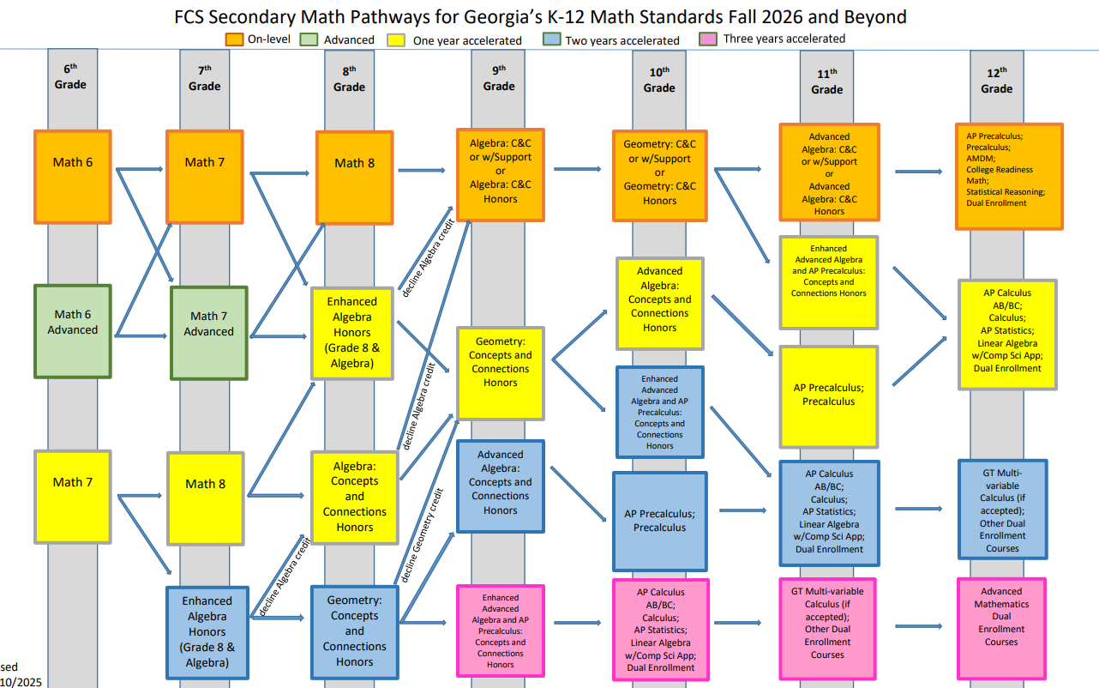
MATH
Notes:
LeMoyne

Slide 27
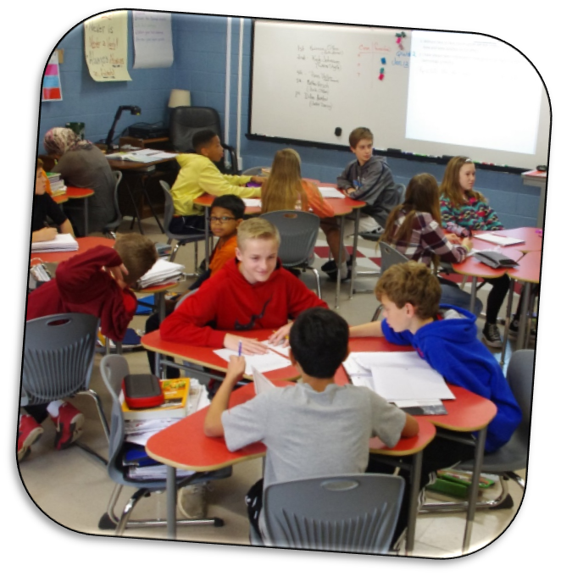
LANGUAGE ARTS
COURSES
On-Level
Advanced
Accelerated (7th)
Team-Taught
Resource
Notes:
LeMoyne

Slide 28
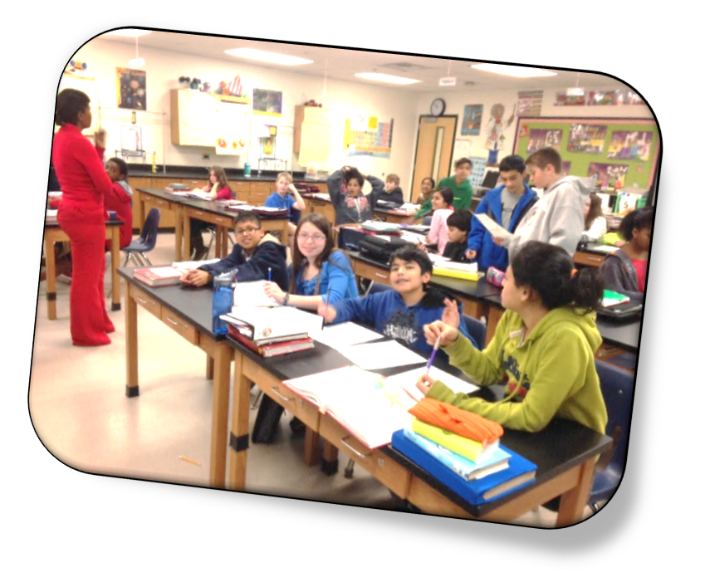
SCIENCE
COURSES
Earth Science
TAG
Team-Taught
Resource
Notes:
LeMoyne

Slide 29
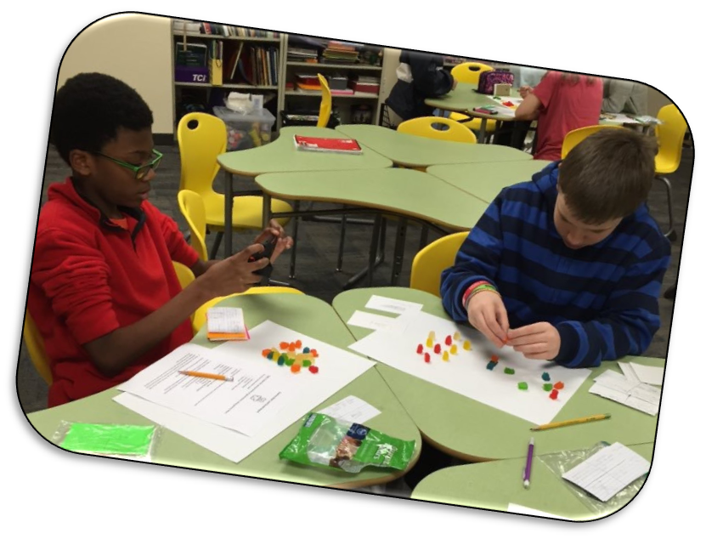
SOCIAL STUDIES
COURSES
Social Studies 6
TAG
Team-Taught
Resource
Notes:
LeMoyne

Slide 30

READING
COURSES
Reading 6
Team-Taught
Resource
*Remedial Math or Reading may also be provided for additional support for identified students.
Notes:
LeMoyne

Slide 31
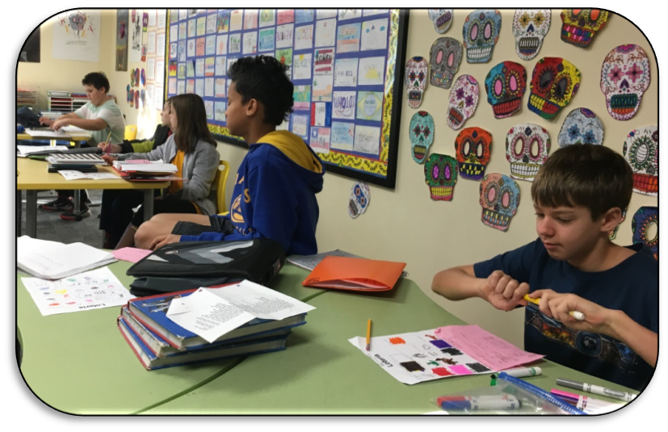
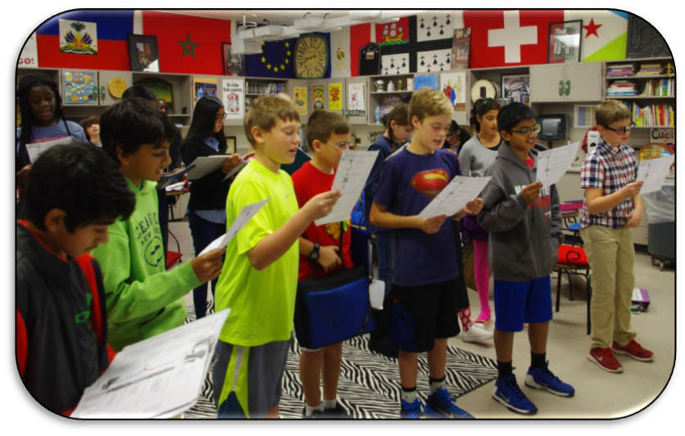
WORLD LANGUAGE
COURSES
Spanish 6
French 6
We recommend native speakers take a different language during the 6th grade year.
Notes:
LeMoyne

Slide 32
WORLD LANGUAGE QUALIFIERS
To qualify to take a World Language, students must meet the following criteria:
Reading on grade level based on Grade 4 Milestones reading indicator AND
Reading teacher recommendation
**We do allow waivers into World Language. Strong reading skills are critical to academic success in all courses.**
Notes:
LeMoyne

Slide 33
Students who take reading in 6th grade
may begin their
World Language study
in subsequent years.
Notes:
LeMoyne

Slide 34

All students who successfully complete 7th and 8th grade French or Spanish are eligible
to receive one unit of LEVEL 1 World Language credit towards high school graduation.
Students must pass ALL FOUR semesters of both years to qualify.
Notes:
LeMoyne

Slide 35
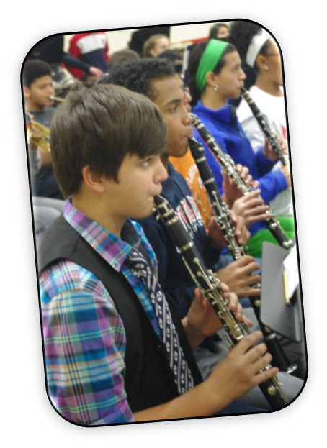
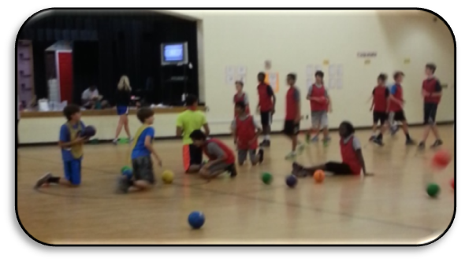
CONNECTIONS
Students have two periods of CONNECTIONS every day.
There are two options for connections.
Notes:
Johnson

Slide 36
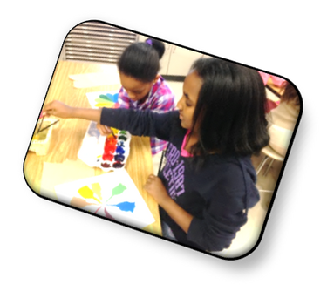
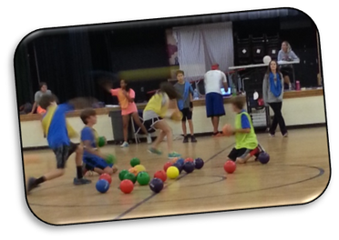
OPTION 2: GENERAL CONNECTIONS
All students will have two daily periods of Connections (Periods 8 & 9)
1 full year of Physical Education/Health Combo (4 quarters)
4 other course offerings from the following:
• Visual Arts •STEM Class (ABE Science)
• Exploring Agriculture • Library Research Skill
All students take Career Awareness
* Connections change every 9-weeks! *
Notes:
Johnson

Slide 37
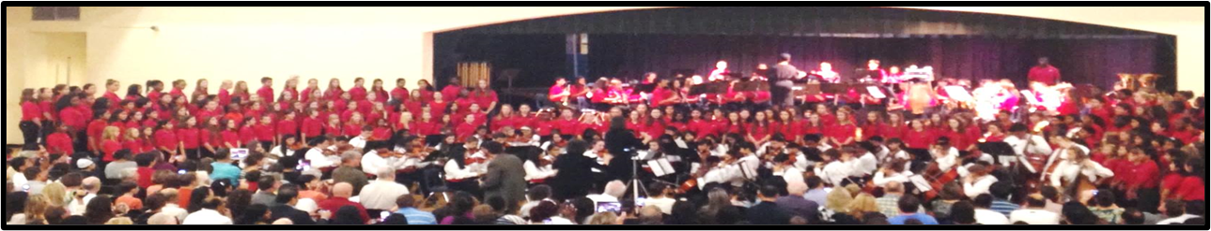
OPTION 1: PERFORMING ARTS
All students will have two daily periods of Connections (Periods 8 & 9)
1 full year of Band, Chorus or Orchestra (4 quarters)
1 semester of Physical Education/Health Combo
2 other course offerings from the following:
• Visual Arts •STEM Class (ABE Science)
• Exploring Agriculture • Library Research Skills
All students take Career Awareness
Notes:
Johnson

Slide 38
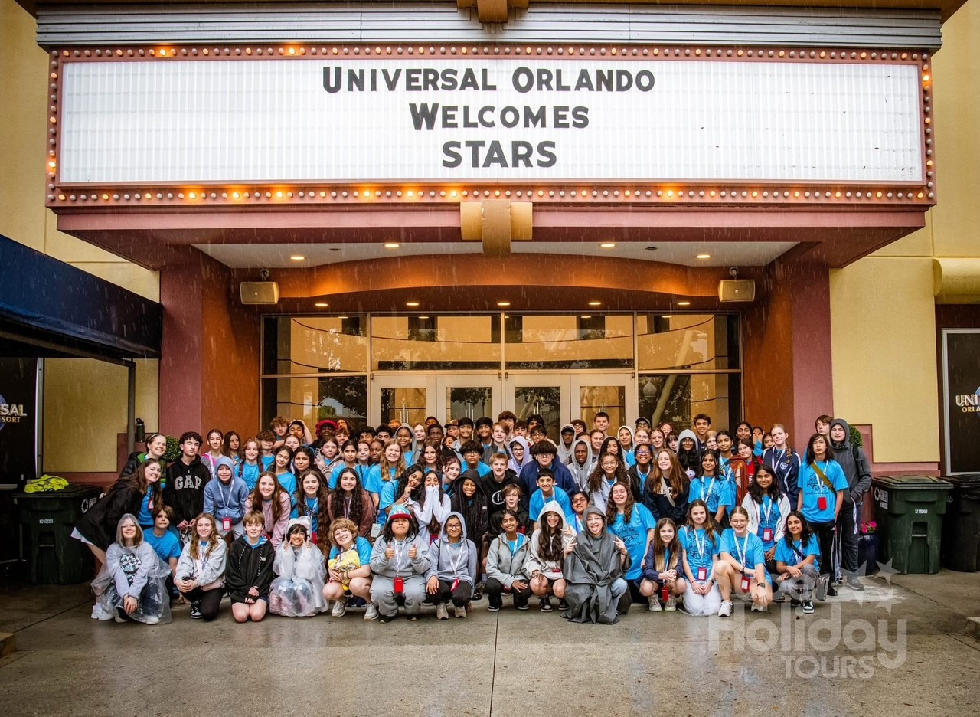


HOPEWELL
PERFORMING
ARTS
BAND, CHORUS, AND ORCHESTRA

Slide 39
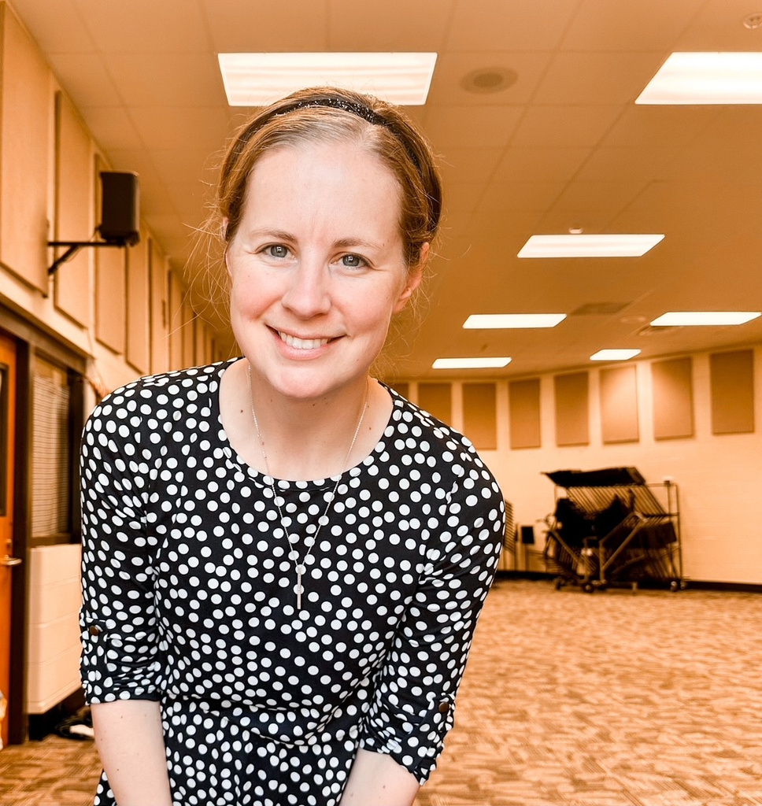
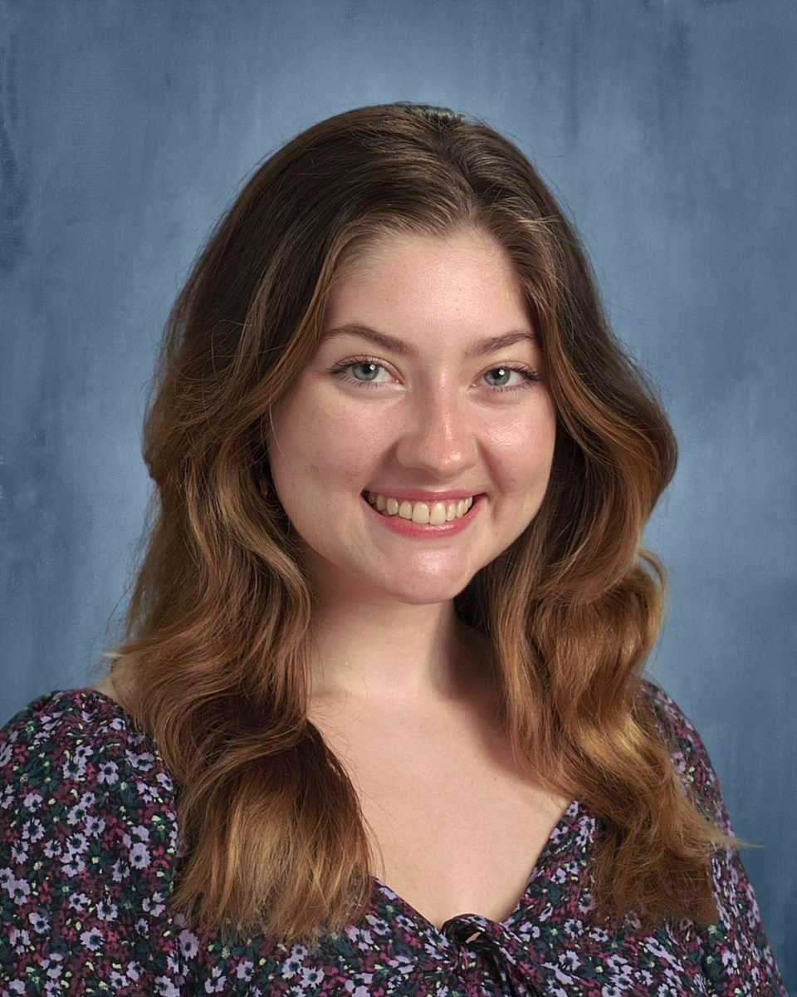
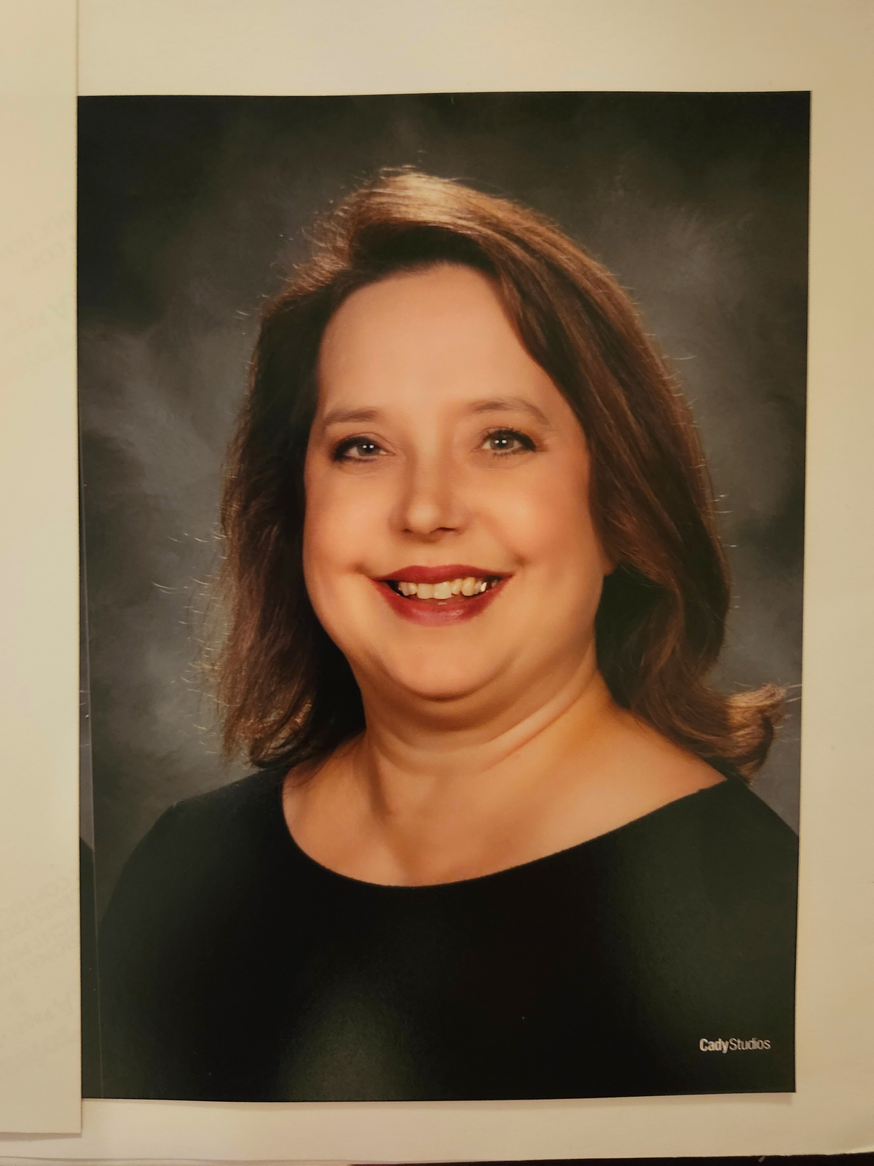
OUR FACES
Ms. Graeme
Chorus
graemeg@fultonschools.org
Ms. Hoebeke
Orchestra
hoebeket@fultonschools.org
Ms. Thomas
Band
thomasj18@fultonschools.org

Slide 40
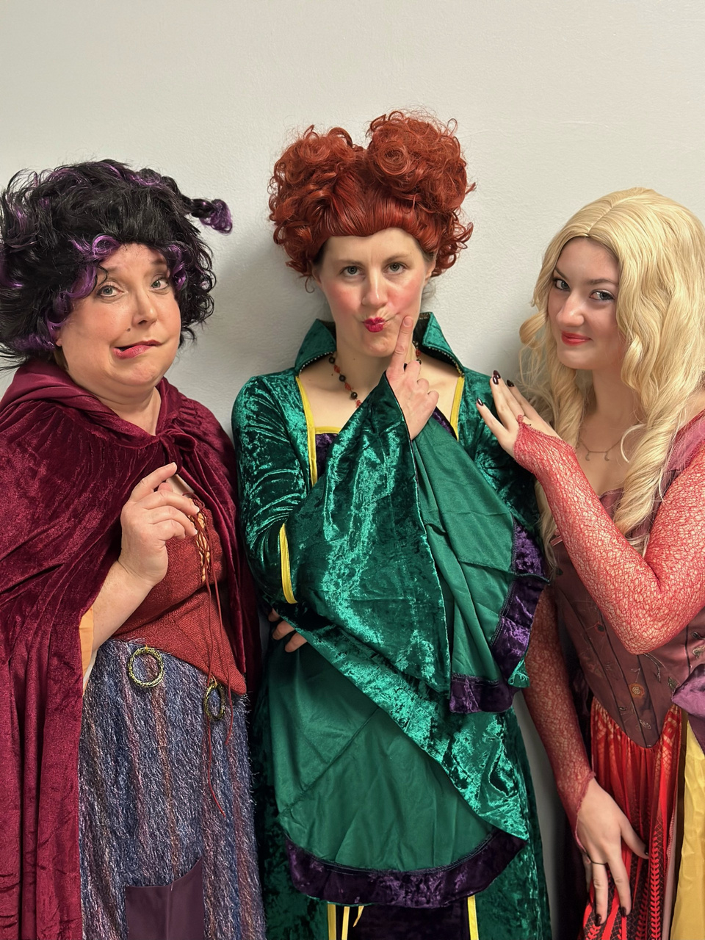

WHY MUSIC?
  Boosts Brain Power: Music helps kids remember things, focus better, and solve problems.
  Sparks Creativity: It encourages kids to think creatively and express themselves by making and playing music.
  Helps with Schoolwork: Kids who do music often do better in math and reading.
  Teaches Patience and Discipline: Learning an instrument takes practice, which helps kids become patient and persistent.
  Encourages Teamwork: Playing music with others teaches kids how to work and communicate in a group.
  Builds Confidence: Performing for others can make kids feel more confident and improve their speaking skills.
  Lets Kids Express Feelings: Music is a great way for kids to share their emotions.
  Improves Time Management: Balancing music practice with school helps kids learn to manage their time.
  Gives a Lifelong Skill: Music is something kids can enjoy and use all their lives.
  Broadens Cultural Understanding: Listening to different kinds of music helps kids learn about various cultures and traditions.

Slide 41
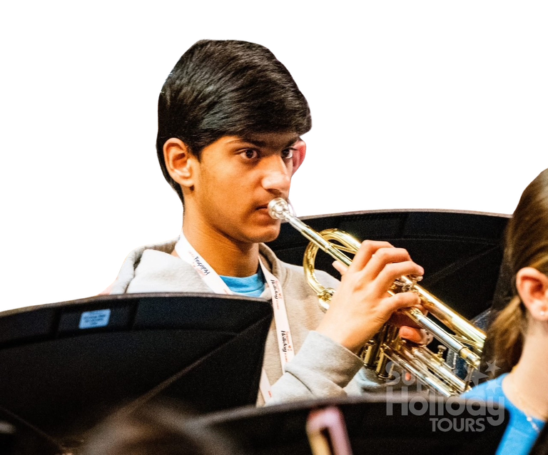
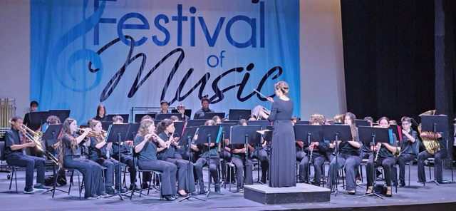
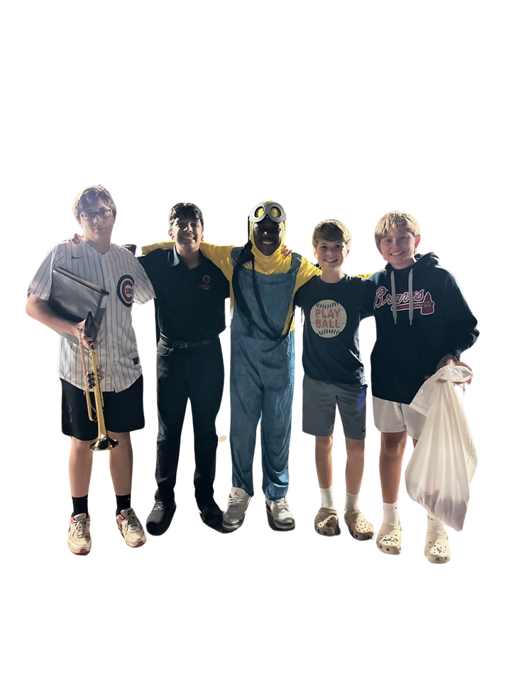
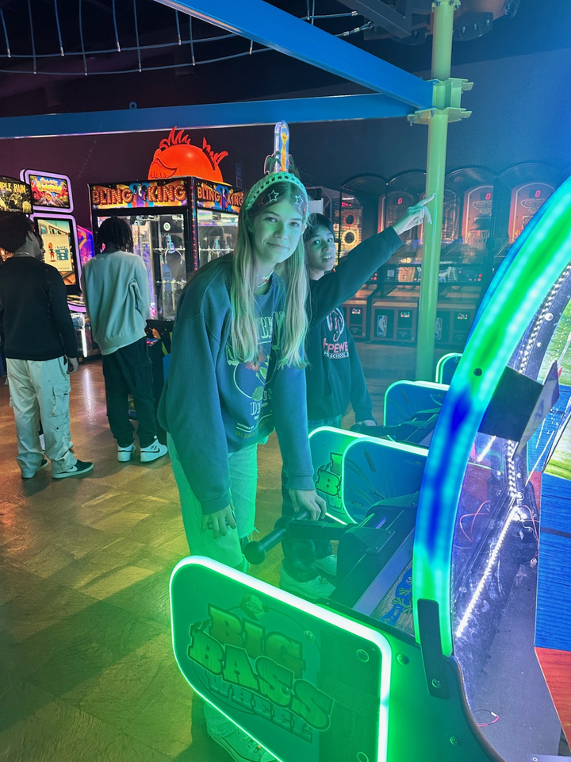
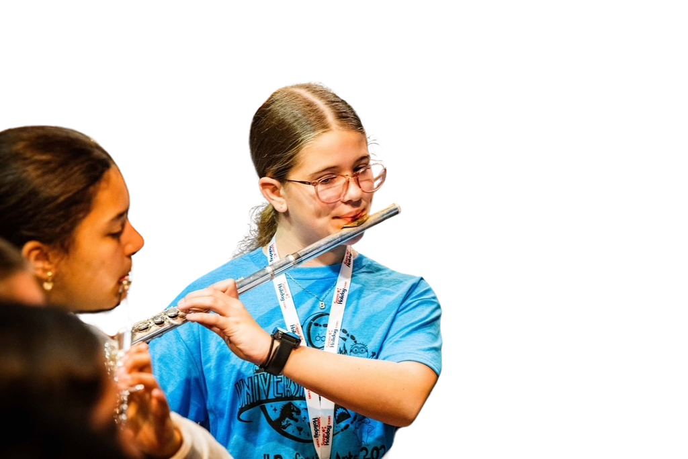
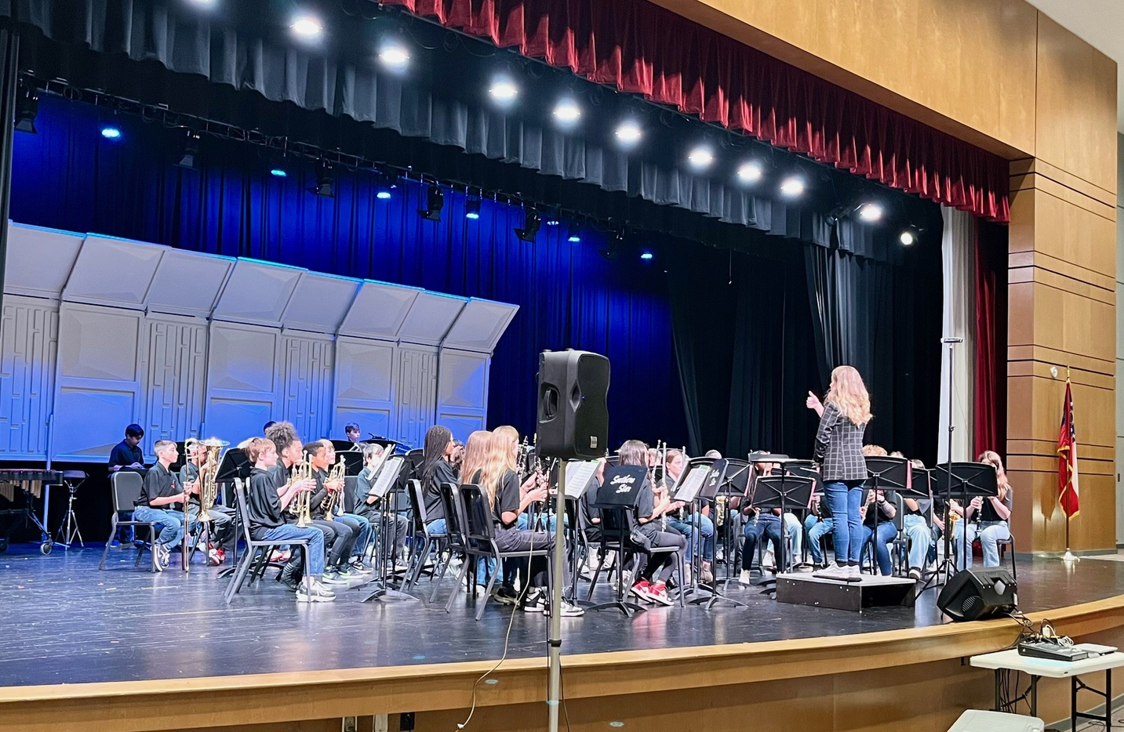
BAND
  Currently serves 230 students in Grades 6-8
  Students are divided by which instrument they play. In each grade we have a brass and percussion class as well as a woodwind class. These classes combine to perform.
  In 6th Grade, students can choose from the following instruments: Flute, Oboe, Bassoon, Trumpet, French Horn, Trombone, Euphonium, Tuba. We audition current students for Saxophone and Percussion during the second semester of 6th Grade.

Slide 42
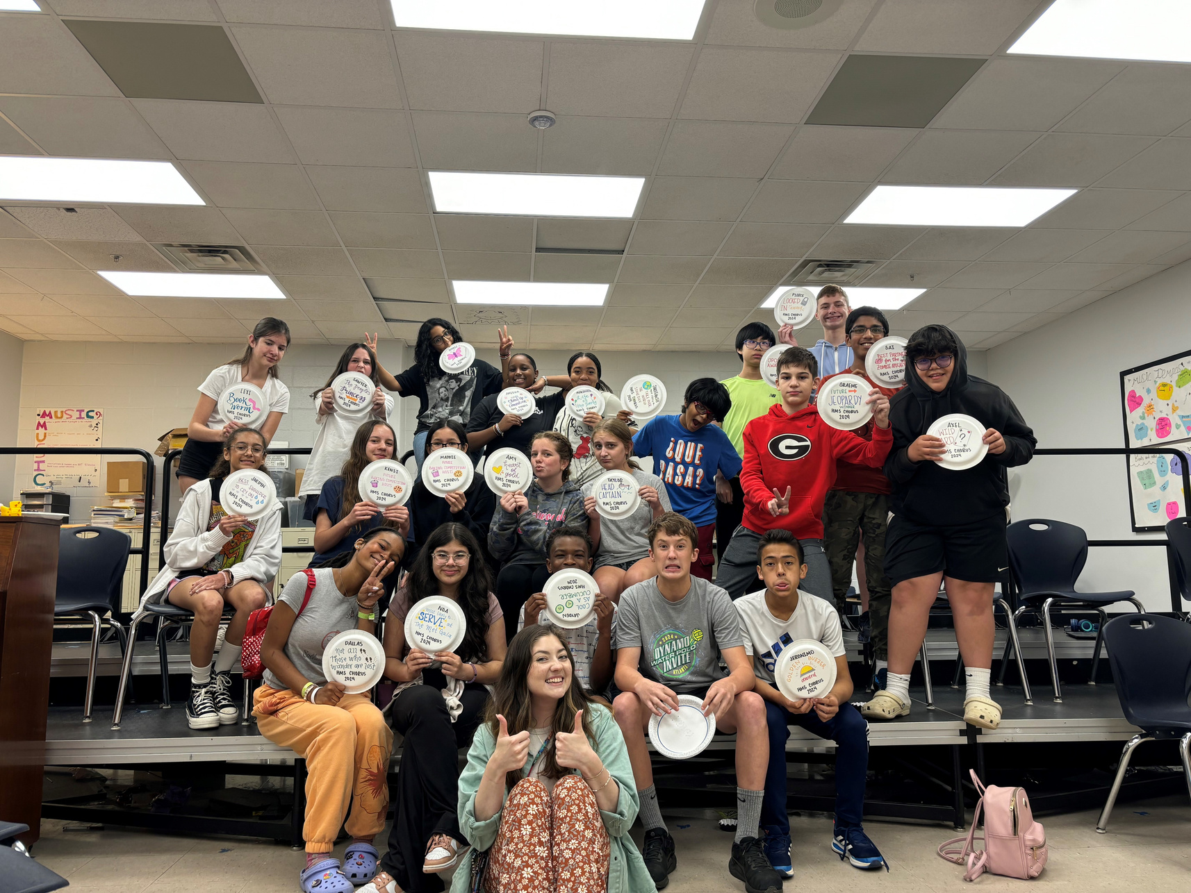
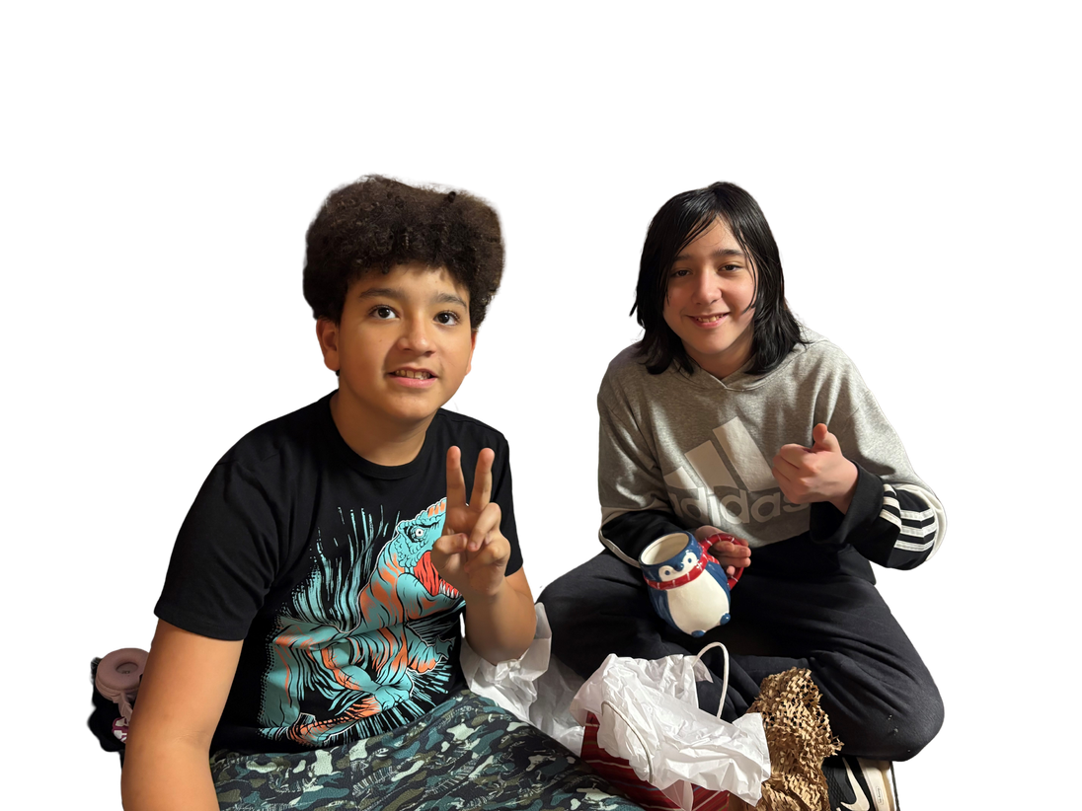

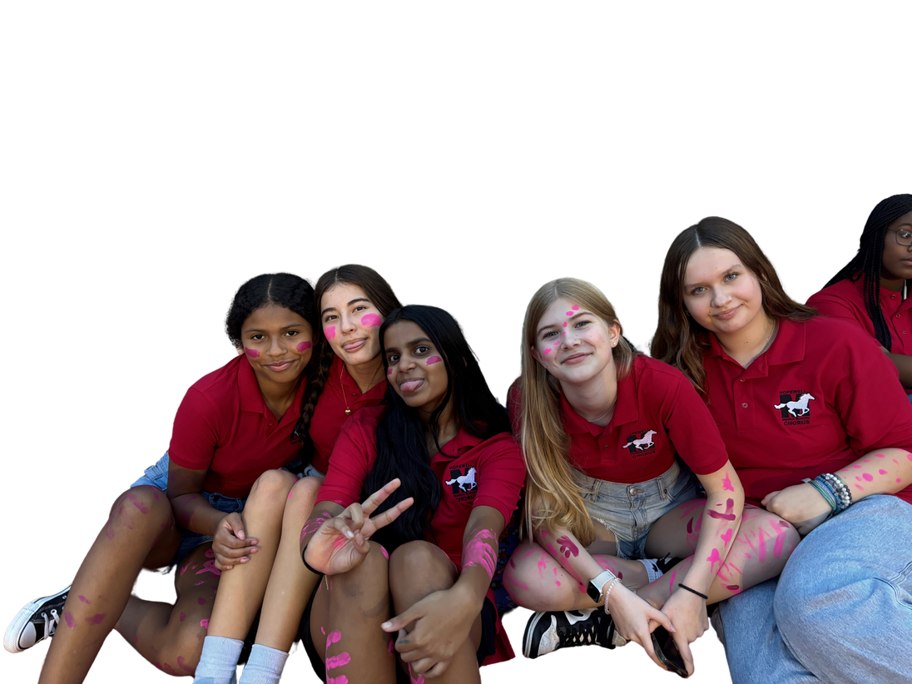
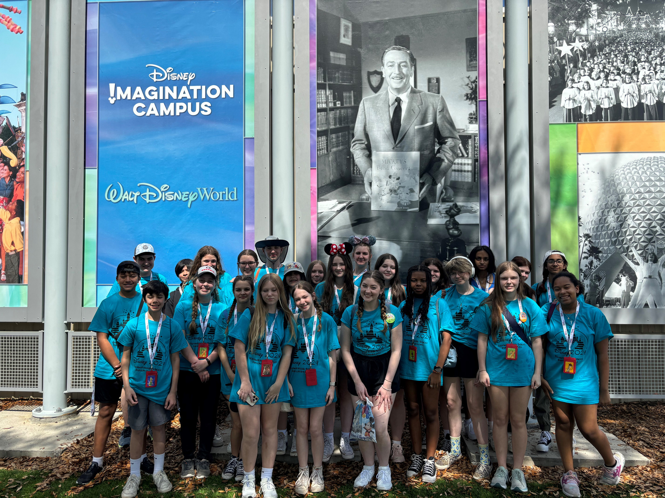
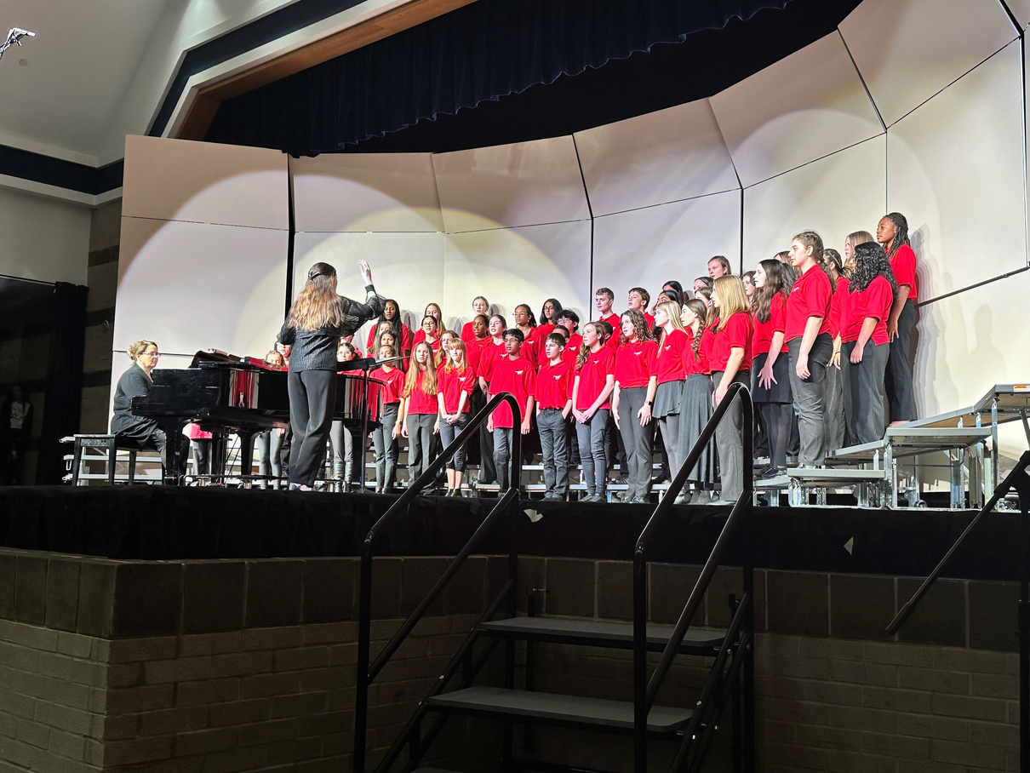
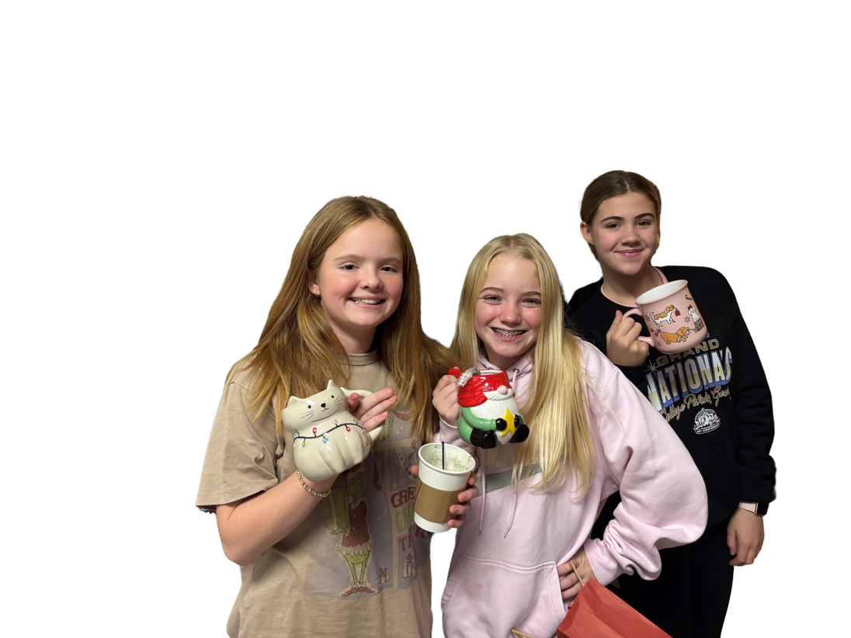
CHORUS
  Calling all voices 6th-8th grade!
  Learn how to develop your singing skills and strengthen your vocal instrument in Chorus.
  No auditions required- every voice low, high, and in between is welcome!
  Focus on building choral musicianship in a safe group environment. Opportunities for solo singing are always available, but never required.

Slide 43
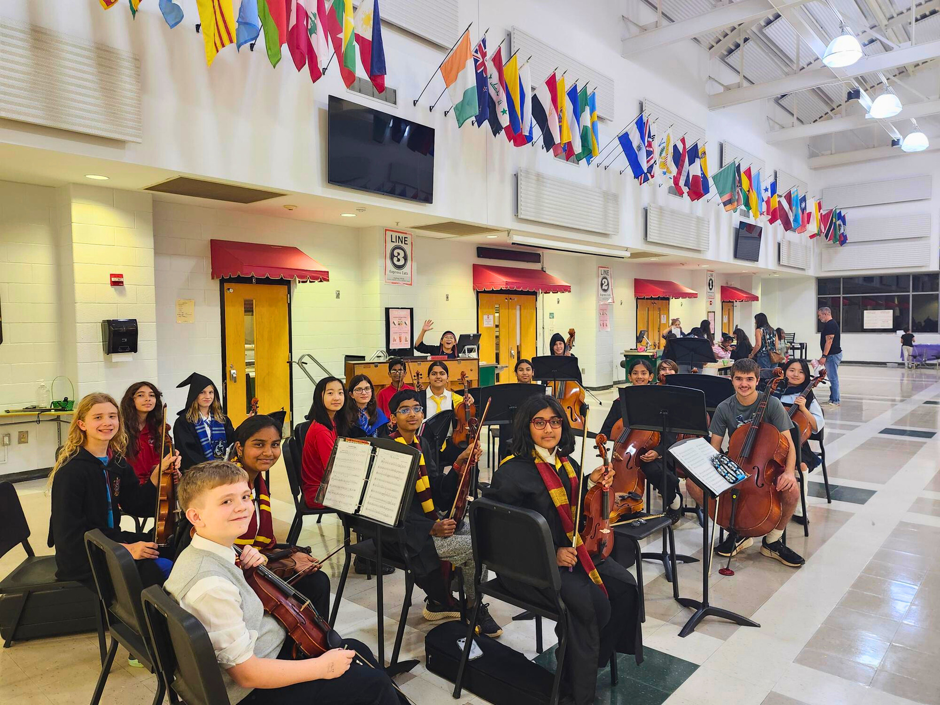
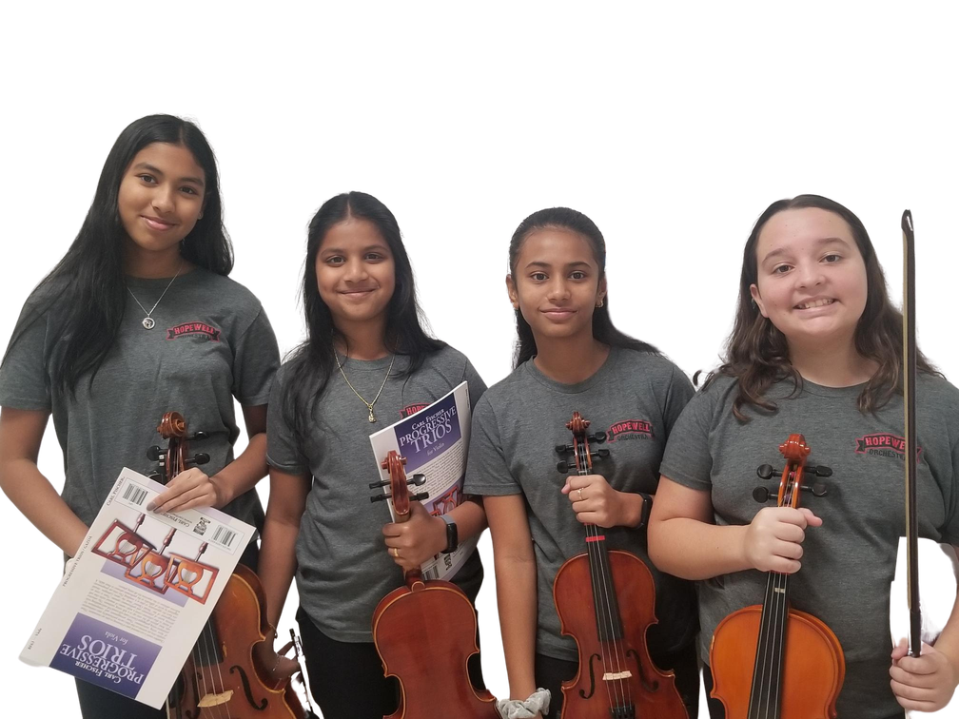
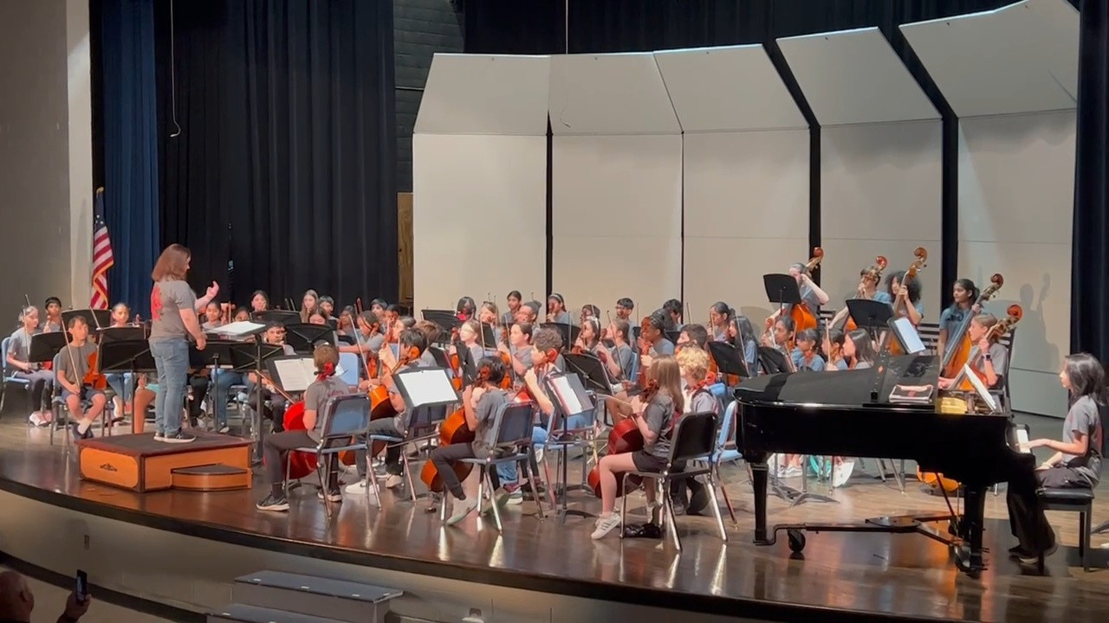
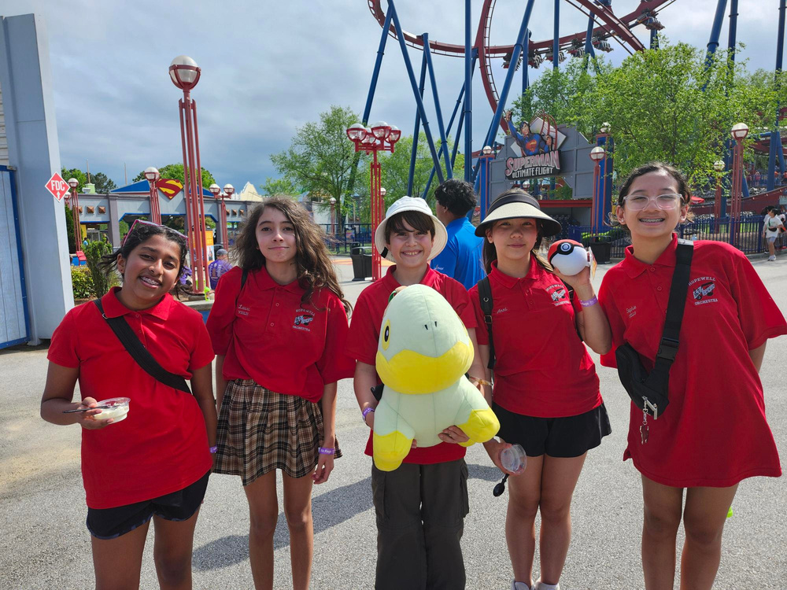
ORCHESTRA
  Learn to play: Violin, Viola, Cello, Bass, or Harp
  Orchestra focuses on developing basic technique (bowing and left hand), note reading skills, music theory, and musicianship.
  6th Grade Orchestra students perform in three concerts each year, with additional solo and chamber music opportunities.

Slide 44
COMMON QUESTIONS
AND CONCERNS
  Time Commitment
    Band, Chorus, and Orchestra meet as a class every day. You get two connections classes and music only takes up one. Your other class will be PE, Art, etc.
    Expect to practice about 30 minutes a few times a week.
  Prior Experience:
    No prior experience necessary; our programs accommodate beginners with lessons and groups. All skill levels are welcome.
  Choosing an Instrument:
    Ms. Thomas (band) and Ms. Hoebeke (orchestra) will help you select your instrument in the first few weeks of class. Music and Arts and other local music stores have rent to own programs so you aren’t stuck paying for something if you decide to switch.
  Missing Rehearsals and Performances:
    6th Grade only rehearses during the school day as a class and has 3 concerts: Fall, Winter, and Spring.
    Communicate with teachers about absences; we are flexible when we know and can plan.
  Costs:
    Costs vary; some instruments can be provided through the school, while others may require rentals or purchases. Financial aid is available.
  Multiple Extracurriculars:
    Our students do sports, church, theatre, dance, drama, etc.

Slide 45
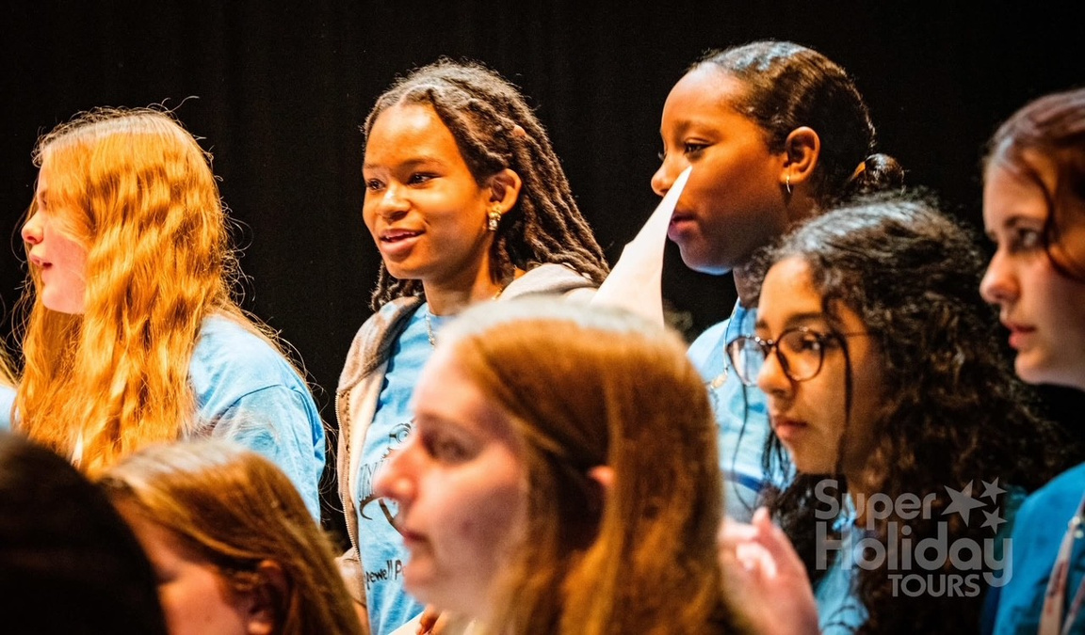
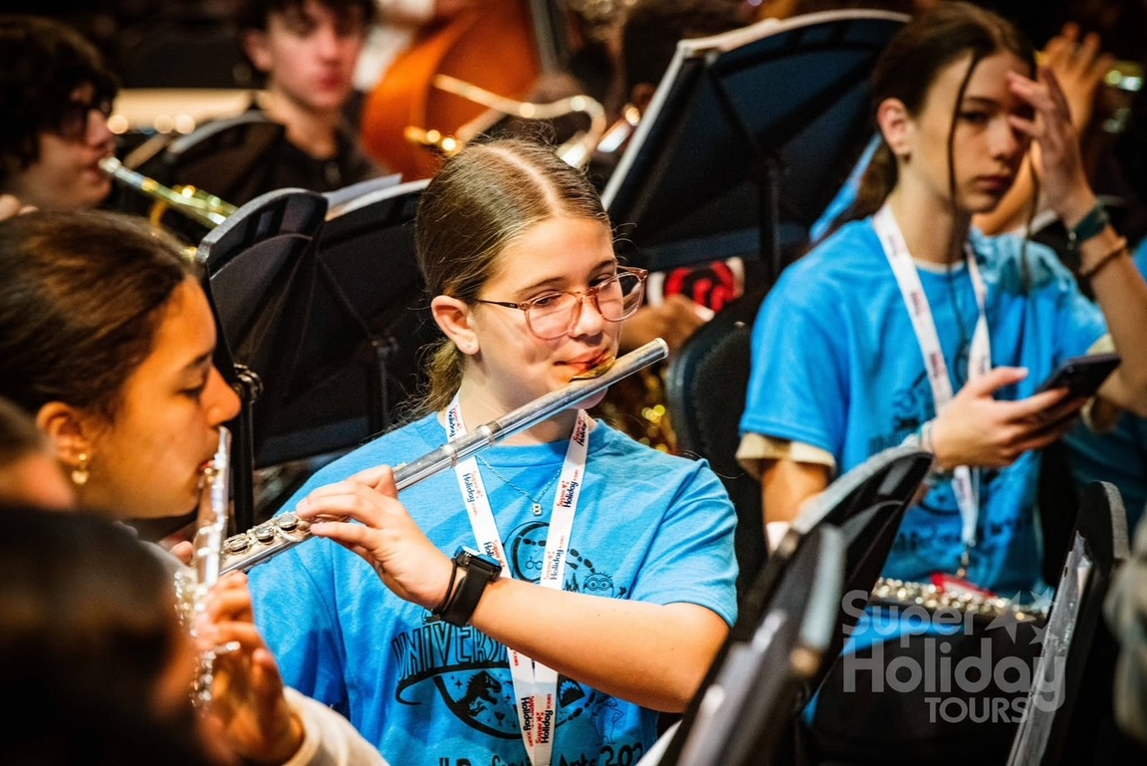
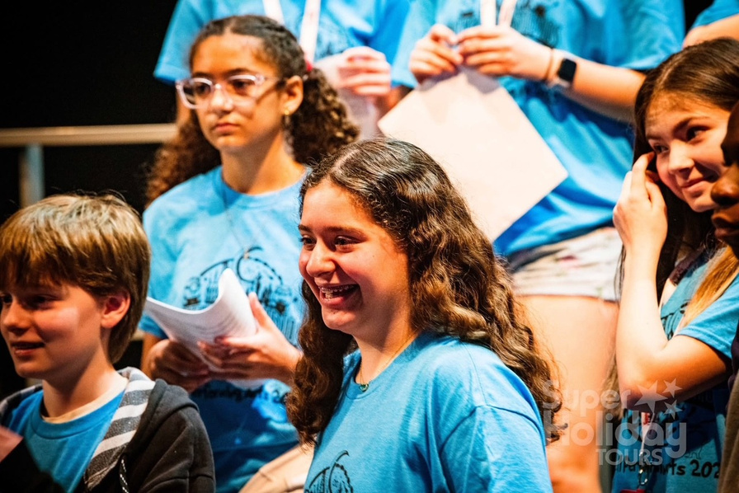
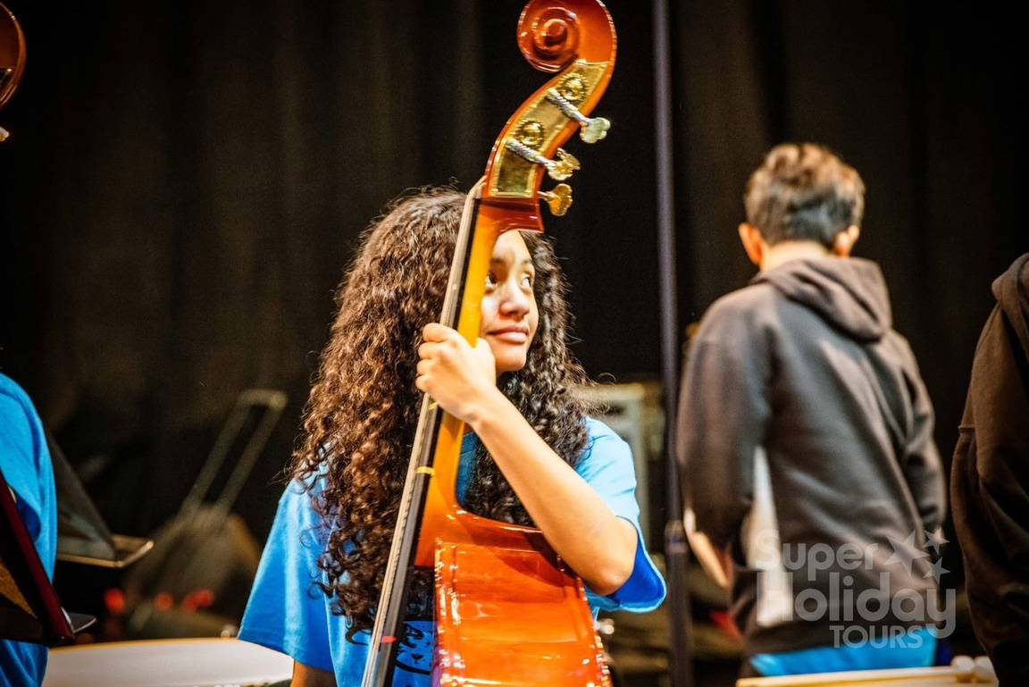
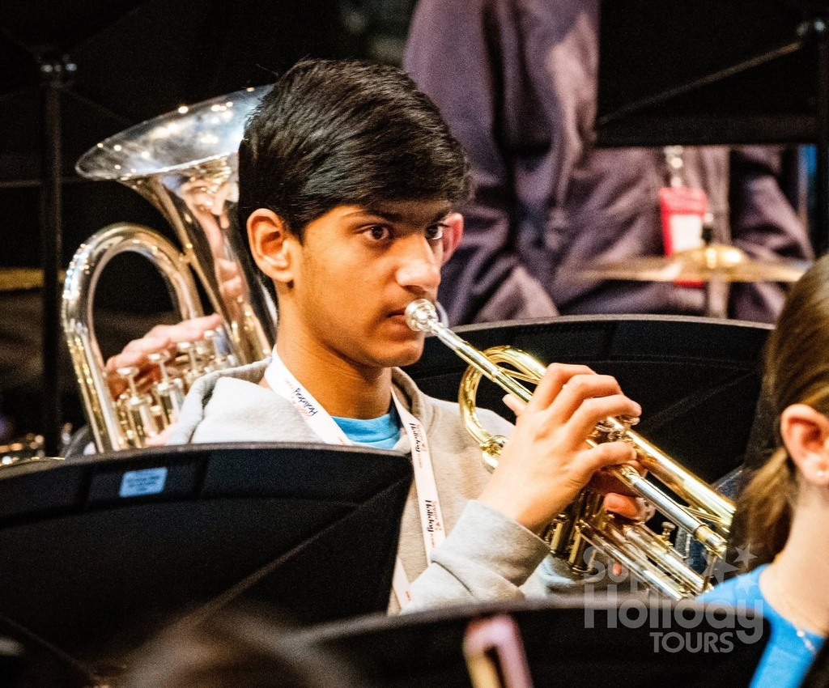

الموسيقى للجميع.
MUSIEK IS VIR ALMAL.
A MÚSICA É PARA TODOS.
מוזיקה מיועדת לכולם
संगीत सभी के लिए है.
ХӨГЖИМ ХҮН БҮРТ ЗОРИУЛАГДСАН.
LA MUSIQUE EST POUR TOUT LE MONDE.
సంగీతం అందరికీ ఉంటుంది.
ÂM NHẠC DÀNH CHO TẤT CẢ MỌI NGƯỜI.
LA MÚSICA ES PARA TODAS.
موسیقی سب کے لیے ہے۔
MÜZIK HERKES IÇINDIR.
음악은 모든 사람을 위한 것입니다.
MIZIK SE POU TOUT MOUN.
MUSIK IST FÜR ALLE DA.
இசை எல்லோருக்கும் பொதுவானது.
MUSIC IS FOR EVERYONE

Slide 46



SCAN HERE TO SIGN UP
Or Click Here

Slide 47
COUNSELING SERVICES
Individual/Small Group Counseling
Classroom Guidance
Coordination of:
•Parent/Teacher Conferences • Stress Management Help
•Referrals to outside agencies • Organizational Help
•Career Programs • New Student Orientation
•Mentoring • Transition Programs
Consultation in:
•RtI Meetings • IEP Meetings • Parent/Teacher/Student Conferences
•Discipline Matters • Peer Disputes • Academic Goal Setting
Notes:
Johnson

Slide 48

FINDING A BALANCE
Notes:
Johnson

Slide 49


MEDIA SERVICES
  Makerspace activities​
  Support in finding a Just-Right-Book​
  A genrefied collection of over 10,000 books​
  e-resources for research and reading​
  An early morning space for students, opening most days at 7:45 AM​
  A destress area to relax
Notes:
Johnson

Slide 50

HOME/SCHOOL COMMUNICATION
•Campus Parent
•E-Mail
•Microsoft Teams/Canvas
•Conferences
•Grade Reporting -every 4 ½ weeks
•Weekly Newsletter
•PTA Sponsored Directory
•School Messages via Blackboard
School Website: fultonschools.org/hopewellms
Notes:
Johnson

Slide 51


PLANNING AHEAD
Proof of Residency &
updated immunizations will be required for all rising 6th graders
Notes:
Johnson

Slide 52

THANKS FOR COMING!
Notes:
LeMoyne

