Slide 1




WELCOME
Notes:
Welcome to this year’s Course Registration Information and Timeline Video!

Slide 2

Registration Information
2026-2027

Slide 3
Timeline for registration here at RHS
Course Registration Night for Parents (Grades 8-11) Thursday, March 5 10th, 6:00pm in the RHS Auditorium
Course Registration Information shared with 8th Grade Students at Trexler - Starting Monday, March 9, 2026. Registration Sheets are due back to TMS by Wednesday, March 18.
Individual Scheduling Meetings with 8th Grade Students – March 23-27, 2026
New Bridge Middle School 8th Grade Presentation – March 6. Registration Sheets Due by Friday, March 20.
Pre-Registration forms distributed to current RHS Students – March 6, 2026
Current RHS students turn in pre-registration forms to The GUIDANCE OFFICE By March 13th.
Individual Scheduling Meetings with students in grades 9-11 – March 9-27.

Slide 4
Graduation Requirements
Core Requirements
4-English, 4-Math, 3-Science,
4-Social Studies & 1-Health and PE
6 Electives:
(Arts, CTE, AVID, and/or World Languages)
*Arts Requirement: MS/HS
*Computer Science
CPR Certified
(typically happens in Middle School)
But if it didn’t happen, we will get it before they graduate!)
TOTAL CREDITS: 22
(However, it has to be the right combination of 22 credits)

Slide 5

Yearly Layout
4 classes per semester=8 classes per year
4 years x 8=32 opportunities
HONORS, NCVPS, CCCC, AP, or other classes you are interested in
Graduating at the END of your JUNIOR YEAR.
Graduating HALF way through SENIOR YEAR.
Graduating at the END of your SENIOR YEAR.
Grade Classification:
Freshmen 0-5 credits
Sophomore- 6 credits
Junior-12 credits
Senior-18 credits
Graduation Options

Slide 6

ACADEMIC RIGOR
Regular Classes
Honors Classes
Advanced Placement Classes
Career & College Promise Classes
NCVPS Classes
.

Slide 7
Grades/GPA
Numeric Grade | Letter Grade | Regular Class | Honors Class | AP/CCCC Classes
90-100 | A | 4.0 | 4.5 | 5.0
80-89 | B | 3.0 | 3.5 | 4.0
70-79 | C | 2.0 | 2.5 | 3.0
60-69 | D | 1.0 | 1.5 | 2.0
59 & Below | F | 0 | 0 | 0

Slide 8
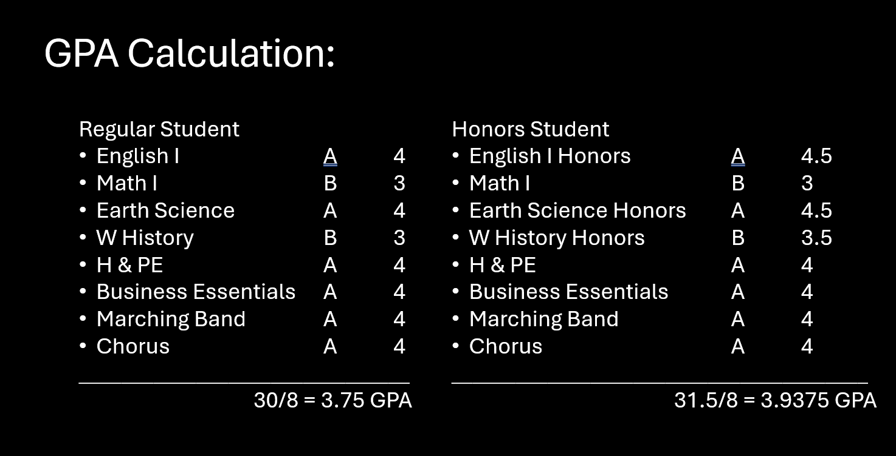
GPA Calculations/Comparison
.

Slide 9
Attendance
*Attendance is taken in EACH class period!
No more than 10 unexcused absences or there is the potential that you don’t receive credit for the class.
*It is the responsibility of the STUDENT and PARENT to monitor attendance and turn in documentation accordingly.
*If attendance is an issue, we do have a waiver process in place BUT this does NOT make any promises to a student receiving credit.
*If your attendance waiver is NOT approved, there is the potential that you will receive an INC. Incomplete means that a grade is not assigned to your transcript and no credit is issued for that class.
.
Notes:
Attendance is taken during each class period and Onslow County Schools Board Policy indicates that a student who misses more than 10 days is at risk of not receiving course credit. This means that you could actually pass the class, but have to repeat it if you miss more than 10 days. At RHS, we have a variety of course offerings to meet the needs of each individual student.

Slide 10
What happens if I fail a Class?
If the class is Necessary to meet graduation requirements, then you will have to earn that credit for graduation.
your choices are:
1. You can retake the class face-to-face. The grade that you earn (a 60 or higher) will go on your transcript to replace the failing grade.
2. You can take the class through our ONLINE credit recovery program. Doing it this way—you will get the average of your FINAL Grades (50% from your original grade & 50% from the grade you earn through the credit recovery program.)
Ex. 40 in Class, You have to earn an 80 through the ONLINE Credit RECovery.

Slide 11

Spanish
Spanish I & Spanish II are NOT a graduation requirement.
They are HIGHLY recommended if you plan on attending a 4 year
college/university upon high school graduation!
Must be taken in order!
You should take language classes as close together as possible.
It is a bad idea to take Spanish I as a freshman then Spanish II as a senior!
We do offer Spanish III Honors and AP Spanish! They are completely optional & are more difficult than a regular education class!
Online classes options with different languages are available depending on GPA, and class availability.

Slide 12
What do Colleges Look at?
GPA
Class rank
Test Scores
Class Load
High School/Community Involvement
References

Slide 13

SAT Scholarship
You can earn $1500 towards college during your High school Career!
You must complete the following:
1. Maintain a 3.5 or higher GPA
2. Complete 100 hours of Community Service (from an approved agency-but 35 hours can
be School Based or Church based Hours)
3. Score either an 1100 on the SAT (reading & Math)
OR a 23 or higher on the ACT
4. Waiver= If a student has a 4.0+ GPA, they do not have to meet the Test Score Requirement!
Please come by guidance
for more information! ☺

Slide 14

The following slides will cover academies/Programs and course offerings specific to RHS

Slide 15


Lacee Estes
lacee.estes@onslow.k12.nc.us
Joy Roberts
joy.roberts@onslow.k12.nc.us

Slide 16
FINE ARTS Department
Marching Band, Concert Band, Guitar, & Piano Mr. NEWBY
Concert Chorus, Chamber Chorus, Piano, & Theatre Arts Mr. Conner
Dance Classes Ms. Jones-LIMA
Visual Art Classes Mrs. Tripp
Orchestra Mr. Amengual

Slide 17

Career & Technical Education
Notes:
We have several Career and Technical Education Opportunities for students.

Slide 18


Slide 19
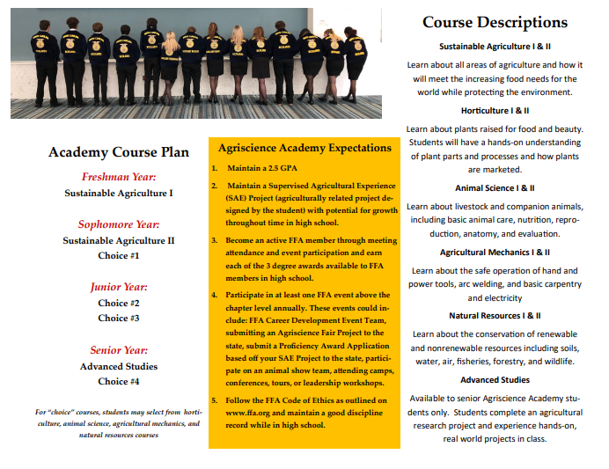

Slide 20
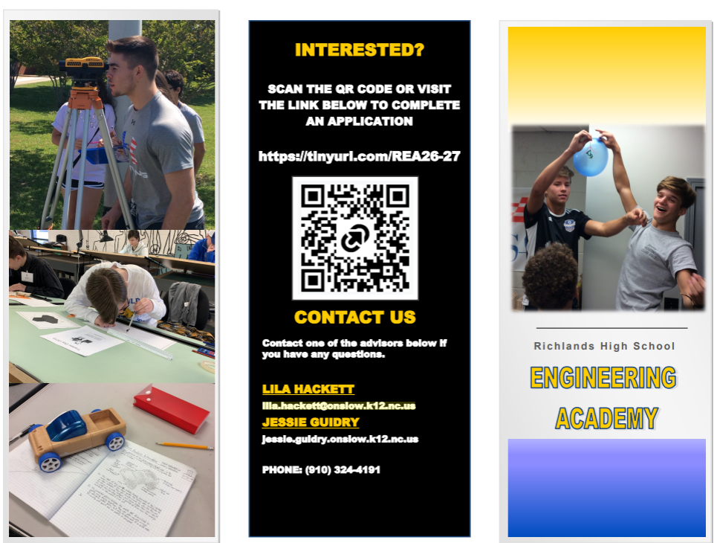

Slide 21
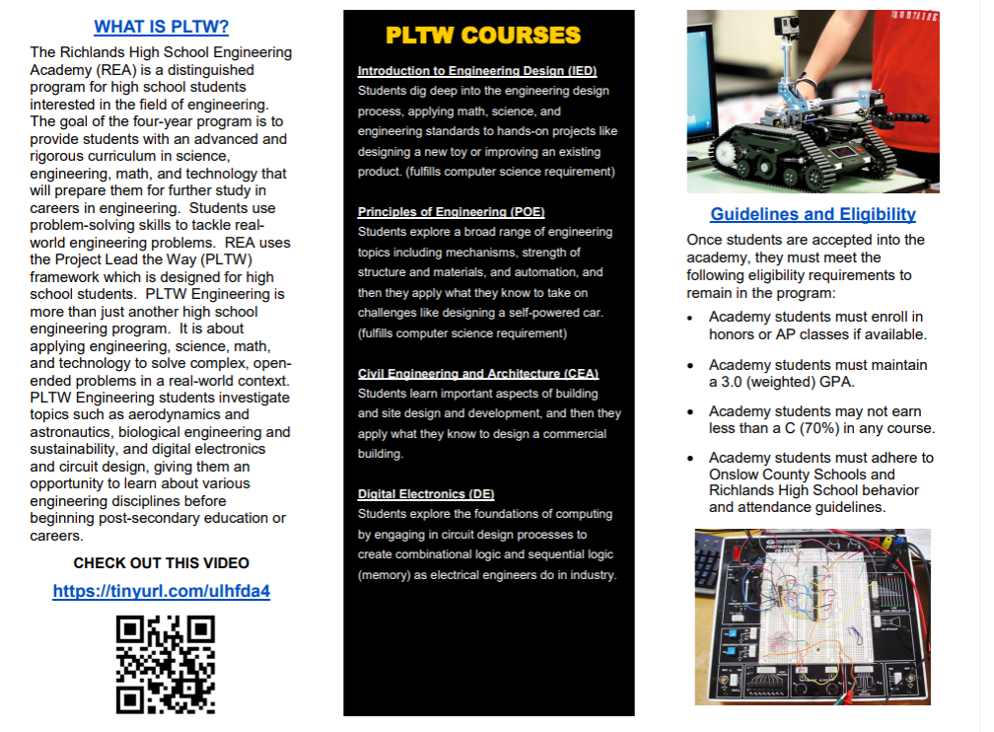

Slide 22
CTE Department
Masonry Classes: Mr. Jones
Health Science Classes: Mrs. Lanier
Food Science Classes: MRs. James & Mrs. Leonard
Adobe Visual: Mr. Floyd
Teaching as a Profession: (10,11, & 12) Mr. Tucker

Slide 23

Career Development at
Richlands High School
Career Development/
Special Populations Coordinator
Notes:
We have a Career Development Coordinator at Richlands High School.

Slide 24
Career Development Activities
Guest Speakers
Field Trips
Resume Writing
Career Exploration through Ready, Set Onslow
Job Shadowing
Interview Training
Career Counseling
CTE Internships

Slide 25
Notes:
Our students have the opportunity to attend the Eastern NC Regional Skills Center.

Slide 26
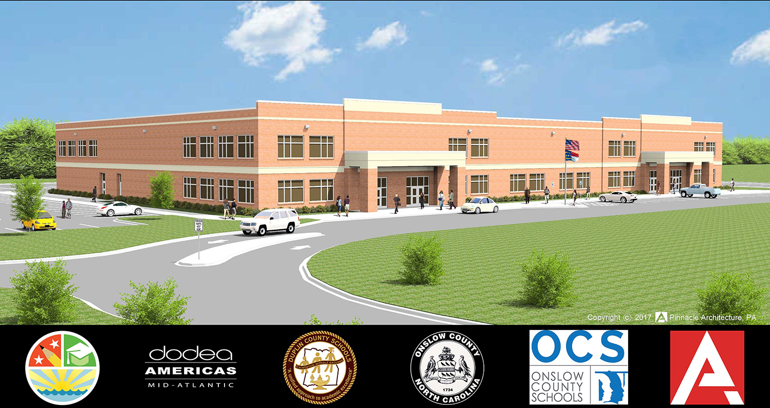
Notes:
The Regional Skills Center was envisioned and crafted with a single purpose - to be a bridge between education and industry, equipping our students with the skills, knowledge, and confidence they need to flourish in their chosen fields.

Slide 27
Do you like working with your hands?
Do you like to build things?
Do you like to take things apart?
Do you like to create things for others?
Do you like to solve problems?

Slide 28
If you said YES to any of these…
…the Eastern North Carolina Regional Skills Center is for you!

Slide 29
What do we offer?
Automotive Service
Autobody Repair
Culinary Arts & Hospitality
3D Modeling & Animation
Game Art & Design
Firefighter Technology
HVAC/R
Cybersecurity
Network Administration
Nursing Fundamentals (CNA)
Medical Assisting
Welding
Notes:
The skills center offers a variety of courses and programs.

Slide 30
How does it work?
Students register for a program they are passionate about
Students going to the Skills Center travel to the facility, located in Burton Park, for half of the day
Each period is over 2 ½ hours long
Students will take 2 courses in 1 semester – 9 weeks each
Attendance is the most important thing
Being motivated to learn and work is the next most important thing

Slide 31
What do you get?
Most programs have certifications or credentials from the industry that will demonstrate to a possible employer the students have successfully completed the requirements for the course.
This can help a student get a new job or help advance them in their current job.
This can also help the get into courses at the community college level.

Slide 32
Things to think about
We are a very different type of school, with different expectations
  Attendance is more important than ever – 9 weeks vs. 18 weeks
  Being prepared each day is essential
  We will hold you accountable
  You will hold you accountable
  We will offer as many opportunities as possible

Slide 33
What do you need to do next?
Make a plan…
  Speak with your counselor about the options
  Talk with other students who have gone to the Skills Center
  Ask question about the different programs
  Talk with your parents
  Come to the Skills Center for a tour

Slide 34
Questions? https://rsc.onslow.k12.nc.us
Speak with Counselor
Thank you

Slide 35
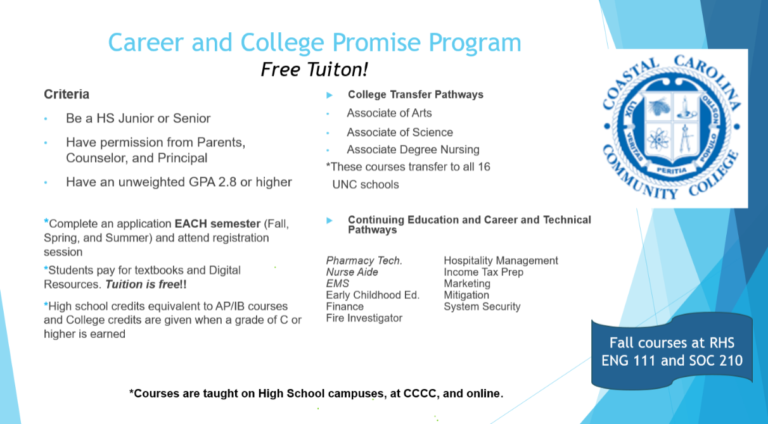
Jeana Hayes
hayesj@coastalcarolina.edu

Slide 36

Lisa Butler
Lisa.butler@onslow.k12.nc.us

Slide 37

Questions??
nicole.cox@onslow.k12.nc.us
portia.kresse@onslow.k12.nc.us
angela.lanier@onslow.k12.nc.us
OR REFER TO THE COURSE REGISTRATION INFORMATION on our school website!

