Slide 1

FY27 Budget Finalization Meeting

Slide 2
Agenda
Action Items (add items as needed)
  A. Approval of Agenda
  B. Approval of Previous Minutes
  C. Final Budget Recommendation Discussion Items A. Presentation of the final budget recommendation
    i. ACTION ITEM: GO Team vote on Budget Information Items Principal’s Report
    Elementary Schools: Math Curriculum Choice
  CAT Meeting Report
    ESPLOST 2027: Priorities
    Strategic Plans: Cross-Collaboration
  Committee Reports Announcements
Public Comment

Slide 3
Norms
This is a meeting of the GO Team. Only members of the team may participate in the discussion. Any members of the public present are here to quietly observe.
We will follow the agenda as noticed to the public and stay on task.
We invite and welcome contributions of every member and listen to each other.
We will respect all ideas and assume good intentions.

Slide 4

Overview of FY 27
GO Team Budget Process
Step 3 Principals & Assoc. Supt. Discussions
Step 1 Finalize Strategic Plan & Rank Objectives
Step 6 Principals HR Staffing Conferences Begin
February 23-27
Step 2 District-wide Budget Allocation Training
January 2026
Step 7* GO Team Budget Finalization Meeting
Budgets finalized by March 13th
Step 5 Associate Supt. Review
Step 4* GO Team Feedback Mtg. Completed February 2026 (BEFORE STAFFING CONFERENCE)
GO Teams are encouraged to have ongoing conversations
* GO Teams will need to take ACTION on the budget at these meetings.

Slide 5
Budget Finalization Meeting
What
During this meeting GO Teams will review all components of the budget, which should be updated based on feedback from the Cluster Superintendent and key leaders. After review, GO Teams will take action (i.e., vote) on the FY27 Budget.
Why
Principals will present the final budget recommendations for GO Team approval.
When
All approval meetings must be held after staffing conferences. Budgets must be approved by March 13th.

Slide 6
Budget Updates

Slide 7
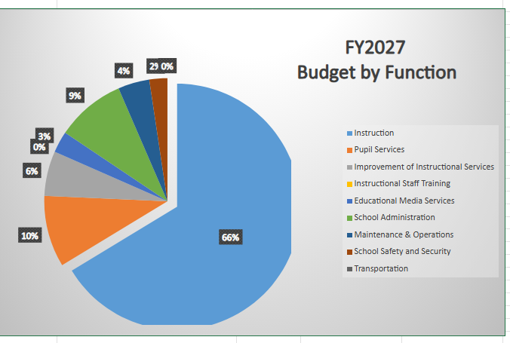
FY27 BUDGET BY FUNCTION
(Required)
School | West Manor Elementary School
Location | 2569
Level | ES
Principal | Reginald Lawrence
Projected Enrollment | 259
Account | Account Description | FTE | Budget | Per Pupil
1000 | Instruction | 26.90 | $3,536,039 | $13,653
2100 | Pupil Services | 3.75 | $501,156 | $1,935
2210 | Improvement of Instructional Services | 2.00 | $313,556 | $1,211
2213 | Instructional Staff Training | - | $- | $-
2220 | Educational Media Services | 1.00 | $149,632 | $578
2400 | School Administration | 3.00 | $485,423 | $1,874
2600 | Maintenance & Operations | 3.00 | $220,043 | $850
2660 | School Safety and Security | 1.00 | $126,054 | $487
2700 | Transportation | - | $- | $-
Total |  | 40.65 | $5,331,904 | $20,587

Slide 8

Discussion &
Questions

Slide 9
Action on the Budget
The GO Team needs to TAKE ACTION (vote) on its FY27 budget.
After the motion and a second, the GO Team may have additional discussion.
Once discussion is concluded, the GO Team will vote.

Slide 10
Additional Agenda Items

Slide 11
Information Items (add items as needed)
  Principal’s Report
    Elementary Schools: Math Curriculum Choice
  CAT Meeting Report
    ESPLOST 2027: Priorities
    Strategic Plans: Cross-Collaboration
  Committee Reports (as needed)
Announcements
Public Comment (if applicable)

Slide 12
Principal’s Report

Slide 13
CAT Report:
ESPLOST
Strategic Planning

Slide 14


Redistricting, Capital Planning, and the Road to E-SPLOST 2027
  January - March 2026: Recommendation development (APS staff/leadership)
  February - May 2026: Community Engagement (including Accelerate APS Series; Cluster Advisory; Teacher Advisory; Student Advisory)
  March - April 2026: Present E-SPLOST proposal to Board
  April - October 2026: Non-SPLOST dependent redistricting (for SY 2027-2028 )
  June 2026: Board of Education adoption of E-SPLOST 2027 referendum and call for vote
  July - October 2026: Website of E-SPLOST 2027 information
  November 3, 2026: E-SPLOST 2027 vote on referendum
  November and December 2026: First and second reads of Non-SPLOST dependent redistricting
    Begin redistricting based on 2027 SPLOST projects
  July 1, 2027: If E-SPLOST 2027 passes, collections start
25

Slide 15
For Conversation
  As we plan for E-SPLOST 2027, which capital improvement projects do you think have the greatest impact on our students (i.e. construction, renovation, infrastructure improvements, athletics, safety, security, technology, transportation, nutrition) and why?
  Out of the following 6 E-SPLOST Program Areas, prioritize your top three areas:
    Facilities: Infrastructure
    Technology
    Transportation
    Safety and Security
    Athletics
    Nutrition
  Looking ahead to 2032 (which would be the final year of SPLOST 27), what are 1 to 2 physical changes/capital projects that would make you feel E-SPLOST was a success?
26

Slide 16


GO Team Declarations EXTENDED: NOW – March 8
During the GO Team election, each school will fill:
2 parent/guardian seats
2 instructional staff seats
Scan the QR Code to
Declare Your Candidacy!
http://tinyAPS.com/?2026GOTeamDeclaration

Slide 17

Thank you!

Slide 18
Appendix
FY27 Feedback Presentation

Slide 19
Principals
To ensure transparency, consistency, and clarity for stakeholders, please COPY your Budget Feedback Presentation into this appendix using one of the following methods:
Option 1
Copy Your Budget Feedback Presentation into This Template
Open your Budget Feedback presentation in PowerPoint.
Click on the first slide in the left panel of the Feedback Presentation.
Select all the Feedback Presentation slides (Ctrl+A/Cmd+A to select all slides).
Right-click and choose Copy.
Click after this slide (you’ll see a red bar in the left pane)
Right-click and select Paste. Choose Keep Source Formatting to maintain formatting.
Option 2
Add These Slides to the Front of your Budget Feedback Presentation
Open your Budget Feedback presentation in PowerPoint and Save a Copy (File/Save a Copy). This will become your Finalization Presentation.
Click on the first slide in the left panel of this presentation.
Select all the Finalization Presentation slides (Ctrl+A/Cmd+A to select all slides).
Right-click and choose Copy.
Open the Copy of your Feedback Presentation and Click before the first slide (you’ll see a red bar in the left pane)
Right-click and select Paste. Choose Keep Source Formatting to maintain formatting.

Slide 20

West Manor
FY27 Budget Feedback Meeting
02/10/26

Slide 21
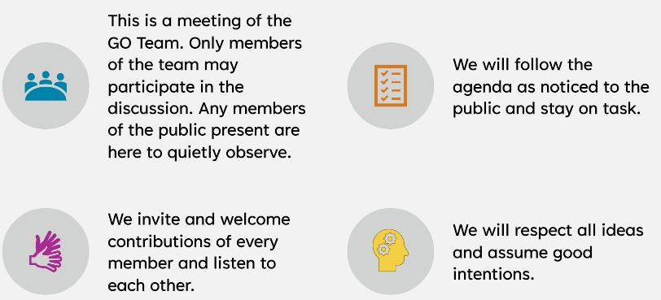
Purpose, Agenda, & Norms
During this meeting the GO Team will discuss the proposed school budget, how it supports the school's programmatic needs and aligns to the School’s Strategic Plan. The GO Team will also review and provide feedback on proposed use of school-level flexibility in the FY27 Budget.
Meeting Agenda
Meeting Norms
Action Items Approval of Agenda
  Approval of Previous Minutes
Discussion Items
  Budget Development Presentation
    ACTION ITEM: GO Team vote on Draft Budget
Information Items
  Principal’s Report
Announcements
Public Comment
Notes:
As a reminder this is the district's 2025-2030 Strategic Plan. We will use this as a guide as we continue our work today to develop our school's 2025-2030 Strategic Plan that is aligned to the district's new plan.

Slide 22
FY 27 GO Team Budget Development Process Timeline
Step 3 Principals & Assoc. Supt. Discussions
Step 1 Finalize Strategic Plan & Rank Objectives
Step 6 Principals HR Staffing Conferences Begin
February 23-27
Step 2 District-wide Budget Allocation Training
January 2026
Step 7* GO Team Budget Finalization Meeting
Budgets finalized by March 13th
Step 5 Associate Supt. Review
Step 4* GO Team Feedback Mtg. Completed February 2026 (BEFORE STAFFING CONFERENCE)
GO Teams are encouraged to have ongoing conversations
* GO Teams will need to take ACTION on the budget at these meetings.
Notes:
As a reminder this is the district's 2025-2030 Strategic Plan. We will use this as a guide as we continue our work today to develop our school's 2025-2030 Strategic Plan that is aligned to the district's new plan.

Slide 23
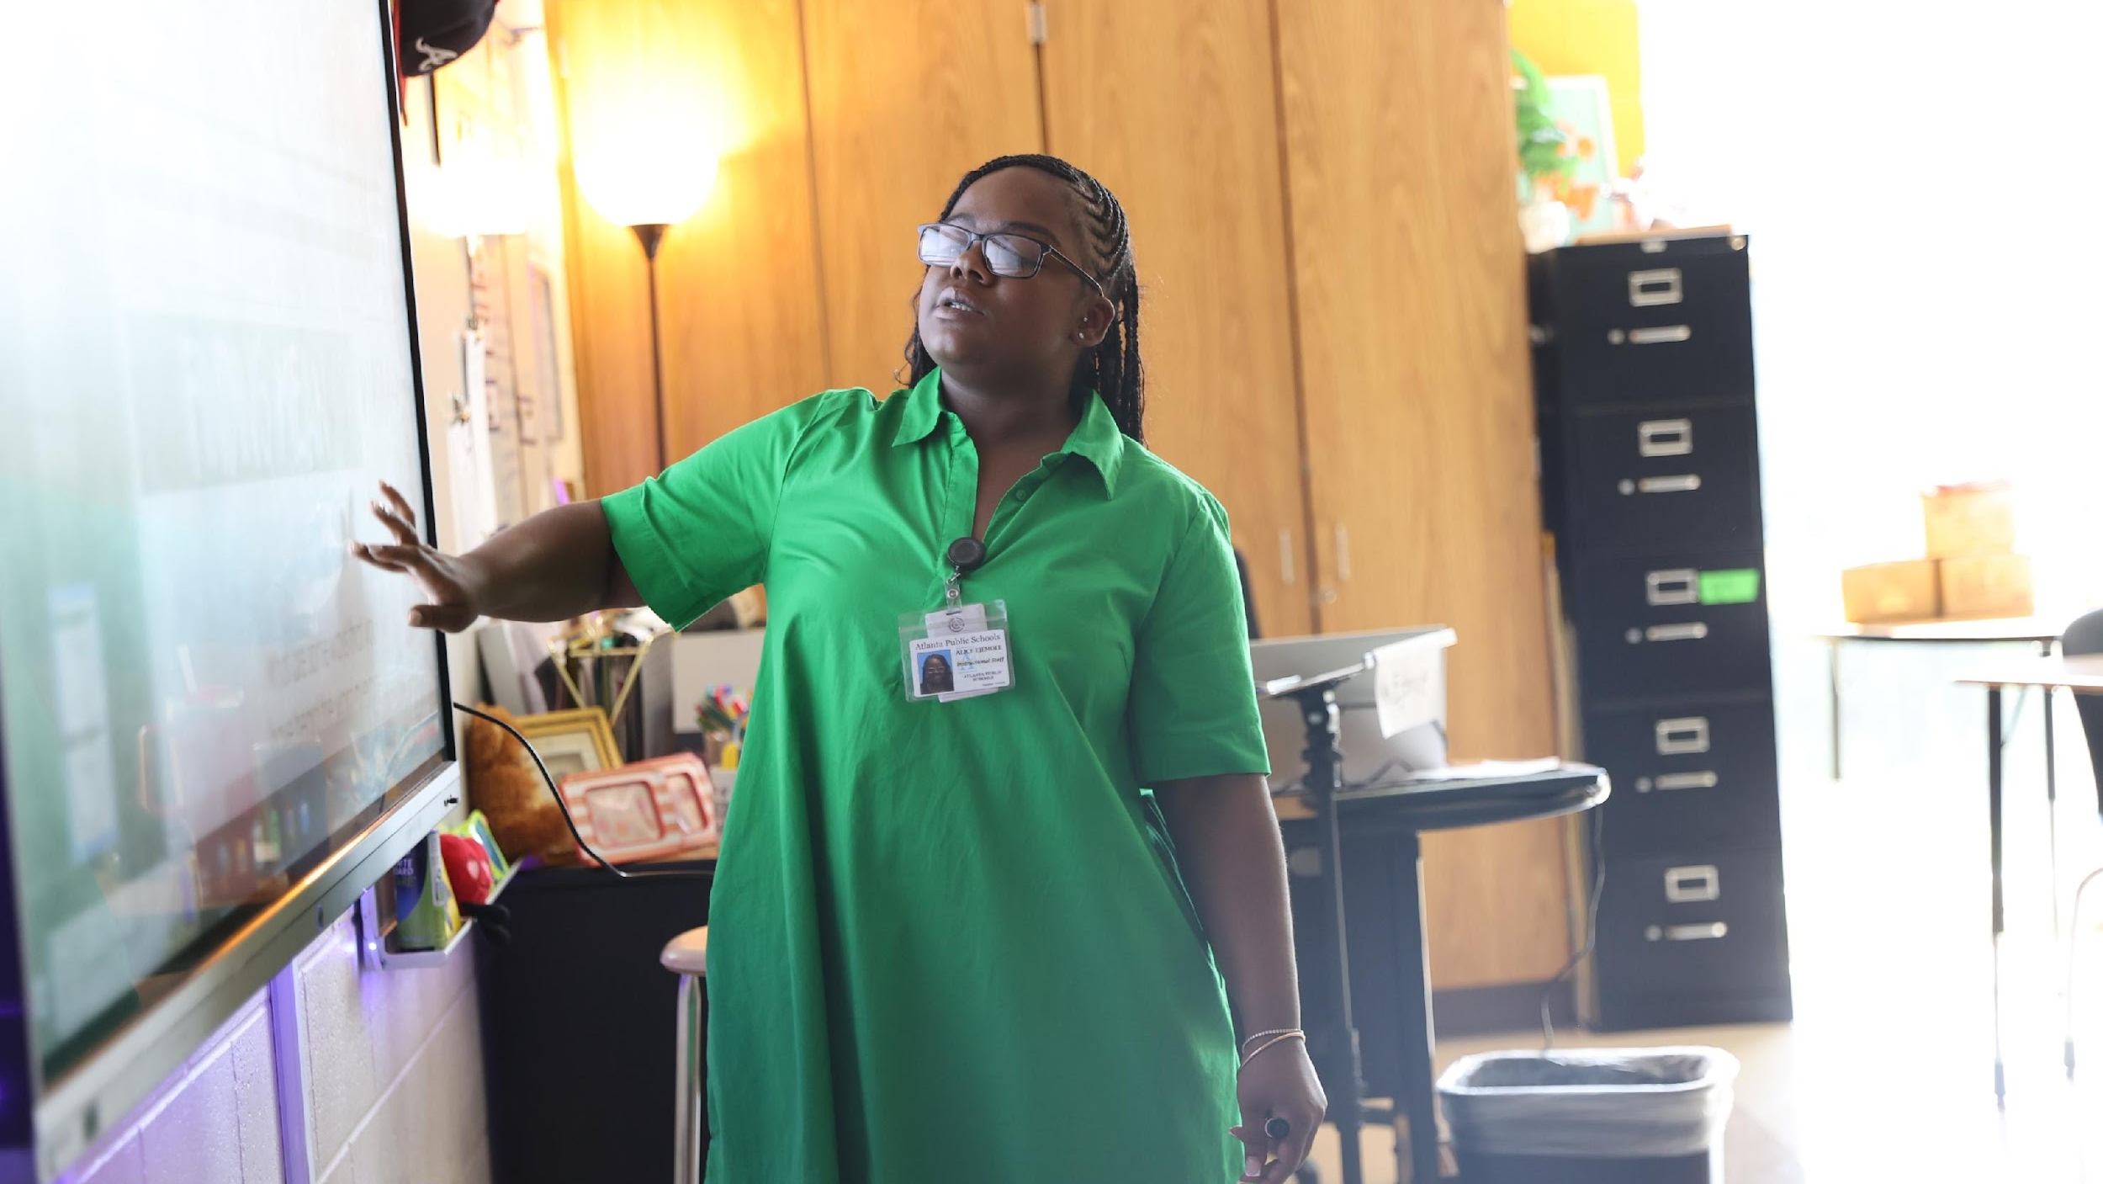

West Manor FY27 Strategy and Budget Alignment
Strategic Resource Allocation to Support Student Outcomes
One District. One Goal. Every Child.

Slide 24
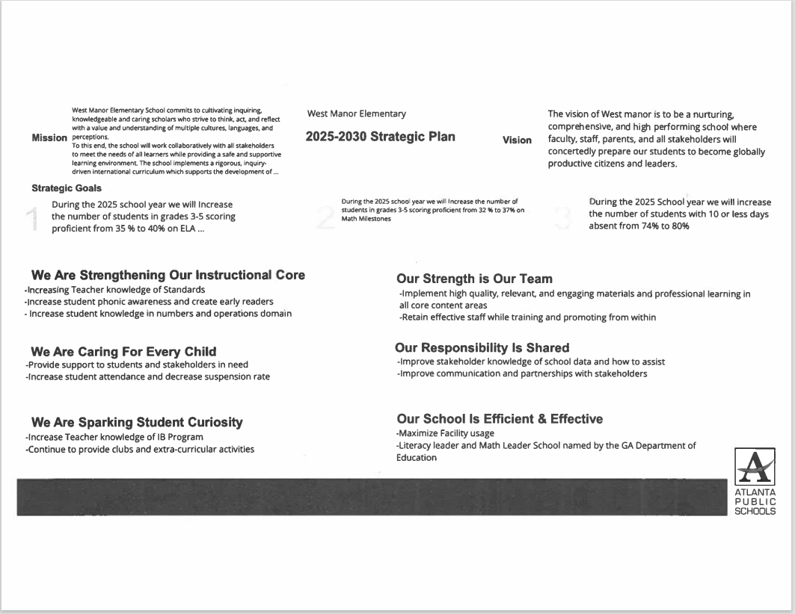
West Manor Strategic Plan
Notes:
As a reminder this is the district's 2025-2030 Strategic Plan. We will use this as a guide as we continue our work today to develop our school's 2025-2030 Strategic Plan that is aligned to the district's new plan.

Slide 25
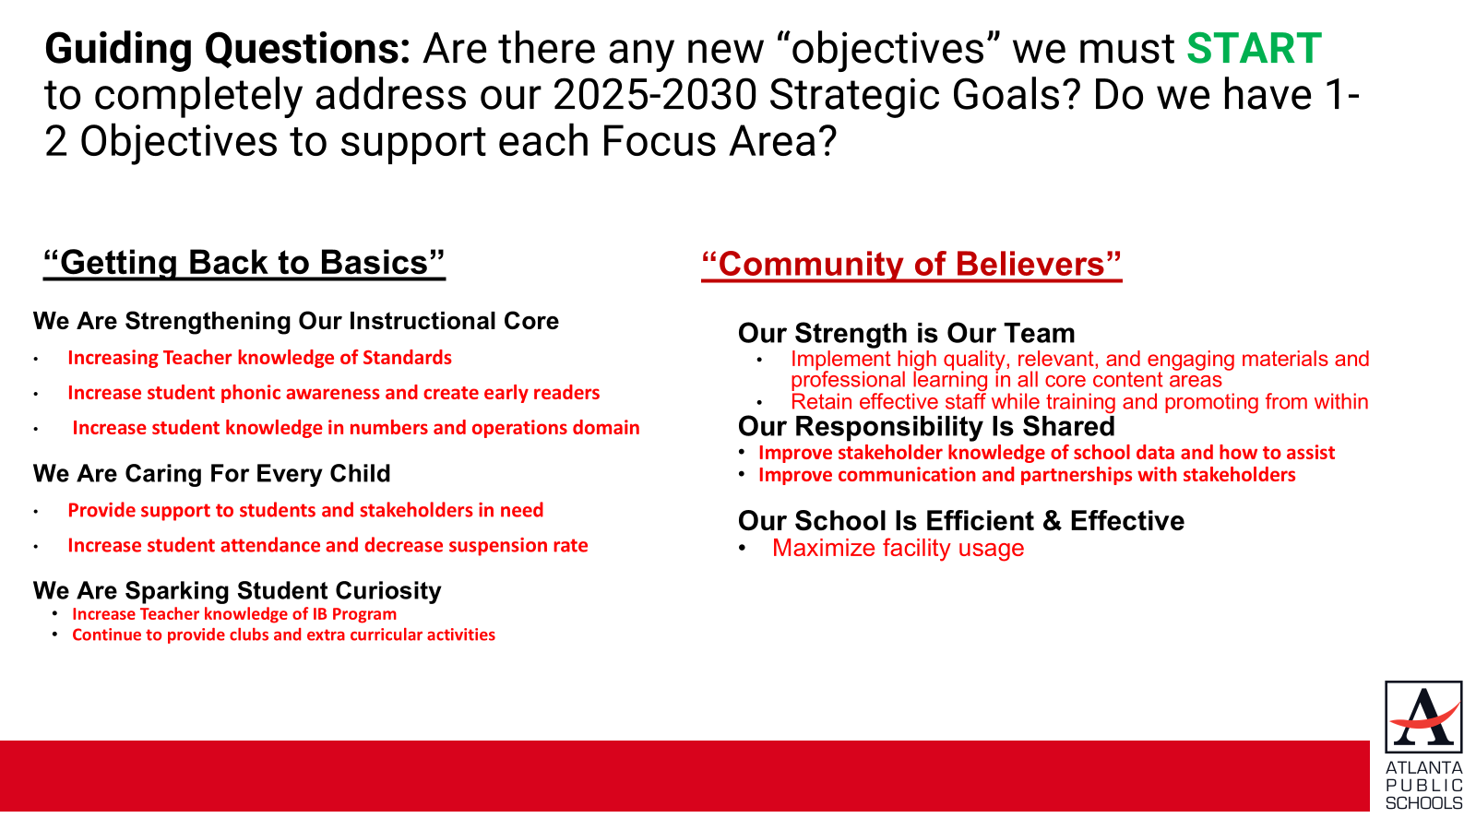

Slide 26
Strategic Plan Objective Rankings
1.Increase student phonic awareness and create early readers
2.Increase student knowledge in numbers and operations domain
3. Increase student multiplication skills
4. Increase student attendance and decrease suspension rate
5.Increasing Teacher knowledge of Standards
6.Increase Teacher knowledge of IB Program
7. Improve stakeholder knowledge of school data and how to assist
8. Provide support to students and stakeholders in need
Notes:
As a reminder this is the district's 2025-2030 Strategic Plan. We will use this as a guide as we continue our work today to develop our school's 2025-2030 Strategic Plan that is aligned to the district's new plan.

Slide 27
Strategic Plan Objective Rankings w/School Context
FY27 Ranked Objectives Insert the Strategic Objectives as ranked by the GO Team from Highest to Lowest | What Does This Mean for West Manor in the 2026-2027 School Year?
Increase student phonic awareness and create early readers | Focus on grades k-2 literacy with small class sizes and providing paraprofessionals for intentional small groups, intervention support
Increase student knowledge in numbers and operations domain | Math PLC reviewing new standards, small group instruction, intervention support
Increase student multiplication skills | Use technology to increase fluency with mathematical functions, PLC, small group instruction, MTSS intervention
Increase student attendance and decrease suspension rate | Care Team, attendance incentives, Social emotional learning
Increasing Teacher knowledge of Standards | Instructional Coaches reviewing best practices of implementing new standards, extended planning block
Increase Teacher knowledge of IB Program | IB Coordinator, IB PLC, Toddle for evidence and planning,
Improve stakeholder knowledge of school data and how to assist | IB APTT meetings, Parent Liaison in contact with community, parent university, data days, student conferences, title One meetings
Provide support to students and stakeholders in need | Care Team, Social Worker Services , Counseling groups, Nurse, SRO
Notes:
As a reminder this is the district's 2025-2030 Strategic Plan. We will use this as a guide as we continue our work today to develop our school's 2025-2030 Strategic Plan that is aligned to the district's new plan.

Slide 28
Strategic Use of Resources: Category Descriptions
WHAT? |  | HOW MUCH? | WHY?
Focus Area | Strategic Objective | FY27 Resource Recommendation | Additional Information (OPTIONAL)
We Are Sparking Student Curiosity | Increase STEAM Integration | K-5 Science Lab Materials ($10,000) | To ensure we have the appropriate supplies for students to complete project-based learning opportunities
WHAT?
What are we doing to achieve our goals?
Focus Area: Which focus area is the objective aligned with?
Objectives: FY27 Objectives from the school’s strategic plan, ranked by the order of importance.
HOW MUCH?
What resources (financial, staffing) are recommended to support this work in your school?
FY27 Resource Recommendation: Shares what resources you have allocated to support the objective in your FY27 Budget Proposal. Can be staffing and/or non-staffing resources.
WHY?
Why is this important?
Additional Information: Share why this recommendation is important to achieving your goals. Is it new for FY27?

Slide 29
Strategic Use of Resources (Required)
Focus Area | Strategic Objective | FY27 Resource Recommendation
We Are Sparking Student Curiosity | Continue IB Program Continue Gifted inquiry lab, Clubs and activities | 280,000 IB Coordinator and Gifted teacher
We Are Strengthening Our Instructional Core | Increase student phonic awareness and create early readers Increase student knowledge in numbers and operations domain Increase student multiplication skills | 305,000 MTSS Interventionist and Instructional Coach, additional Teacher cost
We are Caring for Every Child | Provide support to students and stakeholders in need Increase student attendance and decrease suspension rate | 310,000 Nurse, Social Worker, Counselor
Notes:
As a reminder this is the district's 2025-2030 Strategic Plan. We will use this as a guide as we continue our work today to develop our school's 2025-2030 Strategic Plan that is aligned to the district's new plan.

Slide 30
West Manor
FY27 Proposed Use of Staffing & Non-Staffing Allocation
and School-Level Flexibility
One District. One Goal. Every Child.

Slide 31
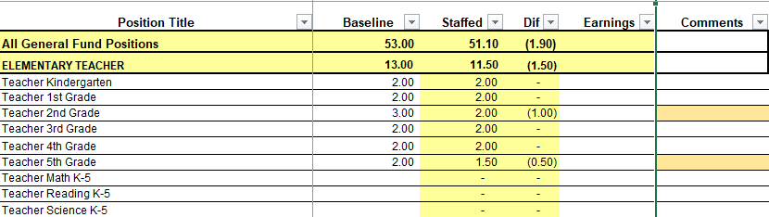
Summary Tab Overview
The Summary Tab provides a summary of the staff in our school. The columns show how many positions are:
Baseline – District’s recommended staffing for positions where there is some school-level flexibility with staffing the position.
Staffed – This shows how the principal is proposing to staff the position for the FY27 school year.
Difference—This shows the difference between the recommendation from the District and the Principal's proposed FY27 staffing plan.
Comments: The principal must provide comments if there is a difference in what is Baseline and Staffed. Principals and GO Teams will discuss the rationale for the use of school-level flexibility.
Notes:
As a reminder this is the district's 2025-2030 Strategic Plan. We will use this as a guide as we continue our work today to develop our school's 2025-2030 Strategic Plan that is aligned to the district's new plan.

Slide 32
FY27 Staffing Proposal and Use of School-Level Flexibility (Required)
Row | Position | Baseline | Staffed | Difference | Comment
13 | All General Fund Positions | 40.05 | 40.65 | 0.6
14 | ELEMENTARY TEACHER | 13 | 12 | -1
15 | Teacher Kindergarten | 2 | 2 | 0
16 | Teacher 1st Grade | 2 | 2 | 0
17 | Teacher 2nd Grade | 3 | 2 | -1
18 | Teacher 3rd Grade | 2 | 2 | 0
19 | Teacher 4th Grade | 2 | 2 | 0
20 | Teacher 5th Grade | 2 | 2 | 0
34 | EIP/REP TEACHERS | 1.5 | 3 | 1.5
36 | Teacher EIP 1-3 | 0 | 1 | 1
37 | Teacher EIP 4-5 | 0 | 2 | 2
42 | ELECTIVES/ENRICHMENTS | 3.9 | 4 | 0.1
43 | Teacher Art 1-5 | 0.6 | 0.5 | -0.1
45 | Teacher Music 1-5 | 0.6 | 0.5 | -0.1
47 | Teacher Physical Ed 1-5 | 0.6 | 1 | 0.4
49 | Teacher World Language 1-5 | 0.6 | 1 | 0.4
66 | Teacher Gifted | 1.5 | 1 | -0.5

Slide 33
CTE/JROTC/SPED | 4.9 | 4.9 | 0
Teacher ESOL | 0.6 | 0.6 | 0
Teacher Interrelated | 3.5 | 3.5 | 0
Lead Teacher Special Ed | 0.5 | 0.5 | 0
Speech Language Pathologist | 0.3 | 0.3 | 0
PARAPROFESSIONALS | 3 | 3 | 0
Paraprofessional Special Ed | 1 | 1 | 0
Paraprofessional Kindergarten | 2 | 2 | 0
SCHOOL ADMINISTRATION | 4.5 | 3 | -1.5
Principal Elementary | 1 | 1 | 0
Assistant Principal Elementary | 1 | 1 | 0
School Secretary | 1 | 1 | 0
Bookkeeper | 0.5 | 0 | -0.5
School Clerk 211 day | 1 | 0 | -1
STUDENT AND SCHOOL SUPPORT | 9.25 | 10.75 | 1.5
Counselor Elementary | 1 | 1 | 0
Instructional Coach 211 Day | 0 | 1 | 1
Instructional Coach Readers are Leaders 211 Day | 1 | 0 | -1 | flex fte
Media Specialist | 1 | 1 | 0
School Nurse LPN | 1 | 1 | 0
Signature Prgm Coach 211 day | 0 | 1 | 1
Social Worker 211 Day | 1 | 0.5 | -0.5 | Approved 1.13.26
Specialist SST Intervention | 0 | 1 | 1
Psychologist | 0.25 | 0.25 | 0
Custodian | 2 | 2 | 0
Site Manager | 1 | 1 | 0
School Resource Officer 202 Day | 1 | 1 | 0

Slide 34
FY27 Non-Staffing Tab Overview
The Non-Staffing Tab shows how funds are allocated for non-staff items in the school. There is school-level flexibility for most of these items. The tab has columns for:
Recommended—District’s recommended amount to spend on the line item.
Allocation – This shows how much the principal is proposing to allocate towards the line item in FY27.
Difference—This shows the difference between the recommended amount and the allocation.
Notes: The principal must provide comments if there is a difference in what is Recommended and what is Allocated. Principals and GO Teams will discuss the rationale for the use of school-level flexibility.
Description | Rec. | Allocation | Diff | Notes
Reserve | $ 95,045 | $ 95,045 | $ -
Custodian Overtime | $ 1,650
School Resource Officer Overtime | $ 4,000
Teaching/Other Supplies | $ 18,650 |  | $ (18,650)
Media Supplies | $ 2,984 |  | $ (2,984)
Academic Stipends | 20,500 | $ 20,500 | $ -
Fine Arts Stipends | 0 | $ - | $ -
Teacher Subs | $ 49,984 | $ 49,984 | $ -
Substitute FICA | $ 725 | $ 725 | $ -
Example
Notes:
As a reminder this is the district's 2025-2030 Strategic Plan. We will use this as a guide as we continue our work today to develop our school's 2025-2030 Strategic Plan that is aligned to the district's new plan.

Slide 35
FY27 Non-Staffing Proposal and Use of School-Level Flexibility (Required)
Row | Description | Recommended | Allocation | Difference | Notes
13 | Reserve | $66,424.92 | $66,424.92 | $-
15 | Secretary Overtime | $- | $5,000.00 | $5,000.00
16 | Custodian Overtime | $1,650.00 | $- | $-
17 | School Resource Officer Overtime | $4,000.00 | $- | $-
22 | Web-based Subsc and Licenses/ Computer Software | $- | $10,000.00 | $10,000.00
30 | Teaching/Other Supplies | $12,950.00 | $15,172.00 | $2,222.00
34 | Media Supplies | $2,072.00 | $- | $(2,072.00)
41 | Dues & Fees (Signature Programs) | $- | $9,600.00 | $9,600.00 | Authorization fee
47 |  | Stipends
48 | Academic Stipends | 20,500 | $20,500.00 | $-
86 |  | Turnaround
93 |  | Substitutes
94 | Teacher Subs | $41,008.00 | $41,008.00 | $-
99 | Substitute FICA | $594.62 | $594.62 | $-
100 |  | Hourly Staff
105 | Hourly Cafeteria Monitor | $- | $9,196.20 | $9,196.20
119 | Hourly Paraprofessional | $- | $19,794.24 | $19,794.24
136 | Hourly Teacher Tutor | $- | $25,200.00 | $25,200.00
150 | Hourly Non Instructional Aide Security | $- | $38,836.80 | $38,836.80
153 | 0 | $- | $133.34 | $133.34
154 | 0 | $- | $652.42 | $652.42
174 | 0 | $- | $563.13 | $563.13
179 | FICA for Hourlies | $- | $1,348.89 | $1,348.89
180 | TOTAL | $128,699.53 | $262,675.67 | $119,126.13

Slide 36
FY27 BUDGET BY FUNCTION
(Required)
School | West Manor Elementary School
Location | 2569
Level | ES
Principal | Reginald Lawrence
Projected Enrollment | 259
Account | Account Description | FTE | Budget | Per Pupil
1000 | Instruction | 26.90 | $3,536,039 | $13,653
2100 | Pupil Services | 3.75 | $501,156 | $1,935
2210 | Improvement of Instructional Services | 2.00 | $313,556 | $1,211
2213 | Instructional Staff Training | - | $- | $-
2220 | Educational Media Services | 1.00 | $149,632 | $578
2400 | School Administration | 3.00 | $485,423 | $1,874
2600 | Maintenance & Operations | 3.00 | $220,043 | $850
2660 | School Safety and Security | 1.00 | $126,054 | $487
2700 | Transportation | - | $- | $-
Total |  | 40.65 | $5,331,904 | $20,587

Slide 37
Discussion of Reserve Funds
One District. One Goal. Every Child.

Slide 38
Plan for FY27 Leveling Reserve (Required)
$_66425 ___​
FOCUS AREA | STRATEGIC PLAN OBJECTIVE | FY27 Resource Recommendation
We Are Strengthening Our Instructional Core | Increase student phonic awareness and create early readers Increase student knowledge in numbers and operations domain Increase student multiplication skills | Provide materials and extra paraprofessional materials for small group instructional assistance (possible teacher)
Notes:
As a reminder this is the district's 2025-2030 Strategic Plan. We will use this as a guide as we continue our work today to develop our school's 2025-2030 Strategic Plan that is aligned to the district's new plan.

Slide 39
Does the budget proposal support our school's strategic objectives and lead to achieving our goals?
If new positions, resources, or programs are being added, what data or feedback supports these changes?
What trade-offs being made in this budget? Are any current programs or resources being adjusted or reduced, and how will that impact our students?
If we are sharing staff positions (e.g., nurse, counselor, teacher), how will this affect student support and service delivery at our school?
Questions for the GO Team To Discuss
Notes:
As a reminder this is the district's 2025-2030 Strategic Plan. We will use this as a guide as we continue our work today to develop our school's 2025-2030 Strategic Plan that is aligned to the district's new plan.

Slide 40
Action on the FY27 Draft Budget
The GO Team needs to TAKE ACTION (vote) on the proposed FY27 budget.
After the motion and a second, the GO Team may have additional discussion.
Once discussion is concluded, the GO Team will vote.
Notes:
As a reminder this is the district's 2025-2030 Strategic Plan. We will use this as a guide as we continue our work today to develop our school's 2025-2030 Strategic Plan that is aligned to the district's new plan.

Slide 41
Next Meeting: Budget Finalization Meeting
(Insert Date, Time)
Step 3 Principals & Assoc. Supt. Discussions
Step 1 Finalize Strategic Plan & Rank Objectives
Step 6 Principals HR Staffing Conferences Begin
February 23-27
Step 2 District-wide Budget Allocation Training
January 2026
Step 7* GO Team Budget Finalization Meeting
Budgets finalized by March 13th
Step 5 Associate Supt. Review
Step 4* GO Team Feedback Mtg. Completed February 2026 (BEFORE STAFFING CONFERENCE)
GO Teams are encouraged to have ongoing conversations
* GO Teams will need to take ACTION on the budget at these meetings.
Notes:
As a reminder this is the district's 2025-2030 Strategic Plan. We will use this as a guide as we continue our work today to develop our school's 2025-2030 Strategic Plan that is aligned to the district's new plan.

Slide 42
Information Items, Announcements and
Public Comment
One District. One Goal. Every Child.

Slide 43
Principal's Report
Notes:
As a reminder this is the district's 2025-2030 Strategic Plan. We will use this as a guide as we continue our work today to develop our school's 2025-2030 Strategic Plan that is aligned to the district's new plan.

Slide 44
Announcements
Notes:
As a reminder this is the district's 2025-2030 Strategic Plan. We will use this as a guide as we continue our work today to develop our school's 2025-2030 Strategic Plan that is aligned to the district's new plan.

Slide 45
GO Team Declarations: Open NOW – Feb. 28
During the GO Team election, each school will fill:
2 parent/guardian seats
2 instructional staff seats
Scan the QR Code to
Declare Your Candidacy!
http://tinyAPS.com/?2026GOTeamDeclaration

Slide 46
Thank you

