Slide 1
Site council meeting
3-5-26

Slide 2


Agenda
Welcome to Site Council
Enrollment
Data
3rd Quarter Events/PTO
Looking Ahead
Tax Credit Vote
Questions, Thoughts, Concerns…

Slide 3
Site Council
Welcome
In-Depth Quarterly Summaries (State of the School)
Ideas and Discussion

Slide 4

Enrollment Update
Year 1- 525
Year 2- 700
Year 3- 715
Year 4- 740
Year 5- 723
Year 7- 756
Year 6- 732
Year 8- 775
Year 9- 775
Year 10- 773

Slide 5
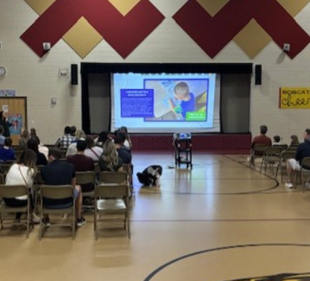
Kindergarten Round-Up
Nearly 100 enrolled for 2026-2027
Approximately 50 families attended
Kindergarten waitlist has started

Slide 6
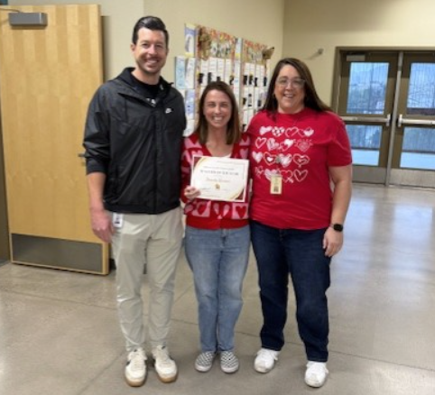
Brandy Resman- Teacher of the Year
Over 20 years of teaching experience
4 years as a principal
Received numerous votes from teachers around campus
Will now compete with the other teachers of the year throughout the district for the overall HUSD Teacher of the Year Award

Slide 7
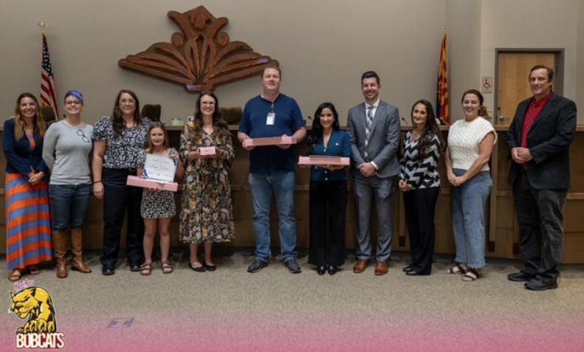
staff of the month
January- Jill Gilroy and Todd Berg
February- Felecia Mendoza and Kris Nelson
March/April- Claudia Henze and Molli Folkman

Slide 8
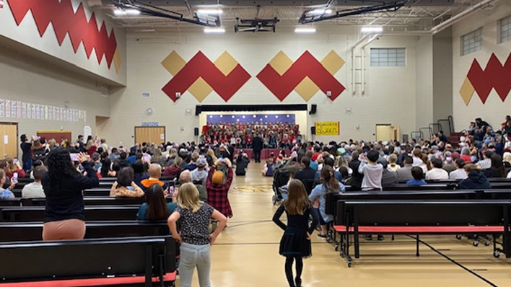
Concerts
Band and Orchestra
2nd and 3rd Grade

Slide 9
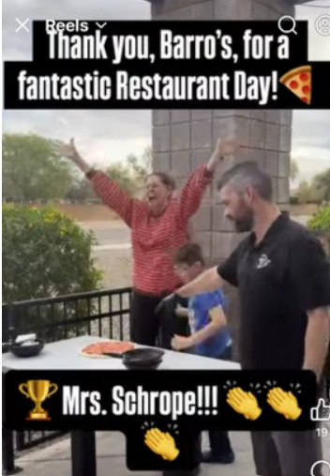

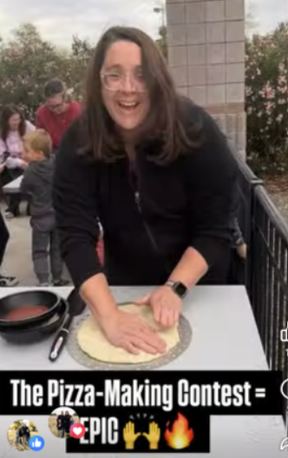
Pizza Contest
Mrs. Schrope snagged her first ever victory!

Slide 10
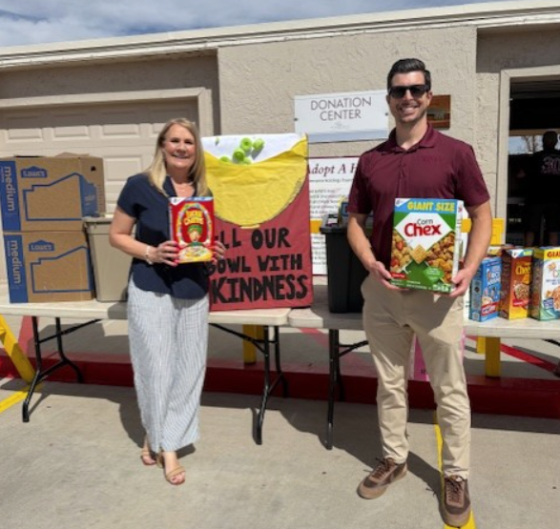
House of refuge
Another successful cereal drive is in the books
Bridges families donated a truck bed full of cereal

Slide 11
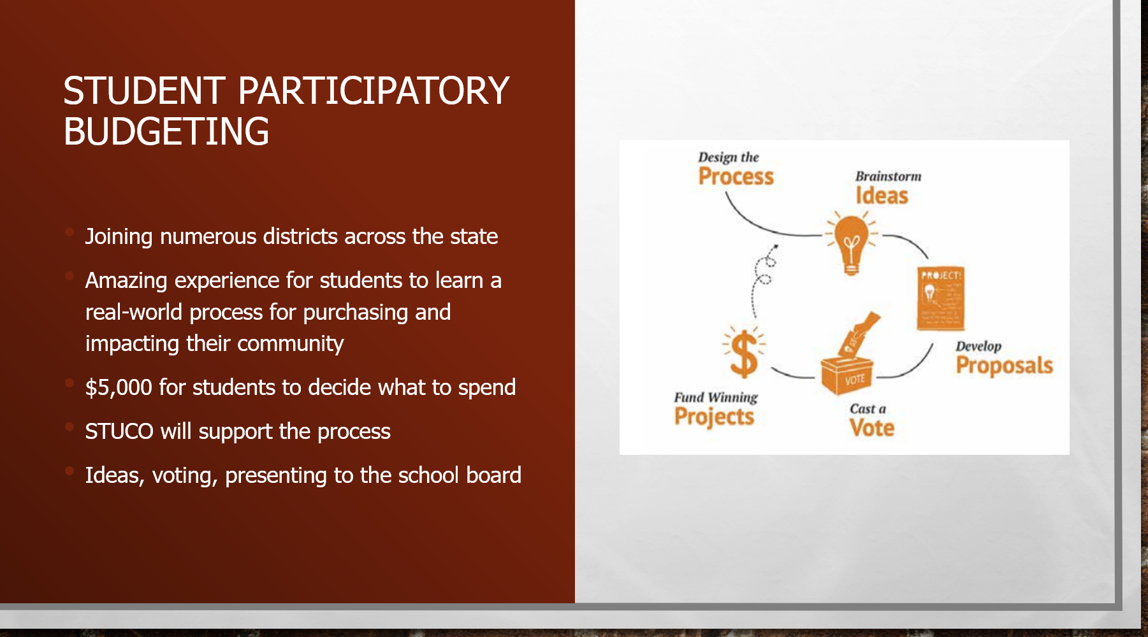

Slide 12
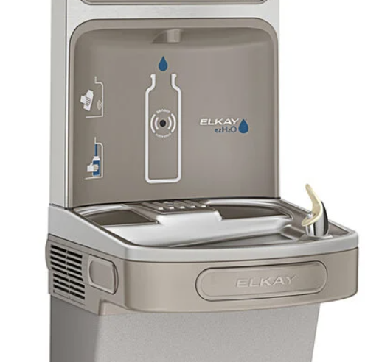
Winning Item- filtered drinking fountains!

Slide 13
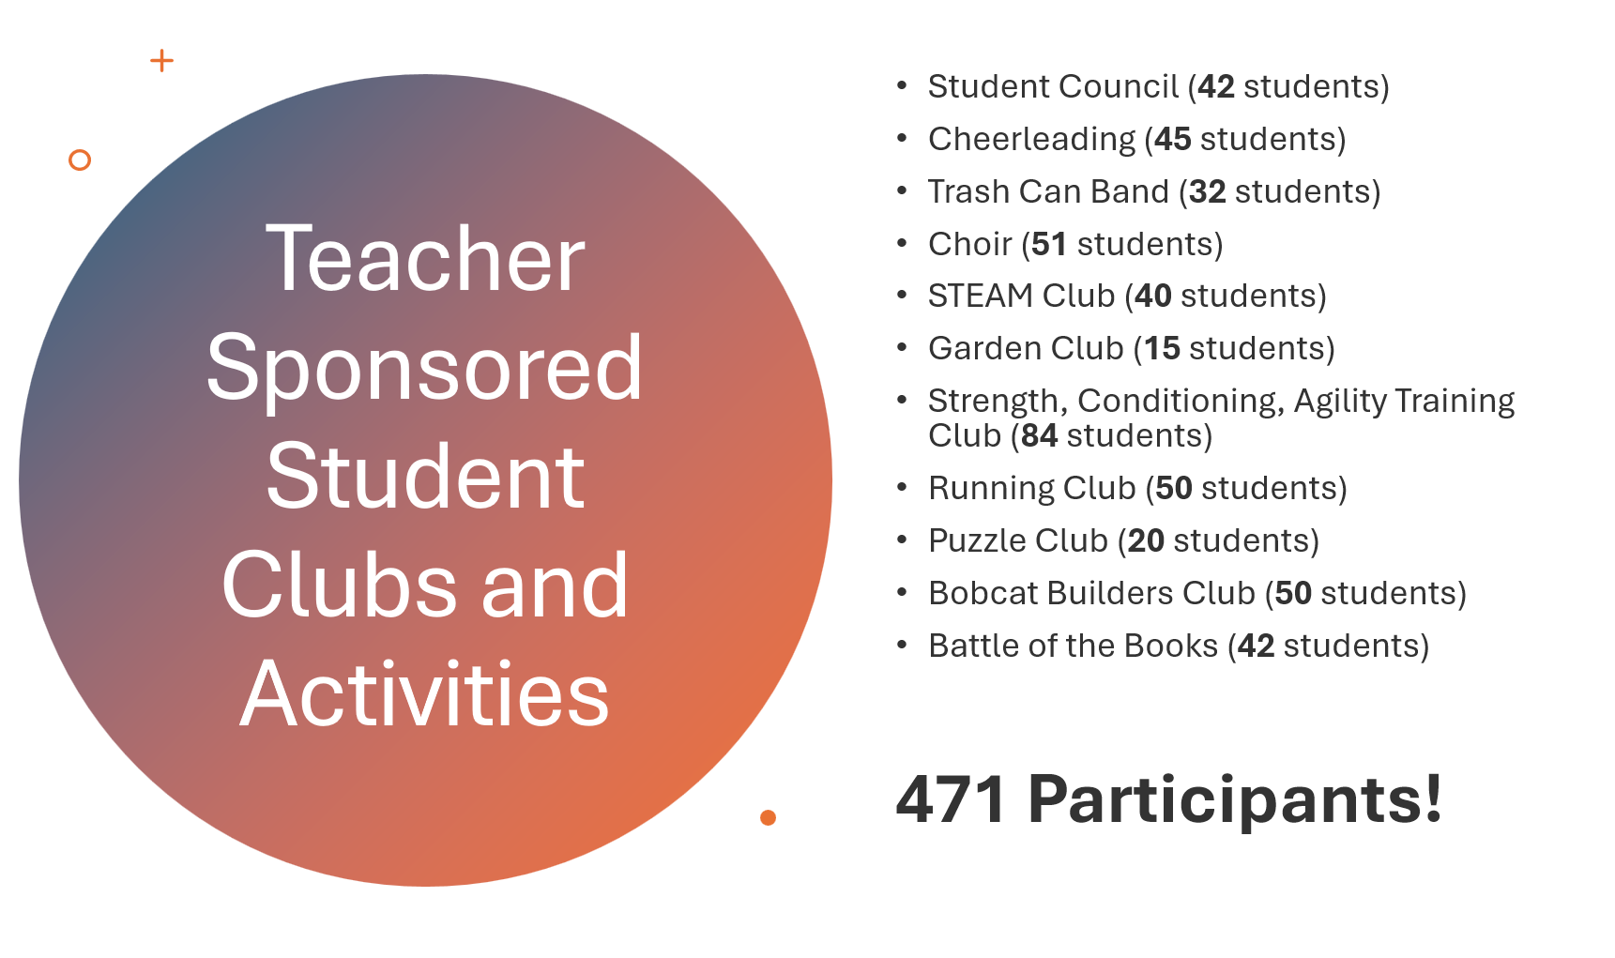

Slide 14
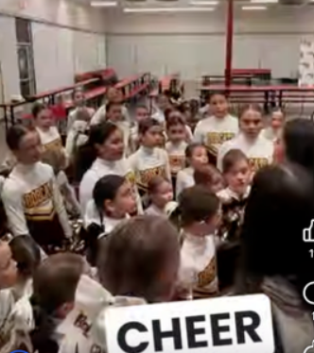
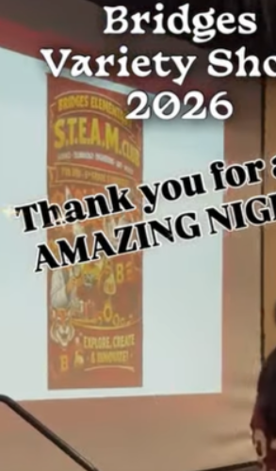
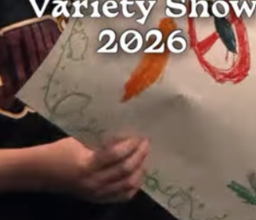
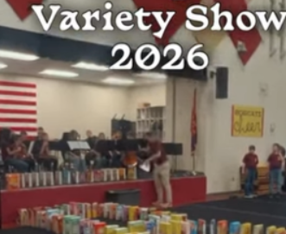
Variety Show
Trash Can Band
6th Grade Band and Orchestra
Student Council
Color Guard
STEAM Club
Garden Club
Choir
Cheer

Slide 15
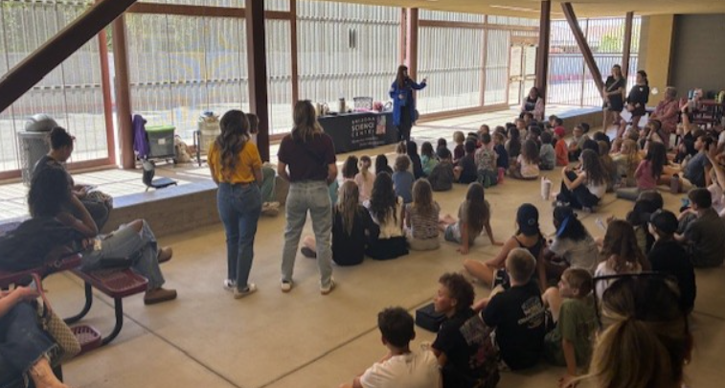
Science center and pbl day

Slide 16

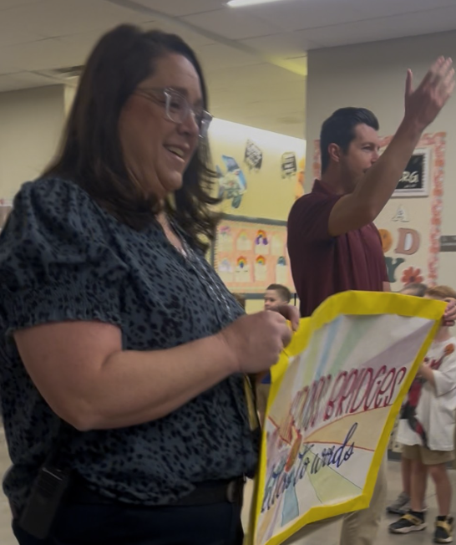
Reading parade
Kindergarten and 5th grade collaboration
Letters and words highlighted to demonstrate the learning progression
Paraded through the entire campus and K/5 parents

Slide 17

Positive Student Behavior Encouragement and Recognition Systems
Character Lessons- Specials Team
Ongoing Positive Recognition for Students
  Schoolwide expectation to submit Student of the Month nominations (resulting in 250+ for the year)
  Winners recognized in front of peers each month
  Medals given to winners
  Extra recess for winners
  Tracking system for SOM recipients for their years at Bridges
  Boo-Yah Tickets
  Stickers
  Sharing of ideas and best practices with between staff members

Slide 18
480 Students of the month recognized since last year

Slide 19
Looking ahead
State Testing
Locked in Academics
End of Year Events- Movie Night and 10 Year Celebration
6th Grade and Senior Clapouts

Slide 20
Questions, Comments, thoughts?
Thank You For
Your Time!

