Slide 1

Melrose High School
Principal – Andrea Talley
ANNUAL TITLE I MEETING
9/24/2025
Presented by Dr. Gwanda Patterson
Notes:
Dr. Patterson

Slide 2

Melrose High School
Notes:
Welcome by Principal Andrea Talley

Slide 3
Agenda/title 1 meeting
9/24/2025
Welcome – Ms. Andrea Talley, Principal
5 mins
Introduction of Administrative Team- Dr. Gwanda Patterson , PLC Coach
5 mins
Title, I program participation/Purpose,Goal Dr. Gwanda Patterson, PLC Coach
10 mins
Parent’s right to know – Dr. Williams ,Family Engagement Specialist
5 mins
Home Compact Spanish-Mr. Thiam
5 mins
DISCIPLINE DATA
Mr. Payne –AP
2 mins
Student Code of Conduct - Dr. Kahdejah Stevens/Mr. Jaylen Pope
2MINS
Teacher Qualifications/Proximity- Principal Talley
5MINS
- Pre-ACT/ACT – Mr. Burton
2MINS
Report Card/Grading Scale – Mr. Bruce
2MINS
Graduation - Mr. Maurice Burton , Counselor
2 mins
Closing Remarks - Ms. Andrea Talley
3MINS
Parent Information- Ms.Hall, Family Engagement Specialist
5 mins
Data Driven Instruction – Principal Talley
5 mins
Assessment Calendar- Dr. Patterson/ Stuckey – AP
2MINS
Notes:
Principal Talley 1-3

Slide 4

TITLE 1/sip CORNER
Notes:
Dr. Patterson

Slide 5
Title I, Part A (Title I) of the Elementary and Secondary Education Act, as amended by the Every Student Succeeds Act (ESSA) provides financial assistance to local educational agencies (LEAs) and schools with high numbers or high percentages of children from low-income families to help ensure that all children meet challenging state academic standards.
(U.S. Department of Education)
Title I
Title, I Program Description
Notes:
Dr. Patterson
What is Title I?

Slide 6

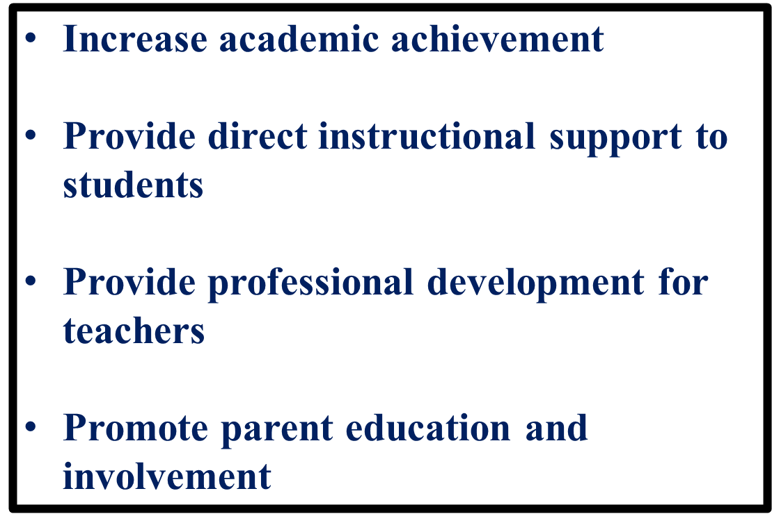
Goals
of
Title I
Notes:
Dr.Patterson

Slide 7
Purpose of the Annual Title I Meeting
The purpose of the Annual Title I Meeting is to provide information to parents of participating children about the Title I program and their right to be involved in their child’s education.
Notes:
Dr.Patterson
Purpose of the Annual Title I Meeting

Slide 8

Tennessee School Improvement Plan
The SIP is a guide describing how you intend to increase student achievement during a school year. It identifies a school's targeted goals and how to achieve them. It functions as a school's academic operations manual. It is developed by a team of stakeholders which must include faculty, staff members, parents, and students, where applicable.
Notes:
Dr. Patterson

Slide 9

Parents corner
Notes:
Dr. Williams

Slide 10
All parents have the right to request the following:
A teacher’s professional qualifications, which includes: state qualifications, licensure, grade/s certification, waivers
A teacher’s baccalaureate and /or graduate degree, fields of endorsement, previous teaching experience
A paraprofessional’s qualifications
An assurance that their child’s name, address, and telephone listing not be released to military recruiters.
All parents will receive information on the following:
Their child’s level of achievement in each of the state academic assessments
Their option to request a transfer to another school within the district if their child is the victim of a violent crime at school
Their right to timely notification that their child has been assigned, or has been taught for four or more consecutive weeks by, a teacher who is not highly effective.
Parents’ Right to Know
Notes:
Dr. Williams/Ms. Boswell Parent’s rights under ESSA - Read slide Parents’ Right to Know

Slide 11

Parent Teacher Conferences
Fall | Spring
September 4, 2025 (4 -7 pm) | January 22, 2026 (4 -7 pm)
Notes:
Dr. Williams – Discuss P/T conference dates as well as the schools’ policy and procedures on scheduling and holding conferences

Slide 12
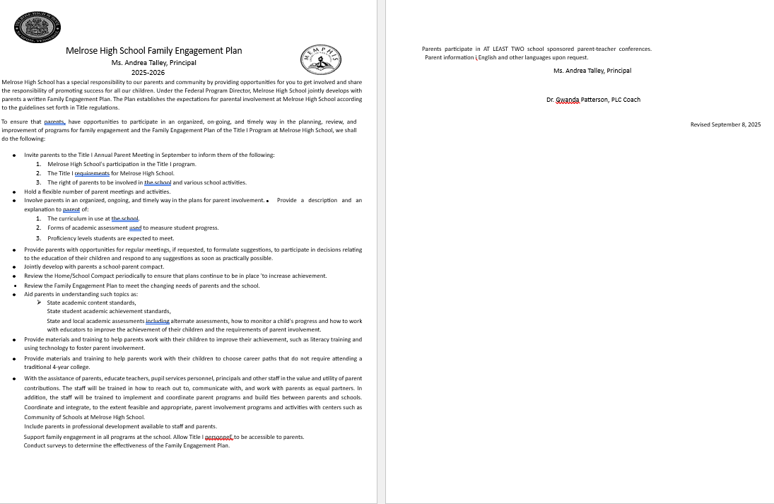
Family Engagement Plan
(SCS Policy 7009)
Notes:
Dr. Williams
Under the Title I Federal Directors Program schools are required to develop an engagement plan to show how we will provide you, the parent with several opportunities throughout the school year to be actively engaged in your child/children education. We want you to know that we can not do this work alone and that your participation in their academic achievement is critical to them being successful this year. Today you have received a copy of the 2025-2026 school year Engagement plan. We would like for you to keep this nearby at all times so that you can be constantly reminded of how vital your presence is to our school.

Slide 13
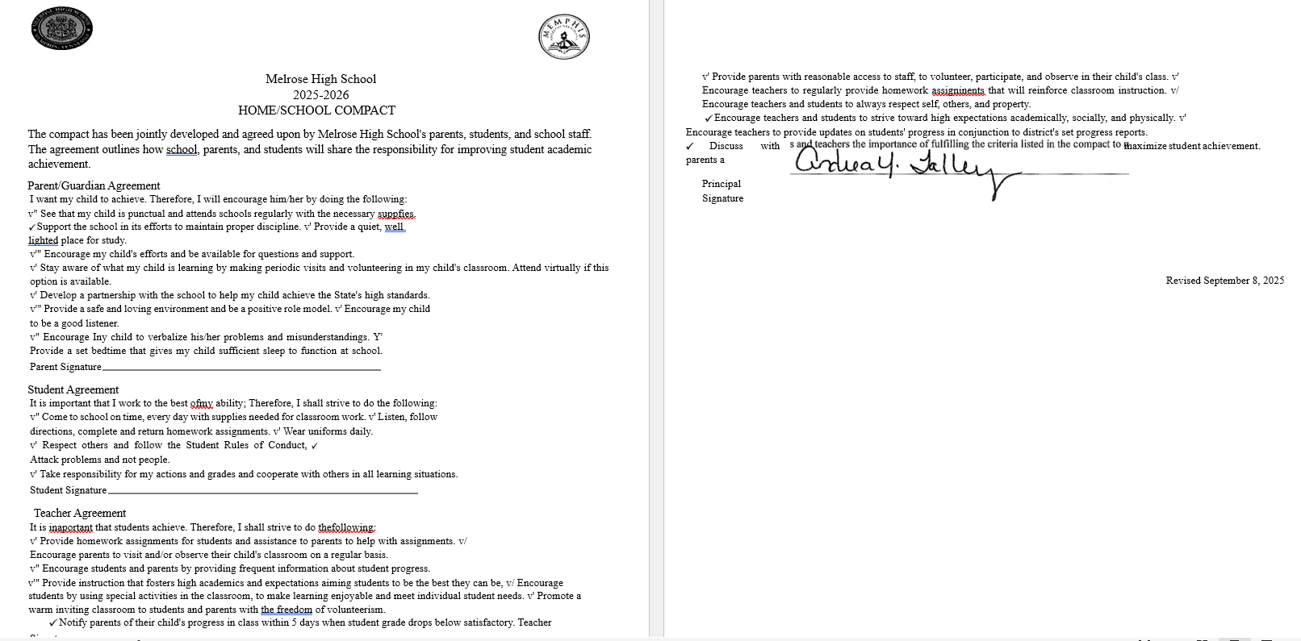
HOME COMPACT
Notes:
Dr. Williams-
Melrose high school encourages and provides active parental involvement in the educational process. Our parent compact was developed jointly with parents. The school and home have a shared goal of promoting success in our children by preparing parents to be knowledgeable of the skills and information needed to assist in the overall academic achievement child/children. As a school, we will strive to inform all stakeholders regularly of school academic status and update parents of their child’s achievement. We ask that you and your child read and sign the school/parent compact.

Slide 14
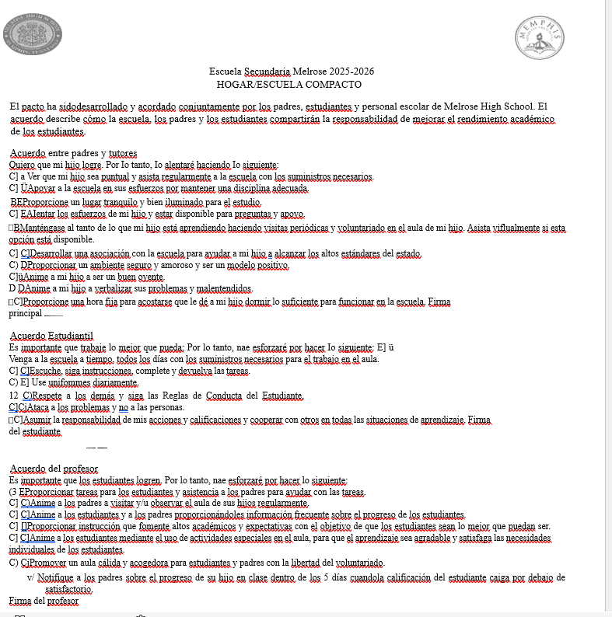
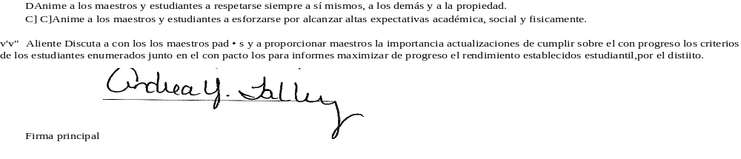
HOME COMPACT SPANISH
Notes:
Home Compact

Slide 15

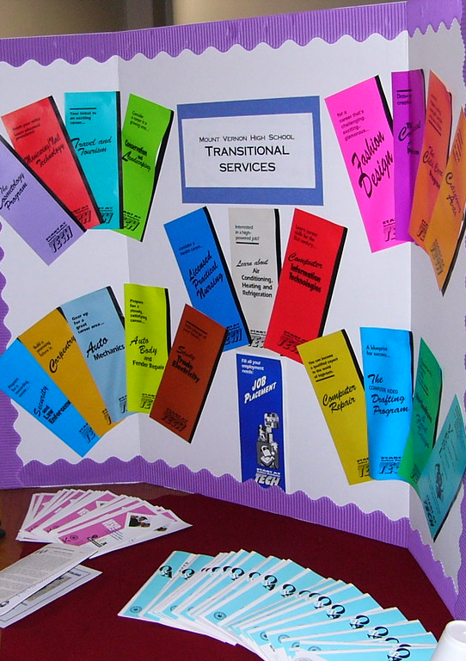

Opportunities for Additional Parent Meetings
ACT Night/FAFSA Assistance
Curriculum Nights
Parent Teacher Organizations
Notes:
Dr. Williams/Ms.Boswell

Slide 16
FAMILY AND COMMUNITY ENGAGEMENT ONGOING SUPPORT
Monthly Family Forums: provide an opportunity for all parents to gather, learn and share important​
information to support student learning and success in school. Families can join the live virtual​
sessions on Microsoft Teams by visiting www.scsk12.org/familyforum​
Family and Community Engagement Center (FACE)
160 South Hollywood Street
Room 164
Memphis, Tennessee 38112
901-416-7600
Notes:
Ms. Hall/Ms. Boswell

Slide 17


Melrose High School PTO
Make a difference:
The PTO services the school, students, and families in many ways. The purpose of the PTO is to communicate effectively with parents during the school year in order to keep our connections strong. The PTO offers various volunteer opportunities that align with the mission of our school, and we are successful because of parents like YOU, who volunteer your time and talents to carry out the fun events for the students that we hold each school year. Volunteering with the PTO is a wonderful way to connect to other parents in our school, learn about important events, and benefit your student!
President
4 Vice Presidents - one for each grade level
1 Secretary
1 Assistant secretary
2 Membership chairs
2 Treasurers
Please scan the QR code to volunteer as a board member or nominate someone for an office.
https://forms.office.com/r/bSQUQBW340
Notes:
Ms.Hall and Ms. Boswell

Slide 18

Data driven instruction
This Photo by Unknown Author is licensed under CC BY-NC-ND

Slide 19
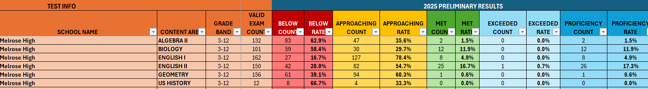
Academic Status
Melrose High School
Notes:
Principal Talley – Share school 2025-2026 EOC Data and AMO Goals

Slide 20
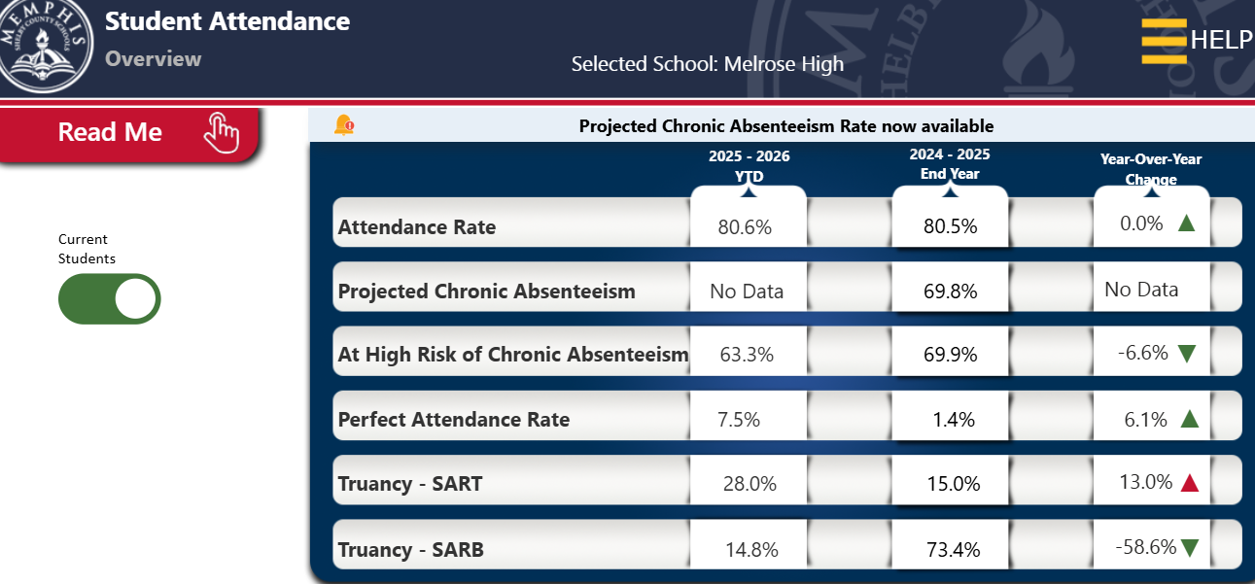
Attendance data

Slide 21
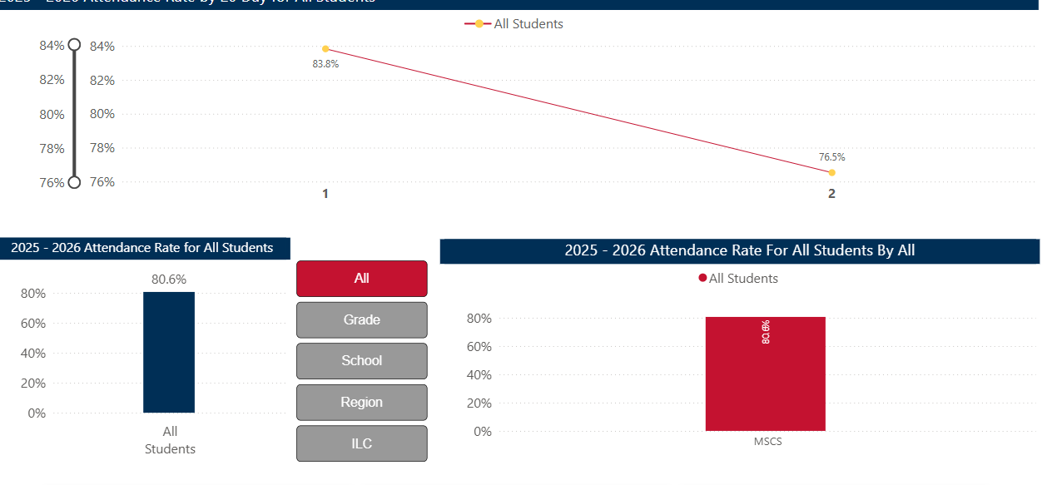
First 20 days

Slide 22
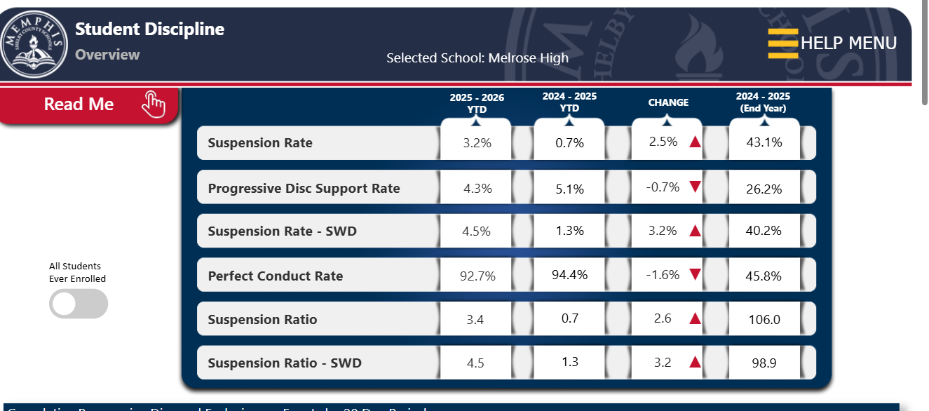
Discipline data
Notes:
Mr. Stephen Payne

Slide 23
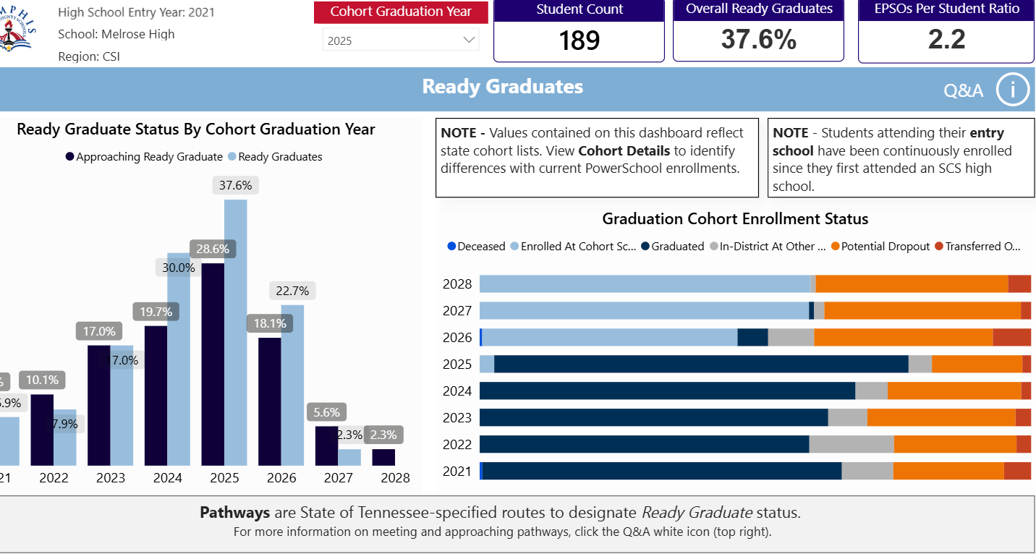
graduation
Notes:
Mr. Burton

Slide 24
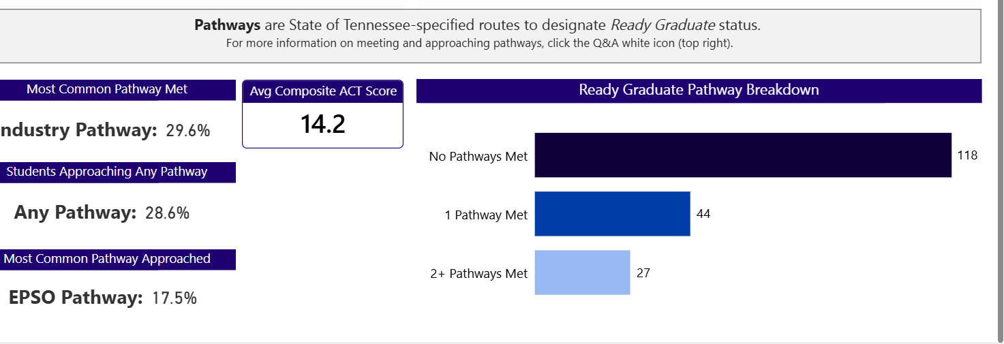
Graduation cont’/act
Notes:
Mr. Burton

Slide 25

Teacher /student information
This Photo by Unknown Author is licensed under CC BY-NC-ND
Notes:
Principal Talley

Slide 26
Title I schools must notify parents if their student(s) has/have been taught for four or more consecutive weeks by a teacher who does not meet the applicable state certification requirements at the grade level and subject area in which the teacher has been assigned.
Teacher Qualifications
Notes:
Principal Andrea Talley, Discuss current status of teachers at Melrose that are not highly-qualified

Slide 27
Student Code of Conduct (SCS Policy #6022)
The Shelby County Board of Education accepts the responsibility for establishing and maintaining proper standards of discipline and behavior in the public schools.
In order to maintain good order and ensure an environment conducive to learning, the Board considers behavior or conduct occurring on school property or at any school sponsored activity occurring off school property which interferes with the above to be offenses.
Notes:
Dr.Kahdejah Stevens – Read SCS Policy #6022 Student Code of Conduct
Also speak also speak about our school’s discipline policy

Slide 28
Student Code of Conduct (continued)
The District establishes the Shelby County Schools Student Code of Conduct to provide a sample of unacceptable student behaviors and a related sample of disciplinary actions.
The Code of Conduct and any revisions shall be approved and adopted by the SCS Board of Commissioners as the student discipline policy of the district.
Notes:
Mr. Pope – Read SCS Policy #6022 Student Code of Conduct
Also speak also speak about our school’s discipline policy

Slide 29
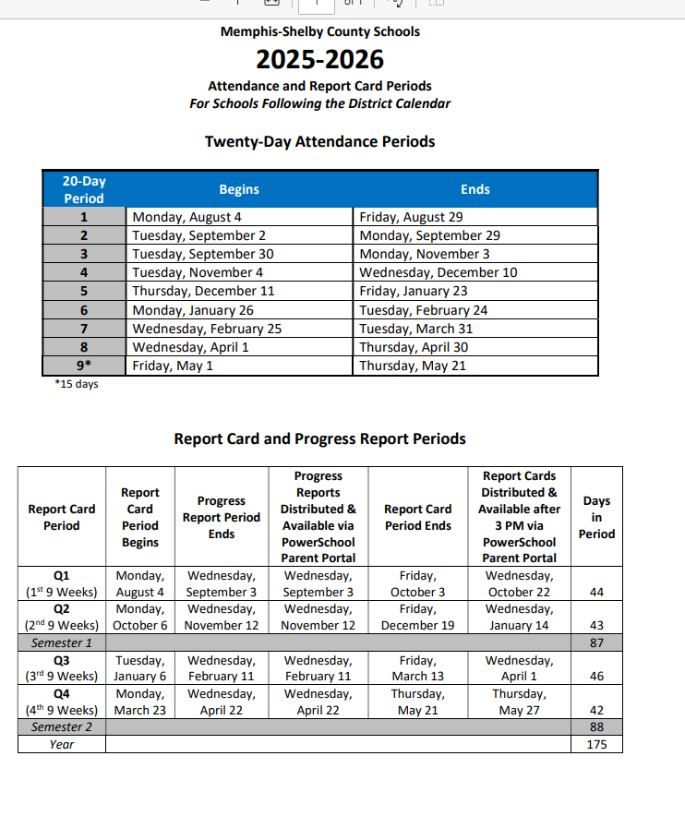
Report Card Period and Progress Reports
Report cards are available for the complete quarter once all school grades are stored and will be housed in the parent portal.​
Access the report card, by going to the SCS Student & Parent webpage.
Sign into your parent account. ​
If you have forgotten the username or password, click on the “Forgot Username or Password” link. ​
After logging in, click the report card icon. ​
​
Notes:
Mr. Bruce

Slide 30
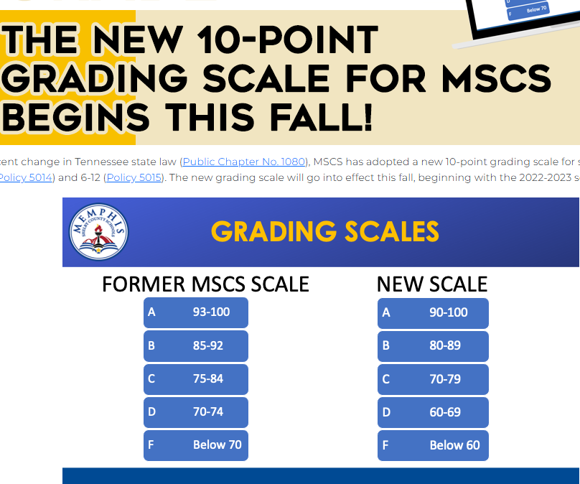
Grading scale
Notes:
Mr. Burton

Slide 31
PRE-ACT AND ACT
UPCOMING TEST- ACT WEEK OF OCT. 20-24 - 12TH GRADERS
PRE-ACT – OCT 27-31 – 9TH AND 10TH GRADERS
Offered again in the Spring 2026 for 11th graders
Notes:
Mr.Burton

Slide 32
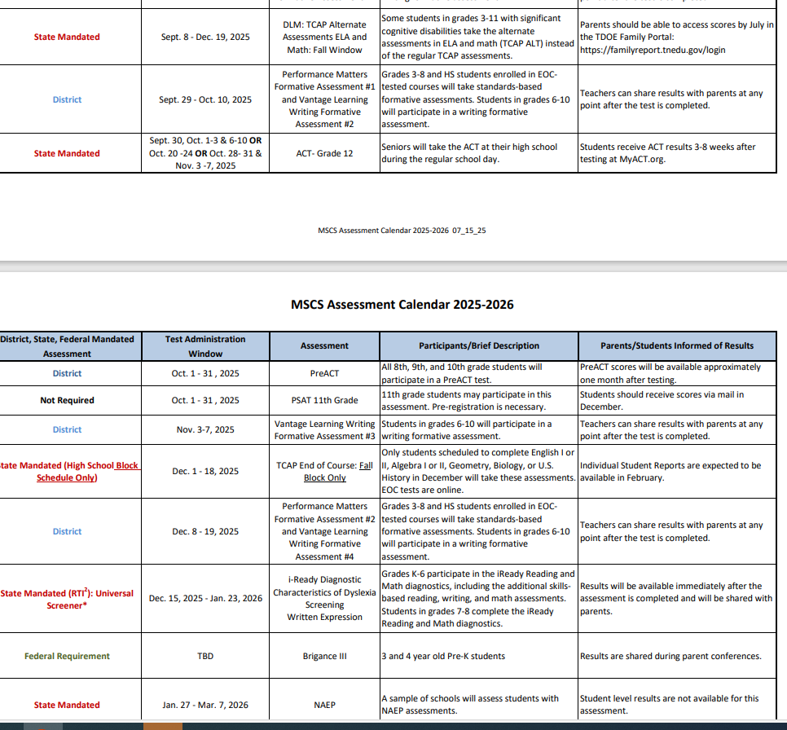
Mscs assessment calendar
Notes:
Dr. Patterson

Slide 33

Your attendance was greatly appreciated.
Notes:
Ms. Talley ,Principal/Dr. Patterson

