Slide 1
NORTH KIRKWOOD
MIDDLE SCHOOL
RANKING
7TH GRADE CLASSES
Infinite Campus Portal: https://kirkwoodmo.infinitecampus.org/campus/portal/students/kirkwood.jsp

Slide 2
Overview of 7th Grade Schedule
7 PERIOD SCHEDULE
TEAM CLASSES PERIODS 2-5
ENCORE/ELECTIVE & WELLNESS PERIODS 1,6, 7

Slide 3
CORE
REQUIREMENTS
ELA
SCIENCE
MATH
SOCIAL STUDIES
WELLNESS

Slide 4
ENCORE/ELECTIVE COURSES
FULL YEAR:
7th Grade Band / 7th Grade Orchestra
Students must successfully complete 6th Grade Band/Orchestra to enroll.

Slide 5
SEMESTER ENCORE/CORE EXTENSIONS:
*Learn about these classes from the Course Description Guide:
On your ipad:
1) Go to Mosyle app
2) Select “My books”
3) Click “install”
4) Will download in Ibooks app
Art 7 Choir Coding/Tech Time Creative Writing Debate Drama 7 Engineering 7 French 7 German 7 Great Outdoors | History Thru Lit & Film Intro to FACS Leaders Among Us Mind and Body Music Musical Theater Spanish 7 Zoology

Slide 6
Sample Schedules
WITH Band / Orchestra (2 total elective choices*) | *1 Semester long elective class each semester = 2 total*
1st Semester: Encore/Core Extension Core Class Core Class Core Class Core Class Band / Orchestra Wellness | 2nd Semester: Encore/Core Extension Core Class Core Class Core Class Core Class Band / Orchestra Wellness
WITHOUT Band / Orchestra (4 total encore choices*) | *2 Semester long encore classes each semester = 4 total*
1st Semester: Encore/Core Extension Core Class Core Class Core Class Core Class Encore/Core Extension Wellness | 2nd Semester: Encore/Core Extension Core Class Core Class Core Class Core Class Encore/Core Extension Wellness

Slide 7
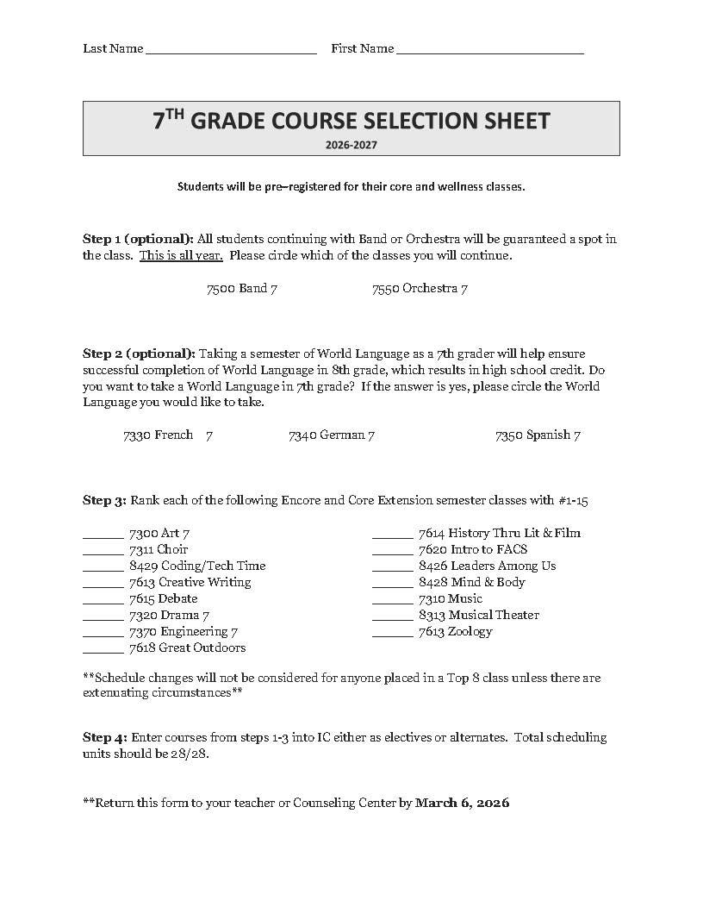
COURSE SELECTION
Rank Semester Classes
2.Enter into
Infinite Campus

Slide 8
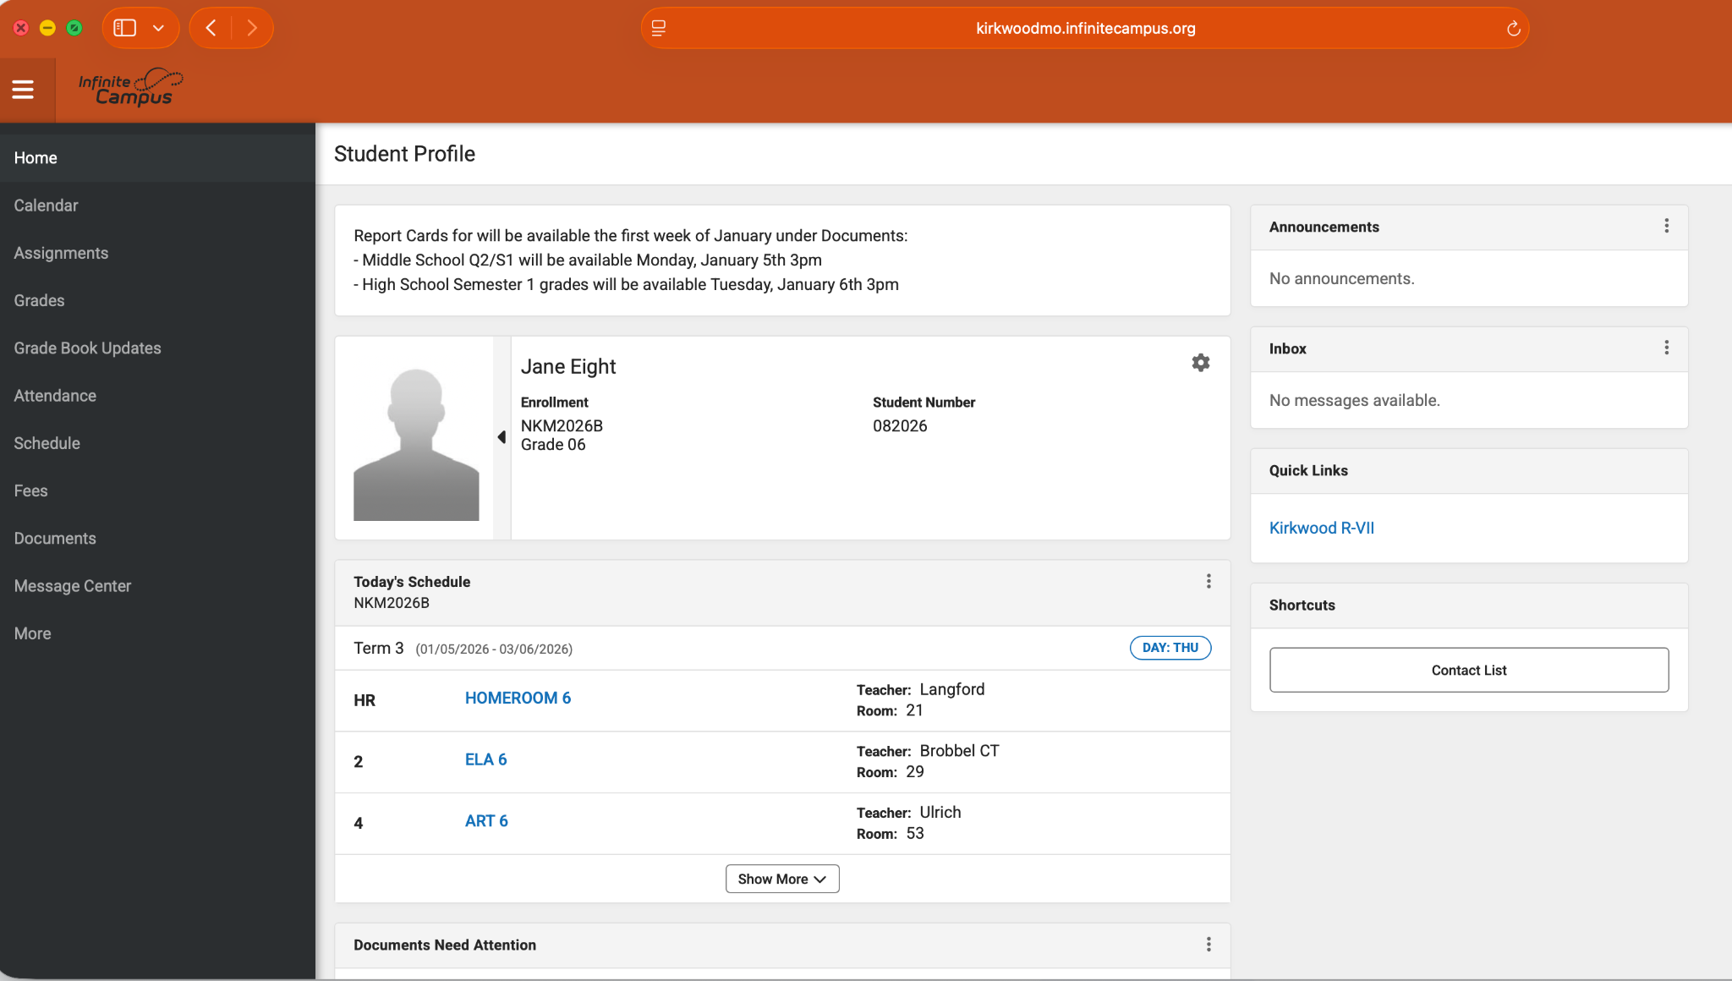
Log into the IC Portal:
http://tinyurl.com/KSDPortal
Log in
Username = 6 digit student ID
Password = 8 digit birthday
Click More on bottom left

Slide 9
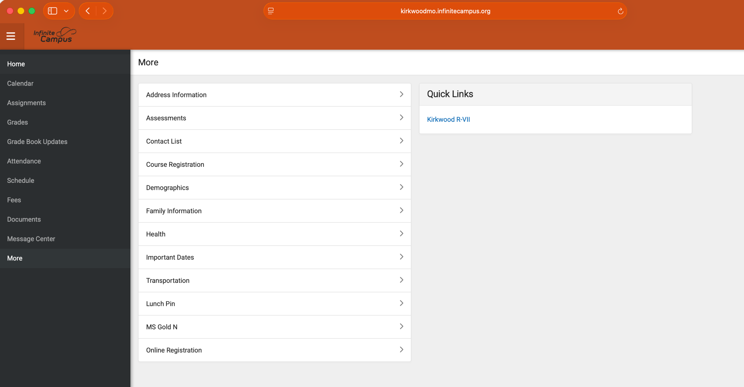
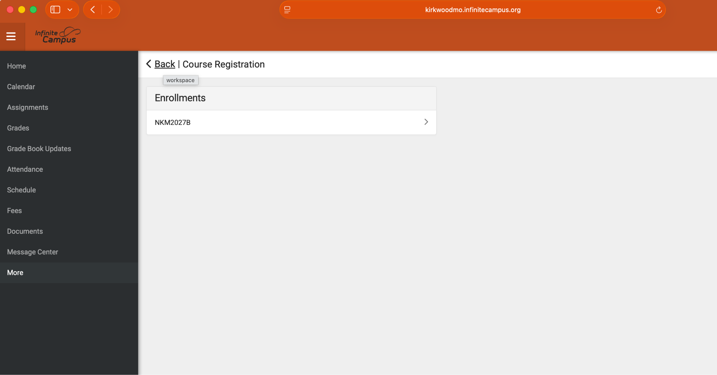
Click “Course Registration”
Click NKM2027B

Slide 10
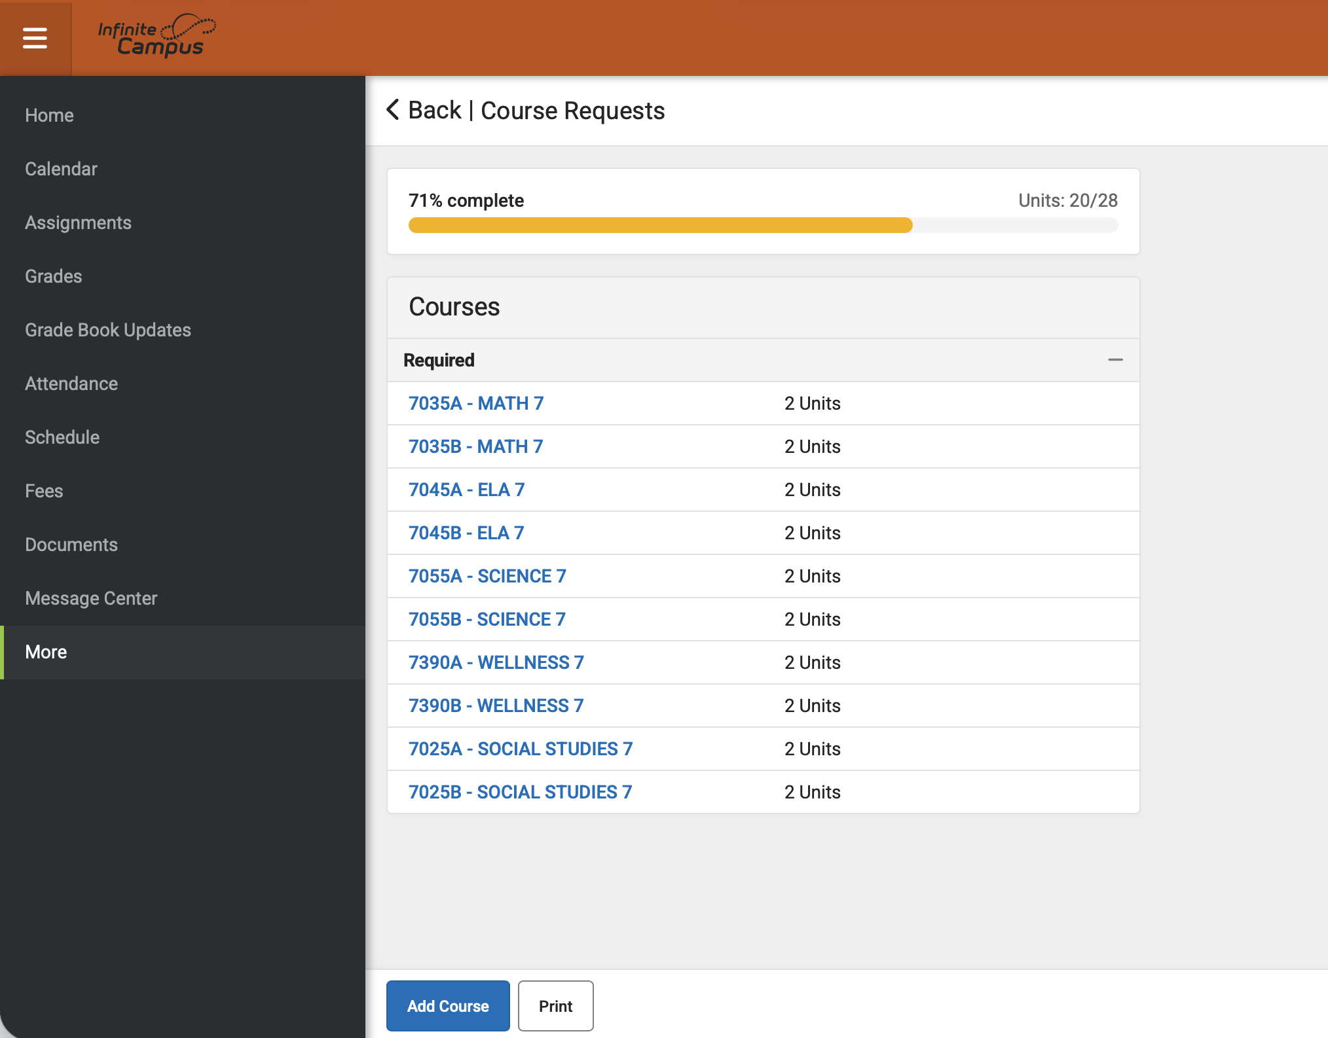
Required Courses have been pre-loaded and total 20 Units.

Slide 11
Request Courses
Click the Add Course button. A list of courses available for selection will be displayed.
Begin typing the name of the course or course # in the Search field. Matching results display below the search field. (Or just click the “+” sign next to class)
Select the desired Course. Information about that course (how many units and a description of the course) displays.
Add the course by clicking Add Request.
Return to the Add Course screen by clicking Back.
Repeat these steps until you have a complete schedule of 28 Units.
Repeat these steps to add Alternate Courses until all Top 8 are entered.

Slide 12
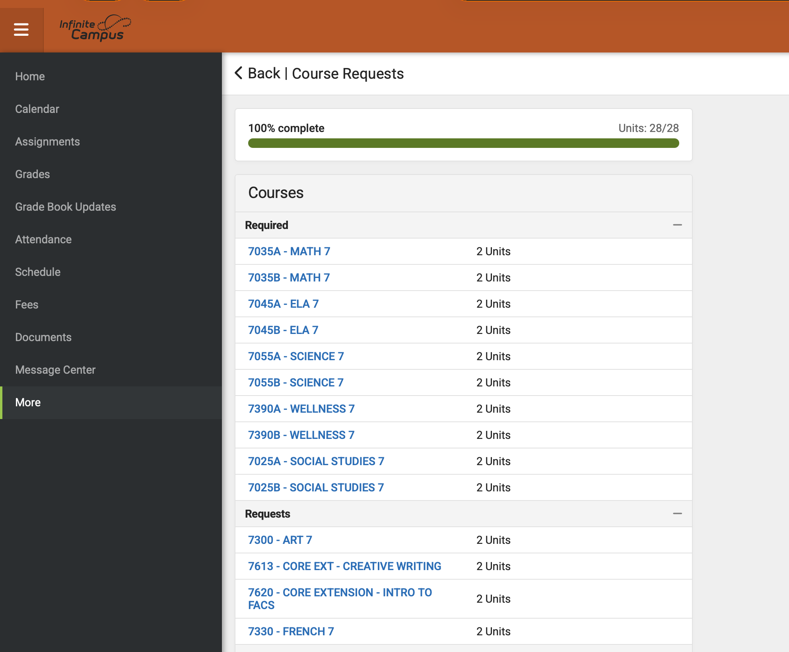
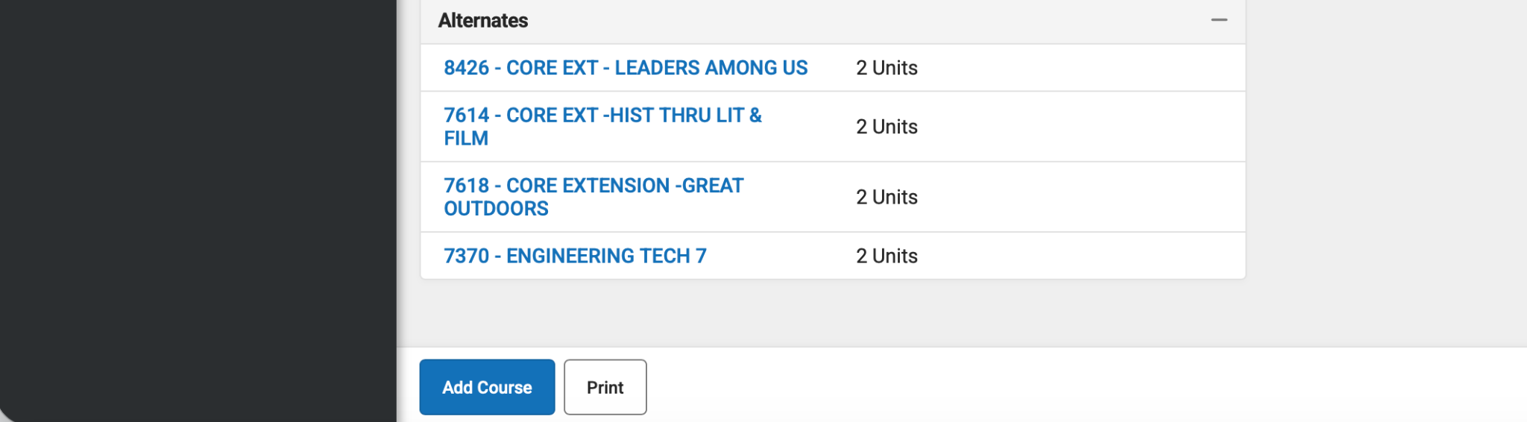
Bar should be 100% and Units: 28/28
4 Alternates listed
Schedule is Complete!

Slide 13
Completed form must be turned in by Friday, March 6th

