Slide 1

Code of Conduct
March 4, 2026
DAC Presentation

Slide 2
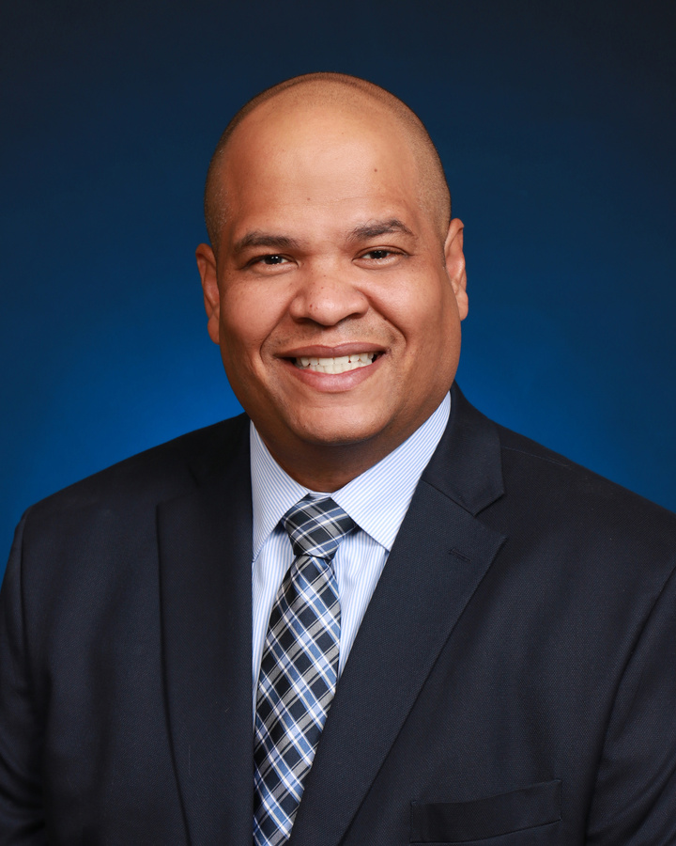





School
Board
Ruben Colón
Krista Goodrich
Board Chair
District 5
Vice Chair
District 2
Jamie Haynes
Jessie Thompson
Donna Brosemer
Dr. Carmen J. Balgobin
Board Member
District 1
Board Member
District 3
Board Member
District 4
Superintendent of Schools

Slide 3
Code of Conduct -- Strategic Alignment
Aligned to the Volusia County Schools 2024-2027 Strategic Plan
Goal: High-Quality Instruction
  Guardrail 1: High-Quality Staff
  Guardrail 2: Safe and Supportive Environment
  Guardrail 3: Resources and Operational Processes
  Guardrail 4: Communication and Community Engagement

Slide 4
Code of Student Conduct & Discipline
MAJOR OVERHAUL -- School Year 2025-2026
  Combined Matrix: Elementary and secondary disciplines unified into one framework
Developmentally Appropriate: Expectations and consequences tailored to each grade level
  Tiered Consequences: Range of options based on severity, frequency, and context
Clear Language: Written so all families and students can easily understand expectations
  Reviewed Annually: Updated each school year and discussed at assemblies, PTA, and SAC
Publicly Available: Published online for all families to access at any time

Slide 5
Code of Student Conduct & Discipline
Discipline offenses and responses defined
Four levels of offenses
Appropriate selection of responses for each level

Slide 6
Code of Student Conduct & Discipline
Level
Level I – Minor
Level
Level II – Intermediate
Level
Level III – Major I
Level
Level IV – Major II

Slide 7
Response to Referrals
School completes investigation
Includes student’s explanation
Administration determines appropriate offense coding(s) as well as response
Parents/Guardians may request a conference with the principal
Level III may be referred to district
Level IV must be referred to district

Slide 8
VAPE Prevention Program
NEW structured intervention program addressing vaping incidents while supporting student wellness
Applies to all students in Grades 4 through 12 district-wide
1st Offense: 9 week Vape Prevention Course
Evidence-based course focused on health impacts and responsible decision-making
2nd Offense and each additional vape offense:
45-Day Off-Campus Alternative Education Assignment

Slide 9
My Words, My Power -- Grades K-2
NEW for 2025-2026: Structured intervention for students in Grades K-2 who make threatening statements
Focus is on EDUCATION, not punishment -- age-appropriate learning over punitive responses
AWARENESS: Students learn that words carry real weight and can impact others emotionally
EMPATHY: Age-appropriate lessons on how threatening words affect the school community
GROWTH: Curriculum helps young students develop healthy communication and emotional regulation
Family Partnership: Parents and guardians are informed and included throughout the process

Slide 10
My Words, My Power -- Grades 3-5
NEW for 2025-2026: Advanced curriculum for Grades 3-5 students who make threatening statements
Focus: Accountability and responsible communication with restorative approach
Threat Assessment: Structured review using age-appropriate protocols to determine level of concern
Restorative Conversations: Facilitated discussions on the impact of threatening words
Skill Building: Targeted curriculum on conflict resolution and emotional regulation
Family Engagement: Parents and guardians as partners with clear communication and support resources

Slide 11
Policy HB 1105
Cell Phone Policy
High School:
Students must put cellphones away (in pocket or bookbag) before entering each class unless directed otherwise by the teacher.
Middle School:
Cellphones/smart glasses/smart watches/Earbuds/any wireless communication device must be off and out of sight in backpack or purse.

Slide 12
CULTURE WALKS
Culture Walks examine the daily experiences of students and staff across classrooms, hallways, common areas, and transitions. Student Services observations focus on adult visibility, interactions, supervision, engagement, discipline practices, schoolwide expectations, mental health supports, counseling, and consistency to assess fidelity of implementation

Slide 13
Timeline for Matrix Review and Policy 208
Review with all stakeholders and request input
April 2026-Input Forms Due
Draft to Superintendent & Cabinet
Draft disseminated throughout system
Required14 day draft review period
Superintendent & Cabinet review & revise
Presentation to School Board/Request to advertise
28 day public notice complete
School Board meeting/Public hearing/Adoption

Slide 14
Provide Conditions that Enhance Student Learning.
Support Services Snapshot
300+ tiered supports delivered district-wide
20+ School Culture Walks
64+ classroom security screenings
Centralized Student Services resource hub via Padlet
Administrative professional learning via trainings and huddles
Weekly structured support at 18 Tier 2/3 schools
Notes:
The Student Services Discipline Team is committed to supporting a safe and supportive learning environment through a structured, systematic approach to student behavior. Using an on‑site support model, the team contributes to the district’s tiered support framework by leveraging discipline data from the Leadership Dashboard to inform how supports are allocated. Progress is monitored through biweekly data updates and quarterly data‑tiering meetings, allowing teams to reassess needs and maximize uninterrupted academic time.
Each week, the team provides structured support to 18 identified Tier 2 and Tier 3 schools across all grade levels. Through this work, more than 300 direct supports have been delivered, including in‑class support for teachers, small‑group instruction focused on social skill development and positive behavior strategies, and the implementation of systems designed to increase on‑task academic engagement for all students.
In addition, the team has conducted 20 School Culture Walks—structured, on‑site observations completed collaboratively with school leadership to review the effectiveness of school‑wide systems, expectations, and climate. These walks highlight effective practices such as strong adult visibility, consistent supervision, and positive interactions, while also identifying opportunities to further strengthen procedures and enhance student engagement.
To support school safety, more than 60 classroom security screenings have been completed using a standardized districtwide process. Two secondary schools are selected each week, with two classrooms per site participating in screenings that include metal detection and the support of Maverick, the K‑9 unit, and his handler, Deputy Akeley.
In addition to school‑based support, the team provides ongoing professional learning for administrators through monthly administrative meetings and weekly principal huddles. To serve as a centralized resource, the Student Services Quick Reference Guide was developed and made available through VPortal. This one‑stop resource includes more than 100 tools and references and has been accessed 1,753 times by 798 users, generating more than 161 hours of engagement.

Slide 15

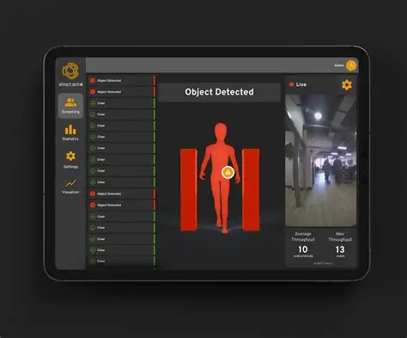
THINGS TO BE AWARE OF….
Xtract One Metal Detection System

Slide 16
School Safety Data
2024 - End of Second 9 Weeks | 2025 - End of Second 9 Weeks
25 Arrests for written threats to kill | 18 Arrests for written threats to kill (28% reduction)
659 FortifyFL Tips | 304 FortifyFL Tips (53% reduction)
28 Weapons | 8 Weapons (71% reduction)
No firearms | No Firearms
 | 196 rooms checked by Maverick
 | 64 classroom security screenings with real-time accountability

Slide 17
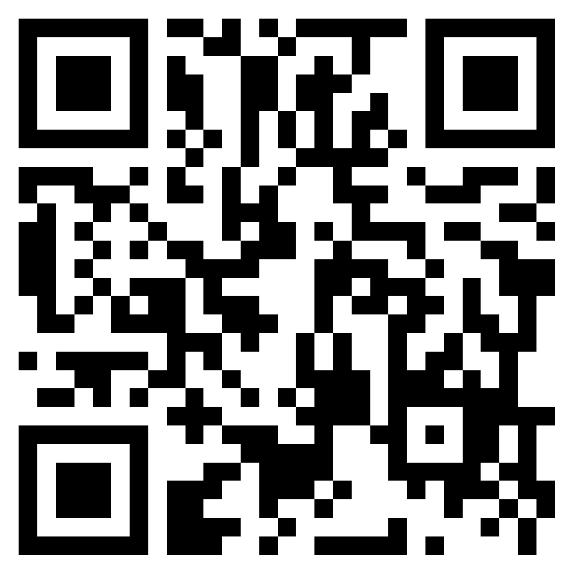
Code of Student Conduct & Discipline Recommendations for Revision

