Slide 1



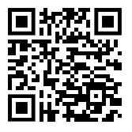
Senior Presentation
Please Sign In using QR Code
March 12, 2026 – Senior Class Meeting
February 24, 2026- Senior Parent Meeting

Slide 2

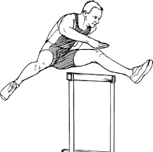
Senior Final Hurdle
Do you still need help getting over the hump and final hurdle of senior year?
Counselors will be hosting our annual Senior Final Hurdle 3/19 from 9 am – 2 pm in the NSHS Media Center.
More information to come from Mrs. Wyche! Stay tuned!

Slide 3
SENIOR EXIT SURVEY
The 2026 Senior Exit Survey will be required of ALL seniors to complete in order to graduate.
The survey will open the first week of April and end on May 1st
Step by Step Directions will be sent to the senior email group and uploaded to Senior Canvas group as well.
Seniors should bring a hard copy of your scholarship letters to Ms. Bryant in the Counseling office.
Counselors will verify completion of the SES- Senior Exit Survey
Cap and Gown can not be distributed until the senior survey is complete

Slide 4
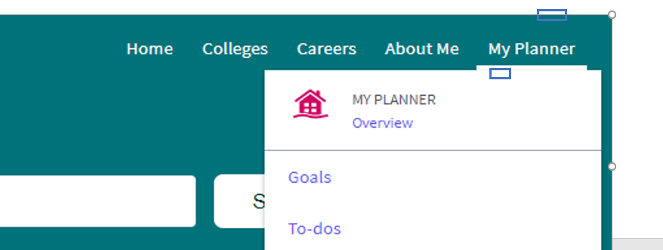
Senior Exit Survey
-Log into ClassLink. Click on the SchoolLinks Icon.
- Locate the Complete Senior Exit Survey/Next Step task and click it.
Many seniors were turned away at Senior Checkout last year for not doing their survey
Don't let that be you!

Slide 5
SENIOR FUN COMMITTEE
Graduation Yard Signs
Remaining events for the year
How can you help?

Slide 6


Slide 7



*A portion of every sign sold goes back to the school.
*Home delivery is available. Get 1-5 signs delivered to your home for one charge of $19.50

Slide 8
SENIOR T-SHIRTS/LANYARD
If you paid your senior dues and HAVE NOT picked up your senior
T-shirt, please stop by Mr. Landreau’s office (A101)and pick that up.
-We have 82 seniors who fall into this category. Ask Mr. Landreau if you are unsure.

Slide 9
Senior Dues
If you haven’t paid your senior dues yet, the link in OSP is still open, and you can still submit those up to 4/3/26 at the current cost ($225). An additional late fee will be added starting on 4/4/24.
The majority of the senior dues goes to the rental cost of the graduation venue. We really need all seniors to be up to date with their dues. If you have questions, or are struggling to pay the senior dues, please reach out to Mr. Landreau.
As of today 2/24, we have 109 seniors that have not paid.

Slide 10
DIPLOMAS:
Seniors need to confirm name spellings for their Diplomas by Friday, 3/13/26.
If they did not confirm with Ms. Bryant during senior conferences, they can come and confirm with Mr. Landreau on 3/12 and 3/13. Please know that if they do not confirm, we will use the name and spelling that is listed in Infinite Campus for your diploma.

Slide 11
Graduation Updates
Graduation is on Wednesday, May 13th at 9:00 am at The Georgia State Convocation Center
Seniors will receive 12 tickets for graduation
Graduation practice is on Tuesday, May 12th from 4:30-6:30 pm at The Georgia State Convocation Center
Please note: ATTENDACE AT GRAD PRACTICE IS MANDATORY!

Slide 12
Graduation Dress Code
Students must have their cap and gown with them on Wednesday in order to participate in the ceremony. Students that do not have their cap and gown will not be allowed to participate.
Pro tips for cap and gowns and what to wear.
  Gowns should be taken out of the bag they were shipped in and allowed to “fall out” a couple of days before the event. The gowns will have folds and creases on them and you want to make sure those are gone before the event.
  You can always take an iron on low heat to remove the folds and creases.

Slide 13
Graduation Dress Code
Dress Code: Students not in dress code will not be allowed to participate in the ceremony. The Dress Code for the graduation ceremony, regardless of gender, is formal, and is what one would expect to where to a formal ceremony. White dress shirt with dark slacks, dark socks and dark dress shoes /tie are preferred.
  Dress or skirt - dresses should not hang below the graduation gown hem
  Dark or neutral shoes - Flat shoes are highly recommended, you will do a lot of walking.
  No athletic shoes.

Slide 14
Senior Important Dates
Friday, May 1– Senior Luncheon and Senior Olympics
Tuesday, May 5th- Seniors will have their last A Day Majors
Wednesday, May 6^{th-} Seniors will have their last B Day Majors
Wednesday, May 6th Last day for any senior that does not need Credit recovery or Majors make ups.
Thursday and Friday, May 7th and 8th – Senior Recovery- By appointment only
Friday, May 8th- Senior grades posted by midnight
Friday, May 8^{th-} Last day for Seniors to return tablets/textbooks to Mrs. Zachry.

Slide 15
Important Dates (continued)
Monday, May 11th- Senior Check out
Tuesday, May 12th – Seniors who sign up to participate in the Senior Elementary School Walks will come to school, in their cap and gown and go with Mr. Hanson to our cluster feeder schools
Tuesday, May 12th - Practice Graduation (4:30-6:30 pm) at The Georgia State Convocation Center
Wednesday, May 13th - GRADUATION!!! (9 am) at The Georgia State Convocation Center (students will arrive between 7:45 and no later than 8:15 am)

Slide 16
Cap and Gown Delivery & Distribution
Cap and Gown can not be distributed until the senior survey is complete
Remember to order your caps and gowns directly from 3rd Ascent. This is not included in the cost of the senior dues. You MUST have a cap and gown to participate in the ceremony.
Late fees will be added to any order placed after 3/1/26. As our gowns are custom made and need to now be rushed through processing.
Deadline to order with late fee is 4/3/26! Please do not get stuck without a Cap and Gown.
As of today, we still have over 50% of seniors that HAVE NOT ordered their Cap and Gown.
Cap & Gowns and Graduation tickets will be distributed during the senior
check out once the check out form is completed and turned into Mr. Landreau.
www.3rdascent.com is the website you order from. It is NOT on OSP and is not included in Senior Dues

Slide 17

Honor Cords and Stoles
If your student has a cumulative 4-year GPA of 88 or higher, they are considered an Honor Graduate and qualify for an Honor Stole. Students will have an opportunity to purchase their honor stole from now until 4/3/26 on OSP.
Honor cords for the various honor societies and clubs will be given out at Senior Honors Night or at the Senior Check out.
Please do not buy random cords off Amazon. We have a list of the approved cords to be worn and will ask students to remove anything that is not approved for the ceremony.

Slide 18


SENIOR WEEK
Monday, April 20- Friday, April 24
Different Themed days for dress up and activities (will be announced soon)
Monday, April 20th will be Pajama Day. All other themes are coming soon!!
We will have games, activities, and food throughout the week to celebrate our seniors, all leading up to PROM on Friday, April 24th.

Slide 19
PROM
Remember that Prom is a North Springs Juniors & Seniors
Date: Friday, April 24, 2026
Location: Guardian Works, 755 Echo St NW, Atlanta, GA 30318
Tickets are currently available for $125
Tickets can be purchased on GoFAN. The link is on the main page of the school website with a PROM logo.
Important reminders about PROM:
-All ticket sales are on GoFAN
-NO DAY OF TICKET SALES
-Students must be in good standing academically
-All eligible students will be able to attend from 7:00 pm to 11:00 pm.
-If you are bringing a guest from another school, you must fill out the guest form, available outside the media center.
-If you have questions, please reach out to Ms. Zachry (zachryk@fultonschools.org )

Slide 20
Testing
End of Course Milestone Exams
  Per state policy these exams are 20% of your 2nd semester grade
  EOC Courses: Biology, Algebra 1, US History, Lit/Comp II
    These are mandatory if you are currently taking the course or re-taking the course
AP Exams
  AP Exams are required for students taking the AP course
  $40 fee for any student who does not take their AP exam

Slide 21

Note from Mr. Hanson
With Graduation just around the corner, now is the time to focus, dig deep, and keep your head in the game. Last week, we sent out emails to all seniors that are failing classes and as such, jeopardizing their ability to walk across that stage on May 13th. We are running out of time to get work turned in and grades raised. We want to see you ALL graduate and will do everything in our power to help you, but you must also do your part in this final stretch of the journey. Come to class. Stay in Class. Turn in your work! Let’s make it to that finish line together!

Slide 22
Graduation Celebration Video
We are creating a video/slide show of all our 2026 graduates to help celebrate this wonderful achievement. This video would have each student, with a picture of them as they were young (like just starting school), and a picture of them now, as they get ready to graduate and start the next phase of their lives.
We are asking that every senior parent send two pictures of their students, one of them when they were young and their senior picture.
We will begin collecting these after spring break. Please send your pictures to hansonm@fultonschools.org

Slide 23
Note from Mrs. Zachry
Tablet and textbook collection will start after spring break.
As you finish your classes and no longer need your books/tablet, please return to the media center.

Slide 24
Notes from Dr. Pritchett
College or military acceptance letters are still being collected on A Days ONLY during the beginning of your lunch period. Please do not drop them off to anyone other than Dr. Pritchett (D218). You may turn them in to Dr. Davis if Dr. Pritchett is absent.
The deadline for at least one acceptance letter is due Monday 3/12. Seniors can bring them to Dr. Pritchett during their lunch period.
Once you submit that first letter by deadline, you will be able to submit other letters through April (TBD) please stay tuned for the exact date.

Slide 25
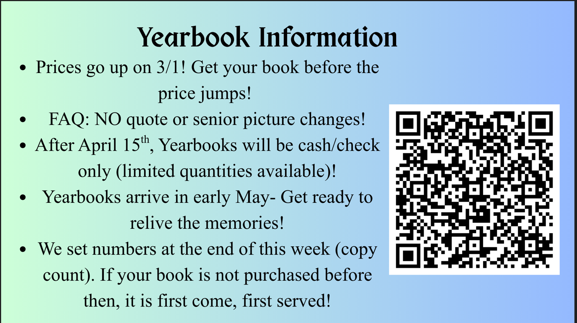

Slide 26



Pot of Gold Gala Needs You!
Join us for the 2026 Spartan Spectacular Pot of Gold Gala and Auction at Mutation Brewing on Saturday, March 7th at 7 pm. This will be an adult-only night of fun! Enjoy bidding for great items and experiences, a delicious buffet from Kid Cashew, and great company. This is Spartan Nation PTO's ONLY fundraiser. Buy your tickets today at potofgold.givesmart.com!
The Spartan Spectacular online silent auction launched a few days ago at potofgold.givesmsart.com and NOW is the time to jump in to bid, rebid and donate if you get outbid. Your participation is vital for this fundraiser! All of the proceeds enrich and enhance our classrooms each year. Last semester, Spartan Nation paid for critical materials for special science experiments, musical instruments, important supplies for ceramics classes, and AP test study materials. Your donations impact every curriculum area!
Please buy tickets, bid and donate today!
https://potofgold.givesmart.com

Slide 27


Slide 28
Orange Envelope
more information to come out after Spring Break
(must be post marked by May 1st to guarantee it will be included)

Slide 29
QUESTIONS?

Slide 30
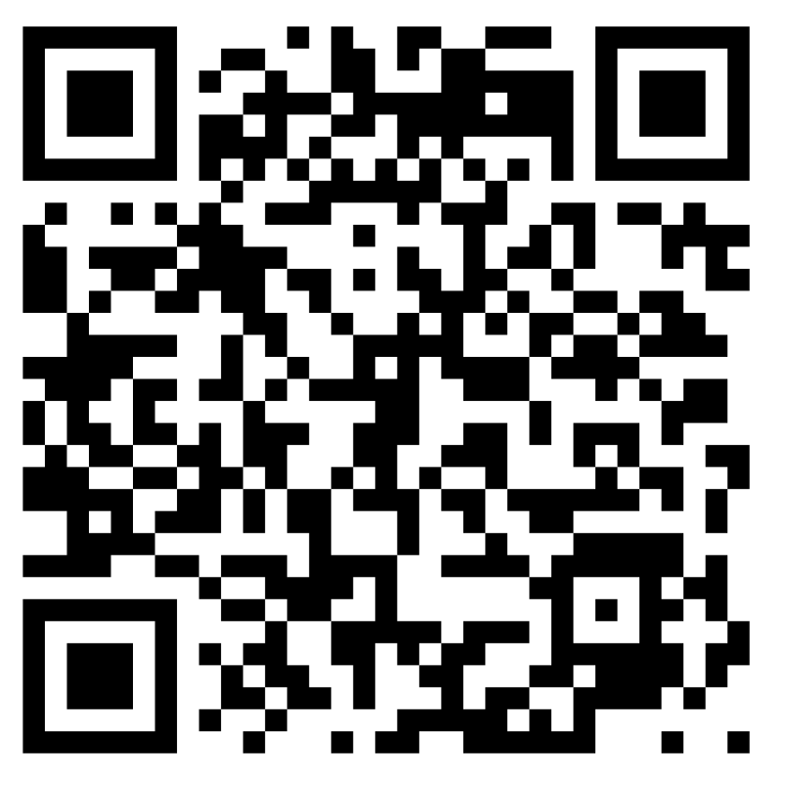
School Climate Survey- Parent QR

Slide 31
School Climate Survey- Parent Survey

Slide 32
