Slide 1
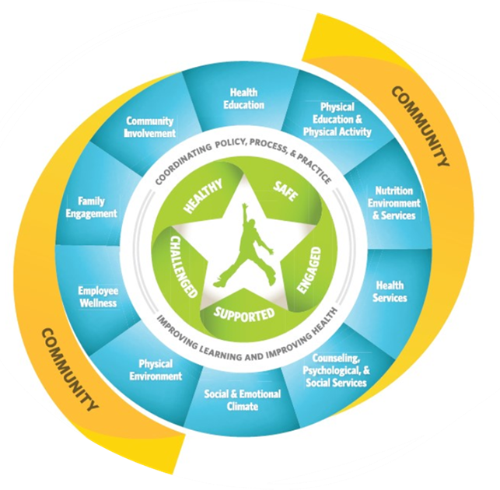
School Health Advisory Council
February 26, 2026

Slide 2

SHAC Meeting #3 of the 2025-2026 School Year

Slide 3
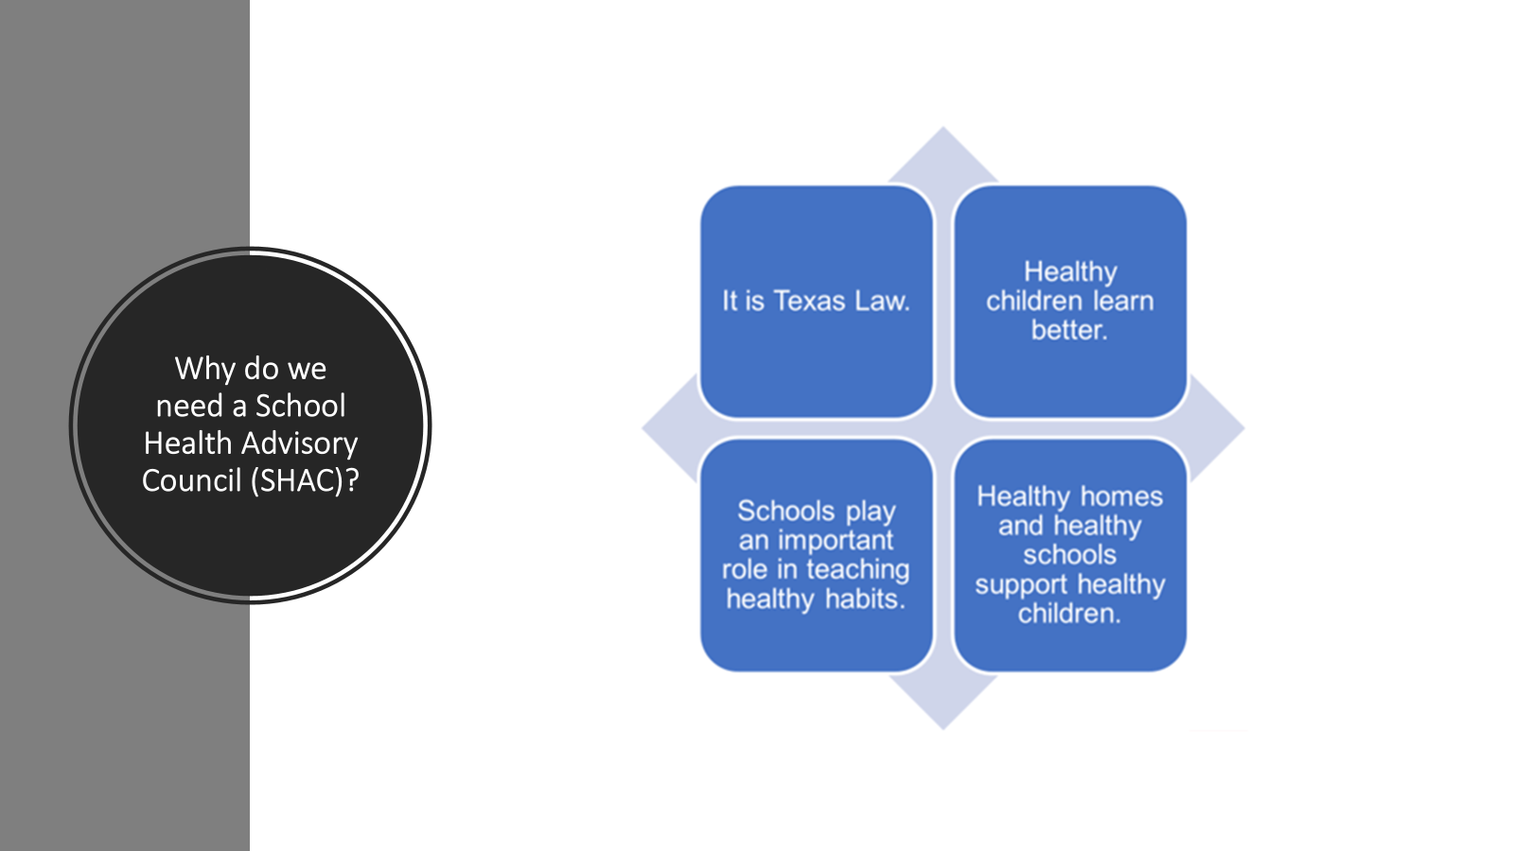

Slide 4
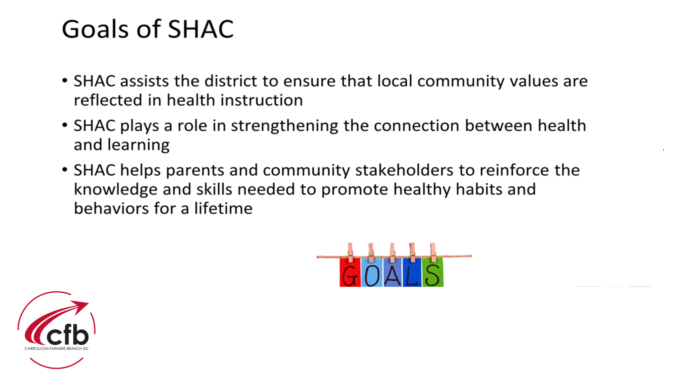

Slide 5
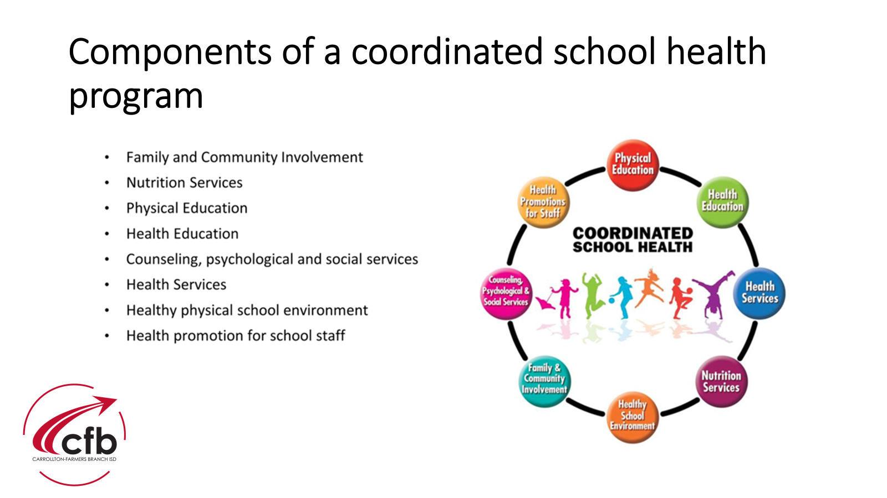

Slide 6


Slide 7
Appointed SHAC Members for
2025-2026 School Year
Parents/Community Members
April Hooper-Christenson
Zoher Bharmal
Lyat Mizrahi
Maria A Retiz
Caleb Rosier
Lacey Tomanek
Elizabeth Aviles
Gwen Perkins
Melissa Munoz
Jaclyn Poole
Josh Carter
Dr. Lakshmi Ananthakrishnan
CFBISD Staff
Leon Sulak
Rachael Freeman
Sandra Lieck
Sylvia Mazuera
Laura Brookover – Ybarra
Renee Putter
Jonathan Wilk
Kim Graham
Linda Villemarette
Veronica Morales
Board of Trustee Representative
Ileana Garza Rojas

Slide 8
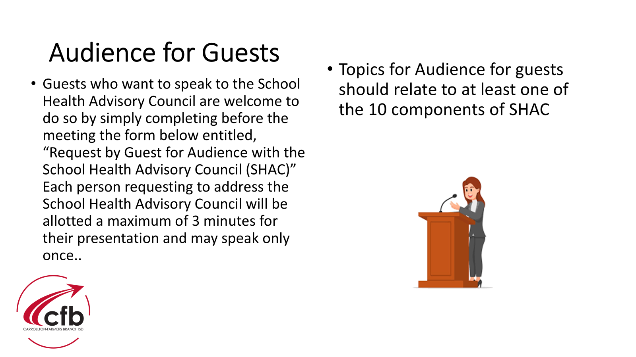

Slide 9

Approval of Minutes
Minutes from last meeting-
October 23, 2025
Minutes are available at sign-in table for review.

Slide 10


Slide 11
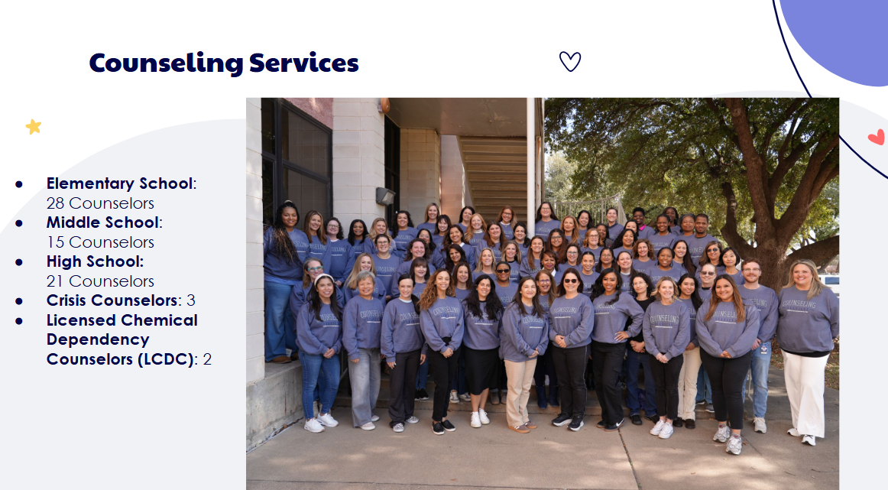

Slide 12


Slide 13


Slide 14
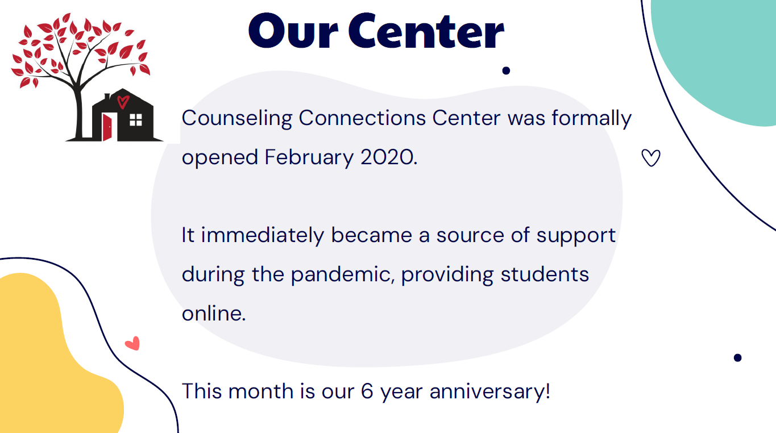

Slide 15
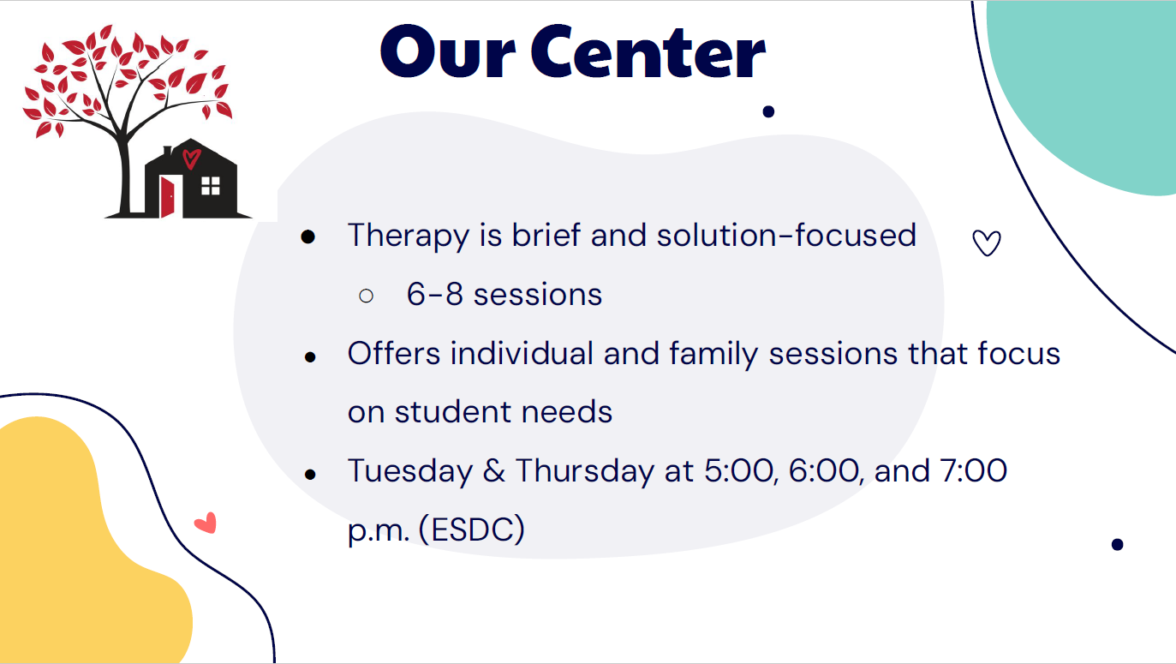

Slide 16


Slide 17


Slide 18


Slide 19


Slide 20
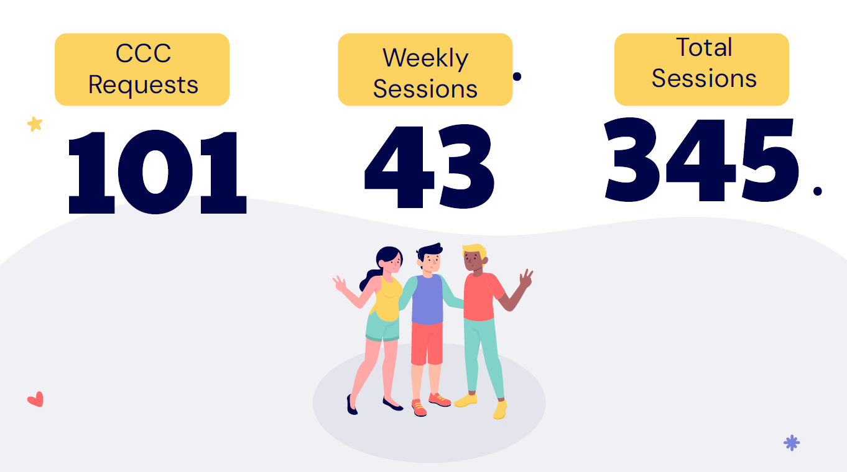

Slide 21


Slide 22
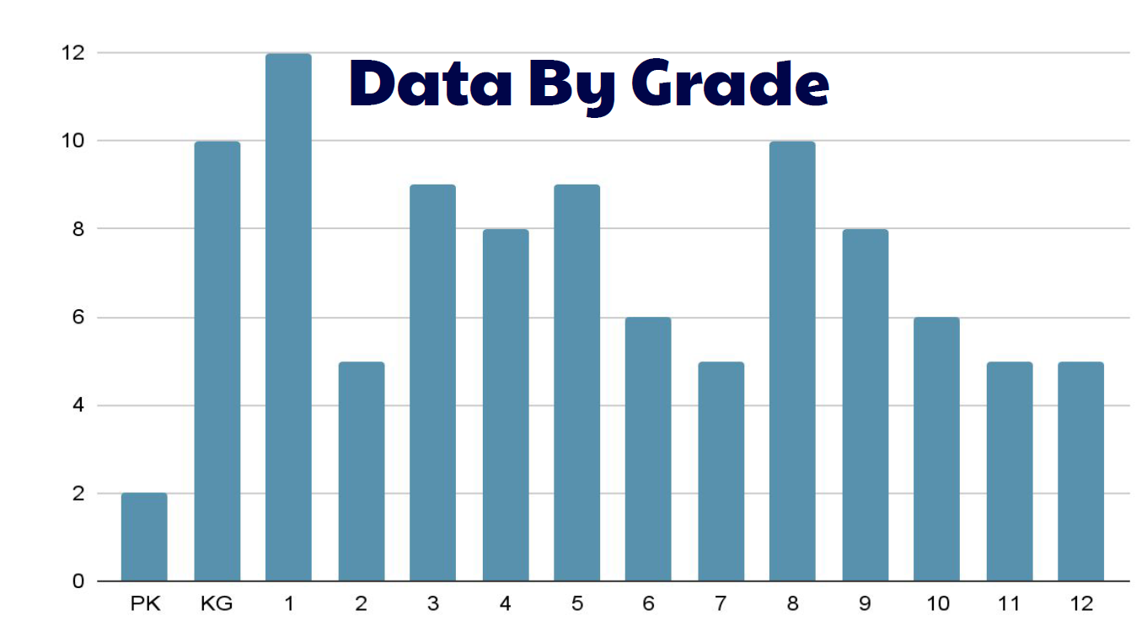

Slide 23


Slide 24


Slide 25


Slide 26
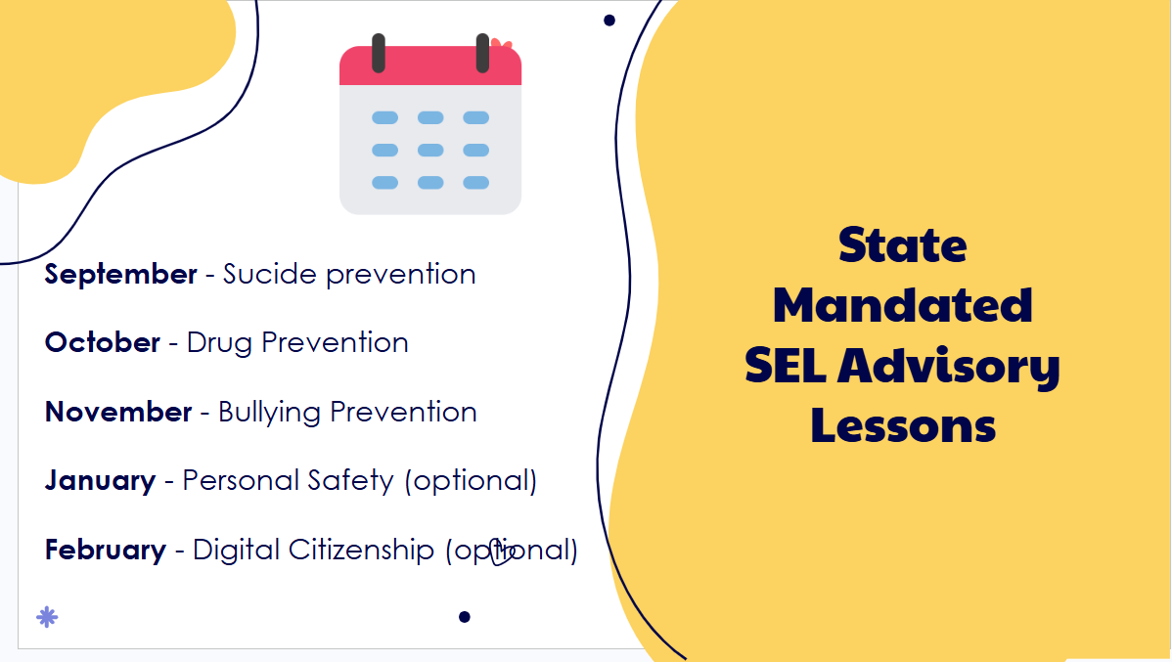

Slide 27


Slide 28
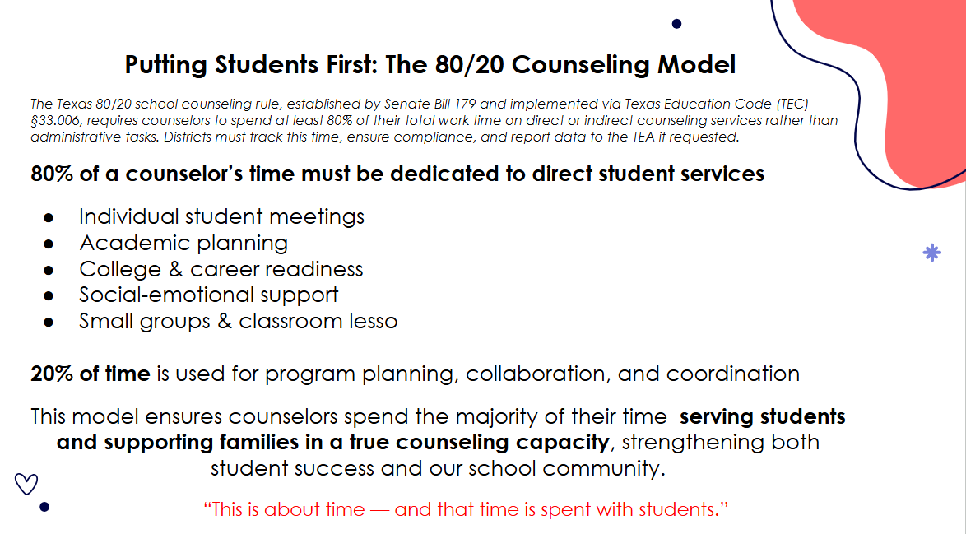

Slide 29
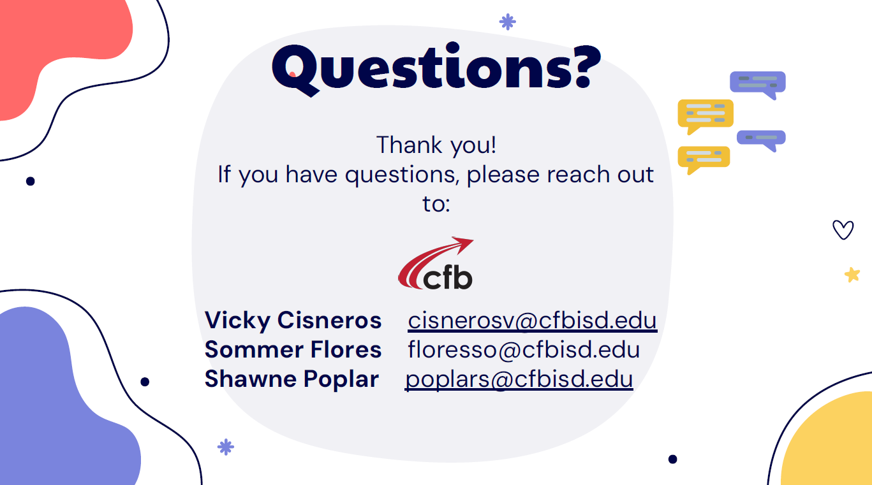

Slide 30

Discussion –
Local Wellness Policy Review/Revision
Kristen Hess, Director of Student Nutrition; Laura Brookover-Ybarra, Assistant Director - SNS Nutrition

Slide 31
SHAC Curriculum Review Committee Report
April Hooper-Christenson, SHAC Chair
Zoher Bharmal, SHAC Co-Chair
Gwen Perkins, SHAC Member
Dr. Lakshmi Ananthakrishnan, Member
Kim Graham, Member

Slide 32
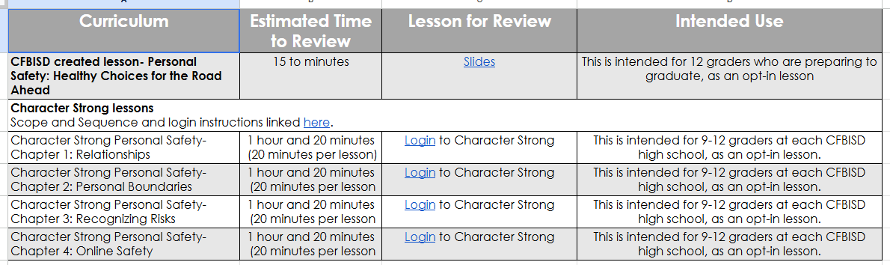
Curriculum Reviewed:

Slide 33
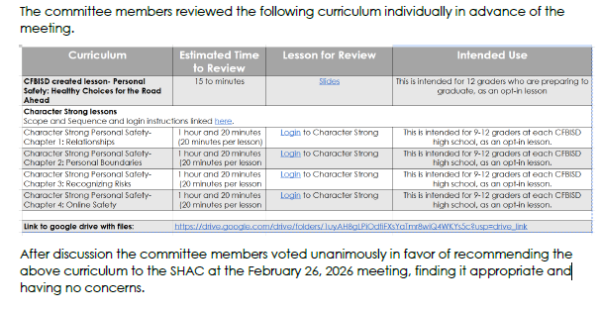
Committee Report:

Slide 34

Discussion -
Topics to be considered for future meetings:

Slide 35
