Slide 1

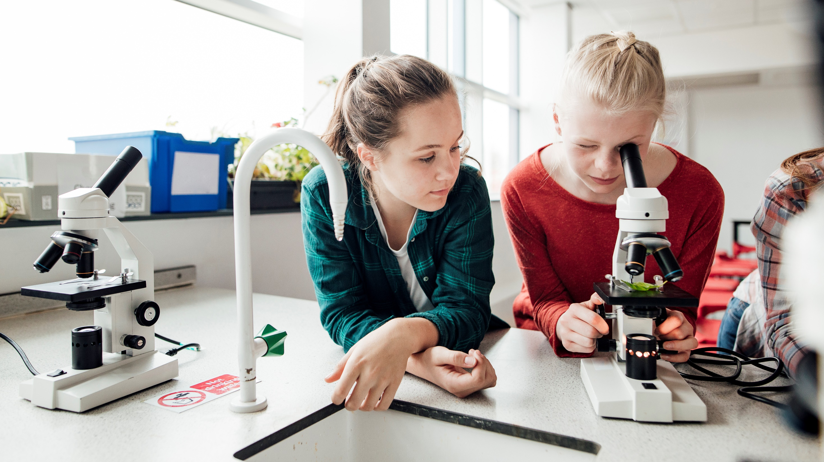
5th Grade Visit to
CMMS
Please sit with your group

Slide 2
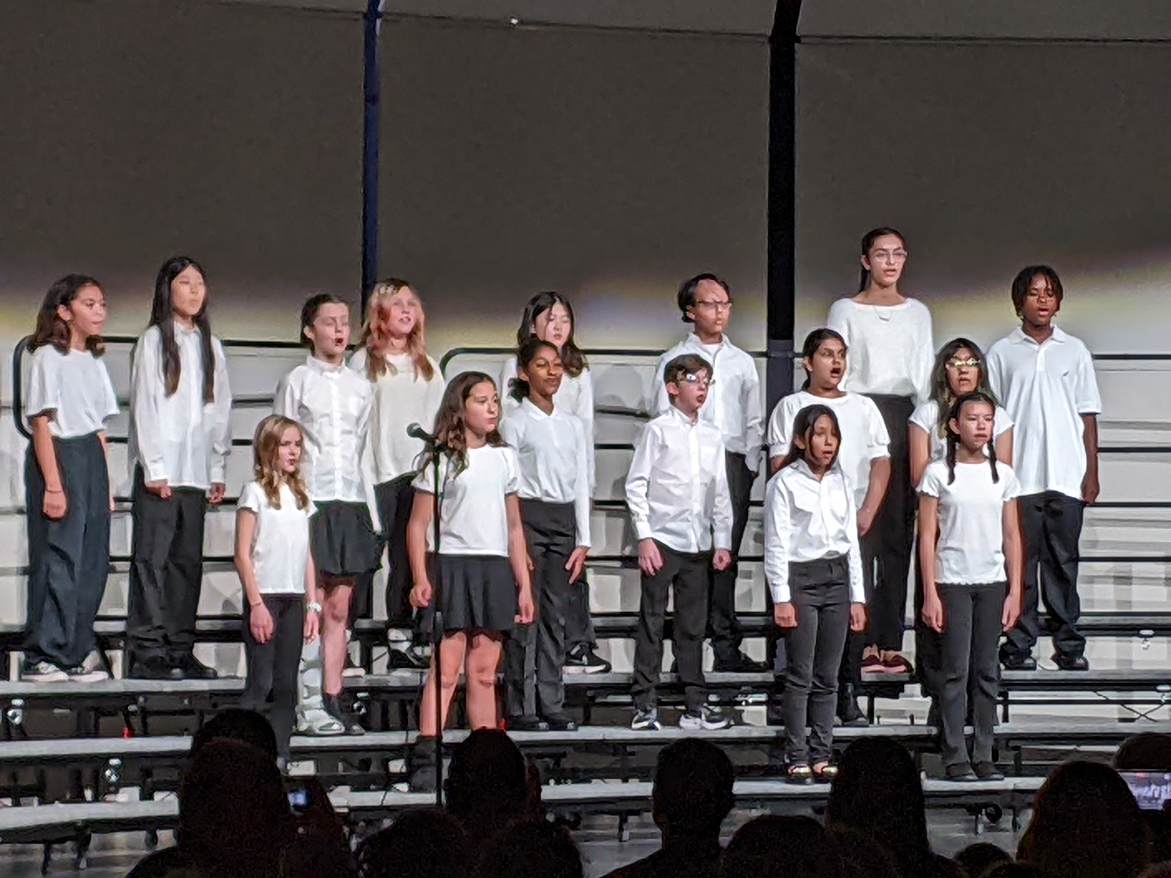
Choir Interlude
Mr. Benabid & Students
It is a year-long elective
No prior experience required!

Slide 3

Welcome 5th Graders!
Hellos & Welcomes
Introductions
Purpose of Today’s Visit

Slide 4
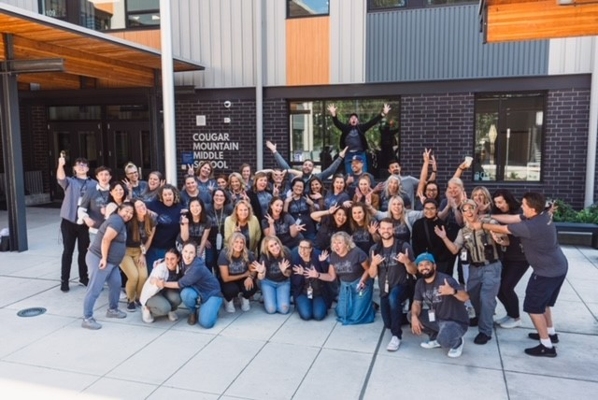

Slide 5



Commons
Tour
End of Event

Slide 6
What other Schools do Students Come from?
NC
CR
IVE
District Programs

Slide 7
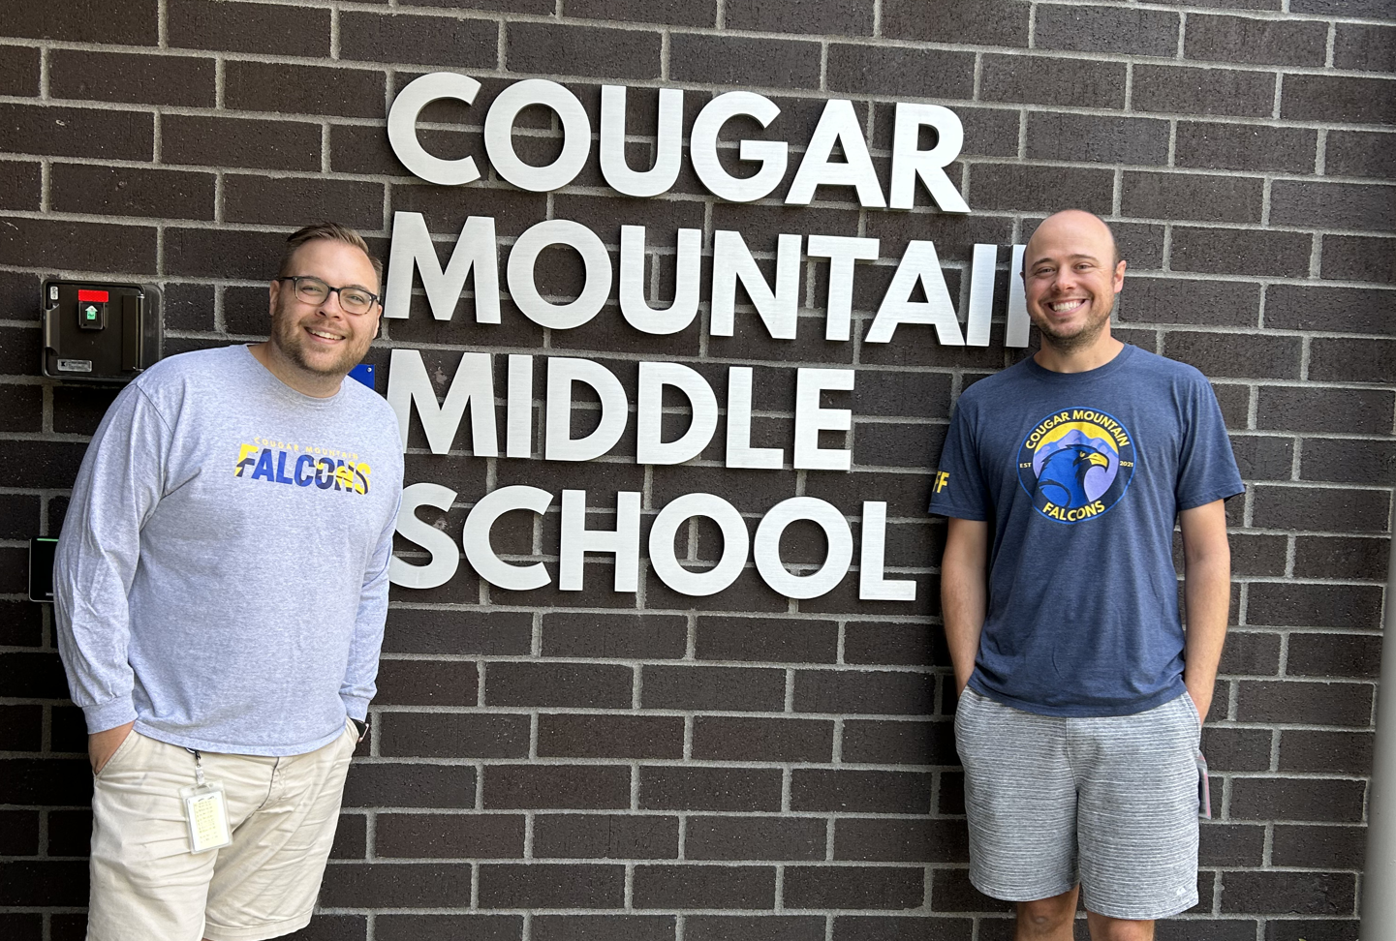
Counseling Department
Mr. Grow & Mr. Hemker
Role of Middle
School
Counselor
Support Offered
for Students

Slide 8
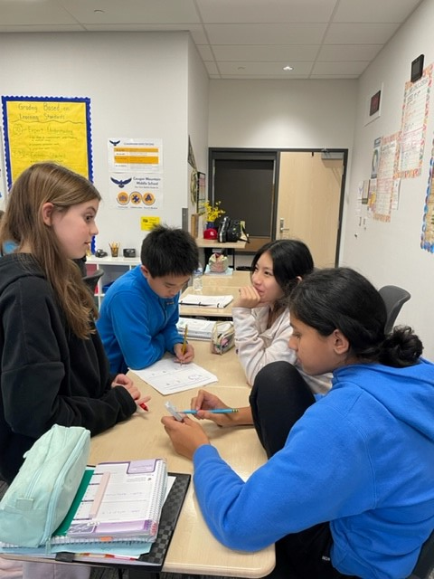
Core Classes
Mr. Hemker & Mr. Grow
Core Classes

Slide 9
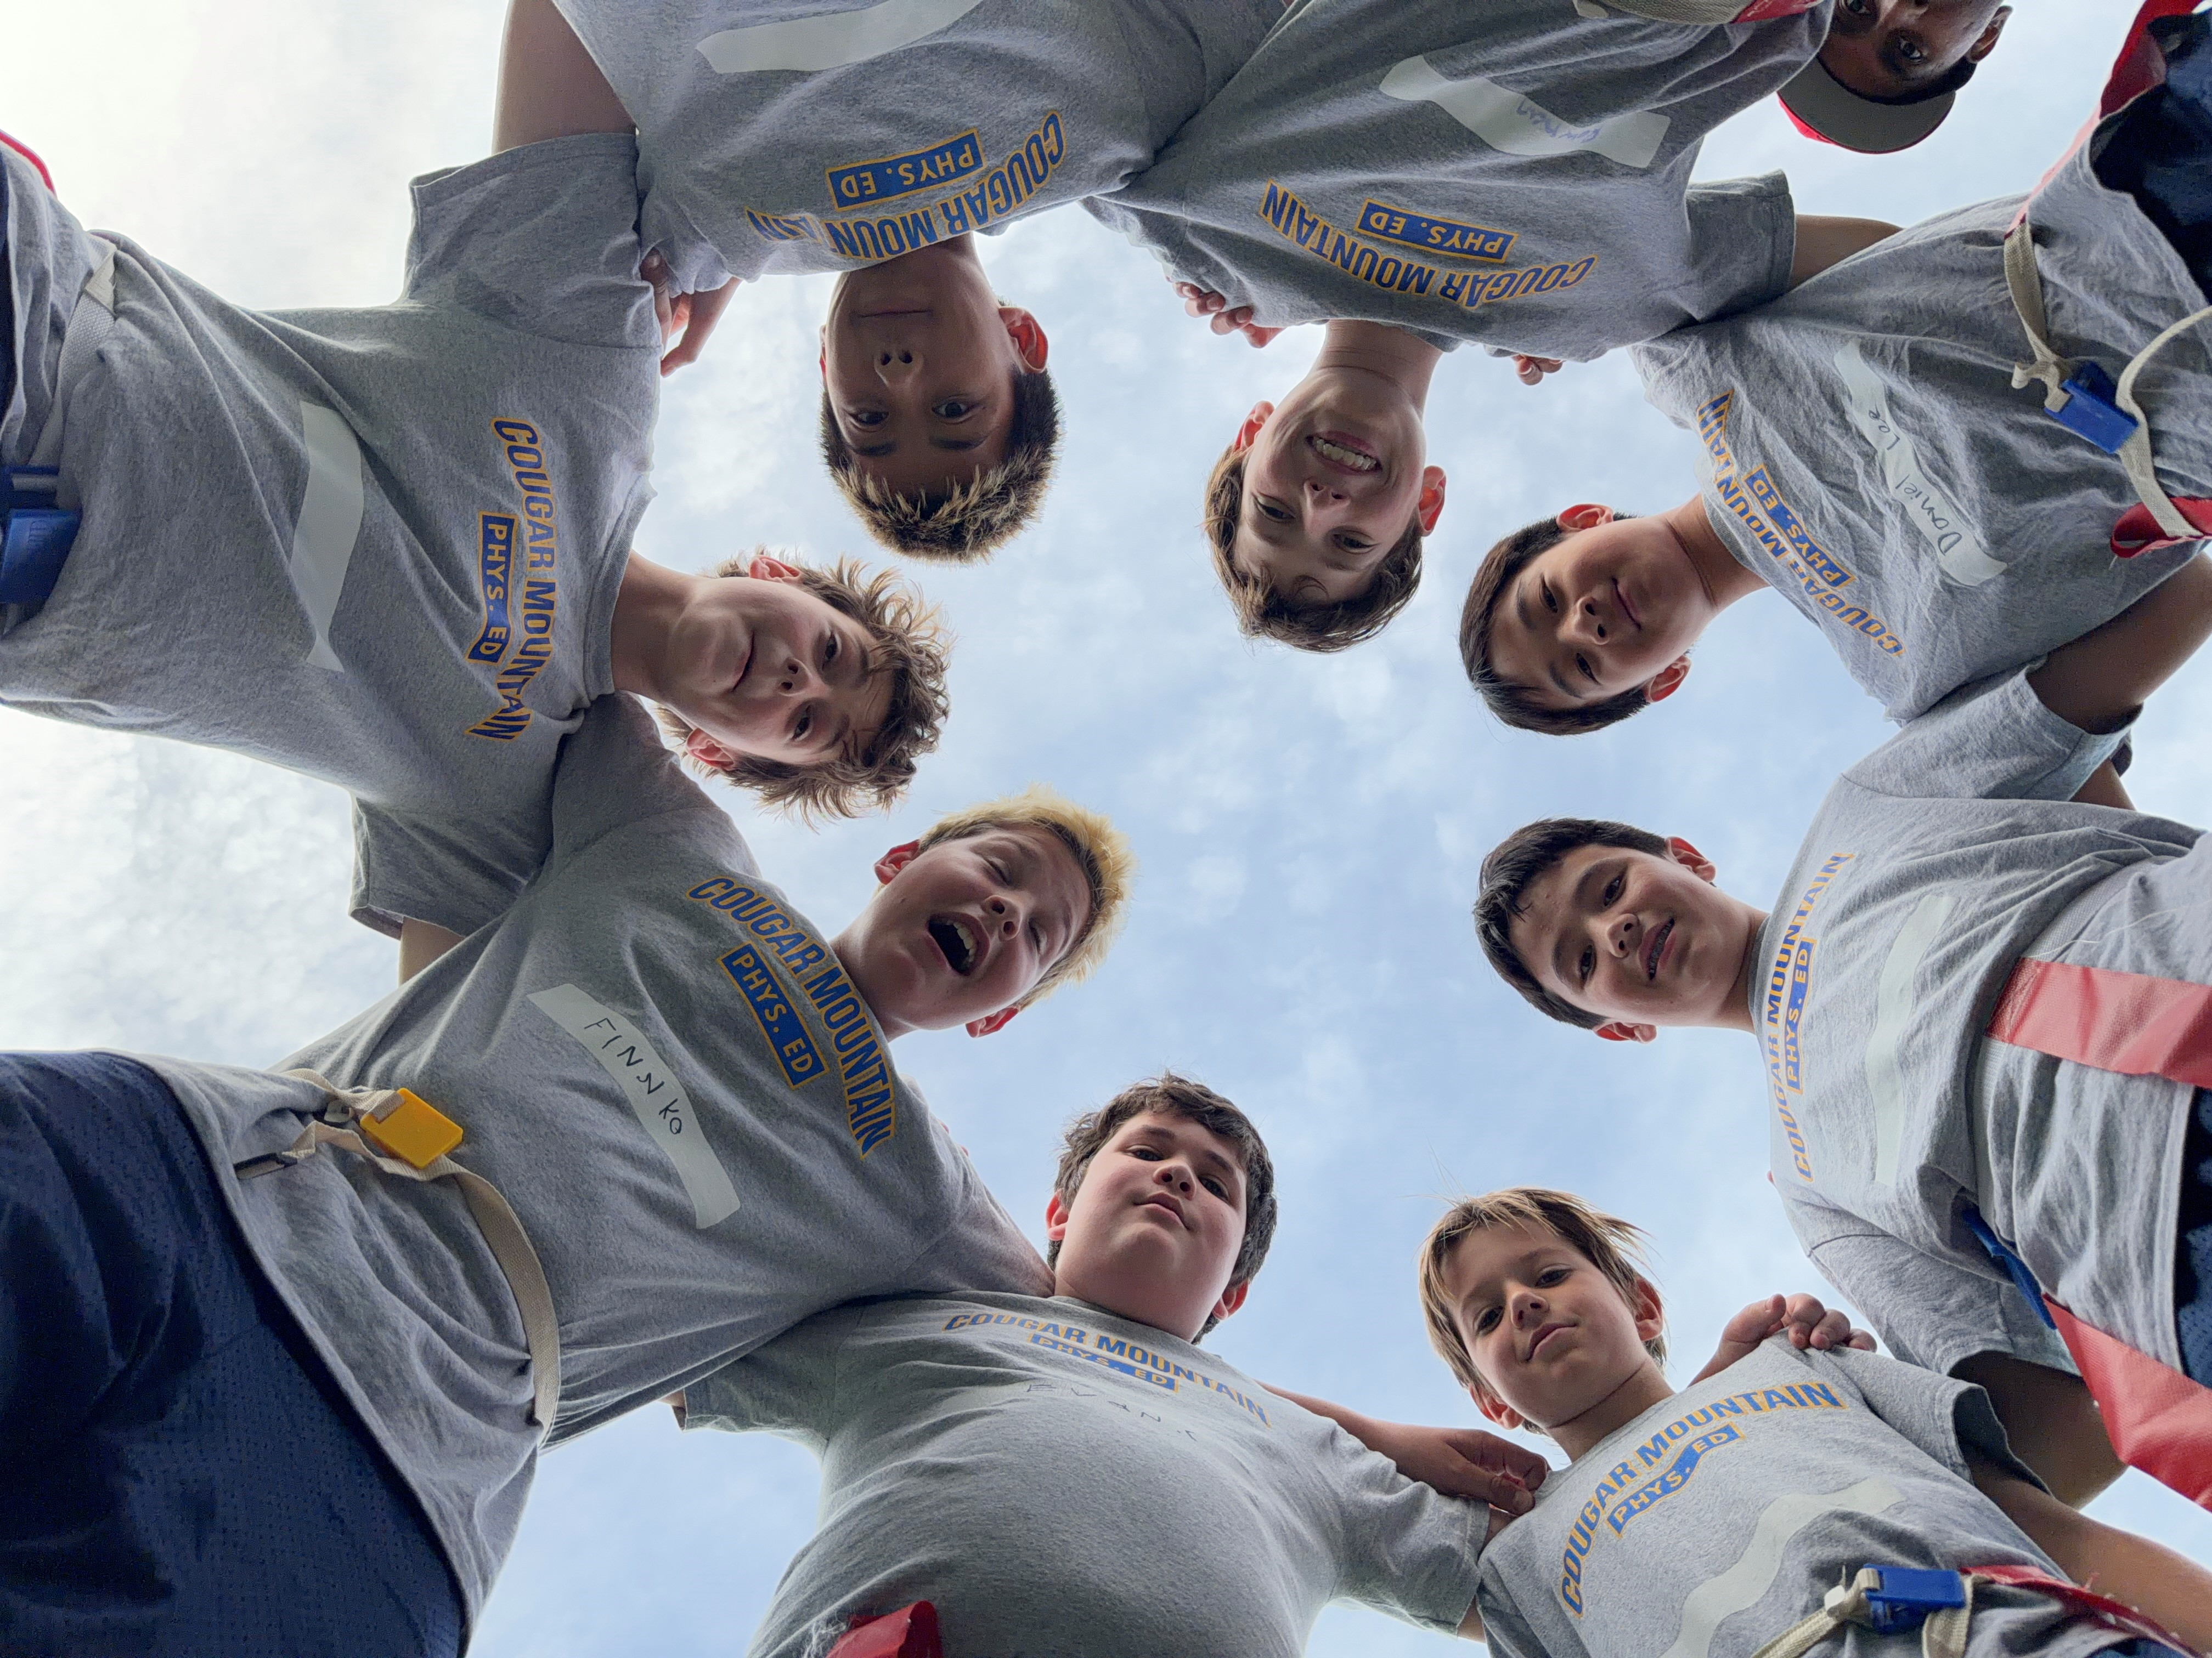
Health & PE mr. Hemker & mr. grow
Every Student takes:
1 Trimester of Health
2 Trimesters of PE

Slide 10
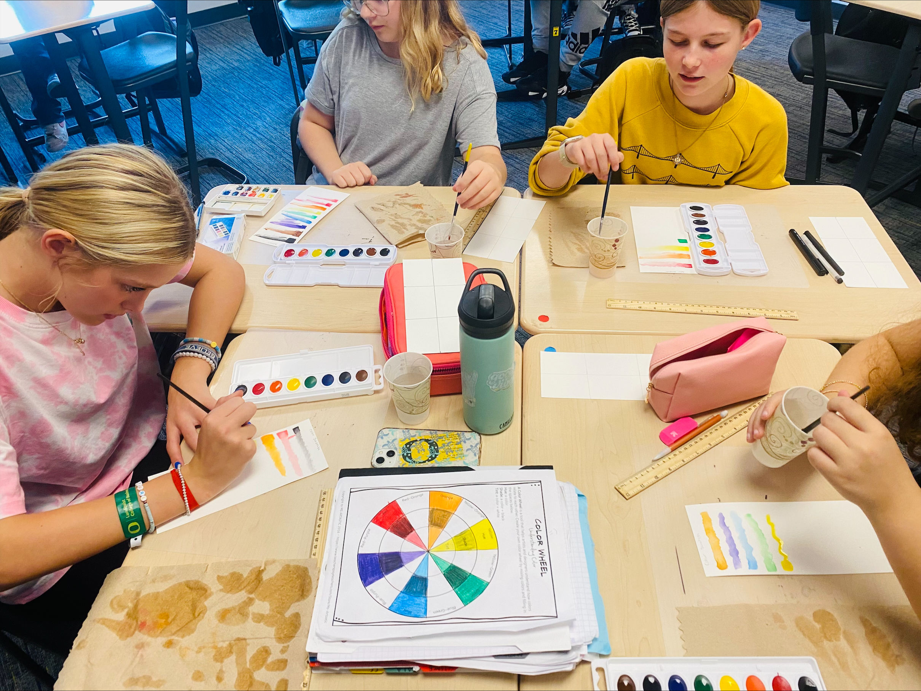
Trimester Electives
Mr. Hemker & Mr. Grow
Exploratory Art
Intro to Drama
Intro to Leadership

Slide 11
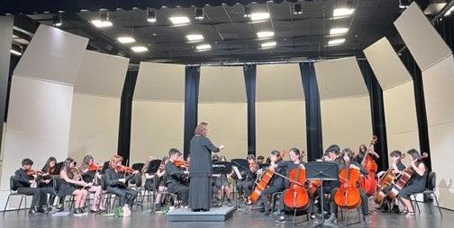
Orchestra
Ms. Swanson & Students
It is a year-long elective
No prior experience required!

Slide 12
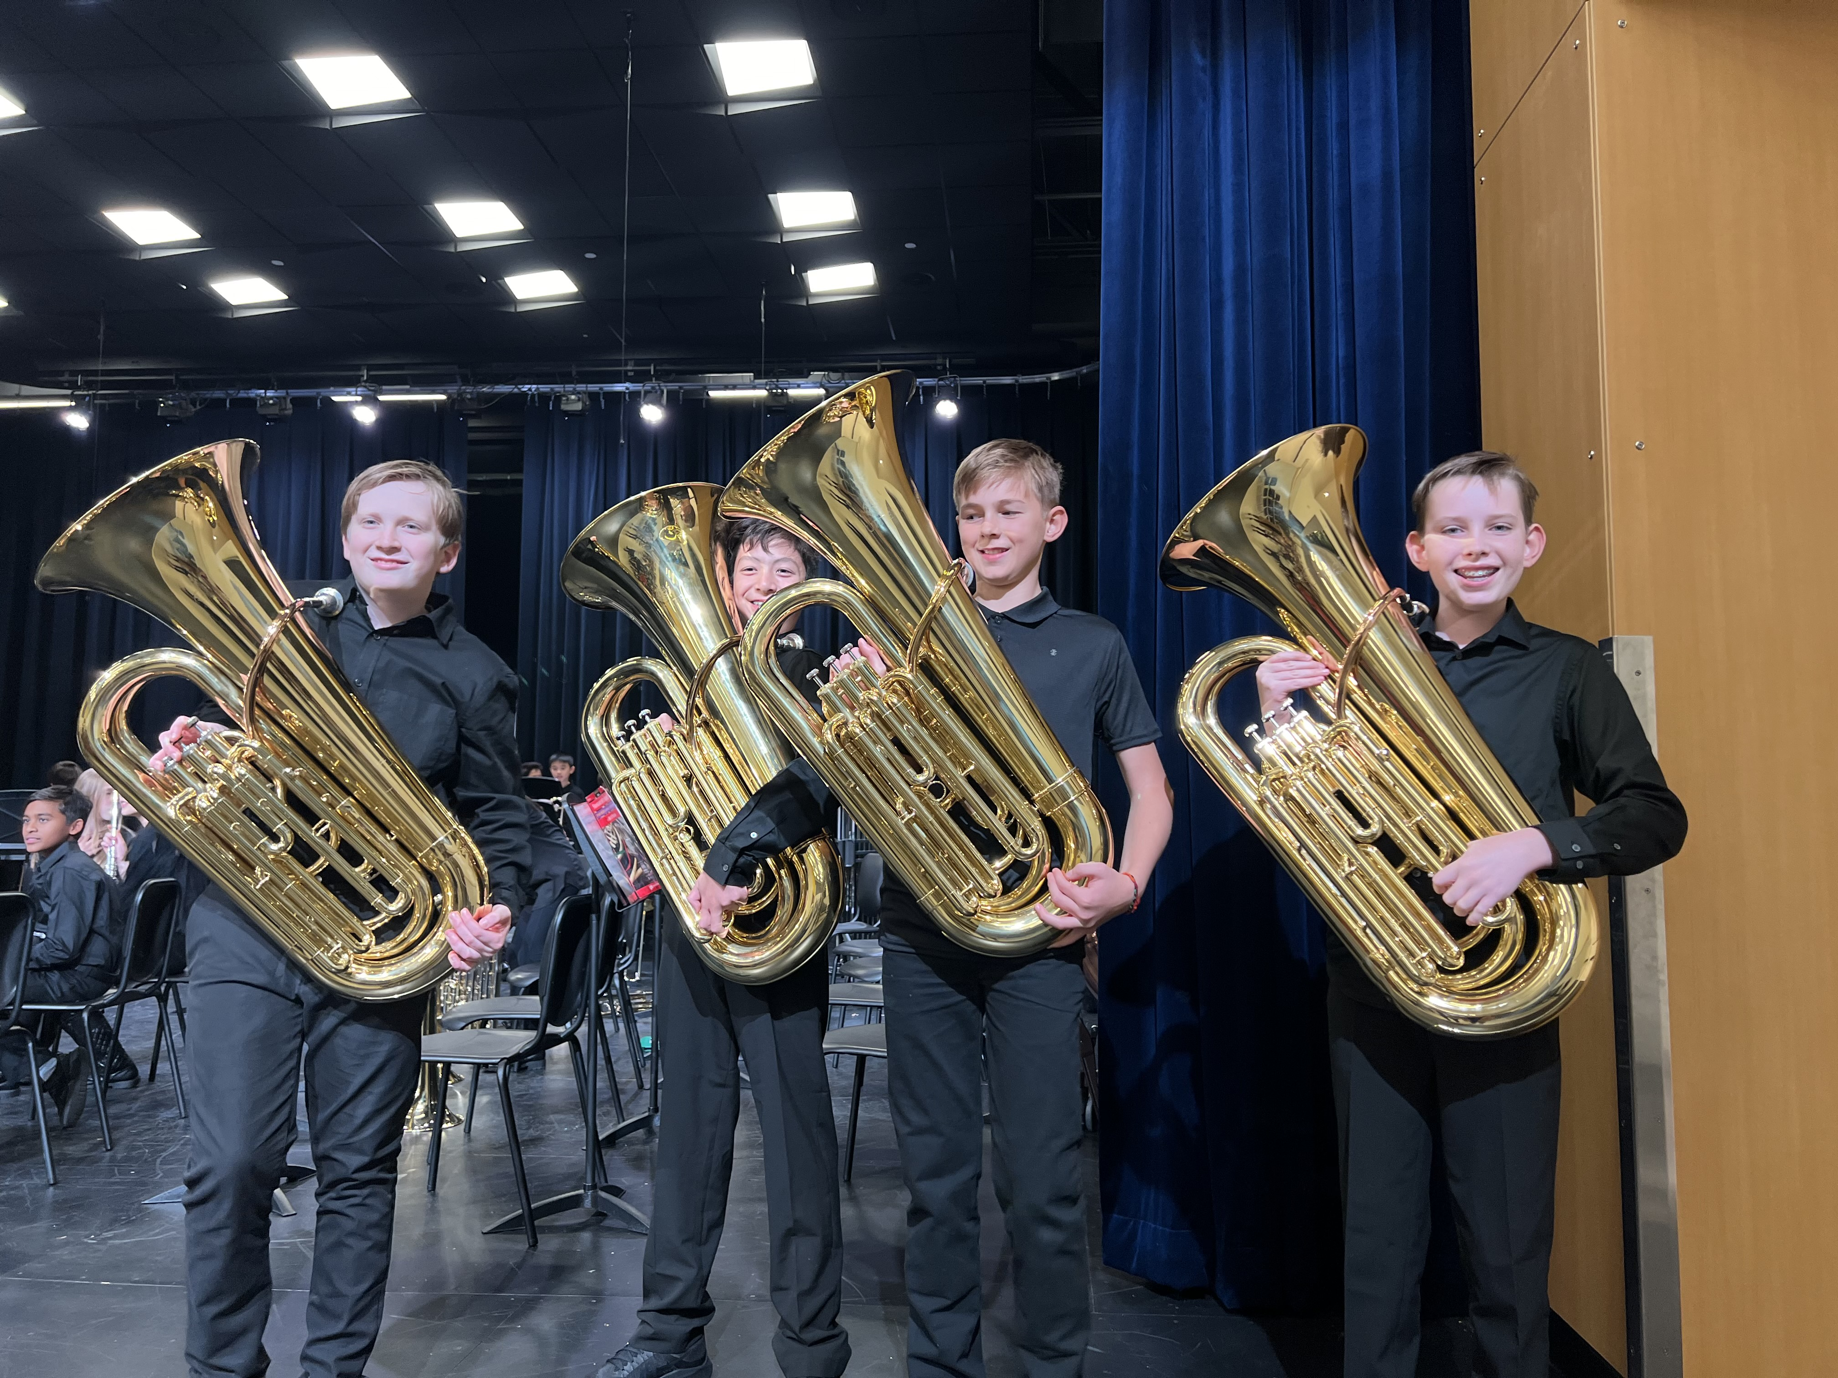
Band
Ms. Swanson & Students
It is a year-long elective
No prior experience required!

Slide 13
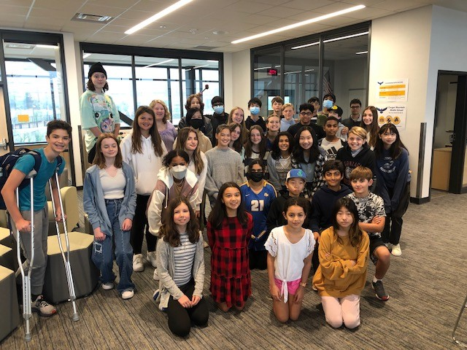
Leadership & Clubs
Mrs. Johnson
Club & activity
opportunities
Benefits of joining
No prior experience is needed to join a club or activity!

Slide 14
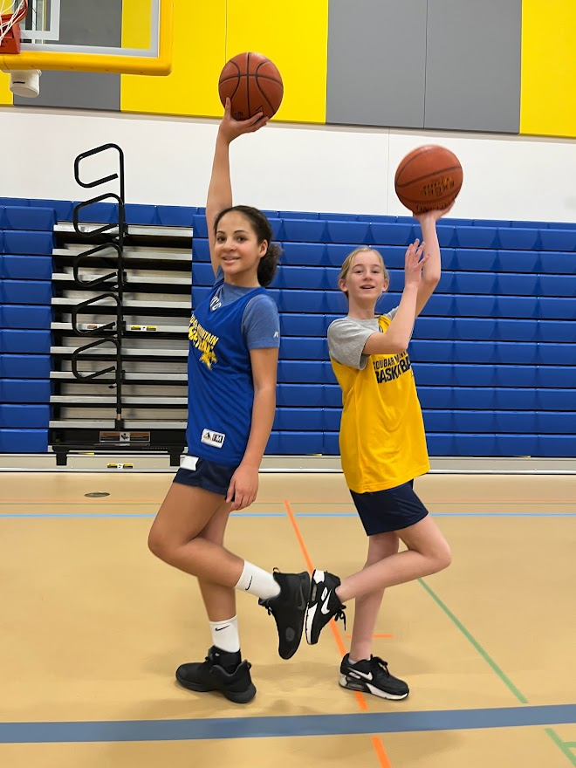
Athletics
Mrs. Johnson
Sports offered in 4 Seasons
Benefits of Joining
No prior experience is needed to join a sport!

Slide 15
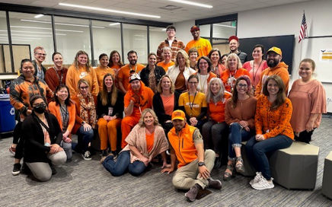
Our Teachers & Staff are so excited to meet you!

Slide 16
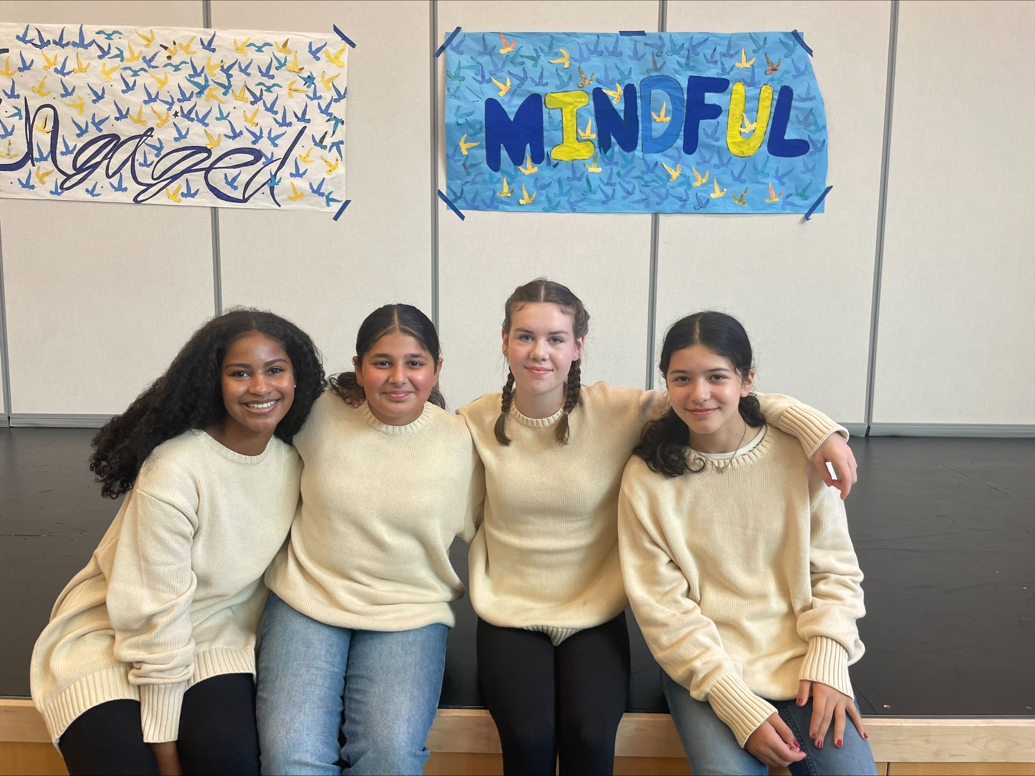
We can’t wait to have you be a Falcon!
Q & A
(if time allows)

Slide 17
Thank
You & Enjoy your Tour!
Please wait to be dismissed for your tour!

