Slide 1


Slide 2
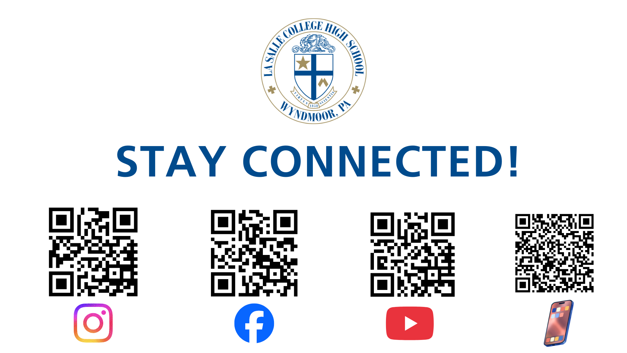

Slide 3
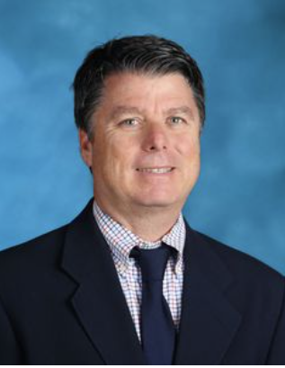
Mr. Lewis Clark
Director
Of Mission and Ministry

Slide 4
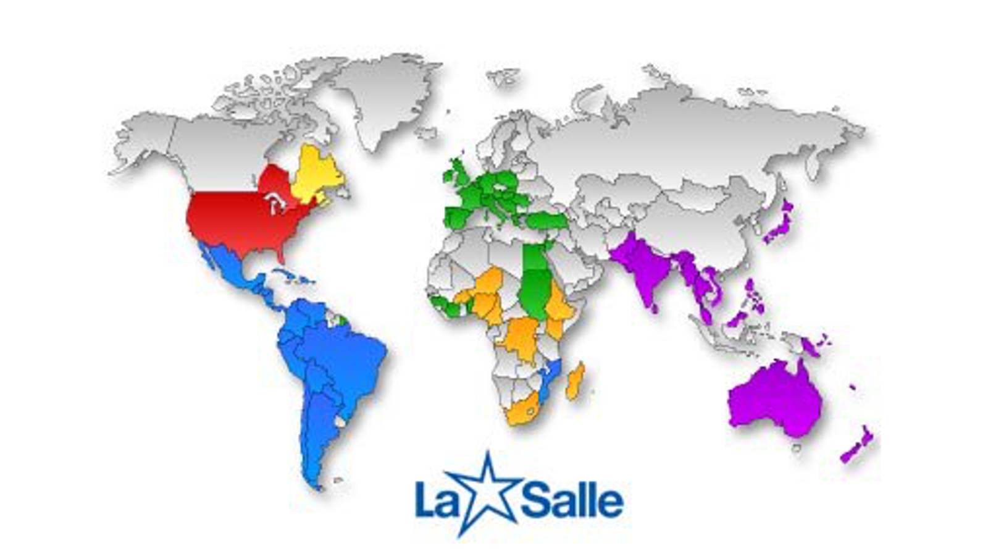

Slide 5
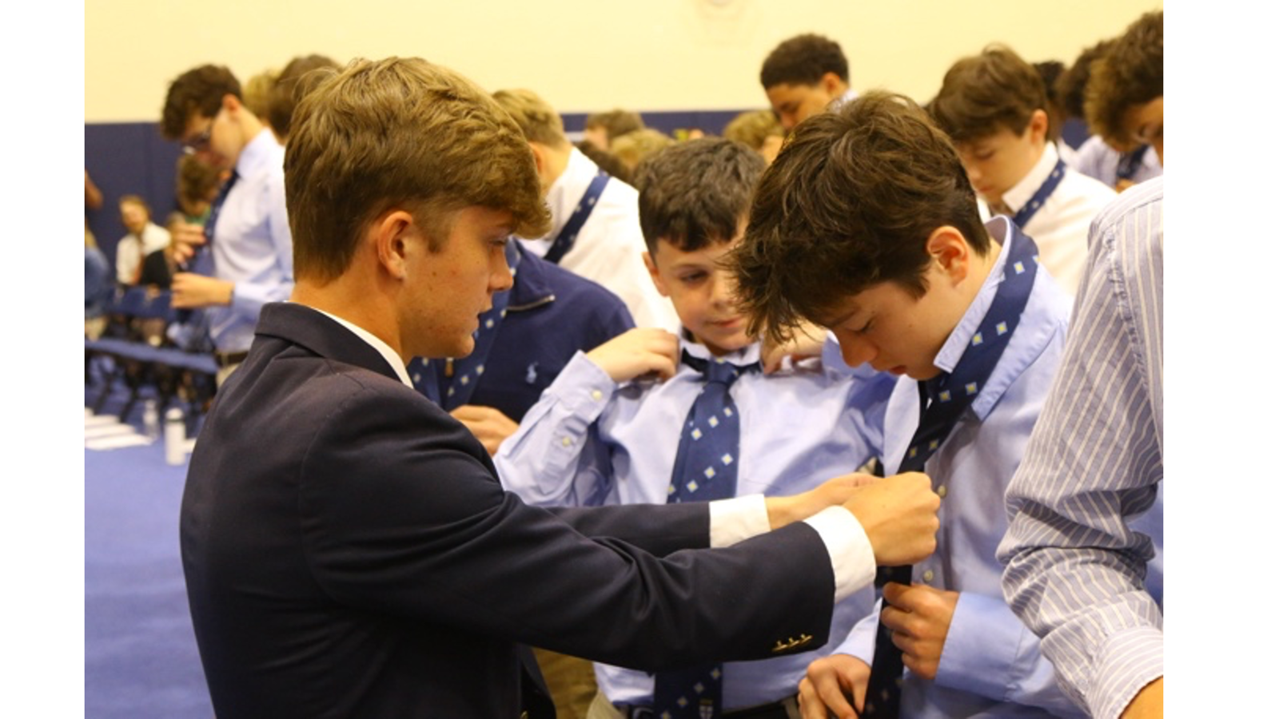

Slide 6
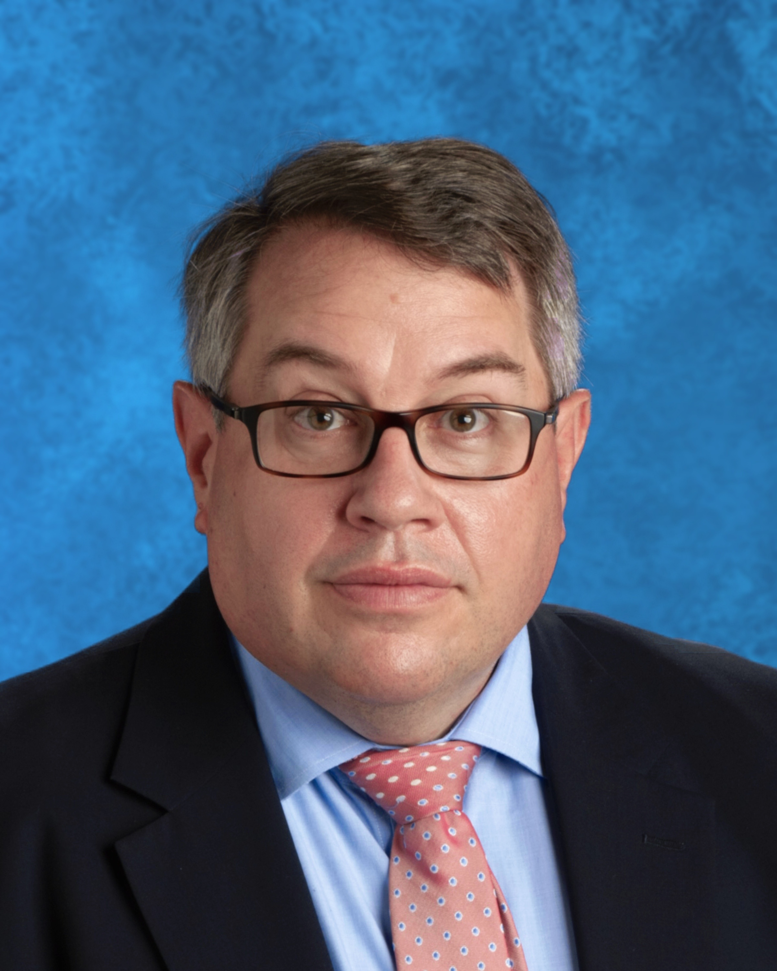
Mr. Charles Cirelli
Dean of Student Life

Slide 7

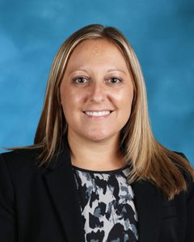
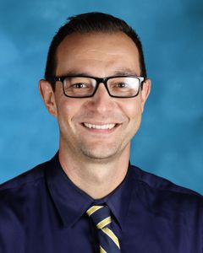
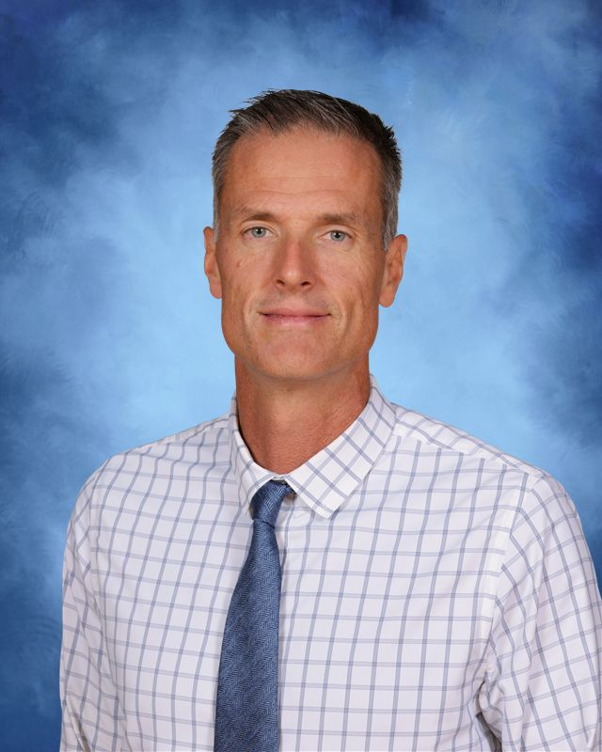
Support outside of academics
Mrs. Marie Stott, Associate Dean of Student Life for Student Activities
Mr. Robert Zanneo, Director of Athletics
Mr. Dan Buckley, Grade Level Counselor, Class of 2030

Slide 8
Transportation
ALL students must have the Transportation Selection Form completed by May 29, 2026
  Private Transportation – La Salle operated
  Public Transportation – Provided by public school districts to you as a tax-payer. NOT A SERVICE PROVIDED TO LA SALLE. WE HAVE NO SAY OR INFLUENCE OVER THEIR ROUTES.
  Car riders – avoid congestion by arriving early (before 7:40 AM) and leaving after 3:10 PM
        AM routine
        PM routine

Slide 9

Dress Code
Dress Shirt and Tie
  Dress shirts are not flannel or Hawaiian print
Dress pants with belt
  Dress pants do not have external pockets or rivets
Dress shoes with socks
  Dress shoes should not be sneakers or boots
  (Acceptable examples include Oxford, Derby, Loafers, or Boat Shoes)
Outerwear
  No hoodies, jackets, crew neck sweaters or sweatshirts
Grooming
  No extreme hair styles, clean shaven

Slide 10

School Calendar
Full School Calendar – we do NOT print and distribute a school calendar
  website ABOUT --> School Calendar
Key Dates for 2026-27 Academic Year for planning travel and holidays
  website ACADEMICS --> Key Dates for 2026-27 Academic Year
App for smartphone
***Your son’s academic calendar for his classes will be available on his Schoology Coursepages.

Slide 11

Character Education in the Boy School Setting
“Honor and Character” are core values at La Salle College High School. A La Salle diploma is more than an endorsement of academic performance. It is a certification that the graduate has become a Man of Character in his time at La Salle.
​
Our school fosters a culture that supports the kid of men we want our students to be.​
Students stand by each other, learn from each other, and hold each other accountable for maintaining the high standards of our school.

Slide 12
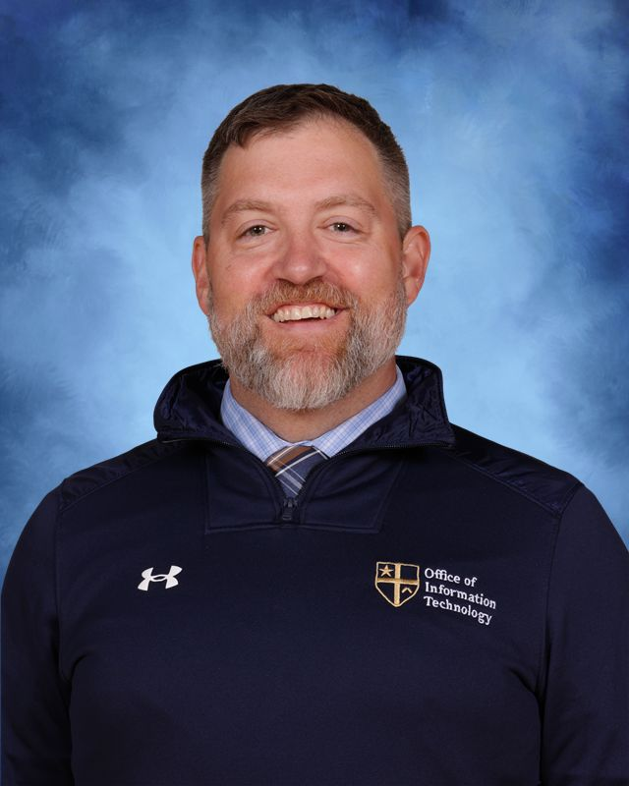
Mr. Michael Sabatino
Chief Information Officer

Slide 13
Technology Information
Your New La Salle Account
PowerSchool
Device of Choice
Freshman Technology Curriculum
Technology Support

Slide 14
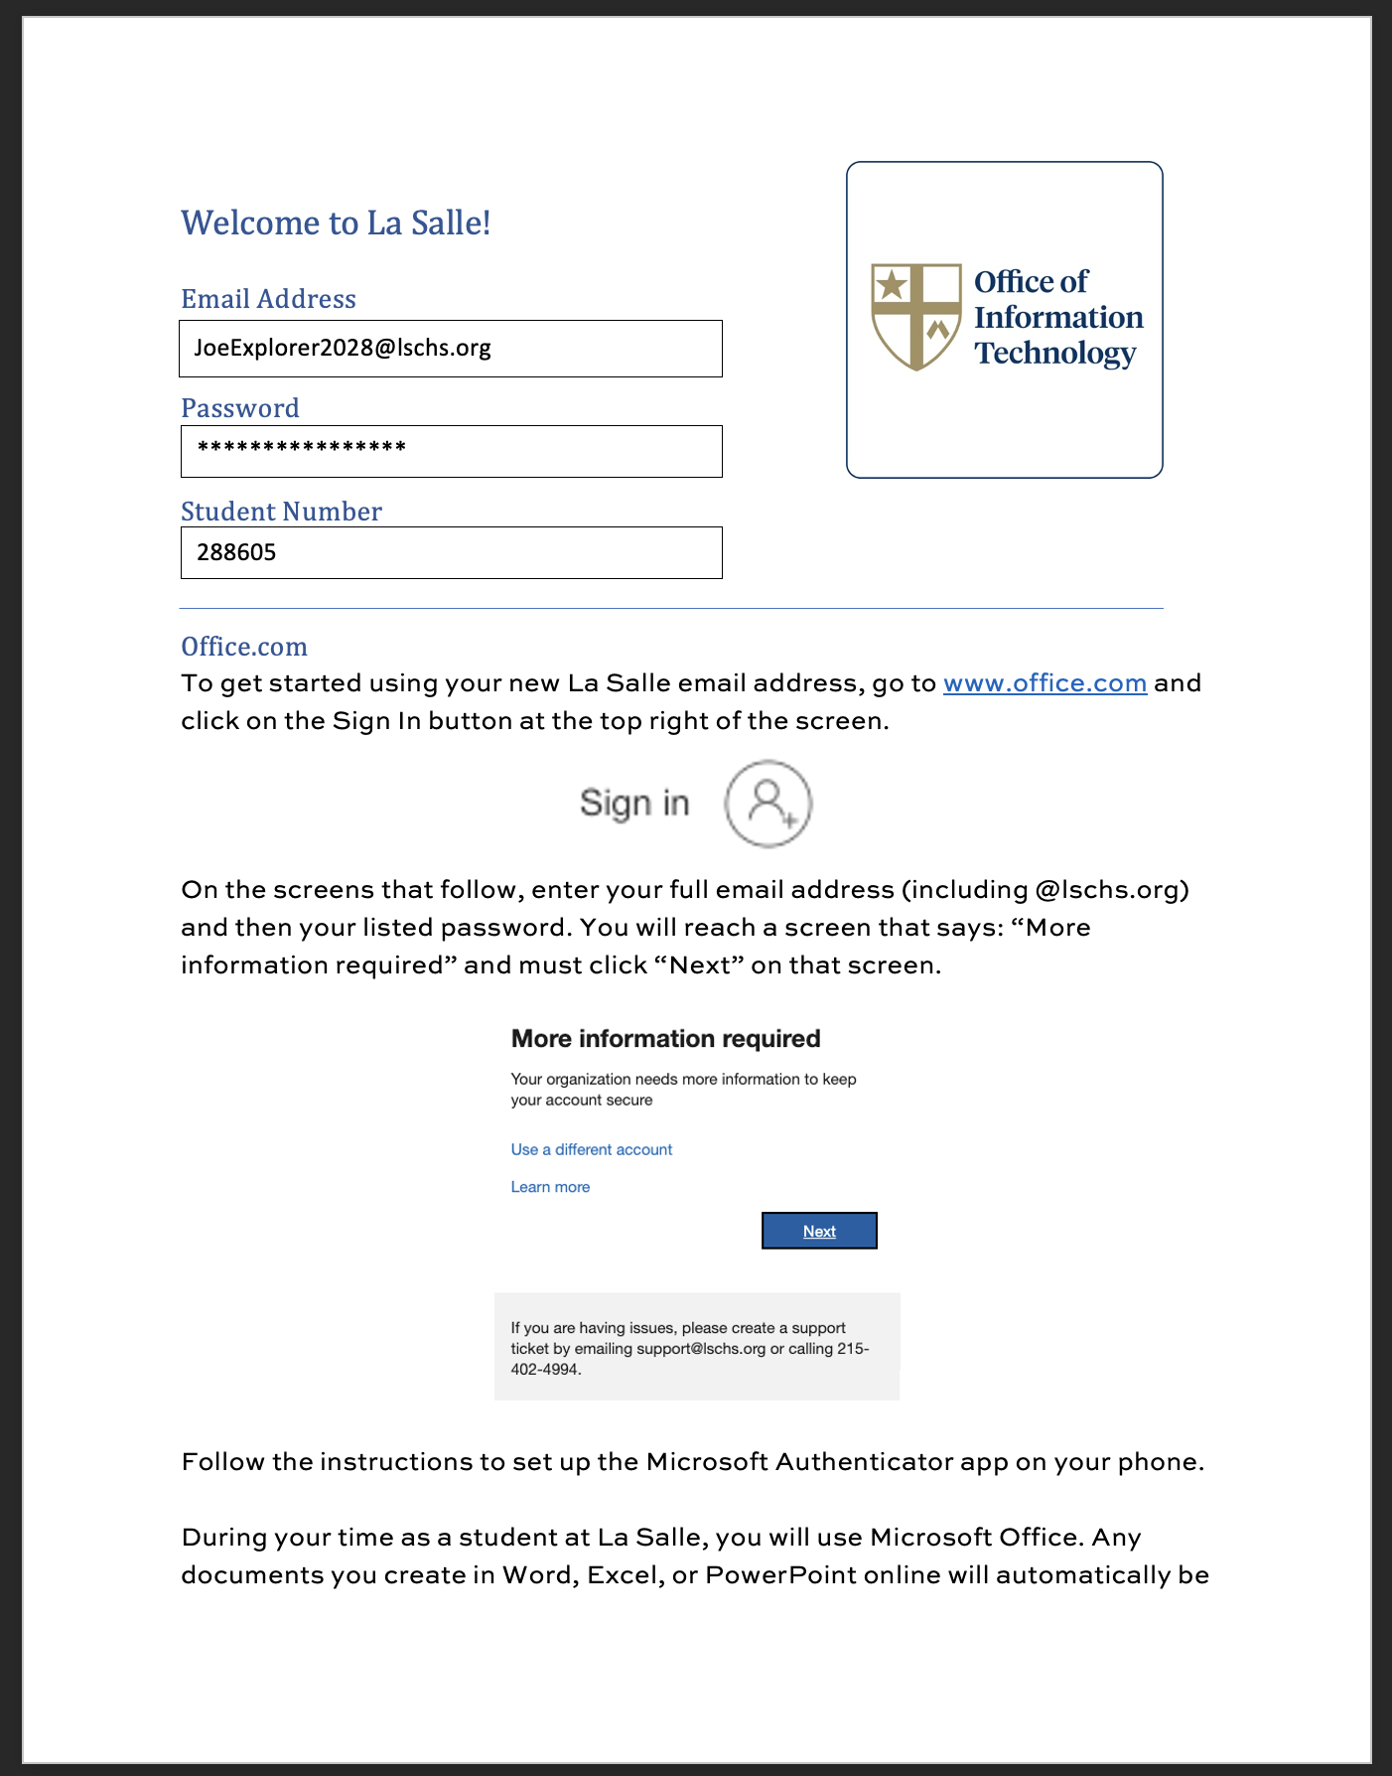
Your New La Salle Account

Slide 15
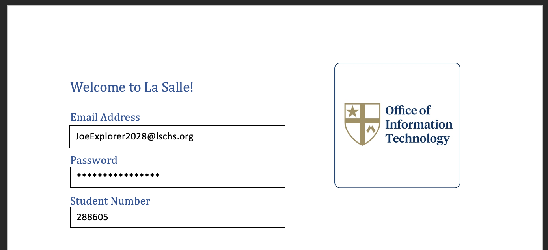
Your New La Salle Account

Slide 16
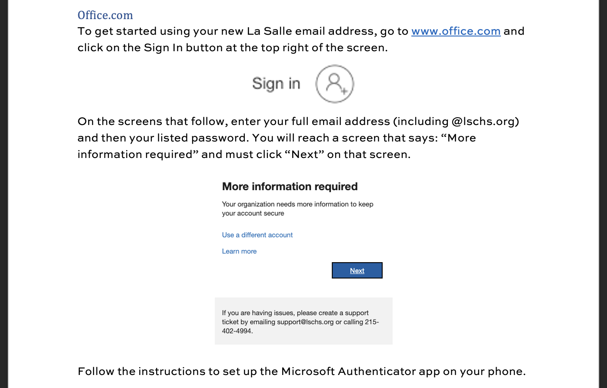
Your New La Salle Account

Slide 17

Powerschool

Slide 18
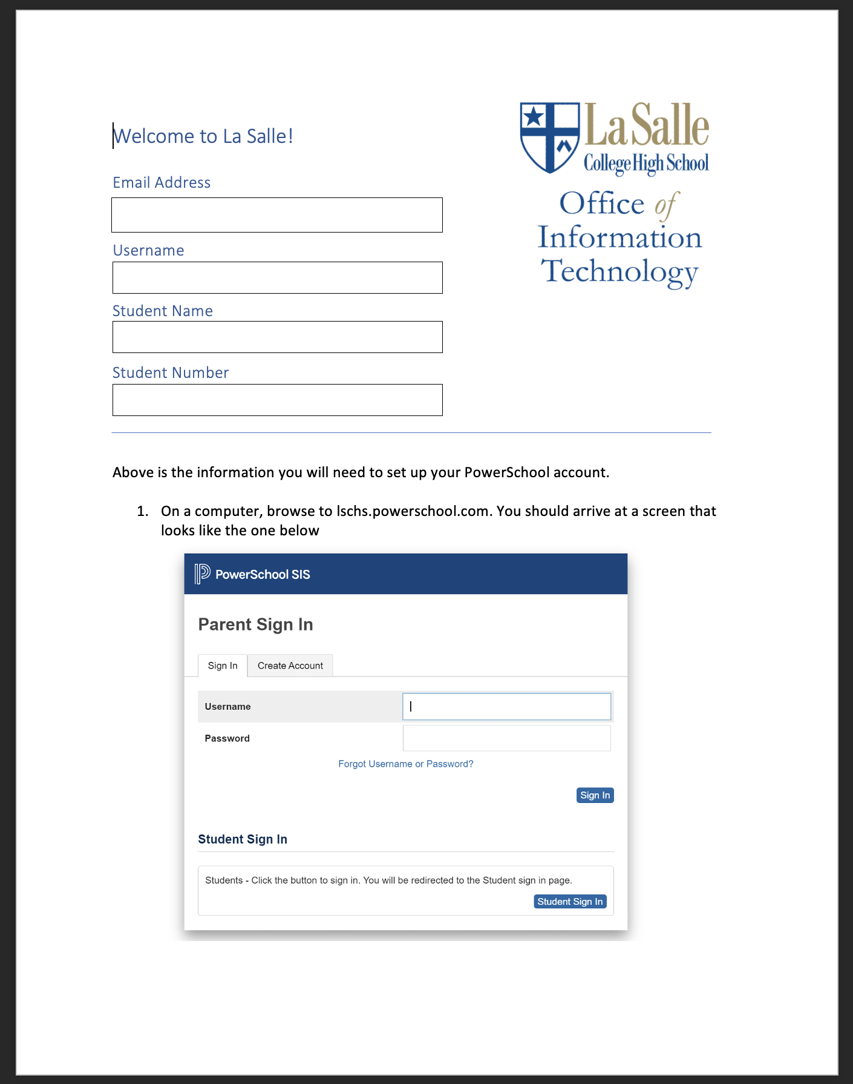
Powerschool

Slide 19
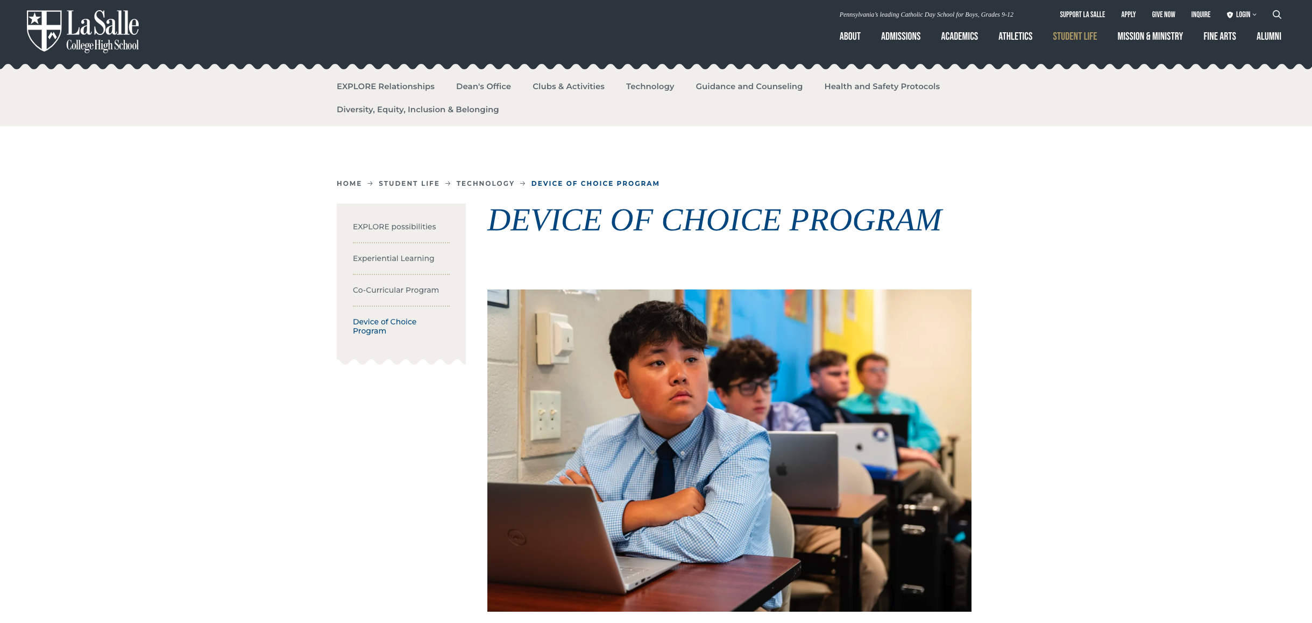
Device of Choice Program

Slide 20
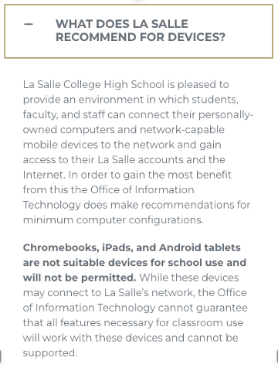
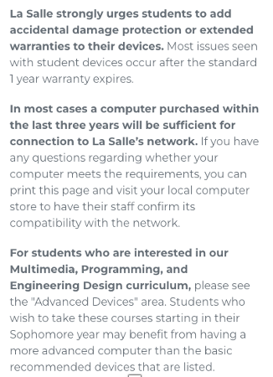
Device of Choice Program

Slide 21
Freshman Technology Curriculum
Providing a pathway to higher level classes for freshmen with experience and interest in
  Information Technology/Networking
  Digital Media (Video, Graphic Design, Photography)
  Computer Programming
Interest Survey and Portfolio
  Due _____
More information via email

Slide 22
Support
If you have any issues with your new account, please email support@lschs.org which will create a ticket in our support system.
If you have any questions about our Device of Choice program or potential devices, please email me directly at sabatinom@lschs.org.

Slide 23
Welcome
Class of 2030
Academic Orientation

Slide 24
agenda
Intro to Academics
Roadmap
Course Placements and Course Selections
Course Selection Process
Summary of Placement Tests and Music Evaluations

Slide 25
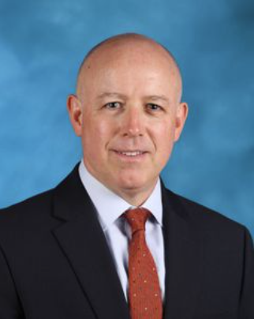
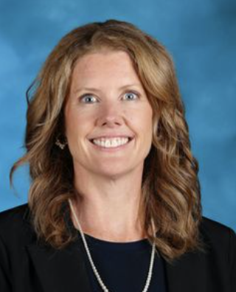
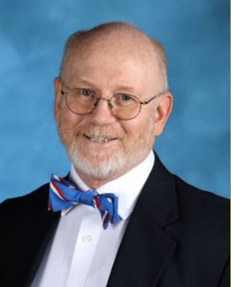
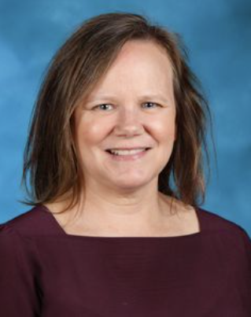
Welcome to the La Salle community!
We’re here to help.
Mrs. Catrina Wheatley
Administrative Assistant for Academic Affairs
Mr. Nicholas Coggins
Dean of Academics
Mrs. Stephanie Smith
Associate Dean of Academics
Mr. Jerry Evans
Scheduler

Slide 26
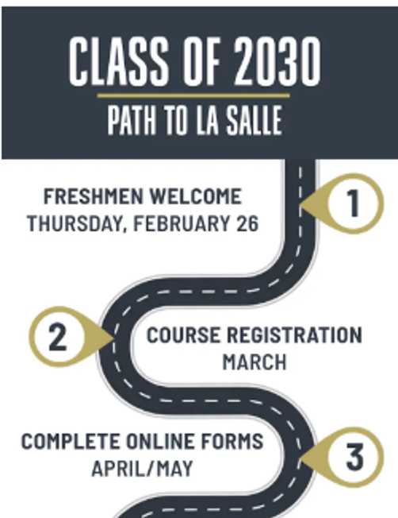
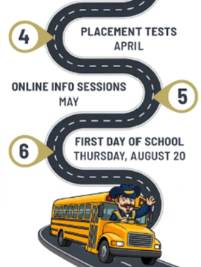

Slide 27
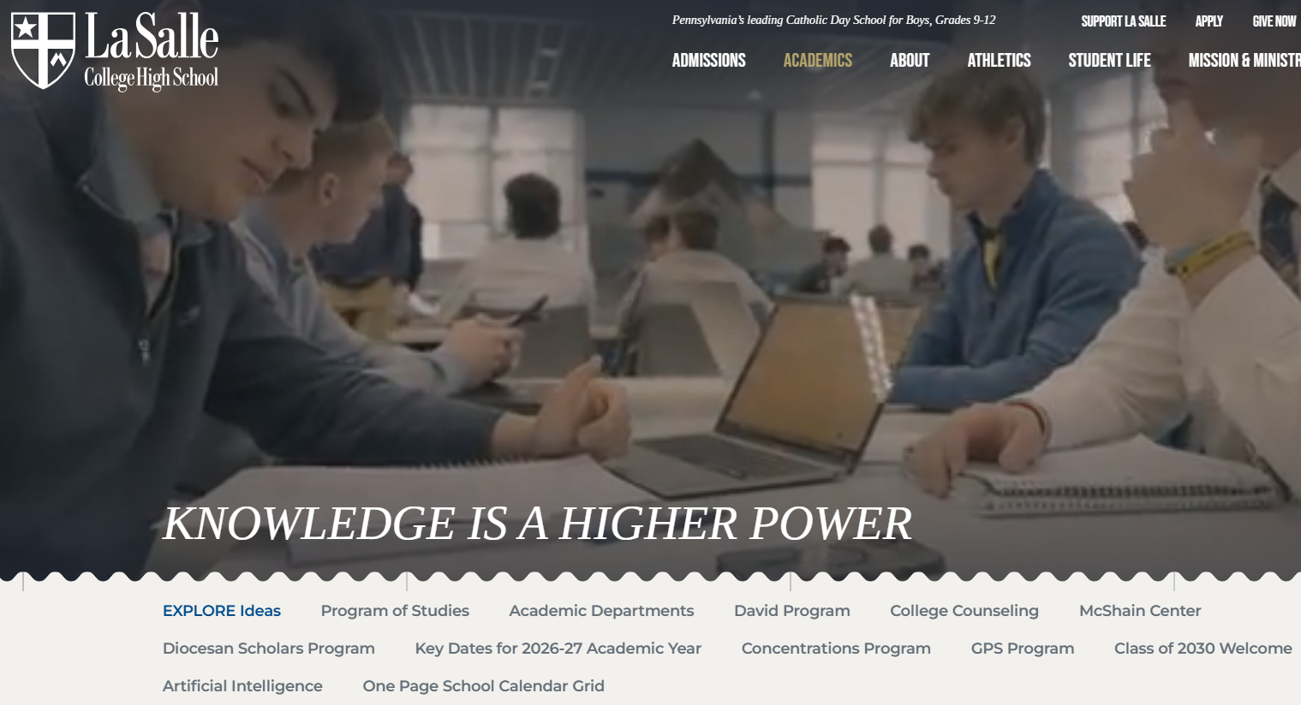


Slide 28

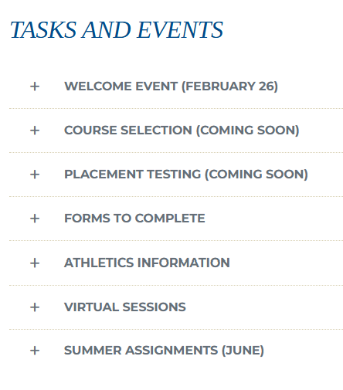
EMAIL
Communications Moving Forward

Slide 29


Starts: Tues (reminder Thursday email)
Ends: 3/23
LSCHS
Course Selection!

Slide 30

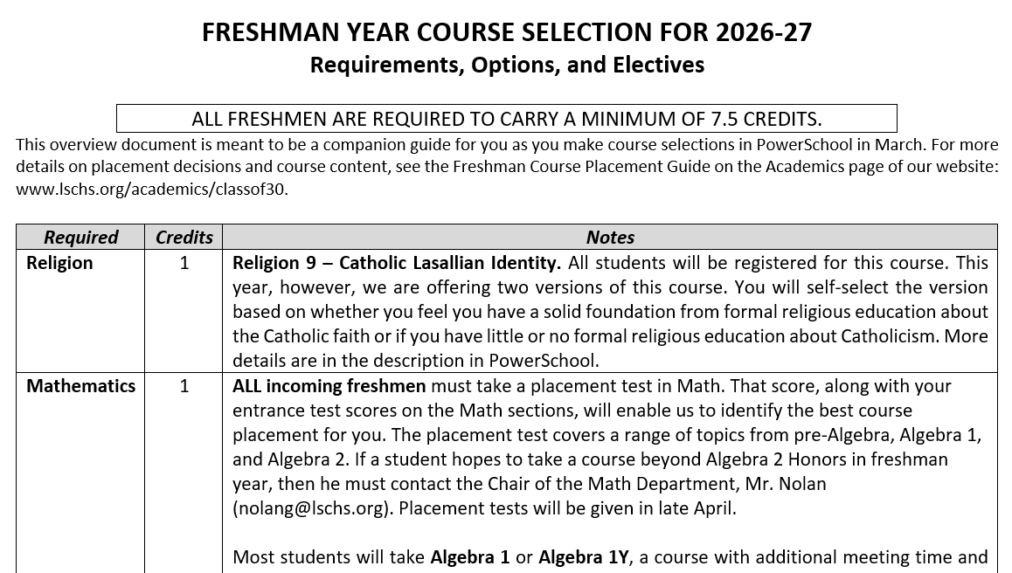

Slide 31
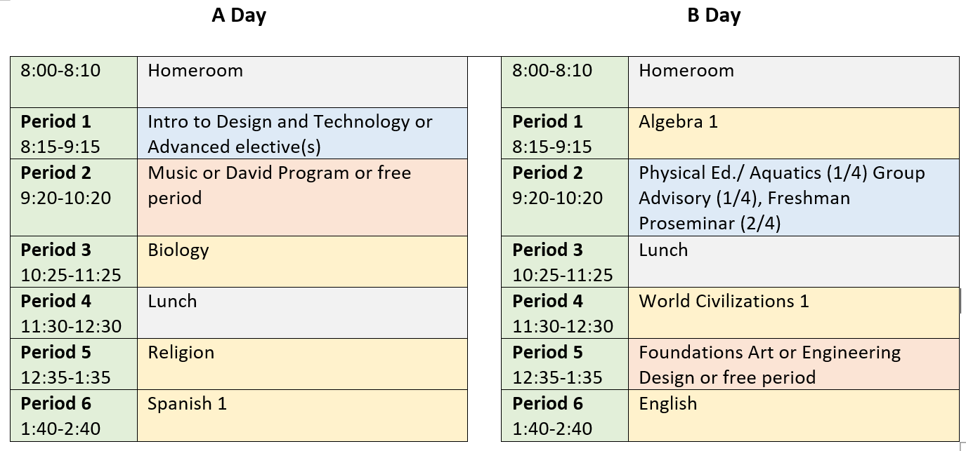

Sample Schedule for a Freshman
4
7
9
8
1
5
2
10
3
6

Slide 32
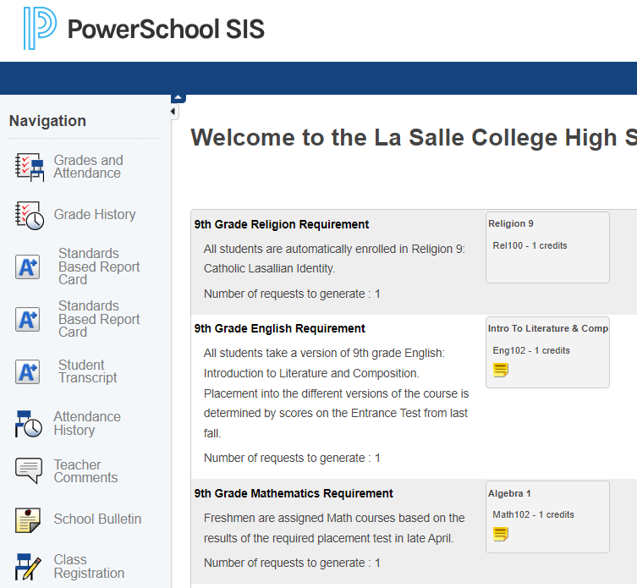

Course selection process in PowerSchool

Slide 33

Departments
Science
World Languages
Math
English
History and Political Science
Religion
Social Sciences
Innovation and Design
Fine Arts
(Additional Courses)

Slide 34
1. Science
2
1
Freshman Optional: Placement test | Honors Biology Academic Scholarship (Not “Diehl”) High score on placement test | Biology A placement test is available to get to Honors
 | Apply: Engineering Design (+1 credit)
Sophomore | Honors Chemistry | Chemistry
Junior | AP Physics 1 | Physics, Honors Physics
Senior | (Elective) | (Elective)
?
Other electives:
AP Biology
AP Chemistry
AP Physics 1
AP Physics 2
AP Environmental Science
Environmental Science
AP Physics C: Electricity and Magnetism (1 sem)
AP Physics C: Mechanics (1 sem)
Engineering Design, Advanced
Principles of Engineering
Aerospace Engineering
Engineering Concentration Capstone
Anatomy and Physiology, Honors
Zoology
Forensic Science
Fundamentals of Health Science
Foundations of Nursing
Health Sciences Concentration Capstone

Slide 35
2. World Languages
1
2
3
4
Freshman Optional: Placement test | Spanish 1 | Latin 1 Latin 1 Honors (after selecting Latin) | Chinese 1 | Arabic 1
Sophomore | 2, 2H | 2, 2H | 2 | Arabic 2
Junior | 3, 3H | 3, 3H | 3 | Arabic 3
Senior | (4, 4H, AP) | (4, 4H, AP) | (4, 4H, AP)
Other electives:
Spanish 1, 2, 3 for students with documental learning differences
Medical Spanish for Professionals
Students may double up on any language.
Independent Study

Slide 36
3. Math
1
2
3
4
5
Freshman: MANDATORY Placement test | Algebra 1 Y (based on entrance test) | Algebra 1 (ALL START with THIS!) | Algebra 2 | Accelerated Algebra 1 | Algebra 2 Honors
Sophomore | Algebra 2 Y | Algebra 2 | Geometry | Accelerated Algebra 2 and Geometry | AP Precalculus or Honors Precalculus (and Honors Geometry)
Junior | Geometry Y | Geometry | Precalculus | AP Precalc, Honors Precalc, Precalc | AP Calculus AB
Senior | (Trig and Statistics) | (Precalculus and/or Statistics) | (Honors Calculus and/or Statistics, AP) | (AP Calculus AB Or Calculus Honors and/or AP Statistics) | (AP Calculus BC and/or AP Statistics)

Slide 37
4. English
1
2
3
Freshman | Honors English 9 Academic Scholarship 80th % - 3 domains of entrance test | English 9: Introduction to Literature and Composition | English 9 Y Entrance test scores
Sophomore | Honors Eng 10 | Eng 10 or Honors Eng 10 | Eng 10
Junior | AP English Language | Eng 11 or AP English Language | Eng 11
Senior | AP English Literature | Eng 12 or AP English Literature | Eng 12
Electives:
Creative Writing I, II
African American Literature

Slide 38
5. History and Political Science
1
2
Freshman | AP Human Geography Academic Scholarship Select others typically above 90% on National Composite of entrance test | World History 1
Sophomore | AP World History | World History 2 or AP World History
Junior | AP US History and US Civil Right (online) | US History or AP US History and US Civil Rights (online)
Senior | (AP European History and/or electives) | (Electives)
AP European History
US Civil Rights
AP US Government and Politics
AP Comparative Gov and Politics

Slide 39
6. Religion
1
Freshman | Religion 9: Catholic Lasallian Identity (2 versions: strong foundation or some/no foundation)
Sophomore | Religion 10: Scripture
Junior | Religion 11: Christian Morality
Senior | Religion 12: Living the Mission

Slide 40
7. Social Sciences
Freshman | n/a
Sophomore | Effective Communication
Junior | (electives)
Senior | AP Business and Personal Finance or Personal Finance and Investment
  AP Macroeconomics
  AP Microeconomics
  Economics
  Introduction to Business and Finance
  Personal Finance and Investment
  Psychology
  Organizational and Social Psychology
  AP Psychology
  Foundations of Law
  Mock Trial
  Data Analytics
  Intercultural Communication
  Modern East Asian Studies
  Advanced Public Speaking
  Foundations of Leadership
  Leadership and Advanced Communication
  Legal Research and Writing
  Global Business Capstone
  Leadership, Public Service, Law Capstone

Slide 41
8. Innovation and Design
1
Freshman | Introduction to Design and Technology or with WAIVER: AP Computer Science Principles, AI and Emerging Technology, Digital Storytelling, Multimedia Journalism
Sophomore | (electives)
Junior | (electives)
Senior | (electives)
  AP Computer Science Principles
  AP Computer Science A
  AP Cybersecurity
  AI and Emerging Technologies
  Programming: Python
  Programming: JAVA
  Mobile App Design
  Digital Storytelling
  Photography
  Esports Management and Production
  Web Design
  Advanced Digital Design
  Networking Essentials
  Cloud Fundamentals
  Digital Media and Communication Capstone
  IT Professional Capstone

Slide 42
9 Fine Arts
?
?
?
Freshman | MUSIC (Evaluation) Introduction to Music Performance and Instrumental Instruction | Art Foundations Art | Chorus Freshman Chorus
Sophomore | Small Ensembles Advanced Music Performance | Drawing 1, Painting 1 Ceramics 1, Sculpture 1 | Chorus
Junior | R&B, Funk, and Latin Concepts Honors Advanced Music Music Theory/Improv | Drawing 2 Painting 2 Ceramics 2 Sculpture 2 | Advanced Chorus
Senior | Music Production Capstone | Advanced Ceram., Sculp. Art Portfolio | Independent Chorus

Slide 43
10. Additional Courses
1
2
3
?
Freshman | Group Advisory 9 (1/4) | Physical Ed/ Aquatics (1/4) | Freshman Proseminar (2/4) | David Program: Academic Support 1
Sophomore | G.A. 10 | * |  | A.S. 2
Junior | G.A. 11/ College Counseling | * |  | A.S. 3
Senior | College Counseling/ G.A. 12 | (Physical Fitness and Wellness) |  | A.S. 4

Slide 44
Course Registration Summary
Choose – Language
Decide electives (extra courses/credits) – if want – take survey
  Art
  Music
  Chorus
  Engineering Design
Decide to skip Intro to Design and Tech – complete survey and test
  AP Computer Science
  Programming
  Digital Storytelling
  AI and Emerging Tech
All students start with “Algebra 1” (until placement tests)
If you qualify for Honors or AP Human Geo, you will have access to choose it
Placement test dates

Slide 45
Placement Tests and Alternative Courses
Math - ALL STUDENTS!
For Students who want advanced courses…
  Science – Honors Biology
  World Languages – Level 2 or 2 Honors in Spanish, Latin, Chinese
Dates - April 21, 22, 23, 27 (No need to RSVP)
Time – 3:30-5:30
Notes:
- Math on 1 day only
- Can double Science and Language on the same day
Fill out form while registering for courses IF…
Want to take a test to try to skip the Introduction to Innovation and Design to take a course such as AP Computer Science Principles, Emerging Technologies or other electives in Innovation and Design
Want to add a full-year course of Engineering Design
For Music – evaluations for placement
Dates – April 23, 29 and May 4
Time – 2:30-5:00 (15-minute time slot assigned)

Slide 46


Slide 47

Summer work to be posted in Schoology in June

Slide 48
Course selection process in PowerSchool

Slide 49


Welcome
to the
La Salle Family!

