Slide 1

Incoming 9th Grade Welcome Night
2.25.2026

Slide 2

Agenda
5:00-5:45 – Extra Curricular Open House (Clubs, Activities, Athletics)
6:00-6:45 – Skyline & Course Request Process (CRP) Information
6:55-8:10 – Instructional Break Out Sessions (Four 15 minute rotations)

Slide 3
Learning Objectives
Welcome
Introduce Administrative Staff
Introduce “Flex Time” - Skyline’s Intervention Period
Introduce the International Baccalaureate (IB) Program & AP offerings
Learn about the Course Request Process (CRP) for 2026-2027 school year

Slide 4
Break Out Session – Locations (6:55, 7:15, 7:35, 7:55)
Counseling at Skyline (Commons) Humanities Department (Library)
College & Career Center (1202) Special Education: LRC I/II (1116) Mathematics Department (2412-2414) Engineering (1304) Police/Forensics/Criminal Justice (1111) World Language: Chinese (2114)
Science Department & IB Science (1311) World Language: Spanish (2406-2408)
Computer Science (2302) World Language: Japanese (1214)
IB Program (Theater) World Language: ASL (1118)
Digital Arts & Yearbook (2207) Music: Choir, Band & Orchestra (2527)
Theater Arts (2519) Business & DECA (2064) Visual Arts (2501)

Slide 5



Follow Skyline on Social Media
spartans_shs
Skyline High School
@SHS_Spartan

Slide 6
Skyline Administration
Keith Hennig – Principal
Allison Strait (A-GAI)
Andrew Guss (GAJ-LIT)
Kevin Adamo (LIU-ROD)
Alanah Baron (ROE-Z)

Slide 7
Skyline Counselors
Hayden Kersey (A-CRO)
ØTodd Caffey (CRP-HOO)
ØMegan Rieke (HOP-LOP)
ØStephanie Anderson (LOQ-PAS)
ØAdam Dickenson (PAT-SPE)
ØKristen Flemer (SPF-Z)

Slide 8



Vision/Mission & HOW Wheel
Develop honorable, thinking, skillful citizens who possess integrity, act with pride, and pursue scholarship and excellence in the service of humanity.
Our goal is that ALL of our students will be prepared for and eager to accept the academic, occupational, personal, and practical challenges of life in a dynamic global environment.

Slide 9
Clubs/Athletics/Activities

Slide 10
Get Involved!
70-80 Clubs
  Chess Club, Games Club, Investing Club, Writers, Club, Rocketry Club, Fashion Merchandising and Design Club, DECA, Coding for Medicine – and MANY MORE!
Athletic Programs (Fall/Winter/Spring)
  Cross Country, Football, Golf, Tennis, Volleyball, Soccer, Swing & Dive, Basketball, Wrestling, Track, Baseball, Girls Flag Football, Badminton, Fastpitch Softball
Activities
  Drama, Cheer, Dance, Unplugged, Gift Drives, Dances, etc.

Slide 11
FLEX TIME

Slide 12
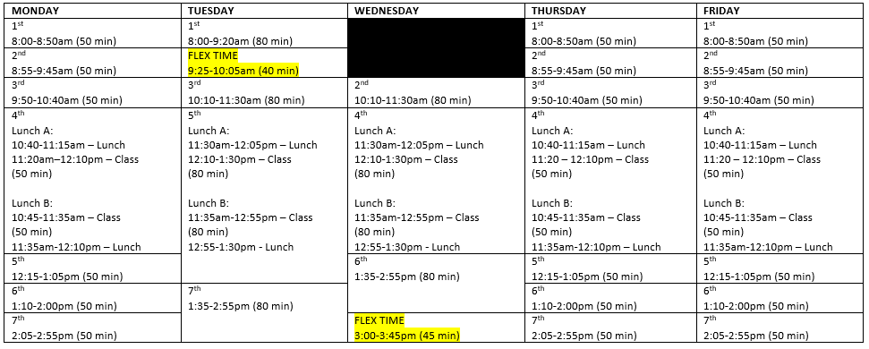
Bell Schedule

Slide 13
Flex Time Interests
Academic Interventions
Retakes and make-ups
Special Education Consult
Communication (announcements, SPTV)
Social/Emotional lessons
Alternate schedules (i.e., assemblies, surveys)

Slide 14
Flex Time Logistics
Students must attend their Flex Time class
Teachers will take attendance
Closed campus
Monitor Halls
Legitimate academic purpose

Slide 15

Flex Time Scheduler - gives Skyline the ability to schedule students to the support they need, while offering extended learning opportunities for others.
Scheduling System:
Teachers can request/require a student to attend a specific Flex Period.
Students are assigned the support area groups they need.
Students have the opportunity to self-select the intervention they need.

Slide 16



Slide 17
International Baccalaureate (IB)
Pathways (11th and 12th grade students only):
  Don’t take any IB courses (outside IB Lang & Lit SL).
  Take an individual IB course(s).
  IB Career Pathway (IBCP): 2-4 IB course, results in an IBCP Diploma.
  IB Diploma Program: Most courses 11th and 12th grade year, results in an IB Diploma.

Slide 18
Advanced Placement (AP) – 9th through 12th
NEW for 2026-2027
AP Human Geography – 9th
AP World History – 10th
AP US History – 11th
AP Language and Composition – 11th
AP Literature and Composition – 12th
Earning college credit in high school (IB & AP) allows students to save time and money by reducing the number of courses they need to take in college, helping them graduate earlier and with less debt.
It also exposes students to rigorous coursework, building the academic skills and confidence needed for postsecondary success in the academic or professional worlds.

Slide 19

2026-2027 Course Request Process For Incoming 9th Graders
SHS Counseling Team

Slide 20

Quick CRP Details
Beginning on February 25th (at 4:00 PM), you will be able to request courses for next school year in Skyward.
The window to request courses is February 25th - March 9th
The ONLY way to request courses is through Skyward Student Access during this window. You CANNOT request courses over email or any other way.
You will additionally request at least 8 alternate courses. Alternates will be used in the event one of the courses you request cannot be added to your schedule due to scheduling conflicts.

Slide 21
Who completes the Course Request Process?
EVERYONE!!

Slide 22
Making Requests in Skyward
Step by Step Instructions can be found on the counseling website under the Course Request Process sub page

Slide 23
Am I guaranteed my course requests?
All requests are used to make our building schedule so students can take as many of their first-choice classes as possible. However, schedule conflicts can arise and graduation requirements will be prioritized. You are not guaranteed your requests, however you are guaranteed classes that meet your graduation requirements.
If there is a schedule conflict and you do not get one of your first-choice classes, we will attempt to add a similar course from your alternates list.
If none of the courses in your alternates list work in your schedule, or you have not listed any alternates, the system will assign you an available course that will meet a graduation requirement.

Slide 24
Required Credits

Slide 25
What should I request?
All 9th Grade students (that’s you) will take:
  Language Arts (Yearlong class)
  Social Studies (Yearlong class)
  Math (Yearlong class)
  Science (Yearlong class)
  World Language (You will need 2.0 World Language Credits during high school) or Elective
  Other Graduation Requirements (1.0 Credit)
  Other Graduation Requirements (1.0 Credit)
  Can be CTE, Fine Art, Health, PE

Slide 26
9th Grade Requirements Humanities
Level: On-level vs Honors vs AP
On-Level
  Standard level curriculum
  More scaffolded support
Honors
  Deeper analysis
  More rigorous discussion
  More student independence
AP (AP Human Geography only)
  Higher Rigor
  More student independence
  Preparation for AP Test (possibility of college credit)
Class Structure: Block vs. Individual
Block
  Interdisciplinary
  Two teachers for support
  Some integrated assignments
  Separate Gradebooks
Individual
  Standard class size
  No integration
  Option for accelerated learning in only one discipline

Slide 27
Humanities Pairing Options
Honors Block**
On-Level Block**
Honors LA Individual + On-Level SS Individual**
Honors SS Individual + On-Level LA Individual **
On-Level LA Individual + On-Level SS Individual**
Honors LA Individual + Honors SS Individual **
AP Human Geo Individual + On-Level LA Individual
AP Human Geo Individual + Honors LA Individual
**AP Human Geo Individual can be added on as an elective in addition to the options indicated with the double asterisk

Slide 28
Course Request Disclaimer
Students are not guaranteed their first-choice courses as there may be schedule conflicts, changes, or adjustments through the scheduling process and number of requests per class. Please remember to add alternate courses for ALL courses, not just for electives! For humanities classes, while you are guaranteed your grade level graduation requirement, the prioritization will then be: 1) request of on-level vs. accelerated and then 2) teaching method (block vs. individual).

Slide 29
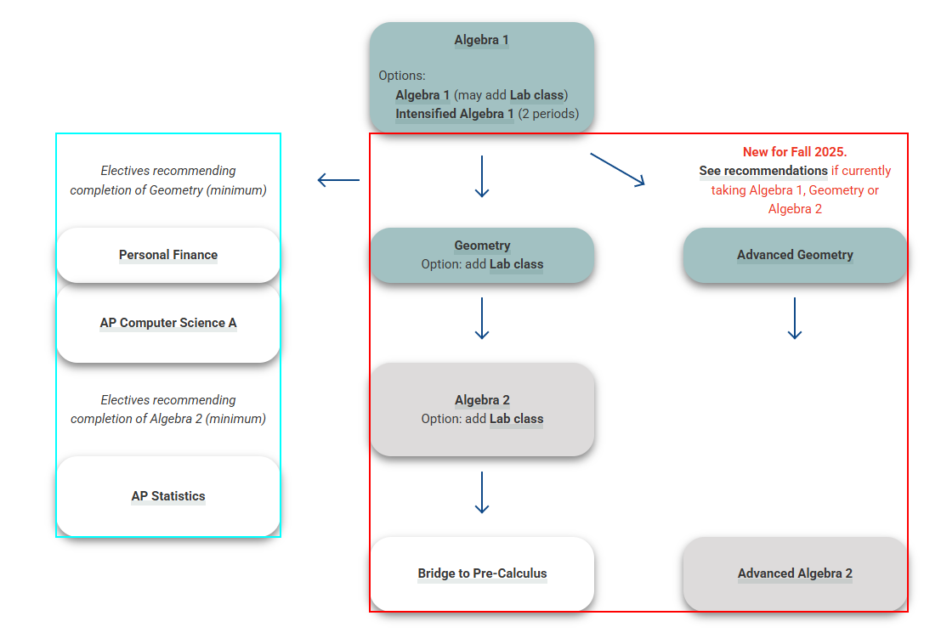
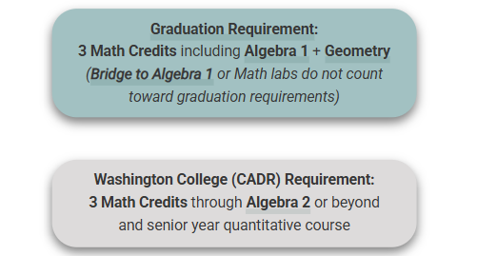
Math Pathways

Slide 30
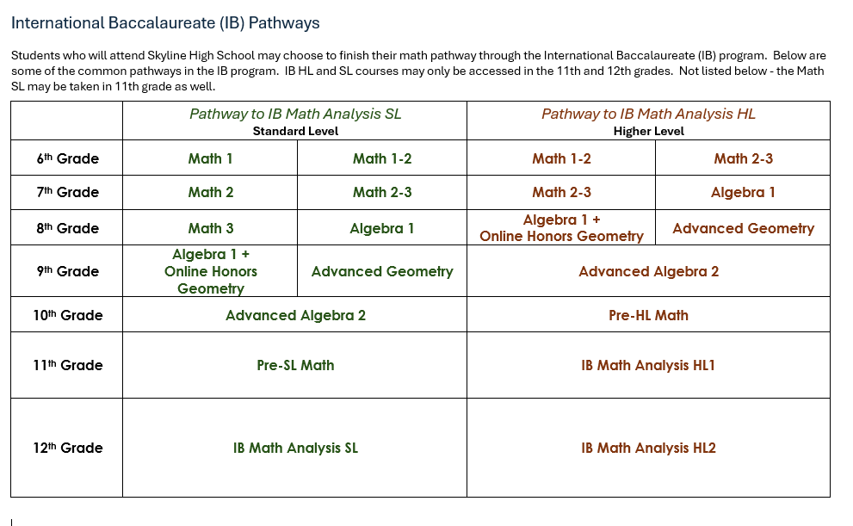
Math Pathways Continued

Slide 31
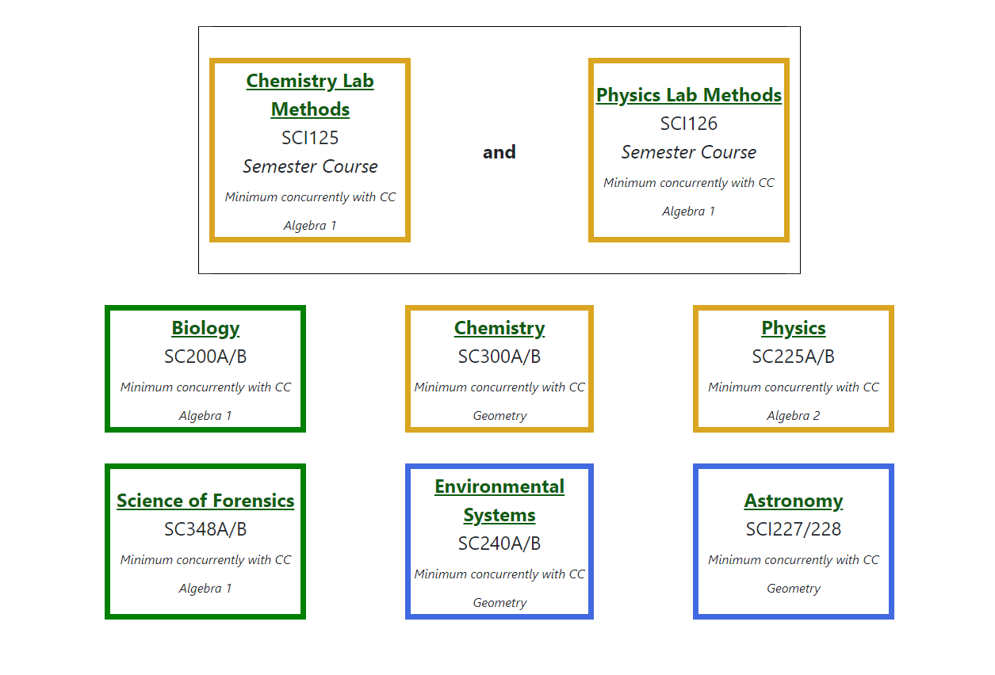
Science Sequencing
Notes about Science Course Options:
Make sure that you are choosing a science class that works with your current level of math. For example, Chemistry should only be taken if you are currently taking Geometry or above.

Slide 32
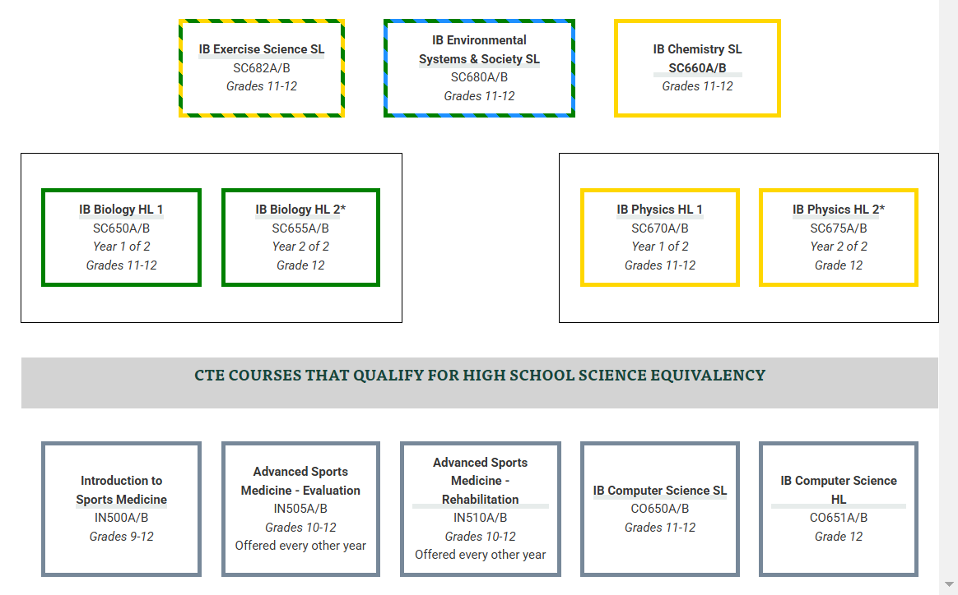
Science continued

Slide 33
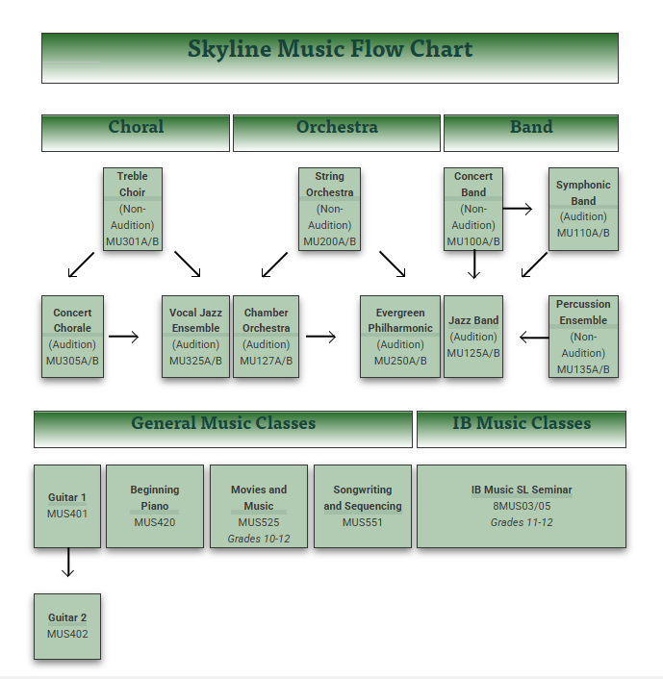
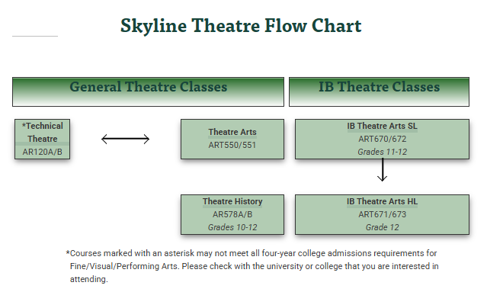
Music and Theater

Slide 34
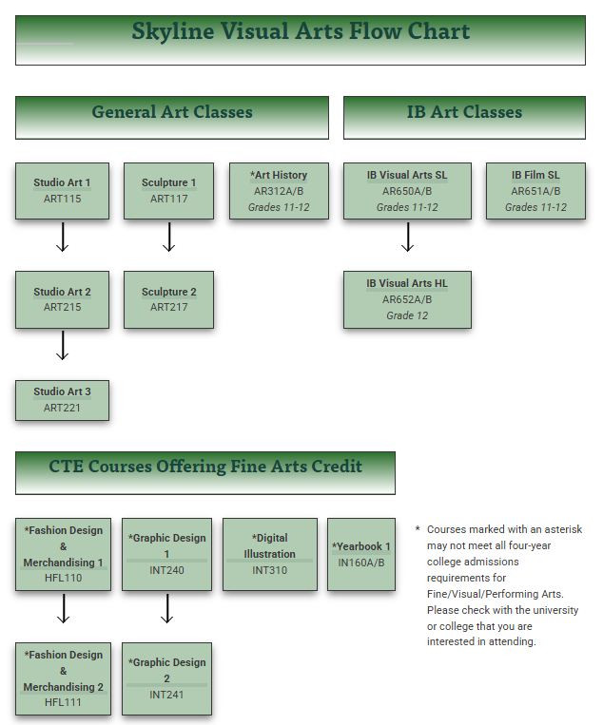
Visual Arts

Slide 35
World Languages
Spanish, French, Mandarin Chinese, Japanese, ASL
What is my post-high school plan?
  Most 4 year colleges require a minimum of 2 years of the same world language Some 4 year colleges recommend 3 years of one world language
  2 year colleges, tech schools, military, etc… do not require world language completion
  If you are fluent in a language other than English, it is possible for you to take the World Language Competency Exam for credit. This does not meet IB Diploma requirements.

Slide 36
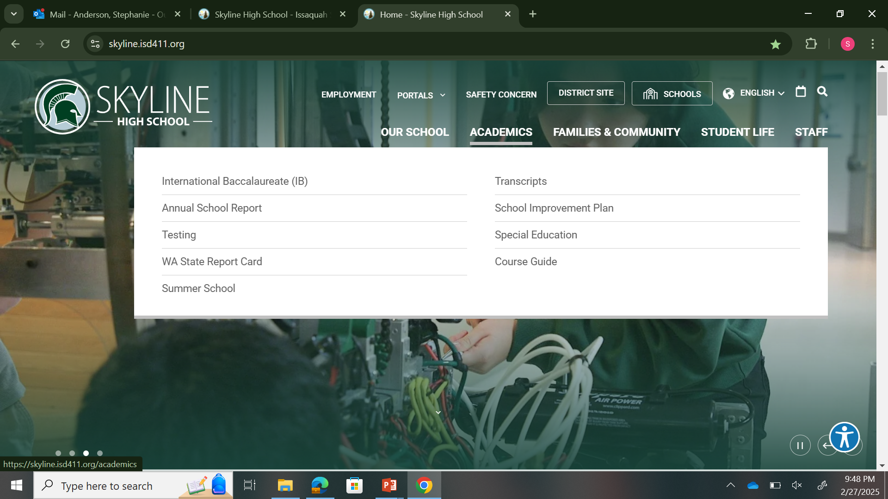
Course Guide: CTE, World Language, Fine Art, Health, PE, and many more!

Slide 37
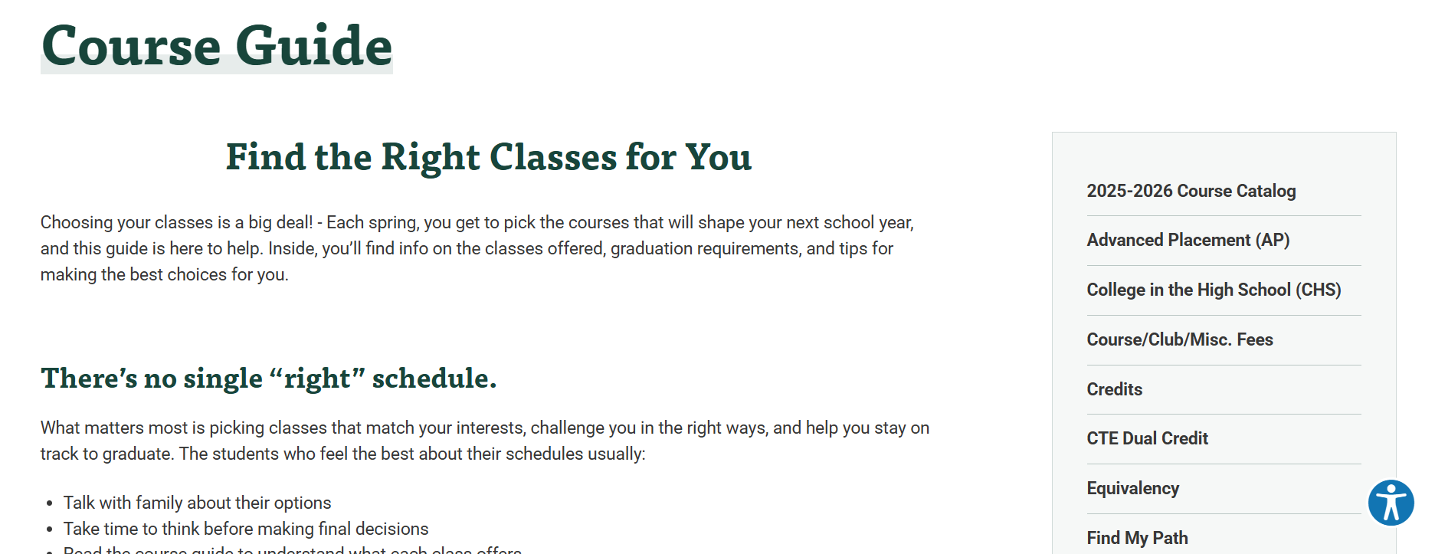

Slide 38
Graduation Requirements

Slide 39
Graduation Requirements: 24 Credits
Subject | Course Requirements to earn High School Diploma - State and District | Minimum College Entrance Required for WA public 4-year universities (CADRs)***
English Language Arts | 4 credits | 4 credits
Mathematics | 3 credits earned in 9th-12th: Algebra 1 Geometry 3rd year Math* If Algebra 1 and/or Geometry are successfully completed before 9th, higher level HS Math can be included. | 3 - 4 credits minimum through Algebra 2 and quantitative class in senior year
Science | 3 credits 2 lab sciences 1 additional science, lab or non-lab* (All ISD classes with SC course code are lab sciences) | 3 credits Biology Chemistry or Physics 1 additional science
Social Studies | 3 credits Complete Washington State History (formerly Northwest Studies) if not passed in 7th grade Earn 3 Social Studies credits Take full year of Social Studies in 9th grade Complete 1 semester of Contemporary World Problems Ex: Global Studies or AP Human Geography or AP World History Complete 2 semesters US History Course Complete 1 semester Civics | 3 - 4 credits

Slide 40
Graduation Requirements: 24 Credits
Subject | Course Requirements to earn High School Diploma - State and District | Minimum College Entrance Required for WA public 4-year universities (CADRs)***
World Language | 2 credits Both credits may be replaced with a Personalized Pathway Requirements** | 2 credits, must be two consecutive years in the same language.
 | NOTE: biliterate students can take a competency test to earn up to 4.0 World Language credits
Art​ | 2 (Fine or Applied Art) 1 credit may be replaced with a Personalized Pathway Requirement** | 1 (must be Fine Art)​
PE/Health​ | 1.5 PE and 0.5 Health​ | Not required for college entrance but provide opportunities for students to demonstrate and explore their learning​ Students are encouraged to reach out directly to colleges they are interested in applying to, as admissions processes and requirements vary by school.
Career and Technical Education (CTE)​ | 1 (many options in high school)
Elective (any course)​ | 4 credits, or enough to reach the total credit requirement for graduation.

Slide 41
Washington State History & Middle School Courses
  Washington State History (can be earned in Middle School or online learning course)
  Credit Earned Before High School
    Credit from ISD middle schools for classes such as Algebra 1, Geometry, Algebra 2, Biology, and World Language are automatically added to HS transcript; students/ families may opt out but must do so by end of 11th grade

Slide 42
High School and Beyond Plan
  The High School & Beyond Plan, a graduation requirement, helps students get the most out of high school and think about their future. It revolves around three questions:
  Who am I?
  What can I become?
  How do I become that?

Slide 43
Graduation Pathway Requirement
The use of the term “Pathway” exists in multiple contexts. The Graduation Pathway refers to the many ways in which students can demonstrate readiness for a meaningful first step after high school.
    Smarter Balanced Assessment
    ACT / SAT / AP / IB Exams
    Armed Services Vocational Aptitude Battery (ASVAB) Test
    Dual Credit Courses
    Career and Technical Education (CTE) Course Sequence
    Washington Access to Instruction & Measurement (WA-AIM) Assessment
  For more information click here for the Graduation Toolkit

Slide 44
Upcoming CRP Events
Wednesday February 25th 6:00-8:15: Incoming 9th Grade Night Student and Family Welcome Night
February 26th: SHS Counselors will be at BLMS for Student CRP Q & A
February 27th: SHS Counselors will be at PLMS for Student CRP Q & A
March 5th: SHS Counselors will be at BLMS & PLMS for Student
CRP Q & A

Slide 45

Follow the counseling team on IG for updates!

Slide 46
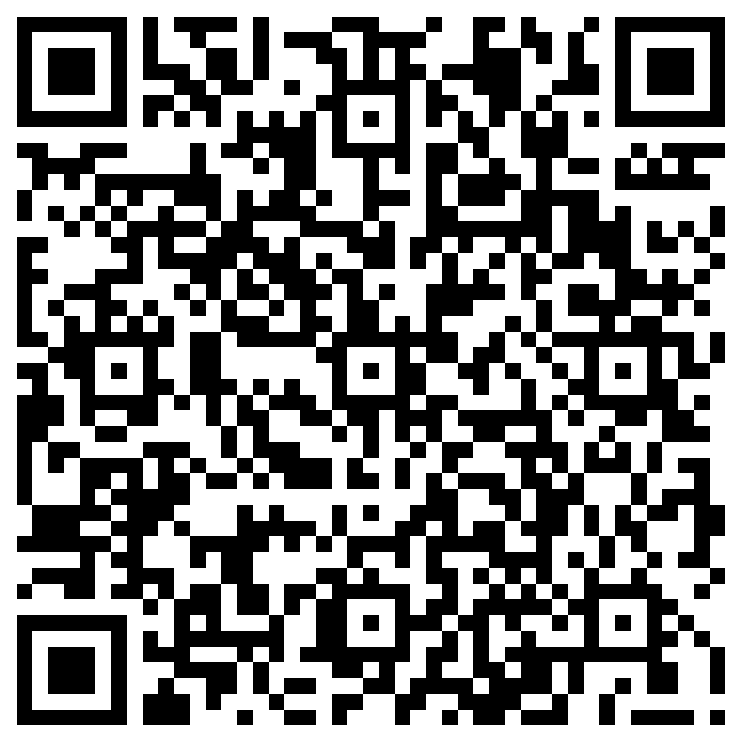
Question Form (answers on the website)

Slide 47
Thank you!

