Slide 1

Welcome Class of 2032!
February 25, 2026
Notes:
Matt

Slide 2
Introductions & Tonight’s Purpose
Begin your transition process to MMS
Gain an understanding of the registration process and educational options
Share some general information about MMS
Two important handouts
  Yellow Program of Studies
  Pink “Save the Date”
Notes:
Matt

Slide 3
Transition to Middle School
New Building
  Changing classes
  Navigating 3 flights of stairs with 3 minute passing time
  Lockers
New Teachers
  Every class has a different teacher
New Classmates
  All 5 elementary schools feed into the middle school
Extracurriculars Activities and Athletics - Get involved!
Notes:
Kendra

Slide 4
7th Grade MMS Bell Schedule for 2026-2027
***Arrival: All buses drop off on Palmetto Street. Parents/Guardians also drop off on Palmetto Street. For good weather, students stay outside until the 7:37am Morning Bell. For bad weather, students go to the cafeteria until the 7:37am Morning Bell. 1st hour starts at 7:45am, so there is 8 full minutes to put belongings in your locker and make it to 1st hour on time
1st: 7:45 - 8:29am (44 mins.)
2nd: 8:32 - 9:16am (44 mins.)
3rd: 9:19 - 10:03am (44 mins.)
4th: 10:06 - 10:50am (44 mins.)
5th: 10:53 - 11:37am (44 mins.)
Lunch/Recess: 11:40am - 12:10pm (30 mins.)
6th: 12:13 - 12:57pm (44 mins.)
7th: 1:00 - 1:44pm (44 mins.)
8th: 1:47 - 2:31pm (44 mins.)
Advisory: 2:34 - 2:55pm (21 mins.)
***Dismissal: Leave building through Door 2 or Door 3 only. 4 transfer buses will be lined up on Palmetto Street and all 4 buses go to Marshfield High School. Parents also pick up in the front along Palmetto Street.
Notes:
Kendra

Slide 5
Yellow Program of Studies and Course Handbook
Yellow Program of Studies
  Enclosed in mailing sent to your address
  Students/parents record their choices on this form and return to 6th grade teacher by March 5
  6th grade teachers will give this form back to students on March 9 when MMS staff visit 6th grade classrooms to register on the students’ iPads
Course Handbook
  Gives a description of all courses offered to MMS students
  Found on MMS website
Notes:
Matt

Slide 6
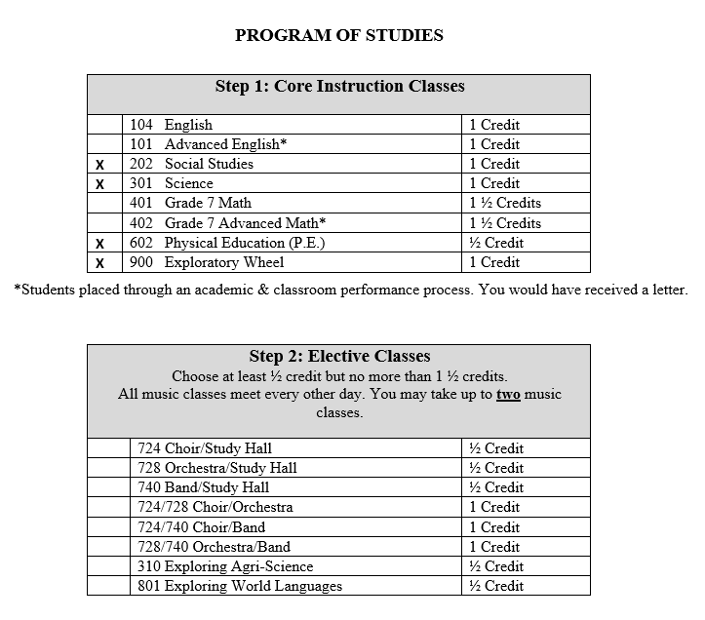
Yellow Program of Studies
Notes:
Matt

Slide 7
All 7th Graders will have…
6 required credits as follows
  Science = 1 credit
  Social Studies = 1 credit
  English = 1 credit
  Math = 1.5 credits (2 periods per day)
  Exploratory Wheel = 1 credit (Art, B&IT, FACS, and Technology Education)
  P.E. = ½ credit (one semester)
*** These 6 credits take up 6 ½ class periods out of the 8 class periods we have at MMS
Notes:
Kendra with Matt explanation of Math block :)

Slide 8
All 7th Graders will have these choices…
.5 to 1.5 credits of electives from the following options
(Every other day for the entire year)
  Band (½ credit)
  Orchestra (½ credit)
  Choir (½ credit)
***NO MORE THAN 2 MUSIC CLASSES!***
(Every day for the semester)
  Exploring World Languages (½ credit)
  Exploring Agriscience (½ credit)
***You can not take 2 electives AND a music class(es)***
Study Halls - if your student has 7.5 credits, they will not have any study hall. If they have 6.5 or 7.0 credits, they will have some sort of study hall (either everyday or every other day)
***PLEASE NOTE: Advisory (21 minutes per day) is often time used as study hall time with flexibility to see a teacher you really need to see.
Notes:
Kendra

Slide 9
MMS School Safety
Secure entry to building (Door #2)
School safety drills (Weather, Fire, Safety, and Emergency team)
School Resource Officer (SRO) program
SRO Therapy Dog (“Reggie”)
Security Cameras
Cell phone usage / proper use of technology
Morning Supervision beginning at 7:15am
Students need to be off campus by 3:05pm (if not in school activity)
Best defense is YOU!
Notes:
Kevin / Anthony

Slide 10
School Attendance
The school day begins at 7:45 AM. Students are expected to be in class and prepared to learn.
Students arriving after 7:45 AM will be marked tardy (if within the first period of the day) or absent (if arriving after 8:00 AM). The handbook states that if arriving late and marked tardy, a student will receive a detention following the first offense.
Parents/guardians are authorized to excuse their child from school for any or no reason up to a maximum of 5 school days in a semester, provided they notify the school in advance. Any days of absence beyond the 5 days may be considered unexcused and subject to the truancy ordinances of the city/county.
An acceptable excuse will be marked as an excused absence.
  Note from a licensed medical provider
  Documentation of a required Court Appearance
  The school sends the student home
  Religious instruction
  Funerals of family members
  Sporting events that are school sponsored
  Pre-approved absences such as extended vacations
Attendance Matters - Students who attend regularly succeed academically, graduate from school on time, develop structure, language & social skills, and learn to accept responsibility.
“Education is the passport to the future, and attendance is the stamp that gets you there”
Notes:
Kevin / Anthony

Slide 11
MMS Athletics & Extracurricular Opportunities
***Encourage your child to get involved!
See Course Handbook (website) for athletic and club offerings
Athletics - start thinking about getting your son or daughter a physical
Athletic Meeting in the spring / summer
  Must attend either May 20th or August 19th @ 5:30pm
Athletic Code of Conduct and follow WIAA rules and regulations
Wisconsin Valley Conference website
  www.wisconsinvalleyconference.org
Registration for sports will NOT open until after the first week of July 6th
  Football will start August 10th. All other sports August 17th
Sports you - Coach communications
Notes:
Mike

Slide 12
Communication
Email - good time to double check email addresses in Skyward
Website (important dates and information)
  MMS Tigers @MfldMSTigers on “X” (formerly Twitter)
Skyward (gradebook, missing assignments, and attendance)
Canvas (posting of assignments, due dates, and course content/syllabi)
My contact information:
***Matt Biederwolf, MMS Principal
***biederwolfm@marshfieldschools.org
***715-387-1249, extension 3610
Notes:
Matt

Slide 13
SAVE THE DATE!
March 5: Completed yellow Program of Studies sheet due to 6th grade teacher
March 9: 6th grade students register during school
April 14: MMS Summer School Arena Scheduling opens at 8:00am
April 24: MMS Summer School Arena Scheduling closes at 3:30pm
May 8: 6th Grade Student Tours @ MMS during school
May 20 Student Athlete-Parent Meeting 5:30pm @ MMS Gym
June 15: MMS Summer School begins
The week of July 6: Fall sports registration will open
August 10, 11, and/or 12: MMS Schedule Pick-Up & Picture Take Day
August 10: Football practices begin (see online for individual sport start dates)
August 13 or 14: “Making the Move” summer school class (optional but highly encouraged)
August 17: All other Fall sports practices begin (see online for individual sport start dates)
August 19: Student Athlete-Parent Meeting 5:30pm @ MMS Gym
August 26: MMS Meet & Greet (5:30 - 7:30pm)
August 27: First Day of School
Notes:
Matt

Slide 14

School Supply Lists
Partnering with Impacks.
Order your items online and have them shipped to your home or school (ready on the day of schedule pickup)
Name brand products are a reasonable price
Able to donate a few dollars to MMS and Impacks will match up to $5
Supply lists will be posted on line with a link to Impacks
This program is for your convenience. If you wish to shop locally, feel free to so.
Notes:
Kevin

Slide 15

We are all in this together!
We are committed to a smooth transition and registration process to Marshfield Middle School!
Thank you for coming tonight and please do not hesitate to contact us if you have any questions.
Notes:
Matt

