Slide 1
Monthly Financial Report
as of January 31, 2026
Ann Westbrooks, CPA, RTSBA
Chief Financial Officer

Slide 2
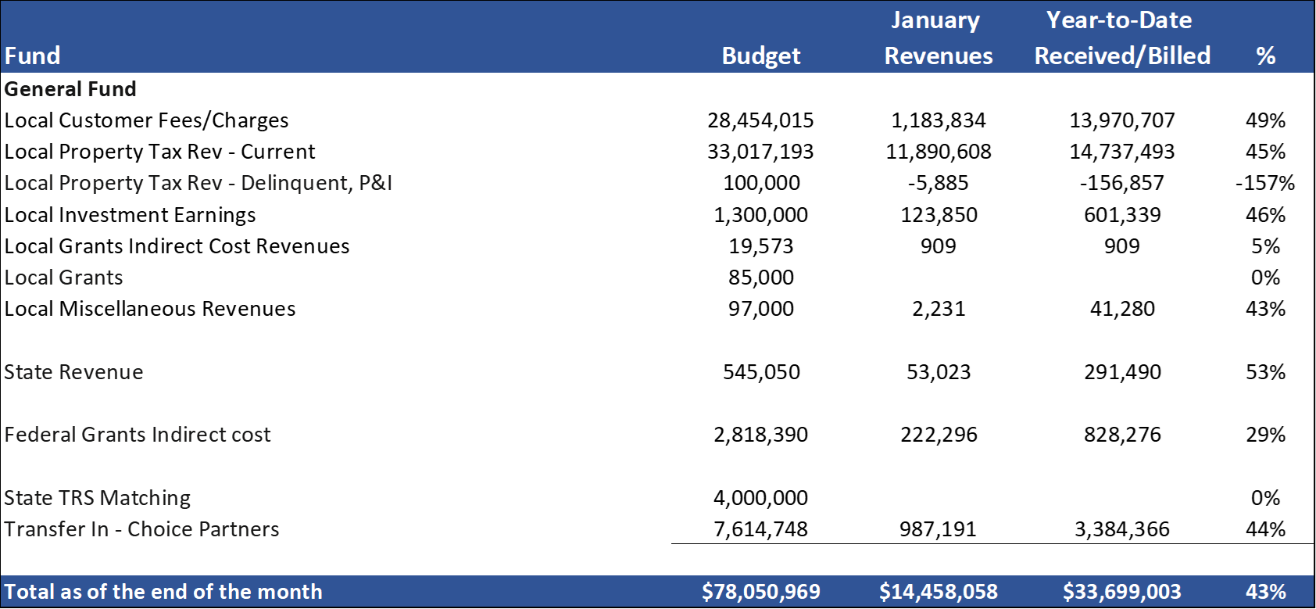


GENERAL FUND
REVENUES (INFLOWS)
Budget to Actual for period ending January 31, 2026

Slide 3

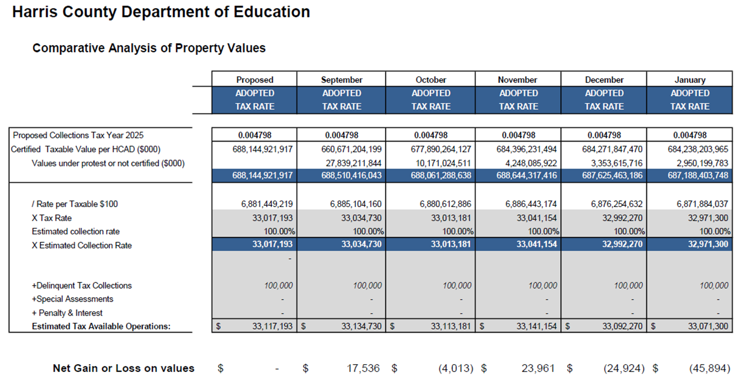



Slide 4

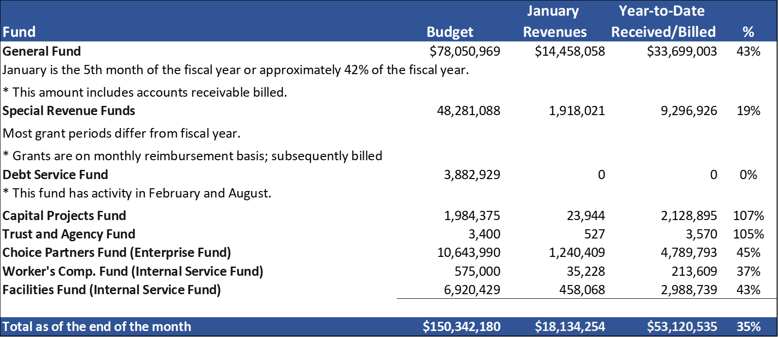

Slide 5

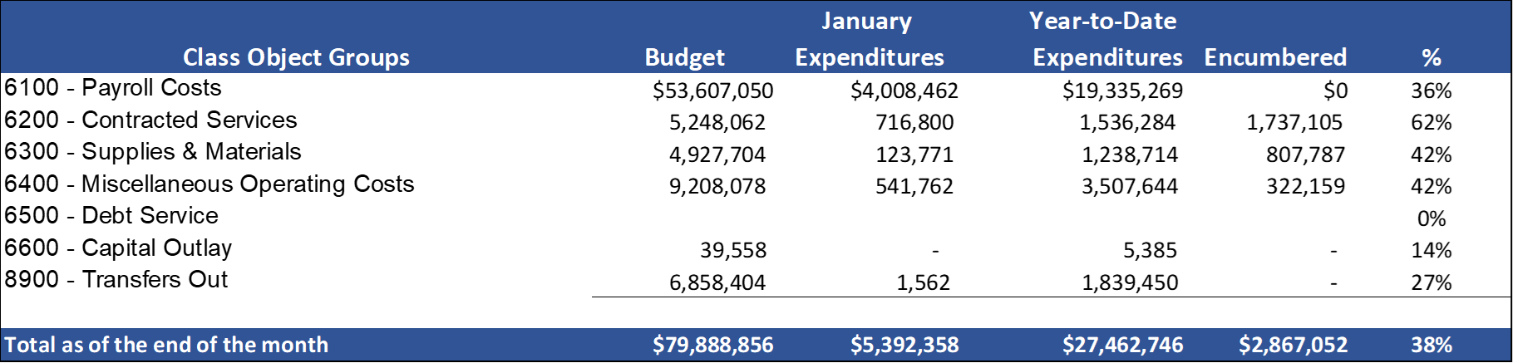


Slide 6

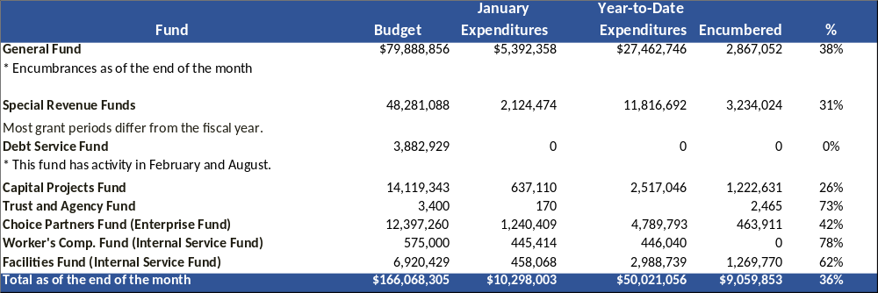

Slide 7
Education Foundation Update

Slide 8
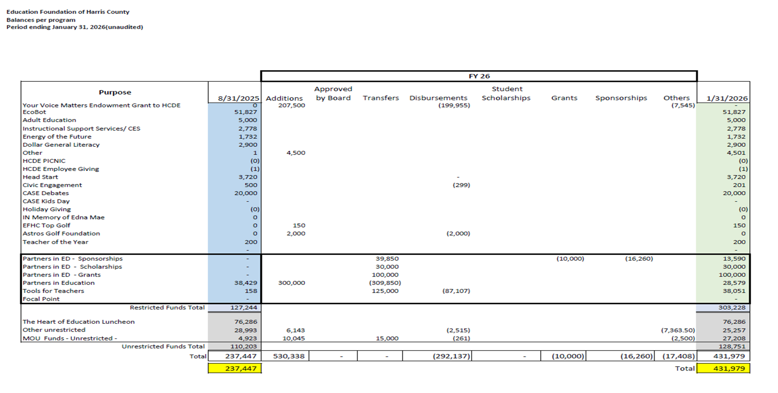

Slide 9
Small Business Report

Slide 10
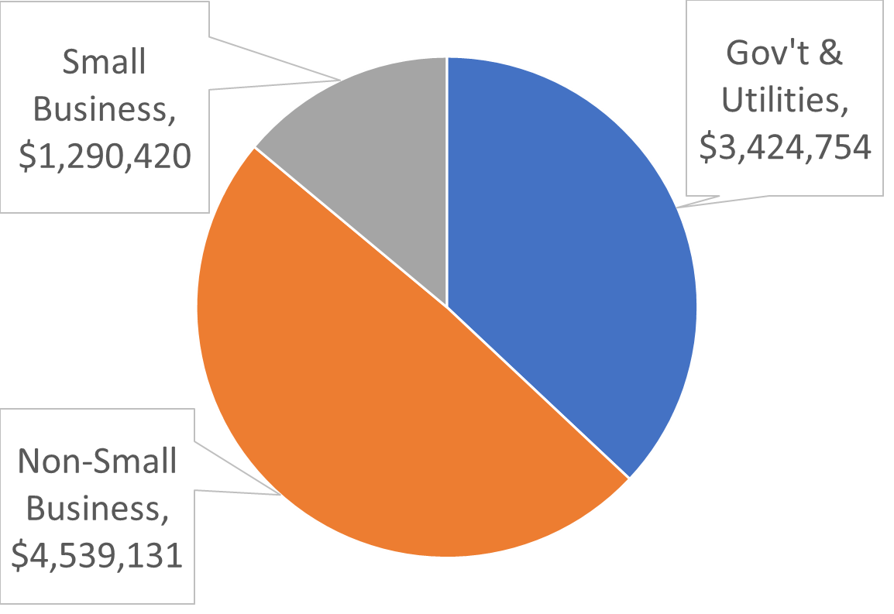
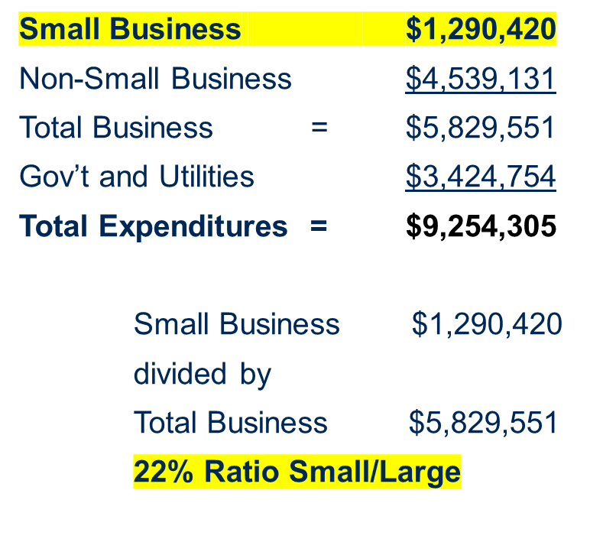

Slide 11
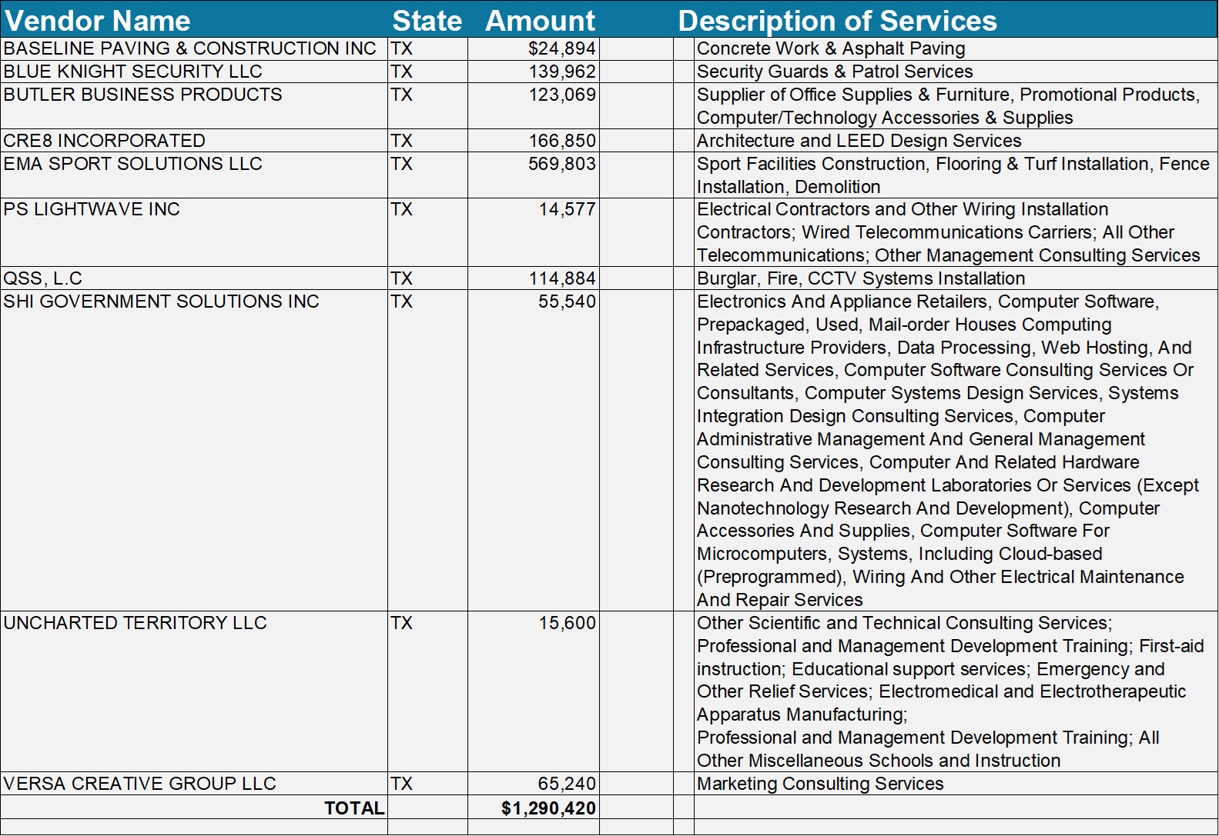

Slide 12
THANK YOU!
The full report can be found online at:
https://www.hcde-texas.org/financial-transparency/finance/monthly-finance-reports

