Slide 1


Orting School District No. 344
January 22, 2026 | Bond Sale Board Briefing
Trevor Carlson
Managing Director, Public Finance
+1 206 628-2890
trevor.carlson@psc.com
Ryan Swanson
Director, Public Finance
+1 206 628 2852
ryan.swanson@psc.com
Ansley Ackerlund
Asst. Vice President, Public Finance
+1 206 628-2854
ansley.ackerlund@psc.com

Slide 2
Bond Financing Goals
  Maximize funds available for construction, maintenance and repair
    Deposit $60,000,000 to the Capital Projects Fund on March 24, 2026
  Minimize interest rate risk
    Lock-in fixed interest rates for a significant portion of the voted bond authorization
  Secure low interest rates
    Utilize an underlying rating
    Apply for credit enhancement
      Washington State School Bond Guarantee Program (“Aaa”)
    Structure bonds in accordance with investor demand
  Target stable bond tax rate at or below $1.27 per $1,000 of assessed value
  Maximum amortization term of 20 years

Slide 3
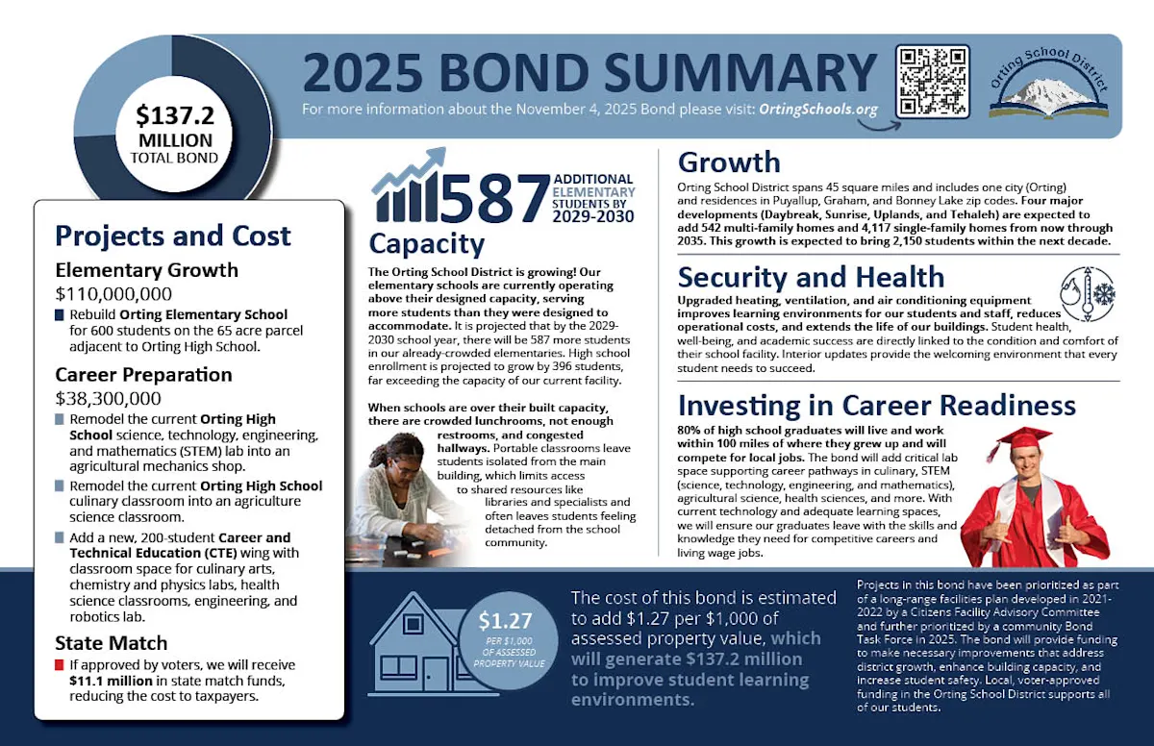
Tax Rate Target

Slide 4
Interest Rates
Bond Buyer Index History
    The Bond Buyer Index is a measurement of tax-exempt interest rates. Interest rates are set when bonds are sold, and lower interest rates result in lower tax rates for the bonds.
    At a regularly scheduled meeting on December 10, 2025, the Federal Reserve lowered its federal funds target range to 3.50% to 3.75% in support of its goals and in light of the shift in the balance of risks. In considering the extent and timing of additional adjustments to the target range for the federal funds rate, the Committee will carefully assess incoming data, the evolving outlook, and the balance of risks. The Committee is strongly committed to supporting maximum employment and returning inflation to its 2 percent objective.
Tax-Exempt Yield Curve

Slide 5
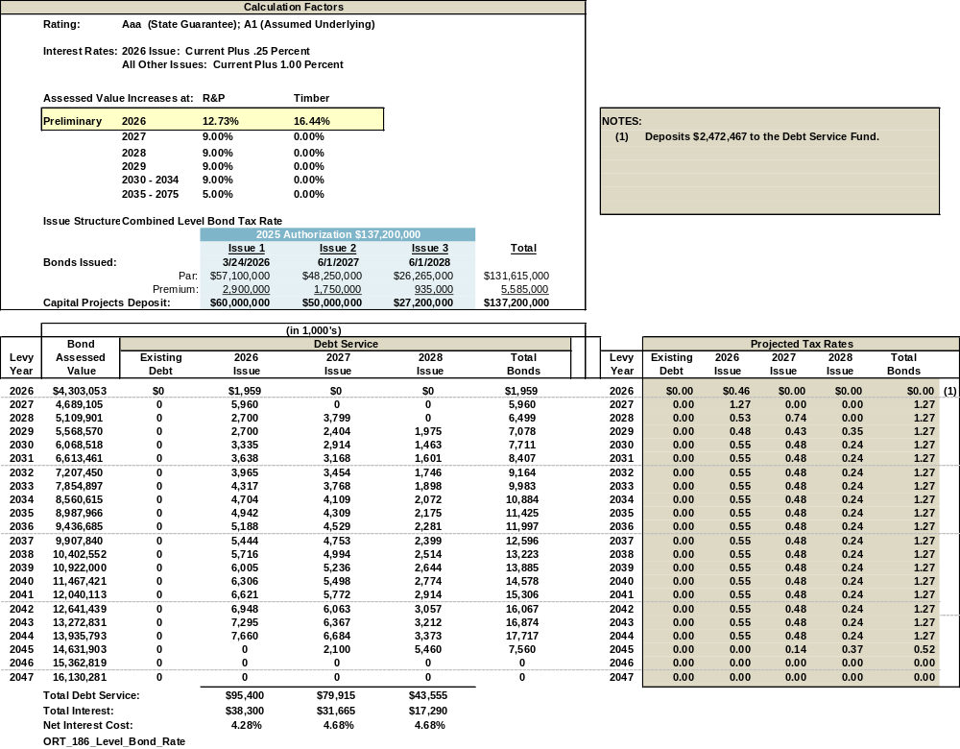
Projected Tax Rates

Slide 6
Schedule of Events
January 2026 S M T W T F S 1 2 3 4 5 6 7 8 9 10 11 12 13 14 15 16 17 18 19 20 21 22 23 24 25 26 27 28 29 30 31 | February 2026 S M T W T F S 1 2 3 4 5 6 7 8 9 10 11 12 13 14 15 16 17 18 19 20 21 22 23 24 25 26 27 28 | March 2026 S M T W T F S 1 2 3 4 5 6 7 8 9 10 11 12 13 14 15 16 17 18 19 20 21 22 23 24 25 26 27 28 29 30 31
Staff: District Staff
Board: District Board
PSC: Piper Sandler & Co. (Underwriter)
BC: Pacifica Law Group (Bond Counsel)
County: Pierce County Treasurer
Date Event Participants
January 22 Adoption of Bond Delegation Resolution Board, Staff, PSC, and BC
(Regular Meeting @ 6:00 PM)
February 9 Bond Rating Presentation PSC and Staff
(Conference Call with Moody’s @ 2:00PM)
March 10 Bond Sale PSC and Staff
March 24 Bond closing BC, County, and PSC

