Slide 1
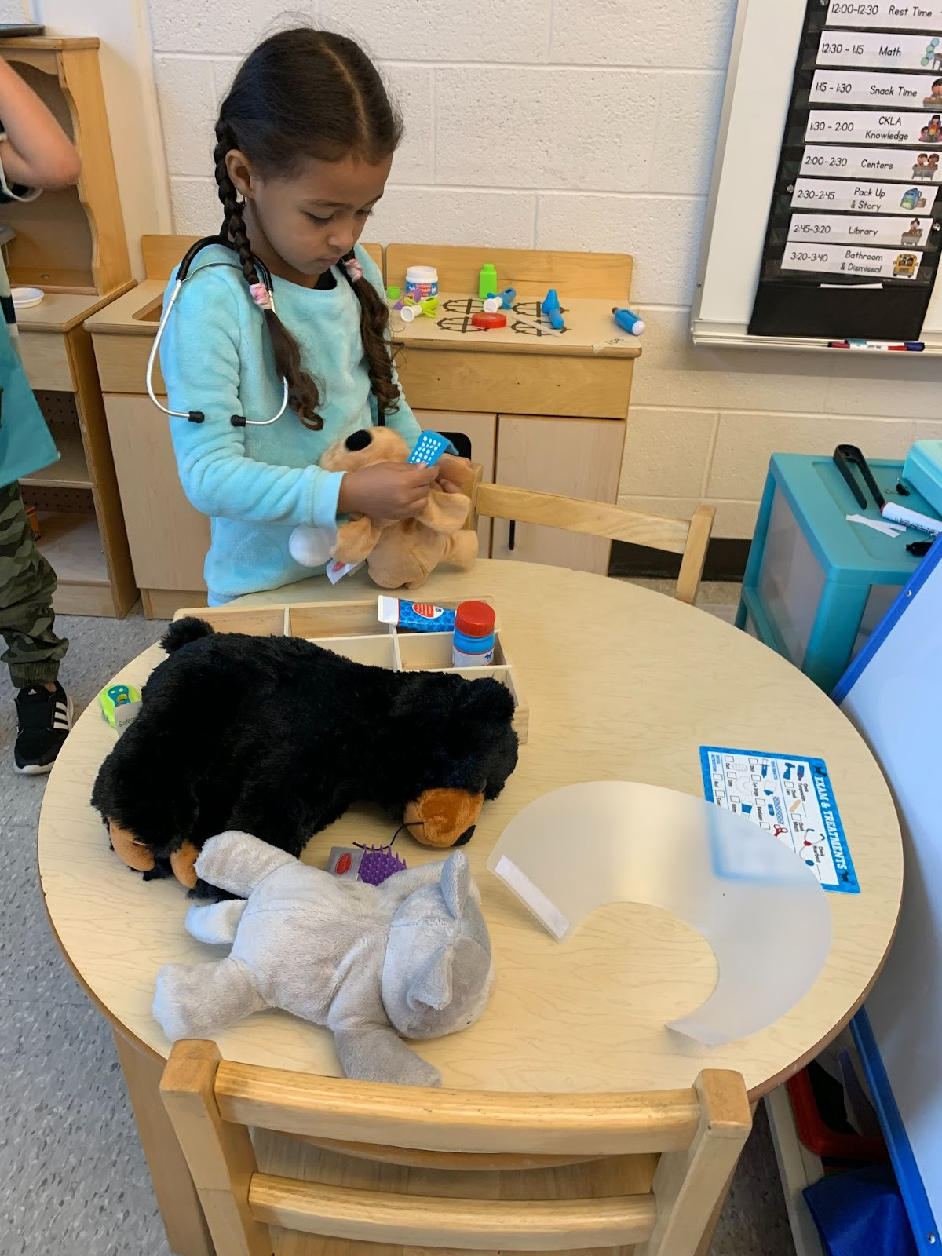
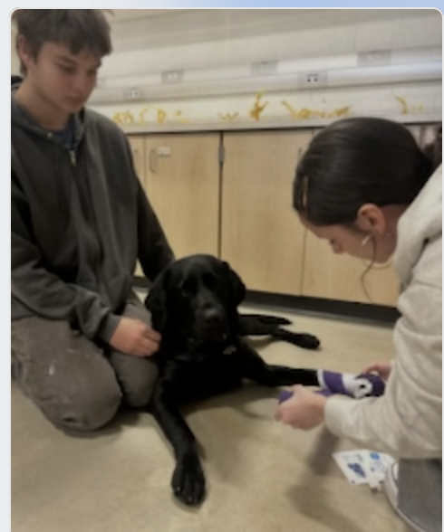
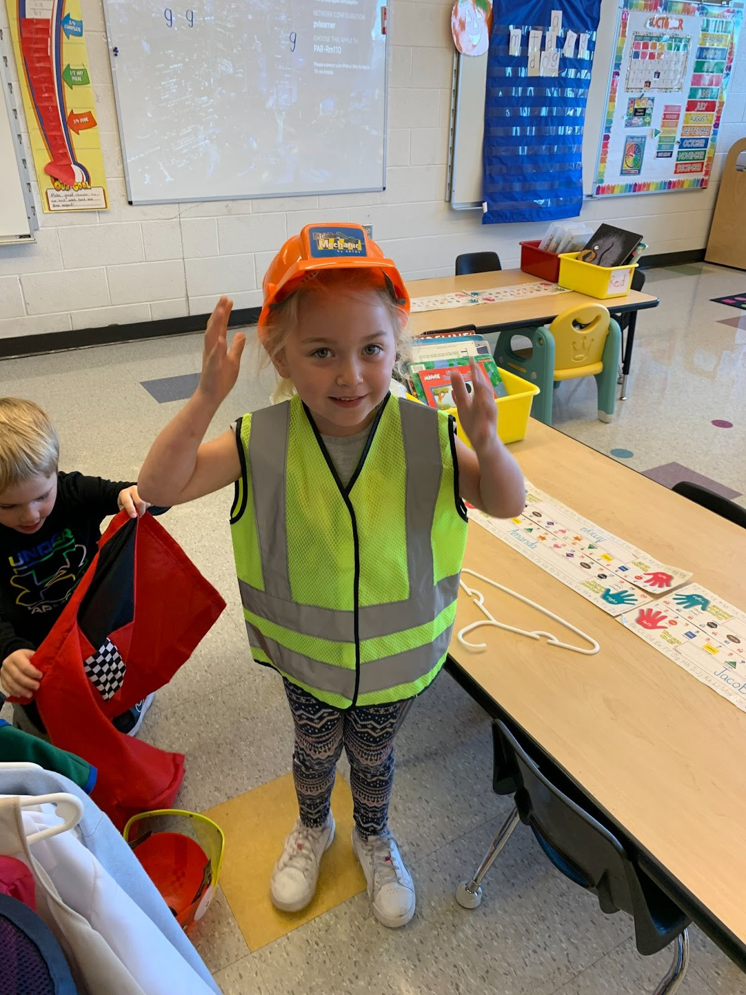
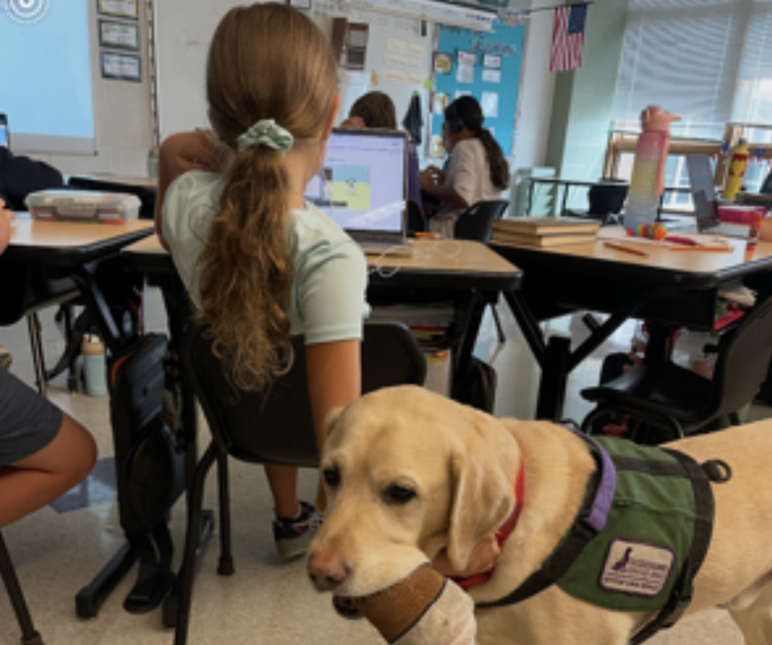
PLAN 339
K-12 SCHOOL Counseling Plan

Slide 2
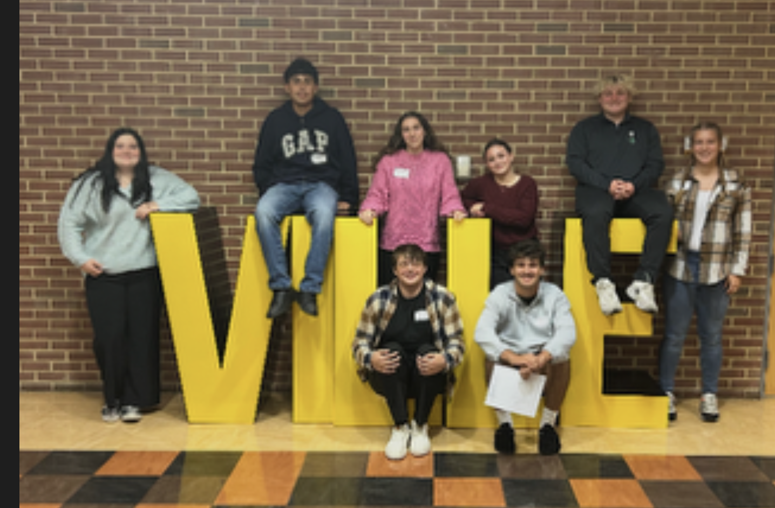
Mission Statement
Pequea Valley School Counseling Department collaborates with learners, staff, families, business/community, and postsecondary stakeholders to challenge all learners to reach their full potential in present and future endeavors. We will promote a safe and equitable learning environment where every learner counts, in order to assist them with their academic, career, and social/emotional development.
School Counselors :
  Kelly Loder: Paradise
  Josh Whitelaw : Salisbury
  Jason Davis, Lela Fredricks, Stephanie Fenimore : Secondary

Slide 3
Programming and Calendars
K-12 Academic Standards Carrer Education & Work
School Counseling Goals
Program Delivery System
Stakeholder Partnerships
Program Canendar
Stakeholder Engagement
(Each icon is linked to a document with more information)

Slide 4
Follow up study
We followed up with families and graduating seniors to better understand what additional supports could be provided at our secondary school to help students feel more prepared for college and postsecondary success. Through this feedback process, we gained valuable insight into student and family needs, which has allowed us to be more intentional and purposeful in the design of our learning sessions and the resources we provide.
As a result, we have implemented targeted learning sessions focused on college readiness, with two sessions held so far this year. These sessions have been well attended, and accompanying materials and resources have been shared with families to extend learning and support beyond the school setting.

Slide 5

ANY QUESTIONS ?

