Slide 1
IXL - Supporting Students at Home

Slide 2
Learning Targets
Parents will be able to:
Understand the student interface of the IXL platform
Motivate and encourage their child to make the most of the IXL tool
Notes:
Scott, 11:00am

Slide 3
Understand
Basics
IXL has standards-aligned skills
Each skill takes anywhere from 10-20 minutes
Each skill has a Smart Score
An 80 Smart Score demonstrates proficiency on the skill
Student NWEA scores have been synced into IXL for tailored NWEA Study Plans
Notes:
Scott, 11:00am

Slide 4
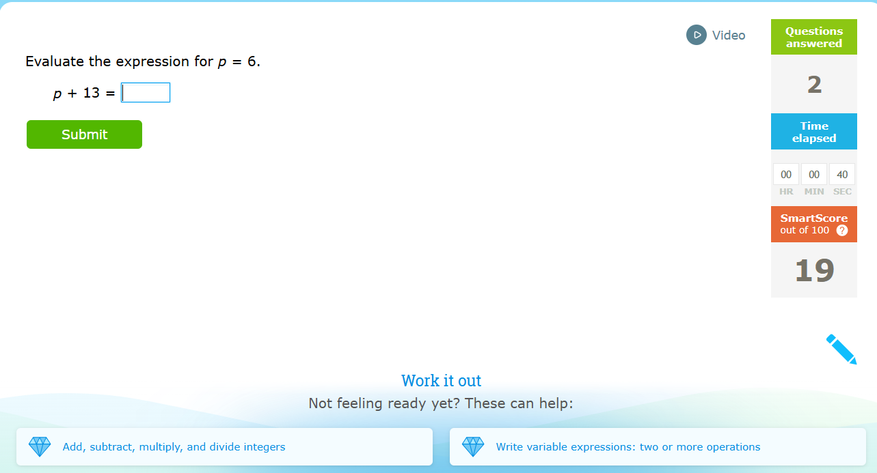
Understand
Smart Score
Each skill has a Smart Score
An 80 Smart Score demonstrates proficiency on the skill
  It’s okay for a student to stop at 80-90 if frustration rises
Smart Score for the skill - adjusts as students progress through the skill
Notes:
Scott, 11:00am

Slide 5
Understand
Other Features
Video example to help students understand how to approach the problem
Alternate foundational skills if the concept is too challenging
Notes:
Scott, 11:00am

Slide 6
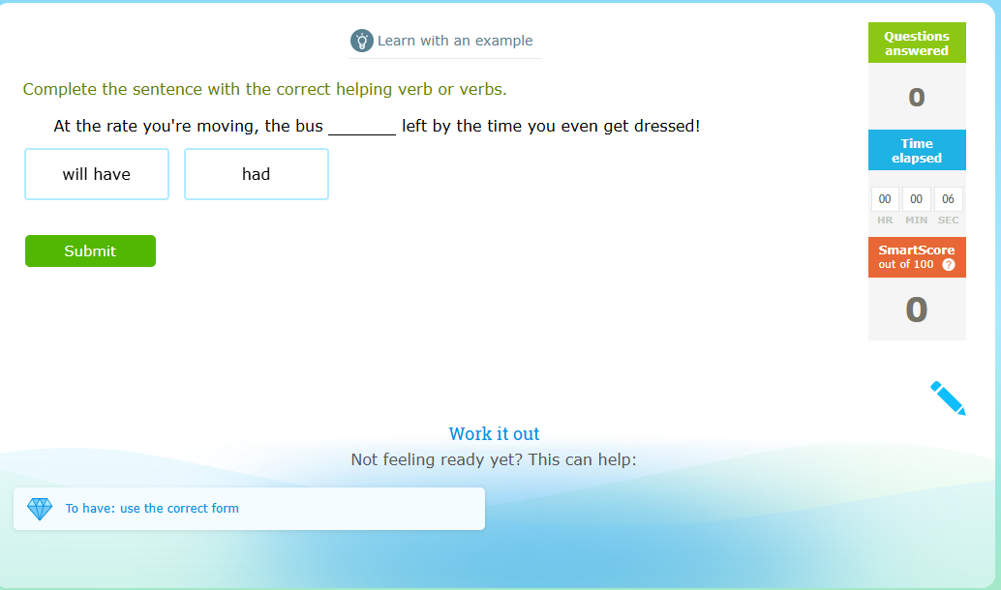
Understand
Other Features
Sometimes, instead of a video, it gives an example
Notes:
Scott, 11:00am

Slide 7
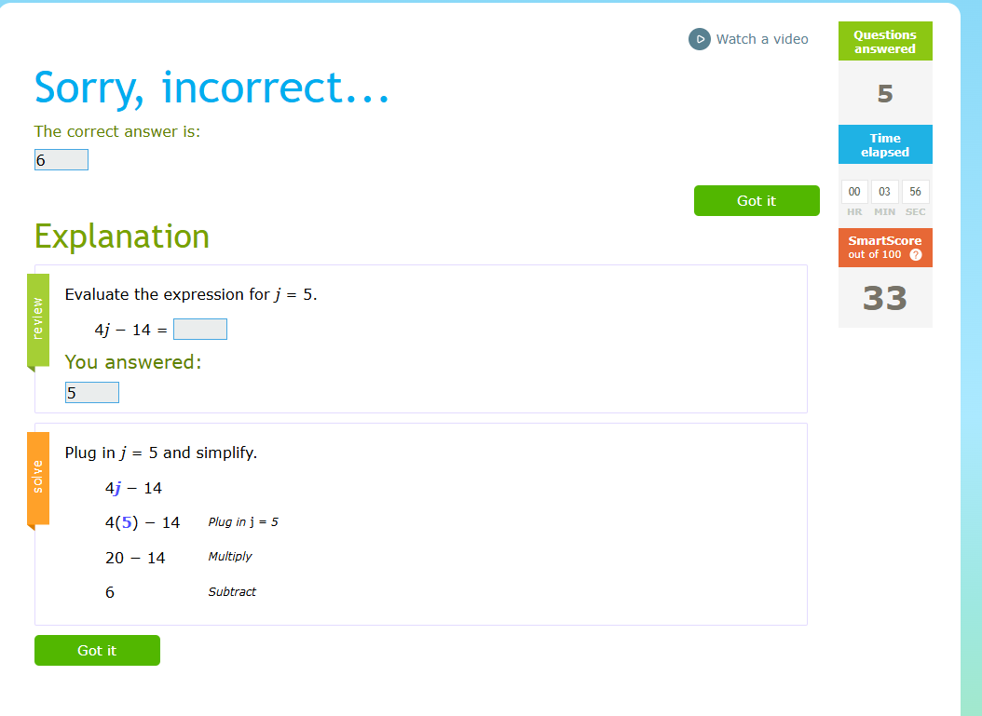
Understand
Other Features - Explanation of Incorrect Answer
Notes:
Scott, 11:00am

Slide 8
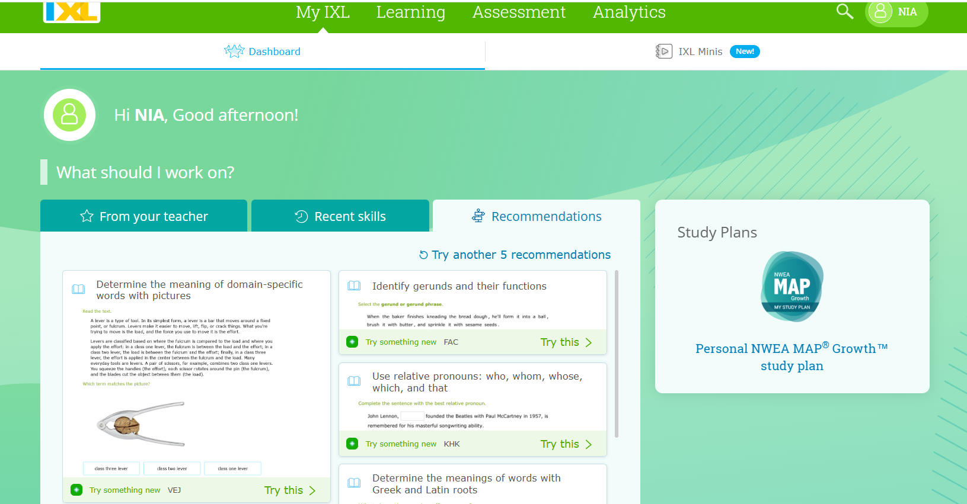
Understand
IXL Home Page
Notes:
Scott, 11:00am

Slide 9
Understand
IXL Home Page - Areas to Access Skills
Skill plan based on student’s NWEA Scores
Teachers will often recommend specific skills
Notes:
Scott, 11:00am

Slide 10
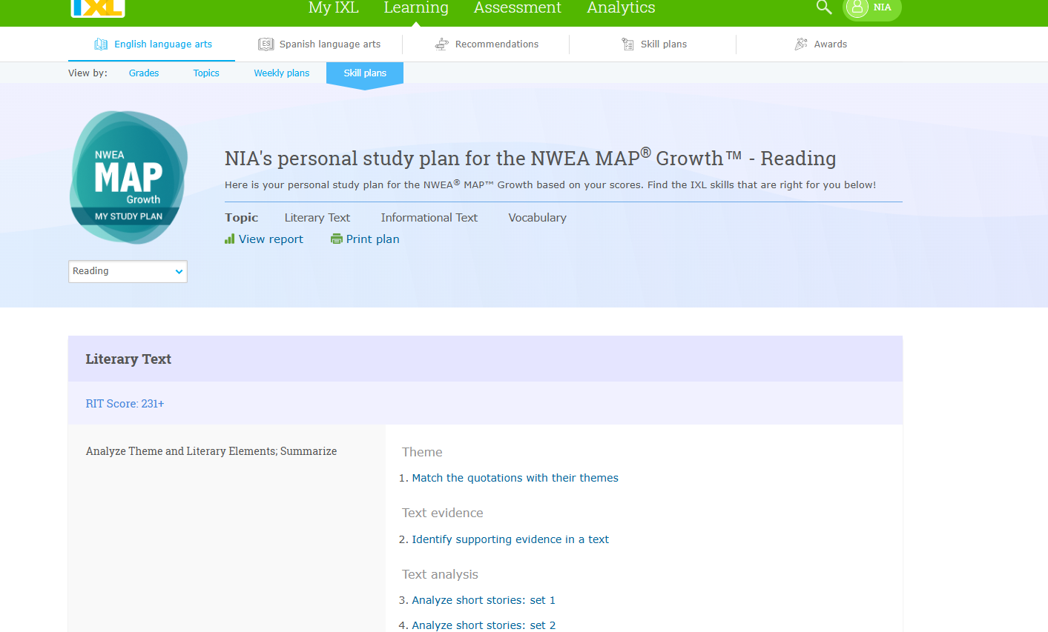
Understand
IXL - Personal NWEA MAP Growth Study Plan
Notes:
Scott, 11:00am

Slide 11
Understand
IXL - Personal NWEA MAP Growth Study Plan
If you click here, you will get access to what you see on the next slide.
Notes:
Scott, 11:00am

Slide 12
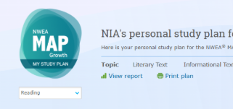
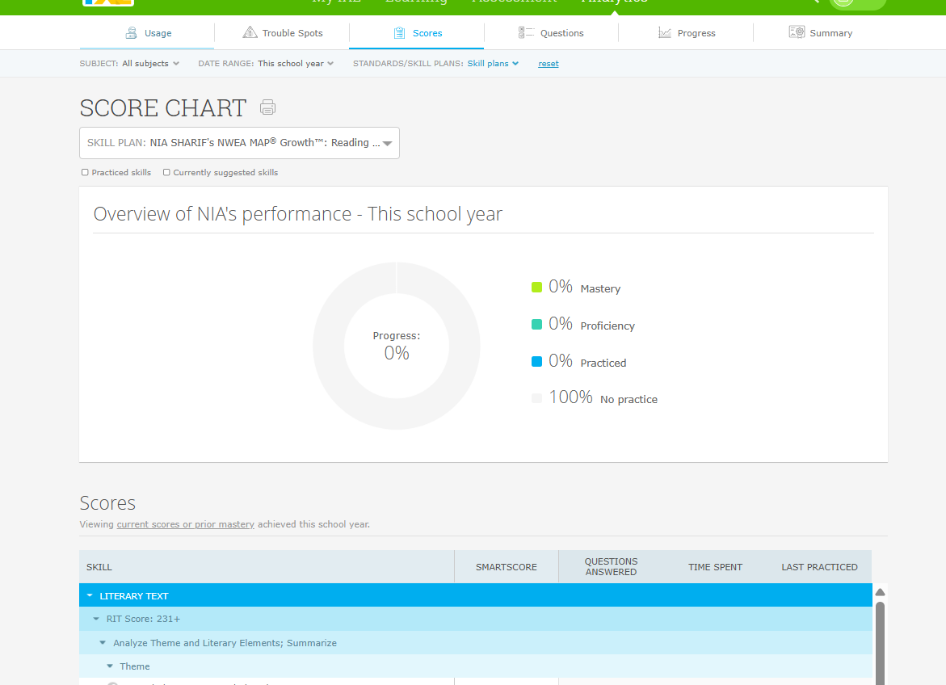
Understand
IXL - Progress with NWEA MAP Growth Study Plan
This report will show the progress your student is making on the NWEA Skill Plan
Notes:
Scott, 11:00am

Slide 13
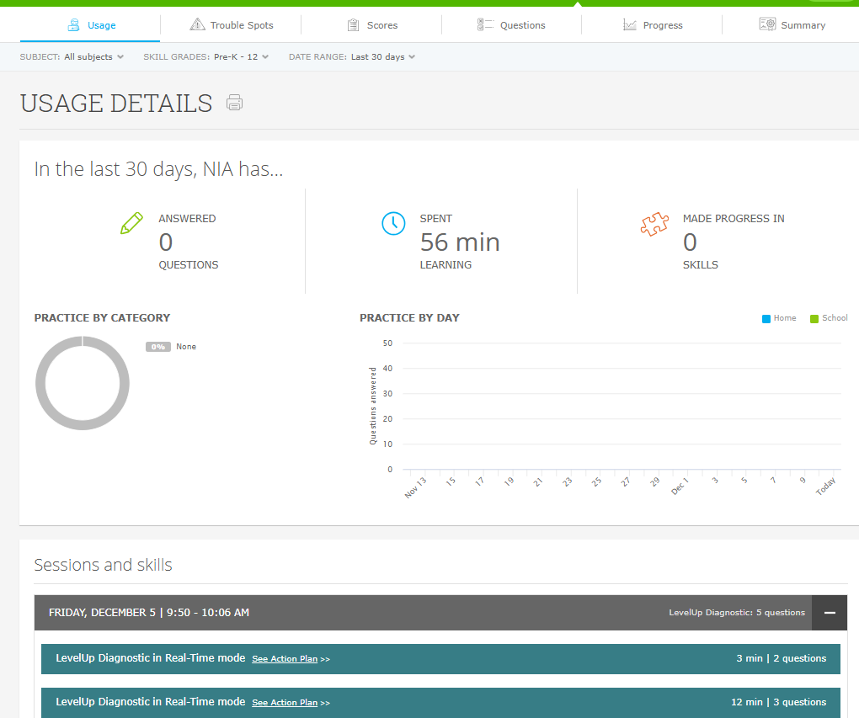
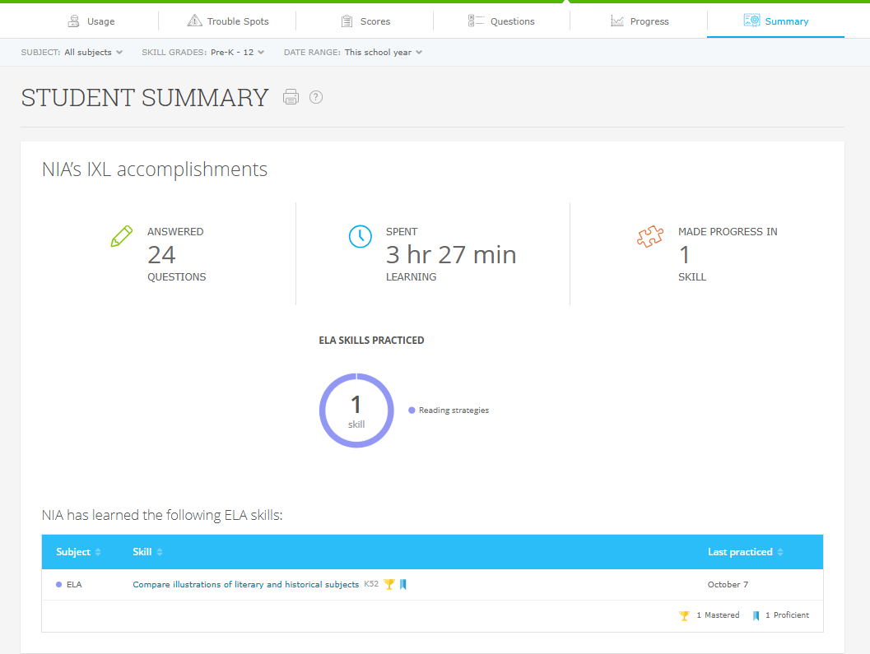
Understand
IXL - Other Student Analytics
Notes:
Scott, 11:00am

Slide 14
Guidance
Working With Your Child at Home
Do | Don’t
Explain the why - point out that IXL is not about more work. It’s about focused practice for you that helps you strengthen specific skills so that you are constantly growing Set up reward goals - “x” number of skills proficient (Smart Score of 80 or higher). Start small and grow. Motivate with praise - “I like how you stuck with that problem” Set IXL boundaries - 20 minutes two or three times a week is plenty Give them space. Tell your child you are available if they need help and encourage them to explain their thinking | Tell them they don’t work hard enough or do enough homework, so they need to go on IXL Administer consequences if they fail to reach the Smart Score of 80 or higher. The productive struggle in IXL is a good thing. Focus on the score only in your feedback - “You only got to 60 here. You can do better.” Turn IXL into nightly battles - it’s okay to take a break from it. Avoid sitting over your child, correcting each mistake
Notes:
Scott, 11:00am

